Slide 1
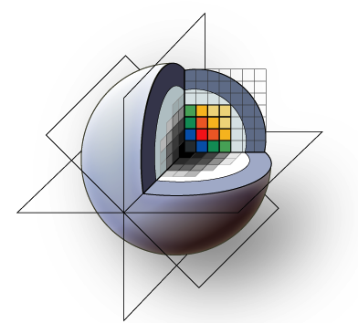
3D Slicer Training Compendium
Using Plastimatch for
Deformable Registration
Tutorial Version 0.0, Apr 22, 2010
Gregory C. Sharp
Department of Radiation Oncology
Massachusetts General Hospital

Slide 2
Learning Objective
This tutorial is a step-by-step guide, and includes:
1) Downloading the Plastimatch extension to 3D Slicer
2) Loading the sample images
3) Running deformable registration on the CPU
4) Running deformable registration on the GPU
5) Inspecting registration quality in 3D Slicer

Slide 3
Prerequisites
This tutorial assumes that you have already downloaded the sample data. You can get the data from here:
http://forge.abcd.harvard.edu/gf/download/frsrelease/85/1004/rider-lung-images.tar.gz

Slide 4
Conclusion
Congratulations! You have completed the tutorial.
Please send corrections or suggestions to:
Greg Sharp
gcsharp@partners.org

Slide 5

Acknowledgements
National Alliance for Medical Image Computing
NIH U54EB005149

