Slide 1
COSMICAI / RADIOASTRO-ML
Accelerating Radio Interferometry Error Detection with AI
Main claim: this is still a Phase I infrastructure effort. The current win is a repeatable path from real VLA calibrator observations to controlled faults, standardized imaging, and future labels.
real public VLA data
controlled corruptions
diagnostics before ML
THESIS
The project should not claim an ML result yet. It should claim that the data, corruption, imaging, and QA machinery is finally becoming trustworthy enough to support one.
Extracted-image contact sheet from the current sample-building workflow.
Pipeline focus: data -> corruption -> CASA imaging -> diagnostics -> future labels
radioastro-ml | Phase I infrastructure deck
01

Slide 2
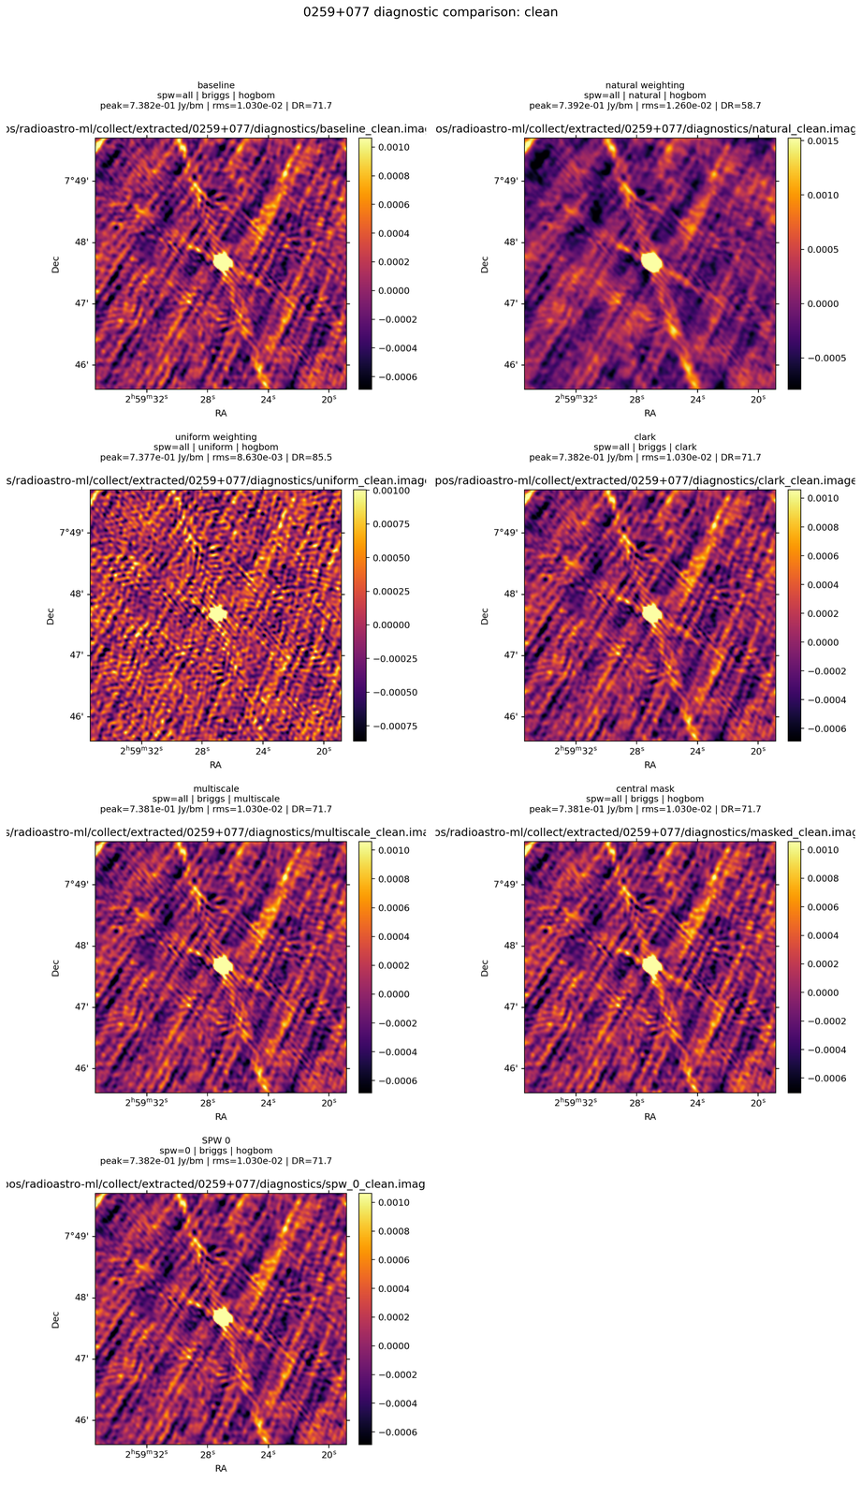
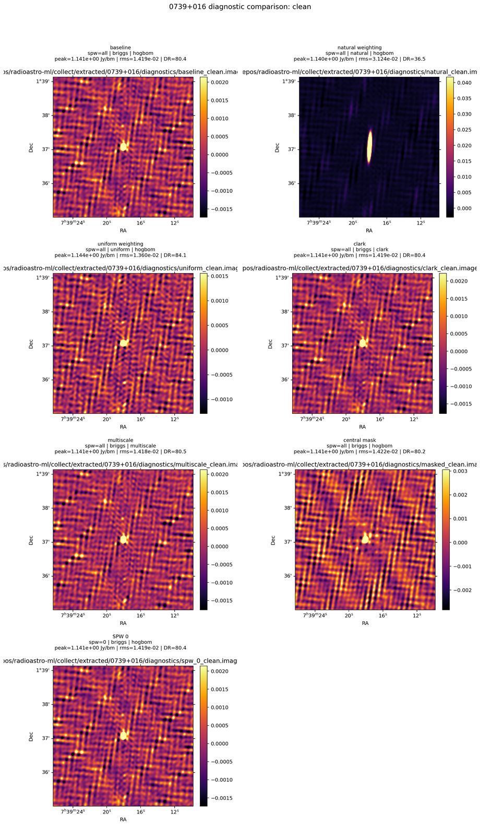
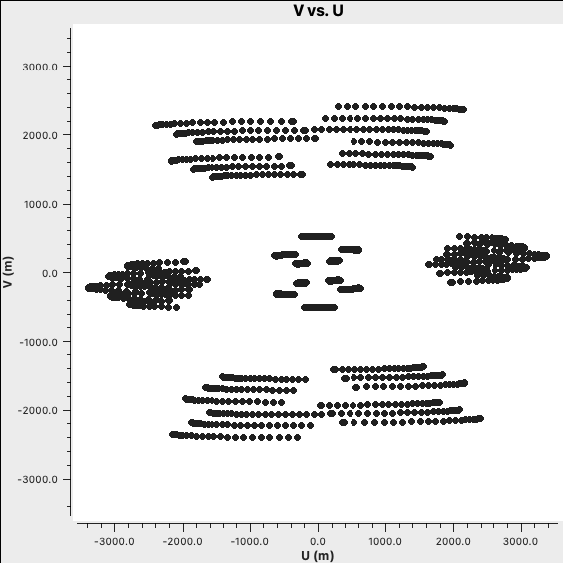
PROBLEM
Why this is hard: image artifacts do not come with clean labels
Calibration issues, imaging choices, and bad visibilities can all create structure that looks deceptively real.
calibration
imaging
bad data
- Expert inspection still matters, but it does not scale.
- Naturally bad images are not enough if the cause of the failure is ambiguous.
- Any future ML effort needs examples where the underlying cause is actually known.
Example: persistent spokes that line up with the PSF.
Example: the dirty image already contains suspicious structure.
WHY REAL DATA MATTERS
The project is trying to keep the sky and uv-coverage realistic while controlling the fault itself.
Poor or unusual uv coverage can be part of the explanation, which is exactly why the labels are tricky.
radioastro-ml | Phase I infrastructure deck
02

Slide 3
APPROACH
Core workflow: turn uncertain bad images into examples with known causes
The project uses real calibrator observations, then adds controlled faults so the diagnostic outputs can be interpreted against a known intervention.
1
2
3
4
5
Public calibrator data
Extraction
Controlled corruption
CASA imaging
Diagnostics / labels
Search public VLA calibrator observations and select usable projects.
Keep the calibrator data and build a consistent sample-processing path.
Inject gain-table based phase or amplitude faults with known settings.
Re-image the data with a more standardized grid and recipe.
Compare visibilities, gains, images, PSF, residuals, and uv coverage.
WHAT GETS COMPARED
WHY THIS MATTERS
clean vs corrupted visibilities | gain tables | dirty image | clean image | residual image | PSF | uv coverage
The labels come from the intervention itself, not from guessing after the fact which artifact 'looks like' a certain problem.
radioastro-ml | Phase I infrastructure deck
03

Slide 4
STATUS
Current scope: still Phase I, and that is the honest framing
The most important progress has been making the pre-ML workflow reproducible enough to trust.
Three-phase roadmap
THIS DECK IS
Phase I
Phase II
Phase III
- data pipeline progress
- corruption validation
- diagnostic standardization
data + corruption + diagnostics
pilot labeled dataset
ML experiments
THIS DECK IS NOT
- a large labeled dataset
- a benchmarked classifier
- a final ML result
WHY THE PHASE I LABEL MATTERS
It prevents overselling the work and keeps the next milestone concrete: produce a small, clean pilot dataset before claiming ML success.
radioastro-ml | Phase I infrastructure deck
04

Slide 5
DATA + TOOLS
Data acquisition is now repeatable, even if the dataset is not fully curated yet
The README shows steady progress from initial sample batches toward a working path for selecting, downloading, extracting, and imaging candidate calibrators.
- Search public VLA calibrator observations and prioritize useful projects.
- Download only the calibrator-relevant data products.
- Extract and image candidate samples with a consistent pipeline.
- Keep vetting because some projects are too flagged or otherwise unsuitable.
BY-PRODUCT 1
A structured VLA calibrator catalog makes selection more programmable and tracks metadata such as band, flux, and uv-limit information.
Larger sample batch after the data-requesting and download pipeline was automated further.
BY-PRODUCT 2
The NRAO archive querying / downloading utilities were split into their own fetcher workflow to make requests and manifests more reproducible.
radioastro-ml | Phase I infrastructure deck
05

Slide 6
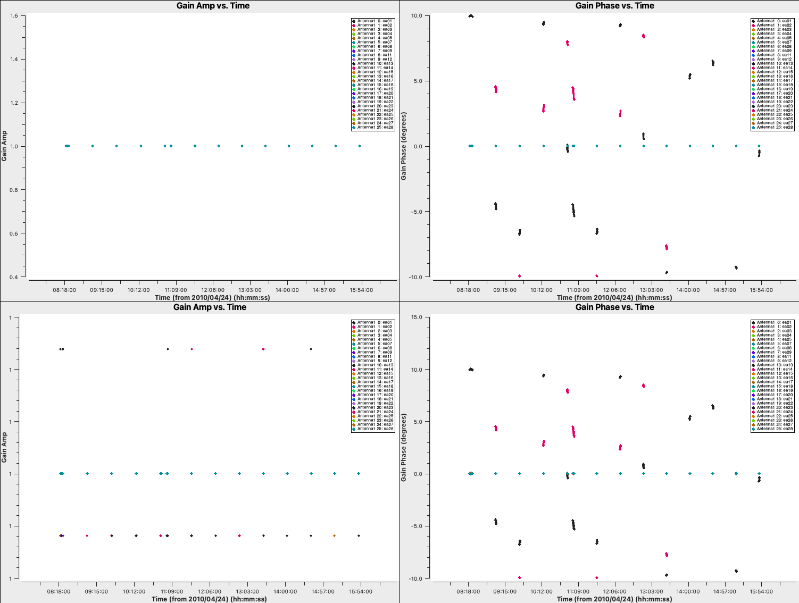
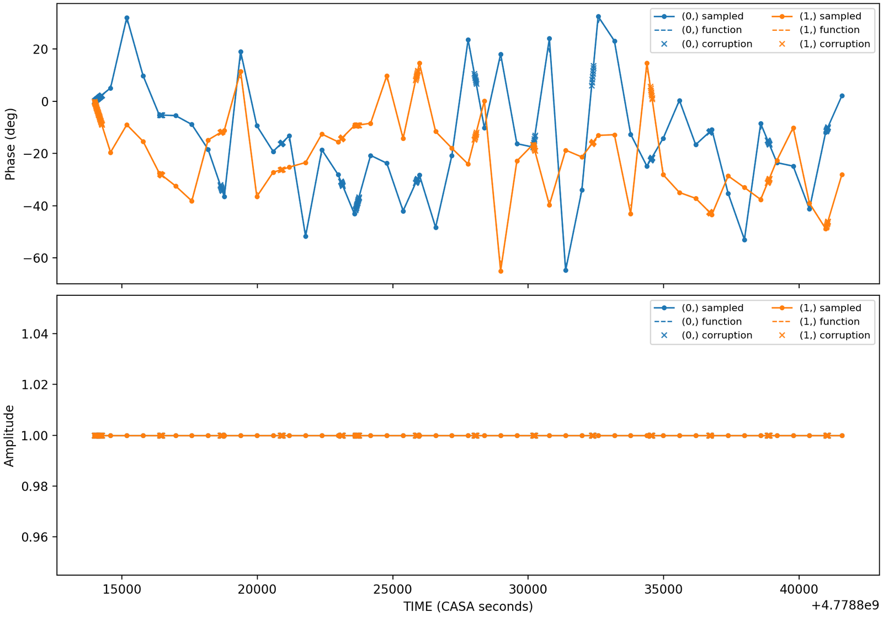
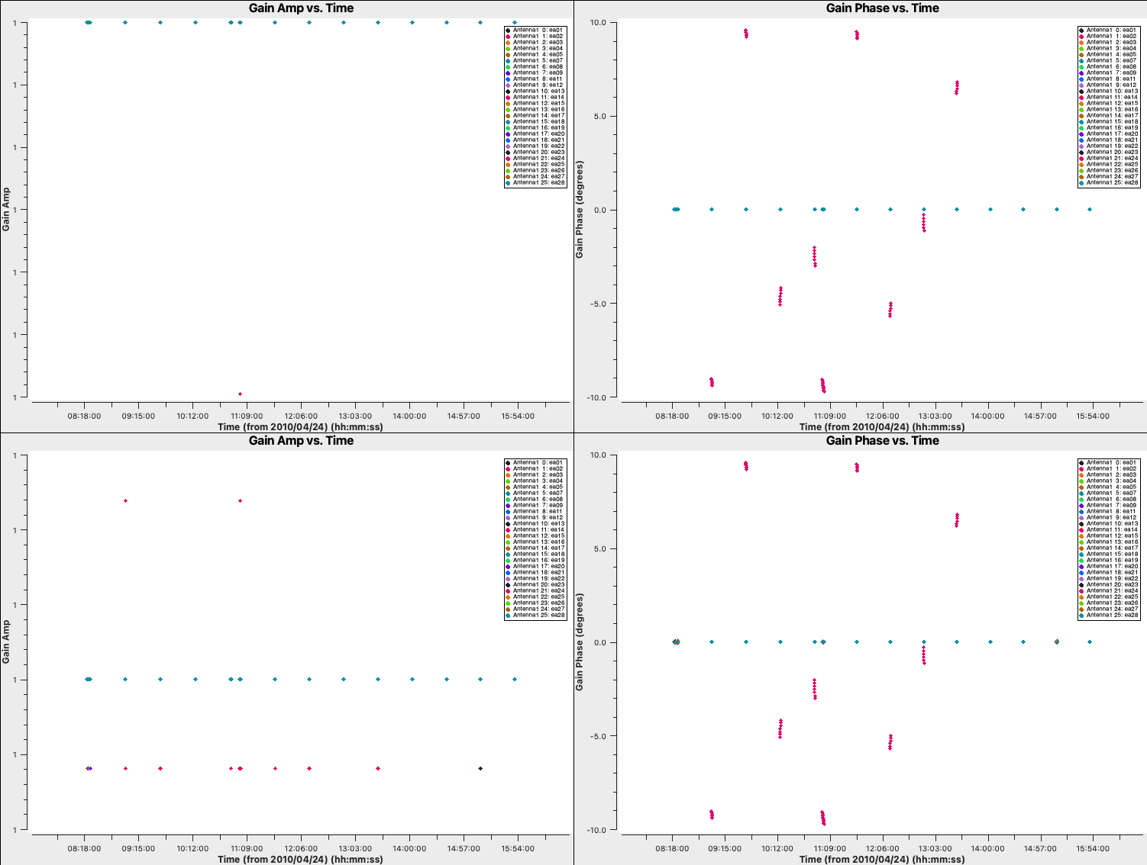
CORRUPTION
Controlled fault injection is shifting from simulator exploration to gain-table based experiments
The target is not just to make corrupted images. The target is to make corrupted images whose cause is controlled and interpretable.
- Initial focus is on antenna-based phase and amplitude gain errors.
- Time-varying patterns such as sine-like drift and fBM-style drift have been explored.
- README notes that some simulator modes were useful for understanding the problem, but not ideal for reliable dataset generation.
TAKEAWAY
Sinusoidal corruption stored in the gain table.
fBM-style drift as a more stochastic time-varying pattern.
Image-domain effect after a controlled corruption is applied.
Move toward corruption settings that can be reasoned about physically and reproduced cleanly from run to run.
radioastro-ml | Phase I infrastructure deck
06

Slide 7
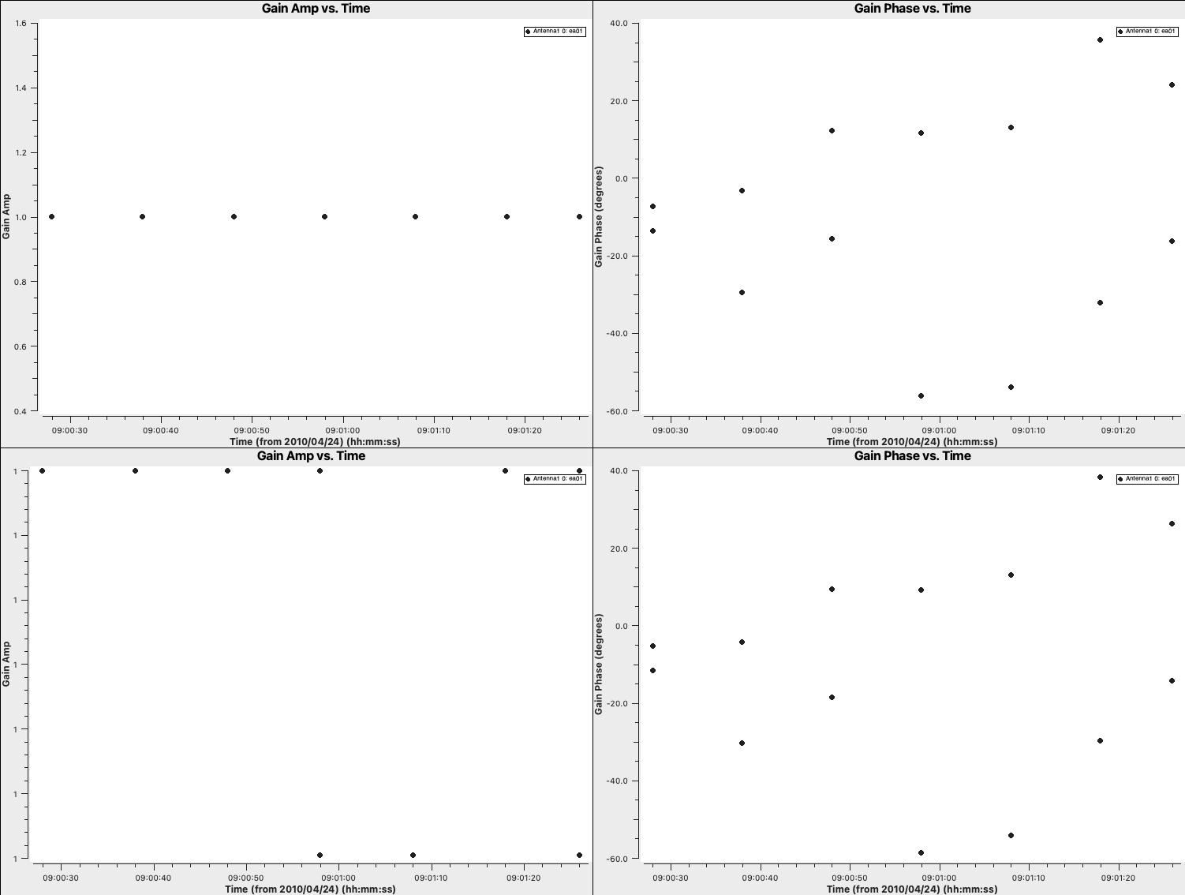
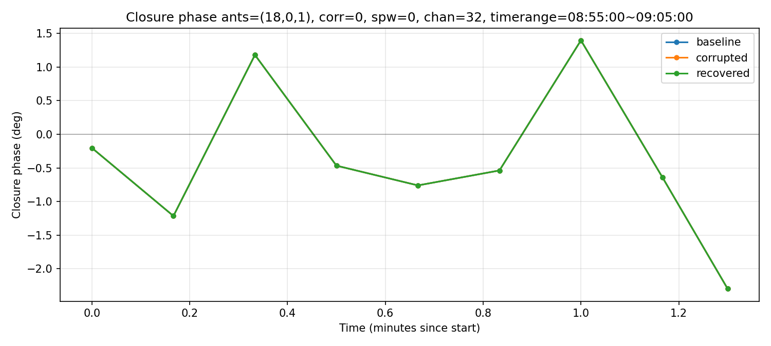
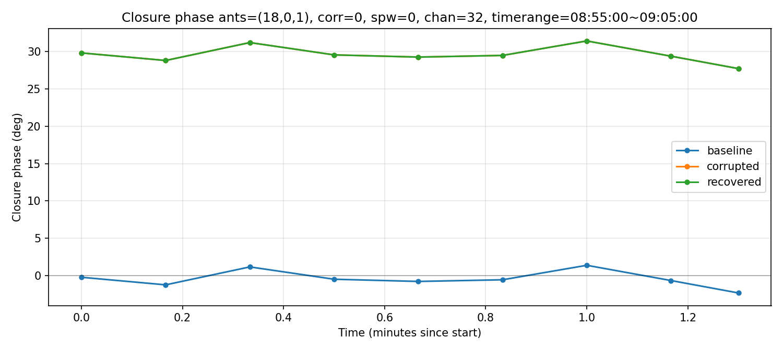
VALIDATION
The labels only matter if the injected faults behave the way the calibration model predicts
Closure tests are a sanity check on what kind of error is actually being injected, and what gain calibration should or should not be able to remove.
- Antenna-based phase corruption preserves closure phase.
- Baseline-only corruption violates closure.
- Baseline-only corruption is not removed by antenna-based gaincal, which separates it from per-antenna faults.
WHY THIS IS IMPORTANT
Per-antenna corruption: closure stays consistent.
One-baseline corruption: closure breaks.
Recovery behavior after gaincal is another check on error class.
This is the difference between a meaningful label and a visually interesting artifact with unclear physical interpretation.
radioastro-ml | Phase I infrastructure deck
07

Slide 8
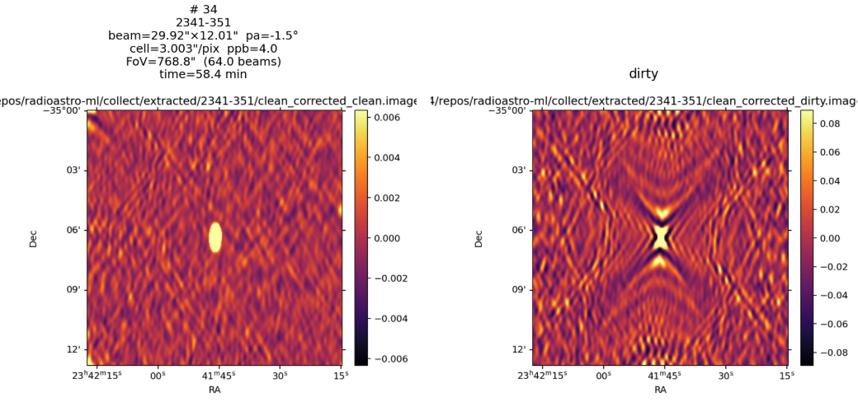
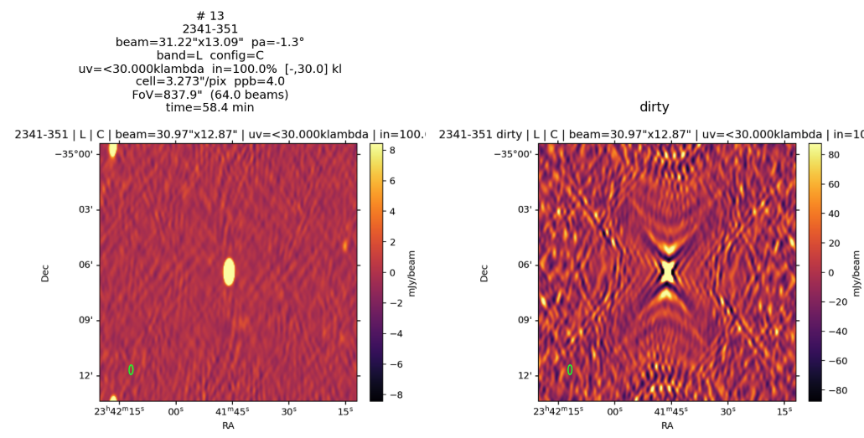
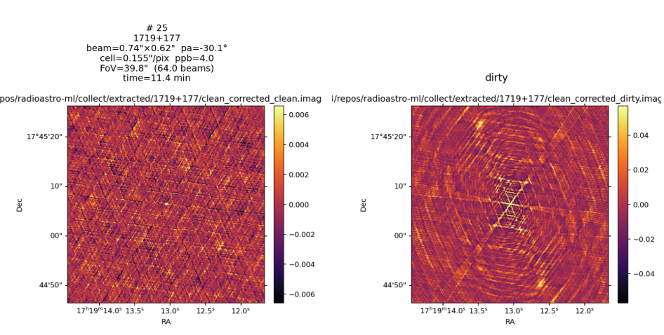
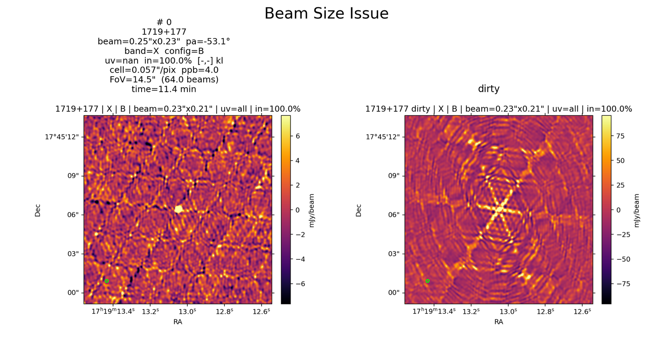
IMAGING
The imaging and diagnostics pipeline is more standardized, but the results are still mixed
README progress here is about consistency and interpretation, not a magic correction recipe.
- Outputs now include dirty image, clean image, residual image, PSF, uv coverage, and summary metrics.
- Beam-based cell size and field-of-view choices reduce arbitrary imaging settings.
- Several fixes were tested: uv-lim recalibration, more MT-MFS terms / iterations, box masks, and the VLA selfcal pipeline.
Old beam-size estimate.
Beam-based first-pass estimate.
CAUTION
Lower residual sigma or nicer scalar metrics do not automatically mean the image is scientifically better. README explicitly warns that CLEAN can improve metrics while still fitting artifacts.
Before: problematic field-of-view / grid choice.
After: more reasonable imaging setup.
radioastro-ml | Phase I infrastructure deck
08

Slide 9
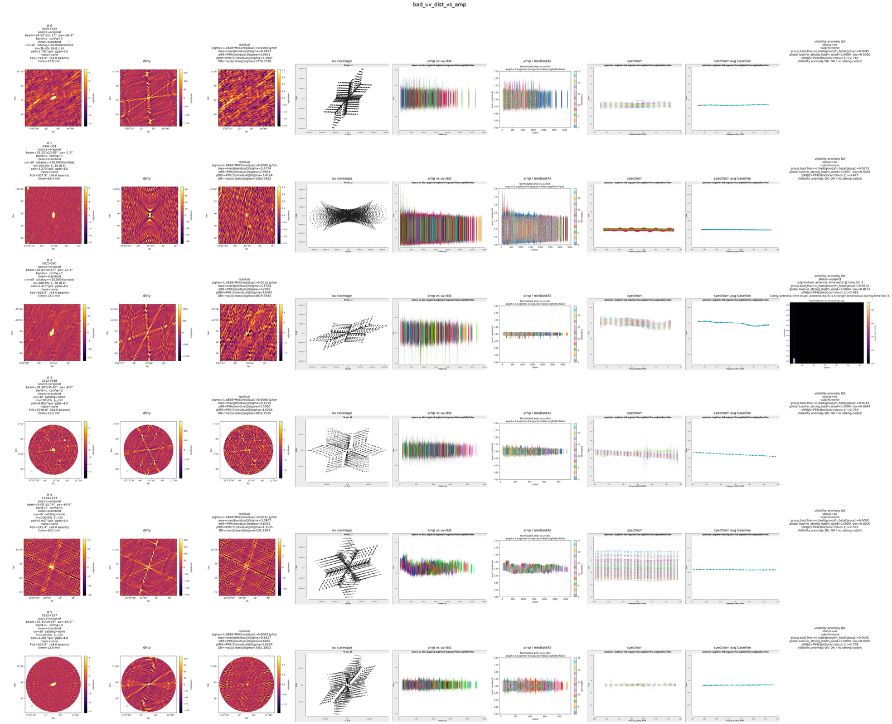
VISIBILITY QA
New work in progress: robust anomaly scoring directly in the visibility domain
This adds a bad-data QA pass that can point to suspicious antennas, baselines, time bins, or channel ranges before relying only on image artifacts.
PIPELINE
1. take log-amplitude
2. bin by uv-distance / channel / SPW
3. compute robust local z-scores
4. aggregate strong outliers by antenna, baseline, time, and channel groups
THRESHOLDS IN README
strong outlier: |z| >= 8
moderate outlier: |z| >= 5
candidate groups are scored by coverage, enrichment, bad fraction, and data loss
Visibility-QA contact sheet for the BAD_UV_DIST_VS_AMP batch.
diagnostic tool, not automatic flagging
radioastro-ml | Phase I infrastructure deck
09

Slide 10
PROGRESS
What exists now, and what still blocks a serious ML claim
The right summary is not 'ML works.' The right summary is 'the pilot-data-generation workflow is finally taking shape.'
What exists now
What still blocks ML
- candidate-data workflow
- structured calibrator catalog
- archive querying / download tooling
- gain-table corruption experiments
- closure / recovery validation
- automated imaging diagnostics
- visibility anomaly prototype
- final fault-class list
- final severity ranges
- sample vetting / rejection rules
- pilot labeled dataset
- first ML benchmark
- generalization checks across calibrators / setups
NEXT MILESTONE
Build a small, clean pilot dataset first. Only then is a baseline classifier worth treating as evidence rather than as a curiosity.
radioastro-ml | Phase I infrastructure deck
10

Slide 11
NEXT STEP
Near-term plan: produce a small pilot dataset and ask the right questions now
The README's own framing is useful here: the next milestone is a clean pilot, not a full-scale ML system.
1
Choose the first fault classes.
Feedback needed
QUESTION 1
QUESTION 3
2
Freeze one imaging / diagnostics recipe.
Which fault classes should come first?
Which products should be ML inputs and what is the first success criterion?
3
Define sample rejection rules.
QUESTION 2
QUESTION 4
4
Generate a pilot labeled dataset.
What should count as a usable calibrator sample?
What output is most useful in the near term: pilot dataset, diagnostic pipeline, software tools, or first ML baseline?
5
Run a small sanity-check baseline classifier.
radioastro-ml | Phase I infrastructure deck
11

