Slide 1
Data processing, analysis and visualisation in Python
Workshop UWC, 26th august
Simon Perneel

Slide 2


Simon Perneel
simon.perneel@ugent.be
https://github.com/simonperneel
Data scientist @Imec-mict-Ugent
Research topics:
smartphone behaviour
digital media use
Python enthousiast

Slide 3
Introduction
Notes:
Why data science?

Slide 4
Data
index | date
2 | 19930000
8 | 1992-930
27 | 20050500
34 | 201405.01
162 | 7/9/2287
1400 | 0.0
2800 | start of the year 2015
3777 | Summer
8733 | 2013-2016
26766 | 26/09/2002 and later 1/1/2016
40788 | Nan
41277 | /
51002 | -999
51007 | -9999

Slide 5
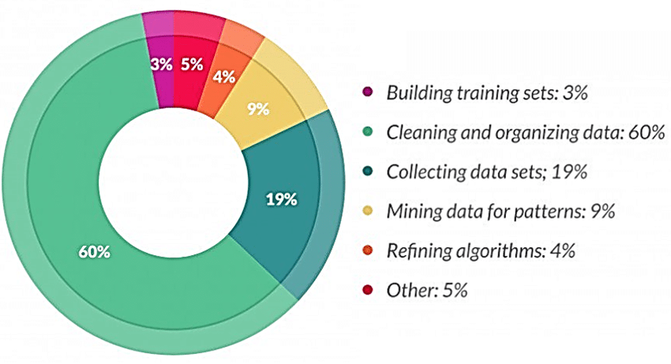
What does a data scientist spend the most time on?
Sarih, Houda & Tchangani, Ayeley & Medjaher, Kamal & PERE, Eric. (2019). Data preparation and preprocessing for broadcast systems monitoring in PHM framework.

Slide 6
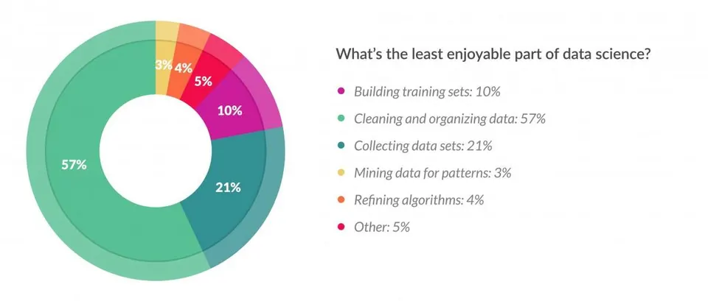
What’s the least enjoyable part of data science?
Sarih, Houda & Tchangani, Ayeley & Medjaher, Kamal & PERE, Eric. (2019). Data preparation and preprocessing for broadcast systems monitoring in PHM framework.

Slide 7

Working with Python

Slide 8











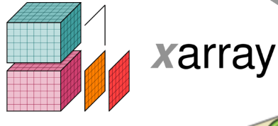




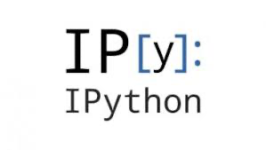

Python ecosystem

Slide 9
Setup workshop
Day 1: Introduction and exercises on working with pandas library
Day 2: Use case: Solve the crime!
Install Python and the required Python packages (if on own computer)
Download the course material to your computer: here
Test your configuration and installation
Start Jupyterlab from Anaconda

Slide 10
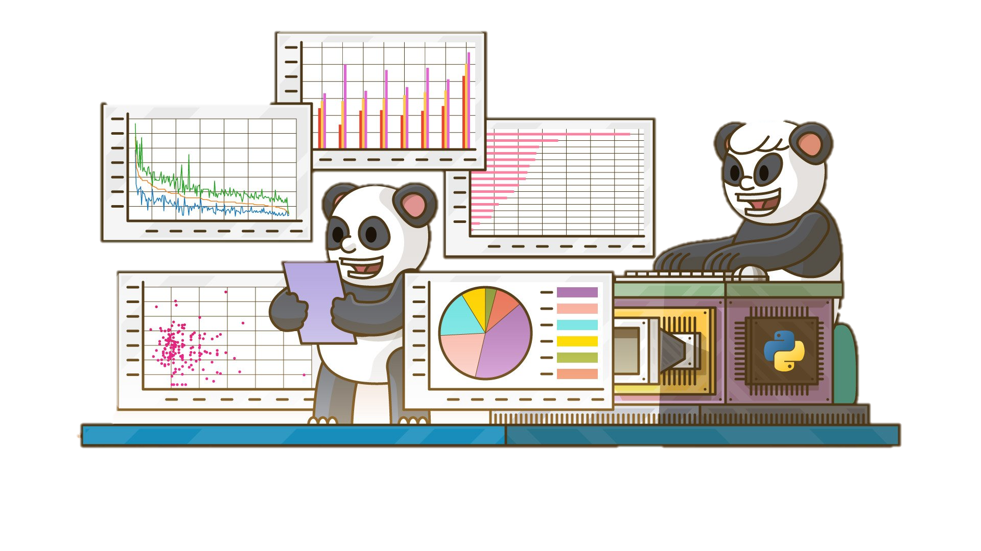
Let’s get started!

