Slide 1
Data processing, analysis and visualisation in Python
Workshop UWC, 26th August 2023
Simon Perneel
https://github.com/simonperneel/DS-python-data-analysis

Slide 2
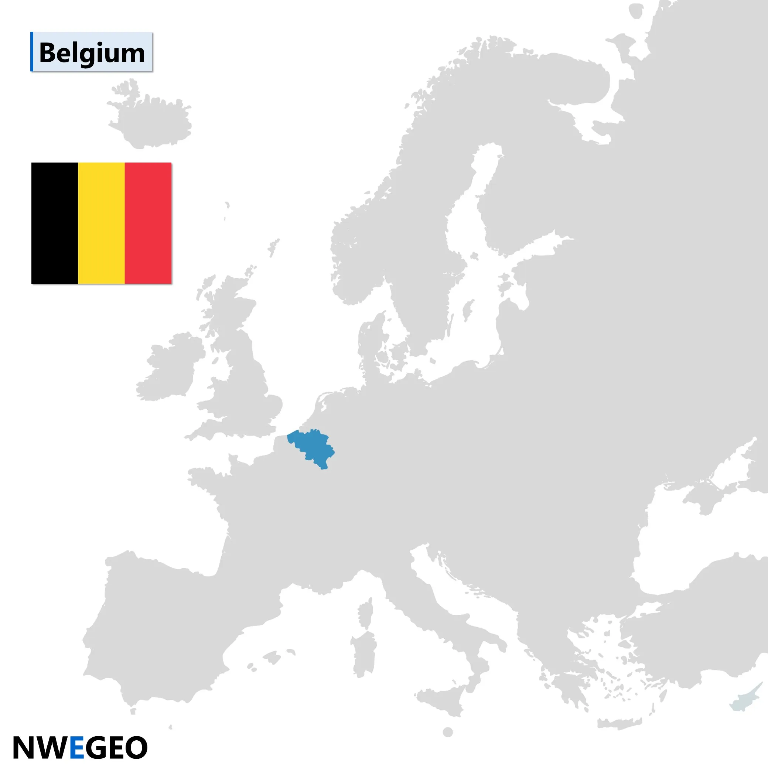


Simon Perneel
simon.perneel@ugent.be
https://github.com/simonperneel
Data scientist @Imec-mict-Ugent
Research topics:
smartphone behaviour
digital media use
Relationship with moods/stress
Python enthousiast
Notes:
Goal of the workshop:
Learn
- how to code more efficiently to process your datasets
- visualise location data

Slide 3
Introduction
Notes:
Why data science?

Slide 4
Data
index | date
2 | 19930000
8 | 1992-930
27 | 20050500
34 | 201405.01
162 | 7/9/2287
1400 | 0.0
2800 | start of the year 2015
3777 | Summer
8733 | 2013-2016
26766 | 26/09/2002 and later 1/1/2016
40788 | Nan
41277 | /
51002 | -999
51007 | -9999
Notes:
Here is an example of the kind of messy data that data scientists frequently encounter. All values appear as dates, but in a different format, like numeric, textual, missing data and placeholders. The challenge here would be to convert all these various formats in a standardized data format.

Slide 5
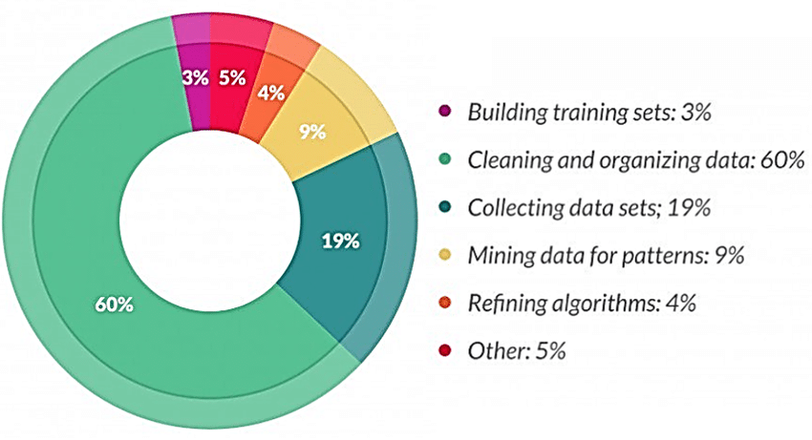
What does a data scientist spend the most time on?
Sarih, Houda & Tchangani, Ayeley & Medjaher, Kamal & PERE, Eric. (2019). Data preparation and preprocessing for broadcast systems monitoring in PHM framework.
https://www.forbes.com/sites/gilpress/2016/03/23/data-preparation-most-time-consuming-least-enjoyable-data-science-task-survey-says/
Notes:
So you may ask yourself the question how a data scientist spend his time.
In a report published by Forbes [7], data preparation accounts for about 80% of a data scientists role, with 60% of that time spent with the cleaning and organizing of that data for analysis;

Slide 6
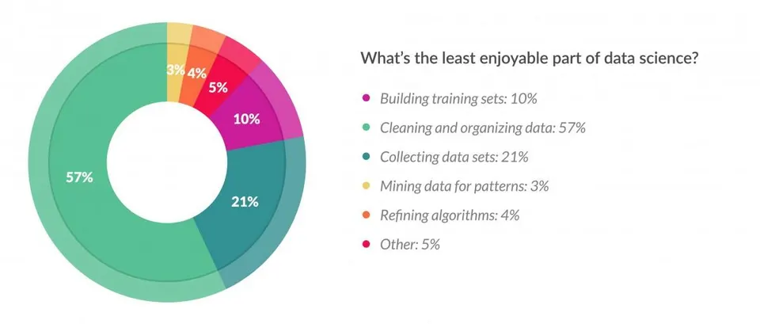
What’s the least enjoyable part of data science?
Sarih, Houda & Tchangani, Ayeley & Medjaher, Kamal & PERE, Eric. (2019). Data preparation and preprocessing for broadcast systems monitoring in PHM framework.
Notes:
At thes ime time, 57% of the respondents in the study of Forbes view data preparation as the least enjoyable part of their work
So, we want to reduce the time spending cleaning and organising data, by coding efficiently and working with the right tools.
That workshop should be the first step towards it.

Slide 7
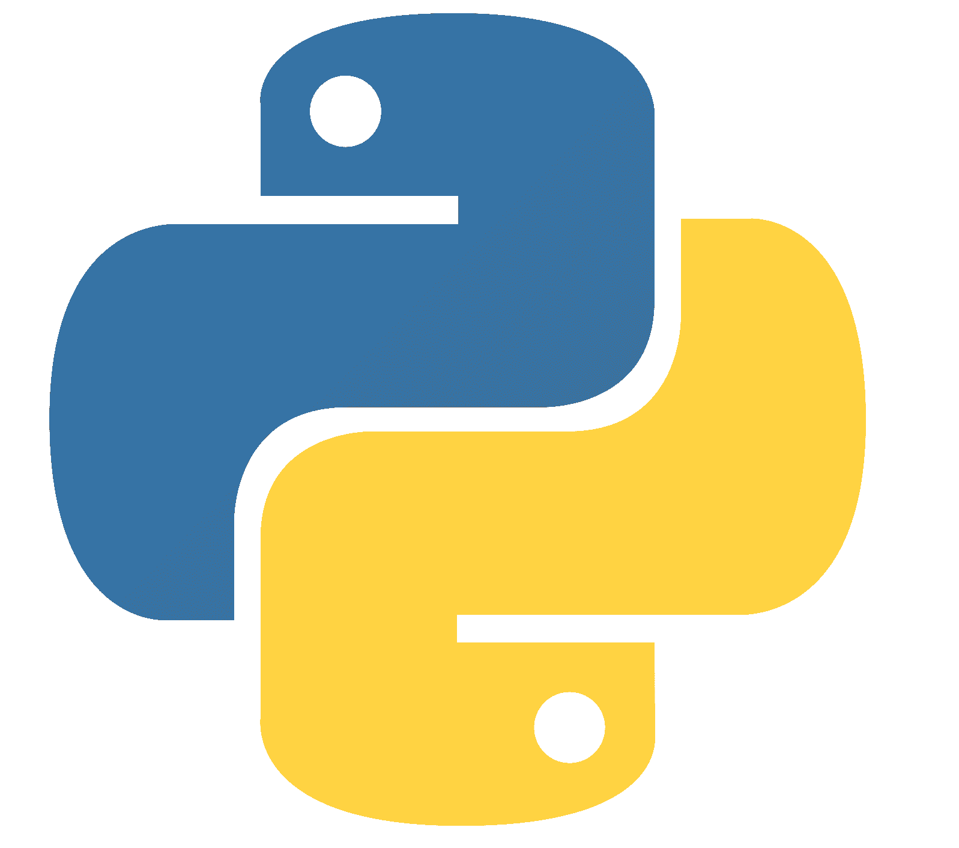
Python for data science
Notes:
I think Python stands out as the ideal programming language for data science and processing because it is very versatily and it has a robust ecosystem.
It has an intuitive syntax that enables quick development so it is accesibble to both beginners and expert programmers
It’s free to use and there is a lot of documentation to find about at the internet, so I think it is the way to go.

Slide 8













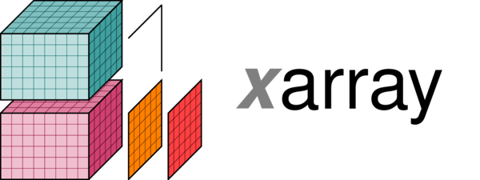




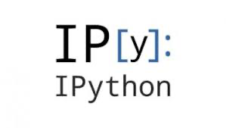

Python ecosystem
Notes:
This is how the python landscape looks like, it depicts the most used packages in python
The base layer is the pure python interpreter
The packages in the layers above increasingly add functions, and depend on the libraries below.
For example,
- numpy is a scientific package to do advanced numerical computations and array operations
- Jupyter is a web application that enables interactive and collaborative computing, allowing users to create and share documents containing live code, equations, visualizations, and text across various programming languages.
- Pandas library provides versatile data structures and tools/functions for efficiently manipulating, cleaning, and analyzing structured data, essential for data analysis and preparation.
- In the top layer there are frequently used packages for data visualisation, but also functions to do machine learning (like Keras, Tensforflow) and Computer vision tasks with OpenCV, these are offten dependent on the packages below

Slide 9
Setup workshop
Day 1:
- Introduction on Pandas library
- Exercises on different aspects of data processing
Day 2:
- Use case: Solve the crime in Amsterdam!
Time is divided between:
- group sessions: explaining new concepts
- practice sessions: you work on excercises
In case of questions, remarks, suggestions, you can always intterupt and just ask!

Slide 10
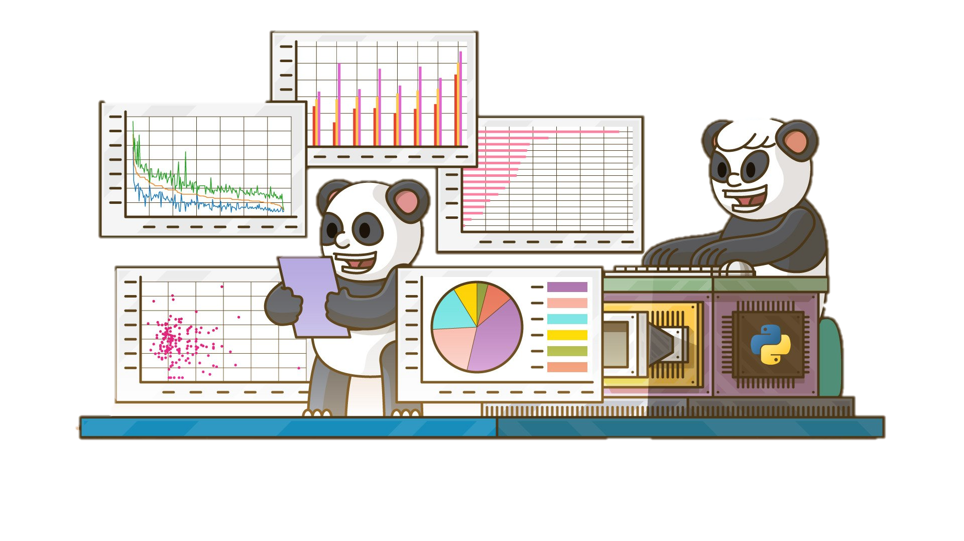
Let’s get started!
Download the course material to your computer:
Set up your environment and install the needed packages for the workshop
Test your configurations
Start Jupyter lab from Anaconda
Detailed instructions: https://simonperneel.github.io

