Slide 1
Simon PICARD
BUSINESS PLAN
CoPark
MiM Master Thesis Supervisor Kurt DESENDER
Universidad Carlos III de Madrid 2016 - 2017

Slide 2
A SHORT STORY
“Parking your car can be a challenge”
CoPark is the solution !
The following is the presentation of the business plan built for CoPark, a service that allows one to rent private parking spots through a mobile phone in a sustainable way

Slide 3
PRESENTATION
AGENDA
The Opportunity
Industry Environment
The Product
Marketing Plan
The Team and Operations
Critical Risks
Financial Plan

Slide 4
PARKING OPTIONS
P
In street
Parking lot
Private parking
Time consuming
Time bounded
Chargeable
Scarce
Expensive
Slow
Fixed location
Inefficient
Scarce

Slide 5
Facts observation
Struggle
To PARK
Working from 9 AM to 5 PM leave an empty parking spot for 8 hours !

Slide 6
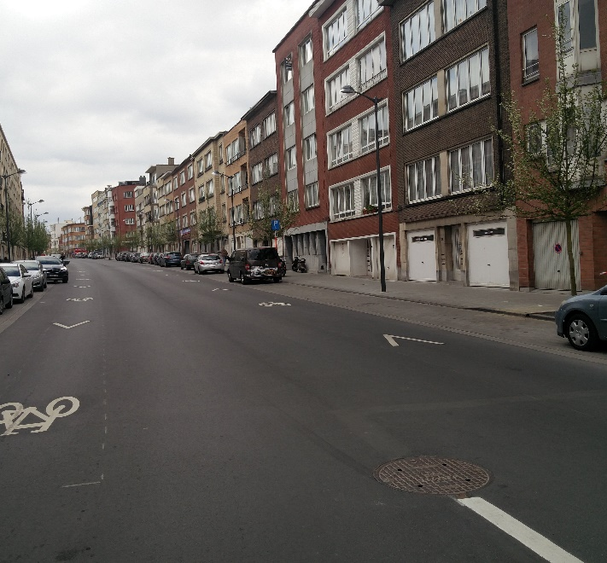
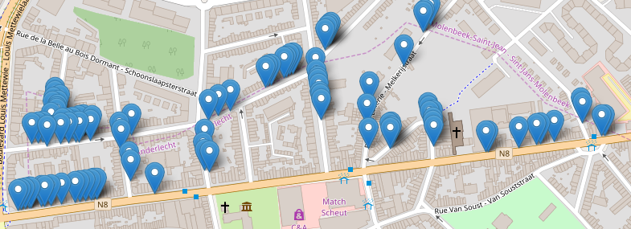
REALITY CHECK
The following figure
shows how many in street access are present in a selection of streets in the west of Brussels. As one can see, the amount of unused space is large.
Laura is Our Communication Manager during last ten years and all are satisfied with her.

Slide 7

Private Parking Short-Term Rent
COPARK:
MOBILE APPLICATION
A parking owner register his spot and its availability
A driver rent the spot from the application
cP
SHORT STAY
Frequent
AFFORDABLE
CONVENIENT

Slide 8
MACRO ENVIRONMENTAL REQUIREMENTS
Sustainable development
Widespread internet
Tech savvy
€
Stable politics
Wealthy Population
BRUSSELS

Slide 9


COMPETITORS
UK Based
Belgium based
Mostly in London, no offer in Belgium
Created one year ago
VS
Non fixed price
Non fixed price
The parking owner sets his price
Same business model
Successful
rising
750,000 users and 25,000 spots available
JustPark
ShareMyPark
But still not popular

Slide 10
Porter’s five forces
Threat of entry
Uncaptured Market
User base as entry barrier
Supplier power
Industry rivalry
Parking owner
Total control
Cannot hold up alone
Competition for the user
Network effect
$
Buyer power
Threat of substitutes
Price Sensitive
Always another parking option
Other parking mean
Other transportation mean

Slide 11
COMPETITIVE STRATEGY
FIXED PRICE
The price to rent a spot will be fixed with 20% fee
FAST
CHEAP
CONVENIENT
SUSTAINABLE
cP
DONATIONS
5% of CoPark’s profit will be donated to the environmental cause
Advantaging driveway owners
To avoid over usage of non-driveway renters, they will have an advantage
The goal is for renters to use their revenue only to rent other parking spots. Ultimately, leading to a service where parking owners just exchange their driveways.

Slide 12
Sustainability VS. Profit
Driveways will be rented as a sustainable act and not with a profit goal
Fixed price of 1€
User will want to be able to park his car in other driveway
80% of online sellers say the extra money they earn is "nice to have but not essential,
85% of people driving frequently would want to be part of an exchange of driveway.
1
JustPark can be successful in the UK because the market is bigger, finding a spot is even harder.
2
3

Slide 13
Relevant market
835 000 cars
55 000 driveways
smartphone presence
Target
485 000 from Brussels
350 000 commuters
265 000 garages
55 000 linked to a house
With an expected driveway
100% of people driving said they were owning a smartphone
200 answers
college graduates, high-income and under 45 years old are the most likely to use on demand and shared services

Slide 14
Pricing
Sharemypark
2€00 and 2€50
1€00
Per hour
Parking lot
1€30 – 2€50, >2€00
Same price as in street, aimed at short term and midterm stay, safe feeling.
20% fee
myflexipark
1€00, 2€00 and 4€00
In street
First hour 1€00 then 1€50 to 3€00
The prices of the services are average or most popular, some spot would be rented for more than 5€00 !

Slide 15
Communication plan
Public Relationship and Events
Flyering at festivals with 10 hours of free parking, Photobooth at student balls and involvement in the shared economy community
advertising
Social media
Target online advertising though Facebook and direct flyering under garage door
Facebook, YouTube, Twitter and Instagram all having a different goal
Sales promotion
Referral promotion, 10€ for the new user and the person who invited him

Slide 16
Asset and Service requirements
CoPark
Back end
iOS front end
Android front end
Web front end
Hosting service
The core of the Copark’s software, where computations are done
Allow the user to access CoPark through an iOS smartphone
Enable the usage of CoPark from an Android smartphone
Let the user set CoPark parameters from a computer, mostly for leasers
To deploy our back end and thus make the front-end parts able to connect with it

Slide 17
The Team
Simon PICARD : Master in Computer Science and Master in Management, CEO
Dan MARTENS : Bachelor in IT Management and Master in Computer Science, CTO
Develop the software
01
Both will be involved, planned for July and August 2017
Promotion
02
Heavily invested by the CEO at the launch of CoPark
Maintenance
03
Dan Martens will the maintenance of the software
75% - 25% initial equity division
Match the cost of opportunity of Simon Picard and the initial investment.

Slide 18
The Process
Add driveway with location, description and availability
Compare your stat with your friend
Account creation
Rent a spot
Be safe
Register a driveway
Challenge friend
Start
Finish
Personal account, register name, phone and car
Open the application, select a spot and rent it
Engage in strike procedure if there is an abuse of your spot

Slide 19
SWOT Analysis
Strengths
Weaknesses
Sustainability value
Application design
Promotion strategy
Fixed price
Safe operation
Low investment
Low experience in the industry
Little work experience of the founders
Untested business model
Success depends on driveway owners
Strengths
Weaknesses
Internal Factors
S
W
O
T
Opportunities
Threats
External Factors
Lack of parking spots
Repetitive work schedule
Sharing economy love
Smart phone omnipresence
Big market
Potentially illegal
Moral hazard
Potential success of competitors
Opportunities
Threats
Positive
Negative

Slide 20
Offer and DEMAND
Maximal user base
Seasonality
11% of the population has used a service similar to AirBnB to stay overnight in a private residence, JustPark extrapolation yield similar result
During summer, the worker can take one week of holiday, increasing the hours of availability of the driveway.
10% capture rate
Spot demand
10 % of capture rate of the maximal market will be assumed
On average, excluding weekends, during the daytime : what is the proportion of the time where your car is parked in a spot that you have to pay for ? 22%
Driveways to rent
15 drivers for 1 driveway
A worker can rent his driveway 8 hours a day, 5 days a week. Thus 160 hours per month. 20% of the total number of driveways will be removed to deduce unemployed.
As there is 15 drivers for 1 driveway, driveway can be expected to be fully rented. A discount of 10% will be used to represent inefficiency

Slide 21

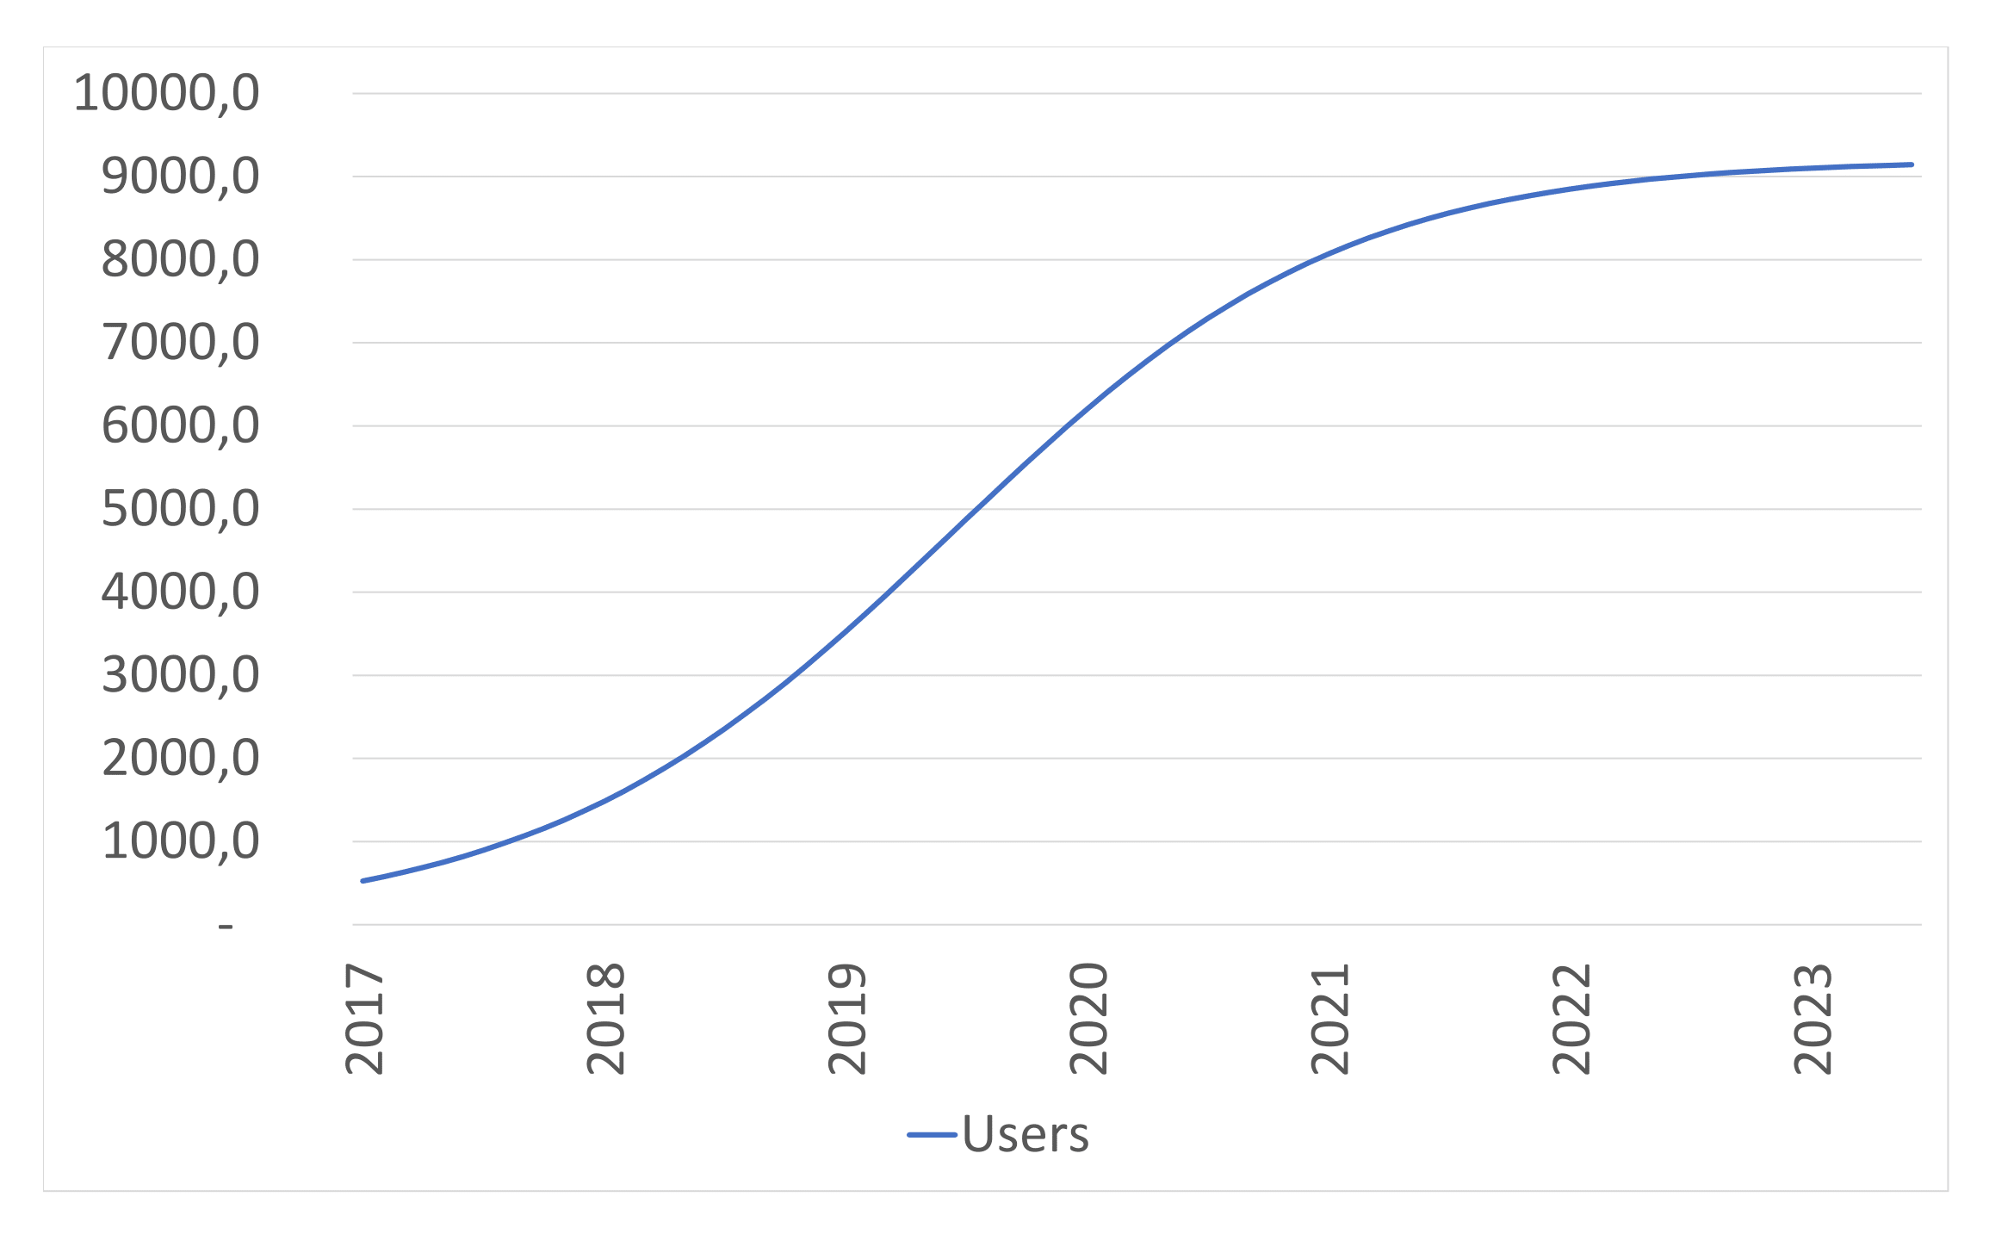
User base growth
Contagion Model
Coming from the epidemiology field.
Initial user base: the number of users at the start depends of the marketing campaign, evaluated at 480 in this case
Total population: the end population, 9 205 for CoPark
Propagation rate: how fast users invite new users, estimated at 10%

Slide 22
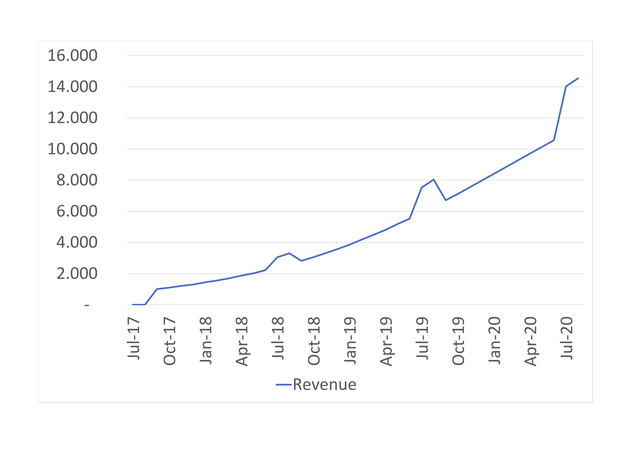
Sales Forecast
The price per hour is 1€, the company thus earns 0.2€ per hour of rent
1
Get number of driveways
FEATURES:
Sed ut perspiciatis unde omnis iste natus error sit volup tatem accus antium dolor emque lauda nt ium, totam rem aperiam.
2
Get offer by multiplying number of driveways per average amount of rent per month
3
Get number of hours rented by discounting the offer by the occupancy rate
4
Get revenue by multiplying the number of hours rented by the fee

Slide 23
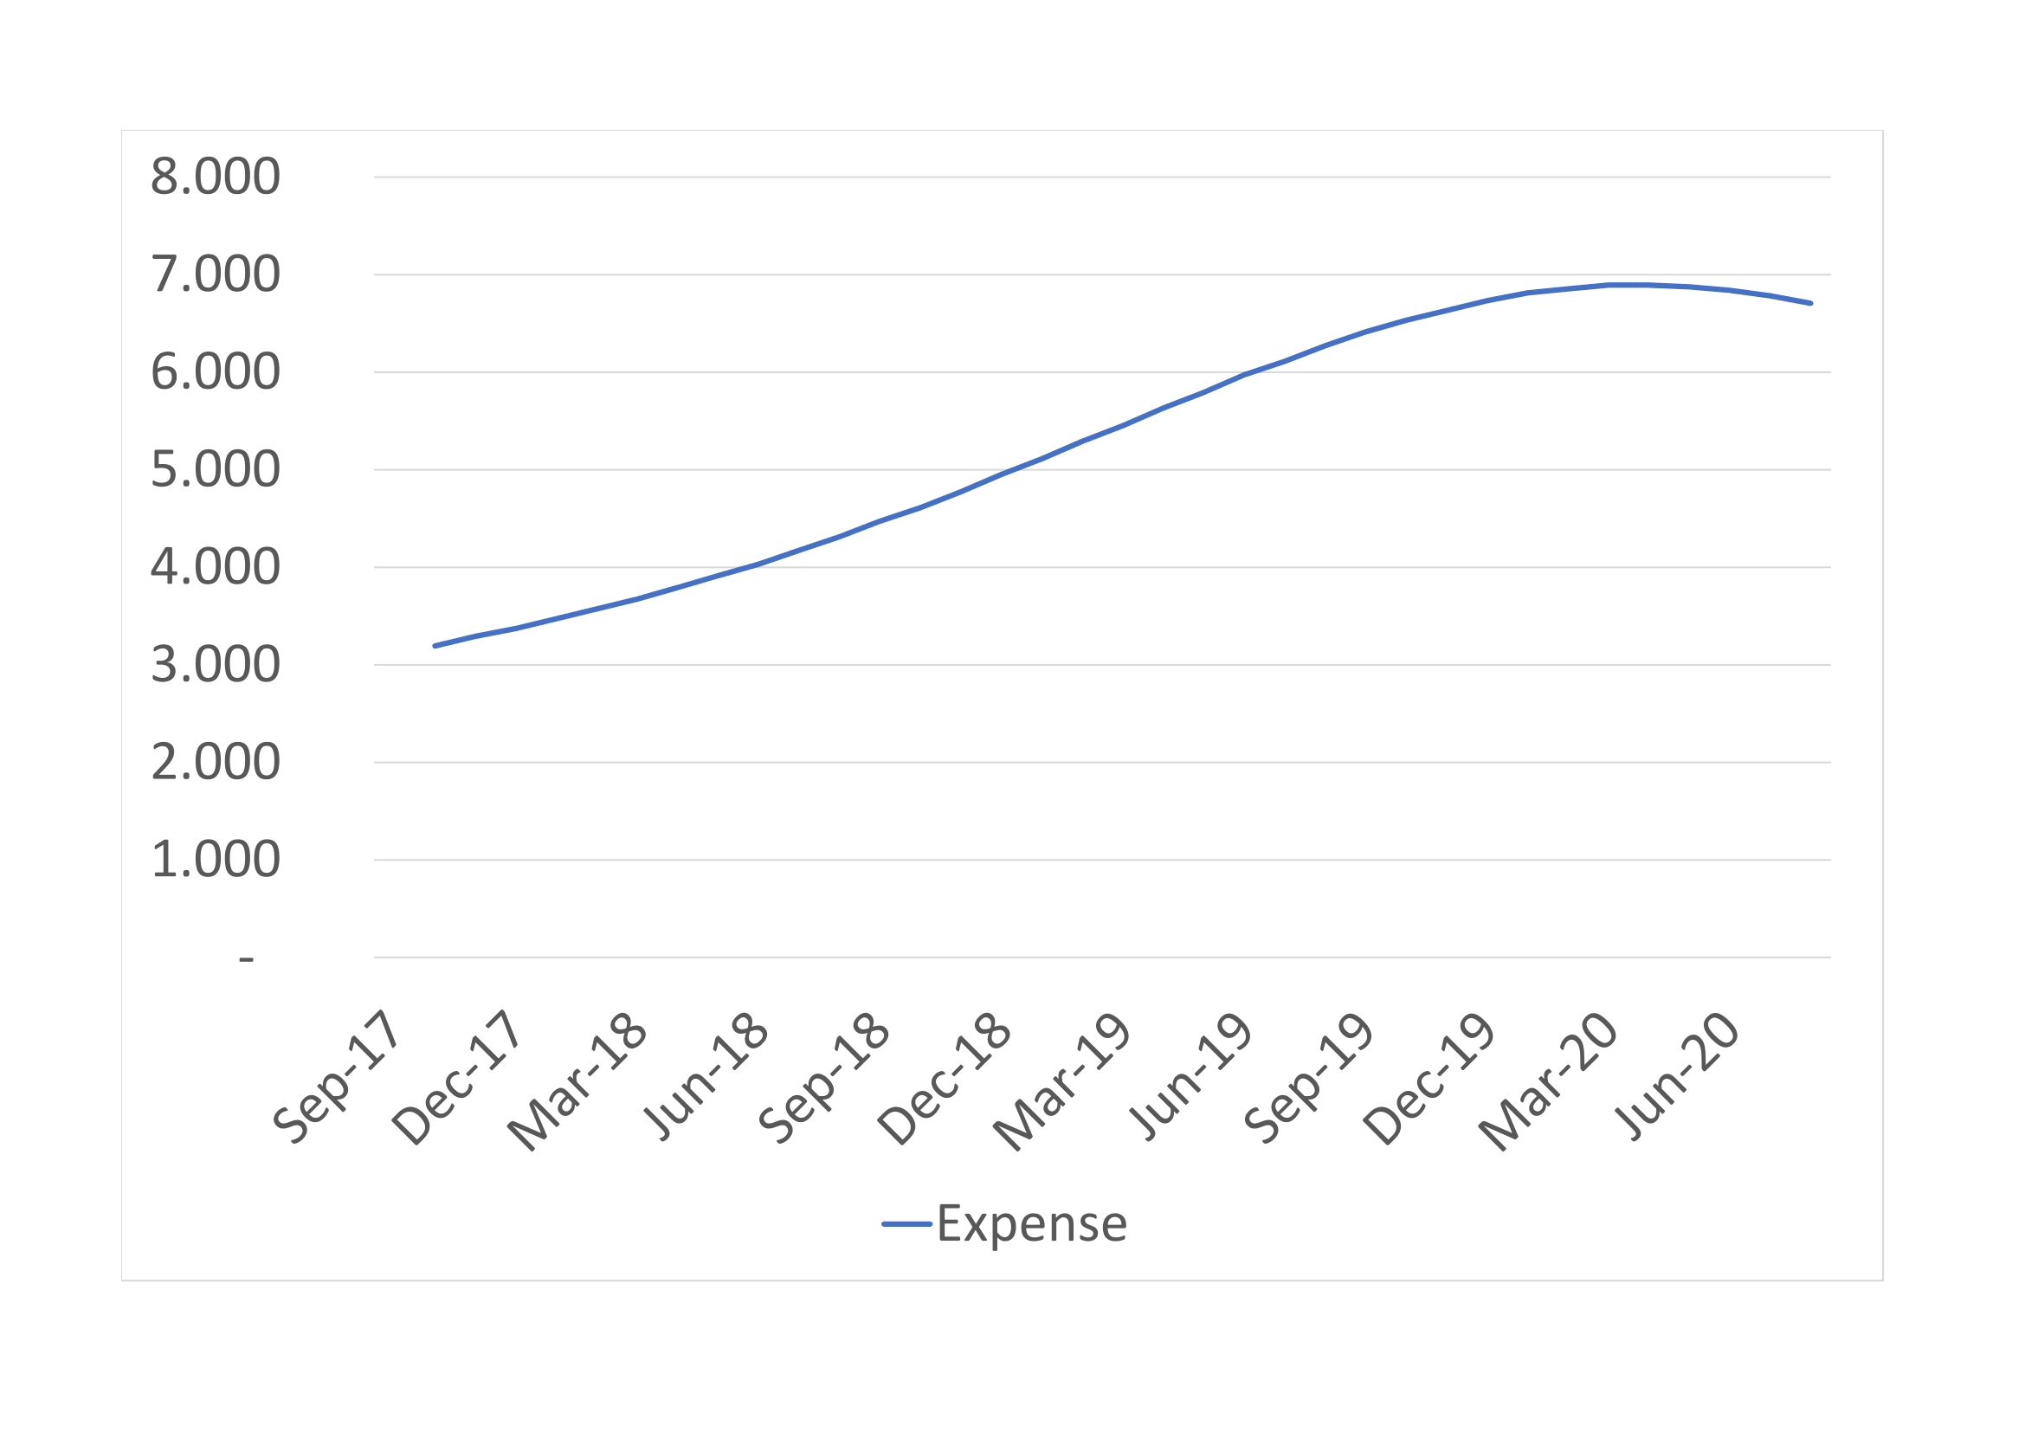
Expenses forecast
recurring fee
Hosting fees: estimated at 81.66e per month to sustain 5 000 users
Referral program: each new user costs the company 20€
Wage: Simon Picard will be the only full-time employee at the minimal rate : 1 500€
Maintenance: the software is valuated at 19 000€, to be fully outdated in 3 years

Slide 24
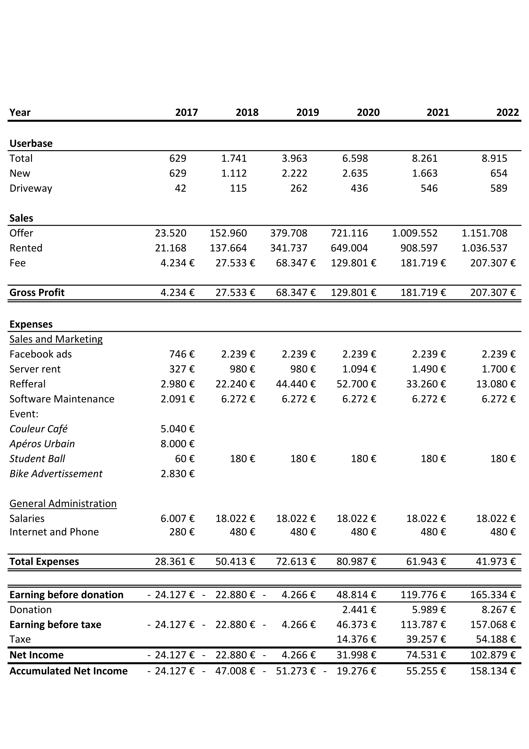
income statement
Higher marketing expense in the beginning
Steady growth
Profitable after 2 years
BEP in 3,5 years
160 000€ of profit in 5 years
Our Office in New Jersey

Slide 25
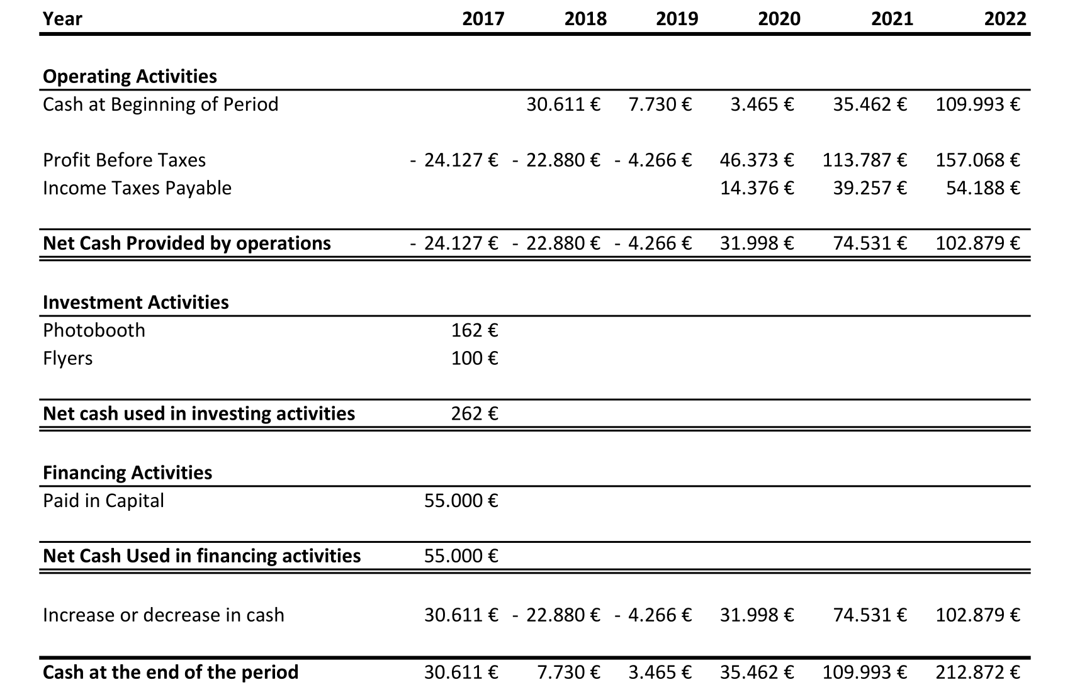
Cash-flow statement
Full investment at the beginning of the operation
55 000 €

Slide 26
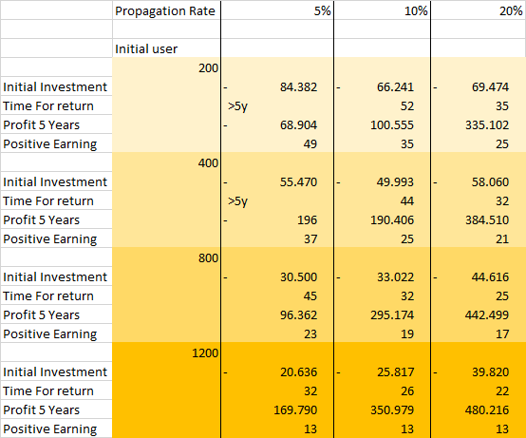
sensitivity analysis
The fewer initial users there are, the more the initial investment is high
Same referral cost
10 000 € per month after market capturation
Investment means success !
Our Office in New Jersey

Slide 27
Key take away and the future
Low investment
Total market
The mandatory investment is 16 132€, the rest depends on the referral program
01
02
If reached infrastructure costs are expected to rise, Dan Martens would join the company full-time
Weekends ?
Wage increase
Only the weekdays are analysed as there is no clear schedule in the weekend
03
04
Once break even happened, Simon will slowly increase his salary to match what he could obtain elsewhere
selling data
expansion
The most desired emplacement can be interesting to establish new commerce or parking lots
05
06
New cities or collaborations

Slide 28
THANKS FOR your attention!
Any questions ?

Slide 29
Advantaging driveway owners
01
Key component of copark
No driveway, no offer, no CoPark
02
Willingness to use the service
The goal is sustainability and further personal use of CoPark
03
Over usage need to be prevented
An issue could happen if there is way more users who do not offer driveway than actual leasers
04
Designed for short stay
It is unlikely that all the spots will be rented all the time
24H in advance maximum
05
allows the driveway owner to have a solid and regular parking option

