Slide 1
Join points in practice
Simon Peyton Jones, Epic Games
October 2025

Slide 2
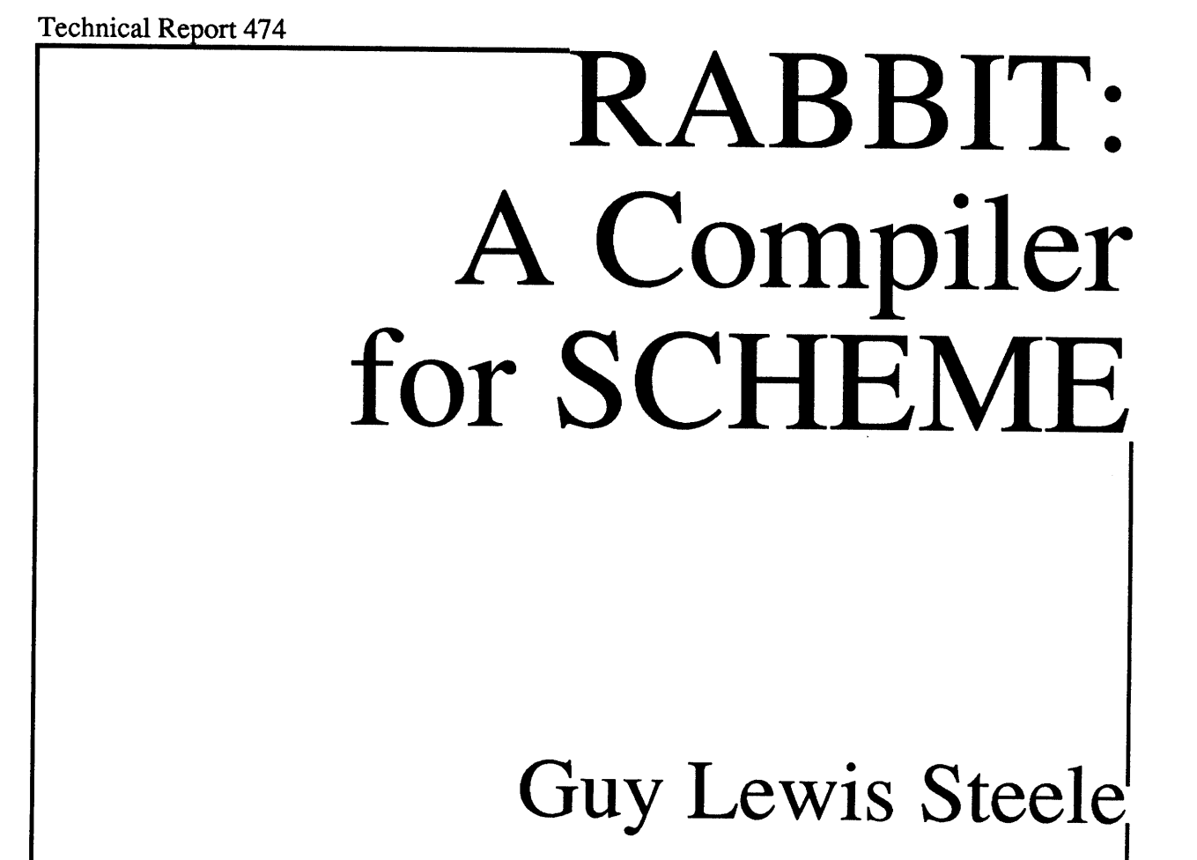

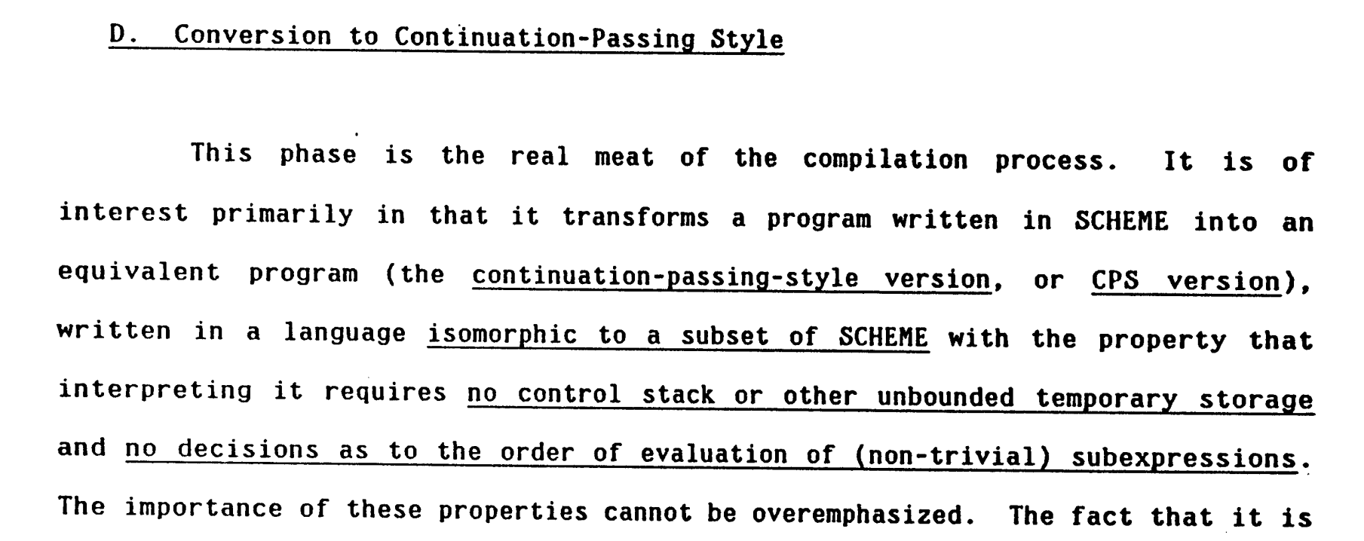
Abandon direct style!
Just use CPS!
Steele [1978]

Slide 3
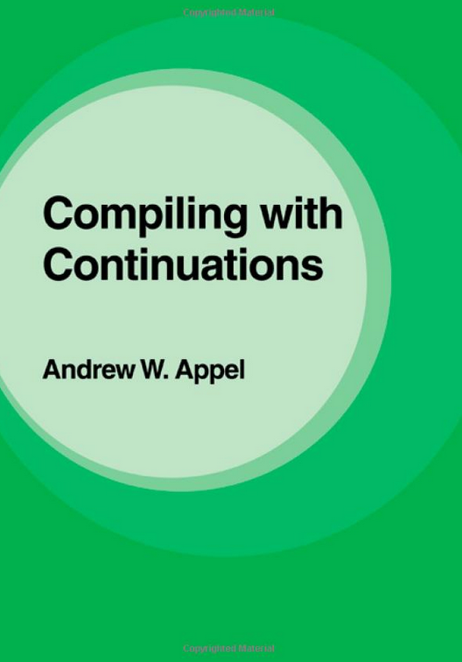

Abandon direct style!
Just use CPS!
Appel [1992]

Slide 4
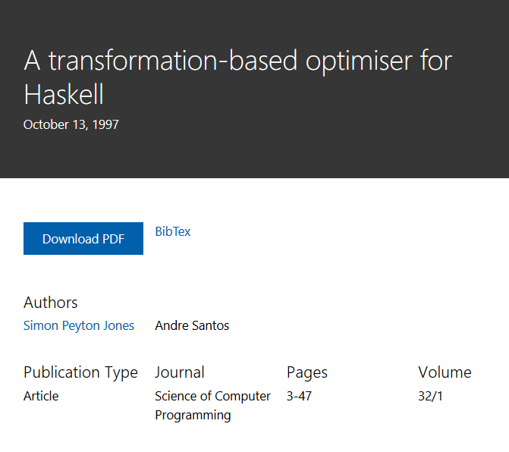

Contuation passing style (CPS): clever, but complicated
Direct style: simple, but misses some tricks

Slide 5
To CPS or not to CPS
CPS is extremely cool, but
CPS fixes order of evaluation
Some transformations much harder e.g
Common subexpression elimination
Rewrite rules f (g x) --> h x

Slide 6

Zap!
No need for CPS!
The essence of compiling with continuations Flanagan et al, PLDI 1993
Contuation passing style (CPS): clever, but complicated
Abandon CPS!
Just use ANF!
Direct style: simple, but misses some tricks

Slide 7

Zap!
No need for CPS! Flanagan et al, PLDI 1993
Abandon ANF!
Just use CPS!
Contuation passing style (CPS): clever, but complicated
Blam!
Oh yes there is!
Compiling with continuations, continued
Kennedy, ICFP 2007
Direct style: simple, but misses some tricks

Slide 8
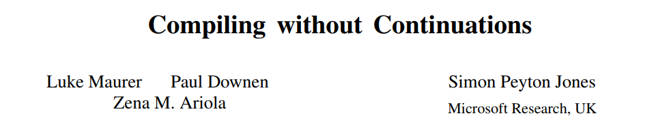
Zap!
No need for CPS! Flanagan et al, PLDI 1993
[PLDI 2017]
Contuation passing style (CPS): clever, but complicated
Blam!
Oh yes there is!
Kennedy et al, ICFP 2007
Pow!
Oh no there isn’t!
Direct style: simple, but misses some tricks
Direct style with join points:
Simple, simple, simple
All the goodness of CPS with none of the pain
New wins (fusion)
Works at scale (GHC)

Slide 9



Natural deduction
Lambda calculus
Core
GHC IR
Core + join points
GHC’s new IR
Curry-Howard isomorphism
Sequent logic
Sequent calculus
Sequent Core
New GHC IR?
Compiling without continuations [PLDI 2017]
Sequent calculus as a compiler intermediate language [ICFP 2016]
Zena Ariola
Paul Downen
Luke Maurer

Slide 10
How GHC works
Tiny Core language:
optimisation happens here
Haskell
Massive language.
Hundreds of pages of user manual.
Syntax has dozens of data types
100+ constructors
Desugar
Typecheck
Rest of GHC

Slide 11
Core: GHC’s intermediate language
data Expr
= Var Var
| Lit Literal
| App Expr Expr
| Lam Var Expr
| Let Bind Expr
| Case Expr Var Type [(AltCon, [Var], Expr)]
| Type Type
| Coercion Coercion
| Cast Expr Coercion
type Kind = Type
data Type = TyVarTy Var
| LitTy TyLit
| AppTy Type Type
| TyConApp TyCon [Type]
| FunTy Type Type
| ForAllTy Var Type
data Var = Id Name Type
| TyVar Name Kind
data Bind = NonRec Id Expr
| Rec [(Id,Expr)]

Slide 12
Commuting conversions

Slide 13
Case of case
notNull xs = not (null xs)
module Prelude where
null xs = case xs of
[] -> True
(x:xs) -> False
not b = case b of
True -> False
False -> True
= case (null xs) of
True -> False
False -> True
= case (case xs of
[] -> True
(p:ps) -> False) of
True -> False
False -> True
case e of
True -> r1
False -> r2
if e
then r1
else r2
means

Slide 14

CASE: case of case
notNull xs = not (null xs)
Push the continuation (the black case) into the arms of the red case
= case (case xs of
[] -> True
(p:ps) -> False) of
True -> False
False -> True
= case xs of
[] -> case True of
True -> False
False -> True
(p:ps) -> case False of
True -> False
False -> True
= case xs of
[] -> False
(p:ps) -> True
Commuting conversions. All good compilers do them.

Slide 15
Not just case-of case
(case x of { True -> R1; False -> R2) arg1 arg2
Again, push the continuation (apply to arg1, arg2) inside the case
case x of
True -> R1 arg1 arg2
False -> R2 arg1 arg2
Any strict evaluation context!
f (case xs of { True -> R1; False -> R2)
If f is strict
Same again
case xs of
True -> f R1
False -> f R2

Slide 16
A worry
= case (case xs of
[] -> True
(p:ps) -> False) of
True -> BIG1
False -> BIG2
Duplicates arbitrary amounts of code :-(
= case xs of
[] -> case True of
True -> BIG1
False -> BIG2
(p:ps) -> case False of
True -> BIG1
False -> BIG2

Slide 17
Join points
= case (case xs of
[] -> True
(p:ps) -> False) of
True -> BIG1
False -> BIG2
No duplication :-)
= let j1 () = BIG1
j2 () = BIG2
in case xs of
[] -> case True of
True -> j1 ()
False -> j2 ()
(p:ps) -> case False of
True -> j1 ()
False -> j2 ()
So far, a “join point” is just an ordinary function

Slide 18

Join points
= case (case xs of
[] -> True
(p:ps) -> False) of
True -> BIG1
False -> BIG2
= case xs of
[] -> BIG1
(p:ps) -> BIG2
j1 is called only once, so inline it
= let j1 () = BIG1
j2 () = BIG2
in case xs of
[] -> case True of
True -> j1 ()
False -> j2 ()
(p:ps) -> case False of
True -> j1 ()
False -> j2 ()
= let j1 () = BIG1
j2 () = BIG2
in case xs of
[] -> j1 ()
(p:ps) -> j2 ()
Inlining removes the extra call when it is not needed

Slide 19
Generalises to arbitrary patterns
= case (case xs of
[] -> Nothing
(p:ps) -> Just p) of
Just x -> BIG1[x]
Nothing -> BIG2
Simply abstract over the pattern bound variables
Pattern binds variable x
= let j1 x = BIG1[x]
j2 () = BIG2
in case xs of
[] -> case Nothing of
Just x -> j1 x
Nothing -> j2 ()
(p:ps) -> case Just p of
Just x -> j1 x
Nothing -> j2 ()
Works fine for existentials, GADTs

Slide 20
Key insight: join points are like control-flow labels
Let bindings allocate a thunk or data constructor
But join points need allocate nothing!
“Calling” a join point = adjust stack pointer and goto
= let j1 x = let v = x+1 in Just v
j2 () = BIG2
in case xs of
[] -> case e1 of
Just x -> j1 x
False -> j2 ()
(p:ps) -> case e2 of
True -> j1 p
False -> j2 ()
xs
e2
e1
j1
j2

Slide 21
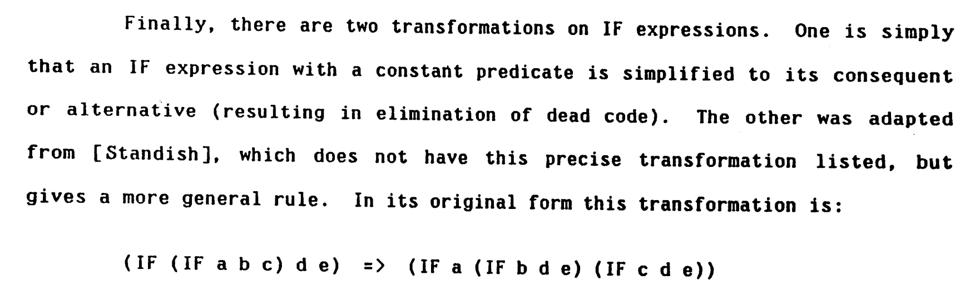
Guy Steele knew this too
Dates right back to Steele’s RABBIT compiler [1978], and the “Lambda the Ultimate...” papers. Maybe earlier!

Slide 22
All this is very very old
Generalisation to arbitrary patterns and GADTs may be newer, but is very simple and obvious.
GHC has spotted join points in the back end (called “let-no-escape” bindings) since 1992, and implemented them as jumps.

Slide 23
But back-end only leaves $$$$$ on the table
Key ideas:
A join point is still a let(rec) binding, but a special one
Formalise what it means to be a “join point”, including operational semantics that justifies their efficient implementation.
Infer join points from user-written code
Teach the optimiser how to exploit join points
Ensure that the optimiser preserves join-point-hood
Develop new transformations to exploit join points
Over the last decade, join points have had an increasingly pervasive influence in GHC.

Slide 24
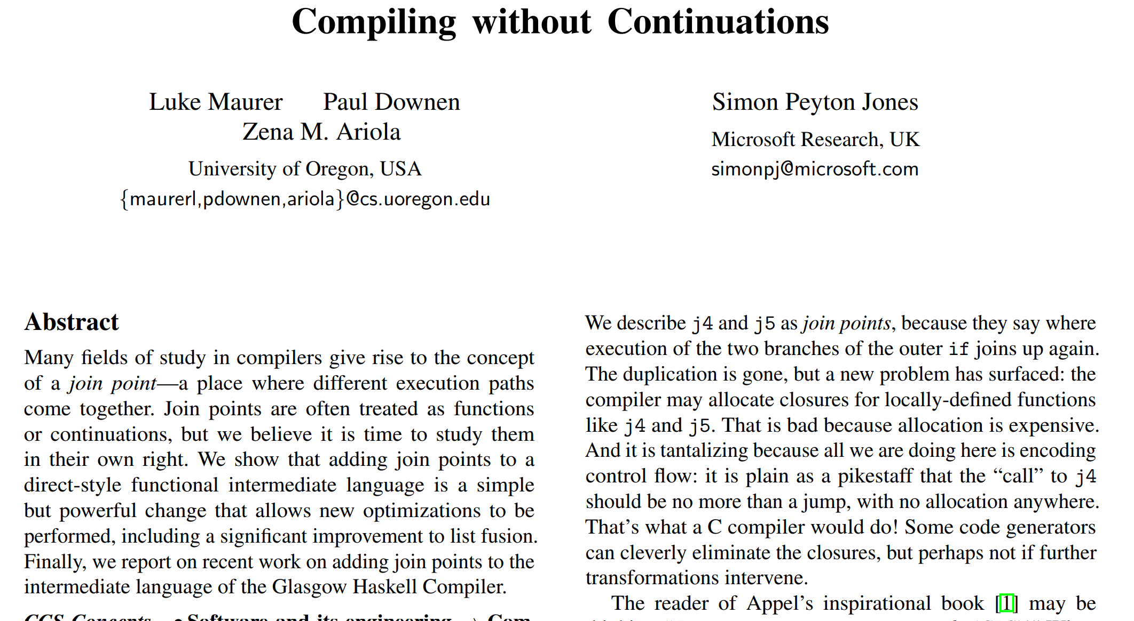

Slide 25
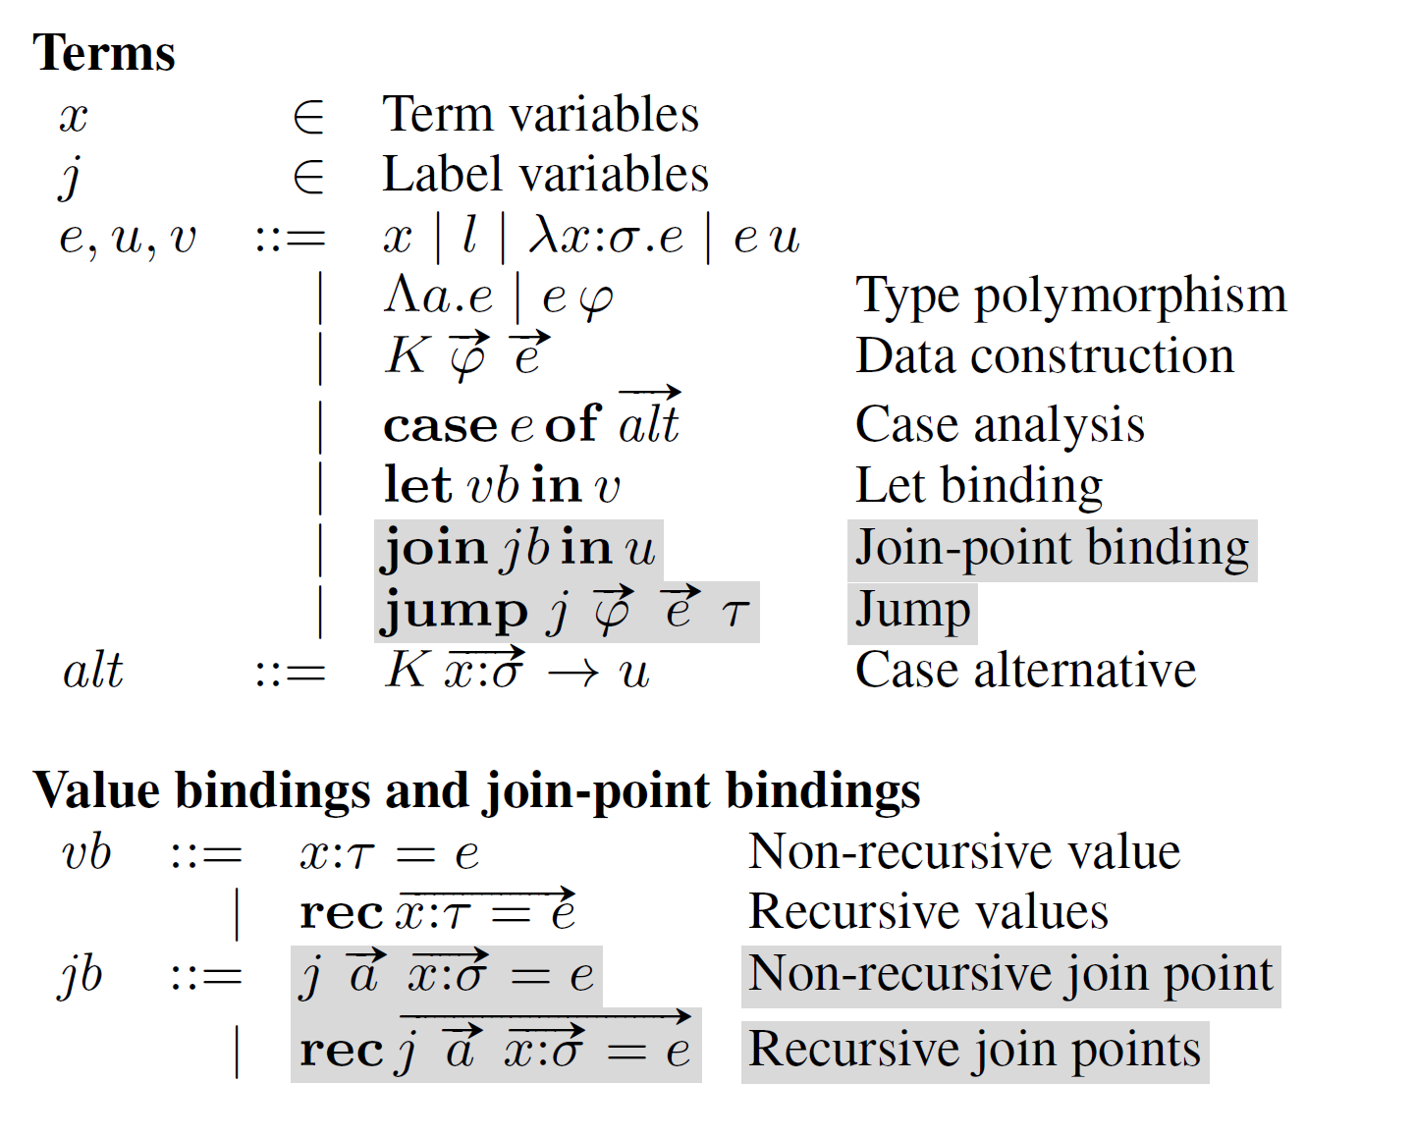

Slide 26
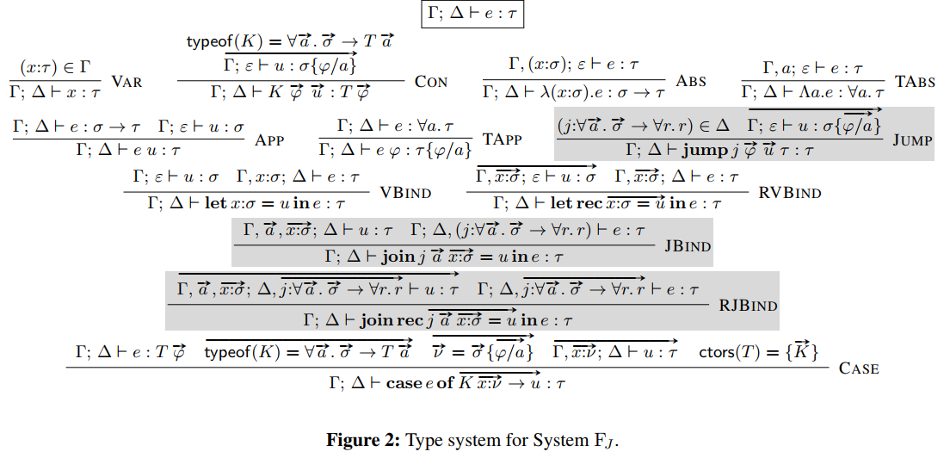

Slide 27
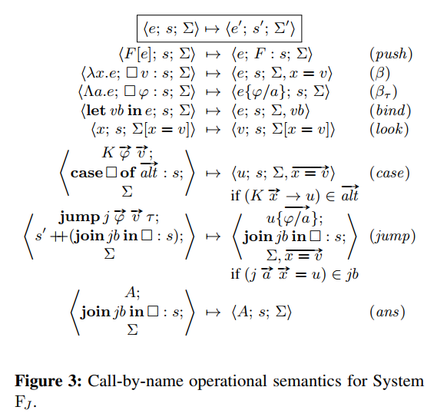

Slide 28
Join points in practice

Slide 29
Implementing join points
GHC: a big, 25-yr-old optimising compiler for Haskell
But it was remarkably easy to add join points to GHC’s tiny intermediate language, Core
A join-point binding is almost exactly like an ordinary letrec
join j x = <rhs>
in ...(jump j <arg>) ...
let j x = <rhs>
in ...(j <arg>) ...

Slide 30
Implementing join points
A join-point binding is almost exactly like an ordinary letrec
join j x = <rhs>
in ...(jump j <arg>) ...
let j x = <rhs>
in ...(j <arg>) ...
where “almost exactly like” means
Same representation
Same semantics
But different operational behaviour
data Expr
= Var Var
| Lit Literal
| App Expr Expr
| Lam Var Expr
| Let Bind Expr
| Case Expr Var Type [(AltCon, [Var], Expr)]
| Type Type
| Coercion Coercion
| Cast Expr Coercion

Slide 31
Join points are just let-bindings; huge win
No need to add extra cases to GHC’s many optimisation passes
Inlining. GHC has elaborate heuristics deciding when to inline a function call; they apply uniformly to join-point calls.
Strictness analysis. If a join point is strict in its argument, the strictness analyser will automatically find it and do a worker/wrapper transformation.
However: many passes have new opportunities that can exploit join points

Slide 32
Not quite what is in the paper!
Is j a join point??
In the paper: yes. “Calling” the join point discards the continuation (adjusts the stack, and jumps)
In GHC: no.
join j x = BLAH
in case j 3 of
True -> R1
False -> R2
Why not?
In the paper, join points have rather strange types. In GHC it is much much easier to keep types uniform.
It would be wrong to replace every join point with an ordinary let-binding. So join bindings are not “just an optimisation” – different semantics.
The extra generality is useless in practice, because we will simply discard the (dead) continuation:
join j x = BLAH in j 3

Slide 33
Optimising join points

Slide 34
The Simplifier
Simplify
Inlining
Beta-reduction
Case-of-constructor
Constant folding
Etc etc etc
Occurrence analysis
Bottom up
(Optionally)
Lint
GHC applies the simplifier many times
In between other transformations (strictness analysis, let-floating, specialisation, common subexpression…)

Slide 35
Inferring join points (“contification”)
let j x = let v = x+1 in Just v
in case xs of
[] -> case e1 of
Just x -> j x
False -> Nothing
(p:ps) -> case e2 of
True -> Nothing
False -> j x
All calls are tail calls, relative to binding site
No call is captured in a thunk or closure
All calls saturated
Easily inferred, in a single bottom-up pass over the code.
The Occurrence Analyser does this
So user-written join points, or accidentally arising ones, are immediately identified as join points – and preserved thereafter

Slide 36
Preserving and exploiting join points
case (let x = rhs in body) of
True -> R1
False -> R2
Usually a super-good transformation
let x = rhs in
case body of
True -> R1
False -> R2

Slide 37
But not for join points!
case (let j x = E1
in case xs of
Just x -> j x
Nothing -> E2) of
True -> R1
False -> R2
Bad bad bad!
Two bad things
‘j’ is no longer a join point
The outer black case does not scrutinise E1
= let j x = E1
in case xs of
Just x -> case (j x) of
True -> R1
False -> R2
Nothing -> case E2 of
True -> R1
False -> R2

Slide 38
Keeping join points
case (let j x = E1
in case xs of
Just x -> j x
Nothing -> E2) of
True -> R1
False -> R2
Move outer (black) case into join point
No no no
= let j x = E1
in case xs of
Just x -> case (j x) of
True -> R1
False -> R2
Nothing -> case E2 of
True -> R1
False -> R2
= let j’ x = case E1 of
True -> R1
False -> R2
in case xs of
Just x -> j’ x
Nothing -> case E2 of
True -> R1
False -> R2
As well as the case RHS
‘j’ remains a join point
The outer black case now scrutinises E1

Slide 39
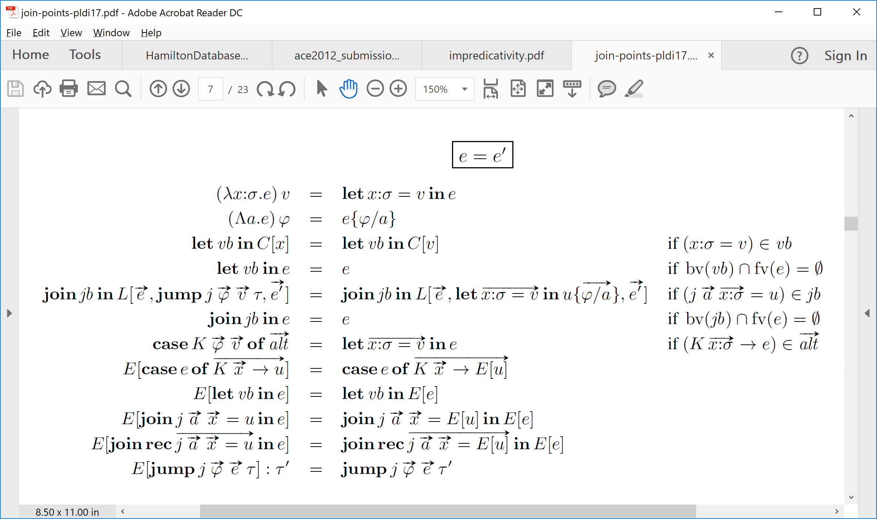
Optimising transformations for join points
Move evaluation context E into
RHS of join point bindings
as well as the body

Slide 40
Optimising transformations for join points
Here!
join j x = case B1 of
True -> R1
False -> R2
in case xs of
Just x -> j x
Nothing -> case B2 of
True -> R1
False -> R2
case (join j x = B1
in case xs of
Just x -> j x
Nothing -> B2) of
True -> R1
False -> R2
And here

Slide 41
Optimising transformations for join points
Discard E altogether at jumps
join j x = case B1 of
True -> R1
False -> R2
in case xs of
Just x -> j x
Nothing -> case B2 of
True -> R1
False -> R2
case (join j x = B1
in case xs of
Just x -> j x
Nothing -> B2) of
True -> R1
False -> R2
Here!

Slide 42
Optimising transformations for join points
Cont directly implements the “E” in the above LaTex
Perfect fit with GHC’s Mighty Simplifier
simplExpr :: Env -> Expr -> Cont -> SimplM Expr
simplExpr env (App fun arg) cont
= simplExpr env f (ApplyTo env arg cont)
simplExpr env (Case scrut alts) cont
= simplExpr env scrut (Select env alts cont)
Cont is just a zipper!
data Cont = Stop
| ApplyTo Env Expr Cont
| Select Env [Alt] Cont
| ...

Slide 43
Optimising transformations for join points
Perfect fit with GHC’s Mighty Simplifier
The rules turn straight into code
simplExpr :: Env -> Expr -> Cont -> SimplM Expr
simplExpr env (Let (NonRec j rhs) body) cont
| isJoinId j
= Let (NonRec j (simplExpr env rhs cont))
(simplExpr env body cont)

Slide 44
Types
GHC’s Core language is statically typed
case (join j :: Int -> Char
j x = chr (x+1)
in case v of
True -> j 4
False -> j 88) of
‘x’ -> “hello”
_ -> “goodbye”
No! The type has changed
join j :: Int -> Char
j x = case chr (x+1) of
‘x’ -> “hello”
_ -> “goodbye”
in case v of
True -> j 4
False -> j 88

Slide 45
But not quite…
The type of a join point changes when you push a continuation into it (of course)
The return type of a join point must not mention quantified type variables
See the paper
case (join j :: Int -> Char
j x = chr (x+1)
in case v of
True -> j 4
False -> j 88) of
‘x’ -> “hello”
_ -> “goodbye”
Not allowed
join j :: Int -> String
j x = case chr (x+1) of
‘x’ -> “hello”
_ -> “goodbye”
in case v of
True -> j 4
False -> j 88
join j :: ∀a. a->a
j (a:Type) (x:a) = …
in case v of
True -> j Int 4
False -> j Int 88

Slide 46
Recursive join points and fusion

Slide 47
Recursive join points
letrec last xs = case xs of
[x] -> x
(x:xs) -> last xs
in last blah
joinrec last xs = case xs of
[x] -> x
(x:xs) -> last xs
in last blah
Join points can be recursive => loop in control flow graph
Easy, easy, easy. Everything just works.
Including mutual recursion

Slide 48
Streams
data Stream a where
Mk :: forall a s. s -> (s->Step s a) -> Stream a
data Step s a = Done | Yield s a
filterS :: (a->Bool) -> Stream a -> Stream a
filterS p (Mk state step)
= Mk state (\s. letrec step’ s = case step s of
Done -> Done
Yield s’ x | p x -> Yield s’ x
| otherwise -> step’ s’
in step’ s)
filter2 p q xs
= filterS p (filterS q xs)
step’ is recursive so filter2 will not fuse
So (Leshchinskiy et al) add a Skip constructor to Step.
But that leads to other Bad Things.
With join points: step’ is now inferred as a (recursive) join point, so fusion just works without Skip.

Slide 49
Stream fusion
case joinrec step’ s = case step s of
Done -> Done
Yield s’ x | p x -> Yield s’ x of
| otherwise -> jump step’ s’
in jump step’ s
BLAH
joinrec step’ s = case step s of
Done -> case Done of BLAH
Yield s’ x | p x -> case Yield s’ x of BLAH
| otherwise -> jump step’ s’
in jump step’ s
Commuting conversions automatically work over loops!

Slide 50
Floating lets in
letrec f x = case x==0 of
True -> 0
False -> f (x-1)
in 1 + f y
Not a join point
…because it is not tail-called

Slide 51
Floating lets in
letrec f x = case x==0 of
True -> 0
False -> f (x-1)
in 1 + f y
Float bindings inwards, down to the call site
This is good anyway: may avoid allocation
And it may mean we get a join point => no allocation at all
1 + letrec f x = case x==0 of
True -> 0
False -> f (x-1)
in f y
Now it is a join point

Slide 52
Inlining and occurrence analysis
GHC’s single most important optimisation decision

Slide 53
Inlining of join points: just like ordinary functions
join j x = <small>
in case y of
True -> jump j e1
False -> jump j e2
Inline if <small> is small
join j x = <BIG>
in case y of
True -> e1
False -> jump j e2
Inline if j is used only once

Slide 54
Inlining into join-point RHSs
Build a thunk
let v = f 22
in join j x = …v…
in …
Can we inline v at its (unique) use site???
GHC is usually paranoid: don’t inline a thunk into the body of a lambda
let v = f 22
in map (\x -> x+v) xs

Slide 55
Inlining into join point RHSs
let v = f 22
in join j x = …v…
in …
Yes! Inline v! Non-recursive join points can only be called once!
All we have to do is to teach the occurrence analyser that a non-recursive join-point lambda is “one-shot”
join j x = …(f 22)…
in …

Slide 56
A tricky example
let v = SMALL
in case x of
A -> case v of (a,b) -> a
B -> case v of (a,b) -> a
C -> case v of (a,b) -> b
D -> []
v occurs 3 times...
...but is only evaluated once
RHS is small so duplication is acceptable
Inlining avoids a thunk allocation
Occurrence analyser discovers this info about v
GHC inlines v
case x of
A -> case SMALL of (a,b) -> a
B -> case SMALL of (a,b) -> a
C -> case SMALL of (a,b) -> b
D -> []

Slide 57
Same again, with join points
let v = SMALL in
join j = case v of (a,b) -> a
in case x of
A -> j
B -> j
C -> case v of (a,b) -> b
D -> []
Boo! now v appears to be evaluated twice (but of course it isn’t really)
We still really want to inline, just as before
Turns out that this can make a Big Difference in practice
Join points making things worse. Oh no.

Slide 58
Solution
let v = SMALL in
join j = case v of (a,b) -> a
in case x of
A -> j
B -> j
C -> case v of (a,b) -> b
D -> []
Make the occurrence analyser behave as if all non-recursive join points were inlined.
Simple to say, a little tricky to implement.
But really the hard bit is recognising the problem in the first place.

Slide 59
Another tricky corner
f is free, e.g.
let f = \y. y*2+z
case (join j x = K f x
in case v of
A -> j 1
B -> j 2
C -> j 3) of
K g y -> y + g 7
Good result
join j x = case K f x of
K g y -> y + g 7
in case v of
A -> j 1
B -> j 2
C -> j 3)
join j x = x + f 7
in case v of
A -> j 1
B -> j 2
C -> j 3)

Slide 60
Another tricky corner
But suppose I inline j.
After all, the RHS is small
case (join j x = K f x
in case v of
A -> j 1
B -> j 2
C -> j 3) of
K g y -> y + g 7
join j1 g y = y + g 7
in case v of
A -> j1 f 1
B -> j1 f 2
C -> j1 f 3
Higher order call. Bad bad bad
case (case v of
A -> K f 1
B -> K f 2
C -> K f 3) of
K g y -> y + g 7
join j1 g y = y + g 7
in case v of
A -> case K f 1 of
K g y -> j1 g y
B -> ..ditto...
C -> ..ditto...

Slide 61
Another tricky corner
case (join j x = K f x
in case v of
A -> j 1
B -> j 2
C -> j 3) of
K g y -> y + g 7
Be careful about inlining join points, even small ones
…Especially ones whose RHS is just a constructor application
Ad hoc. But inlining is ad hoc.
Side note: please fix. (E.g. Lionel Parreaux; Celeste Hollenbeck)

Slide 62
Exit floating aka “Exitification”

Slide 63
Exit floating
f x = let v = g x
in joinrec go 10 = h (v + 8)
go i = jump go (i+1)
in jump go 0
The local binding for v allocates a thunk for (g x)
Call to h allocates a thunk for (v+8)
h may or may not evaluate its argument
But we can do better!

Slide 64
Exit floating
Thunk
Thunk
f x = let v = g x
in joinrec go 10 = h (v + 8)
go i = jump go (i+1)
in jump go 0
The local binding for v allocates a thunk for (g x)
Call to h allocates a thunk for (v+8)
h may or may not evaluate its argument
We want this:
OK, so why not just inline v into the join-point RHS?
Good! No thunk for v
f x = join go 10 = h (g x + 8)
go i = jump go (i+1)
in jump go 0

Slide 65
Exit floating
f x = let v = g x
in joinrec go 10 = h 8
go i = jump go (i + v)
in jump go 0
Inline v
Uses v every iteration
But inlining v could be very very bad!
f x = join go 10 = h 8
go i = jump go (i + g x)
in jump go 0
BAD! Evaluates (g x) on every iteration

Slide 66
Exit floating
f x = let v = g x
in joinrec go 10 = h 8
go i = jump go (I + v)
in jump go 0
Inline v
Uses v every iteration
But inlining v could be very very bad!
So we can’t unconditionally inline a thunk into a joinrec
But sometimes we want to!
What we want: treat exit paths specially
No no no
f x = join go 10 = h 8
go i = jump go (i + g x)
in jump go 0

Slide 67
Exit floating
f x = let v = g x
in joinrec go 10 = h (v + 8)
go i = jump go (i+1)
in jump go 0
Pull out exit path
Key idea: float out the exit path as a join point
Now we can inline v, because j is a non-recursive join point
Exit path as a join point
f x = let v = g x
in join jx = h (v+8)
in joinrec go 10 = jump jx
go i = jump go (i+1)
in jump go 0

Slide 68
Exit floating
f x = let v = g x
in join jx = h (v+8)
in joinrec go 10 = jump jx
go i = jump go (i+1)
in jump go 0
Now we can inline v, because j is a non-recursive join point
Identifying the exit-path of a recursive binding, and creating an exit join point, is done by a dedicated pass.
After that, regular old inlining does the heavy lifting.
Inline v
Exit path as a join point
f x = join jx = h (g x + 8)
in joinrec go 10 = jump jx
go i = jump go (i+1)
in jump go 0

Slide 69
Wrap up

Slide 70
Bottom line
It’s a no-brainer
Every direct-style compiler should use join points
An extremely (almost embarrassingly) simple idea
Excellent power-to-weight ratio
But (of course) some tricky corners
Paper: on my home page: https://simon.peytonjones.org
Q for the audience: are there any remaining advantages to compiling through CPS?

