Slide 1

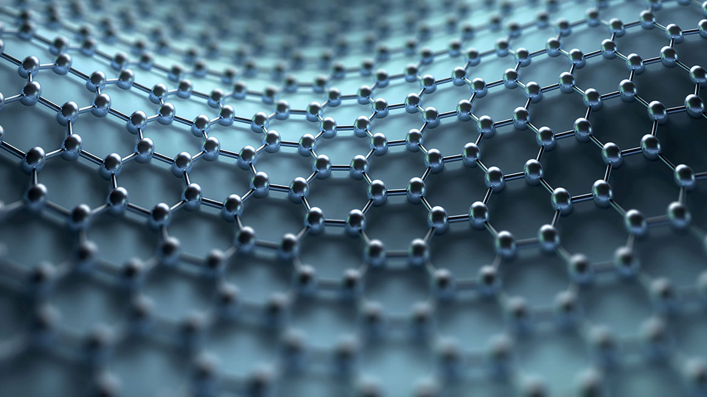
Bits with soul
Simon peyton jones, Epic Games and Pembroke College
January 2025

Slide 2
Everything digital Phones, cars, medicine, energy infrastructure, light switches, data centres, shopping, communicating,
... ... ...

Slide 3
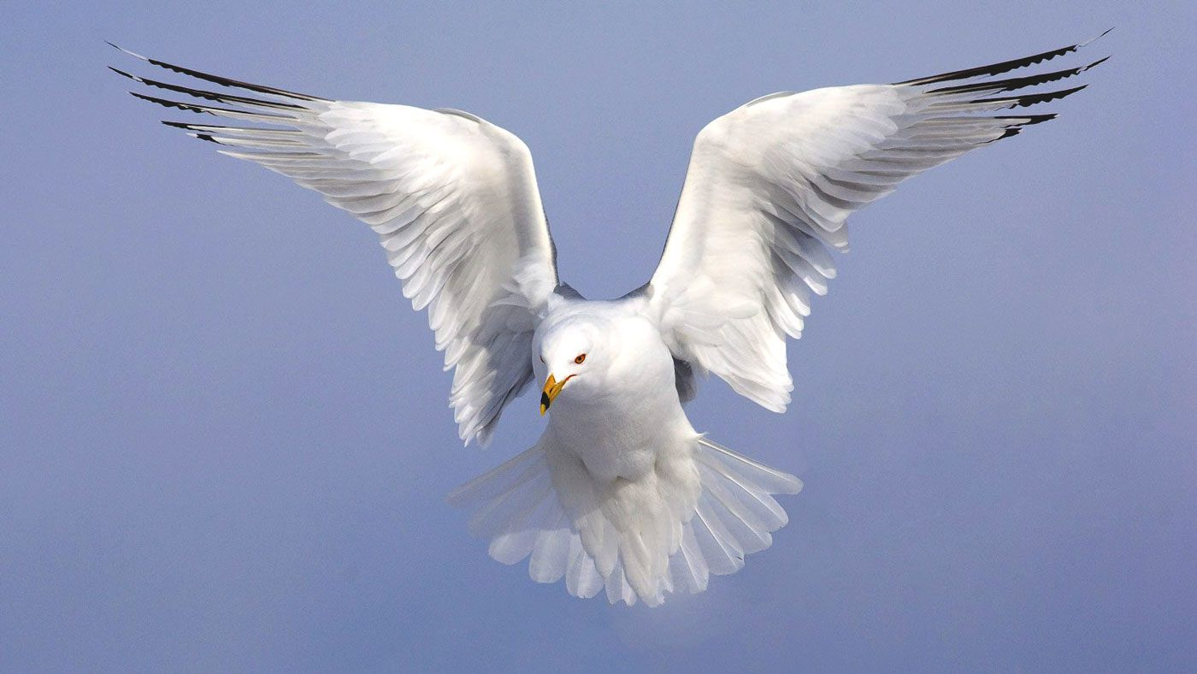
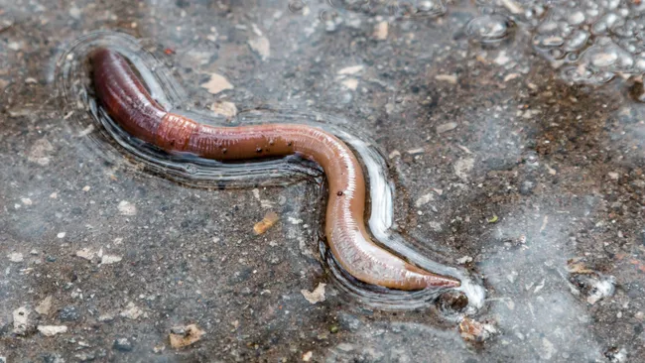
Everything digital Phones, cars, medicine, energy infrastructure, light switches, data centres, shopping, communicating,
... ... ...
Bits

Slide 4
Episode 1: Information
Bits, more bits, more and more bits
Soul
Information
Computation
Communication
Emergent behaviour
Learning

Slide 5
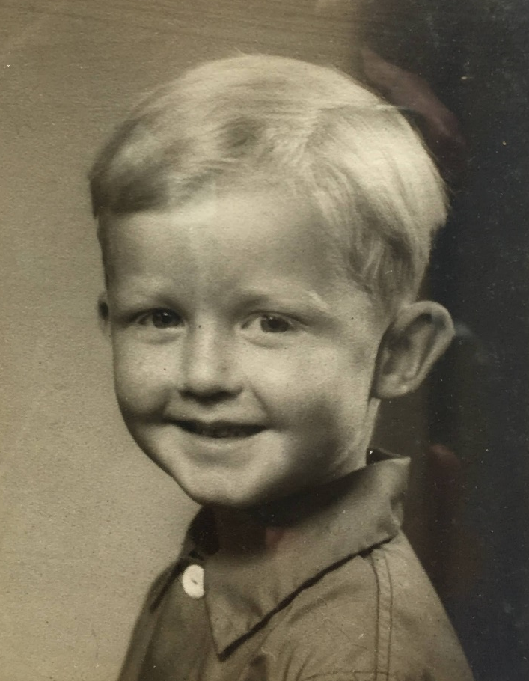
That aha! momemt
An impatient client comes to the bank daily, demanding from £1 to £1000 (always whole pounds) – fast!
The bank clerk figures out that she can just pre-load ten envelopes with cash, and flick them across the counter.
What’s in the ten envelopes?

Slide 6
Envelopes
 |  |  | £1 | Customer wants
 |  |  | ✓ | £1
 |  |  |  | £2
 |  |  |  | £3
 |  |  |  | £4
 |  |  |  | £5
 |  |  |  | £6
 |  |  |  | £7
 |  |  |  | £8
 |  |  |  | £9

Slide 7
Envelopes
 |  | £2 | £1 | Customer wants
 |  |  | ✓ | £1
 |  | ✓ |  | £2
 |  |  |  | £3
 |  |  |  | £4
 |  |  |  | £5
 |  |  |  | £6
 |  |  |  | £7
 |  |  |  | £8
 |  |  |  | £9

Slide 8
Envelopes
 |  | £2 | £1 | Customer wants
 |  |  | ✓ | £1
 |  | ✓ |  | £2
 |  | ✓ | ✓ | £3
 |  |  |  | £4
 |  |  |  | £5
 |  |  |  | £6
 |  |  |  | £7
 |  |  |  | £8
 |  |  |  | £9

Slide 9
Envelopes
 | £4 | £2 | £1 | Customer wants
 |  |  | ✓ | £1
 |  | ✓ |  | £2
 |  | ✓ | ✓ | £3
 | ✓ |  |  | £4
 |  |  |  | £5
 |  |  |  | £6
 |  |  |  | £7
 |  |  |  | £8
 |  |  |  | £9

Slide 10
Envelopes
 | £4 | £2 | £1 | Customer wants
 |  |  | ✓ | £1
 |  | ✓ |  | £2
 |  | ✓ | ✓ | £3
 | ✓ |  |  | £4
 | ✓ |  | ✓ | £5
 | ✓ | ✓ |  | £6
 | ✓ | ✓ | ✓ | £7
 |  |  |  | £8
 |  |  |  | £9

Slide 11
Envelopes
£8 | £4 | £2 | £1 | Customer wants
 |  |  | ✓ | £1
 |  | ✓ |  | £2
 |  | ✓ | ✓ | £3
 | ✓ |  |  | £4
 | ✓ |  | ✓ | £5
 | ✓ | ✓ |  | £6
 | ✓ | ✓ | ✓ | £7
✓ |  |  |  | £8
✓ |  |  | ✓ | £9

Slide 12
Envelopes
£8 | £4 | £2 | £1 | Wants
 |  |  | ✓ | £1
 |  | ✓ |  | £2
 |  | ✓ | ✓ | £3
 | ✓ |  |  | £4
 | ✓ |  | ✓ | £5
 | ✓ | ✓ |  | £6
 | ✓ | ✓ | ✓ | £7
✓ |  |  |  | £8
✓ |  |  | ✓ | £9
Number of envelopes | Deals with ££ less than
1 | £2
2 | £4
3 | £8
4 | £16
5 | £32
6 | £64
7 | £128
8 | £256
9 | £512
10 | £1024

Slide 13
Envelopes
£8 | £4 | £2 | £1 | Customer wants
0 | 0 | 0 | 1 | £1
0 | 0 | 1 | 0 | £2
0 | 0 | 1 | 1 | £3
0 | 1 | 0 | 0 | £4
0 | 1 | 0 | 1 | £5
0 | 1 | 1 | 0 | £6
0 | 1 | 1 | 1 | £7
1 | 0 | 0 | 0 | £8
1 | 0 | 0 | 1 | £9

Slide 14
Binary is just 0 or 1
Decimal 4 7 9 2
A decimal digit is 0,1,2,3,4,5,6,7,8,9
1000’s
100’s
1’s
10’s

Slide 15
Binary is just 0 or 1
Decimal 4 7 9 2
A decimal digit is 0,1,2,3,4,5,6,7,8,9
A binary digit, or bit, is 0 or 1
1000’s
100’s
1’s
10’s
Binary 1 0 0 1 0
16’s
4’s
1’s
8’s
2’s

Slide 16
Binary is 0 or 1
Binary | Decimal
0 | 0
1 | 1
10 | 2
11 | 3
100 | 4
101 | 5
110 | 6
111 | 7
1000 | 8
1001 | 9
1010 | 10
1011 | 11
... | ...
Any number can
be represented in decimal, or
be represented in binary
So “101” and “5” are both codes for five-ness

Slide 17
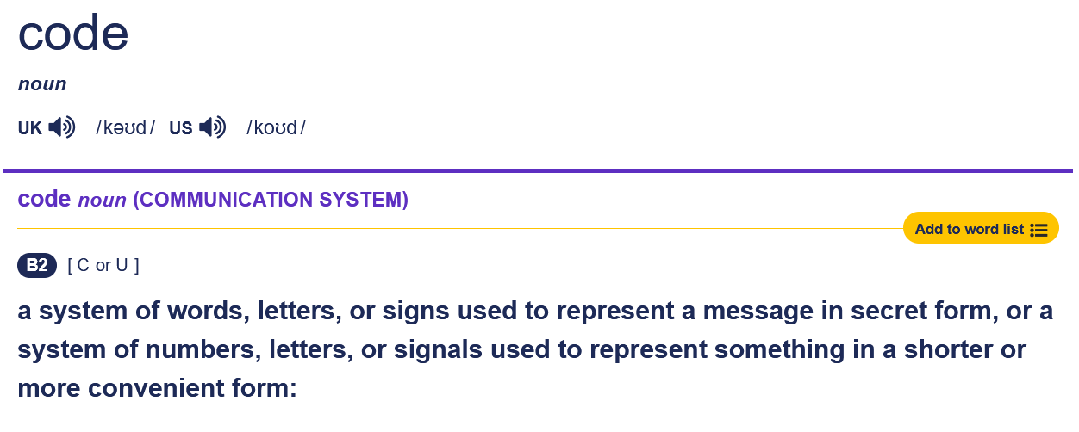

A sequence of binary bits can be a code for..... a number

Slide 18
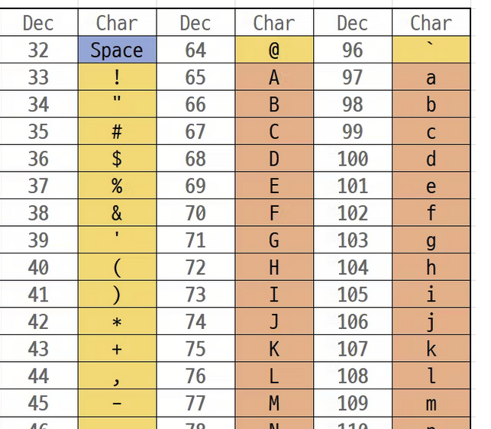
Not just numbers! Bits can be a code for...text
“Simon” is 83,105,109,111,110

Slide 19
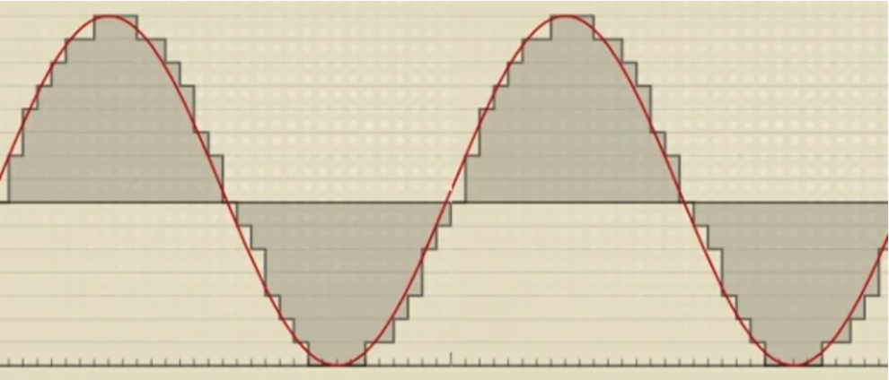
Not just numbers! Bits can be a code for...music
Take a sample, say, 40,000 times/second
Each sample is a number, measuring the height of the soundwave
Remember all those numbers
To play back the sound, move a loudspeaker to the position indicated by the number

Slide 20
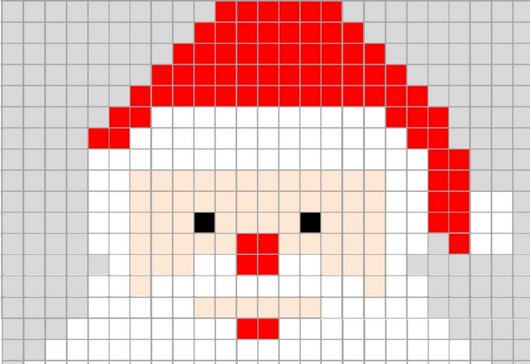
Not just numbers! Bits can be a code for...pictures
Divide the picture into a grid of “pixels”
For each pixel, record three numbers: amount of red, green, and blue

Slide 21
All human writing, drawing, painting, designing, speaking, performing, recording, measuring, creating,
forever...
Encoding all these things as bits lets us
store them
share them
communicate them
transform them
compress them
encrypt them
search them...
all with one set of basic mechanisms
Bits

Slide 22
Scale matters: lots and lots of bits
 |  |  | Or roughly
Byte | 8 bits | 2⁰ bytes | 1 byte
Kilobyte | 1024 bytes | 2¹⁰ bytes | 1000 bytes
Megabyte | 1024 kilobytes | 2²⁰ bytes | 1000,000 bytes
Gigabyte | 1024 megabytes | 2³⁰ bytes | 1,000,000,000 bytes
Terabyte | 1024 gigabytes | 2⁴⁰ bytes | 1,000,000,000,000 bytes

Slide 23
Scale matters
How many bits can a typical PC store?
About a terabyte (1 TB)
1,000,000,000,000 bytes (a byte is 8 bits)
How many copies of the Bible is that?

Slide 24
Scale matters
How many bits can a typical PC store?
About a terabyte (1 TB)
1,000,000,000,000 bytes (a byte is 8 bits)
How many Bibles is that?
A Bible has around 700,000 words, say 5 million letters, or 5MB

Slide 25
Scale matters
How many bits can a typical PC store?
About a terabyte (1 TB)
1,000,000,000,000 bytes (a byte is 8 bits)
How many Bibles is that?
A Bible has around 700,000 words, say 5 million words, or 5MB
So our PC can fit 200,000 Bibles on a single 1 TB drive.
That’s a stack of Bibles that is 10 km high.

Slide 26
Episode 2: Computation
Bits, more bits, more and more bits
Soul
Information
Computation
Communication
Emergent behaviour
Learning

Slide 27
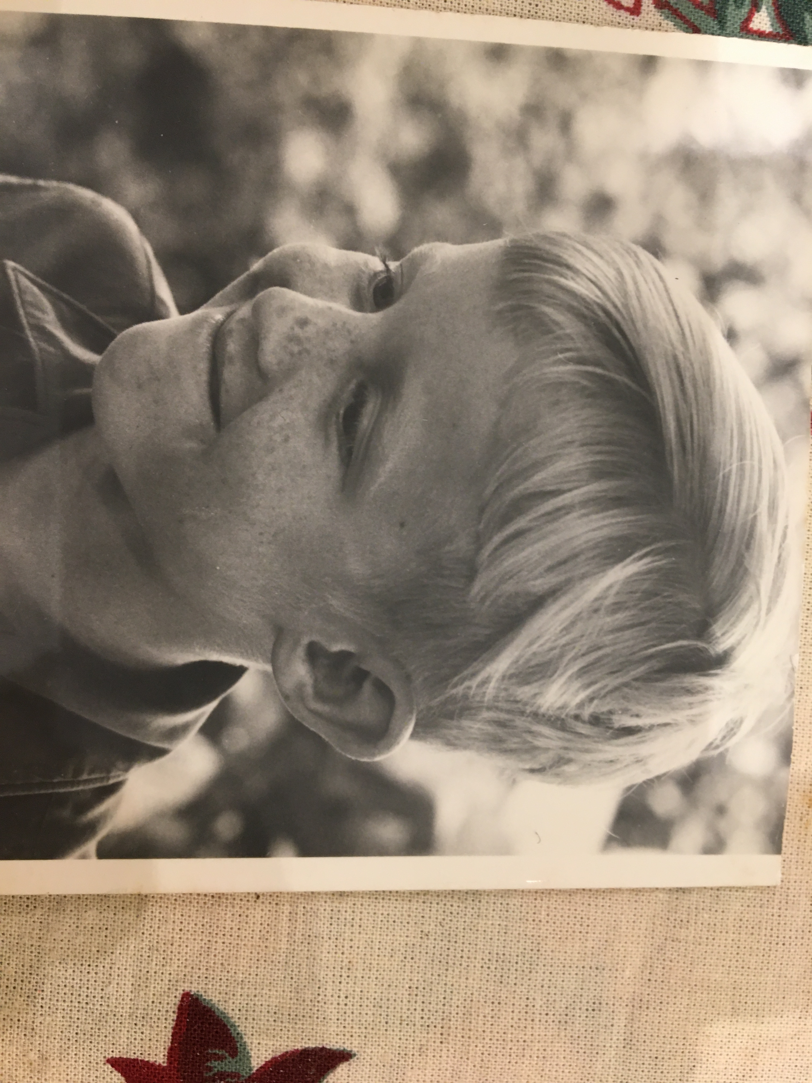
Aha 3: Nim
You have N piles of matches (e.g. 3 or 4 or 27 piles)
Two players take turns.
In your turn, you can take any number of matches from just one pile.
The goal is to take the last match.
You can choose who starts.
Can you always win?

Slide 28
How to win, every time
Piles | Size in binary
5 | 0 0 1 0 1
9 | 0 1 0 0 1
2 | 0 0 0 1 0
 | 0 1 1 1 0
Write the size of each pile in binary
Count the number of 1’s in each column:
Even number => write 0 at the bottom
Odd number => write 1 at the bottom
Your plan: after your turn, the bottom row is all zeros

Slide 29
How to win, every time
Piles | Size in binary
5 | 0 0 1 0 1
9 | 0 1 0 0 1
2 | 0 0 0 1 0
 | 0 1 1 1 0
Find the leftmost “1” in the bottom row

Slide 30
How to win, every time
Piles | Size in binary
5 | 0 0 1 0 1
9 | 0 1 0 0 1
2 | 0 0 0 1 0
 | 0 1 1 1 0
Identify the leftmost “1” in the bottom row
Identify a pile with a “1” in that column

Slide 31
How to win, every time
Piles | Size in binary
5 | 0 0 1 0 1
7 | 0 0 1 1 1
2 | 0 0 0 1 0
 | 0 0 0 0 0
Find the leftmost “1” in the bottom row
Find a pile with a “1” in that column
Make that “1” into “0”
Flip all the other bits in that pile to make the bottom row all zeros.

Slide 32
How to win, every time
Write the size of each pile in binary
Count the number of 1’s in each column:
Even number => write 0 at the bottom
Odd number => write 1 at the bottom
Your plan: after your turn, the bottom row is all zeros
Piles | Size in binary
5 | 0 0 1 0 1
7 | 0 0 1 1 1
2 | 0 0 0 1 0
XOR | 0 0 0 0 0
You can always do this.
Your opponent can never do this
The number of matches decreases in every turn
Eventually you will finish with all zero piles
Result: victory

Slide 33
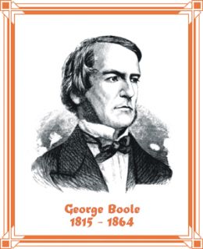
Boolean algebra: 1847
Piles | Size in binary
5 | 0 0 1 0 1
9 | 0 1 0 0 1
2 | 0 0 0 1 0
XOR | 0 1 1 1 0
Count the number of 1’s in each column:
Even number => write 0 at the bottom
Odd number => write 1 at the bottom
A | 0 | 0 | 1 | 1
B | 0 | 1 | 0 | 1
XOR(A,B) | 0 | 1 | 1 | 0

Slide 34
Computation
These Boolean operations compute new bit-patterns (codes) from old bit-patterns
Very few Boolean operations suffice: we can build everything else out of (lots of) them.
This is what computers do: they are just bit-pattern transformers.

Slide 35
Episode 3: Communication
Bits, more bits, more and more bits
Soul
Information
Computation
Communication
Emergent behaviour
Learning

Slide 36


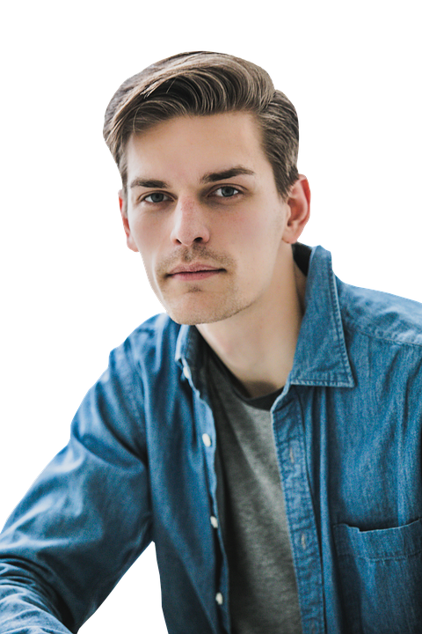
Alice and Bob want to have a private conversation.
But the nosey people can hear everything they say to each other
They could encrypt their messages if only they knew a KEY that the nosey people do not know
How can they agree a KEY?
Alice
Bob
A key is just a (reasonably big) number
Nosey people

Slide 37
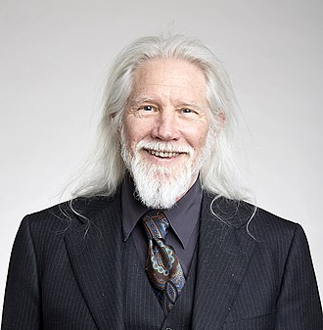
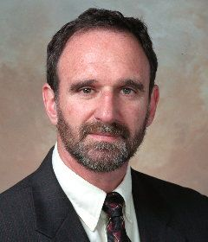

An astonishing solution (1976)
Alice and Bob have a short conversation
In public
At the end, they both know a KEY
But the nosey people do not know it
This is pure magic. And it happens every time you buy something online.
William Diffie (b 1944)
Martin Hellman (b 1945)

Slide 38
An astonishing solution
Orange = public
Alice shouts out a big number N
So everyone knows N
N=5

Slide 39
An astonishing solution
Orange = public
Green = secret
Alice shouts out a big number N
Alice secretly thinks of a number A
She calculates N^{A} and shouts it to Bob
N=5
A=2
Only Alice knows A
N^{A}=25
N^{A} = N x N x N ... x N x N
A times

Slide 40
An astonishing solution
Orange = public
Green = secret
Alice shouts out a big number N
Alice secretly thinks of a number A
She calculates N^{A} and shouts it to Bob
Meanwhile Bob secretly thinks of a number B
He calculates N^{B} and shouts it to Alice
N=5
A=2
Only Alice knows A
N^{A}=25
B=3
Only Bob knows B
N^{B}=125
N^{B} = N x N x N ... x N x N
B times

Slide 41
An astonishing solution
Orange = public
Green = secret
Bob calculates (N^{A})^{B}
Meanwhile Alice calculates (N^{B})^{A}
Both get the same answer
That is the KEY
N=5
(N^{A})^{B} = (N x...x N) x ... x (N x...x N)
A=2
Only Alice knows A
A times
A times
N^{A}=25
B times
B=3
Only Bob knows B
N^{B}=125
(N^{A} )^{B} = 25³ = 15,625
(N^{B} )^{A} =125² = 15,625

Slide 42
Alas: the nosey people can guess A, B
They know N = 5
They know N^{A} = 25
Not so hard to work out A
One simple way: try A=1, A=2, A=3 etc The “British Museum algorithm”.
Slow, but easy to speed up: start half-way guessing A=4, and keep halving.
A | 5^{A}
1 | 5
2 | 25
3 | 125
4 | 625
5 | 3125
6 | 15625
7 | 78125
8 | 390625

Slide 43
An unexpectedly simple solution: clock arithmetic
0
11
1
10
2
2+3 = 5
11+1 = 0
10+4 = 2
5x5 = 1
9
3
8
4
7
5
6

Slide 44
Clock arithmetic
0
1
2+3 = 5
11+1 = 0
10+4 = 2
5² = 5x5 = 1
Short cut: take the remainder when divided by 12, or “mod 12”
E.g. 5² = remainder of 25÷12 = 1
5² mod 12 = 1
11
10
2
9
3
8
4
7
5
6
Mathematicians call clock arithmetic “modular arithmetic” hence “mod”

Slide 45
Just do mod K at every step
Alice shouts out a number K and a smaller number N
Alice secretly thinks of a number A
She calculates N^{A} mod K, and shouts it to Bob
Meanwhile Bob secretly thinks of a number B
He calculates N^{B} mod K, and shouts it to Alice
Alice calculates (N^{A})^{B} mod K
Bob calculates (N^{B})^{A} mod K
The answers are the same and will be their KEY
Each step is simple, and gives a number less than K

Slide 46
What about the nosey people?
Nosey people know N, K, N^{A}
Can they work out A?
Astonishingly, no one knows a way faster than trying A=1, A=2, A=3
Just use an 80 digit A; then the number of tries = number of atoms in the universe.
Better for K to be prime
A | 5^{A} | 5^{A} mod 11
1 | 5 | 5
2 | 25 | 3
3 | 125 | 4
4 | 625 | 9
5 | 3125 | 1
6 | 15625 | 5
7 | 78125 | 3
8 | 390625 | 4

Slide 47
So Alice and Bob are safe?
Is there a faster way to find A, knowing N, K and N^{A} mod K?
No one has found a faster way; but no one has proved you can’t either.
Quantum computing maybe?
Almost all of the world’s digital economy $trillions

Slide 48
Episode 4: Wild bits
Bits, more bits, more and more bits
Soul
Information
Computation
Communication
Emergent behaviour
Learning

Slide 49
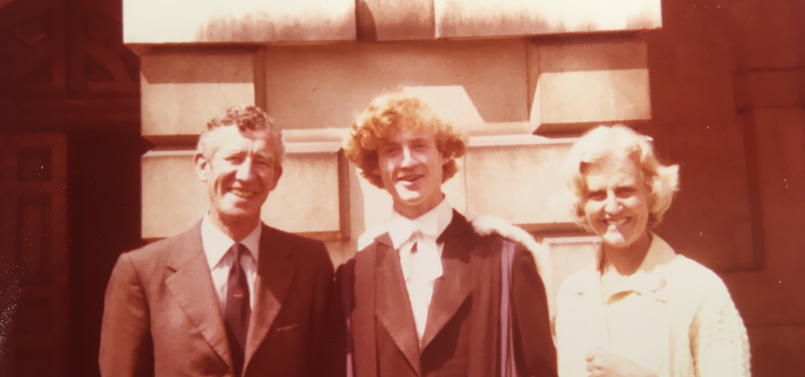
Graduation, Cambridge 1979

Slide 50
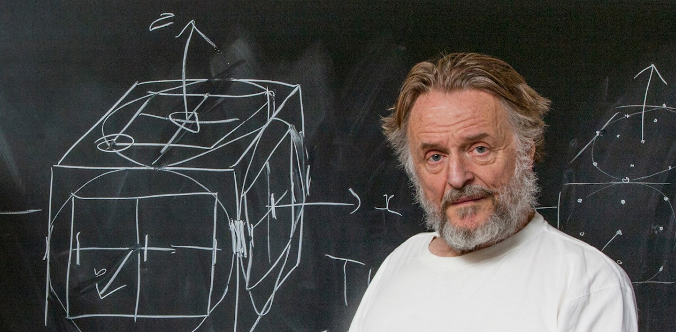
John Horton Conway, 1938-2020

Slide 51
The Game of Life
https://playgameoflife.com
(and look it up on Wikipedia)

Slide 52
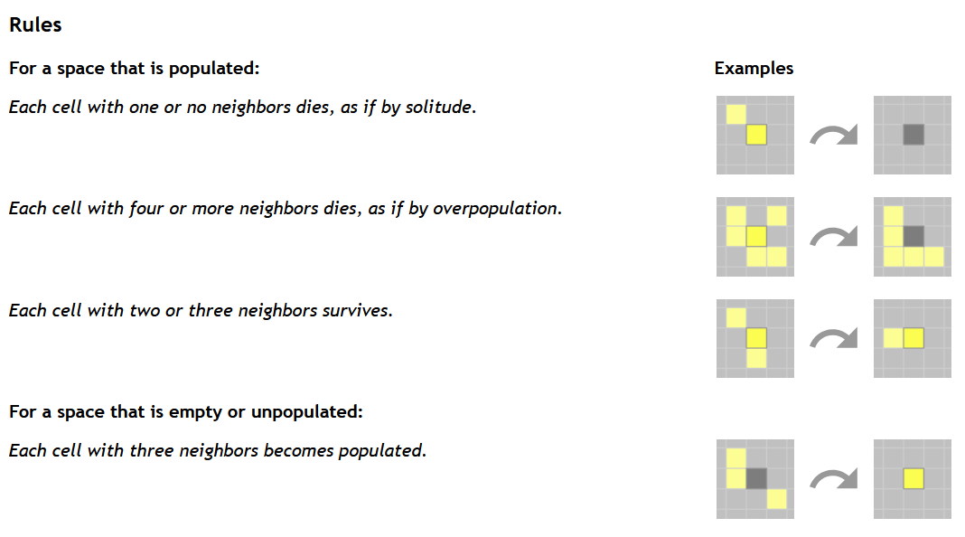

Slide 53
The Game of Life
When Conway thought this up in 1970 (I was 12), there were virtually no computers. He did it with pencil and paper.
But then in 1974...

Slide 54
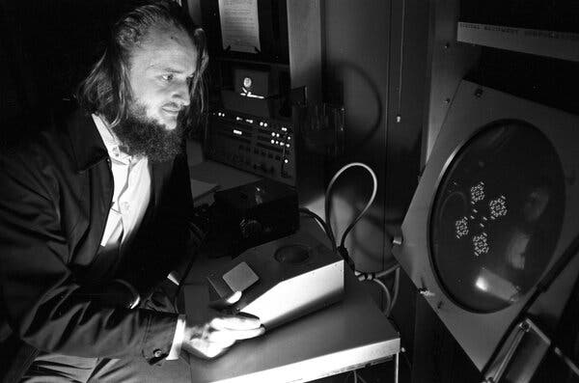
John Conway
1974

Slide 55
Lots of interesting questions
Do all patterns die out, or get into a loop? Or can a pattern grow infinitely?
Conway thought not, and offered a $50 prize to anyone who could disprove it.
Bill Gosper won it the prize in the same year, Nov 1970

Slide 56
Lots of interesting questions
Can you predict what will happen, given a starting pattern?
After all, the rules are super-simple (like XOR).
Answer: no. The only way (so far as anyone knows) is to just run the rules and see what happens.
“Emergent behaviour”
“Computational irreduciblity” (Stephen Wolfram)

Slide 57
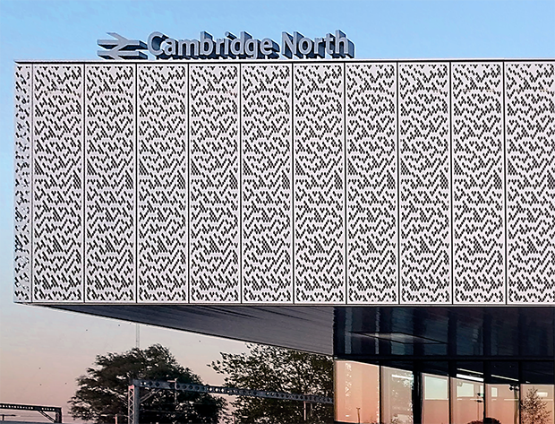
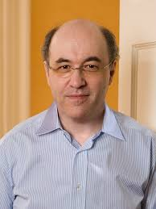
A different cellular automaton, made by Stephen Wolfram, called “Rule 30”
See “A new kind of Science”.
https://writings.stephenwolfram.com/2017/06/oh-my-gosh-its-covered-in-rule-30s/
Stephen Wolfram (b. 1959)

Slide 58
Lots of interesting questions
Can these cells compute? Could they add, multiply, sort a list of numbers? Can we tame the wild bits?
Surprising answer: yes.

Slide 59
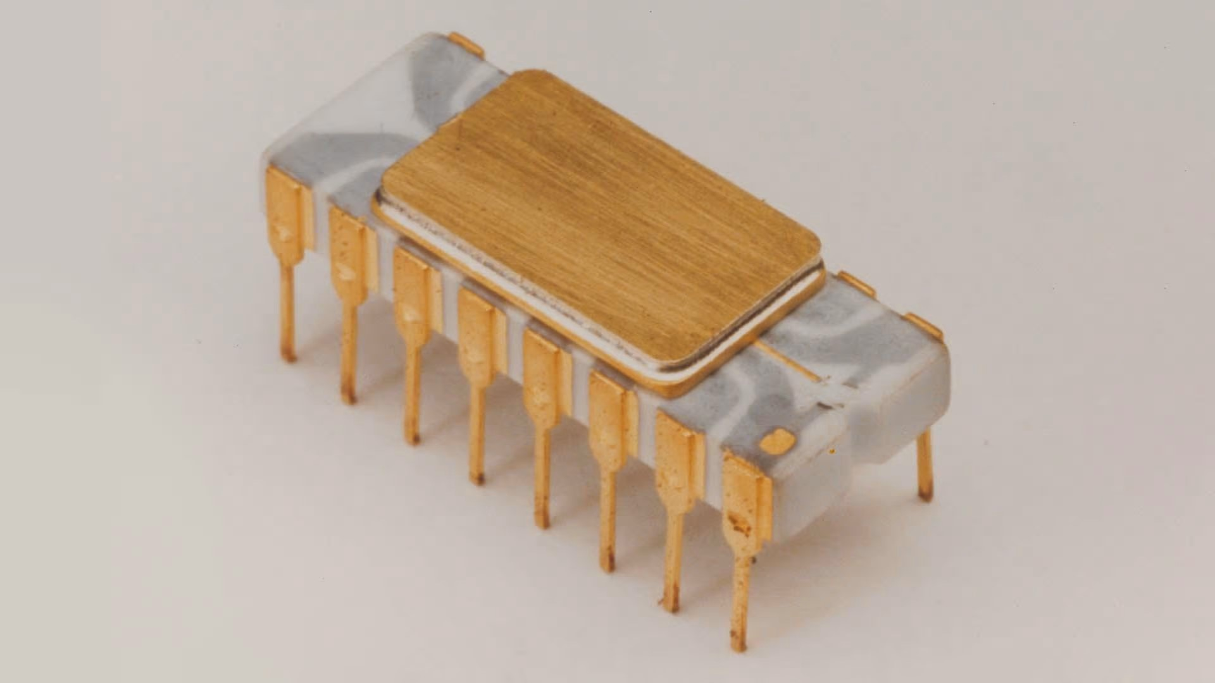
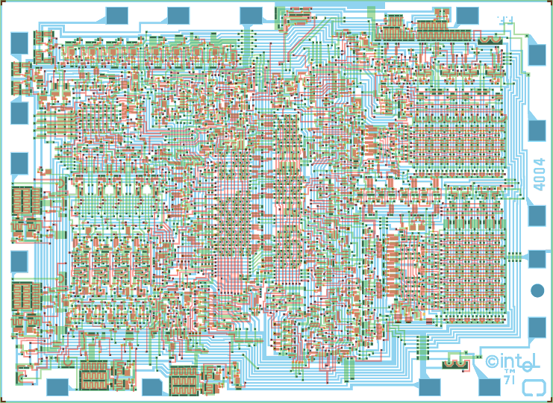
Intel 4004
First microprocessor came out in 1971 (while I was at school)
For the first time: a computer we could all build
2,300 transistors, maybe 1,000 gates
Today’s microprocessors have 50,000,000,000 transistors

Slide 60
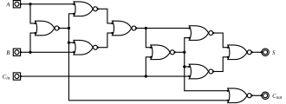
Logic gates
A | 0 | 0 | 1 | 1
B | 0 | 1 | 0 | 1
NOR(A,B) | 1 | 0 | 0 | 0
Digital computers are build from logic gates
Each gate combines the input signals
This circuit is a “full adder”

Slide 61
Taming the wild bits
Idea: a stream of gliders is like an electrical wire
Glider means “1”
No glider means “0”
Build “gates” to combine signals
Connect them up with glider streams
https://nicholas.carlini.com/writing/2021/unlimited-register-machine-game-of-life.html
https://www.nicolasloizeau.com/gol-computer

Slide 62
Now we have a computer
So you can compute, in GoL, anything that any other computer can compute. (Only a lot slower.)
All from three simple rules.

Slide 63
Episode 5: Bits that learn
Bits, more bits, more and more bits
Soul
Information
Computation
Communication
Emergent behaviour
Learning

Slide 64
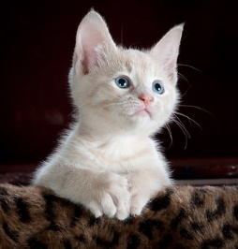
Magic box
Cat / not-cat

Slide 65
The traditional approach
Write a (complex) program in Magic Box, in Haskell, OCaml, Python, Java, etc
Step by step algorithms
Data structures
Loops, procedures
Works very well for e.g. writing a word processor, a video game, a database
Works extremely badly for recognising cats
Magic box
Yes/No

Slide 66
Machine learning / AI
Magic Box instead contains
A pretty simple program, controlled by
1000,000,0000,000 numbers, W. E.g. 3.7, 342.73, etc
Give it thousands and thousands of pictures of cats and non-cats
Adjust W (those numbers)
…until it reliably recognises cats
VERY VERY different to a step-by-step progam
1 trillion weights
Magic box
Yes/No

Slide 67
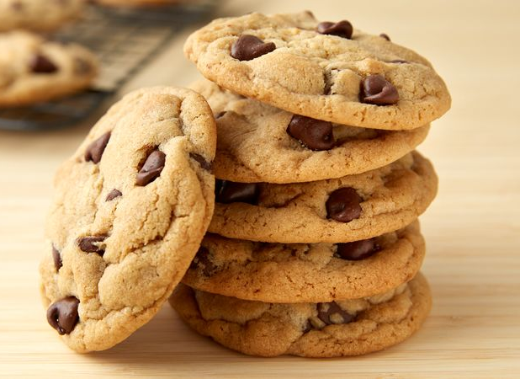
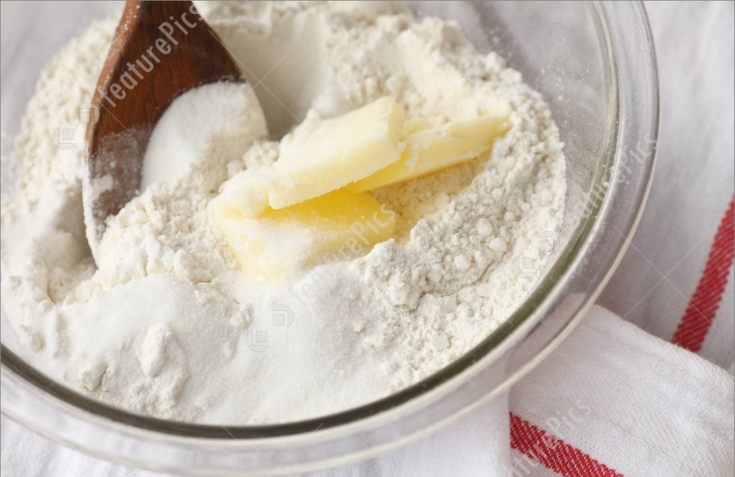
How does the Magic Box work?
x kg of flour
y kg of butter
1-x-y kg of sugar
Magic box
Biscuit Quality Predictor
Good biscuits?
Good/Bad

Slide 68
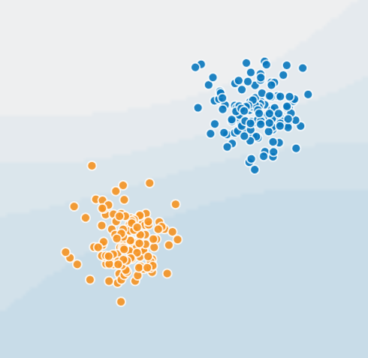
Biscuits!
Good biscuits
“Training data”
Flour | Butter | Verdict
0.2 | 0.5 | Bad
0.1 | 0.5 | Good
0.6 | 0.2 | Good
0.2 | 0.2 | Bad
… | … | …
Butter
Bad biscuits
NB: the rest is sugar, to take you up to 1kg
Flour

Slide 69

$$ax+by+c=0$$
Key point
The numbers (or “weights”) a,b,c say precisely where the red line is
Butter (y)
Here ax+by+c is bigger than 0
Here ax+by+c is less than 0
Flour (x)

Slide 70
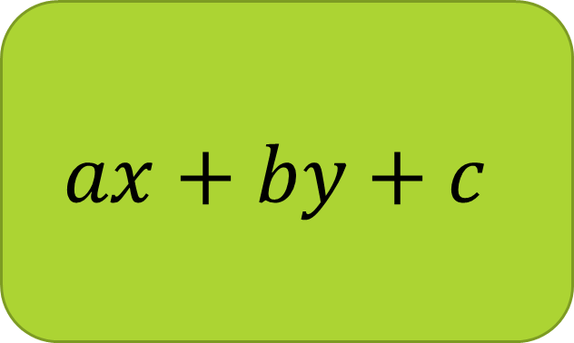
Inside the Magic Box
a
b
c
x kg flour
$$ax+by+c$$
Positive = good biscuit
Negative = bad biscuit
y kg sugar
Problem: how do we choose a,b,c, so that the line separates the clusters

Slide 71
How do we choose a,b,c? This is called “learning” or “training”
These ones are wrongly predicted
Pick initial random values for a,b,c
Pick a mis-predicted biscuit from the training set
Adjust a,b,c to “tug the line towards it”
Repeat from (2)
“Tug” is called “backpropagation”
These ones are wrongly predicted

Slide 72
https://playground.tensorflow.org
Also try https://tm.gen-ai.fi

Slide 73

In practice: SCALE SCALE SCALE SCALE
ChatGPT uses
Around 1 trillion weights (!!!!!)
A very deep stack of neurons
Feedback
AI is everywhere now.
But it is still the same basic idea as the biscuit predictor
10¹² weights
Prompt (your question)
Guessing output word by word
Huge stack of neurons
what ChatGPT has said so far

Slide 74
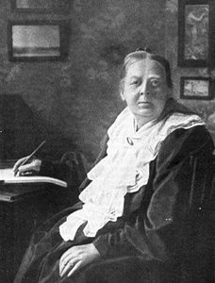
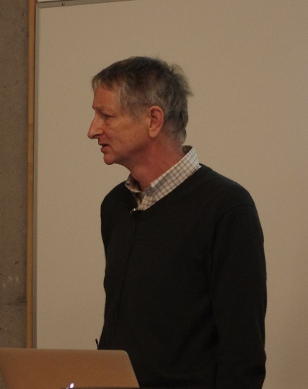
From AND and OR to ChatGPT
Mary Everest Boole
niece of Sir George Everest
Author
Philosophy of Fun of Algebra
Logic Taught by Love
married
Geoffrey Everest Hinton FRS
great-great-grandson
b 1947
Educated at Cambridge and Edinburgh
2024 Nobel prize
5 daughters
(mathematician,
chemist, novelist)
Notes:
Neice of Professor of Greek at UCC

Slide 75
Opportunities and risks
AI is not just a fad. It offers qualitatively new opportunities
Automate meaningless toil (X-ray scans, driving...)
Accelerate progress in science (protein folding...)
Personalised learning
Amplifying human creativity and “reach”
But it comes with qualitatively new risks, such as
Deepfakes – it’s hard to know what is true any more
Effect on jobs and what it means to be human
So we need good judgement, and judgement is rooted in (elementary) understanding.

Slide 76
What could possibly go wrong?
Unrepresentative (or biased) training data: so-called “hallucinations”

Slide 77
Unrepresentative training data
We learn NOTHING about what happens here
Real life example
Face recognition systems that have been trained only on white faces work really badly when recognising black faces

Slide 78
What could possibly go wrong?
Unrepresentative (or biased) training data: so-called “hallucinations”
“Emergent behaviour” is poorly understood (e.g. when GPT3 hit 1.3billion parameters, it was suddenly able to do arithmetic accurately)

Slide 79
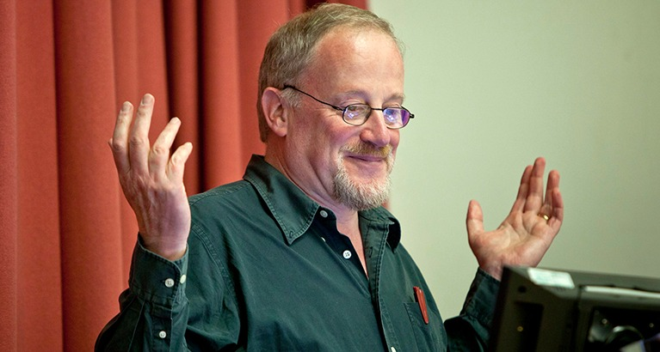
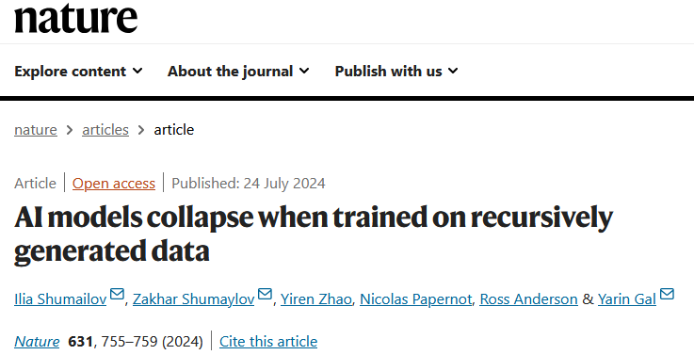
What could possibly go wrong?
Unrepresentative (or biased) training data: so-called “hallucinations”
“Emergent behaviour” is poorly understood (e.g. when GPT3 hit 1.3billion parameters, it was suddenly able to do arithmetic accurately)
“Model collapse”. Big AI models have already consumed the entire internet. Now they are consuming their own output!
Ross Anderson 1957-2024

Slide 80
Bits with soul
Bits, more bits, more and more bits
Soul
Information
Computation
Communication
Emergent behaviour
Learning

Slide 81
Bits with soul
Bits don’t have soul.
ChatGPT is (literally) just 1,000,000,000,000 numbers, and a lot of arithmetic
But bits at scale are changing our world
...in deep and fundamental ways
...mostly for the better
…that carry genuine risks
Dario Amodei, CEO Ahthropic https://darioamodei.com/machines-of-loving-grace

Slide 82
Bits with soul
But we do have soul
Bits at scale enormously amplify
our creativity,
our capability,
our opportunities.
They deeply affect our personal lives (jobs, communities, privacy...)
They deeply affect our society (deepfakes, what is truth?, free speech, democracy...)

Slide 83
Bits at scale affect our souls
This needs all of us, engaged heart and soul
Do not say “I’m not clever enough for this”

Slide 84

Bits at scale affect our souls
Our children need a solid foundational understanding of the underlying principles of computer science, just as they do of maths and natural science, so that they can
have agency in the digital world: masters of technology, not slaves
have well-informed views about the opportunities and risks of technology
have lots of fun
get a great, well-paid job
make the world a better place,

Slide 85
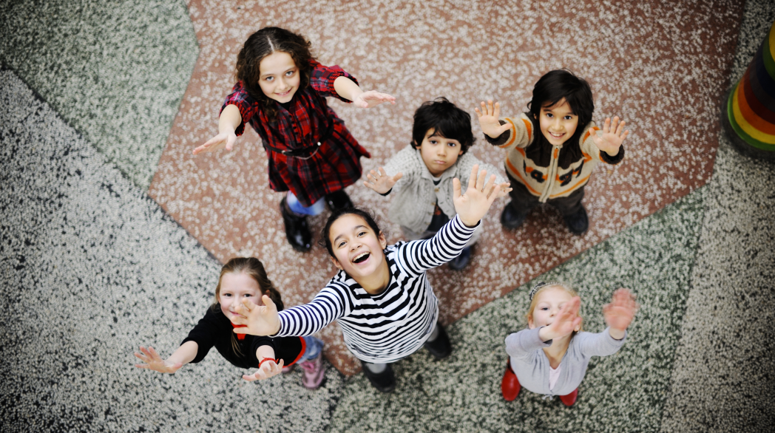
Engaged, curious
Empowered, informed
Creative, playful
Employed

