Slide 1
Lazy functional programming for real
Tackling the Awkward Squad
Simon Peyton Jones
Microsoft Research

Slide 2
Beauty and the Beast
Functional programming is beautiful, and many books tell us why
But to write real applications, we must deal with un-beautiful issues “around the edges”:
  Input/output
  Concurrency
  Error recovery
  Foreign-language interfaces
The Awkward Squad

Slide 3
The direct approach
Do everything in “the usual way”
I/O via “functions” with side effects
putchar ‘x’ + putchar ‘y’
Concurrency via operating system threads; OS calls mapped to “functions”
Error recovery via exceptions
Foreign language procedures mapped to “functions”

Slide 4
The lazy hair shirt
In a lazy functional language, like Haskell, order of evaluation is deliberately undefined.
putchar ‘x’ + putchar ‘y’
Output depends on evaluation order of (+)
[putchar ‘x’, putchar ‘y]
Output (if any) depends on how the consumer evaluates the list

Slide 5
Tackling the awkward squad
So lazy languages force us to take a different, more principled, approach to the Awkward Squad.
I’m going to describe that approach for Haskell
But I think there are lessons for strict, or even imperative, languages too.

Slide 6
A web server
I’ll use a web server as my motivating example
Lots of I/O, lots of concurrency, need for error recovery, need to call external libraries
Client 1
Client 2
Client 3
Client 4
Web server
1500 lines of Haskell
700 connections/sec

Slide 7
Monadic
input and output

Slide 8
The problem
A functional program defines a pure function, with no side effects
The whole point of running a program is to have some side effect
Tension

Slide 9

Functional I/O
main :: [Response] -> [Request]
data Request = ReadFile Filename
| WriteFile FileName String
| …
data Response = RequestFailed
| ReadOK String
| WriteOk
| …
“Wrapper program” interprets requests, and adds responses to input

Slide 10
Functional I/O is awkward
Hard to extend (new I/O operations ⇒ new constructors)
No connection between Request and corresponding Response
Easy to get “out of step” (⇒ deadlock)

Slide 11
Monadic I/O: the key idea
A value of type (IO t) is an “action” that, when performed, may do some input/output before delivering a result of type t.

Slide 12
A helpful picture
A value of type (IO t) is an “action” that, when performed, may do some input/output before delivering a result of type t.
type IO a = World -> (a, World)
result::a
IO a
World out
World in

Slide 13
Actions are first class
A value of type (IO t) is an “action” that, when performed, may do some input/output before delivering a result of type t.
type IO a = World -> (a, World)
“Actions” sometimes called “computations”
An action is a first class value
Evaluating an action has no effect; performing the action has an effect

Slide 14
Simple I/O
Char
Char
()
getChar
putChar
getChar :: IO Char
putChar :: Char -> IO ()
main :: IO ()
main = putChar ‘x’
Main program is an action of type IO ()

Slide 15
Connecting actions up
()
getChar
Char
putChar
Goal: read a character and then write it back out

Slide 16
The (>>=) combinator
(>>=) :: IO a -> (a -> IO b) -> IO b
()
getChar
Char
putChar
We have connected two actions to make a new, bigger action.
echo :: IO ()
echo = getChar >>= putChar

Slide 17
Printing a character twice
echoDup :: IO ()
echoDup = getChar >>= (\c ->
putChar c >>= (\() ->
putChar c))
The parentheses are optional

Slide 18
The (>>) combinator
echoDup :: IO ()
echoDup = getChar >>= \c ->
putChar c >>
putChar c
(>>) :: IO a -> IO b -> IO b
m >> n = m >>= (\x -> n)

Slide 19
Getting two characters
getTwoChars :: IO (Char,Char)
getTwoChars = getChar >>= \c1 ->
getChar >>= \c2 ->
????
We want to just return (c1,c2)

Slide 20
The return combinator
getTwoChars :: IO (Char,Char)
getTwoChars = getChar >>= \c1 ->
getChar >>= \c2 ->
return (c1,c2)
return :: a -> IO a
return

Slide 21
Notational convenience
getTwoChars :: IO (Char,Char)
getTwoChars = getChar >>= \c1 ->
getChar >>= \c2 ->
return (c1,c2)
By design, the layout looks imperative
c1 = getchar();
c2 = getchar();
return (c1,c2);

Slide 22
Notational convenience
getTwoChars :: IO (Char,Char)
getTwoChars = do { c1 <- getChar ; c2 <- getChar ; return (c1,c2) }
“do” notation adds only syntactic sugar

Slide 23
Desugaring do notation
“do” notation adds only syntactic sugar
do { x<-e; s } = e >>= \x -> do { s }
do { e; s } = e >> do { s }
do { e } = e

Slide 24
Getting a line
getLine :: IO [Char]
getLine = do { c <- getChar;
if c == ‘\n’ then
return []
else do { cs <- getLine;
return (c:cs) }
}
Note the nested “do” expression

Slide 25
Control structures
Values of type (IO t) are first class
So we can define our own “control structures”
forever :: IO () -> IO ()
forever a = a >> forever a
repeatN :: Int -> IO () -> IO ()
repeatN 0 a = return ()
repeatN n a = a >> repeatN (n-1) a
e.g. repeatN 10 (putChar ‘x’)

Slide 26
Loops
Values of type (IO t) are first class
So we can define our own “control structures”
for :: [a] -> (a -> IO b) -> IO ()
for [] fa = return ()
for (x:xs) fa = fa x >> for xs fa
e.g. for [1..10] (\x -> putStr (show x))

Slide 27
Loops
A list of IO actions
An IO action returning a list
sequence :: [IO a] -> IO [a]
sequence [] = return []
sequence (a:as) = do { r <- a;
rs <- sequence as;
return (r:rs) }
for :: [a] -> (a -> IO b) -> IO ()
for xs fa = sequence (map fa xs) >>
return ()

Slide 28
First class actions
Slogan: first class actions let us write application-specific control structures

Slide 29
Monads
A monad consists of:
A type constructor M
bind :: M a -> (a -> M b) -> M b
unit :: a -> M a
PLUS some laws

Slide 30
Laws for monads
unit x >>= f = f x
m >>= unit = m
m1 >>= (λx.m2 >>= (λ y.m3))
=
(m1 >>= (λ x.m2)) >>= (λ y.m3)

Slide 31
Third law in do-notation
do { x <- do { y <- m2 ; = do { y <- m2;
m1 } ; x <- m1;
m3 } m3 }
m1 >>= (λx.m2 >>= (λ y.m3))
=
(m1 >>= (λ x.m2)) >>= (λ y.m3)

Slide 32
What does it all mean?

Slide 33

Functional semantics
type IO a = World -> (a, World)
A program that loops forever has meaning ⊥
A program that prints ‘x’ forever has meaning ⊥
What is the meaning of two Haskell programs running in parallel?
Does not scale well to concurrency, non-determinism

Slide 34
Trace semantics
type IO a = Set Trace
type Trace = [Event]
type Event = ReadChar Char
| WriteChar Char
…
echo = { [ReadChar ‘a’; WriteChar ‘a’],
[ReadChar ‘b’; WriteChar ‘b’],
[ReadChar ‘c’; WriteChar ‘c’],
…}
Can deal with non-determinism, and concurrency

Slide 35
Operational semantics
Instead of saying what the meaning of a program is, say how the program behaves
Equivalance of programs becomes similarity of behaviour instead of identity of meaning
α
P → Q
Program state P can move to state Q, exchanging event α with the environment

Slide 36
Program states
A program state represents the current internal state of the program.
Initially, it is just a term, {M}
e.g. {putChar ‘x’ >> putChar ‘y’}
Curly braces say “here is a program state”

Slide 37
Events
Events describe how the program interacts with the external world: i.e. what I/O it performs
P → Q P can move to Q, writing c to stdout
P → Q P can move to Q, reading c to stdin
!c
?c

Slide 38
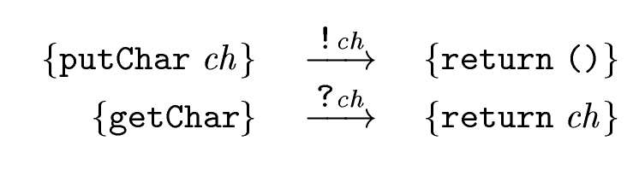
Our first two rules
But: what happens to this?
{getChar >>= \c-> putChar c} → ???
Want to say “look at the action in the leftmost position”

Slide 39
Evaluation contexts
E ::= [.] | E >>= M
An evaluation context E is a term with a “hole” in it.
For example:
E1 = [.] >>= M
E2 = ([.] >>= M1) >>= M2
E[M] is the evaluation context E with the hole filled in by M. So
E1[getChar] = getChar >>= M
E2[getChar] = (getChar >>= M1) >>= M2

Slide 40
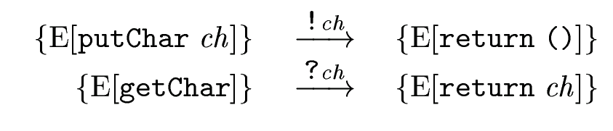
Revised rules for put/get
E ::= [.] | E >>= M
{getChar >>= \c-> putChar c}
→ {return ch >>= \c-> putChar c}
?ch

Slide 41
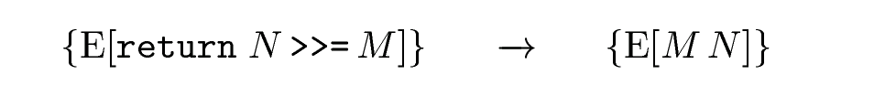
The return/bind rule
Silent transition
{getChar >>= \c-> putChar c}
→ {return ch >>= \c-> putChar c}
→ {(\c-> putChar c) ch}
?ch
Now we need to do some “ordinary evaluation”

Slide 42
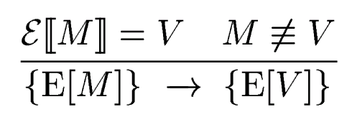
The evaluation rule
If the things above the line are true, then we can deduce the thing below the line
ℇ〚M〛is the denotational semantics for M
V is the value of M
M wasn’t already evaluated

Slide 43
The evaluation rule
ℇ〚M〛is the denotational semantics for M
Treat primitive IO actions as “constructors”;
so (putChar ch) is a value
{(\c-> putChar c) ch}
{putChar ch}
{return ()}
!ch

Slide 44
Mutable variables in C
x is a location,initalised with 3
int x = 3;
x = x+1;
read x, add 1, store into x

Slide 45
Mutable variables in Haskell
x is a location, initalised with 3
do { x <- newIORef 3;
v <- readIORef x;
writeIORef x (v+1) }
read x, add 1, store into x
newIORef :: a -> IO (IORef a)
readIORef :: IORef a -> IO a
writeIORef :: IORef a -> a -> IO ()

Slide 46
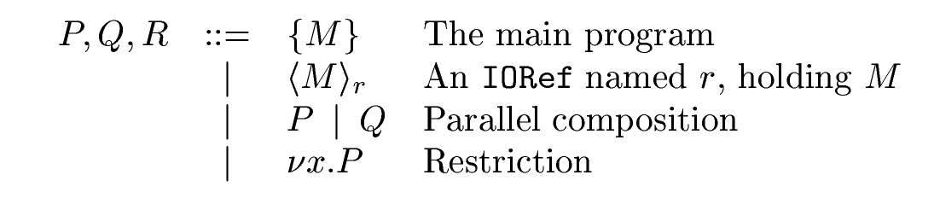
Semantics for variables
Step 1: elaborate the program state
e.g. νr,s. ({M} | <3>_{r} | <89>_{s})
The main program
An IORef called r, holding 3

Slide 47
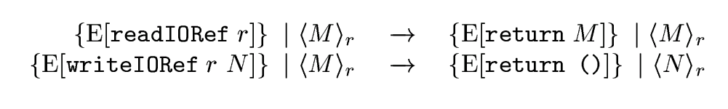
Semantics for variables
Step 2: add rules for read, write IORefs

Slide 48
Semantics for variables
Step 2: add rules for read, write IORefs
But what if the main program is not “next to” the relevant variable?

Slide 49

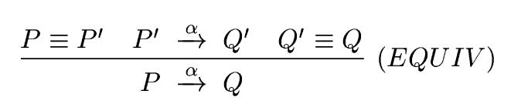
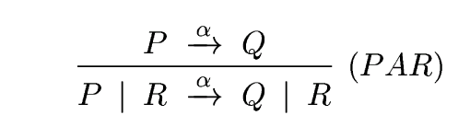
“Structural rules”
Can stir the mixture
Step 3: add rules to bring “reagents” together
Can look under “|”

Slide 50
Restriction
Step 4: deal with fresh IORef names
{E[newIORef M]} → {E[return ?]} | <M>?
What can we use as the IORef name???

Slide 51
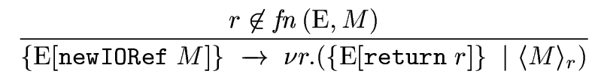
Restriction
Step 4: deal with fresh IORef names
r is not used already
Restriction

Slide 52
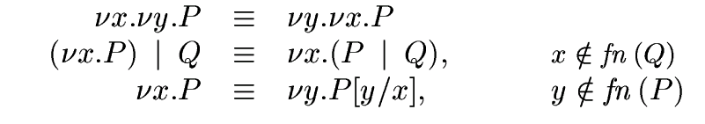
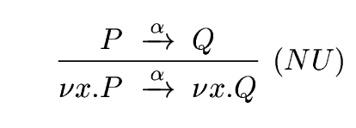
More “Structural rules”
Can float “ν” outwards
Step 5: structural rules for restriction
Can look under “ν”

Slide 53

Phew!
Quite a lot of technical machinery! But:
It’s standard, widely-used, machinery (esp in process calculi), so it’s worth getting used to
It scales to handle non-determinism, concurrency
The machinery (esp structural rules) doesn’t get in the way most of the time

Slide 54
Concurrency

Slide 55
The need for concurrency
Want one thread (“virtual server”) per client
Threads largely independent, but share some common resources (e.g. file system)
Client 1
Client 2
Client 3
Client 4
Web server

Slide 56
Concurrency vs parallelism
Parallel functional programming:
  Aim = performance through multiple processors (e.g. e1+e2 in parallel)
  No semantic changes; deterministic results
Concurrent functional programming
  Aim = concurrent, I/O-performing threads
  Makes perfect sense on a uniprocessor
  Non-deterministic interleaving of I/O is inevitable

Slide 57
Concurrent web service
acceptConnections :: Config -> Socket -> IO ()
acceptConnections config socket
= forever (do { conn <- accept socket ;
forkIO (serviceConn config conn) })
forkIO :: IO a -> IO ThreadId
forkIO spawns an independent, I/O performing, thread
No parameters passed; free variables do fine

Slide 58
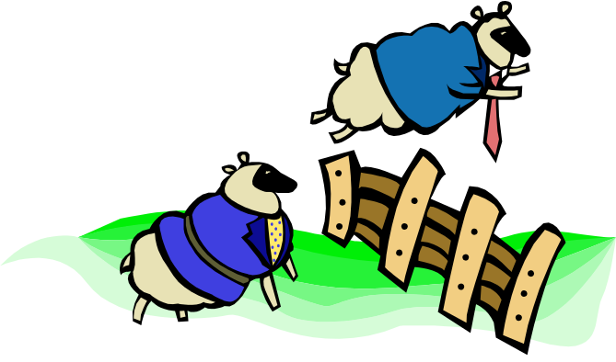
Communication and sharing
What if two threads want to communicate? Or share data?
Example: keep a global count of how many client threads are running
  Increment count when spawning
  Decrement count when dying

Slide 59
Communication and sharing
data MVar a
newEmptyMVar :: IO (MVar a)
putMVar :: MVar a -> a -> IO ()
takeMVar :: MVar a -> IO a
A value of type (MVar t) is a location that is either
  empty, or
  holds a value of type t
27

Slide 60
Communication and sharing
takeMVar :: MVar a -> IO a
putMVar :: MVar a -> a -> IO ()
 | Empty | Full
takeMVar | Block | Return contents, leave MVar empty
putMVar | Fill MVar | Block

Slide 61
Using MVars
acceptConnections :: Config -> Socket -> IO ()
acceptConnections config socket
= do { count <- newEmptyMVar ;
putMVar count 0 ;
forever (do { conn <- accept socket ;
forkIO (do { inc count ;
serviceConn config conn ;
dec count}) }
inc,dec :: MVar Int -> IO ()
inc count = do { v <- takeMVar count; putMVar count (v+1) }
dec count = do { v <- takeMVar count; putMVar count (v-1) }
MVar is empty at this point, hence no race hazard

Slide 62



MVars as channels
An MVar directly implements:
a shared data structure
a one-place channel

Slide 63
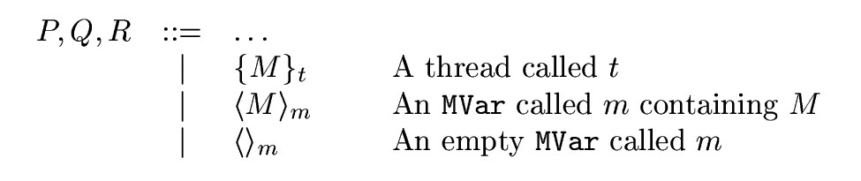
Semantics
Fortunately, most of the infrastructure is there already!
Step 1: elaborate the program state
e.g. {putChar ‘c’}_{t1} | {putChar ‘d’}_{t2}

Slide 64
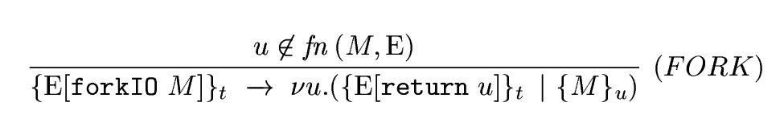
Semantics
Step 2: a rule for for forkIO
The new thread
Restrict the new thread name
Return the thread name to the caller

Slide 65
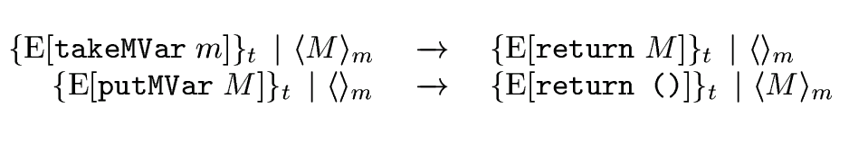
Semantics
Step 3: a rules for new, take, put
Same as readIORef, writeIORef, except that MVar is filled/emptied
Blocking is implicit
Non-determinism is implicit

Slide 66
Building abstractions
MVars are primitive
Want to build abstractions on top of them
Example: a buffered channel

Slide 67
A buffered channel
type Chan a
newChan :: IO (Chan a)
putChan :: Chan a -> a -> IO ()
getChan :: Chan a -> IO a

Slide 68
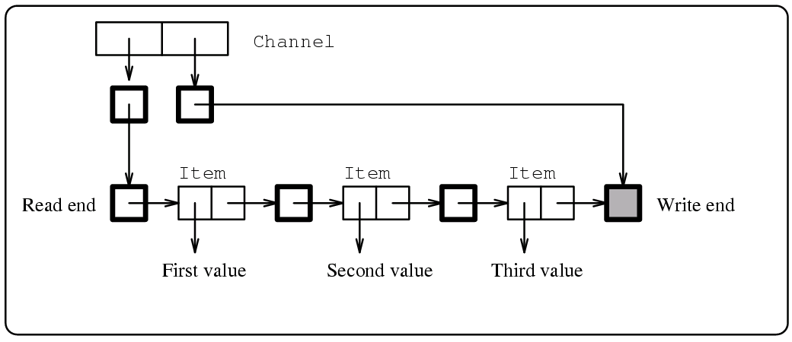
A buffered channel
type Chan a = (MVar (Stream a),MVar (Stream a))
type Stream a = MVar (Item a)
data Item a = MkItem a (Stream a)

Slide 69
A buffered channel
putChan :: Chan a -> a -> IO ()
putChan (read,write) val
= do { new_hole <- newEmptyMVar ;
old_hole <- takeMVar write ;
putMVar write new_hole
putMVar old_hole (MkItem val new_hole) }

Slide 70
Summary
forkIO + MVars are very simple.
MVars are primtive, but surprisingly often Just The Right Thing
Other excellent references
  Concurrent programming in ML (Reppy, CUP)
  Concurrent programming in Erlang (Armstrong, Prentice Hall, 2nd edition)

Slide 71
Exceptions

Slide 72
Why do we need exceptions?
Robust programs deal gracefully with “unexpected” conditions. E.g.
  Disk write fails because disk is full
  Client goes away, so server should time out and log an error
  Client requests seldom-used service; bug in server code gives pattern-match failure or divide by zero
Server should not crash if these things happen!

Slide 73
Approach 1: virtue
“A robust program never goes wrong”
(e.g. test for disk full before writing)
BUT:
Can’t test for all errors (e.g. timeouts)
Some problems are, by definition, errors in the server code
Need a way to recover from ANY error

Slide 74
Approach 2: exceptions
Provide a way to say “execute this code, but if anything (at all) goes wrong, abandon it and do this instead”.
I call this
“Exceptions for disaster recovery”
Exception handler typically covers a large chunk of code
Recovery action typically aborts a whole chunk of work

Slide 75
Aside: bad uses of exceptions
Exceptions are often (mis-) used in a different way:
“Exceptions for extra return values”
e.g. Look up up something in a table, raise “NotFound” if it’s not there.
Exception handler often encloses a single call
Recovery action typically does not abort anything

Slide 76
Exceptions in Haskell 98
Haskell 98 supports exceptions in I/O actions:
catch :: IO a -> (IOError -> IO a) -> IO a
userError :: String -> IOError
ioError :: IOError -> IO a
Protected code
catch (do { h <- openFile “foo”;
processFile h })
(\e -> putStr “Oh dear”)
Exception handler
Dynamic scope: exceptions raised in processFile are caught

Slide 77
Semantics
Step 1: add a new evaluation context
E ::= [.] | E >>= M | catch E M
Says: “evaluate inside the first argument of catch”

Slide 78
Semantics
Step 2: add propagation rule for ioError
An exception before the (>>=)…
…discards the part after the (>>=)
Standard stack-unwinding implementation is possible

Slide 79
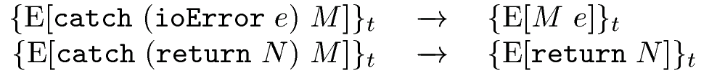
Semantics
What to do if an exception is raised
Step 3: add rules for catch
What to do if an exception is not raised

Slide 80
Synchronous vs asynchronous
A synchronous exception is raised as a direct, causal result of executing a particular piece of code
  Divide by zero
  Disk full
An asynchronous exception comes from “outside” and can arrive at any moment
  Timeout
  Stack overflow

Slide 81
Haskell 98 isn’t enough
Haskell 98 deals only with synchronous exceptions in the IO monad
Two big shortcomings
Does not handle things that go wrong in purely-functional code
Does not deal with asynchronous exceptions

Slide 82
Exceptions in pure code

Slide 83

Embed exceptions in values
Idea: embed exceptions in values
result type unchanged
throw :: Exception -> a
divide :: Int -> Int -> Int
divide x y = if y==0 then throw DivZero
else x/y
A value is
  either an “ordinary” value
  or an “exception” value, carrying an exception
(Just like NaNs in IEEE floating point.)
In a lazy language an exception value might hide inside an un-evaluated data structure, but that’s OK.

Slide 84
Catching exceptions
New primitive for catching exceptions: BAD BAD!
getException :: a -> ExVal a
data ExVal a = OK a
| Bad Exception
Example
f x = case getException (goop x) of
OK result -> result
Bad exn -> recovery_goop x

Slide 85

A well-known problem
What exception is raised by “+”?
(throw ex1) + (throw ex2)
Usual answer: fix evaluation order
BAD ENOUGH for call-by-value languages
  loss of code-motion transformations
  need for effect analyses
TOTAL CATASTROPHE for Haskell
  evaluation order is deliberately unspecified
  key optimisations depend on changing evaluation order

Slide 86
A cunning idea
Return both exceptions!
Operationally, an exceptional value is
  represented by a single representative
  implemented by the usual stack-unwinding stuff
c.f. infinite lists:
  semantically infinite, operationally finite
A value is
  either a “normal value”
  or an “exceptional value”
  containing a set of exceptions

Slide 87
Semantics without exceptions
Denotations of Haskell types, 〚T〛
〚Int〛 ≡ M Z
〚 t1→t2〛 ≡ M (〚t1〛 → 〚t2〛)
〚(t1,t2)〛 ≡ M (〚t1〛 x 〚t2〛)
M t = t ∪ {⊥}
e.g. 〚Int->Int〛 = M (M Int -> M Int)

Slide 88
〚Int〛 : Ordinary Haskell
...
...
0
2
1
-1
-2
⊥

Slide 89
Semantics with exceptions
Denotations of Haskell types, 〚T〛
〚Int〛 ≡ M Z
〚t1→t2〛 ≡ M (〚t1〛 → 〚t2〛)
〚(t1,t2)〛 ≡ M (〚t1〛 x 〚t2〛)
M t = {Ok x | x ε t} ∪
{Bad s | s ⊆ E} ∪
{Bad (E ∪ {NonTermination})}
E ≡ {Overflow, DivZero, …} (fixed set)
Z ≡ the integers
e.g. 〚Int->Int〛 = M (M Int -> M Int)
Same as before
Bottom

Slide 90
〚Int〛 : Exceptional Haskell
...
Bad {}
OK 1
OK 0
OK -1
OK -2
OK 2
Bad {DZ}
Bad {OF}
Bad {DZ, OF}
Bad {NT, DZ, OF}
=⊥

Slide 91
Semantics
〚e₁ + e₂〛 ρ = OK (m + n) if OK m =〚e₁〛 ρ
OK n = 〚e₂〛 ρ
= Bad (S (〚e₁〛 ρ) ∪ S(〚e₂〛 ρ)) otherwise
S(Bad s) = s
S(OK n) = {}
Payoff: 〚 e₁ + e₂ 〛 ρ = 〚 e₂ + e₁ 〛 ρ

Slide 92

Whoa! What about getException?
Problem: which exception does getException choose from the set of possibilities?
getException :: a -> ExVal a ?????
data ExVal a = OK a| Bad Exception
Solution 1: choose any. But that makes getException non-deterministic. And that loses even β-reduction!
let x = getException e in x==x = True
(getException e) == (getException e) ≠ True
Verdict: Cure worse than disease.

Slide 93
Using the IO monad
Solution 2: put getException in the IO monad:
evaluate :: a -> IO a
evaluate evaluates its argument;
if it is an ordinary value, it returns it
if it is an exceptional value, it chooses one of the set of exceptions and raises it as an IO monad exception

Slide 94
Using the IO monad
Key idea:
The choice of which exception to raise is made in the IO monad, so it can be non-deterministic (like so much else in the IO monad)
evaluate :: a -> IO a

Slide 95
Using evaluate
main = do { i <- getInput;
catch (do { r <- evaluate (goop i);
do_good_stuff r })
(\ ex -> recover_from ex)
}
You have to be in the IO monad to use evaluate
You do not have to be in the IO monad to use throw

Slide 96
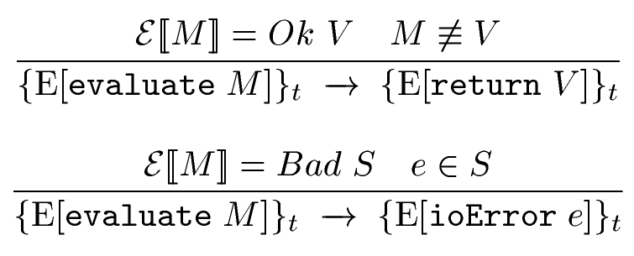
Semantics
An ordinary value
Add rules for evaluate
An exceptional value

Slide 97

Watch out!
We’ve just changed what values look like!
But what if M evaluates to (Bad S)???

Slide 98
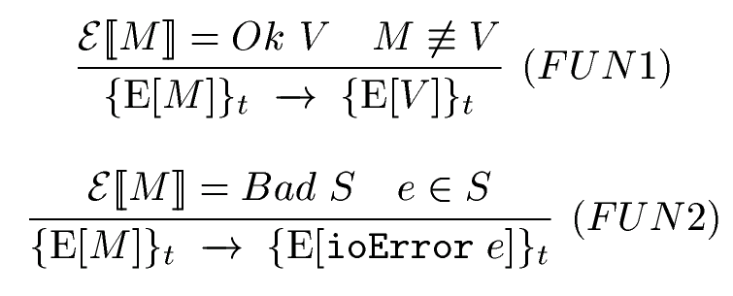
Watch out!
Ordinary value
Exceptional value

Slide 99
Imprecise exceptions
A decent treatment of exceptions in purely-functional code
Quite a lot more to say (see PLDI’99 paper)
No transformations lost!
Good for disaster recovery, poor for extra return values

Slide 100
Asynchronous exceptions

Slide 101

Asynchronous exceptions
A flexible form of asynchronous exception:
throw :: Exception -> IO a
throwTo :: ThreadId -> Exception -> IO a

Slide 102
Timeouts
Fork a thread that sleeps and then throws an exception to its parent
timeout :: Int -> IO a -> IO (Maybe a)
timeout n a
= do { t <- myThreadId ;
s <- forkIO (do { sleep n ;
throwTo t TimeOut });
catch (do { r <- a;
throwTo s Kill;
return (Just r) });
(\ex -> Nothing)
}
Do the action, and then kill the timeout
The timeout won!

Slide 103
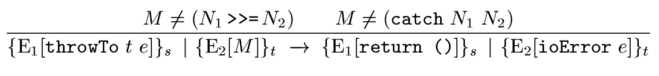
Semantics
Make sure we replace the innermost “current action”
Add a rule for throwTo
Replace “current action” in target thread with ioError

Slide 104
What have we achieved?

Slide 105
My motivation
Functional programming is SO much fun.
Plan of attack
Find an application
Try to write it in Haskell
Fail
Figure out how to fix Haskell
Abstract key ideas, write a paper
Repeat from (2)

Slide 106
What have we achieved?
The ability to mix imperative and purely-functional programming
Imperative “skin”
Purely-functional core

Slide 107
What have we achieved?
...without ruining either
All laws of pure functional programming remain unconditionally true, even of actions
e.g. let x=e in ...x....x...
=
....e....e.....

Slide 108
What we have not achieved
Imperative programming is no easier than it always was
e.g. do { ...; x <- f 1; y <- f 2; ...}
?=?
do { ...; y <- f 2; x <- f 1; ...}
...but there’s less of it!
...and actions are first-class values

Slide 109
Not covered in the lectures
...But in the notes
Asynchronous exceptions
Foreign language interfacing

Slide 110
What next?
Write applications
Real reasoning about monadic Haskell programs; proving theorems
Alternative semantic models (trace semantics)
More refined monads (the IO monad is a giant sin-bin at the moment)

Slide 111
What next?
http://research.microsoft.com/~simonpj
http://haskell.org
Have lots more fun

