Slide 1
Haskell Origins, evolution, and future
Simon Peyton Jones, Epic Games
JuliaCon August 2026

Slide 2
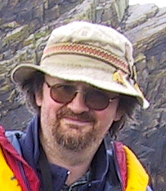
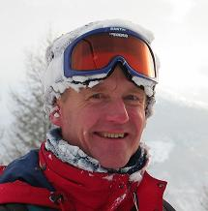
1976-80
John and Simon go to university
Early days of microprocessors
4kbytes is a lot of memory
Cambridge University has one (1) computer

Slide 3
The Call
Functional programming: recursion, pattern matching, comprehensions etc etc (ML, SASL, KRC, Hope, Id)
Lazy functional
programming (Friedman, Wise, Henderson, Morris, Turner)
Dataflow architectures
(Arvind et al)
SK combinators, graph reduction
(Turner)
Lambda the Ultimate
(Steele, Sussman)
John Backus
Can programming be liberated from the von Neumann style?

Slide 4
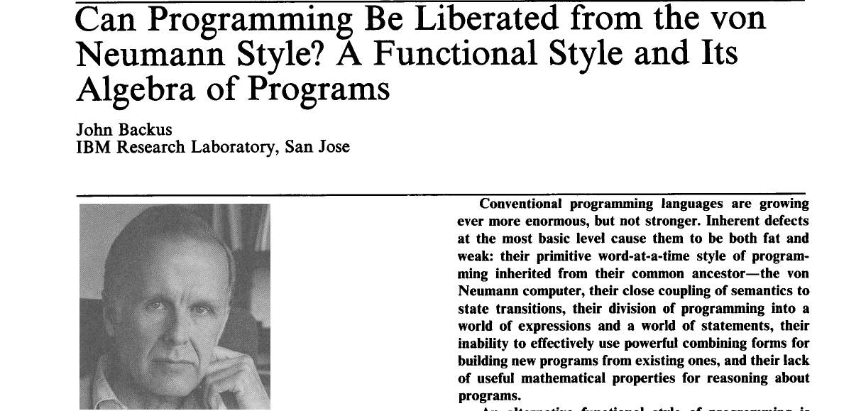
Backus Turing Award 1977
John Backus Dec 1924 – Mar 2007

Slide 5
The Call
Have no truck with the grubby compromises of imperative programming!
Go forth, follow the Path of Purity
Design new languages
and new computers,
and rule the world
Functional programming: recursion, pattern matching, comprehensions etc etc (ML, SASL, KRC, Hope, Id)
Lazy functional
programming (Friedman, Wise, Henderson, Morris, Turner)
SK combinators, graph reduction
(Turner)
Dataflow architectures
(Arvind et al)
Backus
Can programming be liberated from the von Neumann style?

Slide 6
Result … chaos
Many bright young things
Many languages (Sasl, Miranda, LML, Orwell, Ponder, Alfl, Clean)
Many compilers
Many new hardware architectures (mostly doomed)
Many conferences (birth of FPCA, LFP)

Slide 7
Crystalisation: FPCA Sept 1987
A dozen lazy functional programmers, wanting to agree on a common language.
Suitable for teaching, research, and application
Formally-described syntax and semantics
Freely available
Embody the apparent consensus of ideas
Reduce unnecessary diversity
Absolutely no clue how much work we were taking on
Led to...a succession of face-to-face meetings
April 1990 (2½ yrs later): Haskell 1.0 report

Slide 8
Crystalisation: FPCA Sept 1987
Absolutely no clue how much work we were taking on
Led to...a succession of face-to-face meetings
April 1990 (2½ yrs later): Haskell 1.0 report
Julia was born in 2009 Now a teenager

Slide 9

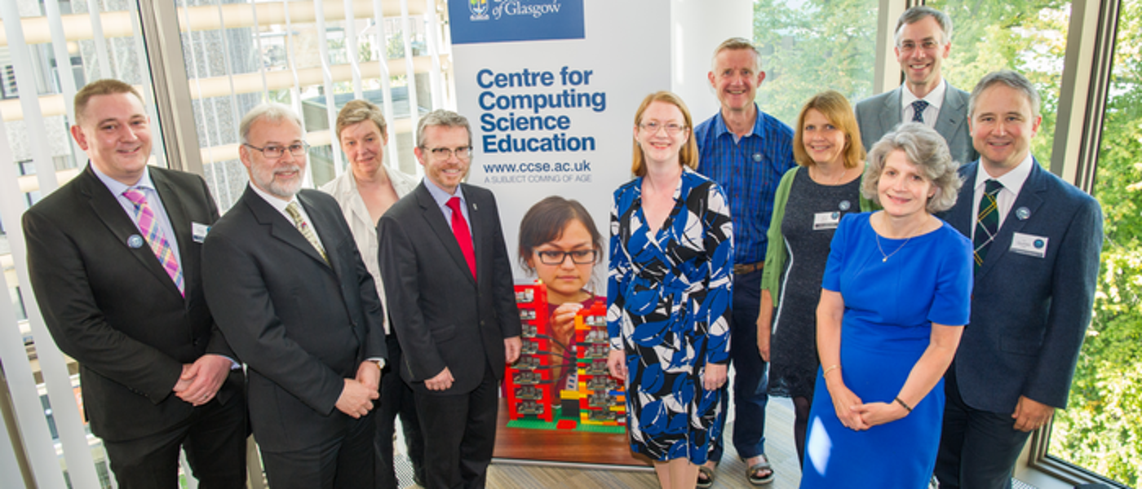
The Era of the Glasgow FP group
It is the late 1980's
Malcolm Atkinson is head of dept
He appoints new faculty
John Hughes
Mary Sheeran
Phil Wadler
And (astonishingly) me, with no PhD and one published paper, in 1990

Slide 10
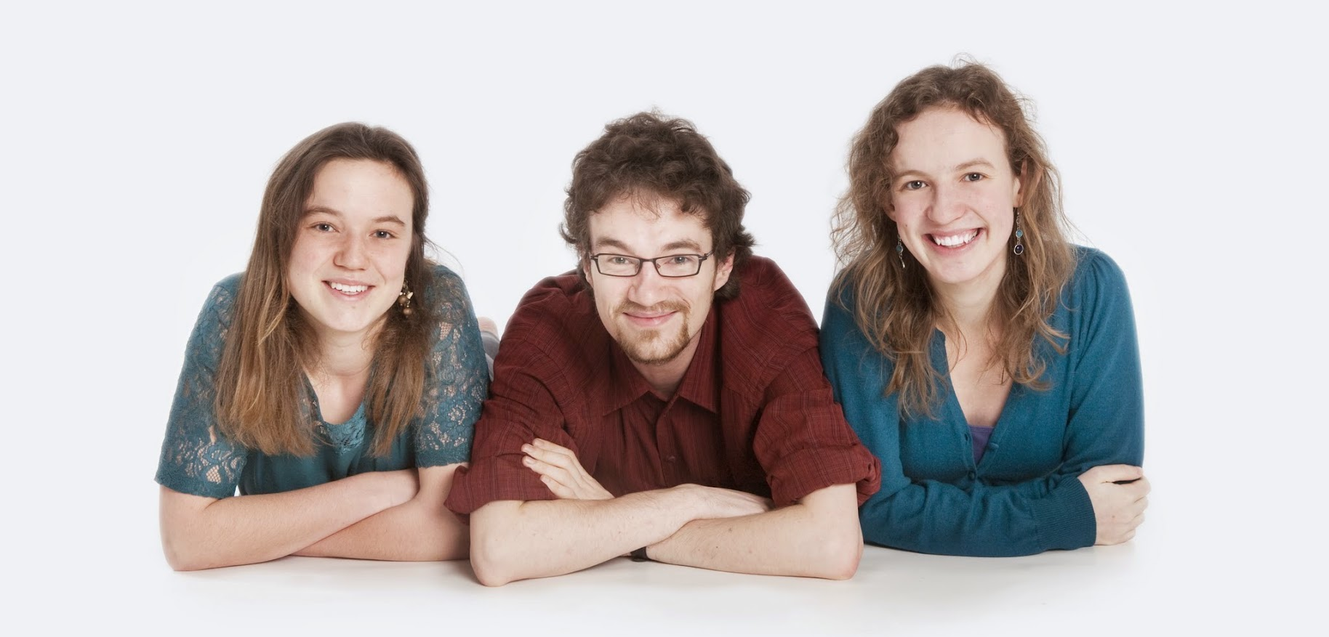
Born April 1990, Haskell is 36
And so is Michael
Meg (b 1995) Michael (b May 1990) Sarah (b 1993)

Slide 11
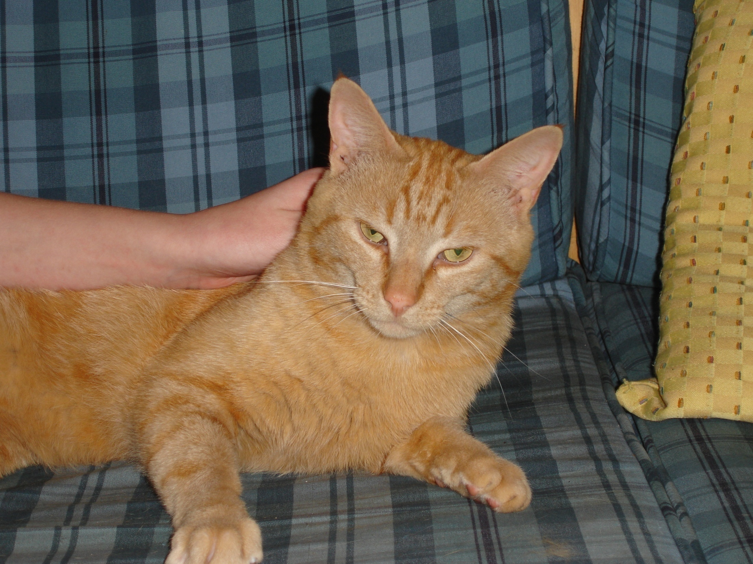
Haskell the cat (b. 2002)

Slide 12
History of most research languages
1,000,000
Practitioners
10,000
100
The quick death
Geeks
1
1yr
5yr
10yr
15yr

Slide 13
Successful research languages
1,000,000
Practitioners
10,000
100
The slow death
Geeks
1
1yr
5yr
10yr
15yr

Slide 14
C++, Java, Perl, Ruby
Threshold of immortality
1,000,000
Practitioners
10,000
The regrettable absence of death
100
Geeks
1
1yr
5yr
10yr
15yr

Slide 15
Committee languages
1,000,000
Practitioners
10,000
100
The committee language
Geeks
1
1yr
5yr
10yr
15yr

Slide 16
Haskell
1,000,000
Practitioners
10,000
100
The second life?
Geeks
1
Apr 1990
2000
2010
2020
Java
Julia

Slide 17
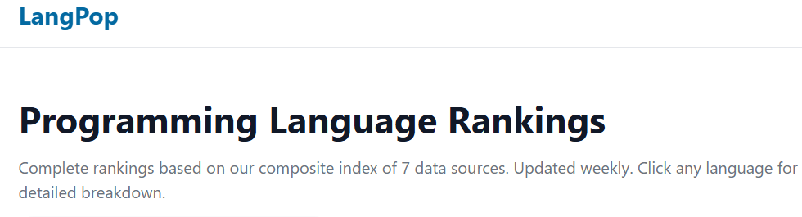
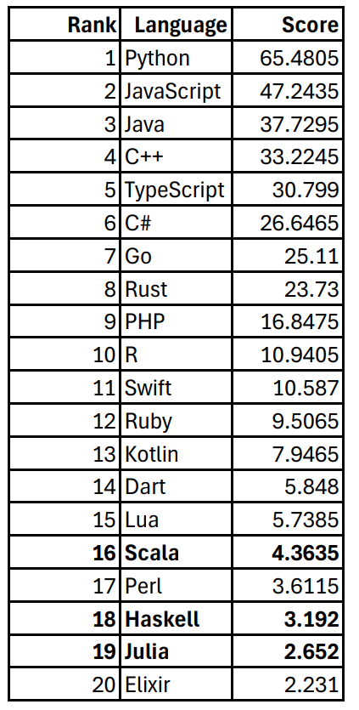
Haskell and Julia
Niche languages, with a solid followingbb

Slide 18
Haskell and Julia: similarities
Even though we recognize that we are inexcusably greedy, we still want to have it all. About two and a half years ago, we set out to create the language of our greed.
“Why we created Julia”, Bezanson, Karpinski, Edelman, 2012
Mission driven
Julia: get stuff done
Haskell: explore purity and laziness
Joyful
Open source, with no major corporate sponsor
But the more I leaned into it, the more I realised Haskell wasn’t just another tool in the programming toolbox. In fact it was a different way of thinking altogether. And that’s exactly why I love it. “Why I love Haskell”, Indu, 2025

Slide 19
Haskell and Julia: differences
Haskell | Julia
General purpose; no killer app | Computational research [Dateris, “Why Julia”]
A laboratory and (hopefully) get stuff done | Get stuff done
Performance is nice | Performance is essential
“Despite static typing we can get productivity” | “Despite dynamic dispatch we can get performance” [Charuvy]
Remorselessly pure (monads for mutation) | Supports functional style (programming with values), but does not require it
Types classes | Multiple dispatch

Slide 20
Julia and GHC’s source code (2026)
Lines of code | Julia | Haskell (GHC)
Compiler source | 100k | 306k
Compiler comments | 17k | 194k
Runtime system source | 61k | 77k
Runtime system comments | 10k | 35k
Overall comment % | 14% | 38%
Uses Julia’s new parser
Counts docstrings as comments
Ignores libraries
Treats “typechecking” as compiler, even though it may happen at runtime in Julia

Slide 21
After 36 years, Haskell has a vibrant, growing ecosystem, and is still in a ferment of new developments.
Why?

Slide 22
After 36 years, Haskell has a vibrant, growing ecosystem, and is still in a ferment of new developments.
Why?
Keep faith with deep, simple principles
Purity
Rich static types
A tiny core language
A joyful laboratory, open to experiments
Increasingly good for getting stuff done
Avoid
success-at-all-costs
Tension here, of course
Avoid success,
at all costs

Slide 23
The joy of Haskell – a bit nerdy but pasionate
Anonymous: I'd love to explain to you how to write hello world in Haskell, but first let me introduce you to basic category theory
neutrino: in many ways, Haskell is like this primodial soup out of which other languages end up springing
hobophobe: So, I can only conclude that Haskell is a memetic virus, and monads are the eggs it lays out in innocent programming forums to entice others to become infected

Slide 24
Avoiding success
A user base that makes Haskell nimble:
Smallish: enough users to drive innovation, not so many as to stifle it
Tolerant of bugs in GHC. Very tolerant. Originally
Innovative and slightly geeky: Haskell users react to new features like hyenas react to red meat
Extremely friendly
Avoided the Dead Hand of standardisation committees

Slide 25
Failing to avoid success
Haskell is now used by lots of companies (many tens, maybe hundreds)
They absolutely hate bugs and breakage
We pay far, far more attention to backwards compatibility than ever before.
A heavy tax. But the price of success.

Slide 26
What deep, simple principles?
A tiny core language
Purity and laziness
Types; especially type classes

Slide 27
A tiny core language

Slide 28
Deep, simple principles
Source language
Intermediate language
Haskell
Dozens of types
100+ constructors
System FC
3 types, 15 constructors
Rest of GHC

Slide 29
Deep simple principles
System F is GHC’s intermediate language
(Well, something very like System F.)
Everything has to translate into this tiny language
Statically typed for the entire compilation pipeline (very unusual)
Fantastic language design sanity check
data Expr
= Var Var
| Lit Literal
| App Expr Expr
| Lam Var Expr
| Let Bind Expr
| Case Expr Var Type [(AltCon, [Var], Expr)]
| Cast Expr Coercion
| Type Type
| Coercion Coercion
data Bind = NonRec Var Expr | Rec [(Var,Expr)]
data AltCon = DEFAULT | LitAlt Lit | DataAlt DataCon

Slide 30
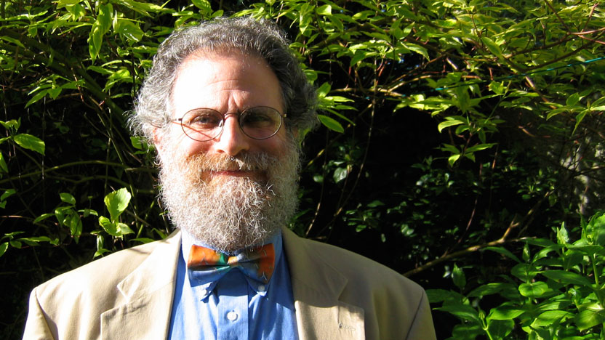
Enter Phil Wadler
You should use System F as your intermediate language

Slide 31
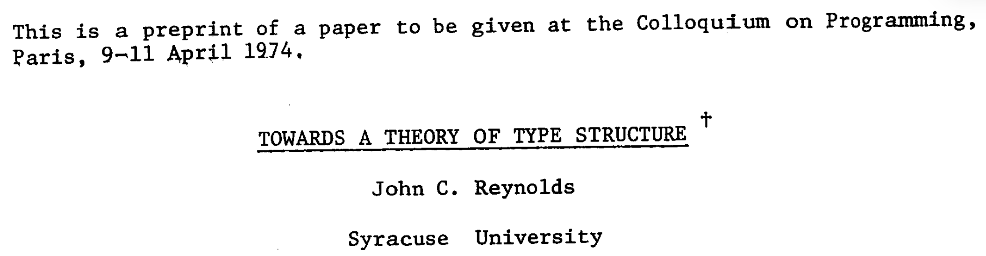
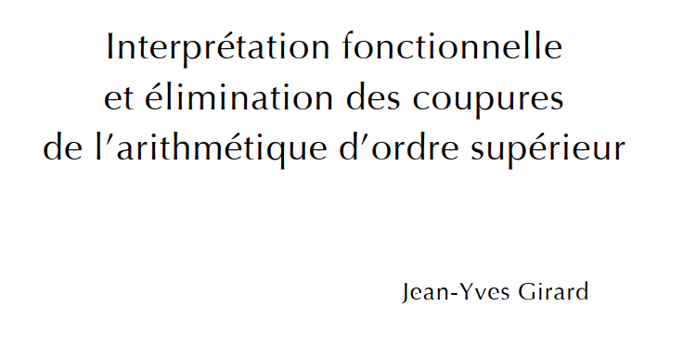
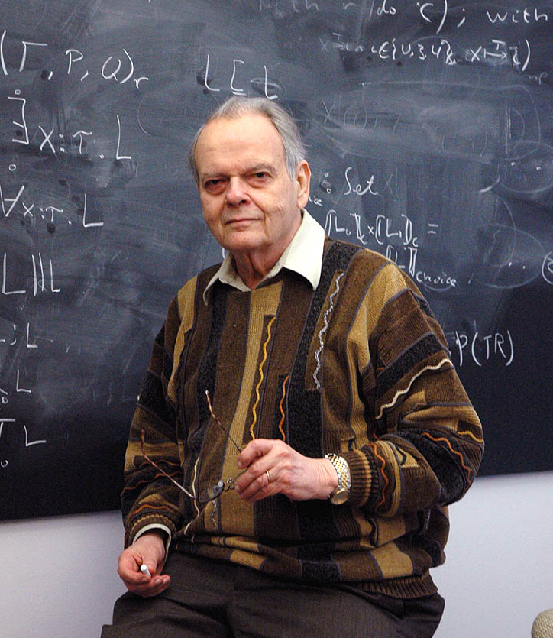
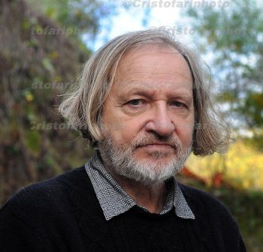
System F
e ::= x | k | τ | e₁ e₂ | λ(x:τ).e | Λ(a: τ).e
1971

Slide 32
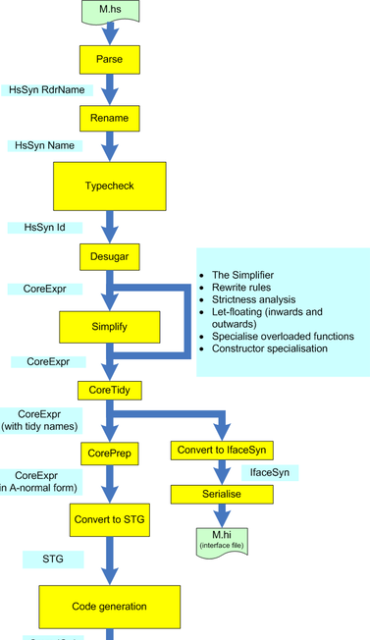
Core to Core passes
The Simplifier
Inlining
Rewrite rules
Beta reduction
Case of case
Case of known constructor
etc etc etc
Specialise overloading
Float out
Float in
Demand, cardinality, and CPR analysis
Arity analysis
Call-pattern specialisation (SpecConstr)
Plugins

Slide 33
Laziness
and
Purity

Slide 34
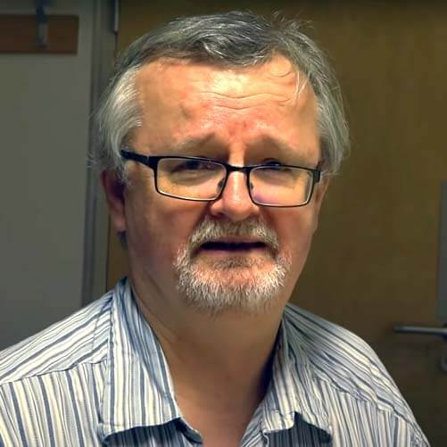
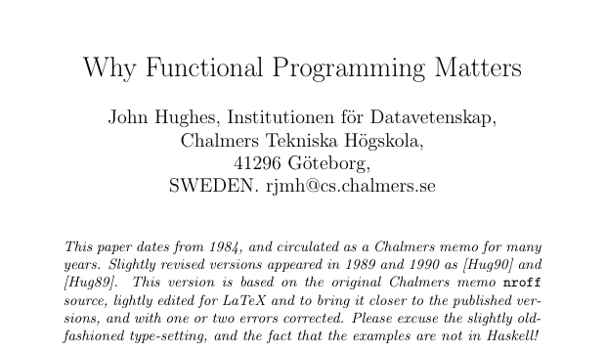
Laziness
Laziness was Haskell’s initial rallying cry
John Hughes’s famous paper “Why functional programming matters”
Modular programming needs powerful glue
Lazy evaluation enables new forms of modularity; in particular, separating generation from selection.
Non-strict semantics means that unrestricted beta substitution is OK.

Slide 35
But...
Laziness makes it much harder to reason about performance, especially space
Laziness has a real implementation cost
Laziness can be added to a strict language (although not as easily as you might think)
And it’s not so bad only having βV instead of β
So why wear the hair shirt of laziness?

Slide 36
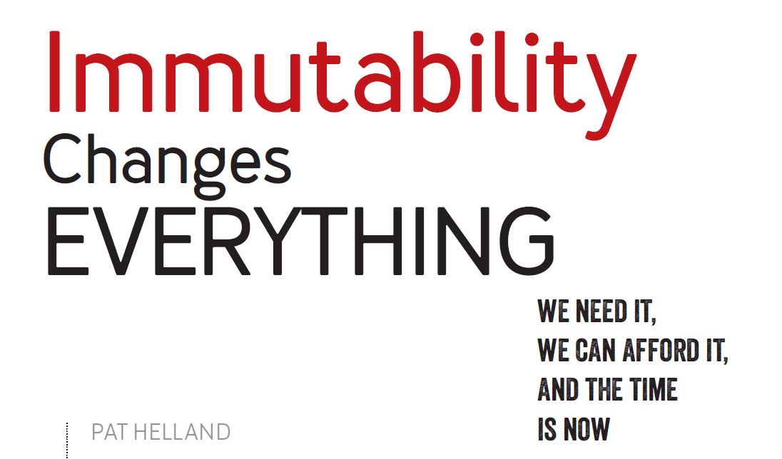
Because…
ACM Queue 2016

Slide 37
Laziness keeps you pure
Every call-by-value language has given into the siren call of side effects
But in Haskell f (print “yes”) (print “no”) just does not make sense. Even worse is [print “yes”, print “no”]
So effects (I/O, references, exceptions) are just not an option.
Result: prolonged embarrassment. Stream-based I/O, continuation I/O... bbut NO DEALS WIH THE DEVIL

Slide 38
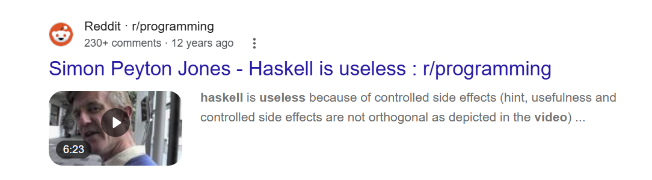
Arbitrary effects
Nirvana
Useful
Plan A
(incremental)
Cross-fertilisation
(eg STM)
Plan B (radical)
No effects
Useless
Dangerous
Safe

Slide 39
Enter Phil Wadler

Slide 40
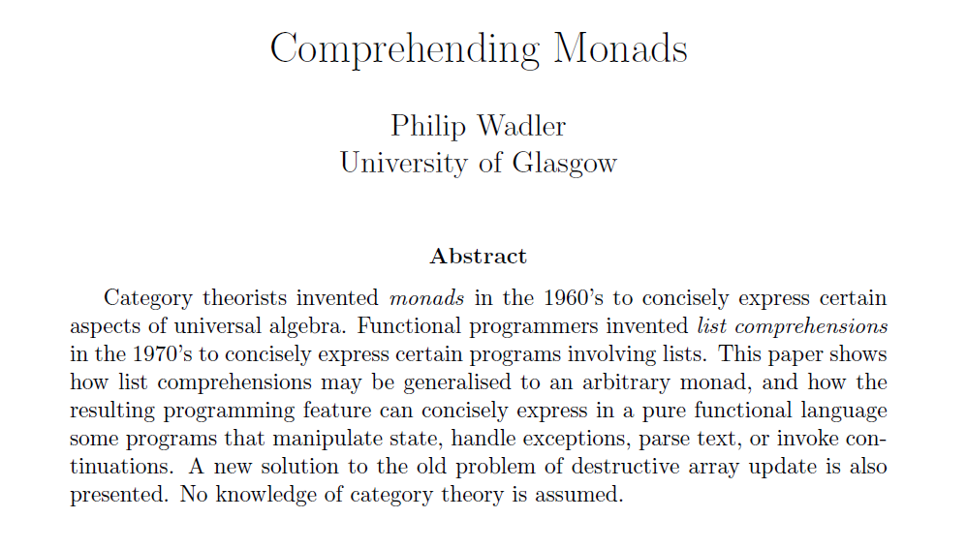
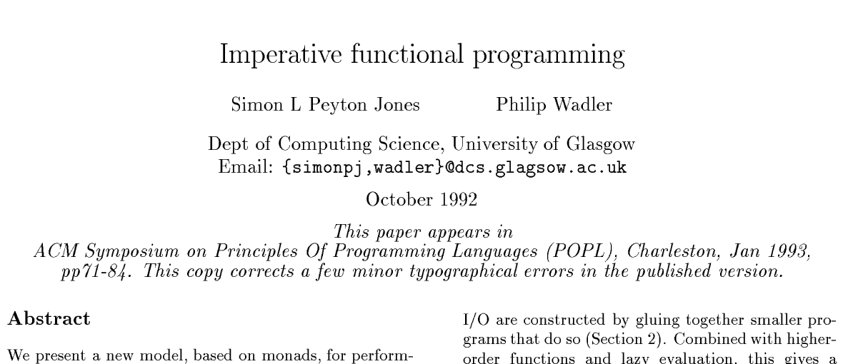
Laziness keeps you pure
Every call-by-value language has given into the siren call of side effects
But in Haskell (print “yes”) + (print “no”) just does not make sense. Even worse is [print “yes”, print “no”]
So effects (I/O, references, exceptions) are just not an option.
Result: prolonged embarrassment. Stream-based I/O, continuation I/O... but NO DEALS WIH THE DEVIL

Slide 41
Salvation through monads
A value of type (IO t) is an “action” that, when performed, may do some input/output before delivering a result of type t.
toUpper :: Char -> Char
getChar :: IO Char
putChar :: Char -> IO ()
The main program is an action of type IO ()
main :: IO ()
main = putChar ‘x’

Slide 42
Connecting I/O operations
(>>=) :: IO a -> (a -> IO b) -> IO b
return :: a -> IO a
eg. Read two characters, print the second, return both
getChar >>= (\a ->
getChar >>= (\b ->
putChar b >>= (\() ->
return (a,b))))

Slide 43
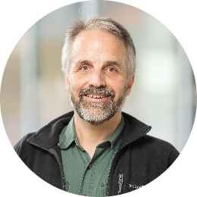
The do-notation
Mark Jones
do {
a <- getChar;
b <- getChar;
putchar b;
return (a,b)
}
getChar >>= \a ->
getChar >>= \b ->
putchar b >>= \()->
return (a,b)
==
Syntactic sugar only
Easy translation into (>>=), return
Deliberately imperative “look and feel”

Slide 44
Control structures
Haskell is the world’s finest imperative programming language
Values of type (IO t) are first class
So we can define our own “control structures”
forever :: IO () -> IO ()
forever a = do { a; forever a }
repeatN :: Int -> IO () -> IO ()
repeatN 0 a = return ()
repeatN n a = do { a; repeatN (n-1) a }
e.g. repeatN 10 (putChar ‘x’)

Slide 45
Concurrency
forkIO :: IO a -> IO ThreadId
(forkIO m) spawns a new thread that runs m concurrently, and immediately returns its ThreadId
The big question: how do threads coordinate?
main = do { forkIO (print “Hello”);
print “Goodbye” }
HeGoodlldbyoe

Slide 46
STM
newRef :: a -> IO (Ref a) readRef :: Ref a -> IO a writeRef :: Ref a -> a -> IO ()
main :: IO ()
main = do { r <- newRef 0 ; forkIO (addR r 1)
; addR r 10 ; v <- readRef r
; print v} addR :: Ref Int -> Int -> IO () addR r n = do { v <- readRef r ; writeRef r (v+n)}
Bad interleaving => prints 1 (not 10 or 11)

Slide 47
STM
atomic :: IO a -> IO a
main :: IO ()
main = do { r <- newTVar 0 ; forkIO (atomic (addR r 1))
; atomic (addR r 10) ; v <- readTVar r
; print v} addR :: Ref Int -> Int -> IO () addR r n = do { v <- readTVar r ; writeTVar r (v+n)}
(atomic m) runs m atomically wrt all other threads

Slide 48
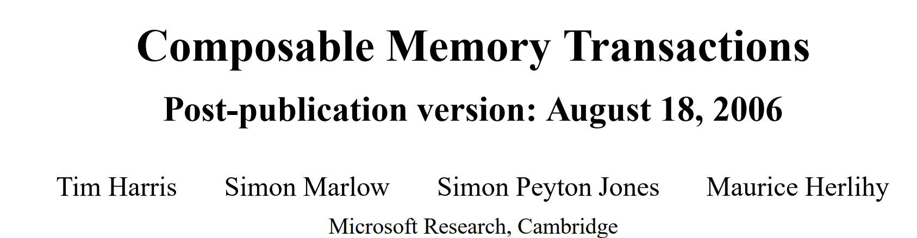
More STM
Studying STM led to an elegant new mechanism for
Blocking
Choice
Better still: transactions compose to make bigger transactions
retry :: STM a orElse :: STM a -> STM a -> STM a

Slide 49
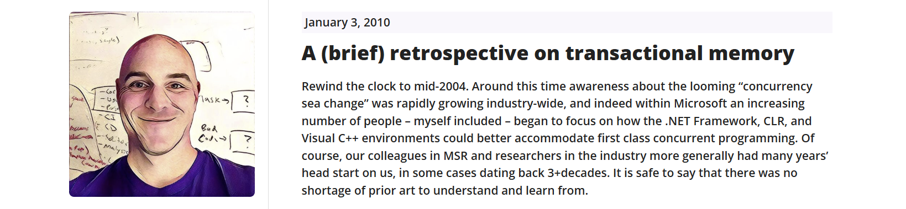
STM in practice
STM in Haskell is fantastic
Type system guarantees: no I/O inside transaction; no mutation outside.
Transactions compose beautifully
Comes “in the box”
Meanwhile the rest of the world has abandoned STM
Too expensive
In Haskell it’s cheap
Effect tracking rules!

Slide 50
What have we achieved
The ability to mix imperative and purely-functional programming, without ruining either: the types keep them separate.
Opens the way to many monads (I/O, STM, Restricted IO, etc) with different effects and guarantees
Guy Steele: “Some people prefer not to commingle the functional, Church-lambda-calculus part of a language with the parts that do side effects. It seems they believe in the separation of Church and state.”

Slide 51

Towards Nirvana
We thought that laziness was the Big Deal, but we were wrong: it’s purity
One of Haskell’s most significant contributions is to relentlessly pursue purity and see where takes us
Controlling effects is liberating, expressive, and much more efficient.
Purely functional programming feels very very different: you have to “rewire your brain”
But it’s not “just another approach”: ultimately, there is no alternative.
Using the scary term “monad”
rather than
“warm fuzzy thing”

Slide 52
Types and
type classes

Slide 53
Starting point: ML
Parametric polymorphism append :: [a] -> [a]
Types are inferred append [] ys = ys append (x:xs) ys = x : append xs ys
Algebraic data types data Tree a = Leaf a | Branch (Tree a) (Tree a)

Slide 54
Problem
Haskell committee hated this, but had no idea what else to do
Functions that are “nearly polymorphic”
member :: a -> [a] -> Bool
sort :: [a] -> [a]
square :: a -> a
show :: a -> String
serialise :: a -> BitString
hash :: a -> Int
Usual solution: “bake them in” as a runtime service

Slide 55
Enter Phil Wadler (yet again)

Slide 56
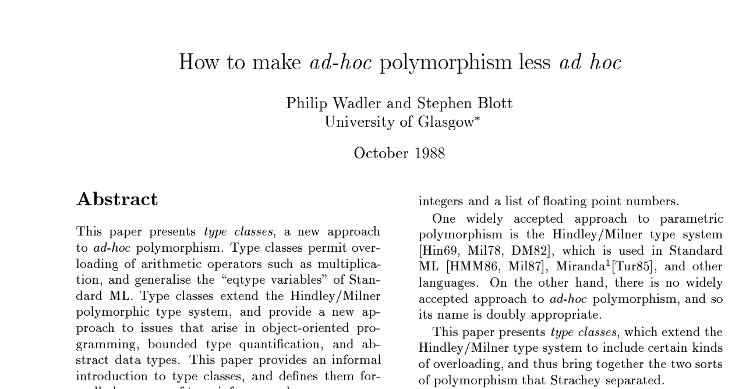
Solution
Functions that are “nearly polymorphic”
member :: a -> [a] -> Bool
sort :: [a] -> [a]
(+) :: a -> a -> a
show :: a -> String
serialise :: a -> BitString
hash :: a -> Int
Usual solution: “bake them in” as a runtime service

Slide 57
Type classes
Works for any type ‘a’, provided ‘a’ is an instance of class Num
square :: a -> a
square :: Num a => a -> a
square x = x * x
Similarly:
sort :: Ord a => [a] -> [a]
serialise :: Show a => a -> String
member :: Eq a => a -> [a] -> Bool

Slide 58
Declaring classes
square :: Num a => a -> a
class Num a where
(+) :: a -> a -> a
(*) :: a -> a -> a
...etc...
instance Num Int where
(+) = plusInt
(*) = mulInt
...etc...
Haskell class is like a Java interface
Allows ‘square’ to be applied to an Int

Slide 59
How type classes work
When you write this...
...the compiler generates this
square :: Num n => n -> n
square x = x*x
square :: Num n -> n -> n
square d x = (*) d x x
class Num a where
(+) :: a -> a -> a
(*) :: a -> a -> a
negate :: a -> a
...etc..
data Num a
= MkNum (a->a->a)
(a->a->a)
(a->a)
...etc...
(*) :: Num a -> a -> a -> a
(*) (MkNum _ m _ ...) = m
The class decl translates to:
A data type decl for Num
A selector function for each class operation
A value of type (Num T) is a vtable of the Num operations for type T

Slide 60
Multi-parameter type classes
class BiNum a b r | a b -> r where
(+) :: a -> b -> r
(*) :: a -> b -> r
instance BiNum Int Int Int where
(+) = plusInt
…etc…
instance BiNum Int Float Float where
a+b = intToFloat a + b
…etc…
Very, very like multiple dispatch in Julia
Fully static (driven by types), whereas Julia is dynamic (driven by values)
Rich opportunities for specialisation, just like Julia

Slide 61
Type classes vs multi-methods
Talk to me
Julia: multi-method dispatch | Haskell: type classes
Super super powerful | Super powerful
“Dynamic”: happens at runtime, driven by values. But often resolved at compile time. | “Static”: happens at compile time, driven by types. But implemented by passing “dictionaries” of code at runtime
Lots of opportunities to specialise code for the particular types involved | Lots of opportunities to specialise code for the particular types involved
Outcome depends on the “load order” of code | No order dependence
Complex: “nominal single subtyping, union types, existential types, covariant tuples, invariant parametric data types, distribuivity, singleton types, the diagonal rule” (Julia Subtyping: a rational reconstruction, OOPSLA 2018). 181 overloads of multiplication (!) | Somewhat complex.
Types like Transpose(Array{Float64,2}) supporting zero-cost transpose (…and other “array views” like slice) | Such types are (I think) possible but I have not seen them in practice
Can’t overload on result type | Can overload on result type

Slide 62
Can overload on result value
class Num a where
fromInteger :: Integer -> a
(*) :: a -> a -> a
double :: Num a => a -> a
double x = x * 2
Numeric literal “2” is read as “fromInteger 2”
double d x = (*) d x (fromInteger d 2)
Unlike OOP (and Julia)
The vtable (d::Num a) is passed in
The value of type ‘a’ is returned out
This ability turns out to be a Big Deal
OOP/Julia can’t overload on the return type

Slide 63
Type classes over time
Type classes are the most unusual feature of Haskell’s type system
Hey, what’s the big deal?
Wild enthusiasm
Hack, hack, hack
Despair
Incomprehension
1987
1989
1993
1997
Implementation begins

Slide 64
Type classes have proved extraordinarily influential
Equality, ordering, serialisation
Numerical operations. Even numeric constants are overloaded
Monadic operations
And on and on....time-varying values, pretty-printing, collections, reflection, generic programming, marshalling, monad transformers....
class Monad m where
return :: a -> m a
(>>=) :: m a -> (a -> m b) -> m b
Note the higher-kinded type variable, m

Slide 65
Type-class fertility
Higher kinded type variables (1995)
Implicit parameters (2000)
Wadler/Blott type classes (1989)
Extensible records (1996)
Multi-parameter type classes (1991)
Computation at the type level
Functional dependencies (2000)
Generic programming
Overlapping instances
“newtype deriving”
Testing
Associated types (2005)
Derivable type classes
Applications
Variations

Slide 66
Beyond type classes
Haskell has become a laboratory and playground for advanced type systems
Polymorphic recursion
Higher kinded type variables data T k a = T a (k (T k a))
Polymorphic functions as constructor arguments data T = MkT (forall a. [a] -> [a])
Polymorphic functions as arbitrary function arguments (higher ranked types) f :: (forall a. [a]->[a]) -> ...
Existential types data T = exists a. Show a => MkT a

Slide 67
Beyond type classes: sexy types
Generalised Algebraic Data Types (GADTs) data Vec n a where Vnil :: Vec Zero n Vcons :: a -> Vec n a -> Vec (Succ n) a
Type families and associated types class Collection c where type Elem c insert :: Elem c -> c -> c
Polymorphic kinds
...............and on and on

Slide 68
Building on success
Static typing is by far the most successful program verification technology in use today
Comprehensible to Joe Programmer
Checked on every compilation
Simple types
ML
Haskell
Rocq/Lean
The spectrum of confidence
Nothing
Increasing confidence that the program does what you want
Hammer (cheap, easy to use, limited effectiveness)
Tactical nuclear weapon (expensive, needs a trained user, but very effective indeed)

Slide 69
Plan for World Domination
Build on the demonstrated success of static types
...by making the type system more expressive
...so that more good programs are accepted (and more bad ones rejected)
...without losing the Joyful Properties (comprehensible to programmers)

Slide 70
Closing thoughts

Slide 71
Language developemnt
{-# LANGUAGE RecordWildCards, MonadComprehensions, TransformListComp, NamedFieldPuns #-}
GHC (language) proposals (RFCs)
https://github.com/ghc-proposals/ghc-proposals
Library stability: the Core Libraries Committee
https://github.com/haskell/core-libraries-committee
Changes made through language extensions
GHC has 150-ish language extensions
So GHC can compile around 2¹⁵⁰ different languages

Slide 72
Critically important stuff that I have not talked about at all
Friction-free installation: ghcup
Library infrastructure
Hackage (where it lives)
Cabal and Stack (seamless download, build, install)
IDE: Haskell Langauge Server

Slide 73
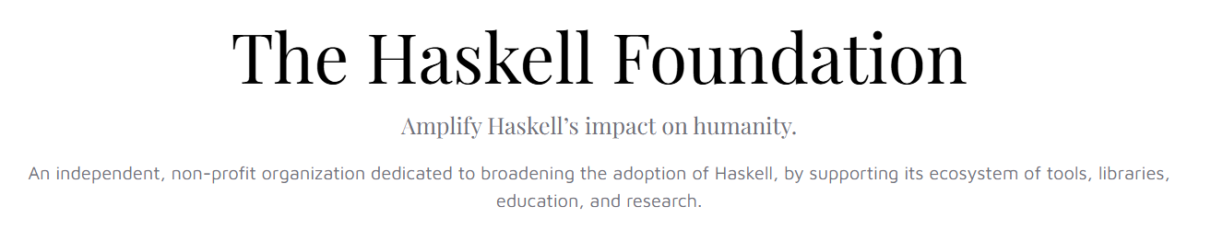
The tragedy of the commons
Lots of companies use Haskell, and rely on the Haskell ecosystem in a mission-critical way
They (rightly) get cross if releases are unreliable, or infrastructure fails
But they all find it hard to justify paying for it
Danger: volunteer burn-out.
Challenge: put all this on a more sutainable footing, in which companies contribute because it is a no-brainer to do so.
Sanity test: 1% of Haskell-developer salaries would be plenty.
Julia has the exact same challenge.

Slide 74
Escape from the ivory tower
The ideas are more important than the language: Haskell aspires to infect your brain more than your hard drive
The ideas really are important IMHO
Purity (or at least controlling effects)
Types (for big, long-lived software)
Haskell is a laboratory where you can see these ideas in distilled form
(But take care: addiction is easy and irreversible)

Slide 75
Luck and friendship
Technical excellence helps, but is neither necessary nor sufficient for a language to succeed.
Luck and friendship, on the other hand, are definitely necessary
We were certainly lucky: the conditions that led to Haskell are hard to reproduce
And the Haskell community is great
I suspect that all this is true of Julia too

Slide 76
Talk to me!
About Julia’s type system, overloading, multiple dispatch
About Julia’s JIT, specialiser, compilation pipeline
About how to make our open-source communities thrive
Of course, anything about Haskell you want to know
I’m here all of Wednesday and Thursday (but not Friday)

Slide 77
The Haskell committee
Arvind
Lennart Augustsson
Dave Barton
Brian Boutel
Warren Burton
Jon Fairbairn
Joseph Fasel
Andy Gordon
Maria Guzman
Kevin Hammond
Ralf Hinze
Paul Hudak [editor]
John Hughes [editor]
Thomas Johnsson
Mark Jones
Dick Kieburtz
John Launchbury
Erik Meijer
Rishiyur Nikhil
John Peterson
Simon Peyton Jones [editor]
Mike Reeve
Alastair Reid
Colin Runciman
Philip Wadler [editor]
David Wise
Jonathan Young

