Slide 1
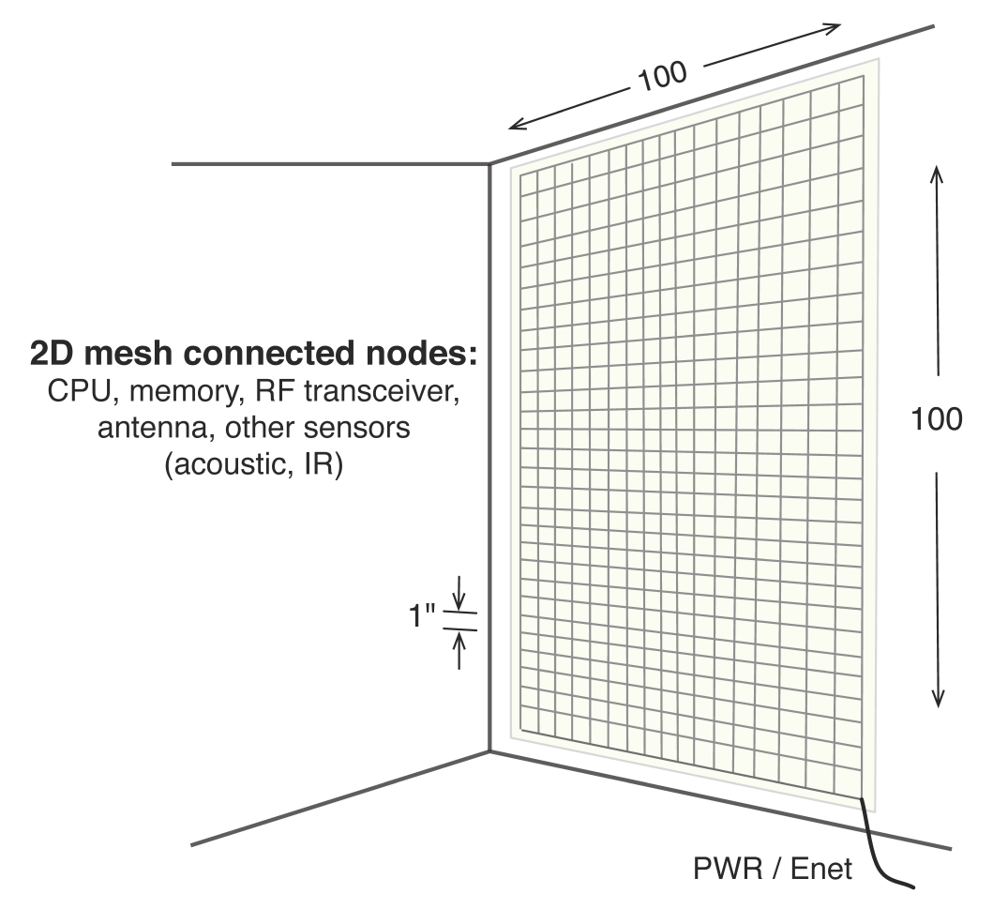
A Distributed Algorithm for 3D Radar Imaging on the eWallpaper
Patrick Li and Simon Scott
eWallpaper: thousands of embedded low-power processors. One antenna per processor.
Application: use the radio transceivers to image the room.
Algorithm: each radio transmits pulses. The responses are combined using SAR techniques to form an image.
Challenges:
Response distributed amongst 16 000 processors
Restrictive mesh topology
Limited local memory per processor

Slide 2
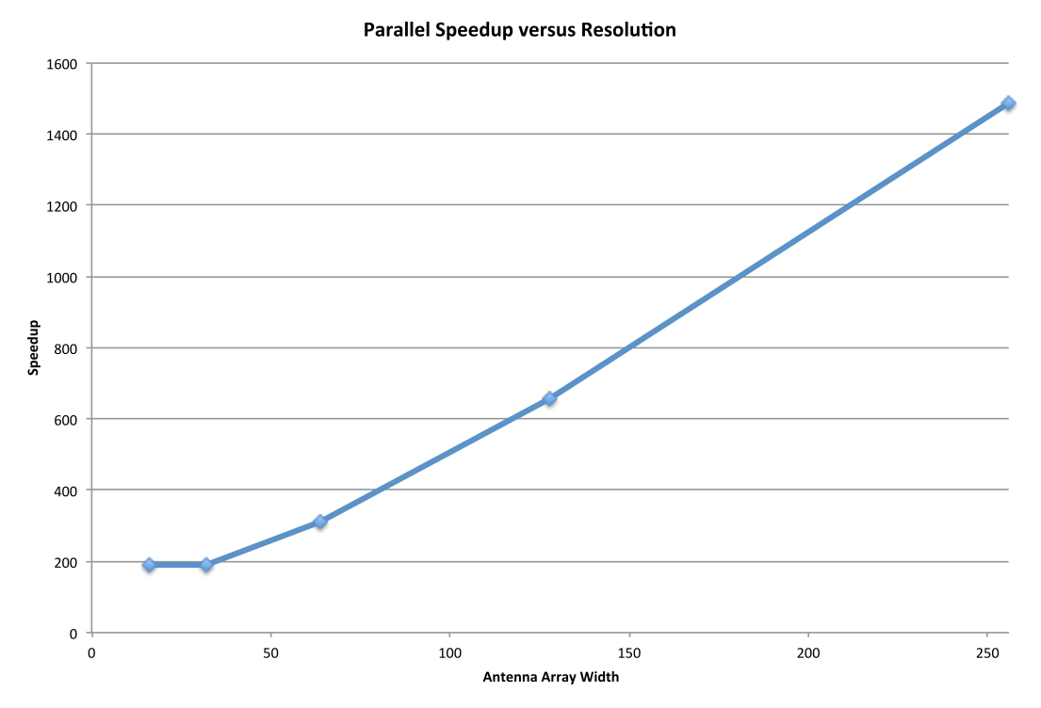
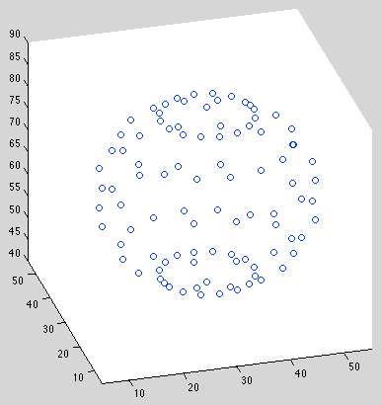
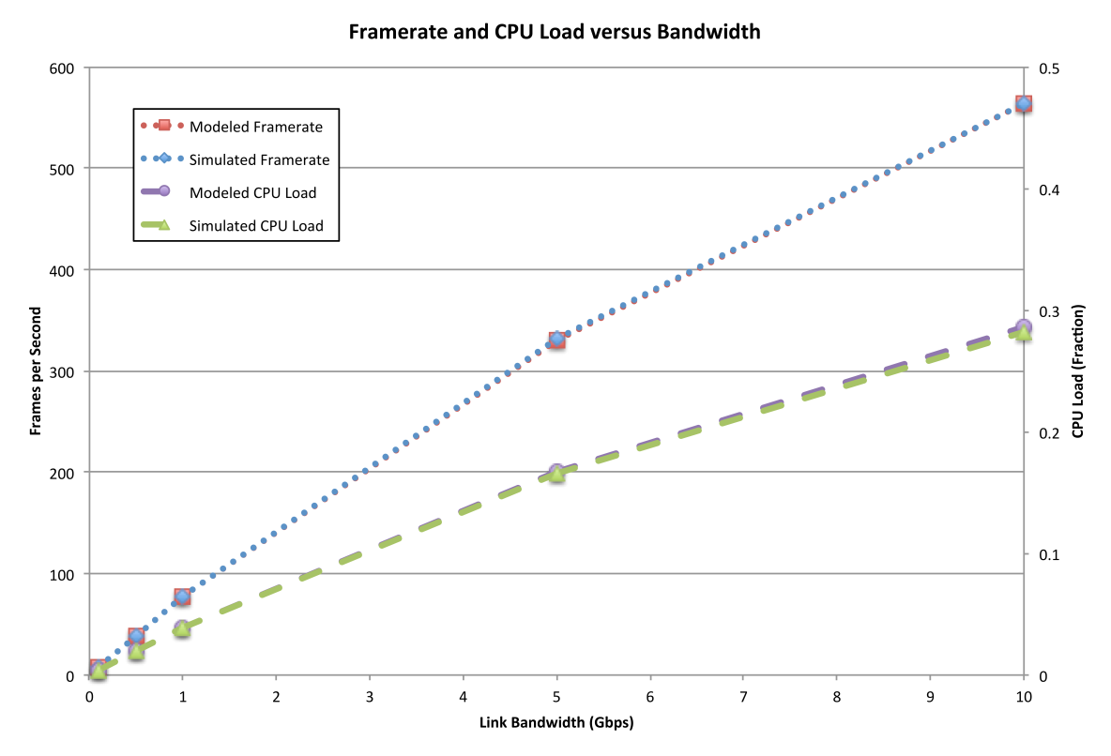
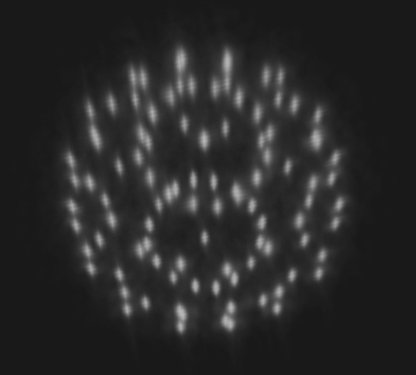
Original Scene
Parallel Speedup versus Resolution
Framerate and CPU Load versus Bandwidth
Recovered Scene

