Slide 1
A Distributed Algorithm for 3D Radar Imaging
Patrick Li
Simon Scott
CS 252 May 2012

Slide 2
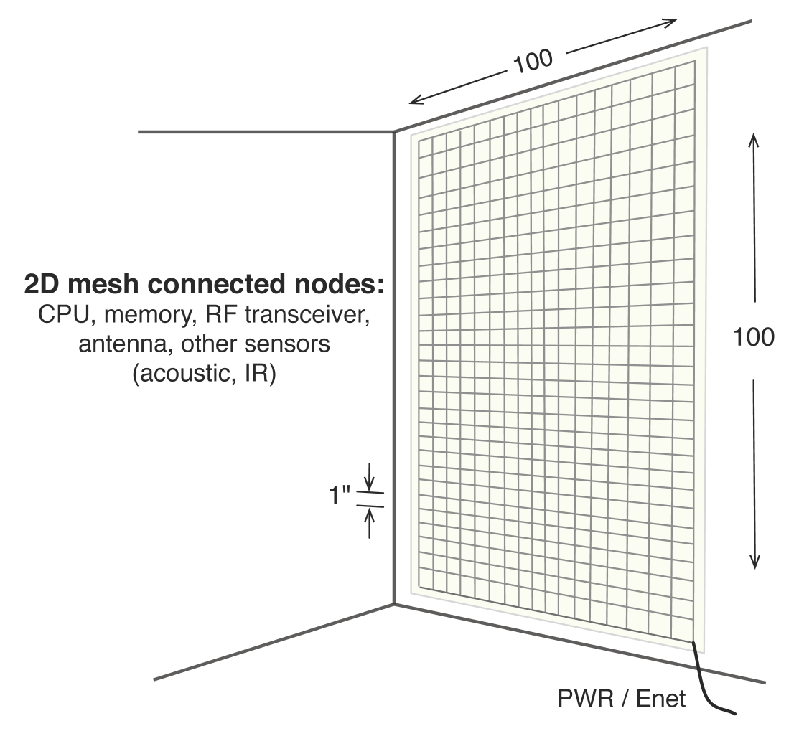
eWallpaper
Thousands of embedded low-power processors.
Connected in 2D mesh network.
One radio and antenna per processor.
128
128

Slide 3
Applications and Challenges
Application:
Use the radio transceivers to image the room
Algorithm:
Each radio transmits pulses and records echoes
The echoes are combined using SAR techniques to form an image
Challenges:
Response distributed amongst the 16 000 processors
Restrictive 2D mesh topology
Limited local memory per processor (100KB)

Slide 4
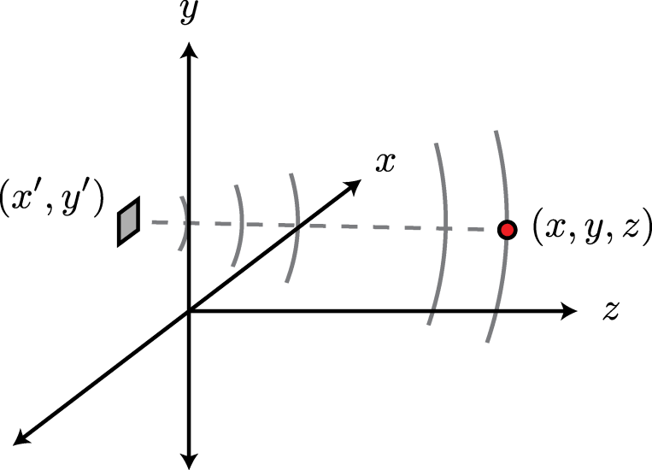
Synthetic Aperture Radar
Yadda yadda yadda

Slide 5
More Equations
Yadda yadda yadda

Slide 6
Expressing ? as FFTs
Yadda yadda yadda

Slide 7
The Row-wise Transpose
Yadda yadda yadda

Slide 8
The Column-wise Transpose
Yadda yadda yadda

Slide 9
The 3D Imaging Algorithm
Yadda yadda yadda

Slide 10
The Functional Simulator
Yadda yadda yadda

Slide 11
Platform for Testing Applications
Yadda yadda yadda

Slide 12
3D Imaging Results
Yadda yadda yadda

Slide 13
Timing and Memory Model
Yadda yadda yadda

Slide 14
Network Simulator
Yadda yadda yadda

Slide 15
Communication Patterns
Yadda yadda yadda

Slide 16
Communication Patterns: Speed
Yadda yadda yadda

Slide 17
Communication Patterns: Memory
Yadda yadda yadda

Slide 18
Results: x vs Resolution
Yadda yadda yadda

Slide 19
Results: x vs Resolution
Yadda yadda yadda

Slide 20
Results: x vs Resolution
Yadda yadda yadda

Slide 21
Results: x vs Bandwidth
Yadda yadda yadda

Slide 22
Results: x vs Bandwidth
Yadda yadda yadda

Slide 23
Effect of Precomputation
Yadda yadda yadda

Slide 24
Conclusions
Yadda yadda yadda

Slide 25
Future Work
Yadda yadda yadda

