Slide 1
A Distributed Algorithm for 3D Radar Imaging
Patrick Li
Simon Scott
CS 252
May 2012

Slide 2
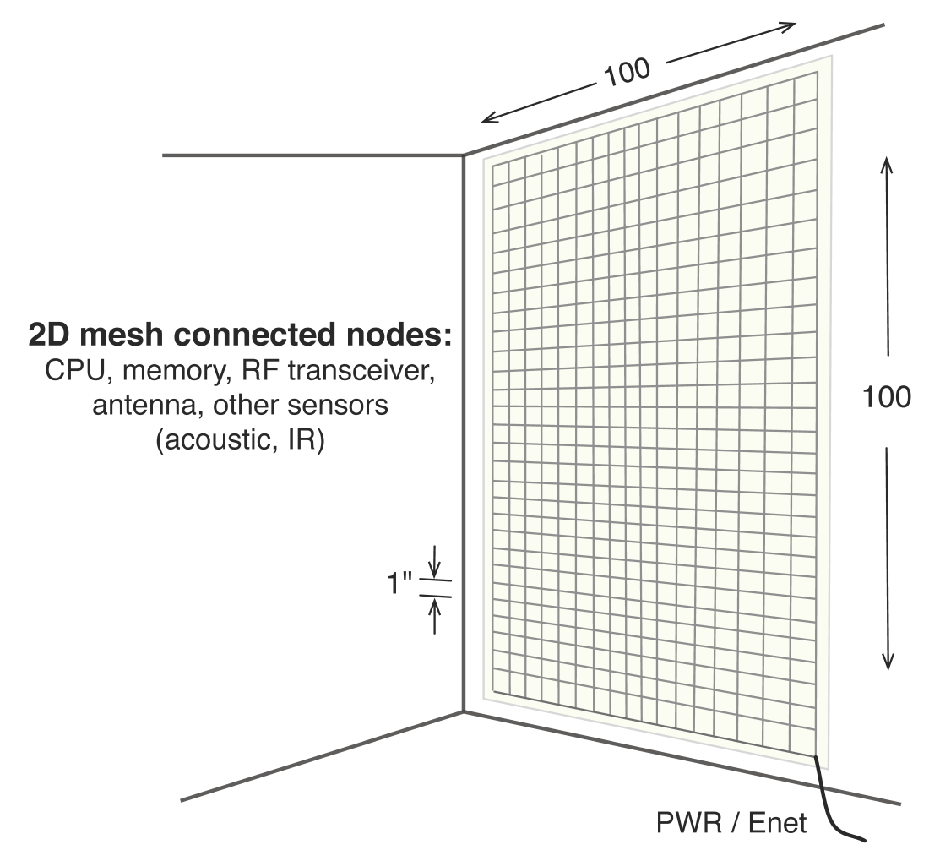
eWallpaper
Thousands of embedded, low-power, RISC-V processors.
Connected in 2D mesh network within wallpaper.
One radio and antenna per processor.
128
128

Slide 3
Applications and Challenges
Application:
Use the radio transceivers to image the room
Algorithm:
Each radio transmits pulses and records echoes
The echoes are combined using SAR techniques to form an image
Challenges:
Response distributed amongst the 16 000 processors
Restrictive 2D mesh topology
Limited local memory per processor (100KB)

Slide 4
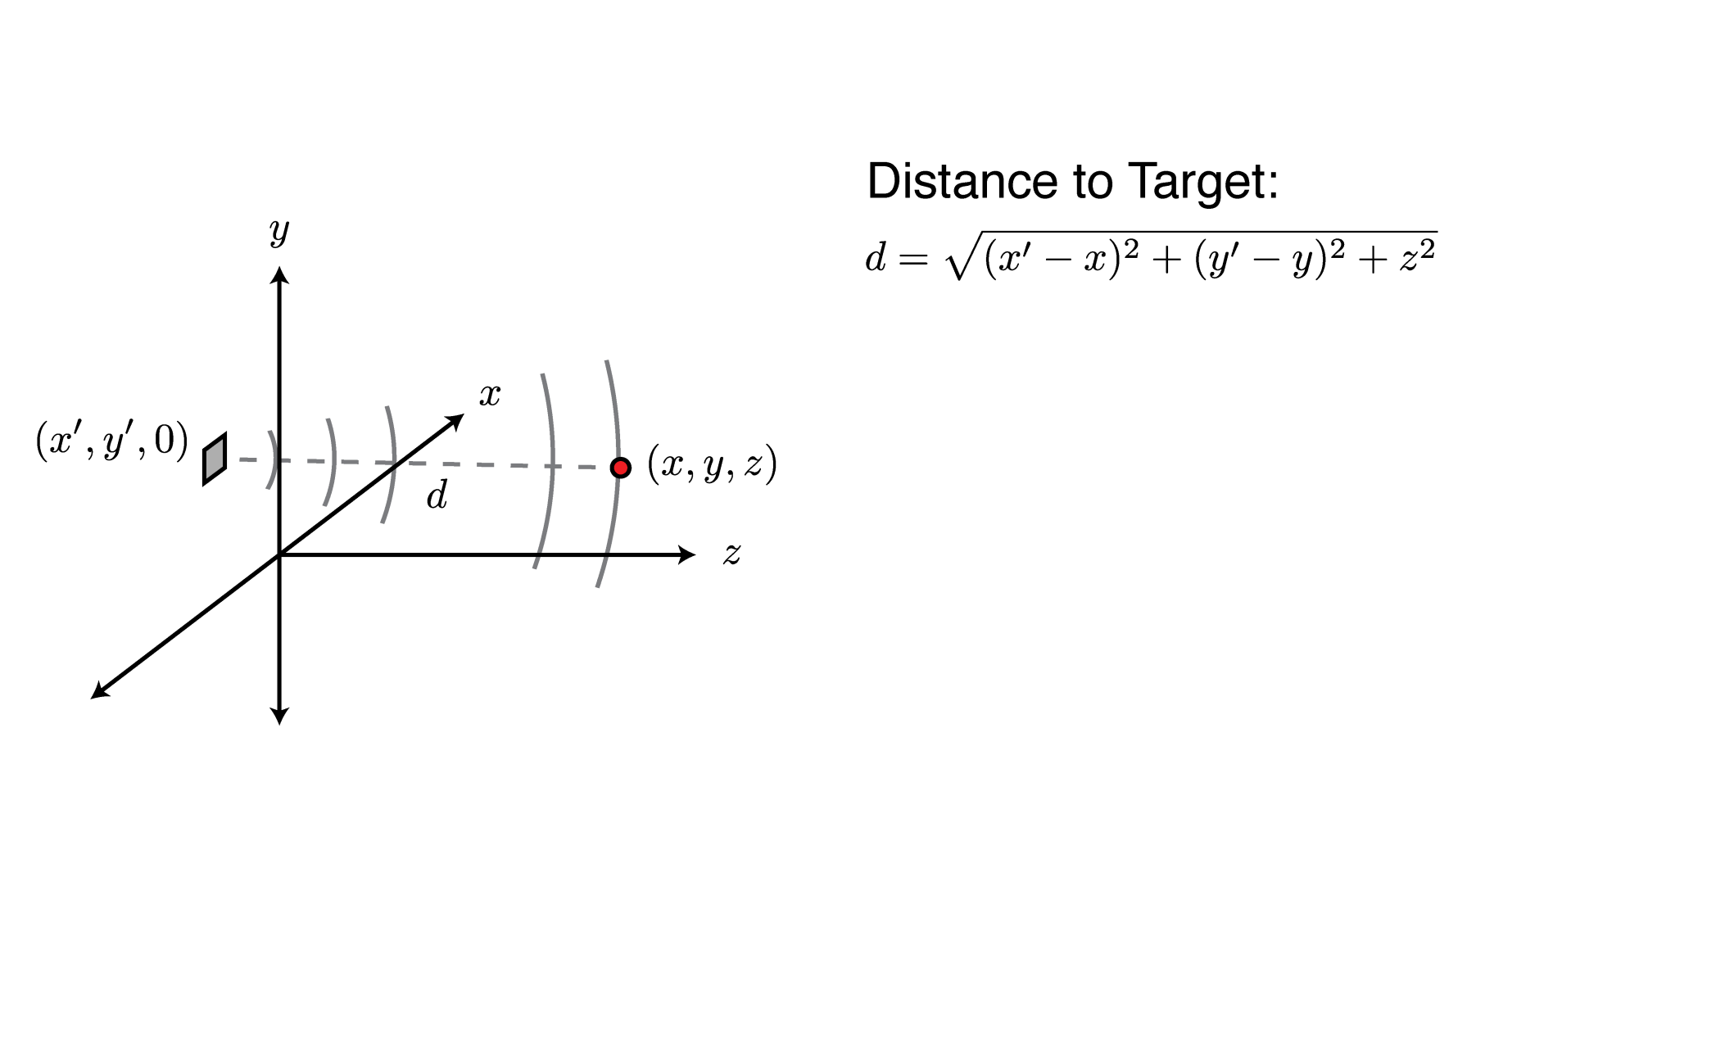
How it Works

Slide 5
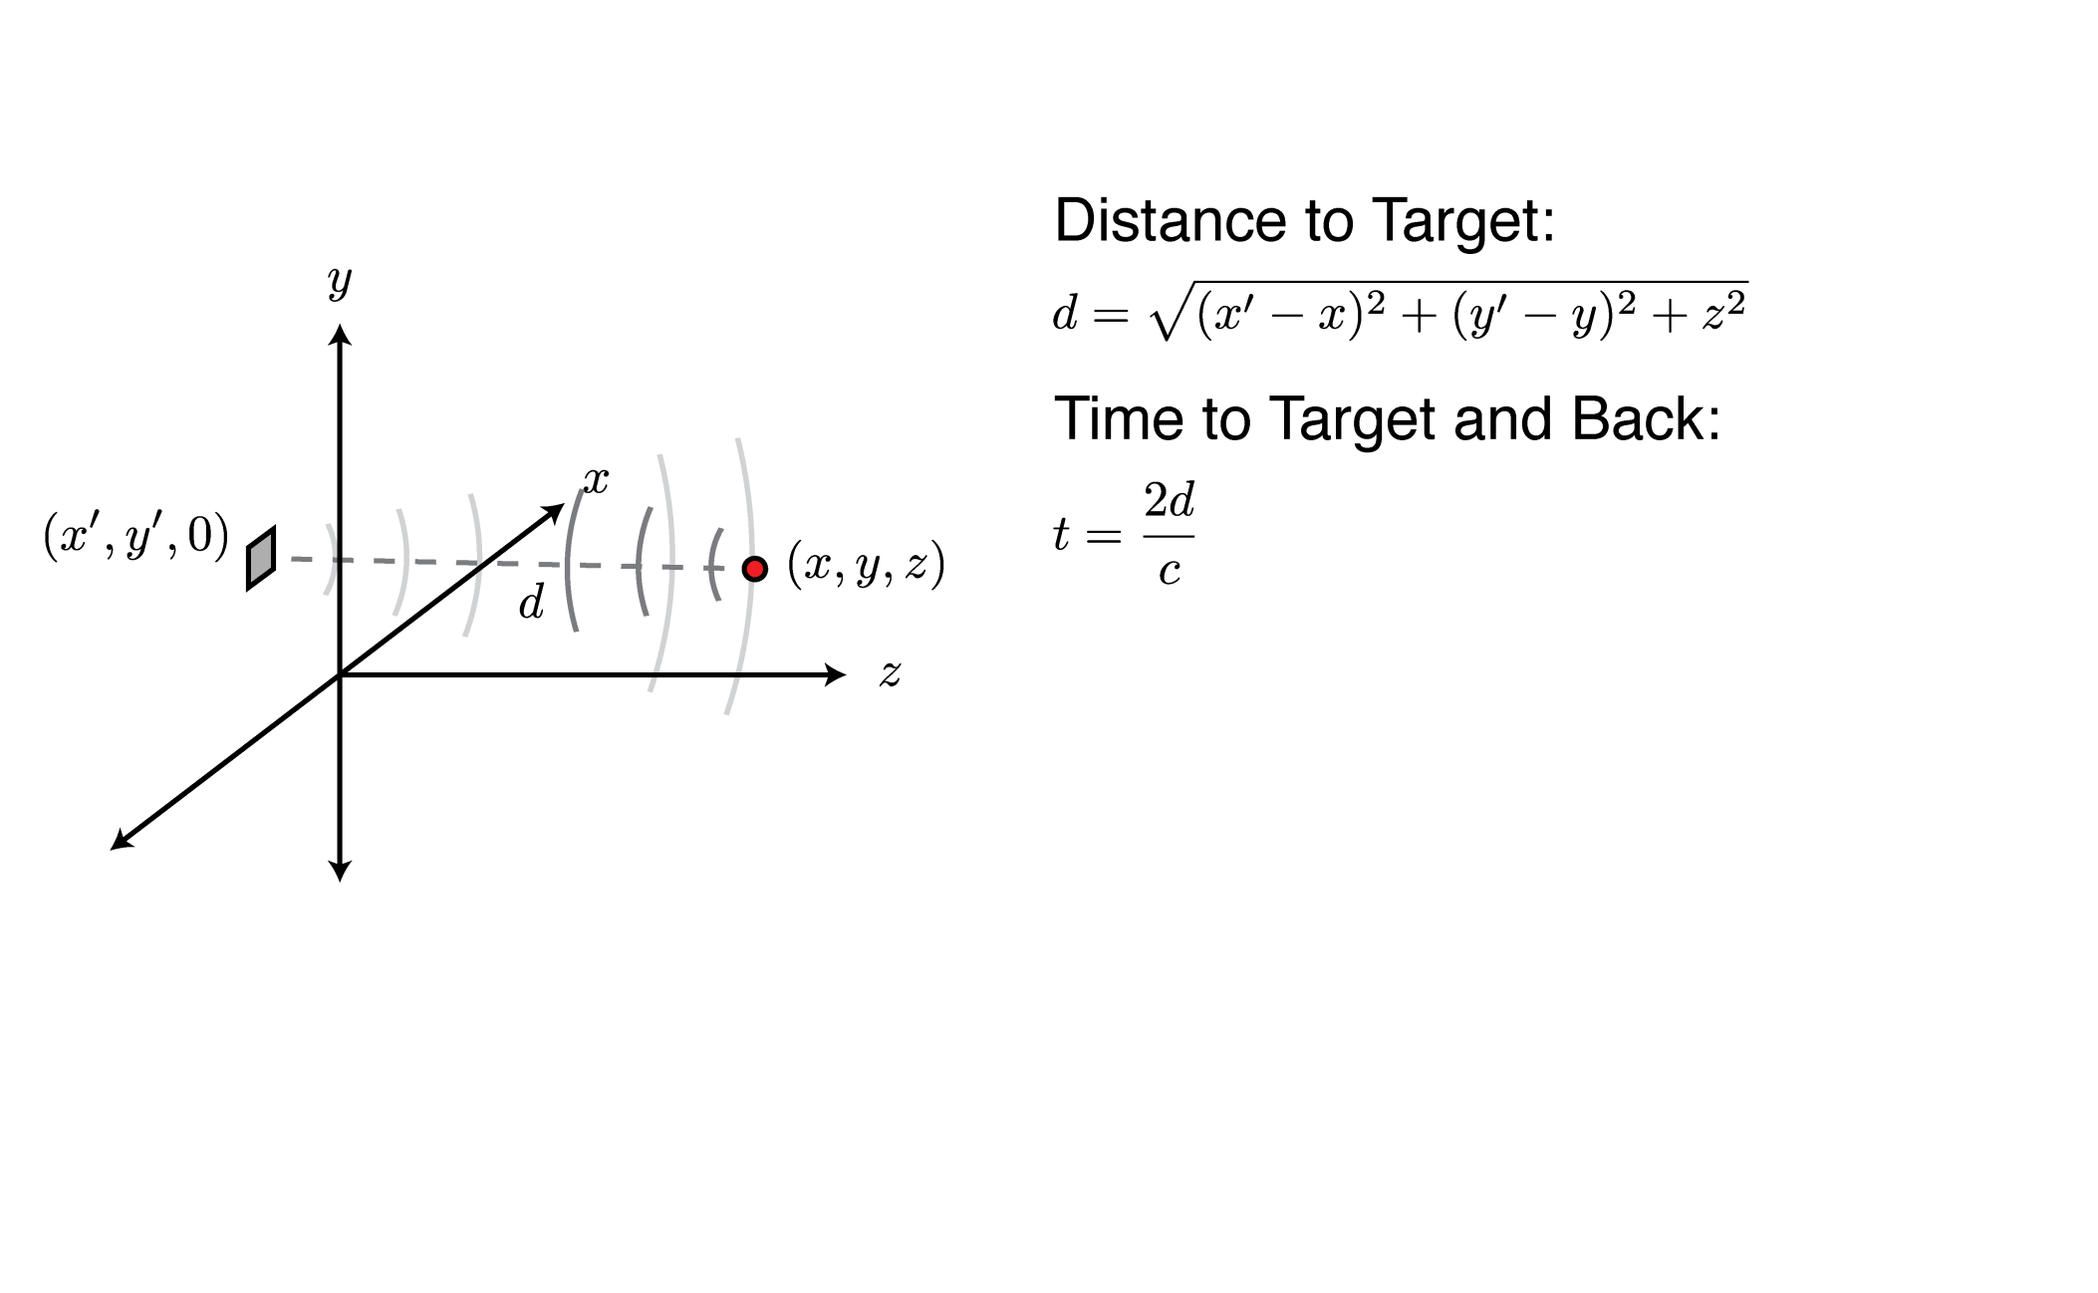
How it Works

Slide 6
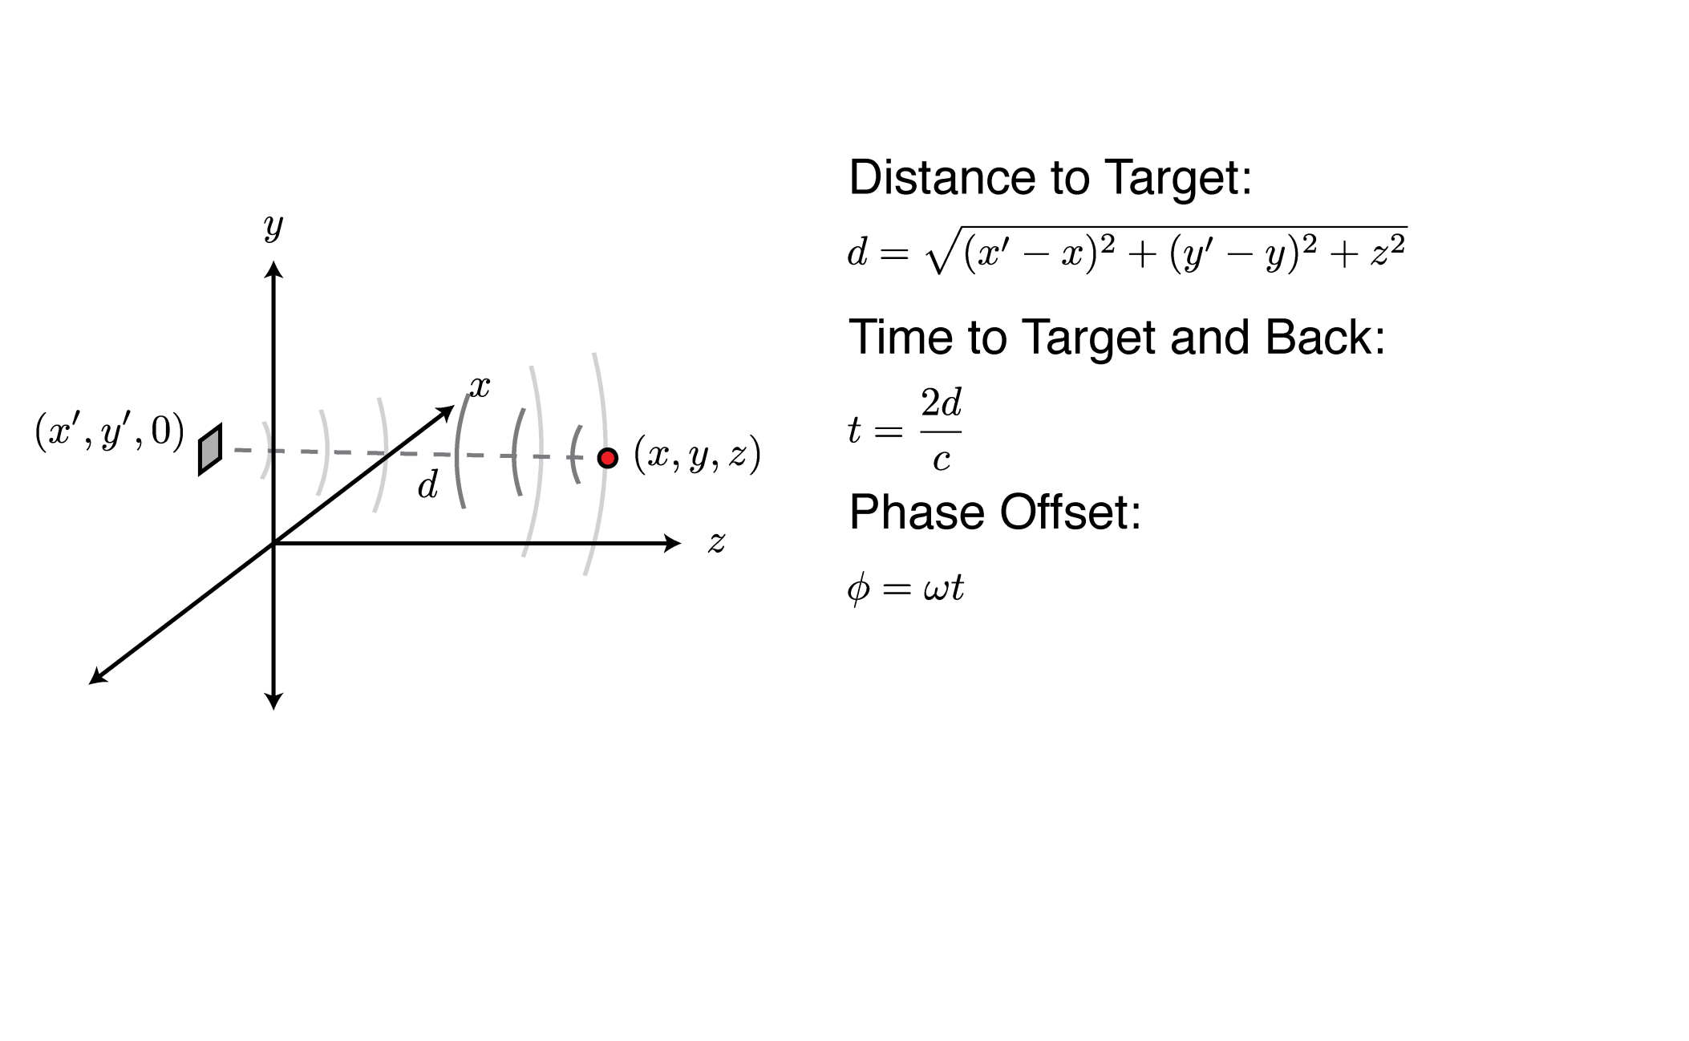
How it Works

Slide 7
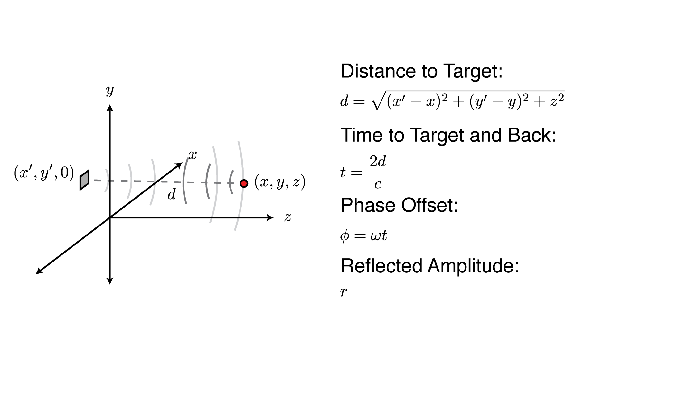
How it Works

Slide 8
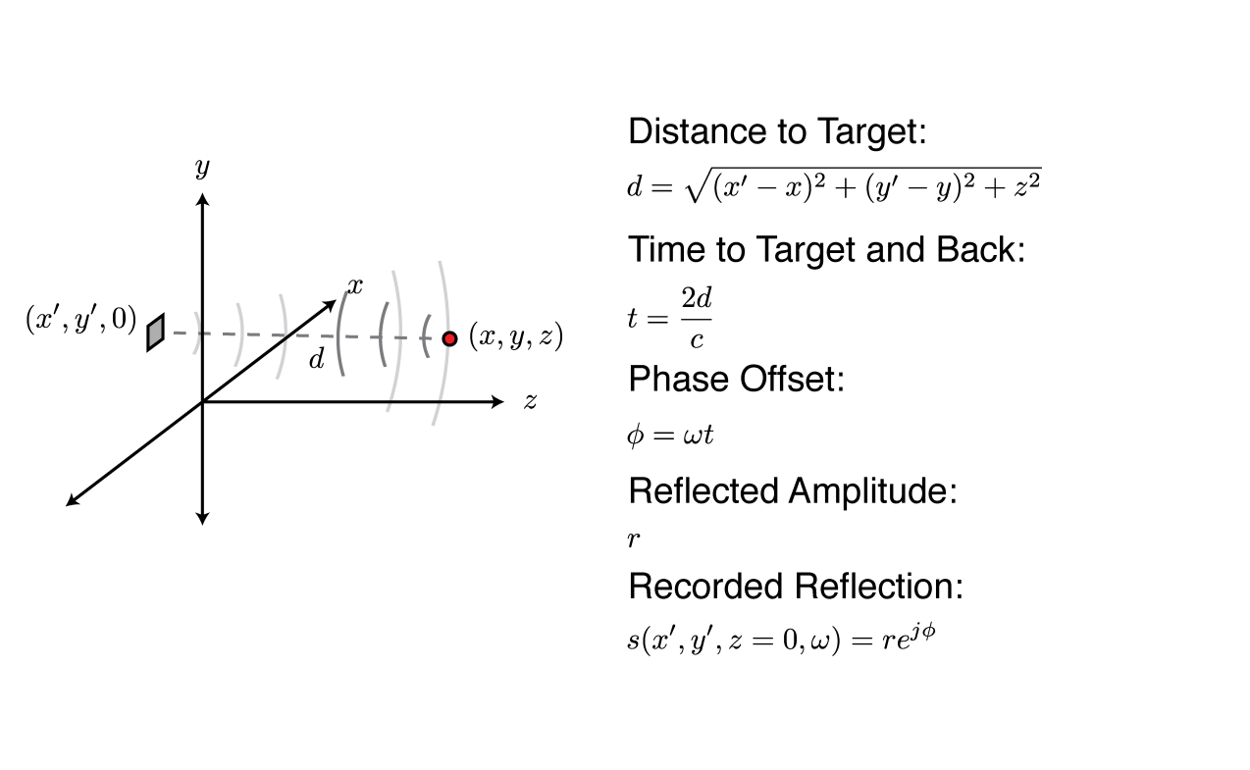
How it Works

Slide 9
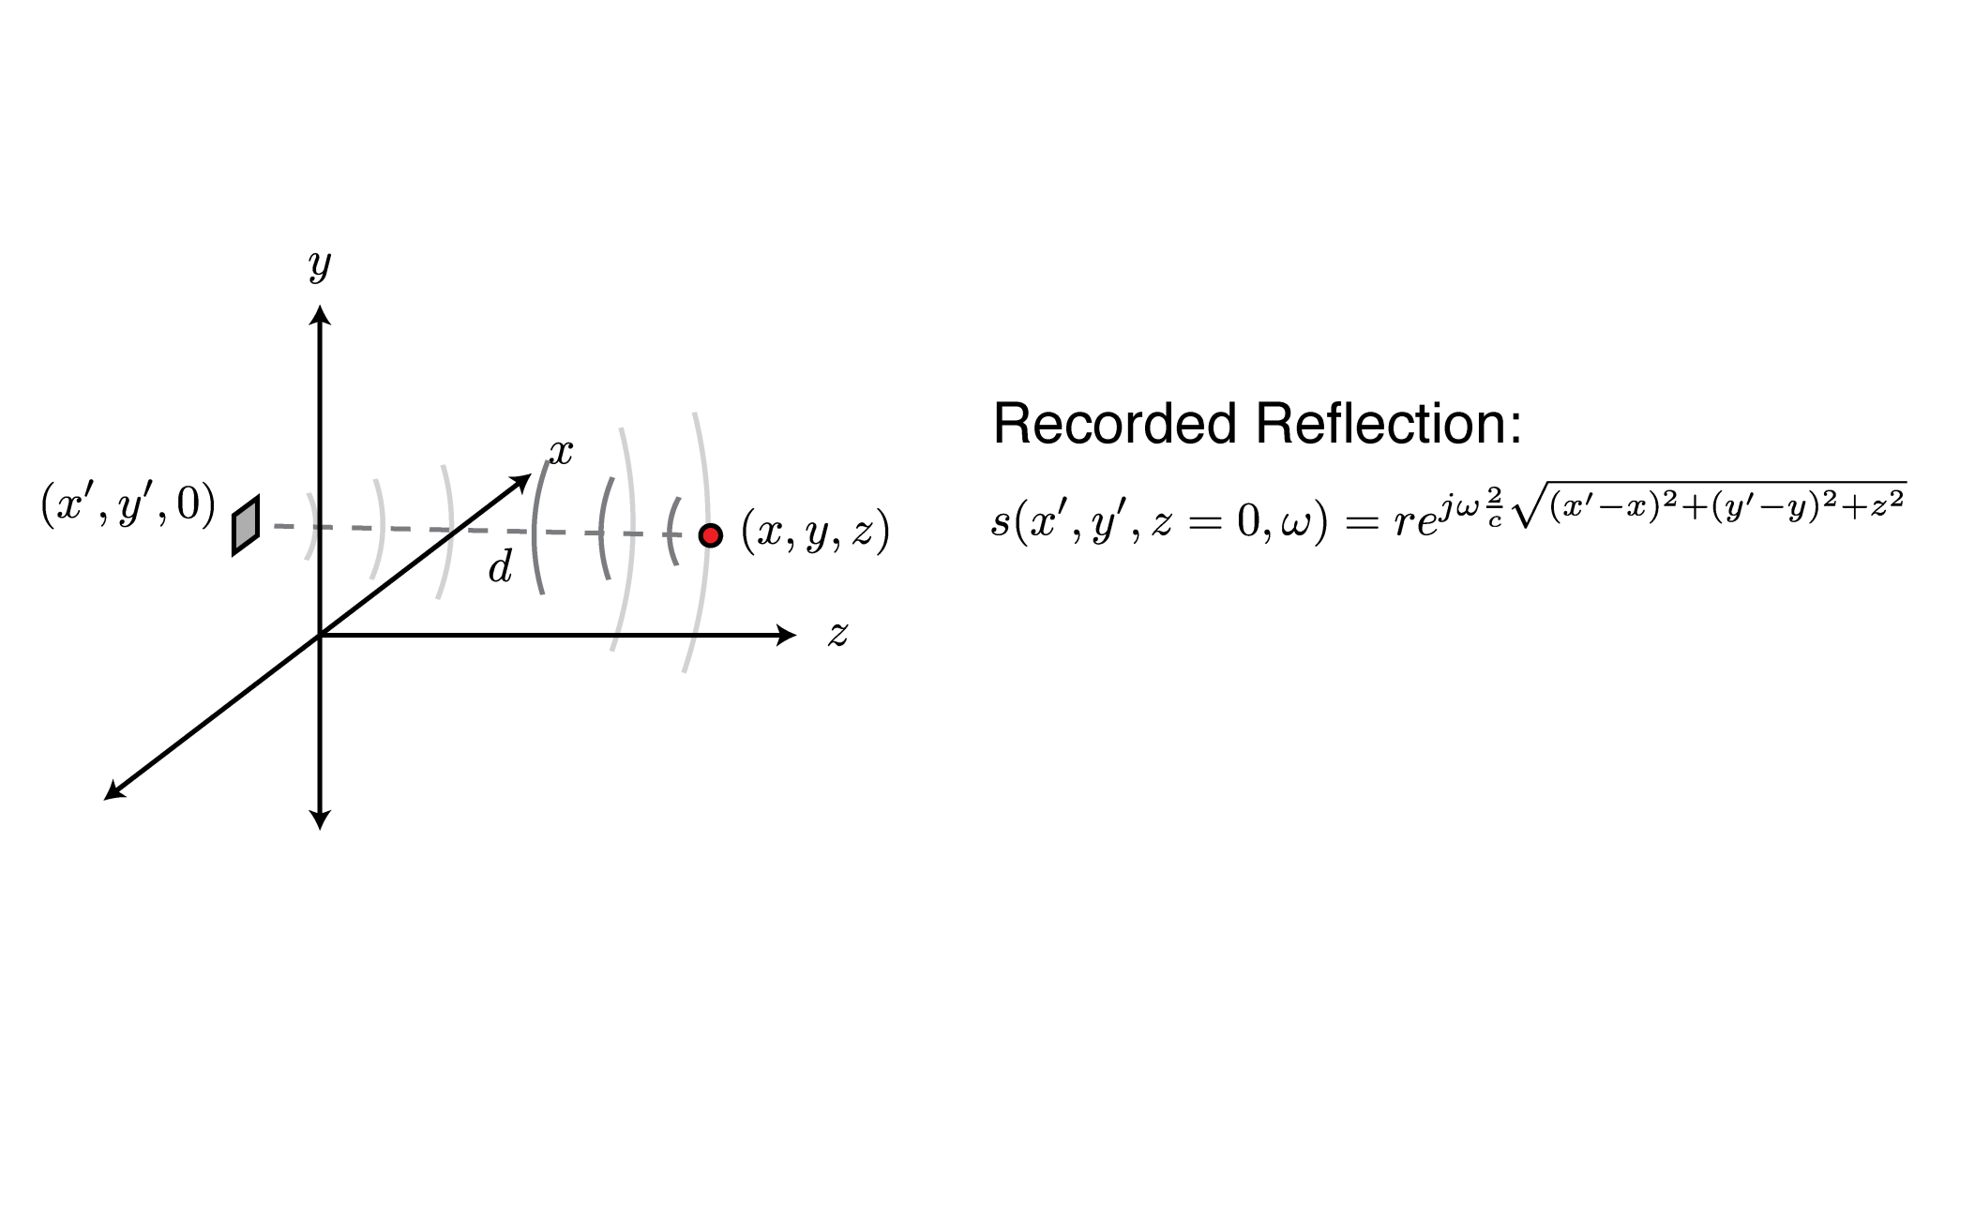
How it Works

Slide 10
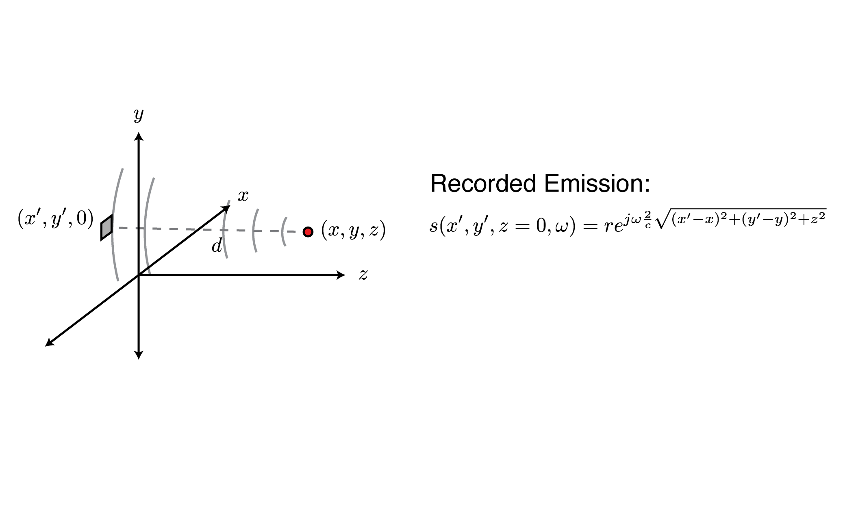
How it Works

Slide 11
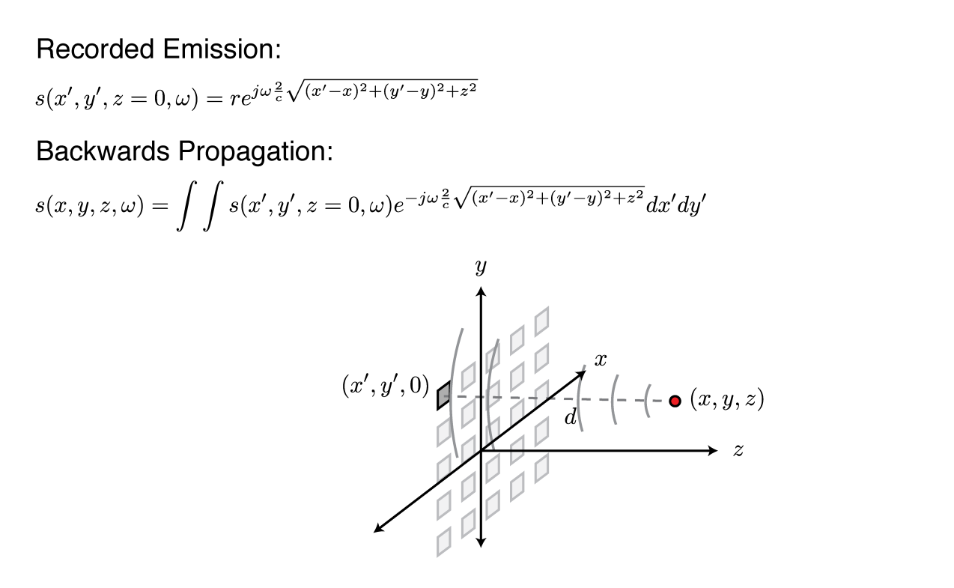
How it Works

Slide 12
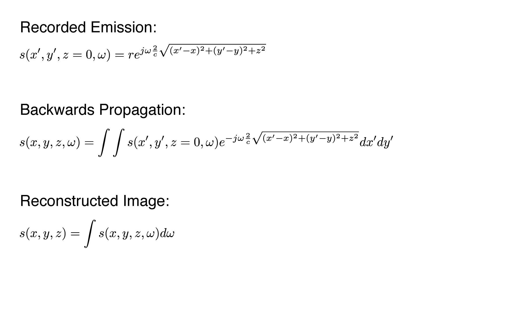
How it Works

Slide 13
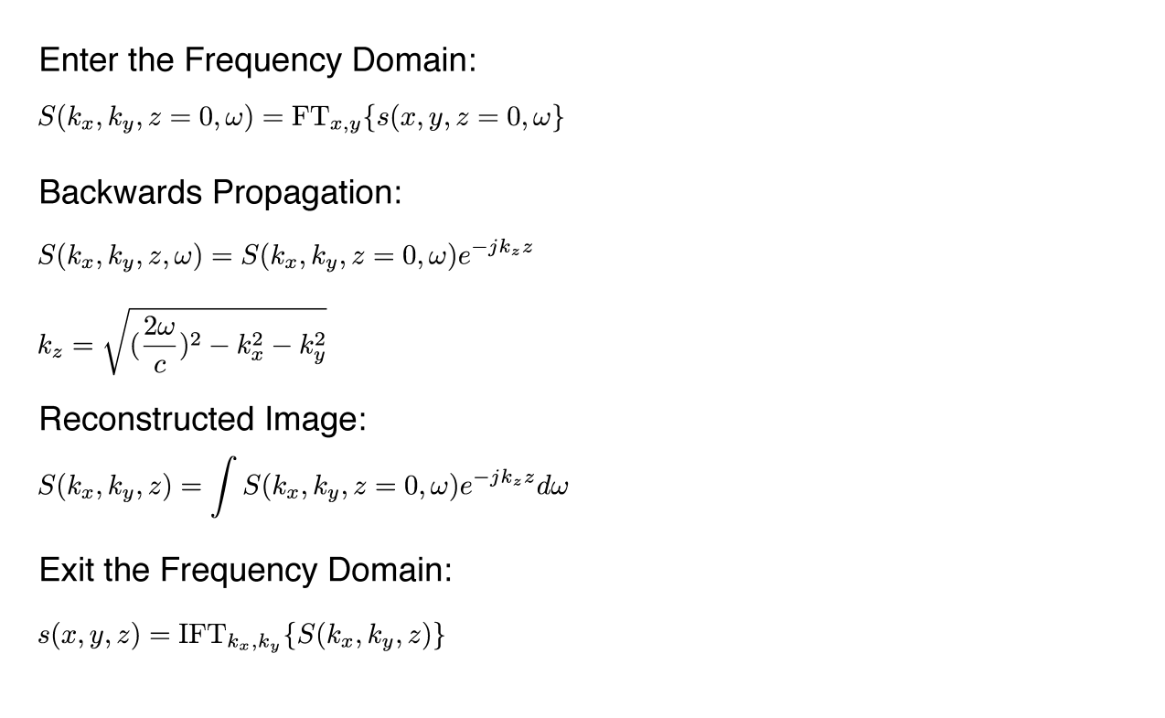
How it Works

Slide 14
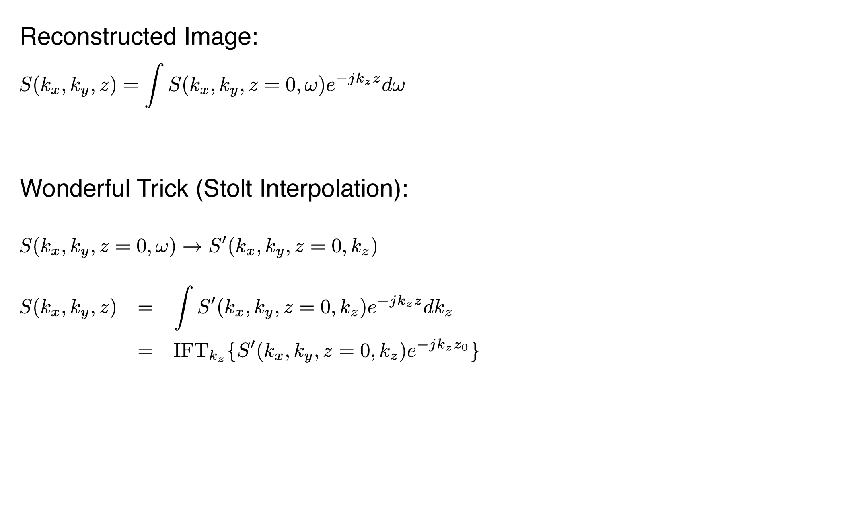
How it Works

Slide 15
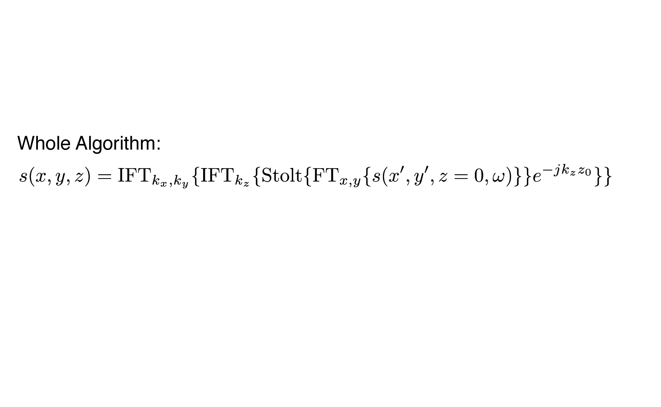
How it Works

Slide 16
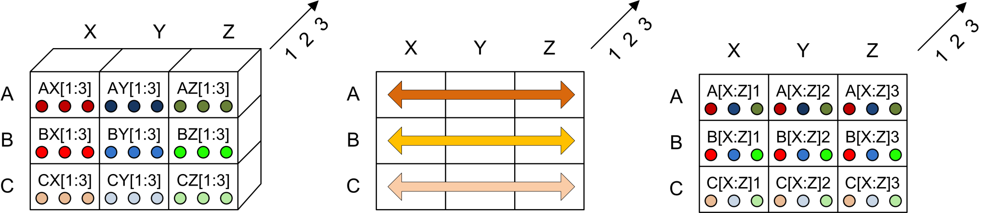
The Row-wise Transpose
Before Transpose
After Transpose
Each processor sends its local data to all other processors in the row.
Each node extracts data and forwards after each hop.
Requires N hops to perform full transpose.

Slide 17
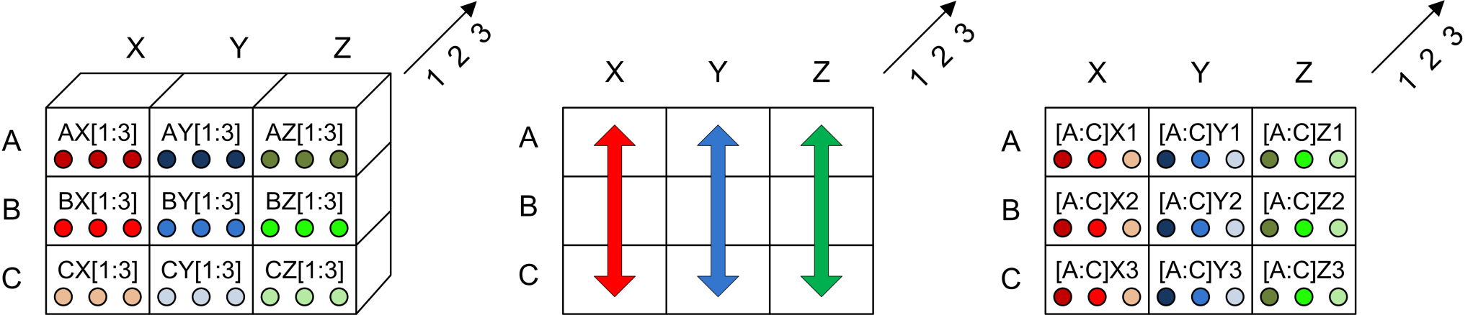
The Column-wise Transpose
Before Transpose
After Transpose
Each processor sends its local data to all other processors in the column.
Each node extracts data and forwards after each hop.
Requires N hops to perform full transpose.

Slide 18
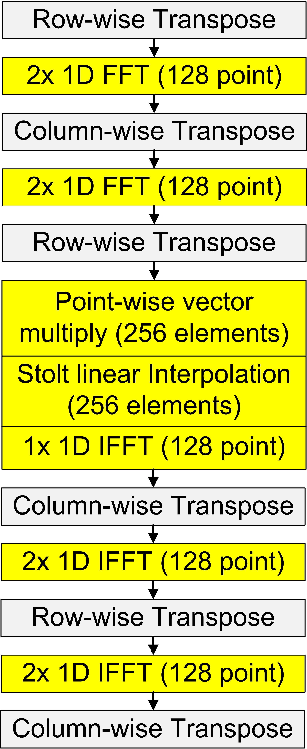
The 3D Imaging Algorithm
2D FFT
The algorithm that runs on each processor.
Key:
Communication in grey
Computation in yellow
Downwards continuation and Stolt
3D IFFT

Slide 19
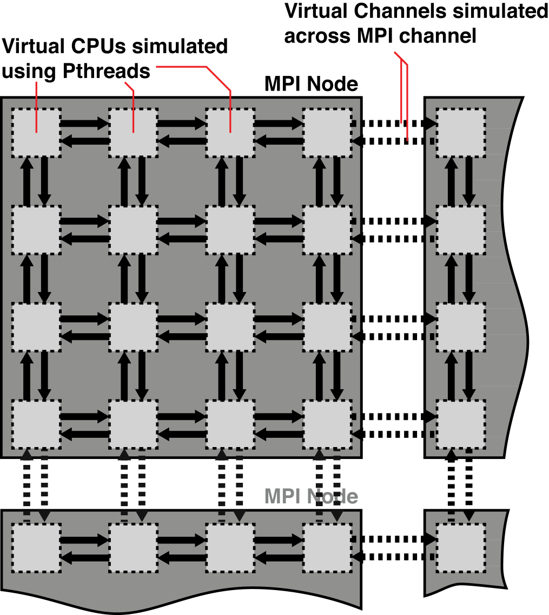
The Functional Simulator
Yadda yadda yadda

Slide 20
Platform for Testing Applications
Yadda yadda yadda

Slide 21
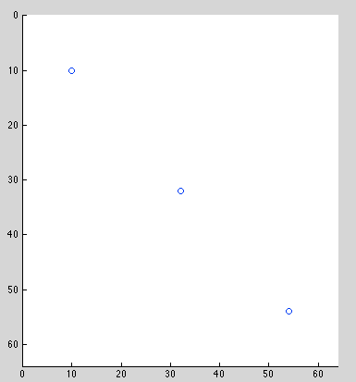
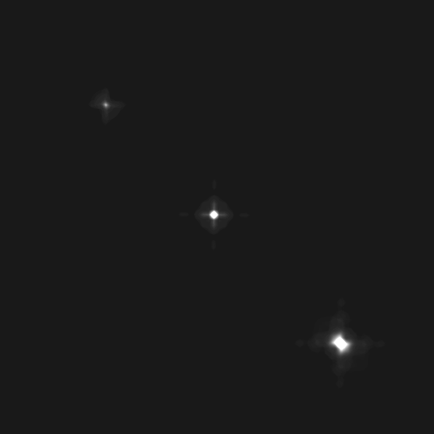
Imaging Results: 3 Points
Yadda yadda yadda
Original Scene
Recovered Scene

Slide 22
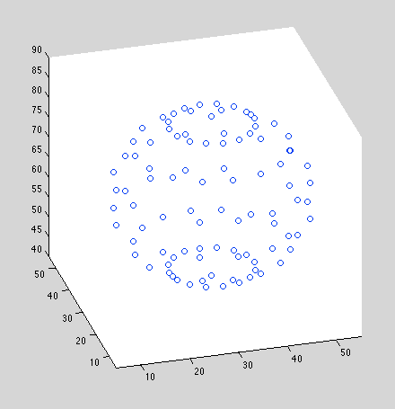
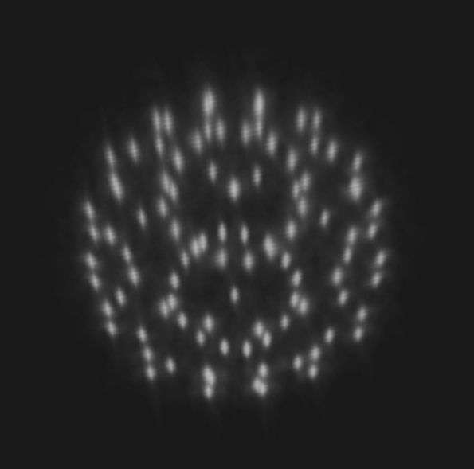
Imaging Results: Sphere
Yadda yadda yadda
Original Scene
Recovered Scene

Slide 23
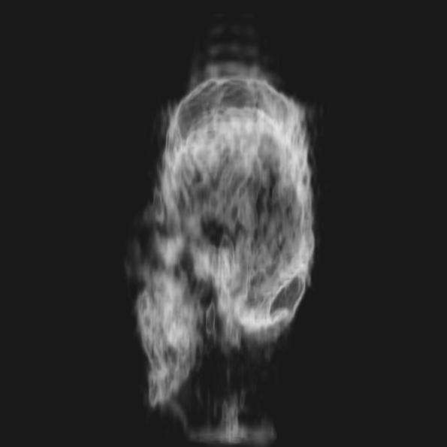
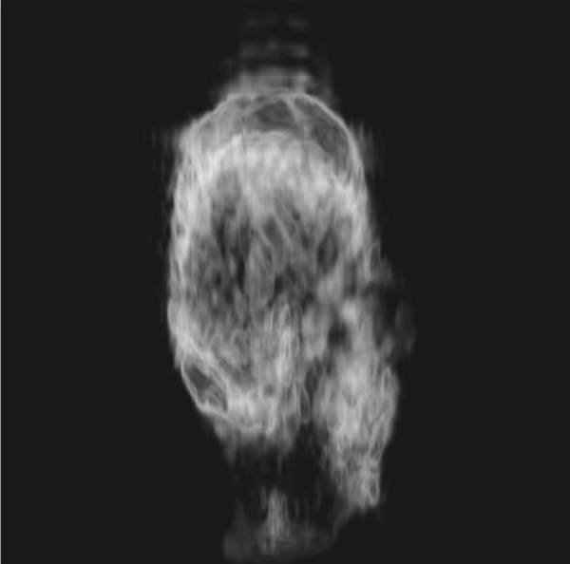
Imaging Results: Human Skull
Yadda yadda yadda
Recovered Scene
Recovered Scene

Slide 24
Timing and Memory Model
Yadda yadda yadda

Slide 25
Network Simulator
Yadda yadda yadda

Slide 26
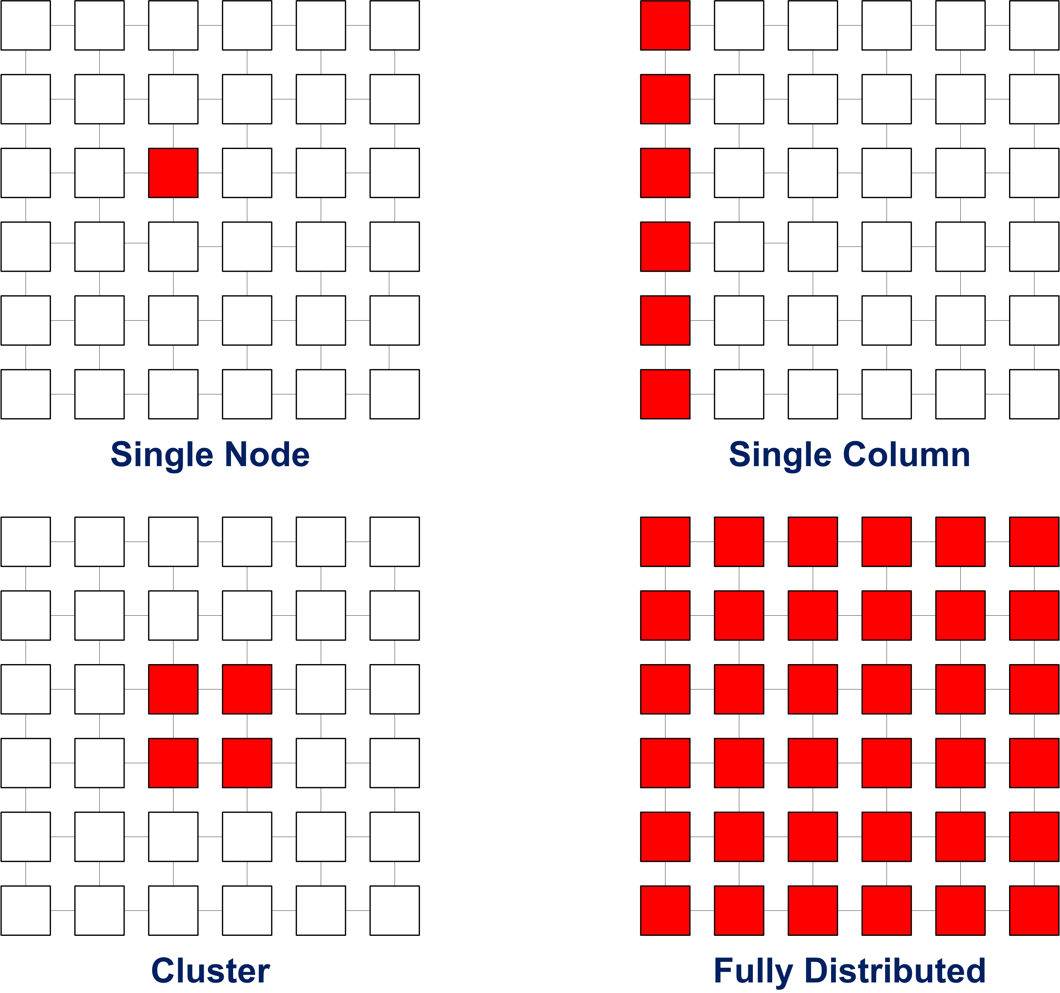
Communication Patterns
Yadda yadda yadda

Slide 27
Communication Patterns: Speed
Yadda yadda yadda

Slide 28
Communication Patterns: Memory
Yadda yadda yadda

Slide 29
Results: x vs Resolution
Yadda yadda yadda

Slide 30
Results: x vs Resolution
Yadda yadda yadda

Slide 31
Results: x vs Resolution
Yadda yadda yadda

Slide 32
Results: x vs Bandwidth
Yadda yadda yadda

Slide 33
Results: x vs Bandwidth
Yadda yadda yadda

Slide 34
Effect of Precomputation
Yadda yadda yadda

Slide 35
Conclusions
Yadda yadda yadda

Slide 36
Future Work
Yadda yadda yadda

