Slide 1
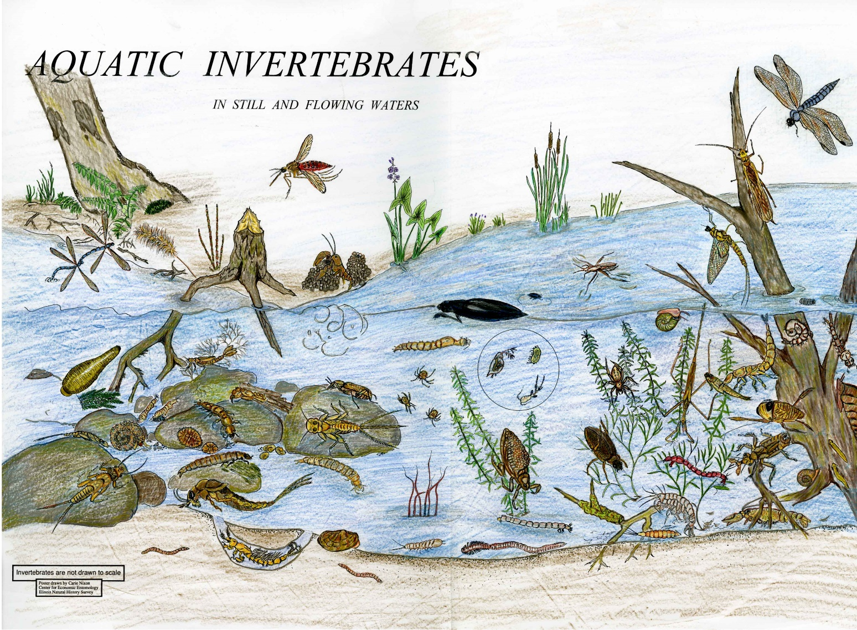
An Introduction to Aquatic Invertebrates
Simon Segar
ssegar@harper-adams.ac.uk

Slide 2
Aquatic invertebrates as indicator species
Aquatic invertebrates are excellent indicators of watershed health because they:
Live in the water for all or most of their life
Stay in areas suitable for their survival
Are easy to collect
Differ in their tolerance to amount and types of pollution; are easy to identify in a laboratory and in the field
Often live for more than one year; and are important components of a streams nutrient and energy system.

Slide 3
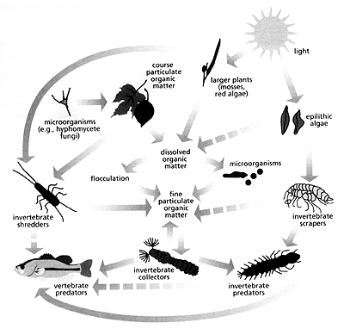
Functional feeding groups
Functional feeding groups are a classification approach that is based on behavioral mechanisms of food acquisition rather than taxonomic group.
The same general behavioral mechanisms in different species can result in the ingestion of a wide range of food items.
The benefit of this method is that instead of hundreds of different taxa to be studied, a small number of groups of organisms can be studied collectively based on the way they function and process energy in the stream ecosystem.
Individuals are categorized based on their mechanisms for obtaining food and the particle size of the food, and not specifically on what they are eating.

Slide 4
Functional feeding groups
This method of analysis avoids the relatively non-informative necessity to classify the majority of aquatic insect taxa as omnivores and it establishes linkages to basic aquatic food resource categories, coarse particulate organic matter (CPOM), and fine particulate organic matter (FPOM), which require different adaptations for their exploitation. The major functional feeding groups are:

Slide 5
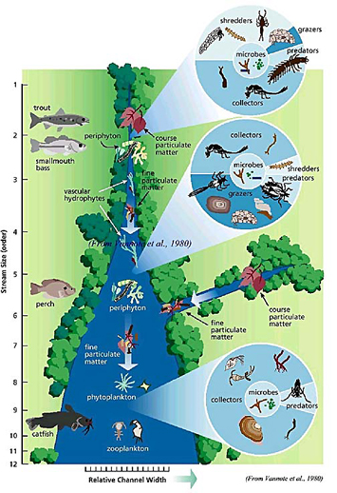
Functional feeding groups
Scrapers (grazers), which consume algae and associated material; shredders, which consume leaf litter or other CPOM, including wood; collectors (gatherers), which collect FPOM from the stream bottom; filterers, which collect FPOM from the water column using a variety of filters; and predators, which feed on other consumers.
A sixth category includes species that do not fit neatly into the other categories such as parasites. It is important to keep in mind, however, that many kinds of invertebrates use a variety of food acquisition methods.

Slide 6
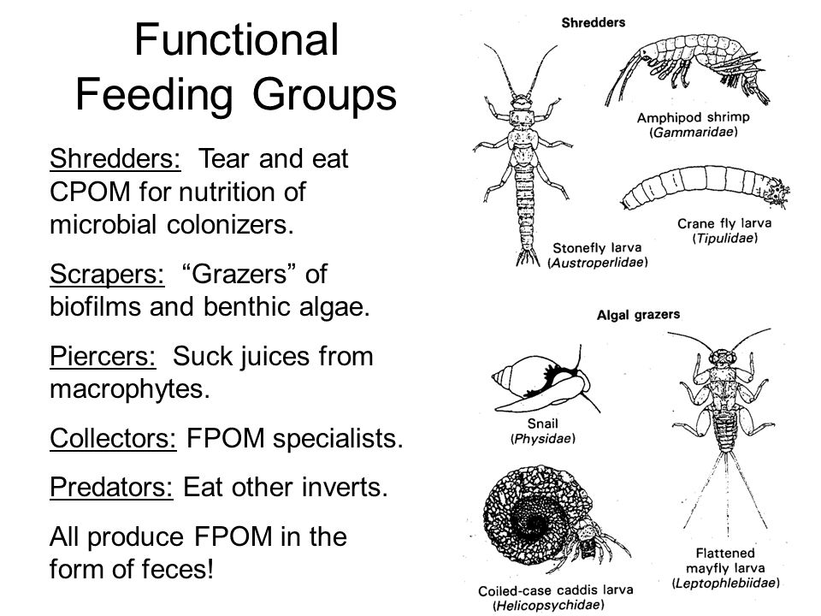

Slide 7
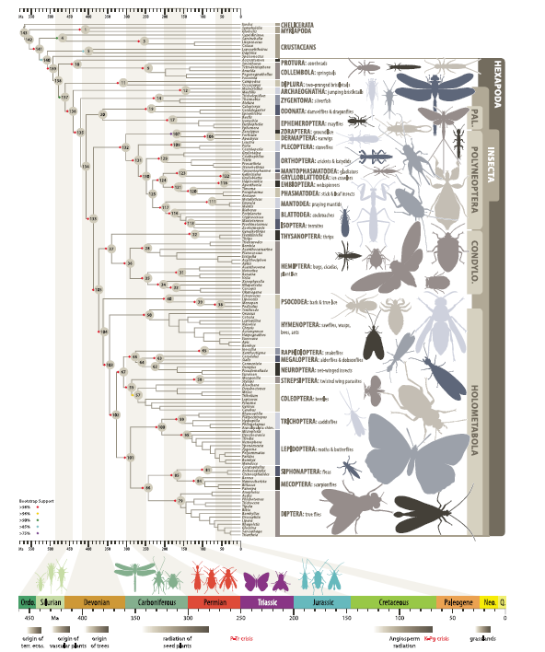

Slide 8
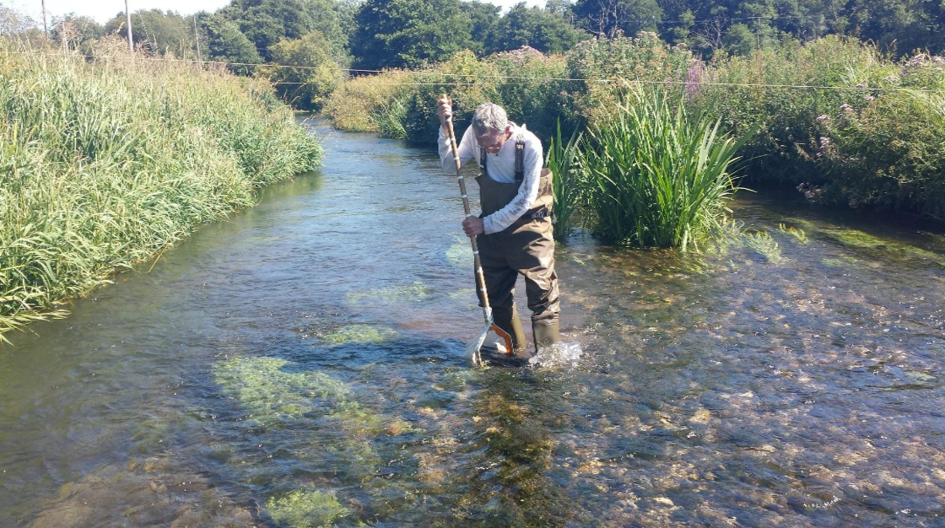
Sampling aquatic invertebrates
Collect samples of invertebrates from the stream using a kick-sampling technique, complimented by visual searching.
At each site the sample should comprise three one minute kicks at different points.
The visual search involves hand-searching by lifting rocks and sifting gravel/leaf litter. Sample at least three locations on the stream

Slide 9
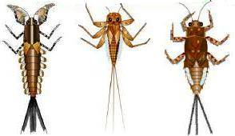
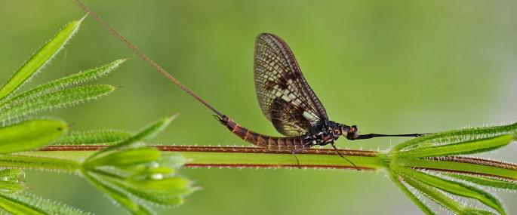
Ephemeroptera (Mayflies): 51 species
Swimming mayflies: 4 families
Clinging/crawling mayflies: 5 families
Burrowing mayflies: 3 families
Wing pads may be present on the thorax; three pairs of segmented legs attach to the thorax; one claw occurs on the end of the segmented legs; gills occur on the abdominal segments and are attached mainly to the sides of the abdomen, but sometimes extend over the top and bottom of the abdomen.
Gills consist of either flat plates or filaments; three long thin caudal (tails filaments) usually occur at the end of the abdomen, but there may only be two in some kinds.

Slide 10
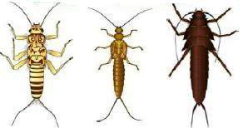
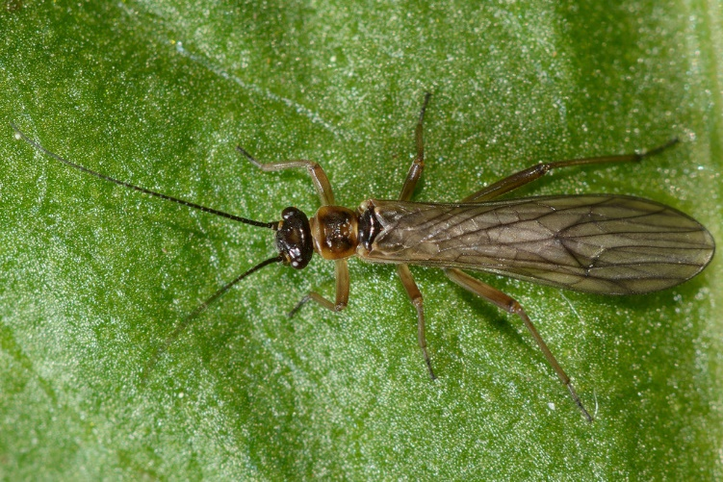
Plecoptera (Stoneflies): 34 species
Winter stoneflies: 3 families
Patterned stoneflies: 3 families
Other stoneflies: 3 families
Long thin antenna project in front of the head; wing pads usually present on the thorax but may only be visible in older larvae; three pairs of segmented legs attach to the thorax; two claws are located at the end of the segmented legs; gills occur on the thorax region, usually on the legs or bottom of the thorax, or there may be no visible gills (usually there are none or very few gills on the abdomen).
Gills are either single or branched filaments; two long thin tails project from the rear of the abdomen. All stoneflies have low-very low (L) tolerance to many pollutants; however, several families are tolerant of slightly acidic conditions.

Slide 11
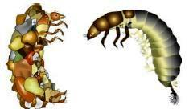
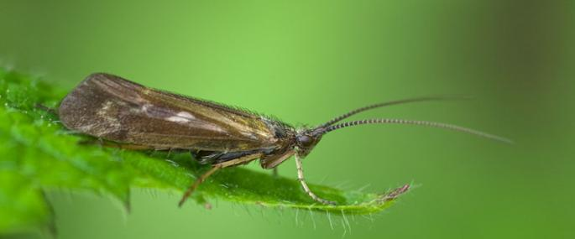
Trichoptera (Caddisflies): 200 species
Net-spinning caddisflies: 4 families
Free-living caddisfly: 1 family
Case-building caddisflies: 11 families
Head has a thick hardened skin; antennae are very short, usually not visible; no wing pads occur on the thorax; top of the first thorax always has a hardened plate and in several families the second and third section of the thorax have a hardened plate; three pairs of segmented legs attach to the thorax; abdomen has a thin soft skin.
Single or branched gills on the abdomen in many families, but some have no visible gills; pair of prolegs with one claw on each, is situated at the end of the abdomen; most families construct various kinds of retreats consisting of a wide variety of materials collected from the streambed.

Slide 12
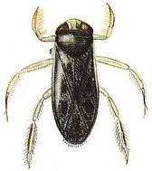
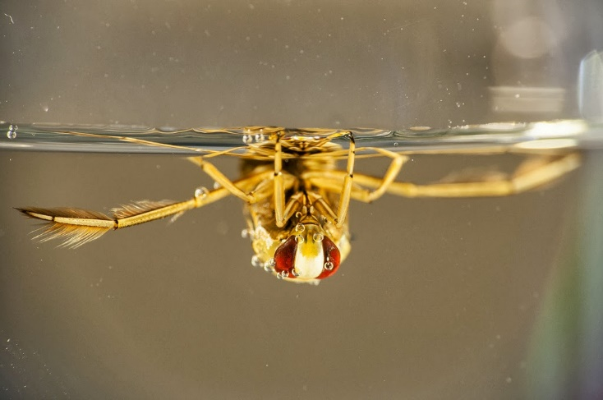
Hemiptera (True Bugs)
Surface: 4 families
Sub-surface: 3 families
The most distinguishing characteristic of the order is the mouthparts that are modified into an elongated, sucking beak. Most adults have hemelytra, which are modified leathery forewings. Some adults and all larvae lack wings; both most mature larvae posses wing pads. Both adults and larvae have three-pairs of segmented legs with two tarsal claws at the end of each leg.
Many families are able to also utilize atmospheric oxygen. This order is generally not used for the biological assessment of flowing waters, due to their ability to use atmospheric oxygen. Several families are described.

Slide 13
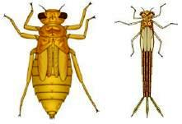
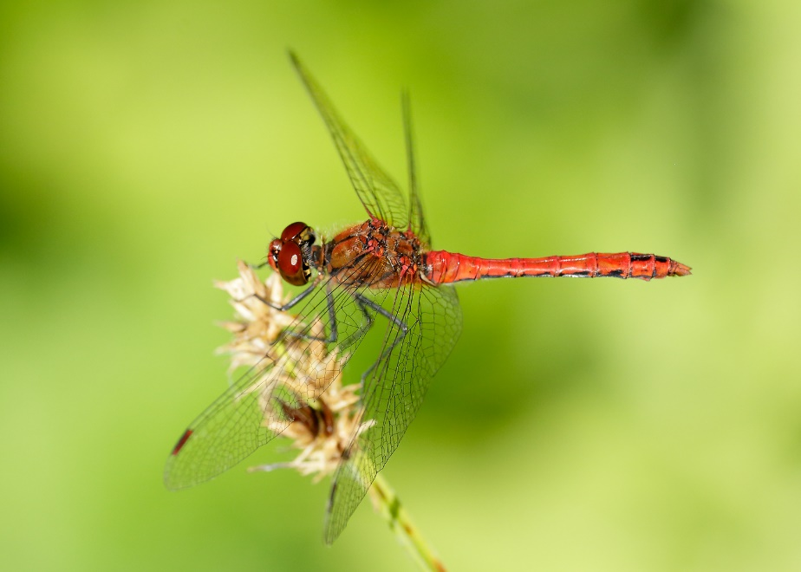
Odonata (Damselflies and Dragonflies): 57 species
Dragonflies (Sub-order Anisoptera): 4 families
Damselflies (Sub-order Zygoptera): 3 families
Dragonflies: Lower lip (labium) is long and elbowed to fold back against the head when not feeding, thus concealing other mouthparts; wing pads are present on the thorax; three pairs of segmented legs attach to the thorax; no gills on the sides of the abdomen; three pointed structures may occur at the end of the abdomen forming a pyramid shaped opening; bodies are long and stout or some- what oval.
Damselflies: Three flat gills at the end of the abdomen forming a tail-like structure and their bodies are long and slender.

Slide 14
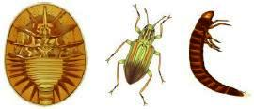
Coleoptera (Beetles)
Coleoptera: 9 families
Head has thick hardened skin; thorax and abdomen of most adult families have moderately hardened skin, several larvae have a soft-skinned abdomen; no wing pads on the thorax in most larvae, but wing pads are usually visible on adults; three pairs of segmented legs attach to the thorax; no structures or projections extent from the sides of the abdomen in most adult families, but some larval stages have flat plates or filaments; no prolegs or long tapering filaments at the end of the abdomen.
Beetles are one of the most diverse the insect groups, but are not as common in aquatic environments.

Slide 15
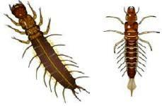
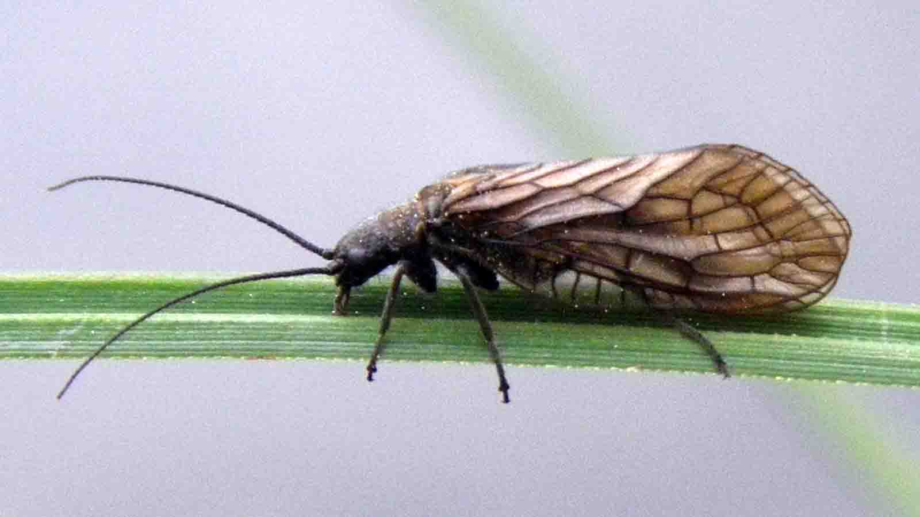
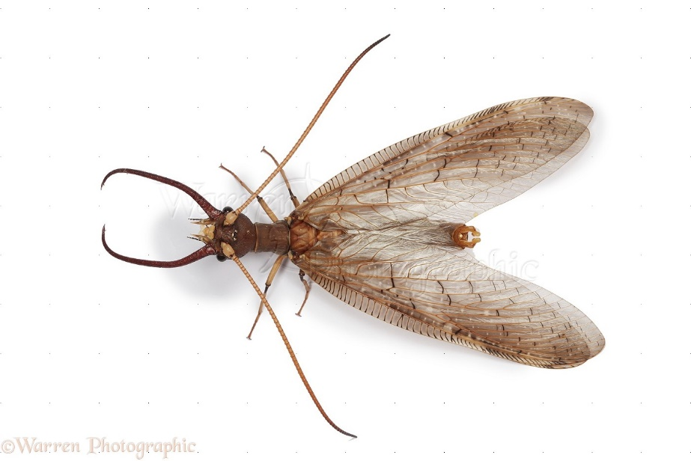
Megaloptera (Hellgrammite, Fishfly and Alderfly): 6 species
Head and thorax has thick hardened skin, while the abdomen has thin soft skin; prominent chewing mouthparts project in front of the head; no wing pads on the thorax; three pairs of segmented legs attach to the thorax; seven or eight pairs of stout tapering filaments extend from the abdomen; end of the abdomen has either a pair of prolegs with two claws on each proleg, or a single long tapering filament with no prolegs.

Slide 16
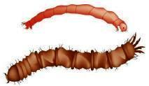
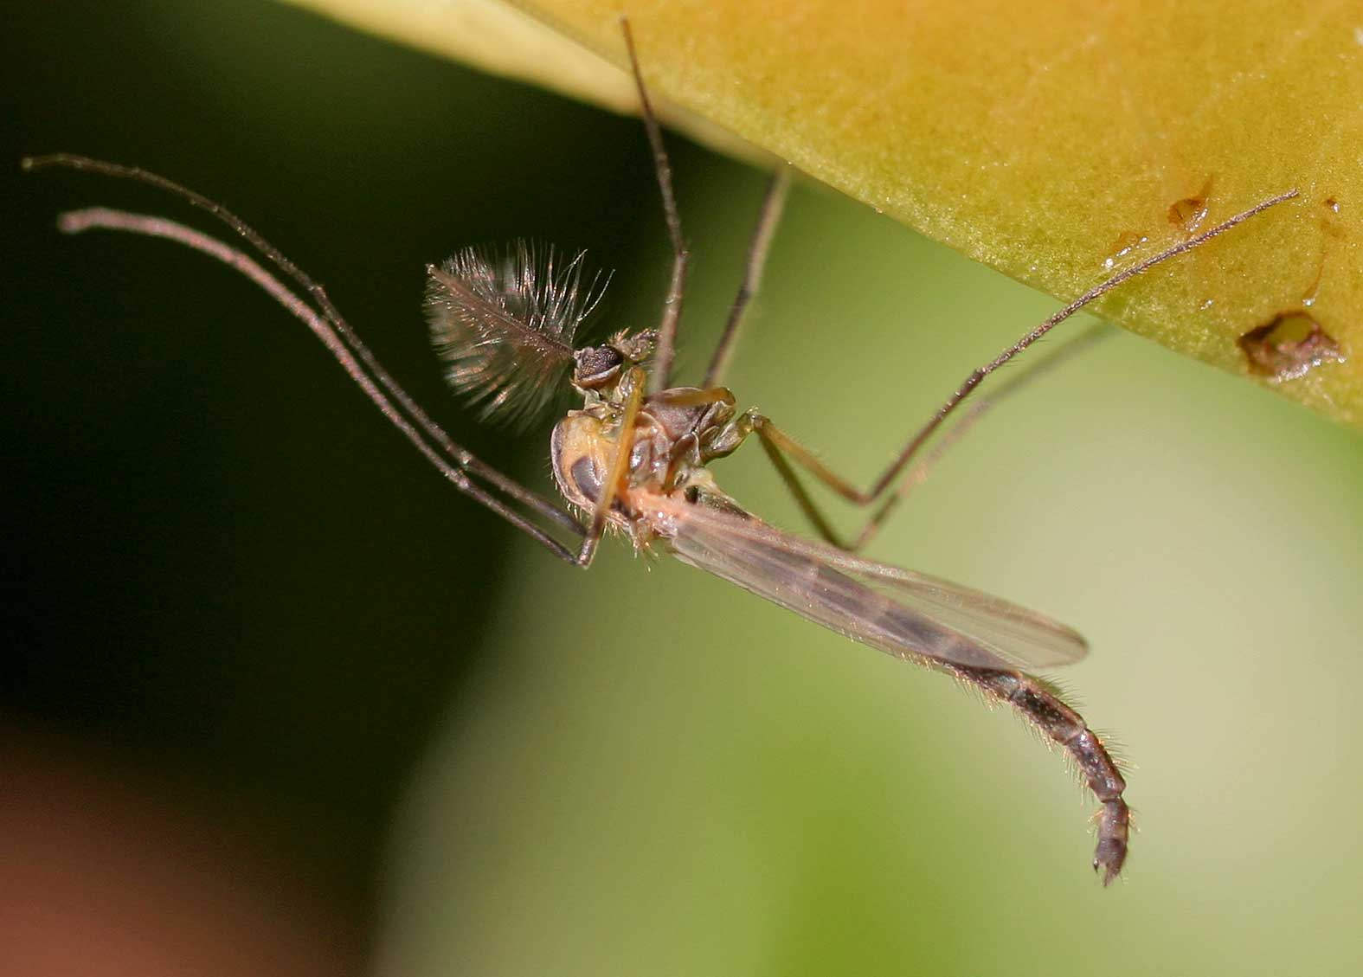
Diptera (True Flies)
Head may be a capsule-like structure with thick hard skin; head may be partially reduced so that it appears to be part of the thorax, or it may be greatly reduced with only the mouthparts visible; no wing pads occur on the thorax; false-legs (pseudo-legs) may extend from various sections of the thorax and abdomen in some families; no segmented legs in the larval forms; thorax and abdomen composed of entirely soft skin, but some families have hardened plates scattered on various body features.
Note: the larval stages do not legs.
Midges/mosquitoes: 6 families
Flies: 9 families

Slide 17
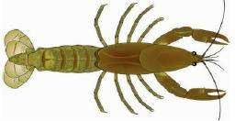
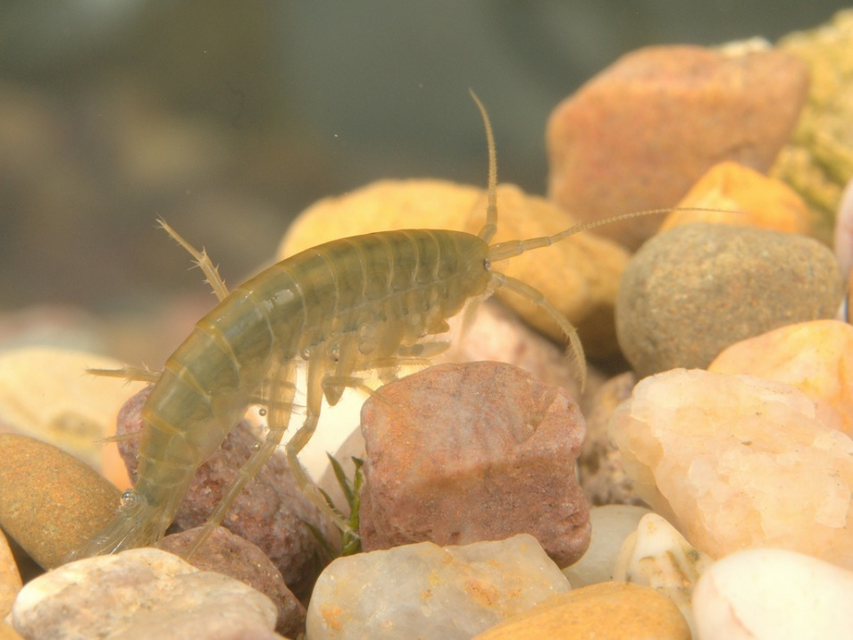
Crustacea (Crayfish, Scuds, Sowbugs etc.)
Amphipoda, Decapoda and Isopoda
More than three pairs of legs (> 6) attached to the thorax; the first several pairs of legs may have a hinged claw, which is often enlarged as in the order Decapoda; bodies strongly flattened from top to bottom or from side to side.
Abdomen consists of individual segments or the segments may be fused to form a thoracic shield; some kinds have a broad flipper on the end of the abdomen.

Slide 18
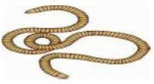
Annelida (Leeches and Worms)
Leeches: 1 family
Worms: 3 families
Body is soft, muscular and cylindrical in shape; body consists of many similar, round ring-like segments arranged in rows; numerous segments along the entire length, number often depends upon the order or family.
Leeches have distinct suckers situated on the bottom of the body, one at the front and one at the rear. All invertebrates within this category have a high tolerance to pollution.

Slide 19

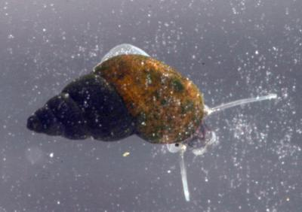
Gastropoda (Snails)
Operculate snails (Sub-class Prosobranchia): 4 families
Non-operculate snails (Sub-class Pulmonata): 3 families
Operculate snails: Flat lid-like structure called an operculum that can seal the body of the snail inside the shell; the whorls of the shell bulge out distinctively to the sides (inflated); most have their opening on the right when the narrow end is held up; shells often extended into a spiral shape. Non-operculate snails: No operculum; the whorls of the shell do not distinctly bulge out to the sides; often the shells of most kinds are shaped like a low flat cone or coiled flat instead of being extended in a spiral shape. Typical size range for most snails is VS-L, which includes the shell.

Slide 20
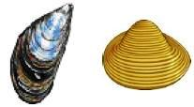
Bivalvia (Clams and Mussels)
Clams: 2 families
Mussels: 2 families
Two shells opposite of each other and strongly connected by a hinged ligament; the shell is thick and strong or thin and fragile in some kinds; growth rings on the shell are either far apart and are distinctly raised, or very close together and hardly raised at all; the foot usually consists of two tubular structures that can often be seen protruding from the shell; the body is soft tissue, often pinkish or gray in color.

Slide 21
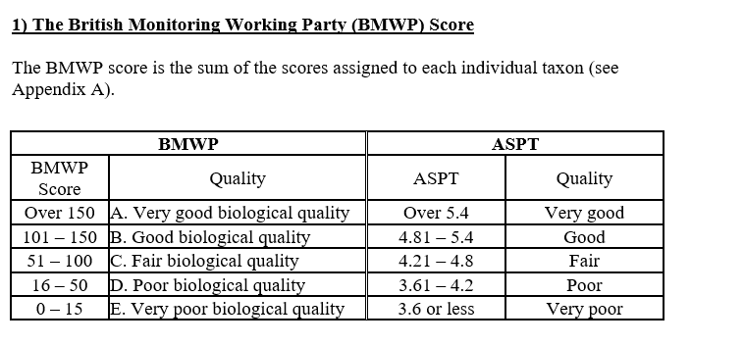
The method is based on the principle that different aquatic invertebrates have different tolerances to pollutants. In the case of BMWP, this is based on the sensitivity/tolerance to organic pollution (i.e. nutrient enrichment that can affect the availability of dissolved oxygen). It is important to recognise that the ranking of sensitivity/tolerance will vary for different kinds of pollution. In the case of BMWP/Organic pollution rankings, the presence of mayflies or stoneflies for instance indicate the cleanest waterways and are given a tolerance score of 10
Biological Integrity

Slide 22
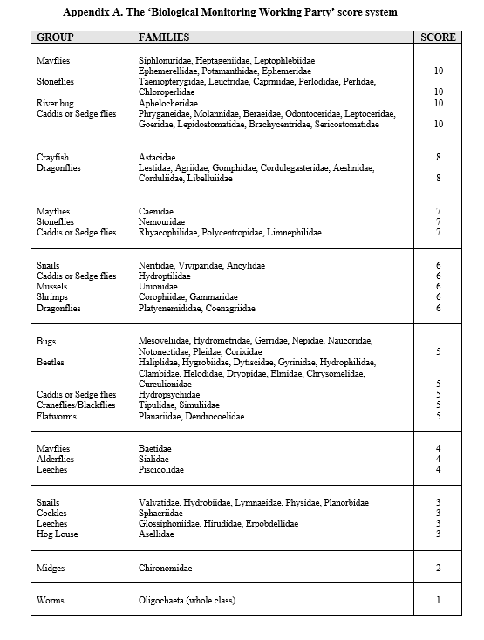

Slide 23
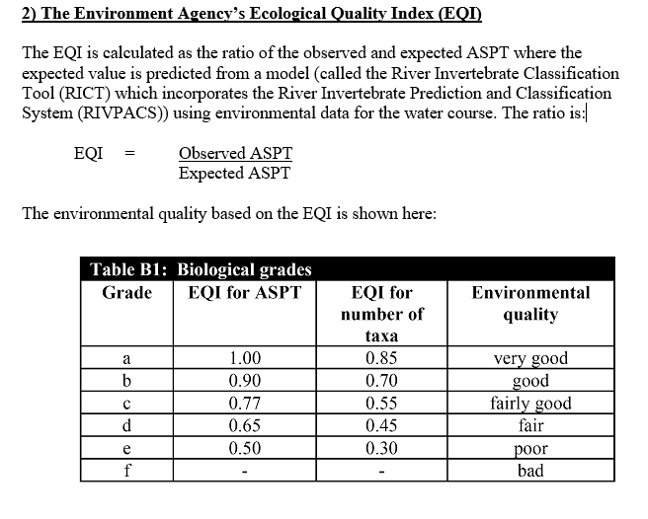
Alternatively, also the Average Score Per Taxon (ASPT) score is calculated. The ASPT equals the average of the tolerance scores of all macroinvertebrate families found, and ranges from 0 to 10.
The main difference between both indices is that ASPT does not depend on the family richness.

Slide 24
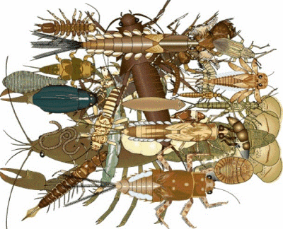
The BMWP score equals the sum of the tolerance scores of all macroinvertebrate families in the sample. A higher BMWP score is considered to reflect a better water quality.

