Slide 1
NERC Entomology Skills Module
A 50 minute crash course in population genetic analysis!
Dr Simon Segar, Jean Jackson Entomology Building: ssegar@harper-adams.ac.uk

Slide 2
Aims
I DO NOT expect you to come out of this session being able to remember equations and calculations
I DO expect you to come out with a greater understanding of research results relating to population genetics
This is about developing a sense of what these indices and statistics mean rather than confusing you with algebra

Slide 3
The software
We will use GenALEx, a freely available Excel plugin designed for research and teaching that comes with a wide range of tutorials and an excellent guide.
Please explore the tutorials and data sets outside of the session if interested
Free software: https://biology-assets.anu.edu.au/GenAlEx/Download.html

Slide 4
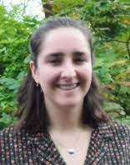
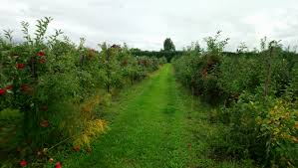
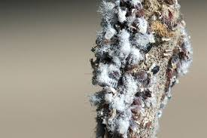
The data
We will use real data from an ongoing research project on woolly apple aphids
Pest of apples (Malus) originating in North America where it also used in elm.
Thought to be asexual in the UK
Sampling throughout its range by Cindayniah Godfrey
Populations
1. Elm Balloon Gall Aphid
2. New Zealand
3. USA
4. USA
5. UK (NIAB EMR)
6. UK (NIAB EMR)
7. UK (NIAB EMR)
10. UK (National Fruit Collection)
11. UK (National Fruit Collection)
12. UK (National Fruit Collection)
14. UK (National Fruit Collection)

Slide 5
Microsatellites
Regions of the genome consisting of multiple repeated units that can vary among individuals:
ATGATGATGATGATGATGATGATGATGATGATG
ATGATGATG
CTCTCTCTCTCTCT
CTCTCTCTCT
CTCTCT
Locus 1, two alleles
Locus 2, three alleles

Slide 6
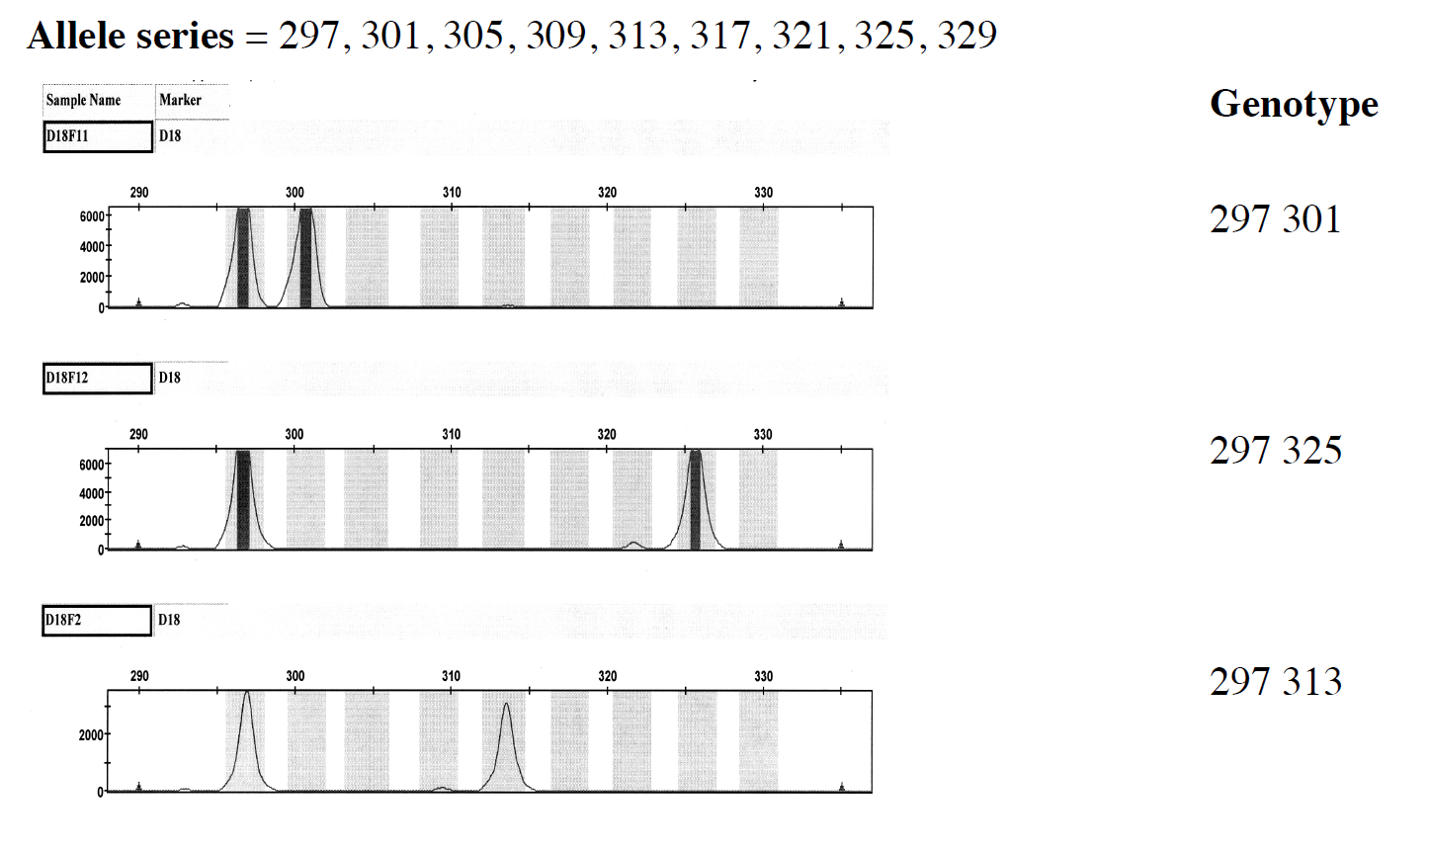
Scoring microsatellites
The allele series and some scored genotypes are illustrated here for a tetra-nucleotide codominant microsatellite or STR locus, D18 with repeat motif [AGAA]n, that is widely used in human forensics.

Slide 7
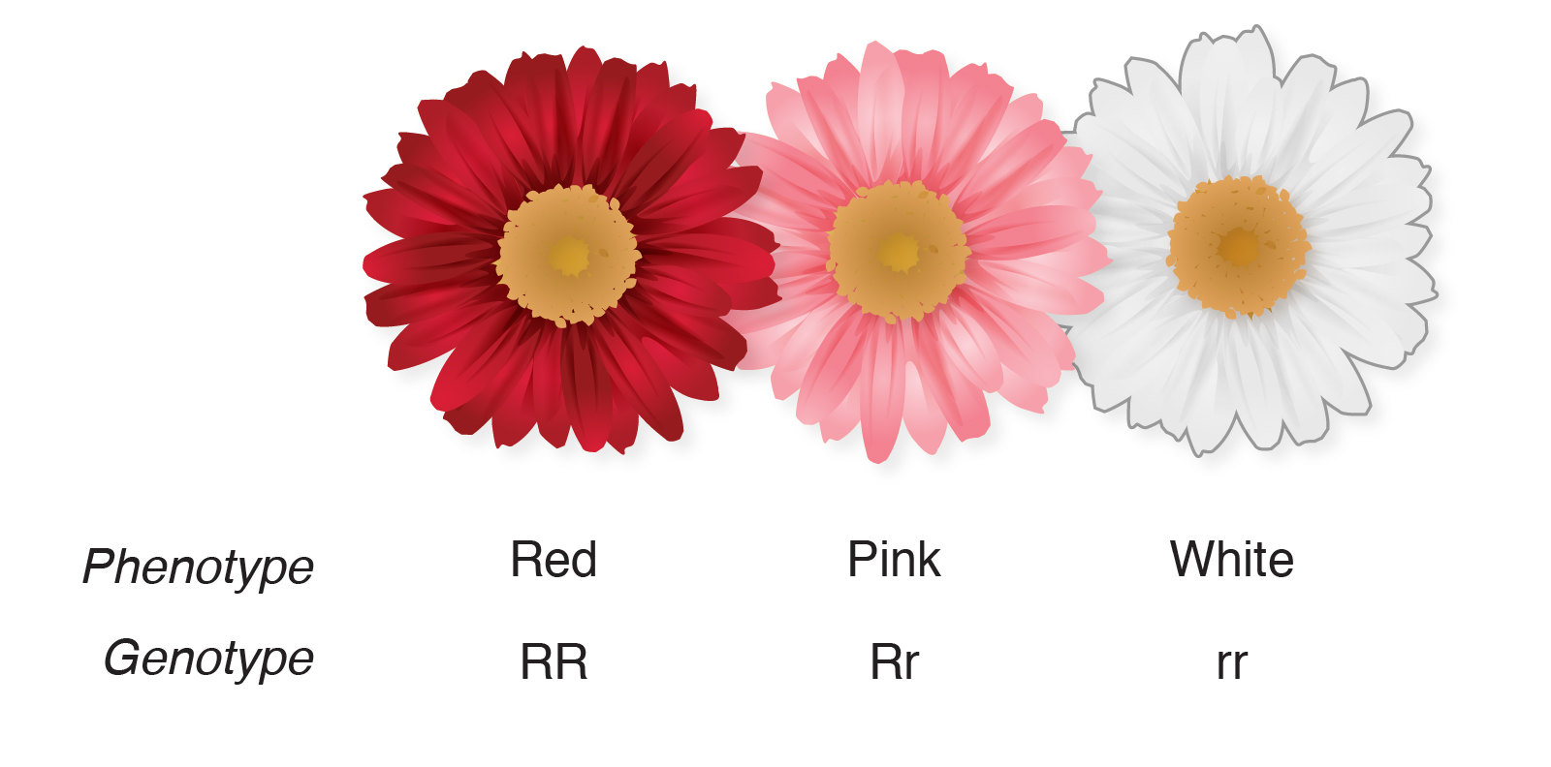
Codominance data
Neither allele is recessive and the phenotypes of both alleles are expressed.
Microsatellite data is codominant

Slide 8
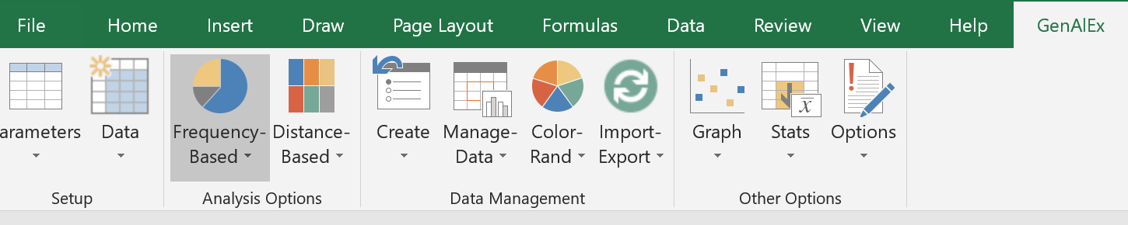
Loading GenALEx
GenALEx is an Excel plugin that can be added in Options > Add-ins
It will be added along the top ribbon in Excel

Slide 9
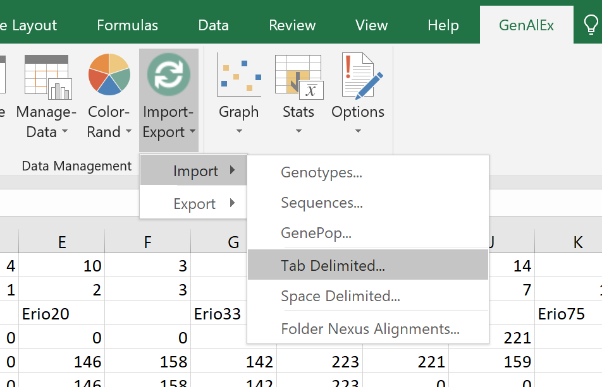
Loading the data

Slide 10
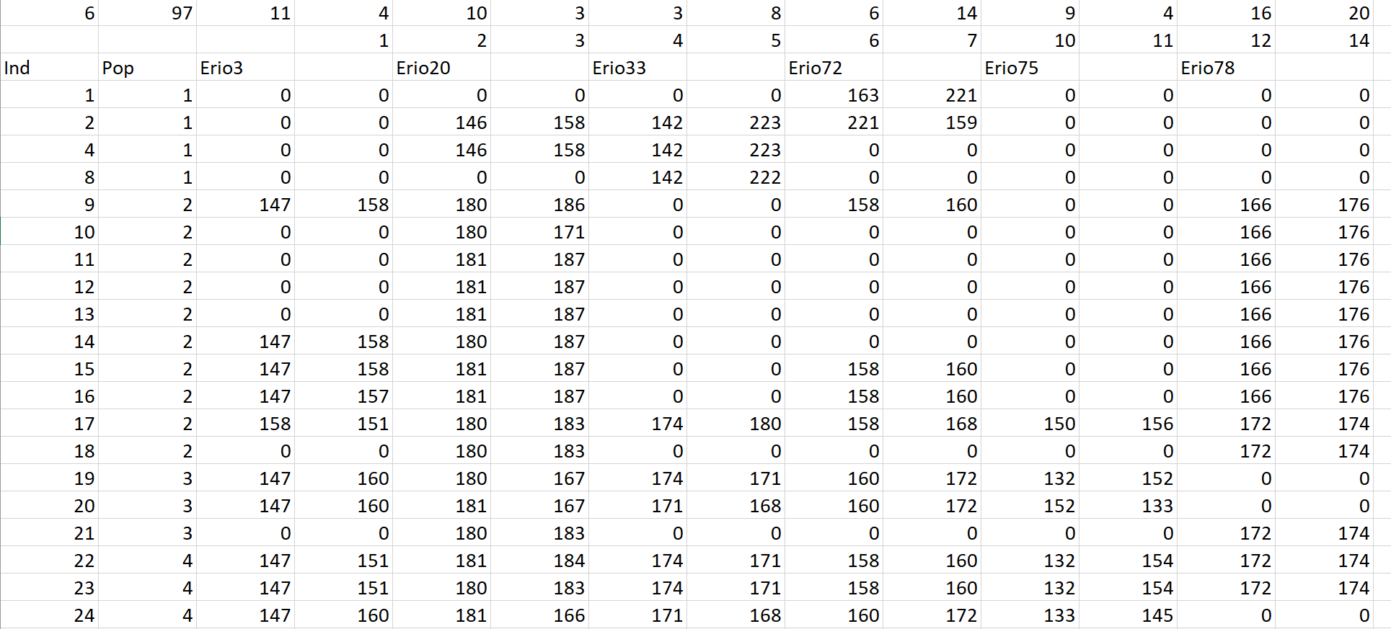
Exploring the data
Populations
Loci
Samples
Individuals per population
This individual is heterozygous for locus Erio3

Slide 11
Statistics based on allele frequency
In these analyses estimates of allele frequencies are the basis for most downstream calculations. For codominant data, frequency-based analyses include F-statistics.
Allele frequency underpins estimations of heterozygosity

Slide 12
Allele Frequency: An example
We will examine a population of aphids with a di-repeat microsatellite marker that has two alleles, 120 and 122. For simplicity, let’s call allele 120 A and allele 122 a. We genotype 100 individuals and find genotype frequencies of AA = 0.25, Aa = 0.5, and aa = 0.25 (check that when summed these genotype frequencies add to one).
We ask the question of whether this population is in Hardy-Weinberg equilibrium. We first need to calculate the p and q (allele frequencies of A and a; note that the A and a are names for the alleles themselves, the p and q refer to the frequencies of those alleles). We calculate the frequencies as follows:
p = p² + (2pq/2) = 0.25 + (0.5/2) = 0.5
q = q² + (2pq/2) = 0.25 + (0.5/2) = 0.5
We see that the allele frequencies sum to one, as required. Using the allele frequencies, we then calculate the expected genotype frequencies:
AA = p² = 0.5 * 0.5 = 0.25
Aa = 2pq = 2 * 0.5 * 0.5 = 0.5
Aa = q² = 0.5 * 0.5 = 0.25
Can test the significance of this difference using a Chi-Square test

Slide 13
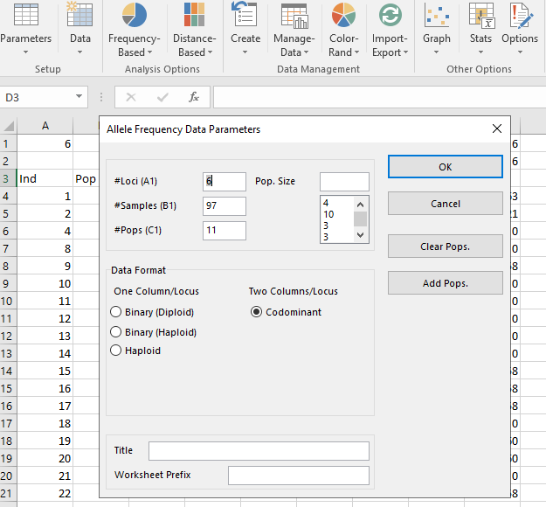
In GeneALEx
Select “Frequency based”
Calculate allele frequencies and inspect output

Slide 14
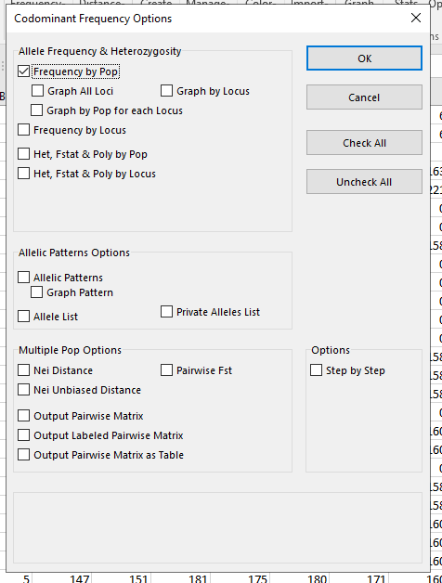

Slide 15
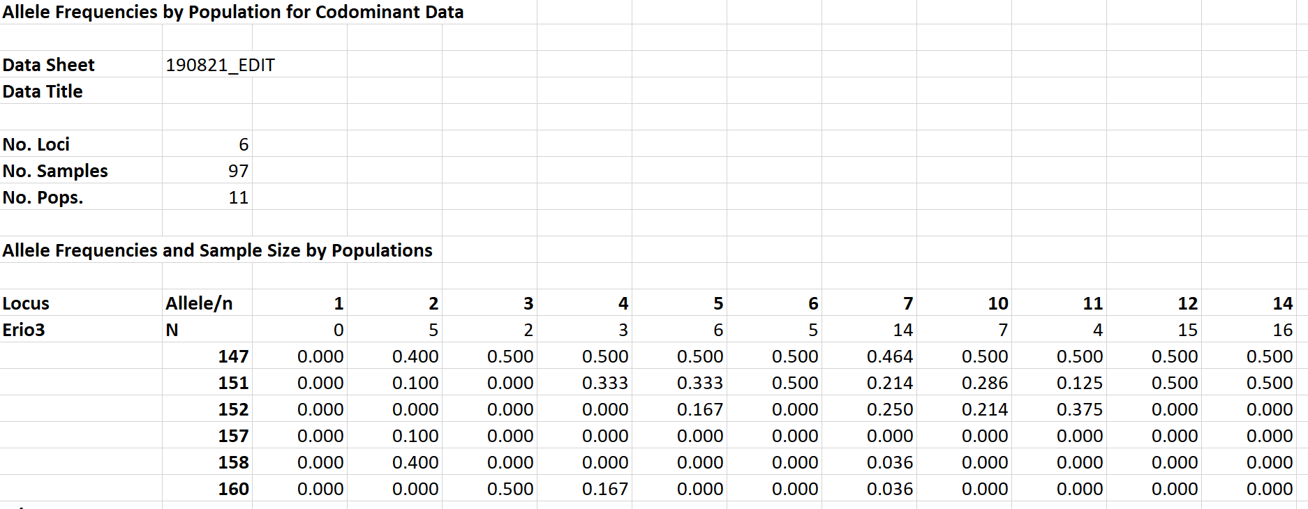

Slide 16
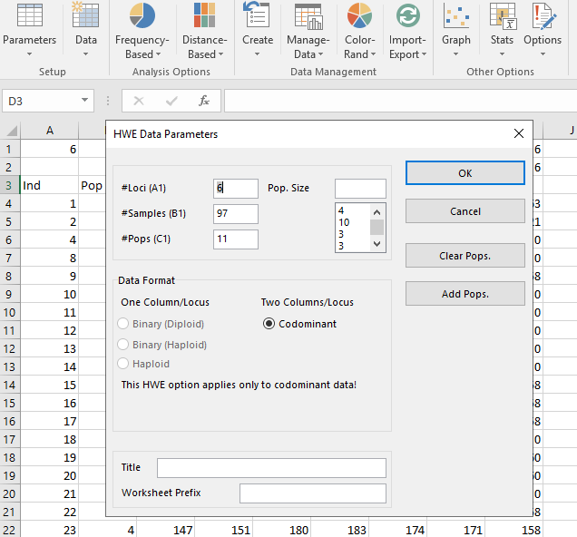
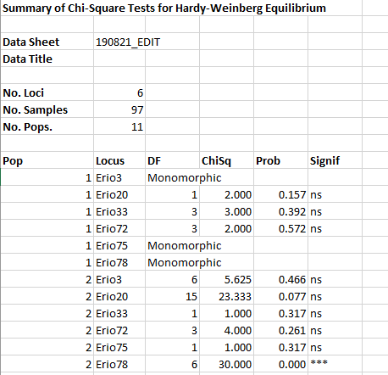
Hardy-Weinberg Equilibrium
Frequency > Disequilibrium > HWE

Slide 17
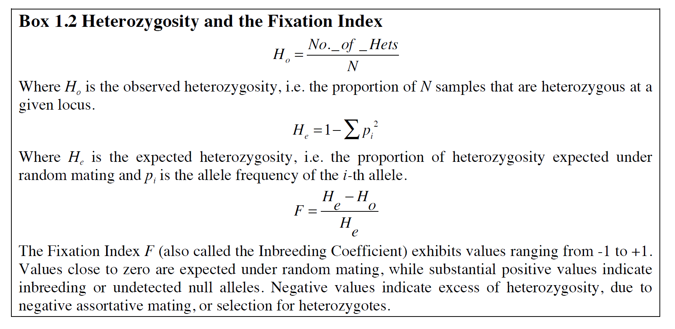
Fixation Index
Where pi is the frequency of the ith of k alleles (two in case of AA, Aa and aa).
The values for heterozygosity (sum of the squared gene frequencies and subtract that from one) are important in determining levels of inbreeding and assortative mating etc. They are also needed for calculations of HWE and Fst etc.

Slide 18
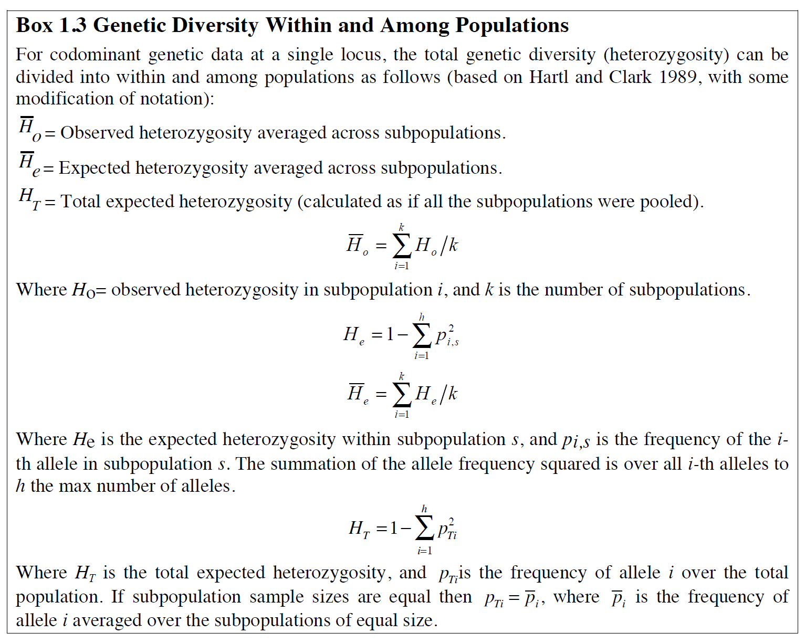
Genetic diversity

Slide 19
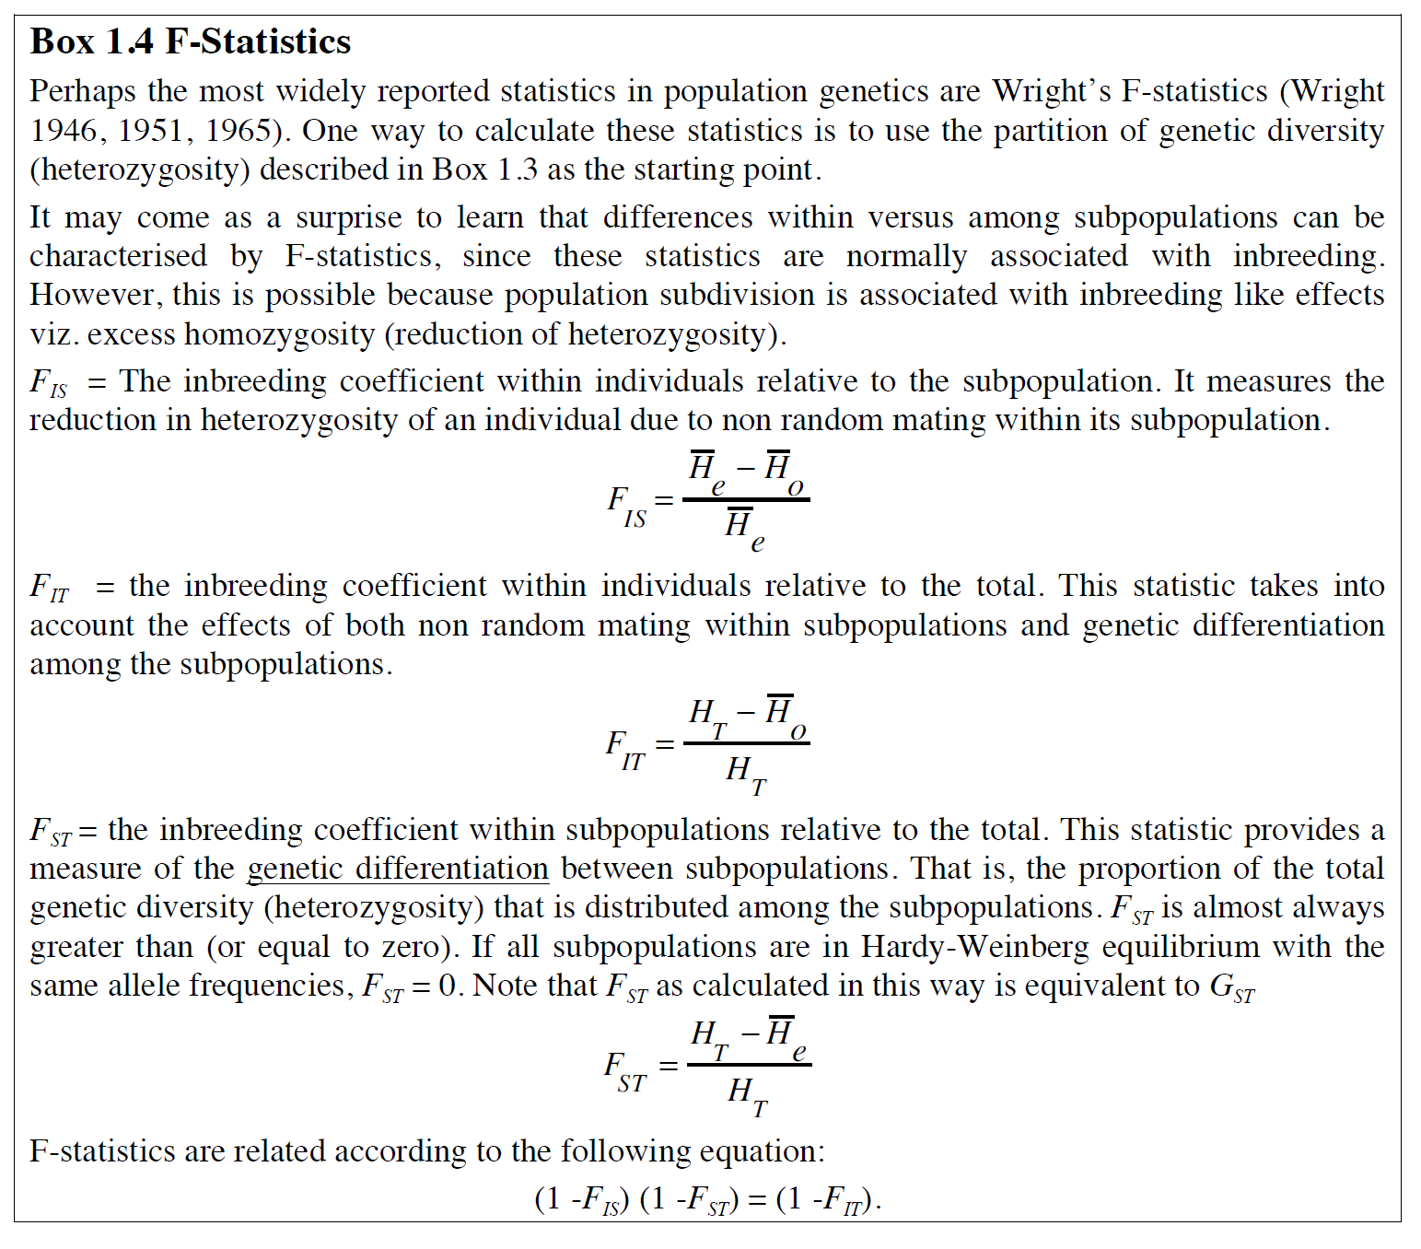
F statistics

Slide 20
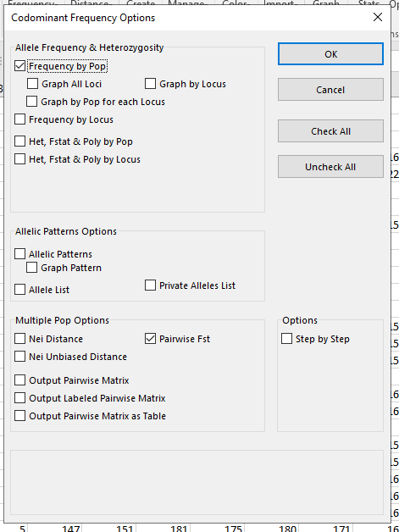
Fst in GeneALEx
Frequency > Frequency > Check “Pairwise Fst” and “Output Pairwise Matrix”

Slide 21
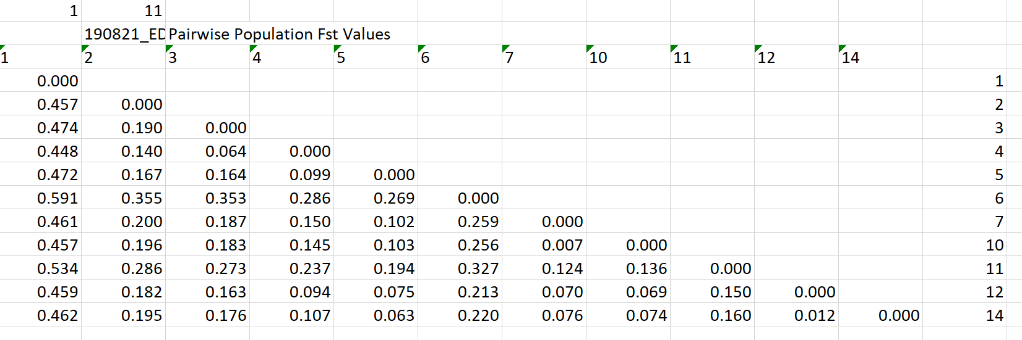
Fst

