Slide 1
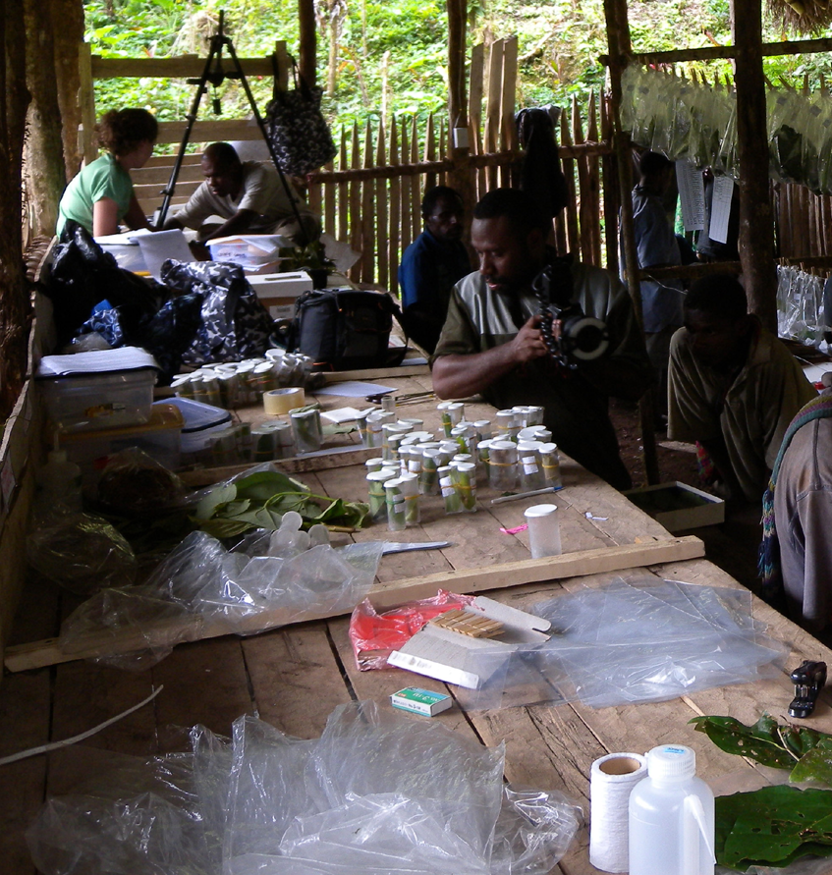
Research Planning
An interactive workshop with some useful tips, tools and lessons from bitter experience along the way!
* Other planning approaches are available!

Slide 2
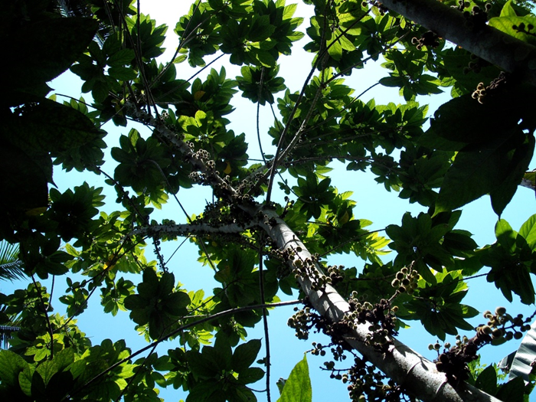
Contents
What’s your project about then?
Where to start, the inter-dimensional nature of the scientific endeavour.
Planning a four-year thesis/project (the 2+1 formula)
Research gaps and how to (try) to fill them
Data collection, how much and when can you stop? Plans and reality (don’t underestimate skills and time needed).
Balancing field work, lab work desk-based tasks.
Hold on, I thought this was about insects?!

Slide 3
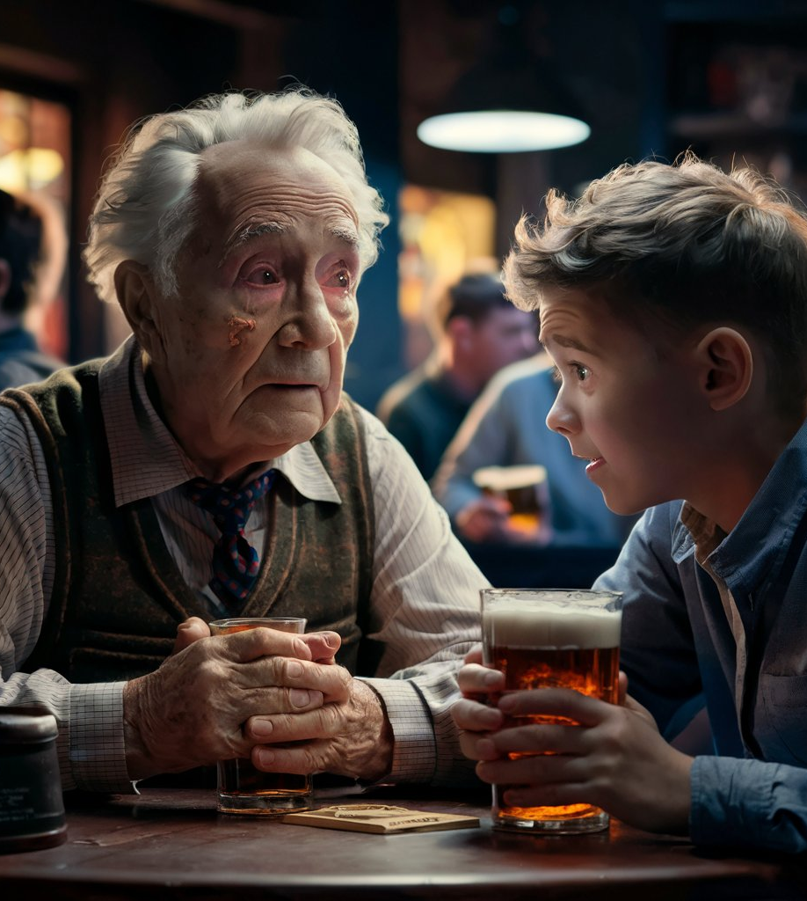

Slide 4
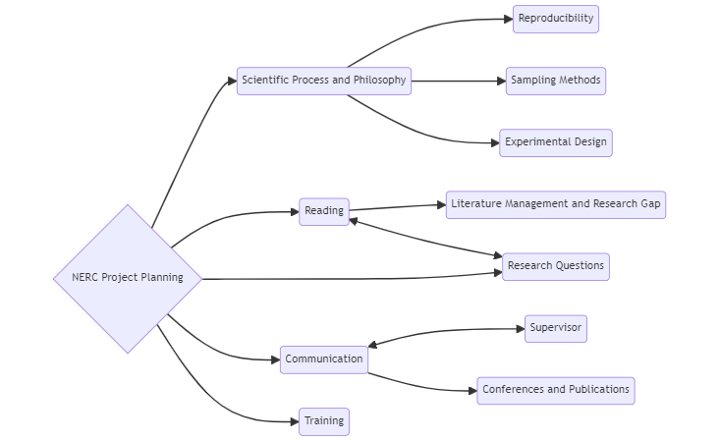
Organising ideas
https://mermaid.live/edit

Slide 5
Mermaid Code
graph LR
A{NERC Project Planning}-->B(Scientific Process and Philosophy)
A-->C(Reading)
A-->D(Research Questions)
A-->E(Communication)
A-->M(Training)
B-->G(Reproducibility)
B-->H(Sampling Methods)
B-->I(Experimental Design)
C-->J(Literature Management and Research Gap)
C<-->D
F(Supervisor)
E<-->F
E-->K(Conferences and Publications)
A-->N(Ethics)
N-->L(Permits and Inclusion)
M-->T(Methods and Techniques)
K-->S(Networking)

Slide 6
The 2+1 Project Formula
Established
Extension
Risky

Slide 7
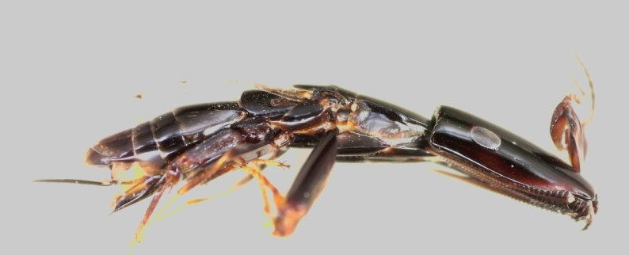
Insects are great I
“Never work solely on rare organisms”
Derek Dunn, 2006. Townsville, Australia.

Slide 8
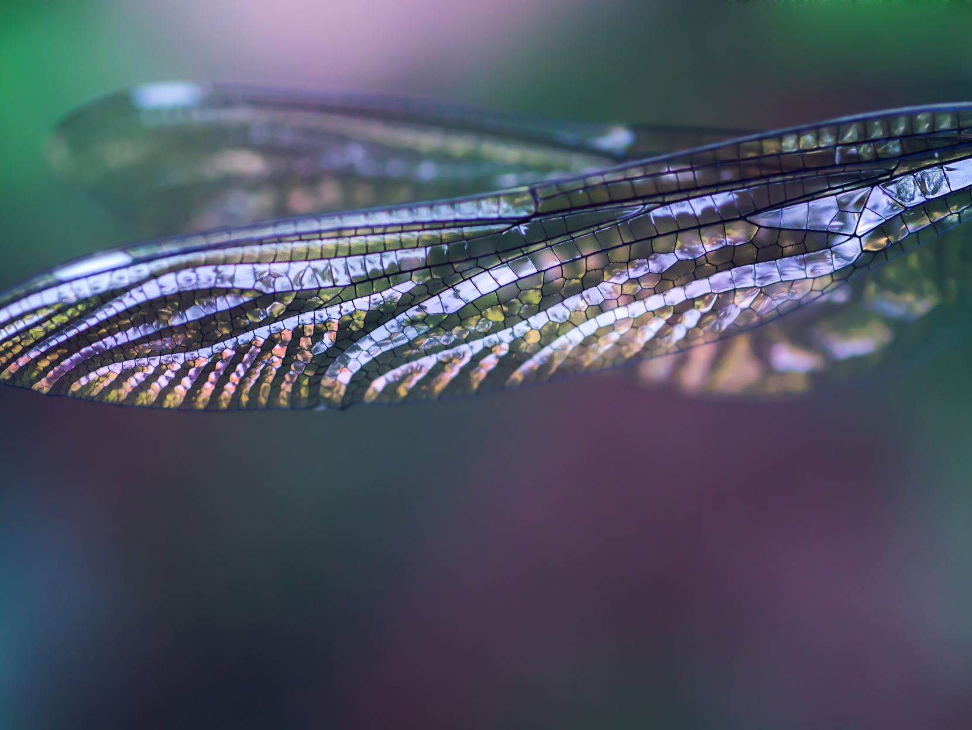
Insects are great II
What are your insects? What are your plans?

Slide 9
Types of data and variables
Community Matrices
Treatment Responses
Molecular data (VCFs, FASTA, FASTQ, .tre, phylip etc.)
Morphological Matrices
More…

Slide 10
Experimental Design and Analysis
Research questions
Variable identification
Hypotheses
Blocking, randomisation and replication
Data storage, reproducible code, transparency, ethics
Repeatability, Replicability, Reproducibility
Data collection (reliability and precision)
Data visualisation
Interpretation
Statistical Analysis

Slide 11
Considerations for the entomologists
Sample sizes
Effort per task
Do plans translate to field work!
Are costs realistic?

Slide 12
Sampling strategies, data collection and statistical power
Data are hard won and valuable, how best to collect yours?
Time management
Logistics (access, time, sampling vs. sample identification)
Optimum sample size
Costs
Ethical considerations
Sampling methods
Insect rearing and maintenance
More…

Slide 13
Sampling methods I
Active Sampling (Flying)
Hand sampling
Pan traps
Sweep Netting
Pheromone traps
Beating
Passive Sampling (Flying)
Light traps
Malaise Trapping
Sticky traps

Slide 14
Sampling methods II
Pitfall traps
Floor dwelling insects
Soil Insects
Tullgren funnels
Aquatic Insects
Deadwood Insects
Kick sampling
Wood baits
Castes
Social insects

Slide 15
A checklist for entomological research
Think broad with your research question, who, ultimately will benefit or be interested beyond your team?
Communicate. Don’t work in isolation and take time to get to know both literature and people (taxonomist are your friends).
Seek training and invest in yourself and others.

Slide 16
What are we aiming for? Theses, publications and jobs.

Slide 17
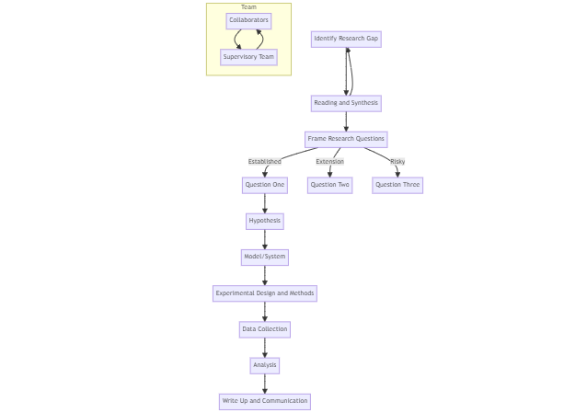

Slide 18
Mermaid Code
flowchart TD
A[Identify Research Gap]-->B[Reading and Synthesis]
B-->A
B --> C[Frame Research Questions]
C -->|Established| D[Question One]
C -->|Extension| E[Question Two]
C -->|Risky| F[Question Three]
G[Supervisory Team]
H[Collaborators]
D-->I[Hypothesis]
I-->J[Model/System]
J-->K[Experimental Design and Methods]
K-->L[Data Collection]
L-->M[Analysis]
M-->N[Write Up and Communication]
subgraph Team
G-->H
H-->G
end

Slide 19
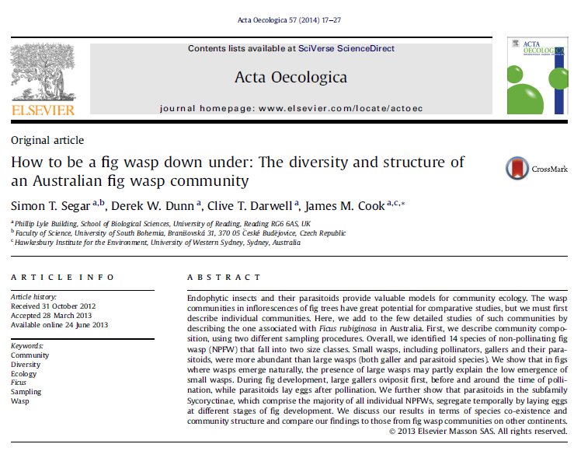
Some examples

