Slide 1
Teaching Mathematics from the outside
Simon Stead

Slide 2
A Little About ME
Simon Stead

Slide 3
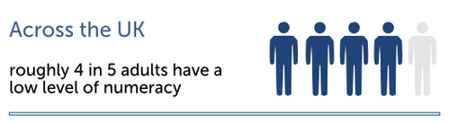
#numeracyproblems

Slide 4
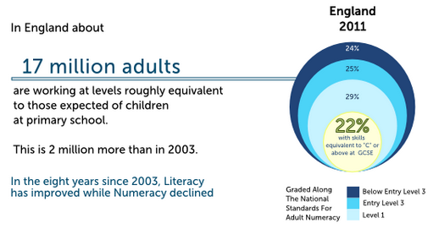
#numeracyproblems

Slide 5
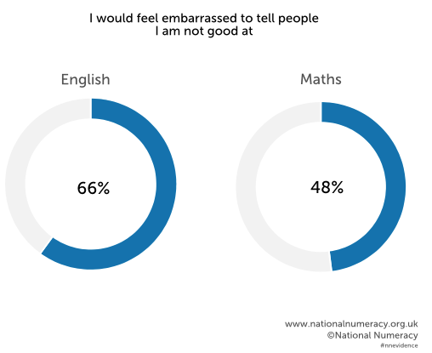
#numeracyproblems

Slide 6
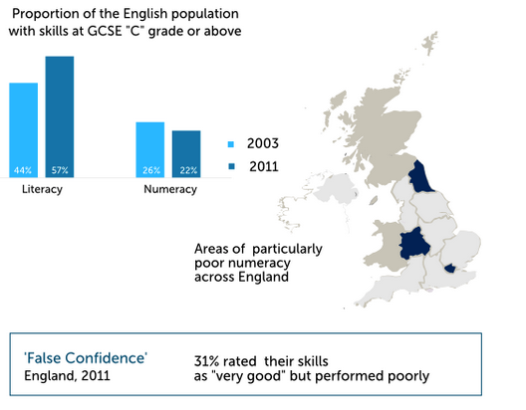
#numeracyproblems

Slide 7
Wait, what?
In 2014, 56% of students achieved A*/A for Further Maths A Level
In 2014, 42.1% of students achieved A*/A for Maths A Level

Slide 8
so what's The problem?
'Maths' is boring.
Exam focused.
Little to no retention of material.
(Children Video)

Slide 9
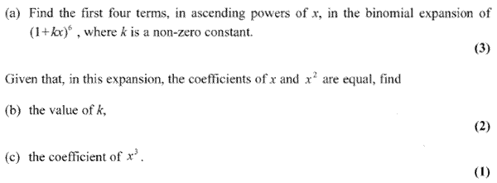
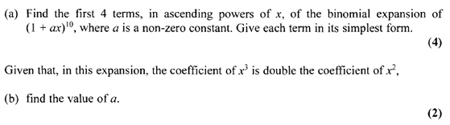
so what's The problem?

Slide 10
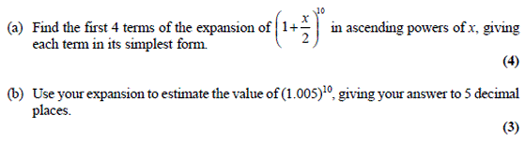
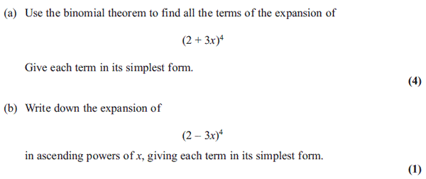
so what's The problem?

Slide 11
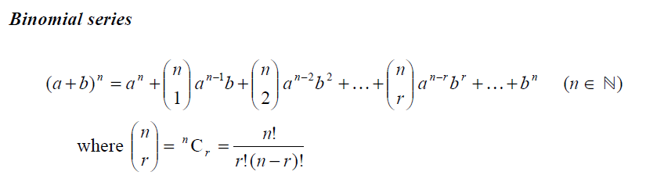
so what's The problem?

Slide 12
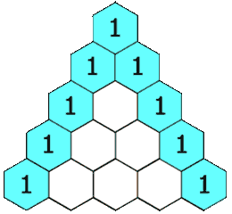
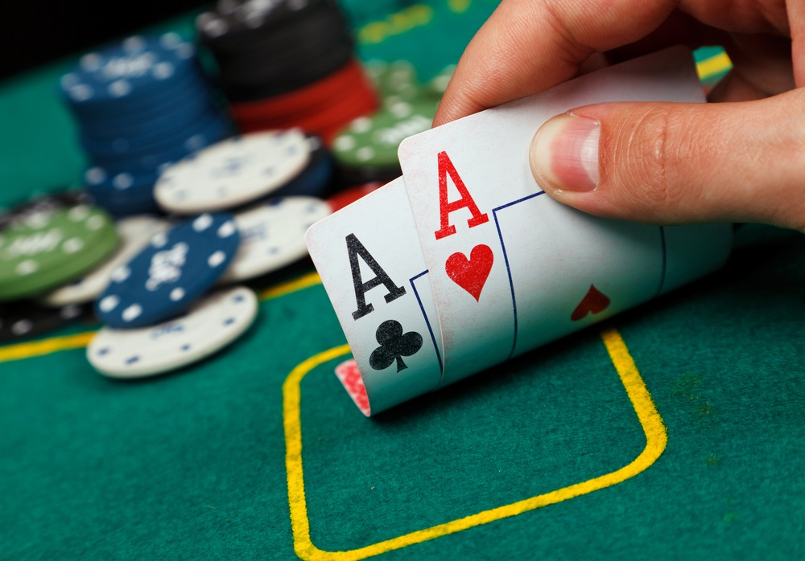
so what's The problem?

Slide 13
What can we do?
Teaching math beyond the basics is useless. You have to teach to curiosity instead.
Confidence is integral to success. (DC video)
Get students talking about maths.
Use technology to engage students.

Slide 14
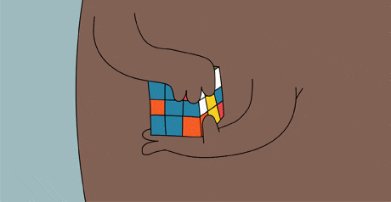

Slide 15


Slide 16
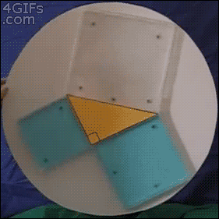

Slide 17
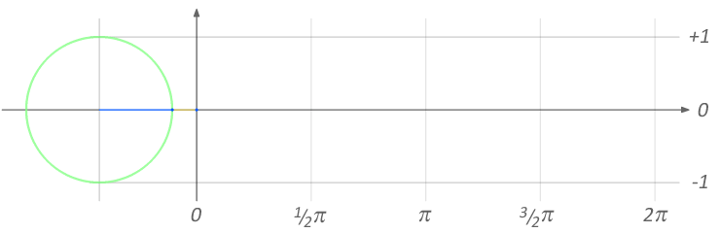

Slide 18
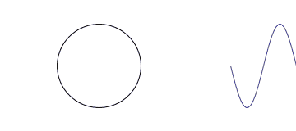

Slide 19
5 Steps to understanding
1. Read the question out loud.

Slide 20
5 Steps to understanding
2. What is the question asking for? What do you need to find?

Slide 21
5 Steps to understanding
3. Without doing any working, how are you going to solve the problem?

Slide 22
5 Steps to understanding
4. Show me how you solve the problem. Explain to me what you're doing as you solve it.

Slide 23
5 Steps to understanding
5. How can you be sure your answer is sensible?

Slide 24
University
'Maths' is boring.
Exam focused.
Little to no retention of material.
...Seem familiar?

Slide 25
University
World class researchers do not necessarily make world class teachers.

Slide 26
University
Lecturers need to undo students' bad habits, and reframe maths in general.

Slide 27
University
Independence of mathematical ideas.
Choosing a path.

Slide 28
Solution?
Curiosity, confidence, technology, talking
Context, history, and sociology of the area.
Seminar style dialogue; a forum.

Slide 29
Conclusion
Everyone is getting a bad deal.
We have the means and ability to change it.

Slide 30
“Type a quote here.”
–Johnny Appleseed

Slide 31
Maths Is MUSIC
Maths is ENVIRONMENTS
Maths is CREATURES
Maths is JAZZ
Maths is not JAZZ

Slide 32
The students are doing their best
The teachers are (mostly) doing their best
Lecturers are doing their best

Slide 33
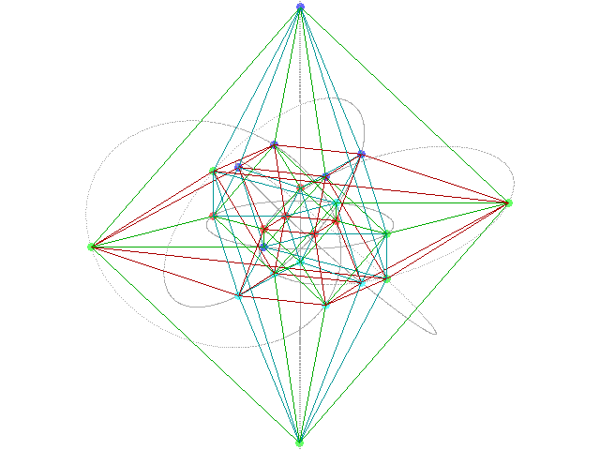
So...

Slide 34
Outline
Children and how they see maths, the Dan Meyer talk
What maths really is, something like zeta function, nice pictures. Environments and creatures. Group theory and children. It's beautiful pictorially, and then groupprops.wiki for more advanced stuff, it's like a game. Rubix Cube?
The relevance of maths obviously needs to be shown.
University, lecturers being great at being mathematicians, sometimes bad at conveying it but usually good. Not knowing how the children are having maths framed (or incapable of helping).
http://www.matematicasvisuales.com/english/html/analysis/seriegeom/seriegeom2.html
The students who aren't going to study maths at uni are getting a shit deal. Those who are are too. FYP "Oh just go read this book" and people getting offended.
It's like one massive culling procedure to really determine if you love it so much.

Slide 35
0-5: Intro, bit about me. No one is doing well at maths. Statistics and that infographic
5-10: Exactly why (a level focus) kids ARE getting good results. (lots of the same question)

Slide 36
Intro:
I am a mathematics tutor, I've grown up living and breathing maths, letting it concepts and techniques be absorbed over the course of my life.
Right now we have the highest pass rate ever for maths A level, and also one of the worst maths literacy rates in the country.
- When I was 5 I sat under the stairs reading Algebra. "it's worthwhile saying how I became interested in mathematics"
- K.A. Stroud, Engineering Mathematics.
Section 1: Consider the set of children going to school. How does this break down into the groups of No uni/not maths at uni/maths at uni.
You start out loving maths, loving every subject.
Maths is dry and dull, and we lose interest very quickly unless we have fantastic teachers.
Not surprising when we think about what we tell students maths is.
(Maths is a way of passing exams, maths is hard, [a way to get a job]
A few ways to solve some of these problems?
Section 2: University
So Children come from this spoon fed subject in discrete, tiny packets of mathematics, thinking of things in terms of C1/C4, (ridonk in itself).
They're then expected to do research projects, think for themselves, and most importantly try to understand which part of maths they enjoy. No history of the subject has been given. No first year knows which parts of maths link with what, and certainly very few first years are able to think independently about mathematical ideas.
Lectures are not going to help this (one hour of sleepily listening to an old man might help the imagination though)
A few ways to solve some of these problems?
Section 3: Conclusion
Everyone is getting a shit deal.
1) Children who do not go to uni 2) Children who go to uni, don't do maths 3) Children who go to uni and do maths
4) School teachers 5) Lecturers A few ways to solve some of these problems?
The point is to look at a all the people here giving talks and the amount of talent there is,
Right now it seems like we're being rewarded for perseverance, rather than being shown/taught how to enjoy the subject.

