Slide 1
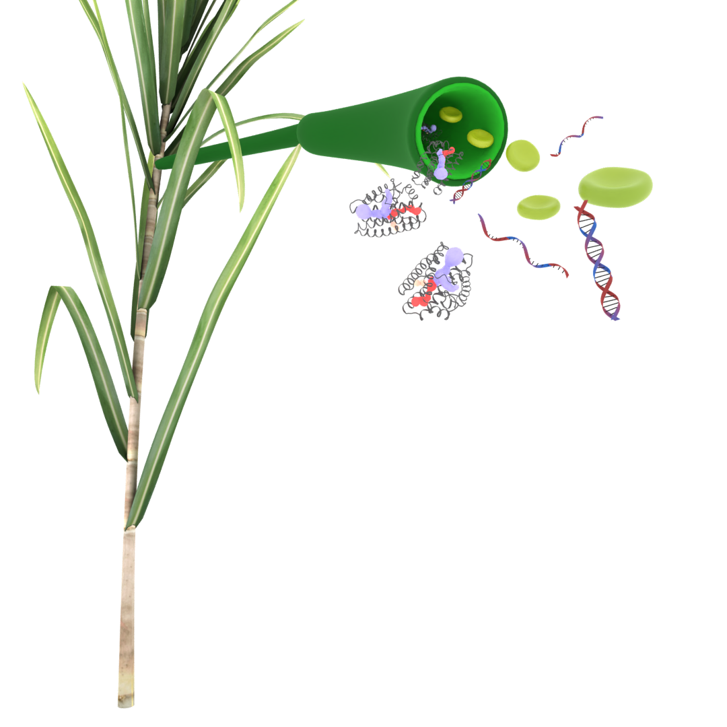
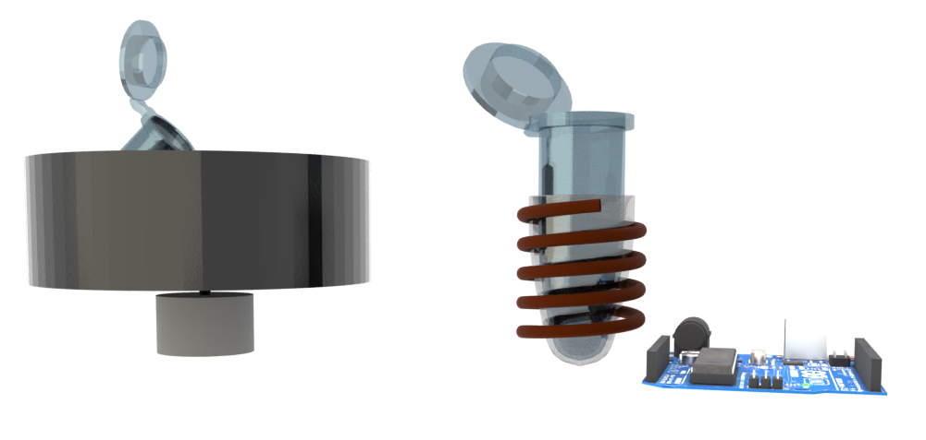
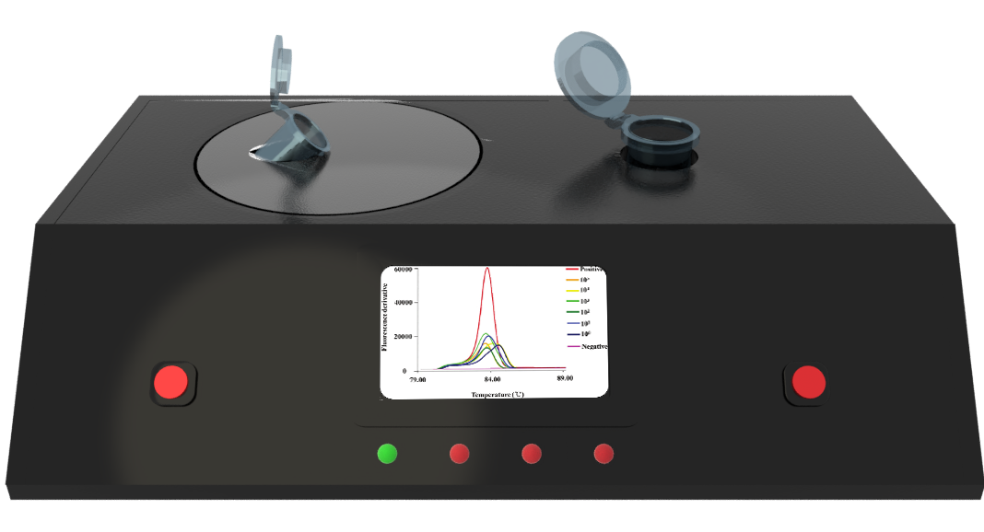
Portable on-farm device for RSD
“One device to get diagnostic results for RSD, Leaf Scald and other sugarcane diseases”

Slide 2
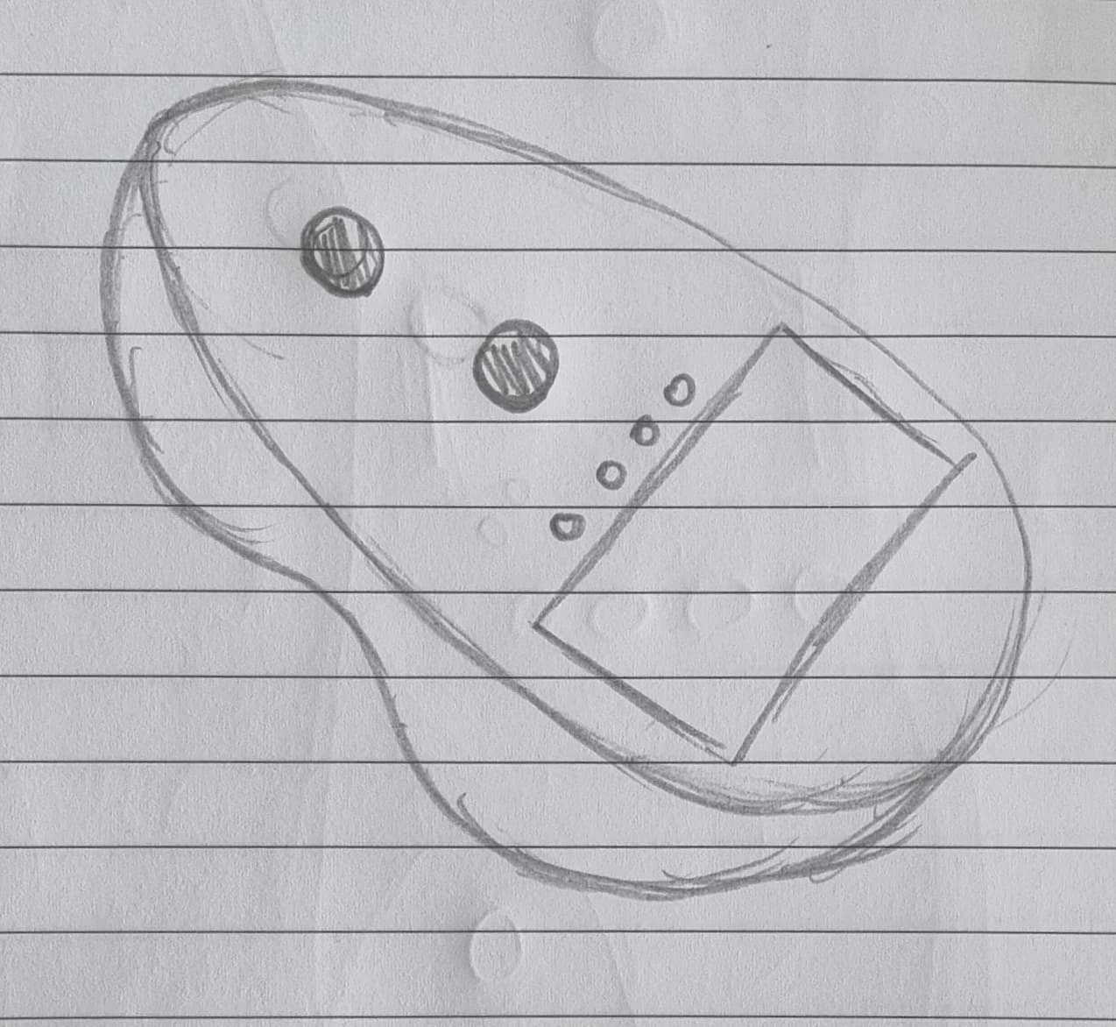
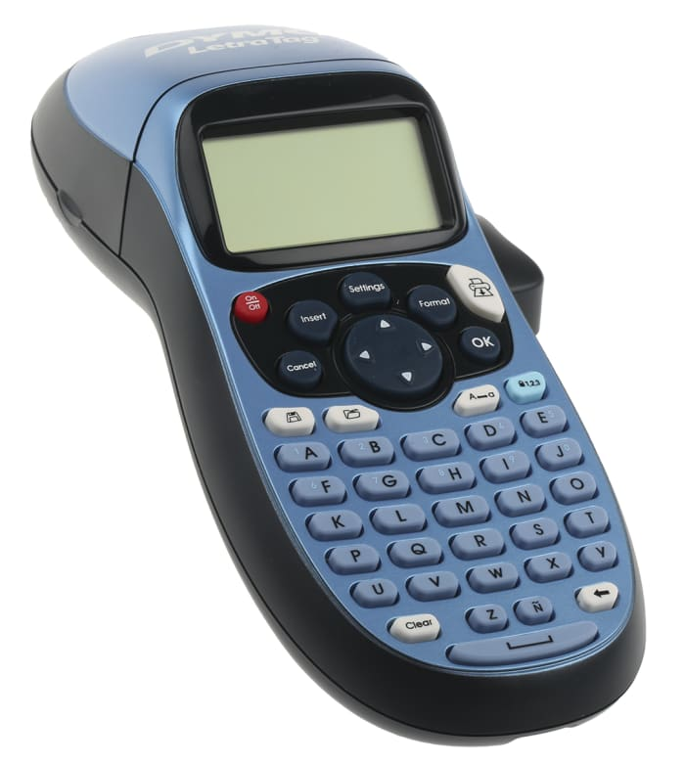
Potential Redesign
Handheld, but supported so can be put down
Bottom shaped to fit hand: shaped after
Possibly 150x100mm
Small touch screens: 77x52mm
Heating tube
Detection tube
LEDs
Touch screen
Modelled after label maker
Easily add slant for improved screen visibility
Shaped for hand but sturdy on table

Slide 3
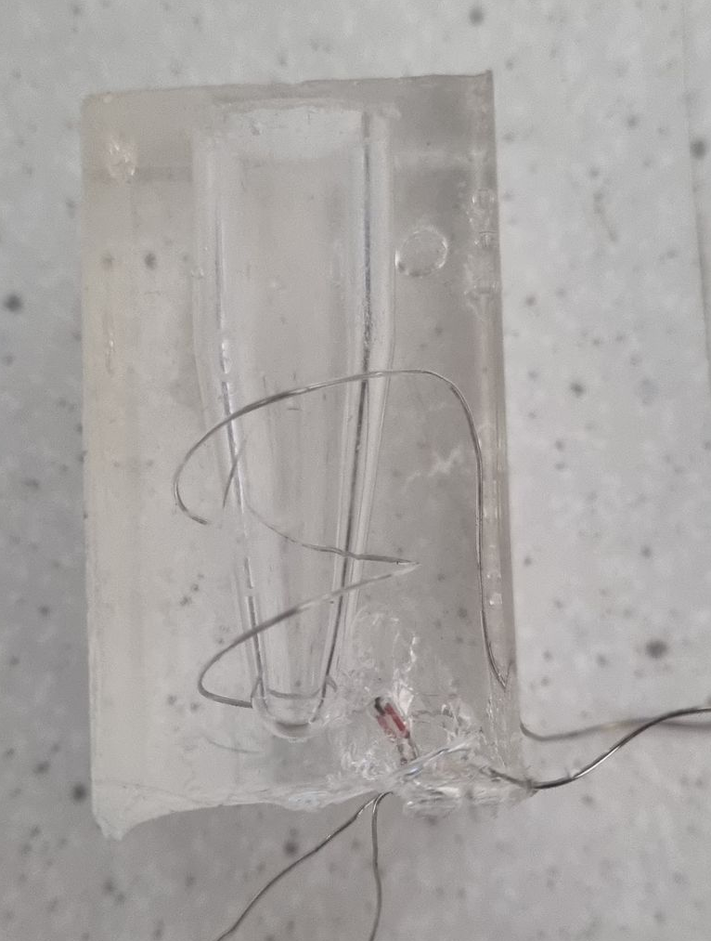
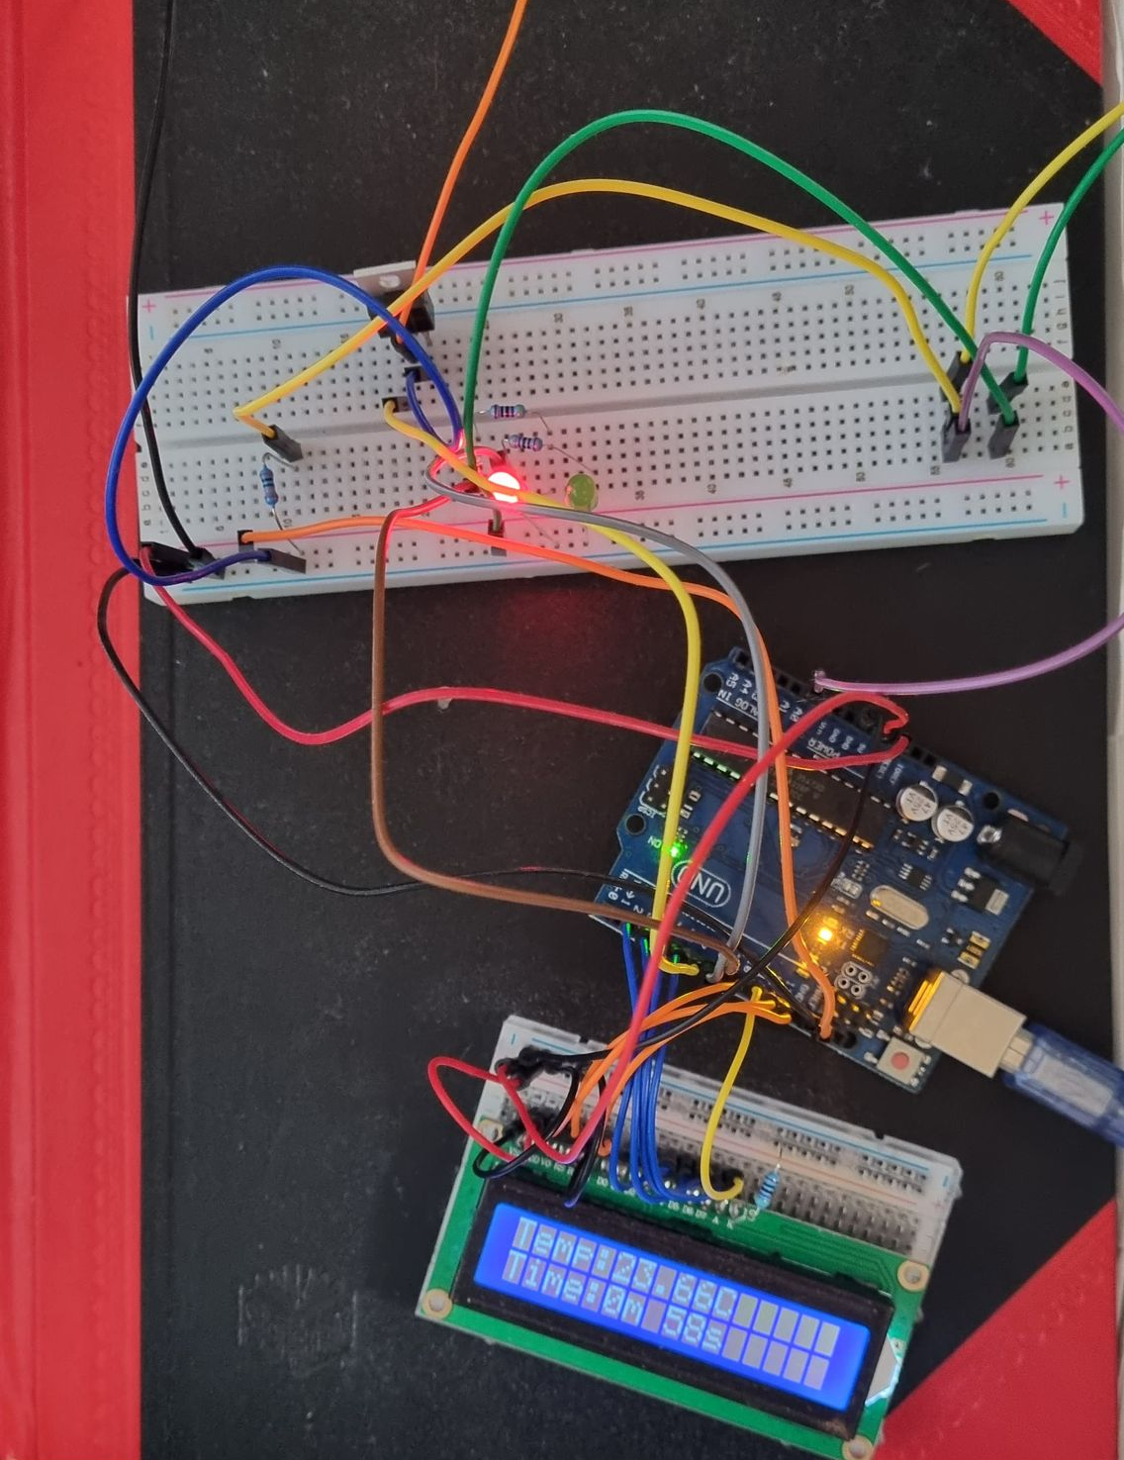
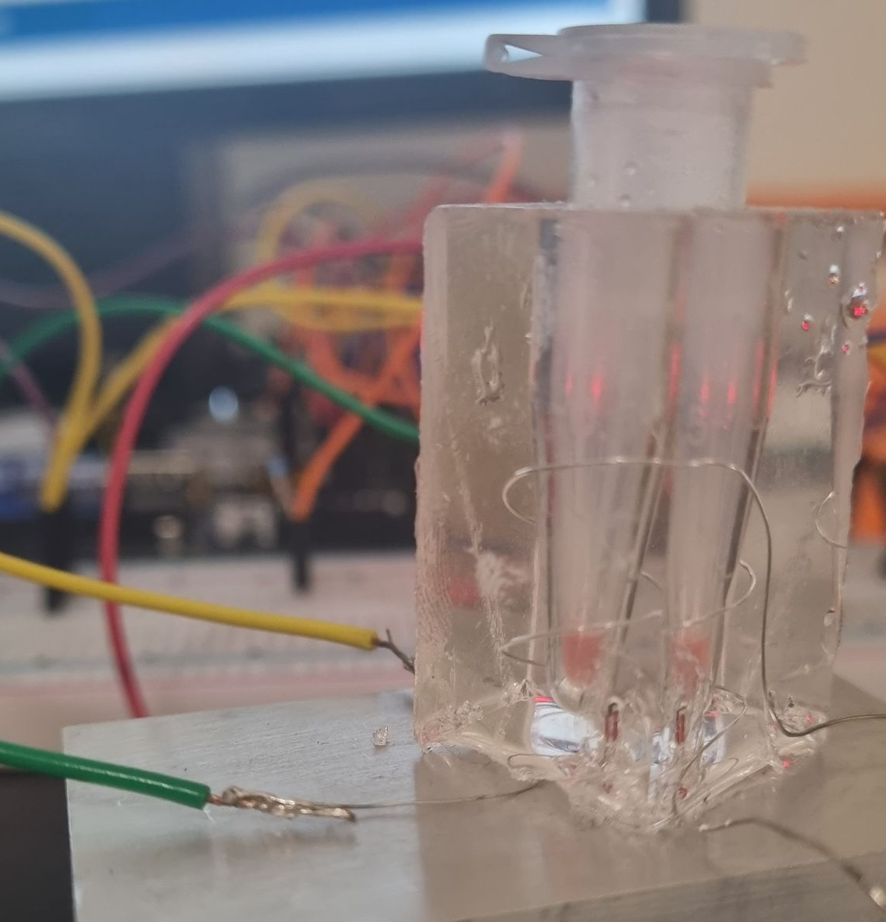
Proof of concept Heating Block
Nichrome Wire
Switching MOSFET
1st PDMS mold
In range out of range LEDs
Thermistor
Voltage divider
Arduino
Time and temp LCD
Device under operation

Slide 4
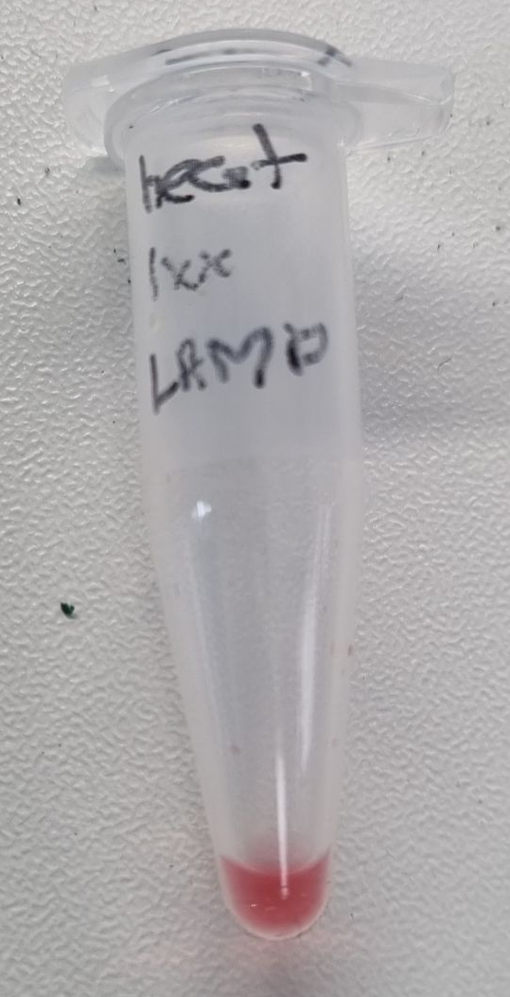
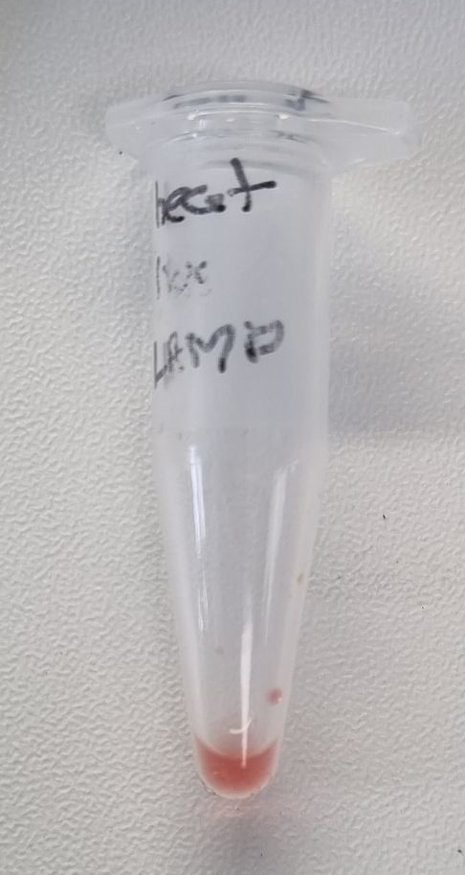
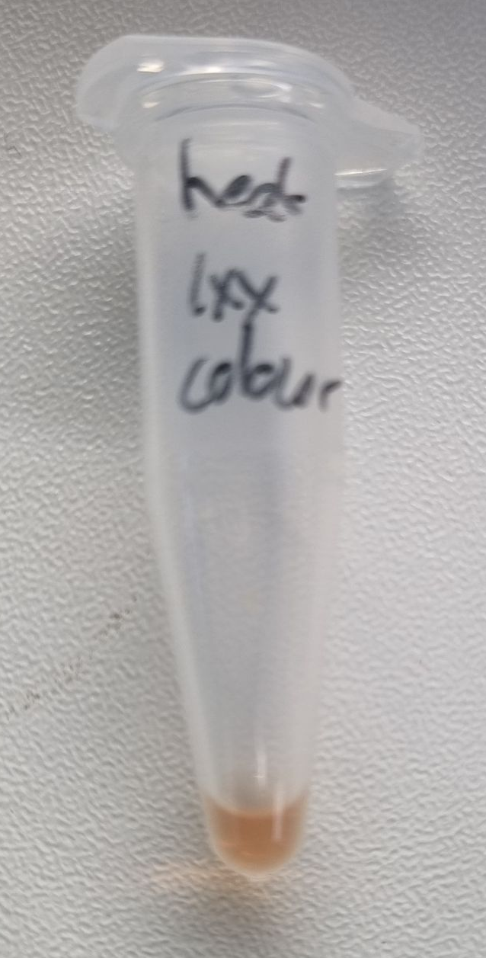
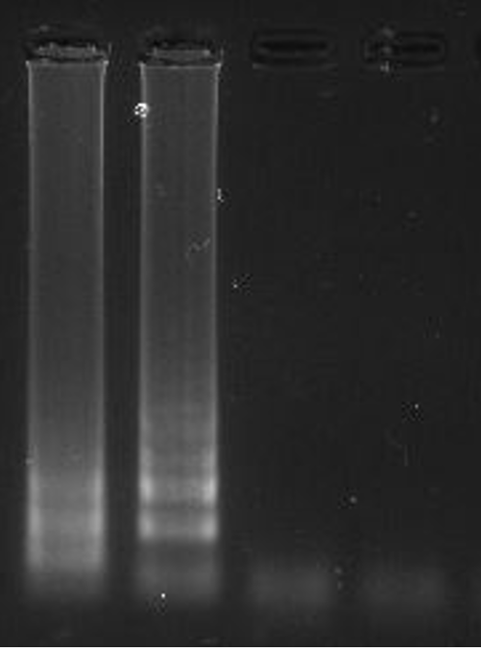
Eppendorf Heatblock LAMP data
1
2
3
1: Before
2: 25µL
3: 50µL

Slide 5
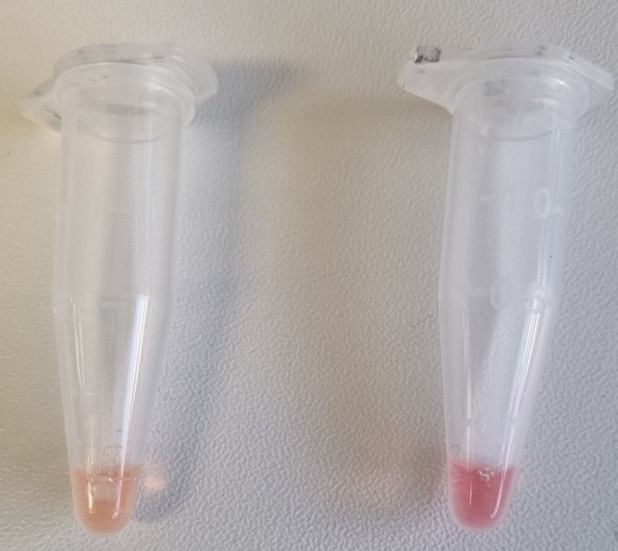
Eppendorf Heatblock LAMP data
1
2

Slide 6
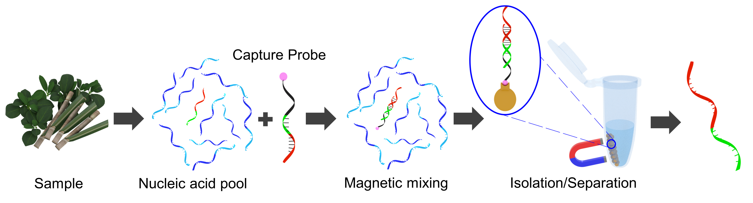
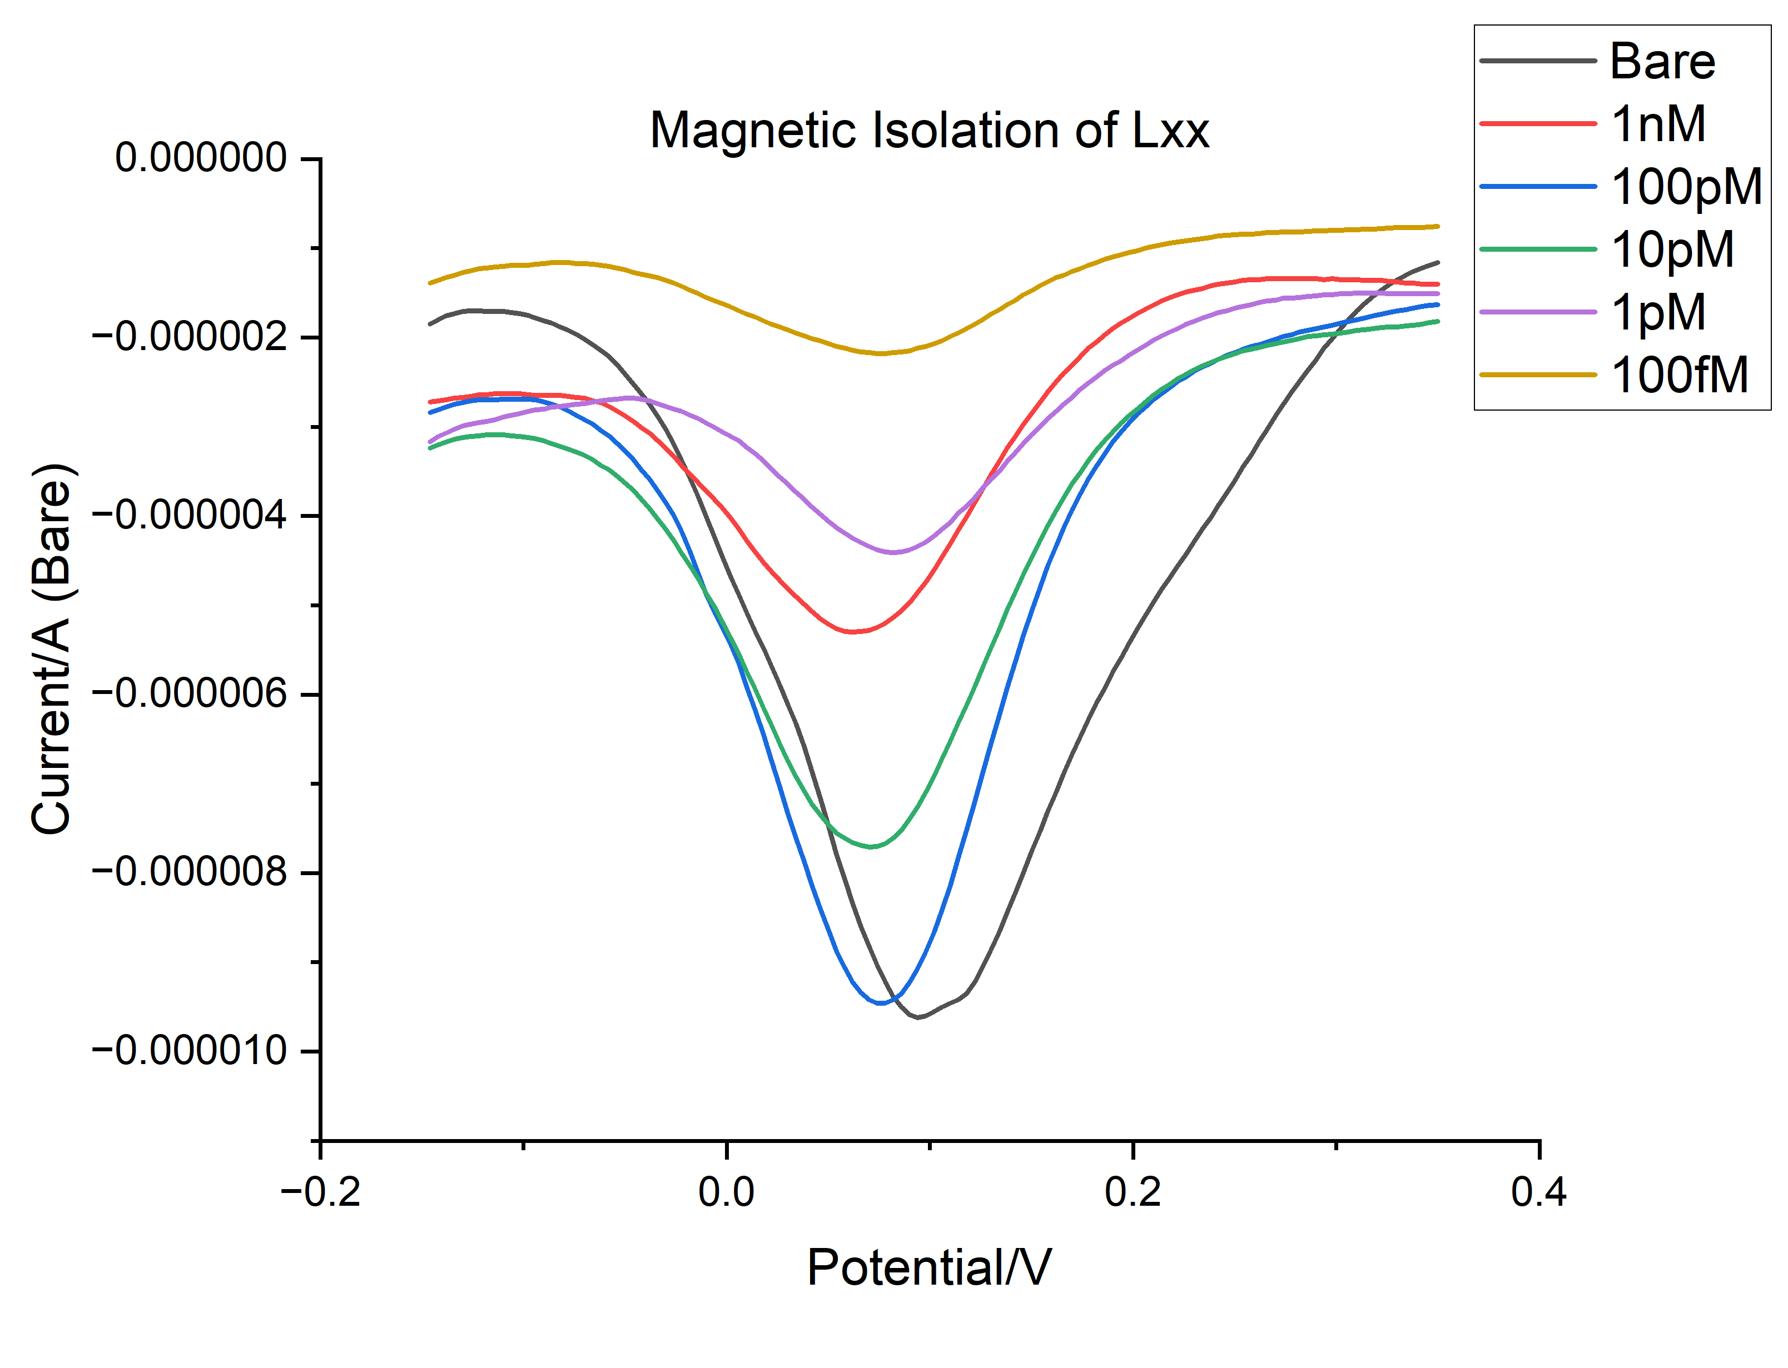
Magnetic Isolation of Lxx

