Slide 1
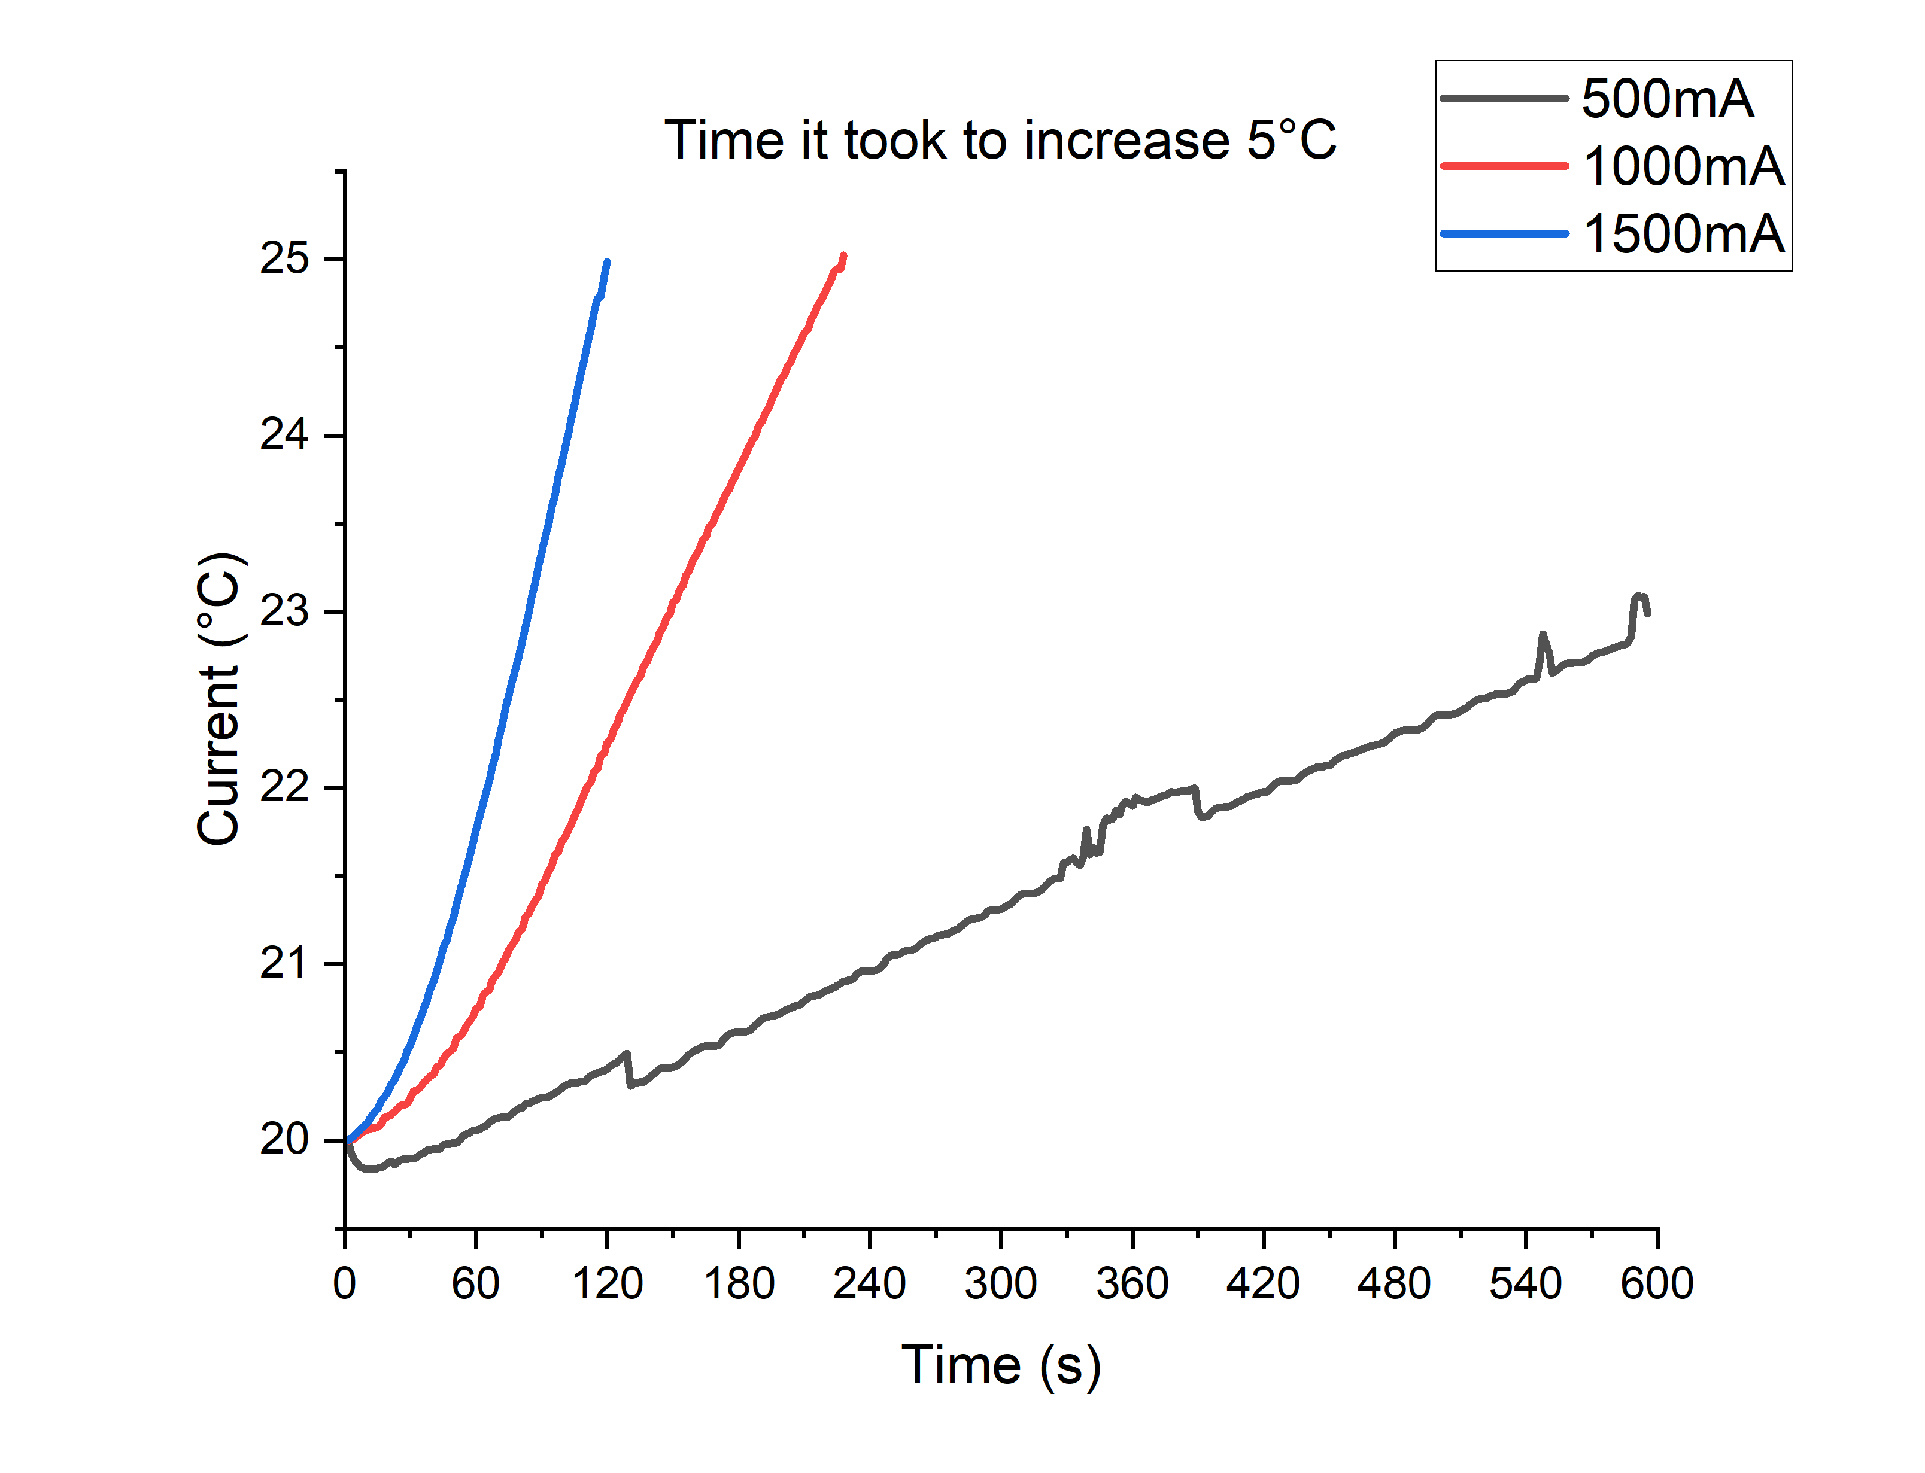
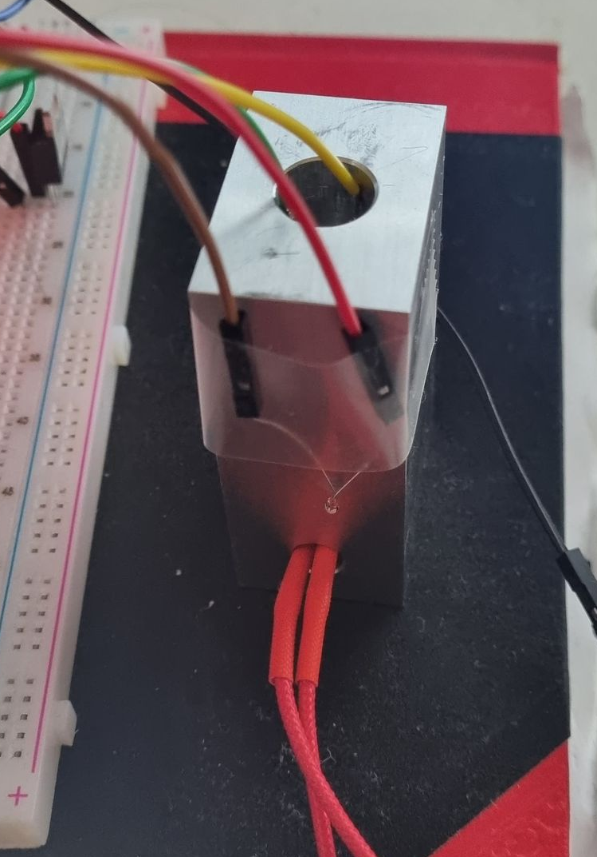
Aluminium Current Experiment
1500mA: 2mins
1000mA: 3mins 48sec
500mA: 10mins only reached 23°C

Slide 2
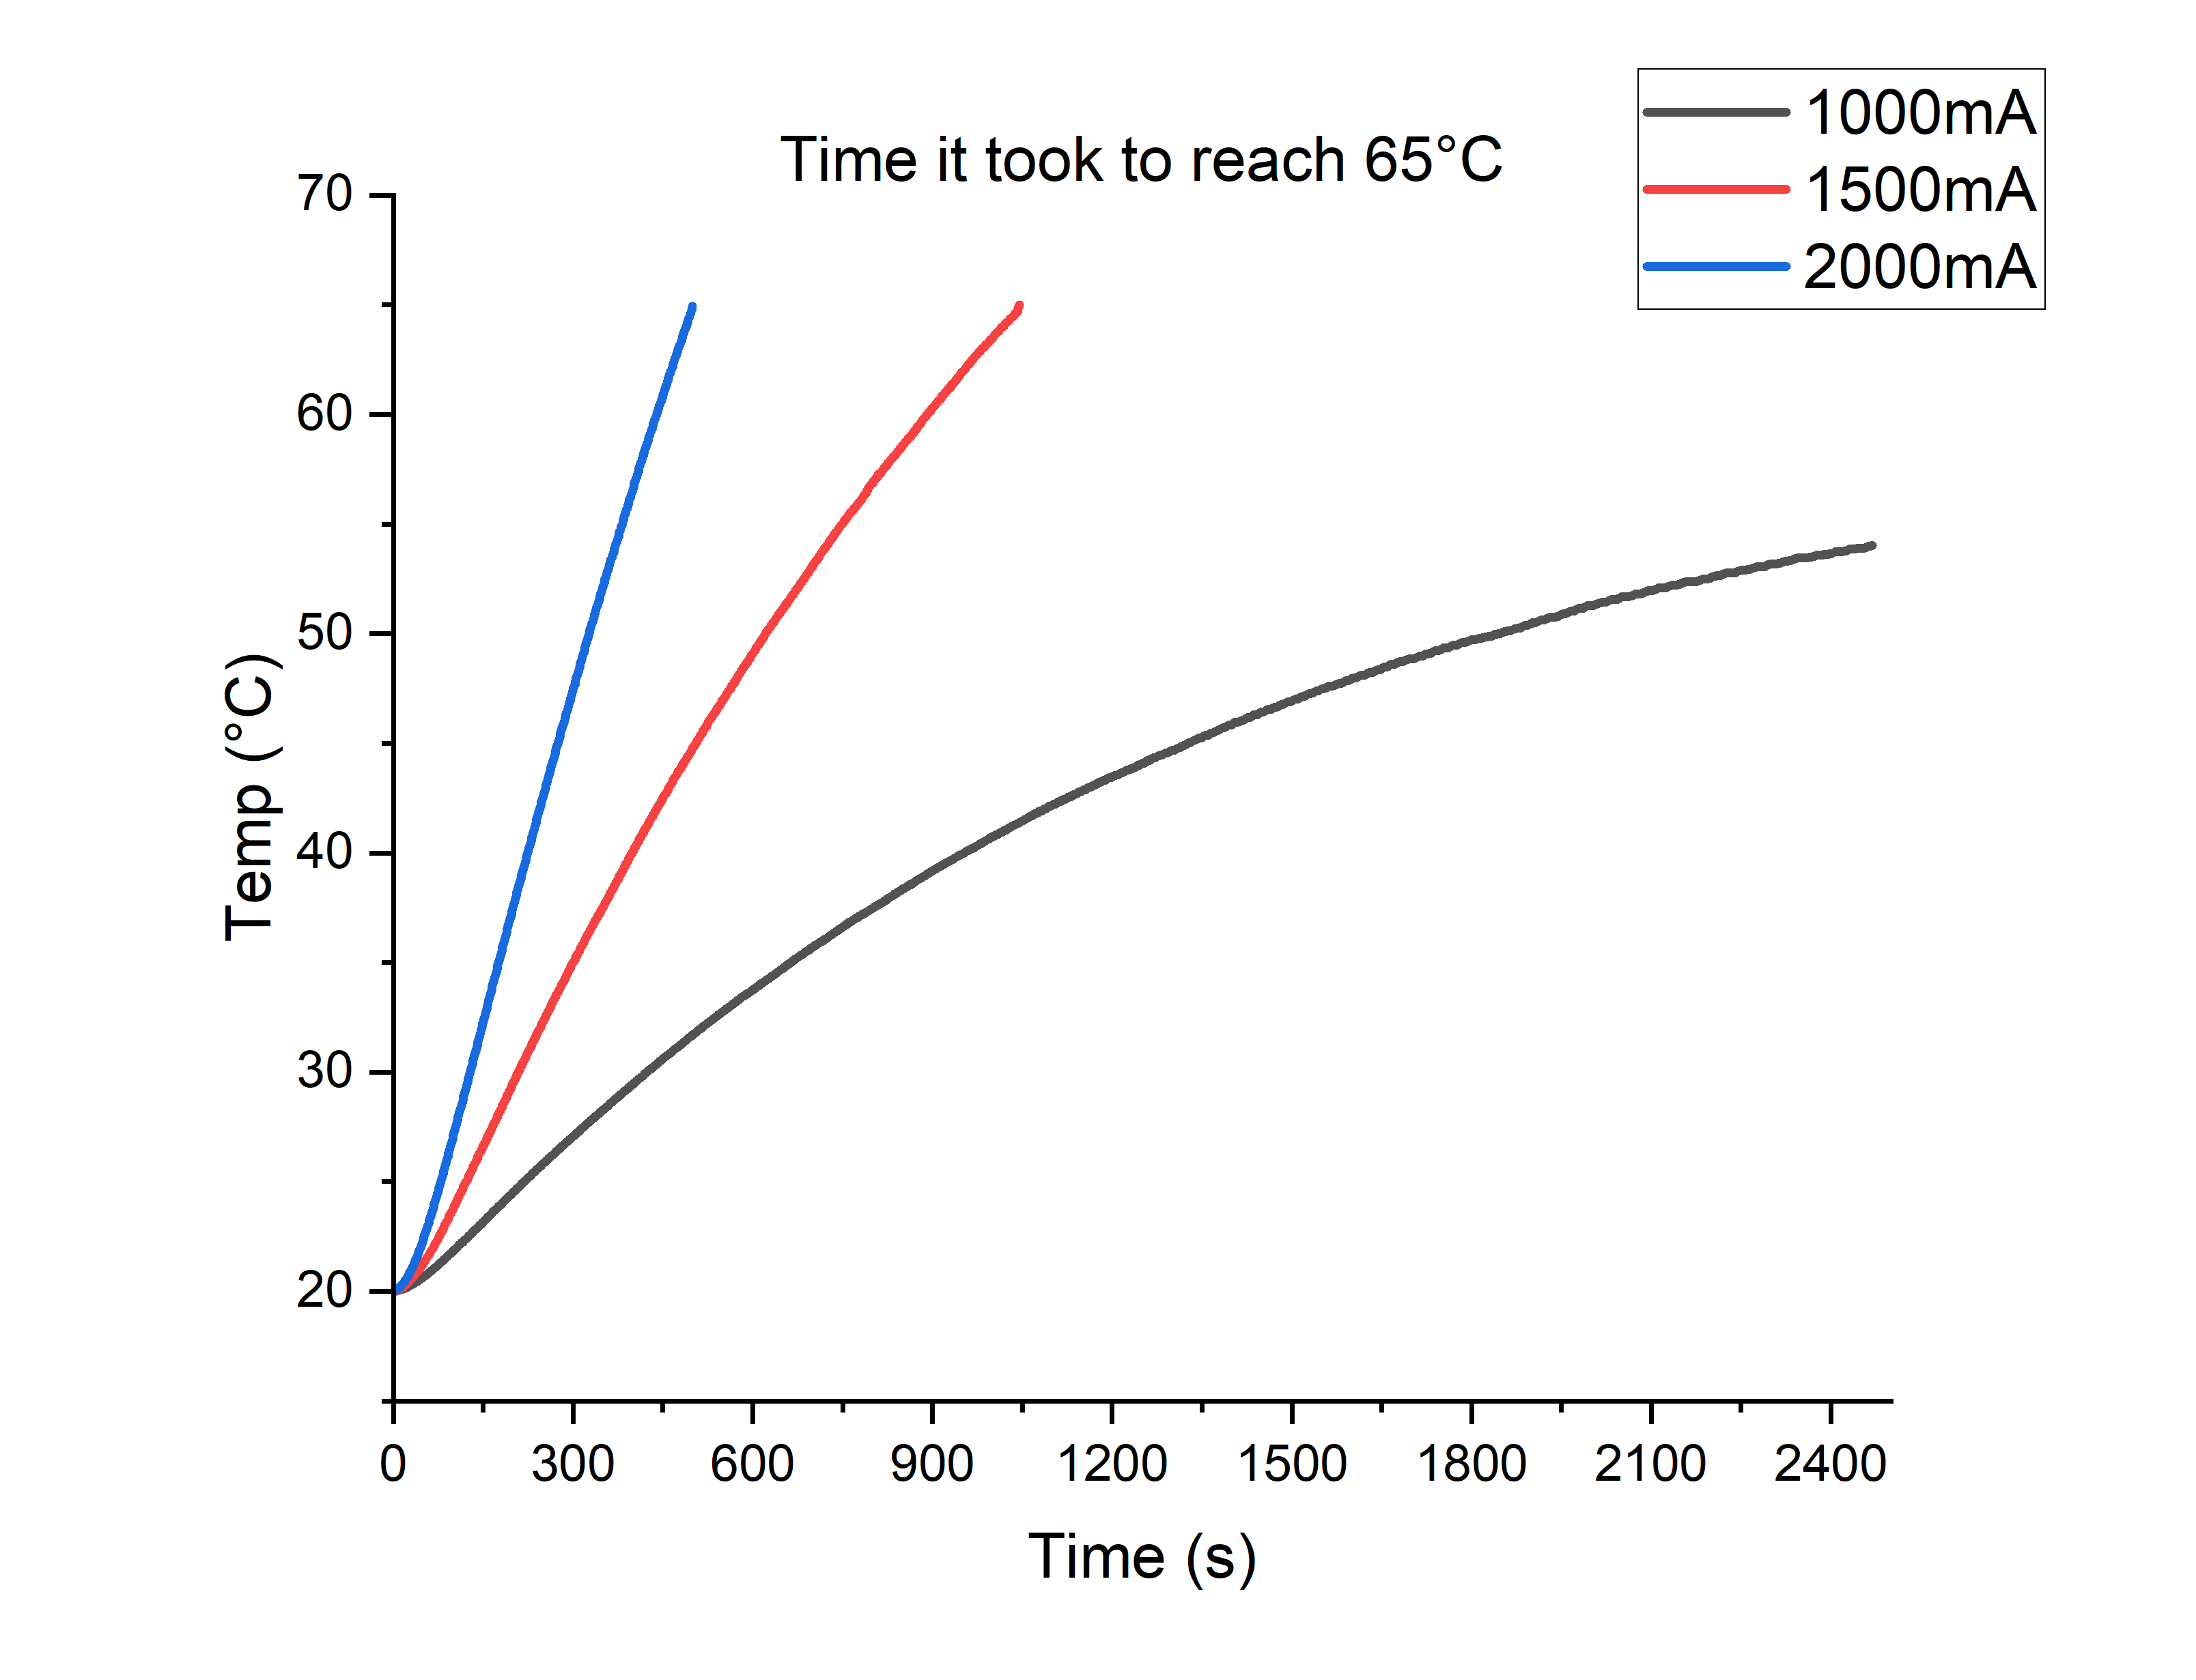
Time taken to 65°C
2000mA: 8mins 20sec
1500mA: 17mins 26sec
1000mA: 41mins 10sec it had only reached 54°C

Slide 3
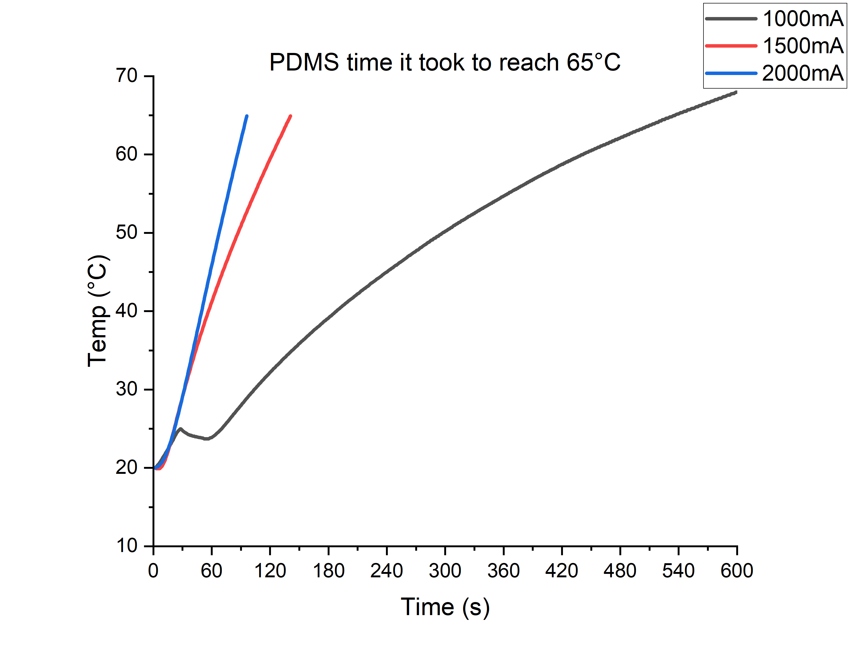
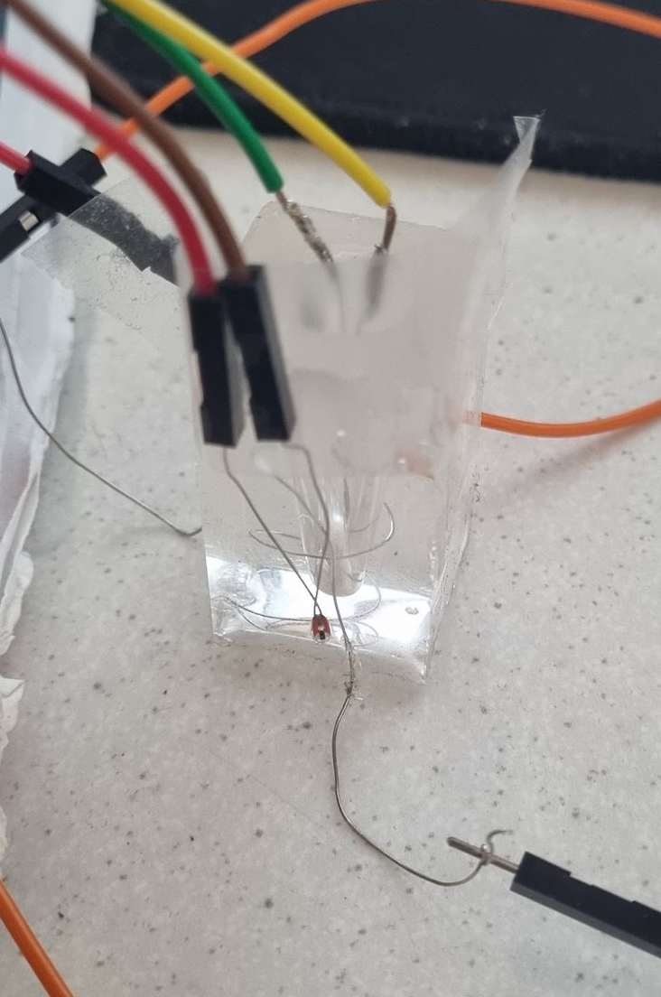
PDMS Current Experiment
2000mA: 1min 35s
1500mA: 2mins 21s
1000mA: 10mins 17s

Slide 4
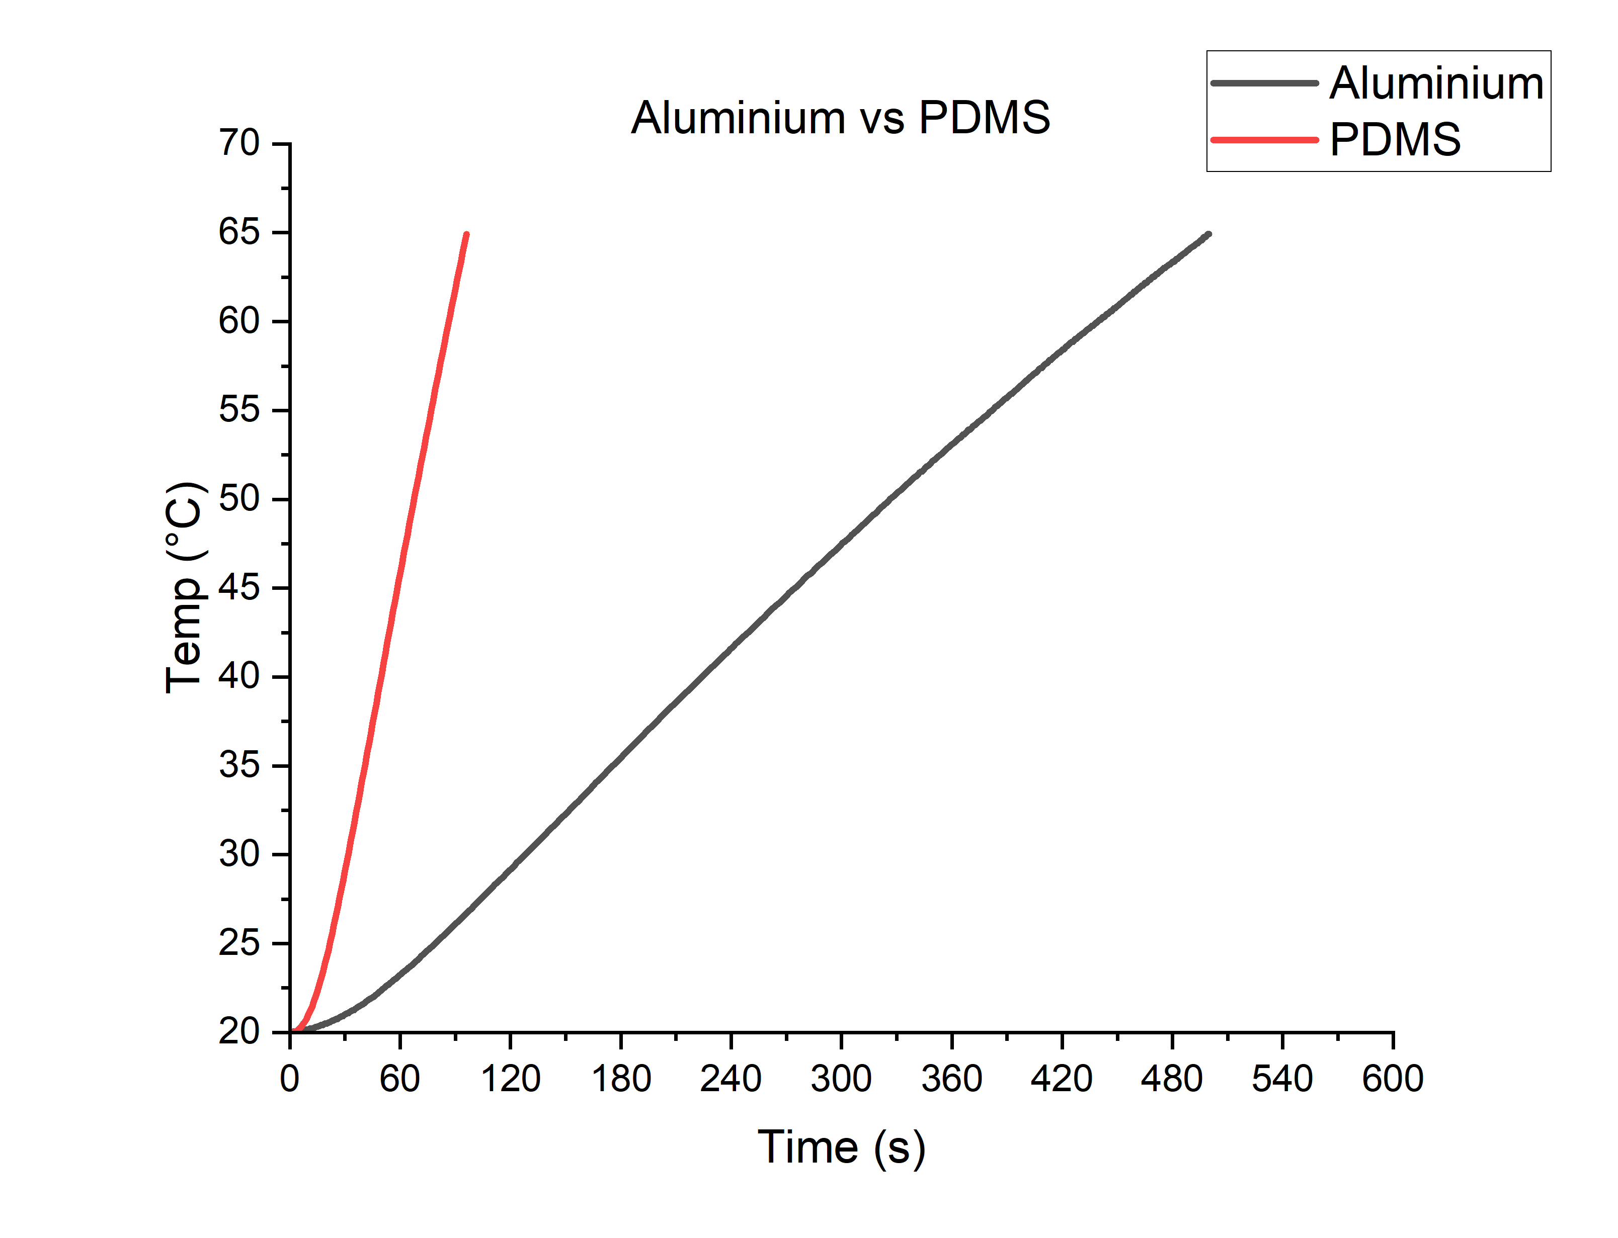
PDMS vs Aluminium
PDMS: 1min 35s
Aluminium: 8min 20s

Slide 5
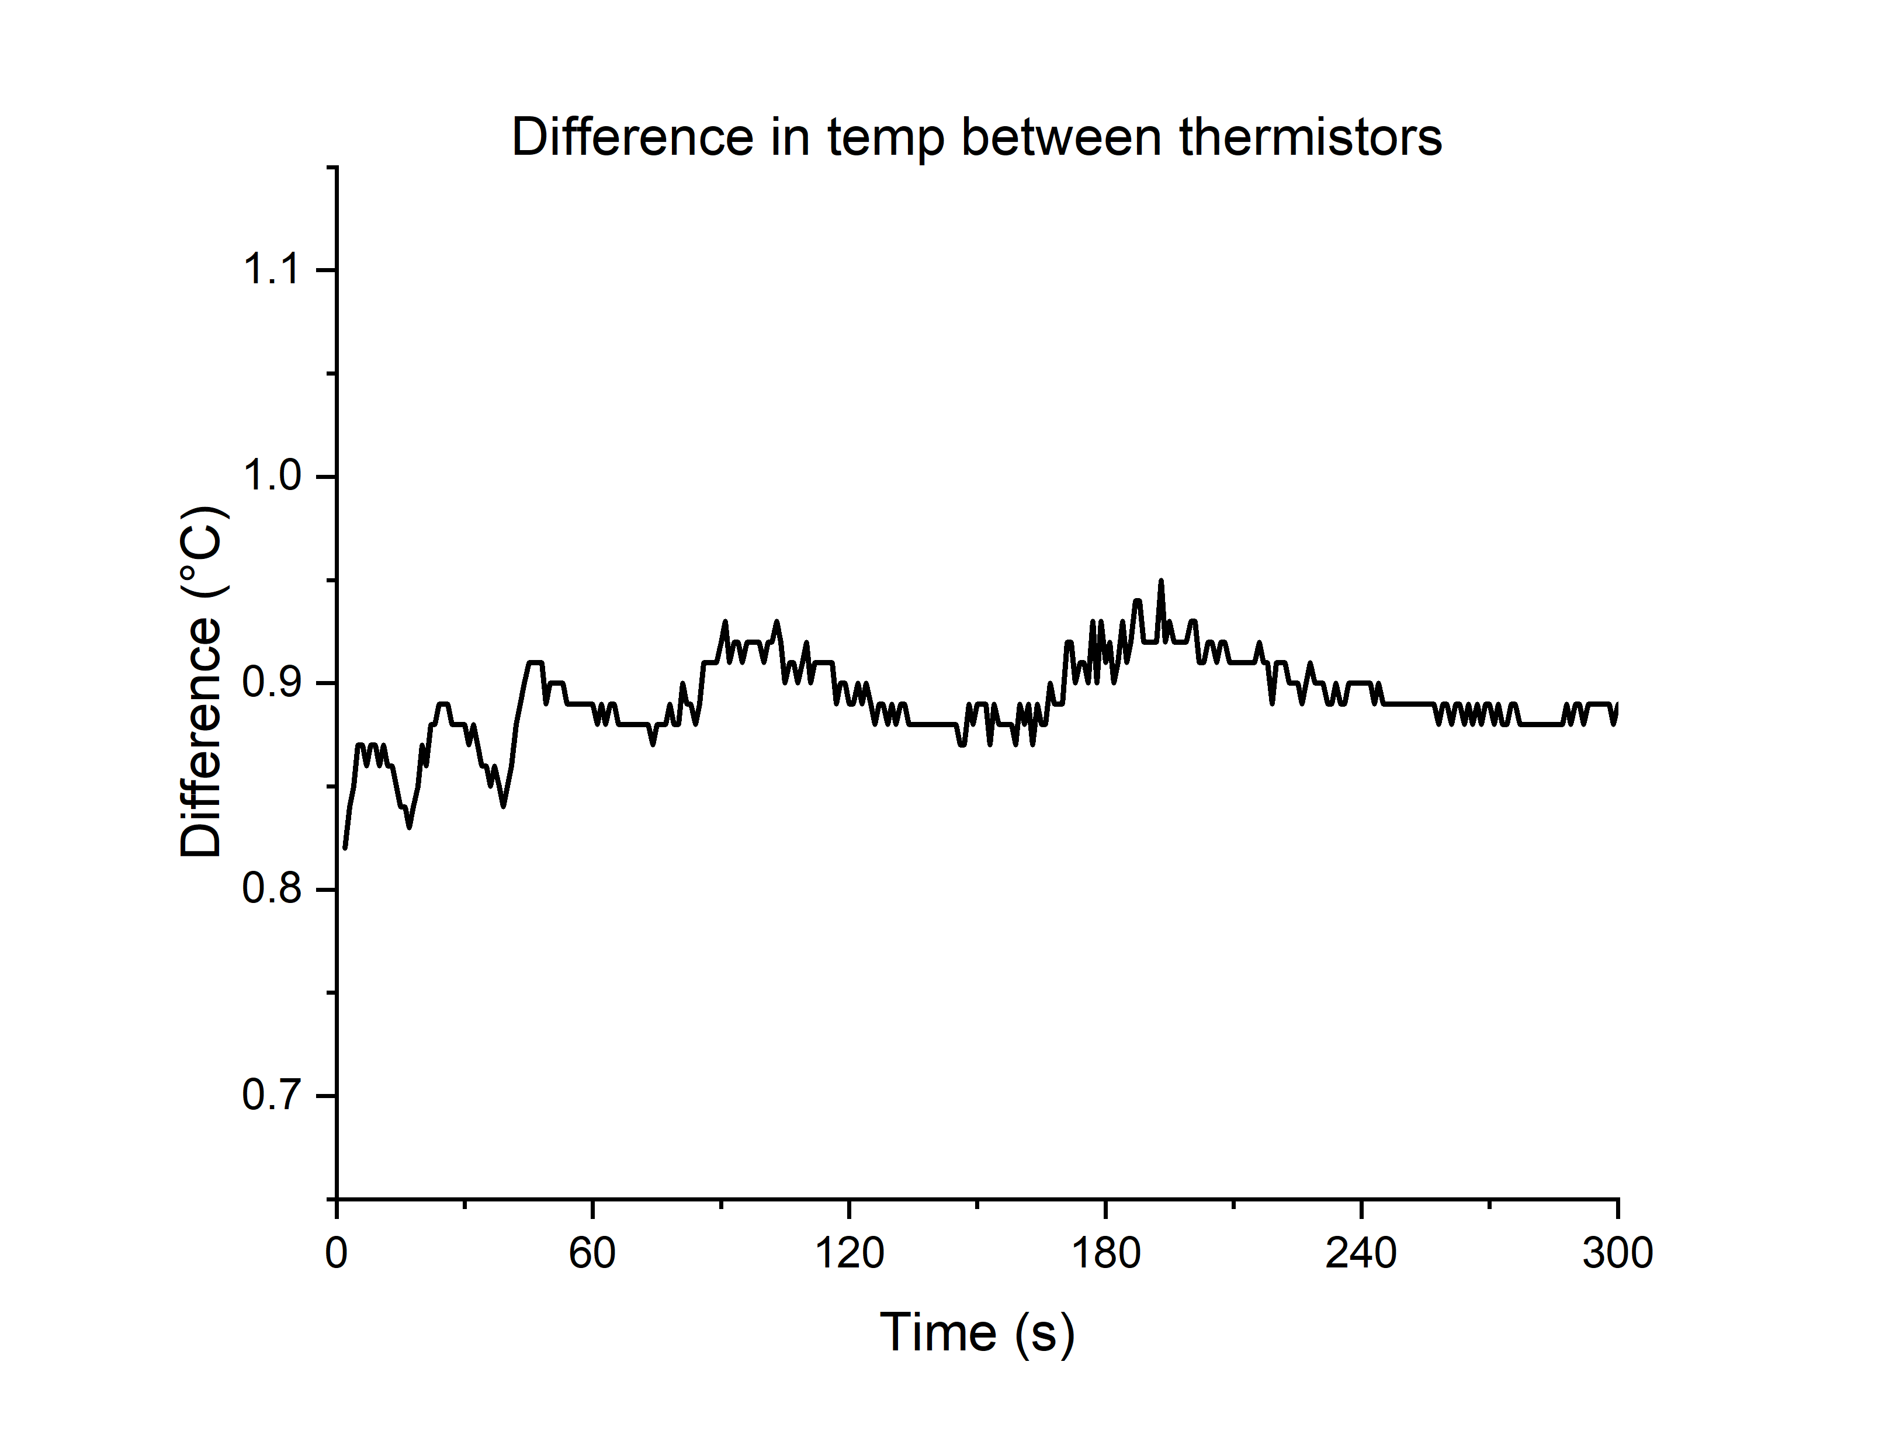
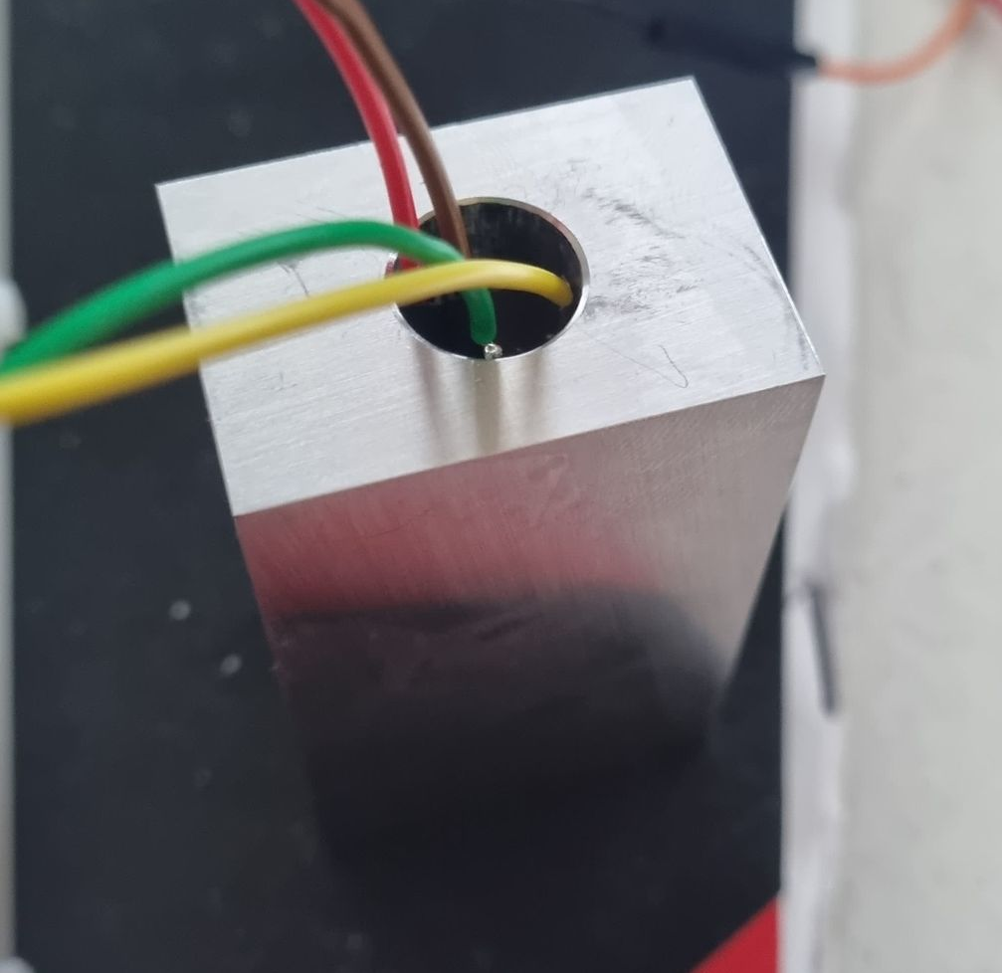
Variation in Thermistors
Average variation 0.9°C

Slide 6
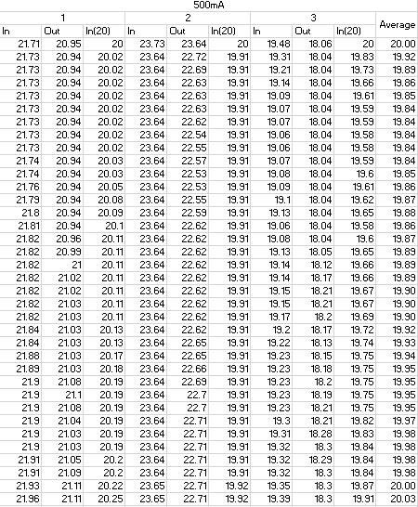
Variation in Thermistors
Slightly less than 1°C difference in all cases up to 25°C

Slide 7
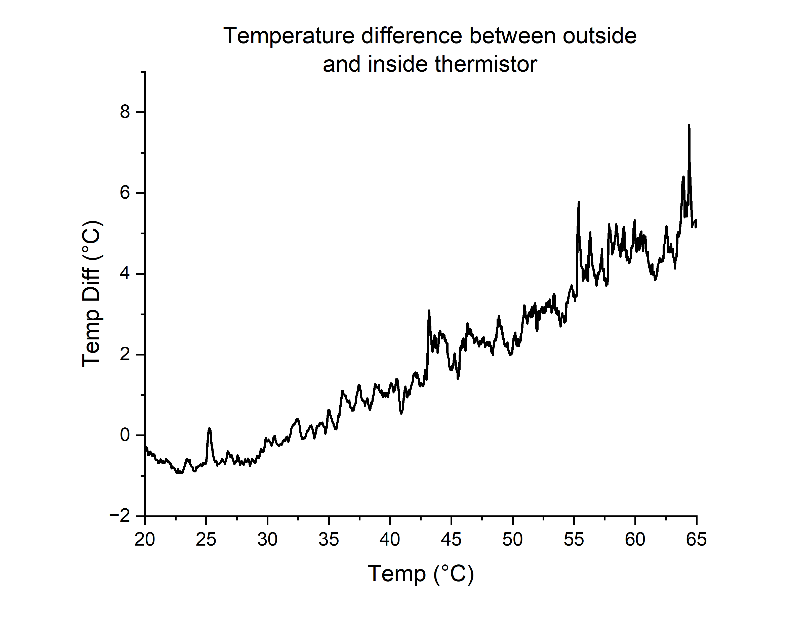
Variation in Thermistors
Around 65°C
Best case: 5°C
Average case: 5.5°C
Worst case:7.2°C

Slide 8
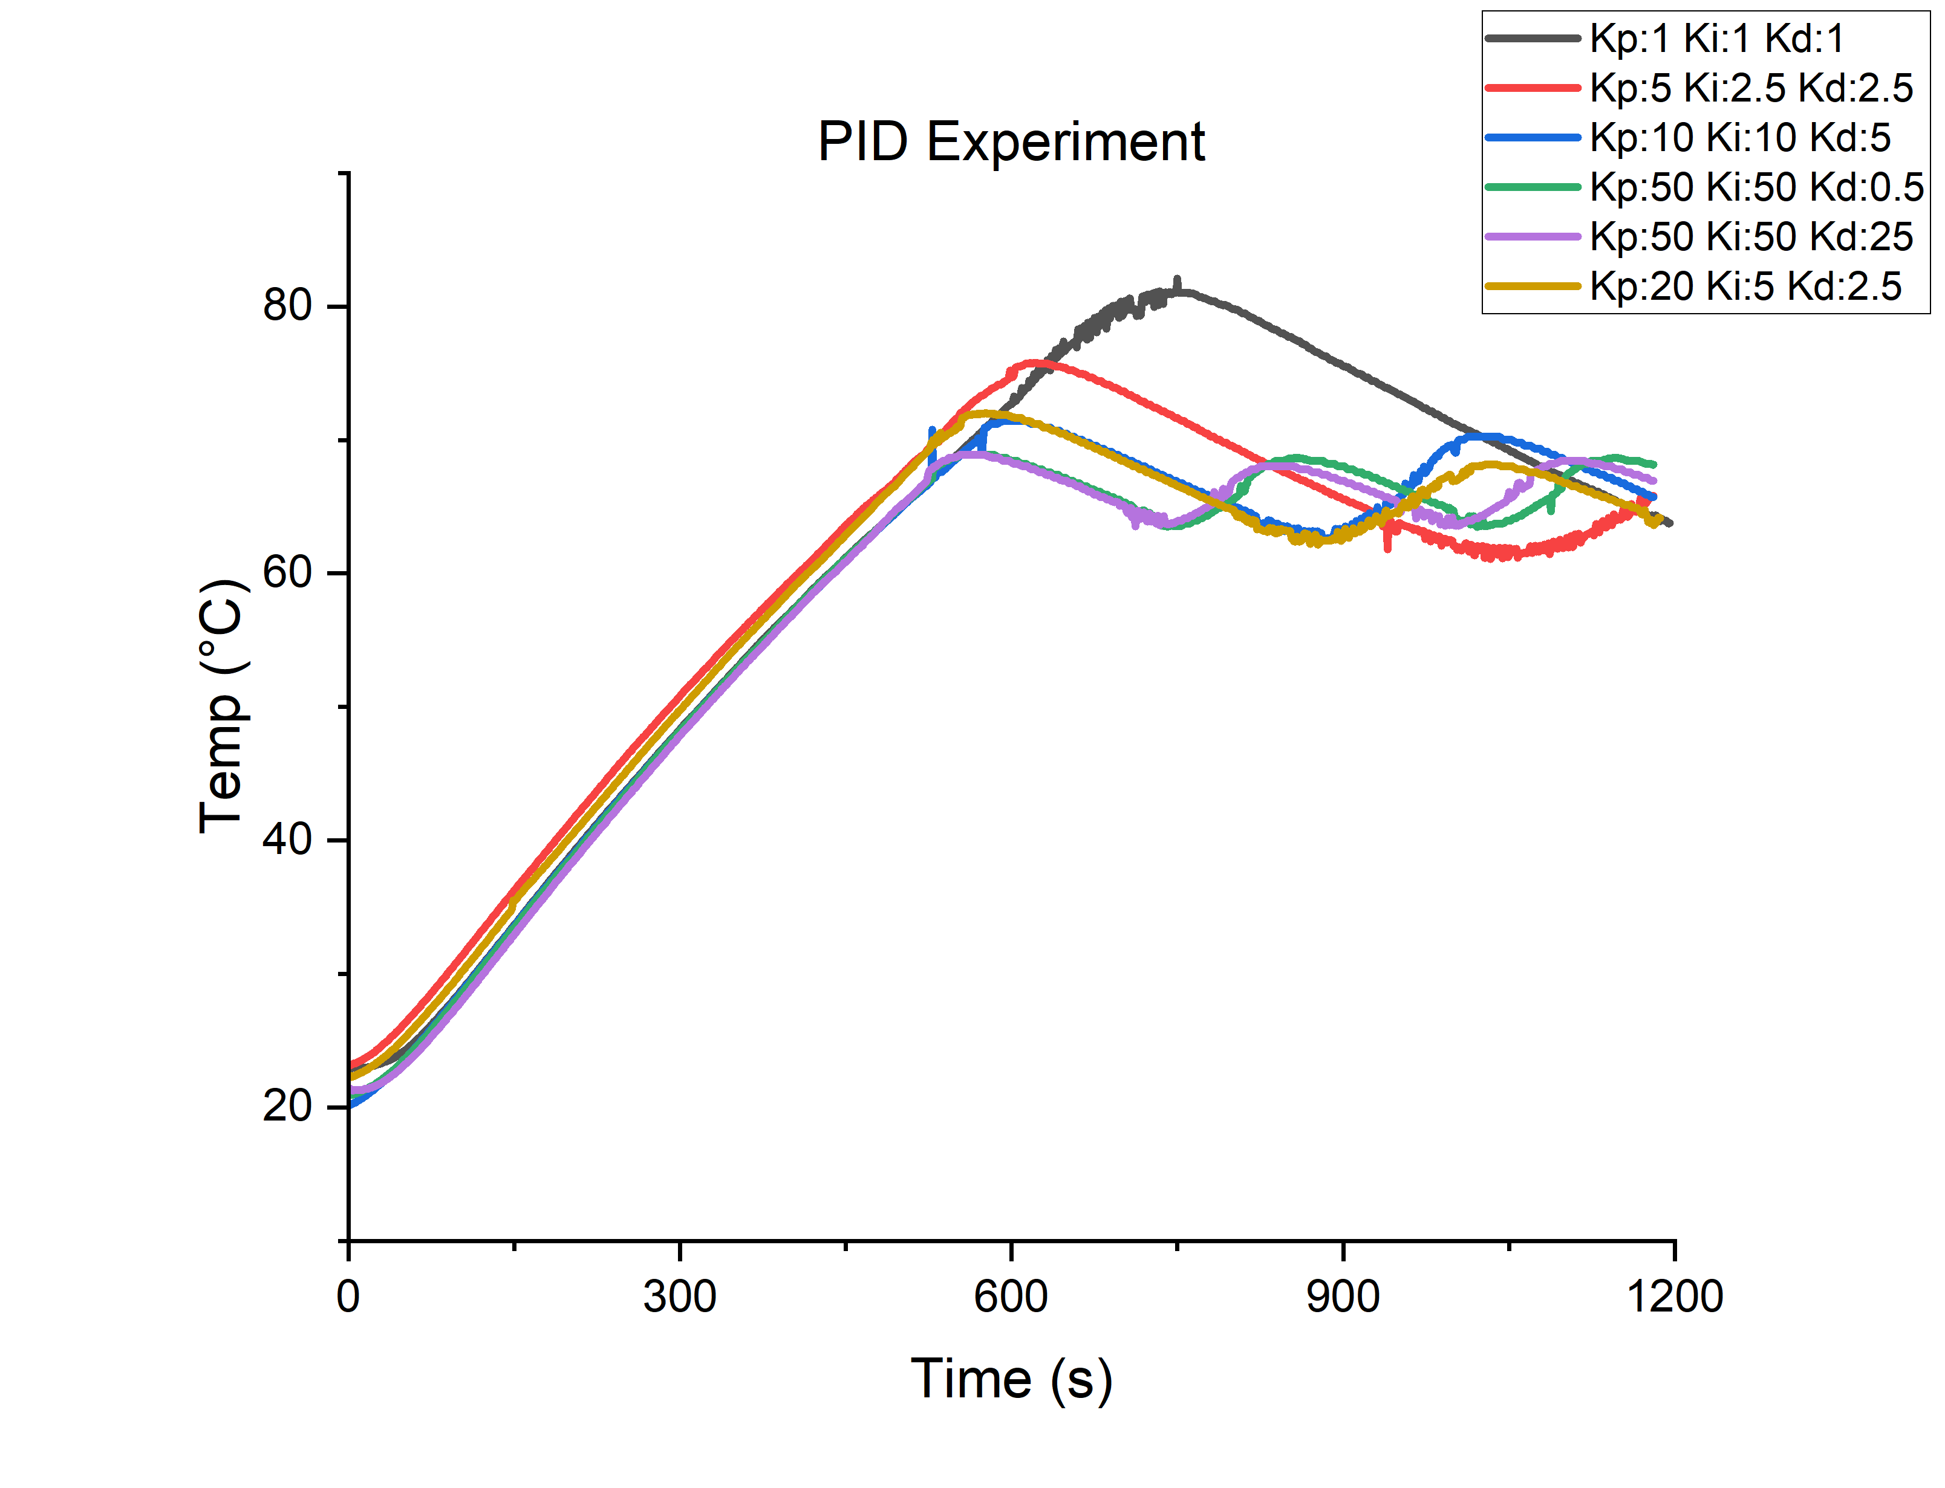
Aluminium PID experiment

Slide 9
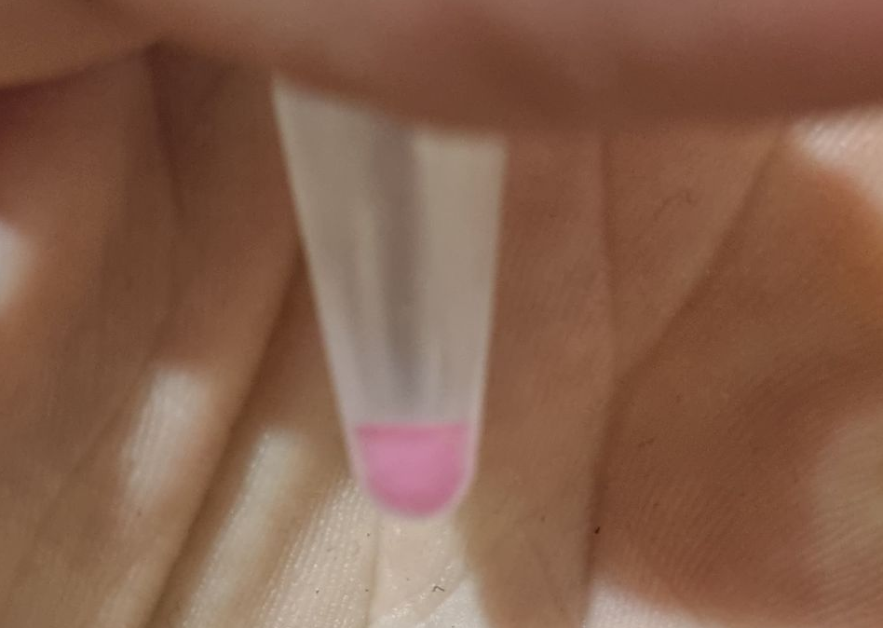
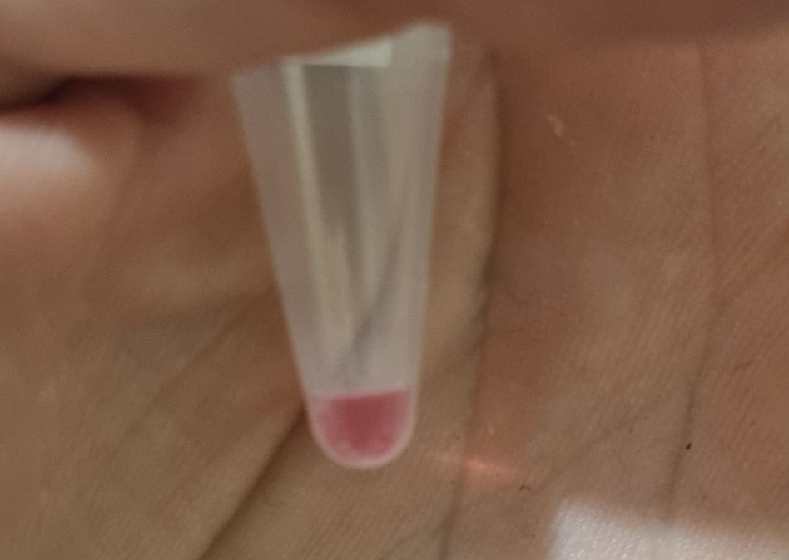
LAMP experiment
Ladder
Sample
Colourimetric before
Colourimetric after

Slide 10
Moving forward:
Obtain heatsink adhesive to stick thermistor on block
Redesign Aluminium block
Run PID experiment on PDMS
Optimise PID settings on Aluminium
Run PDMS size experiment
Develop a comprehensive LAMP experiment for aluminium block
Solder device onto a prototype board
Incorporate fluorescence module
Once LAMP is confirmed use fluorescence imaging

