Slide 1
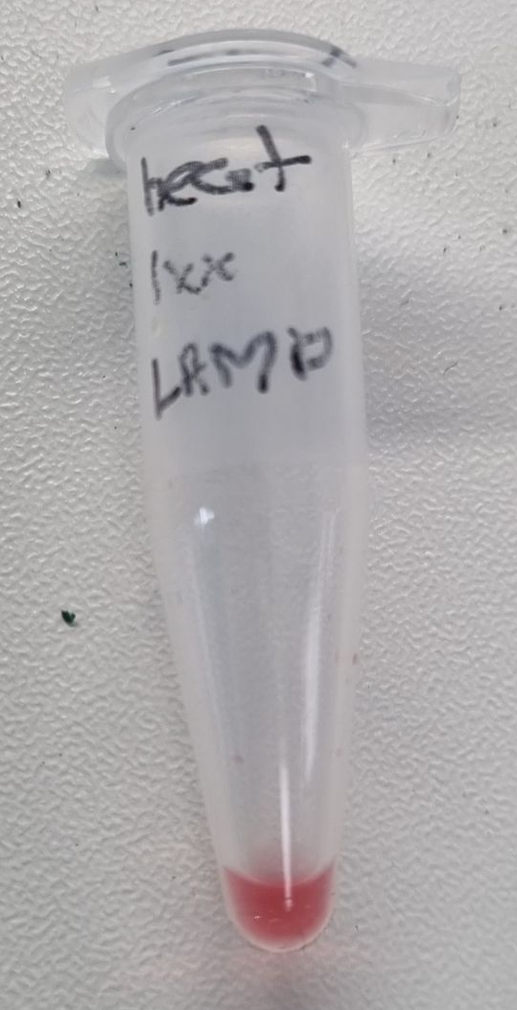
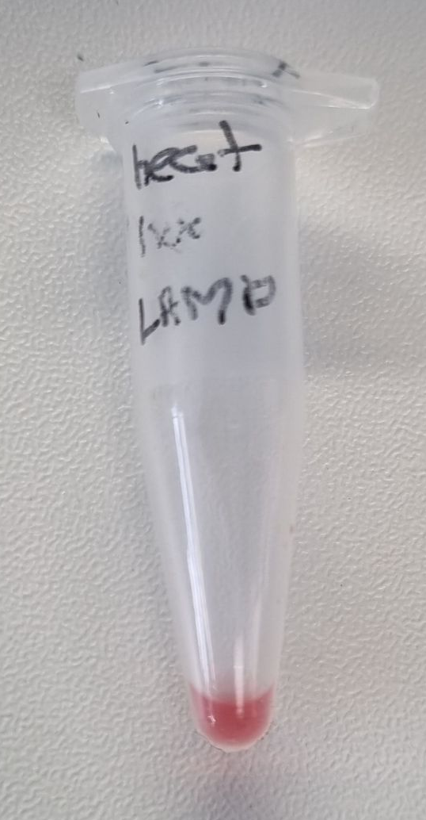
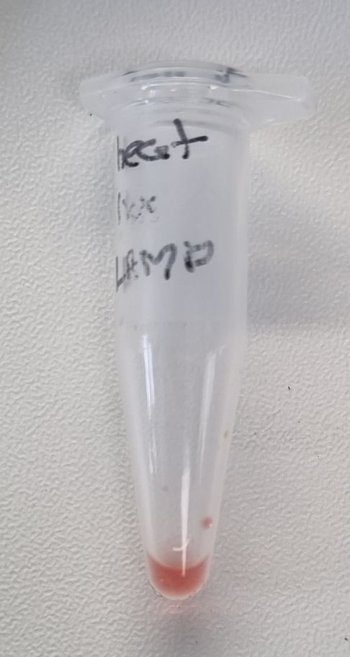
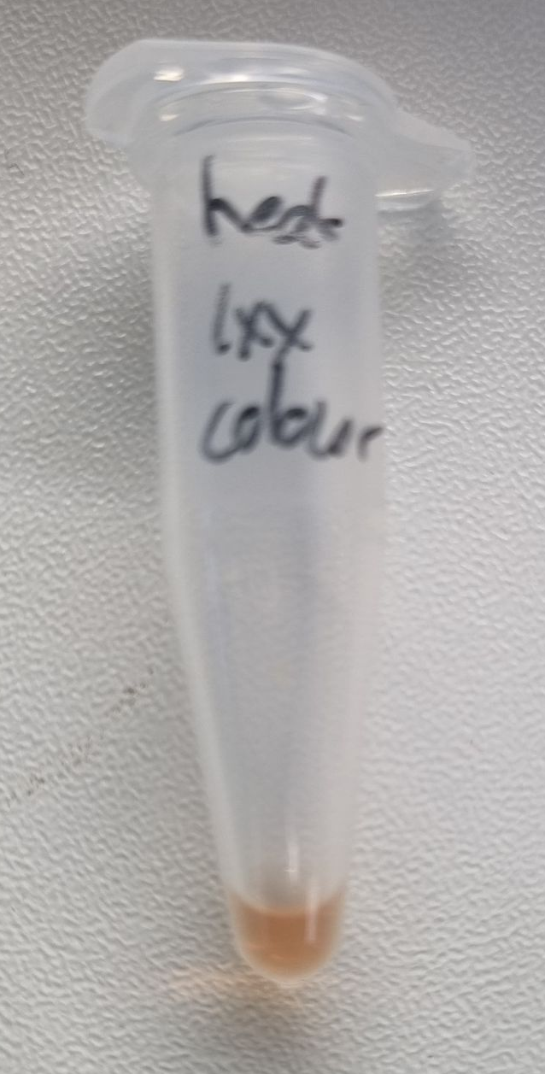
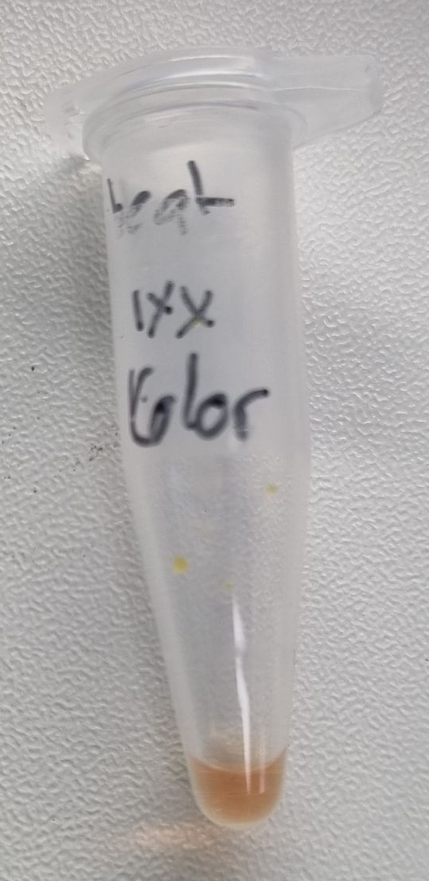
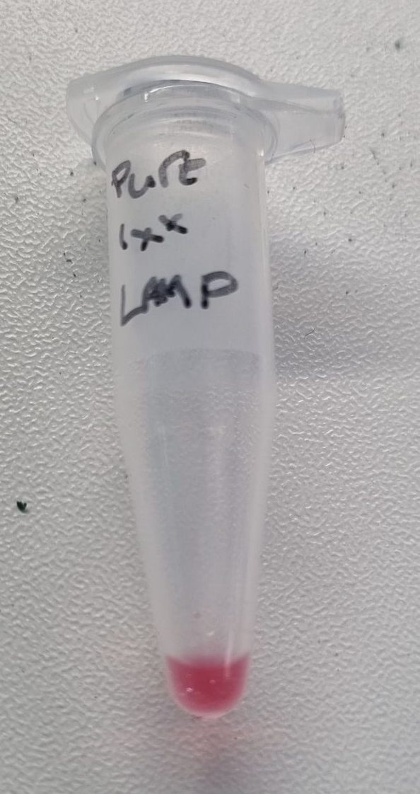
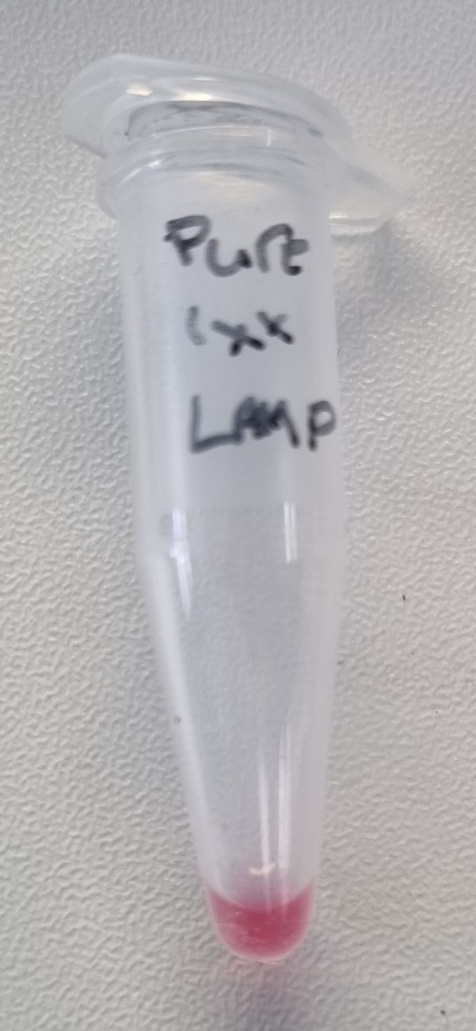
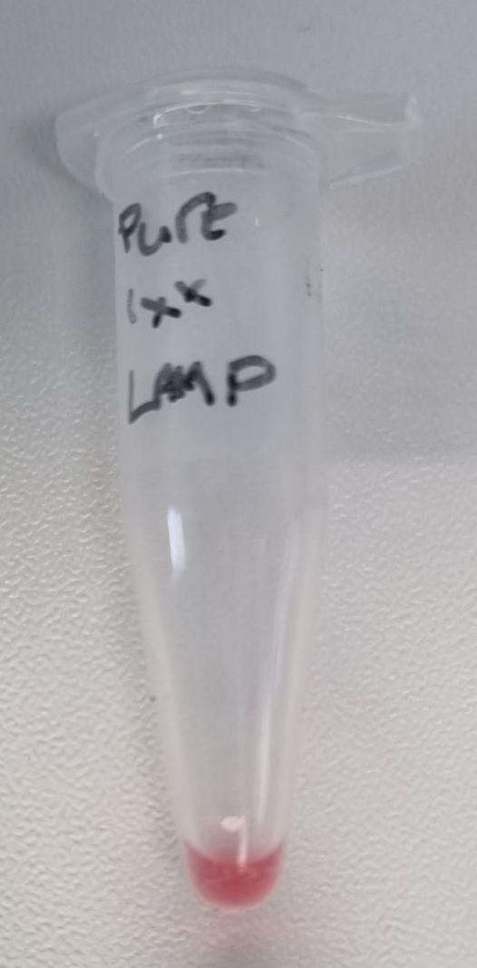
LAMP
1
2
3
7
8
4
5
6
1-3: 1µl of heat lysis DNA in 24µL of LAMP master at 20,30,40mins respectively
4-6: 1µl of purified DNA in 24µL of LAMP master at 20,30,40mins respectively
7-8: 2µl of purified DNA in 48µL of LAMP master at 30mins

Slide 2
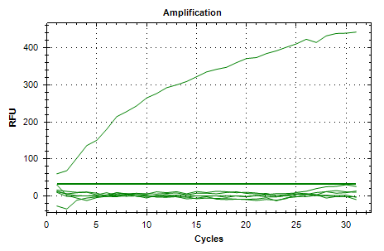
LAMP Data

Slide 3
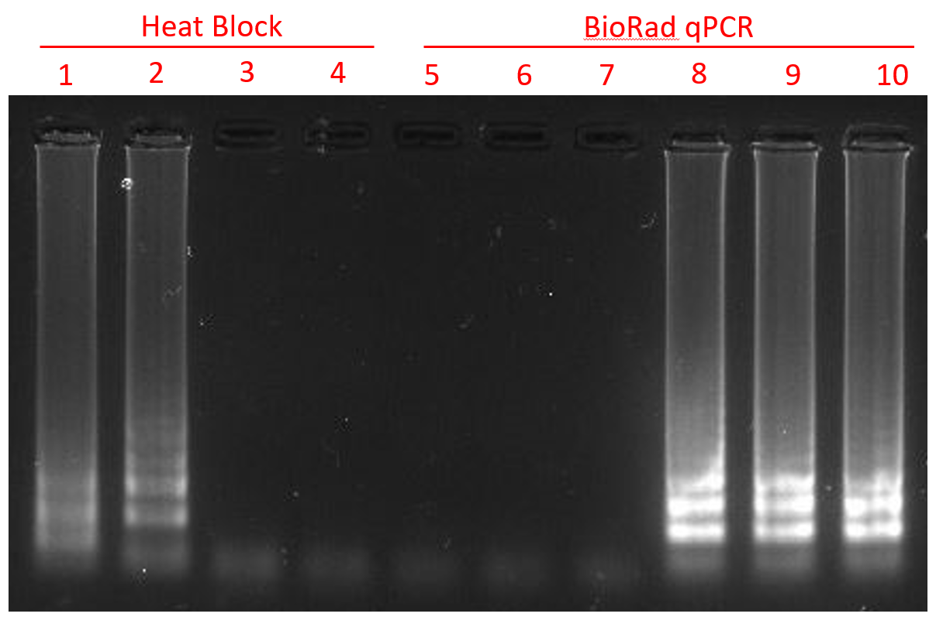
LAMP
1: 1µl of purified DNA in 24µL of LAMP master
2: 1µl of heat lysis DNA in 24µL of LAMP master
3: 2µl of heat lysis DNA in 48µL of LAMP master
4: 2µl of heat lysis DNA in 48µL of LAMP master
5-7: Fluorescent LAMP mix
8-10: Colorimetric LAMP mix

Slide 4
LAMP
1: 1µl of purified DNA in 24µL of LAMP master
2: 1µl of heat lysis DNA in 24µL of LAMP master
3: 2µl of heat lysis DNA in 48µL of LAMP master
4: 2µl of heat lysis DNA in 48µL of LAMP master
5-7: Fluorescent LAMP mix
8-10: Colorimetric LAMP mix

