Slide 1
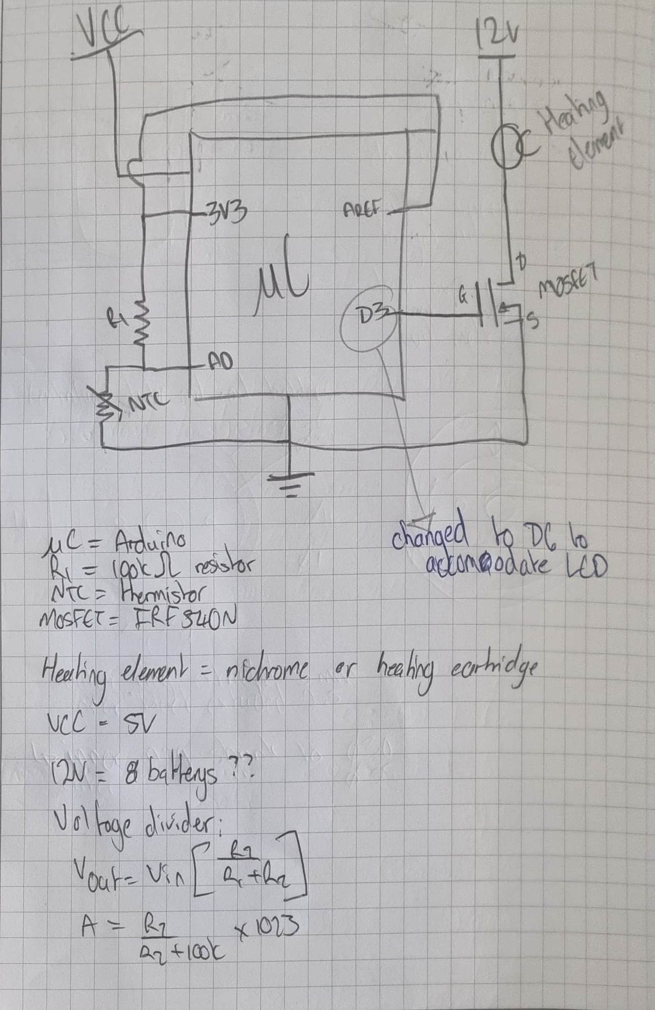
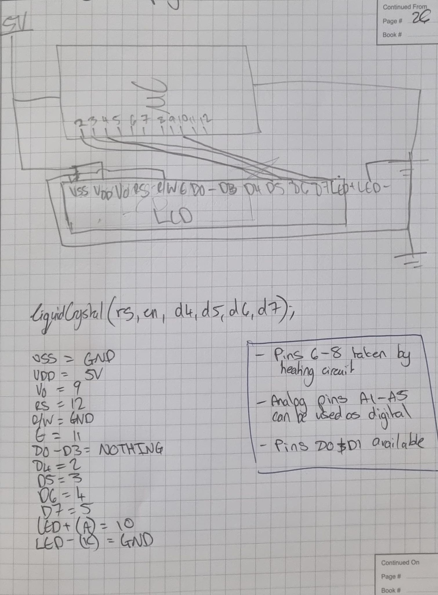
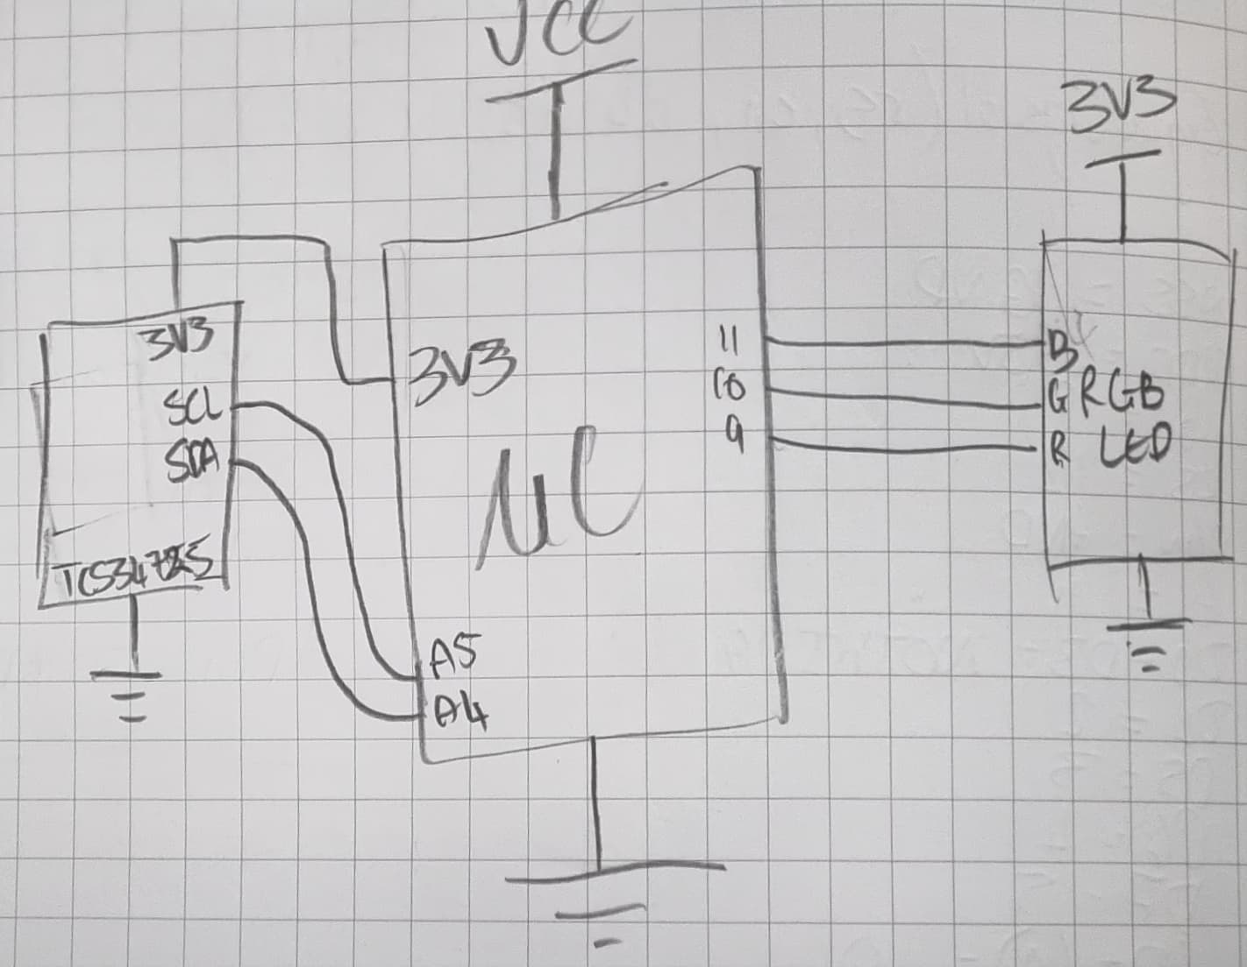
Heating block
LCD block
Fluorescence block

Slide 2
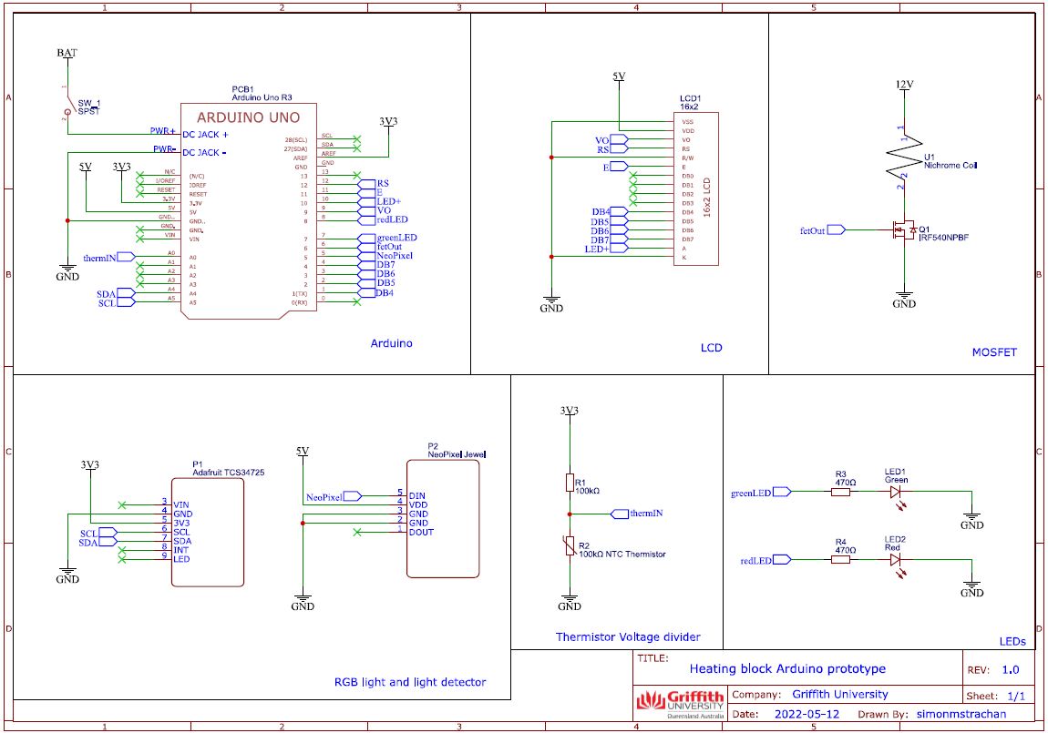

Slide 3
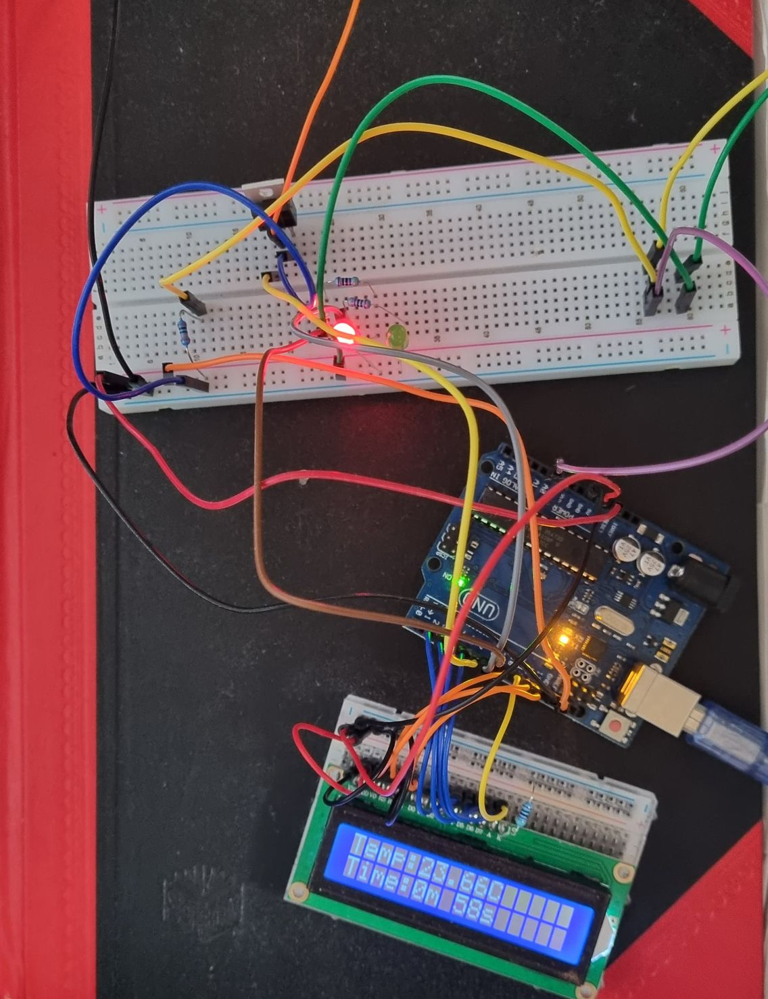
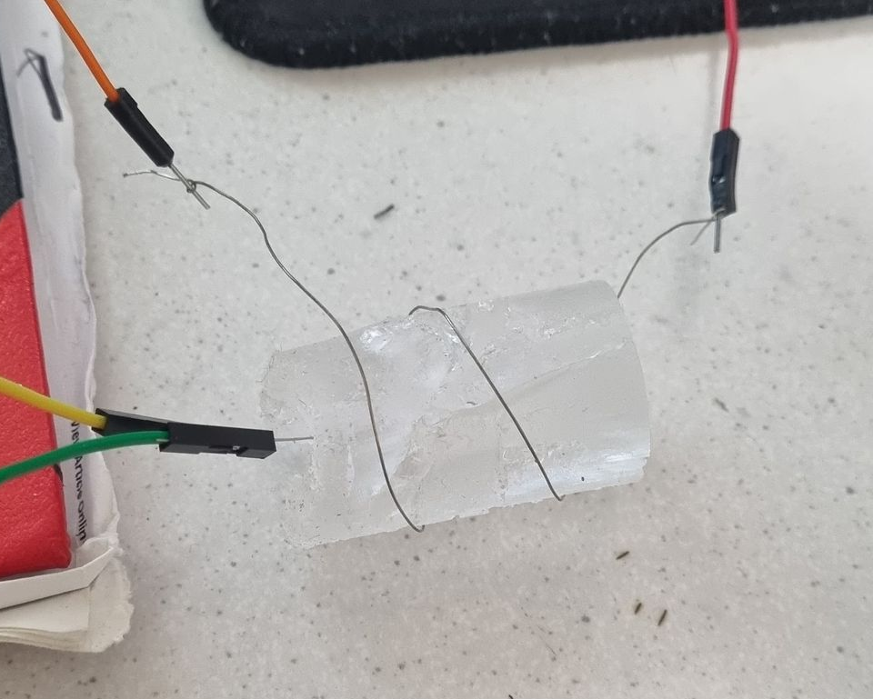
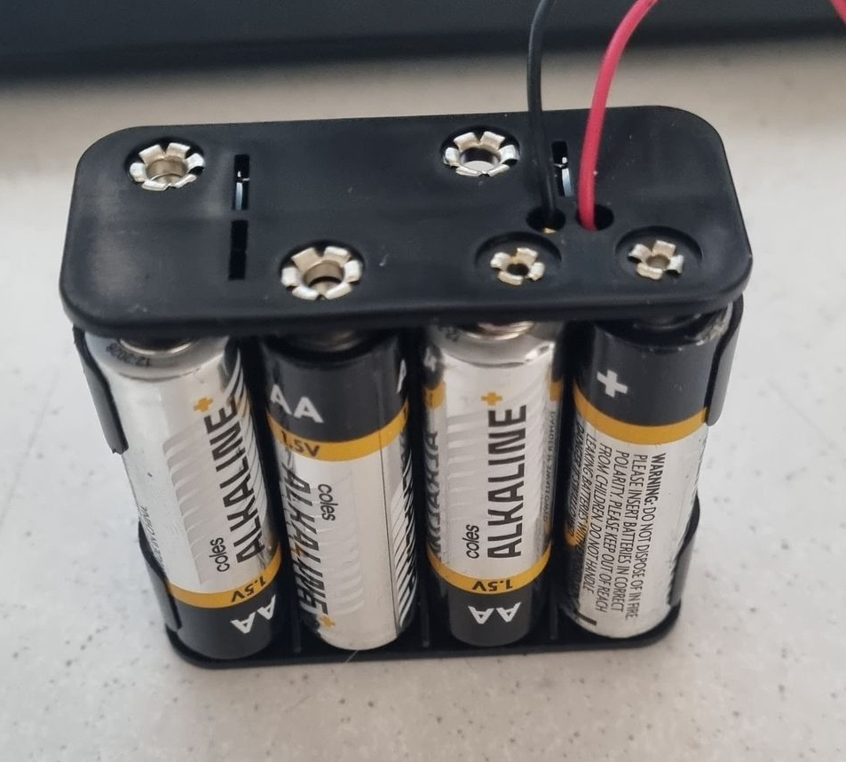
Proof of concept Heating Block
15cm Nichrome Wire
Switching MOSFET
1st PDMS mold
In range out of range LEDs
Voltage divider
Thermistor
Arduino
8x 1.5V AA batteries = 12V
Time and temp LCD

Slide 4
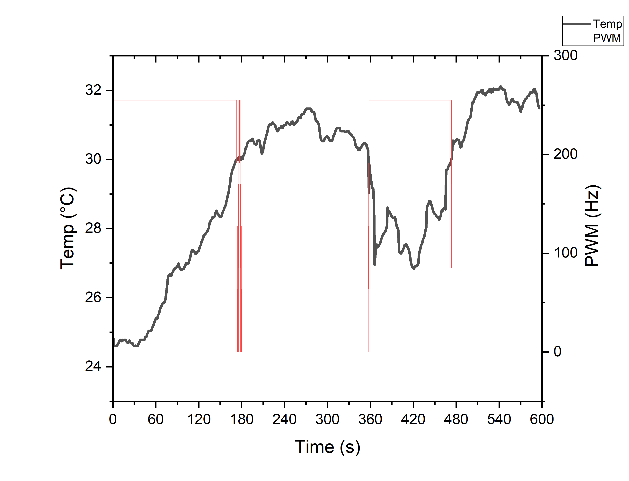
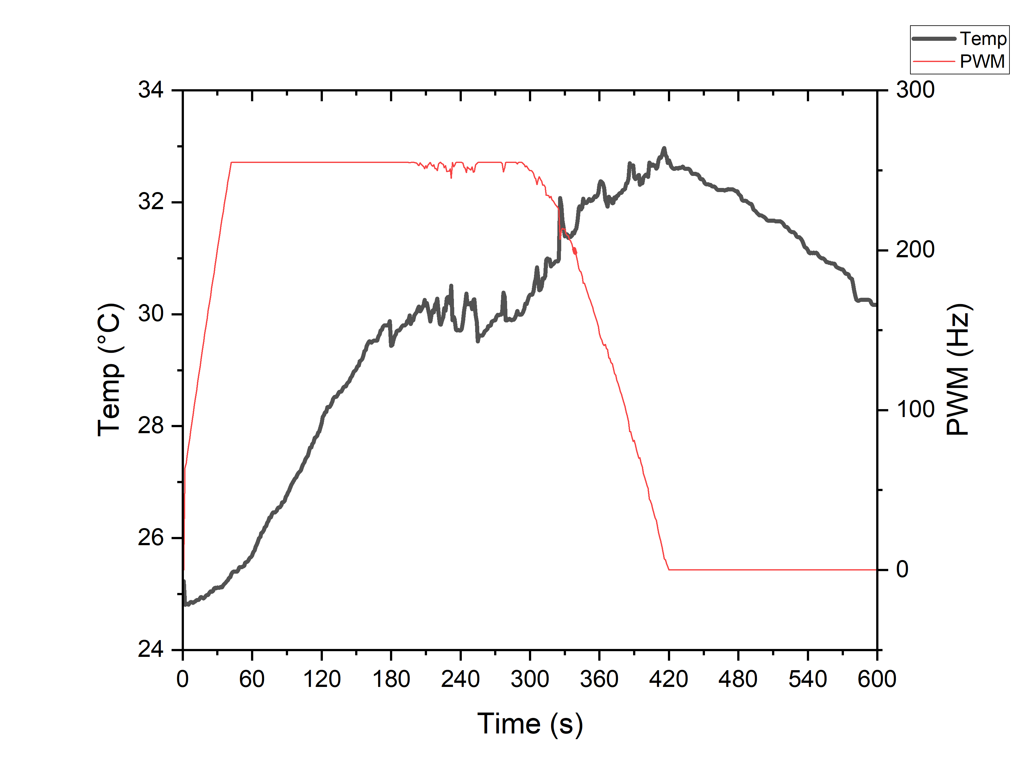
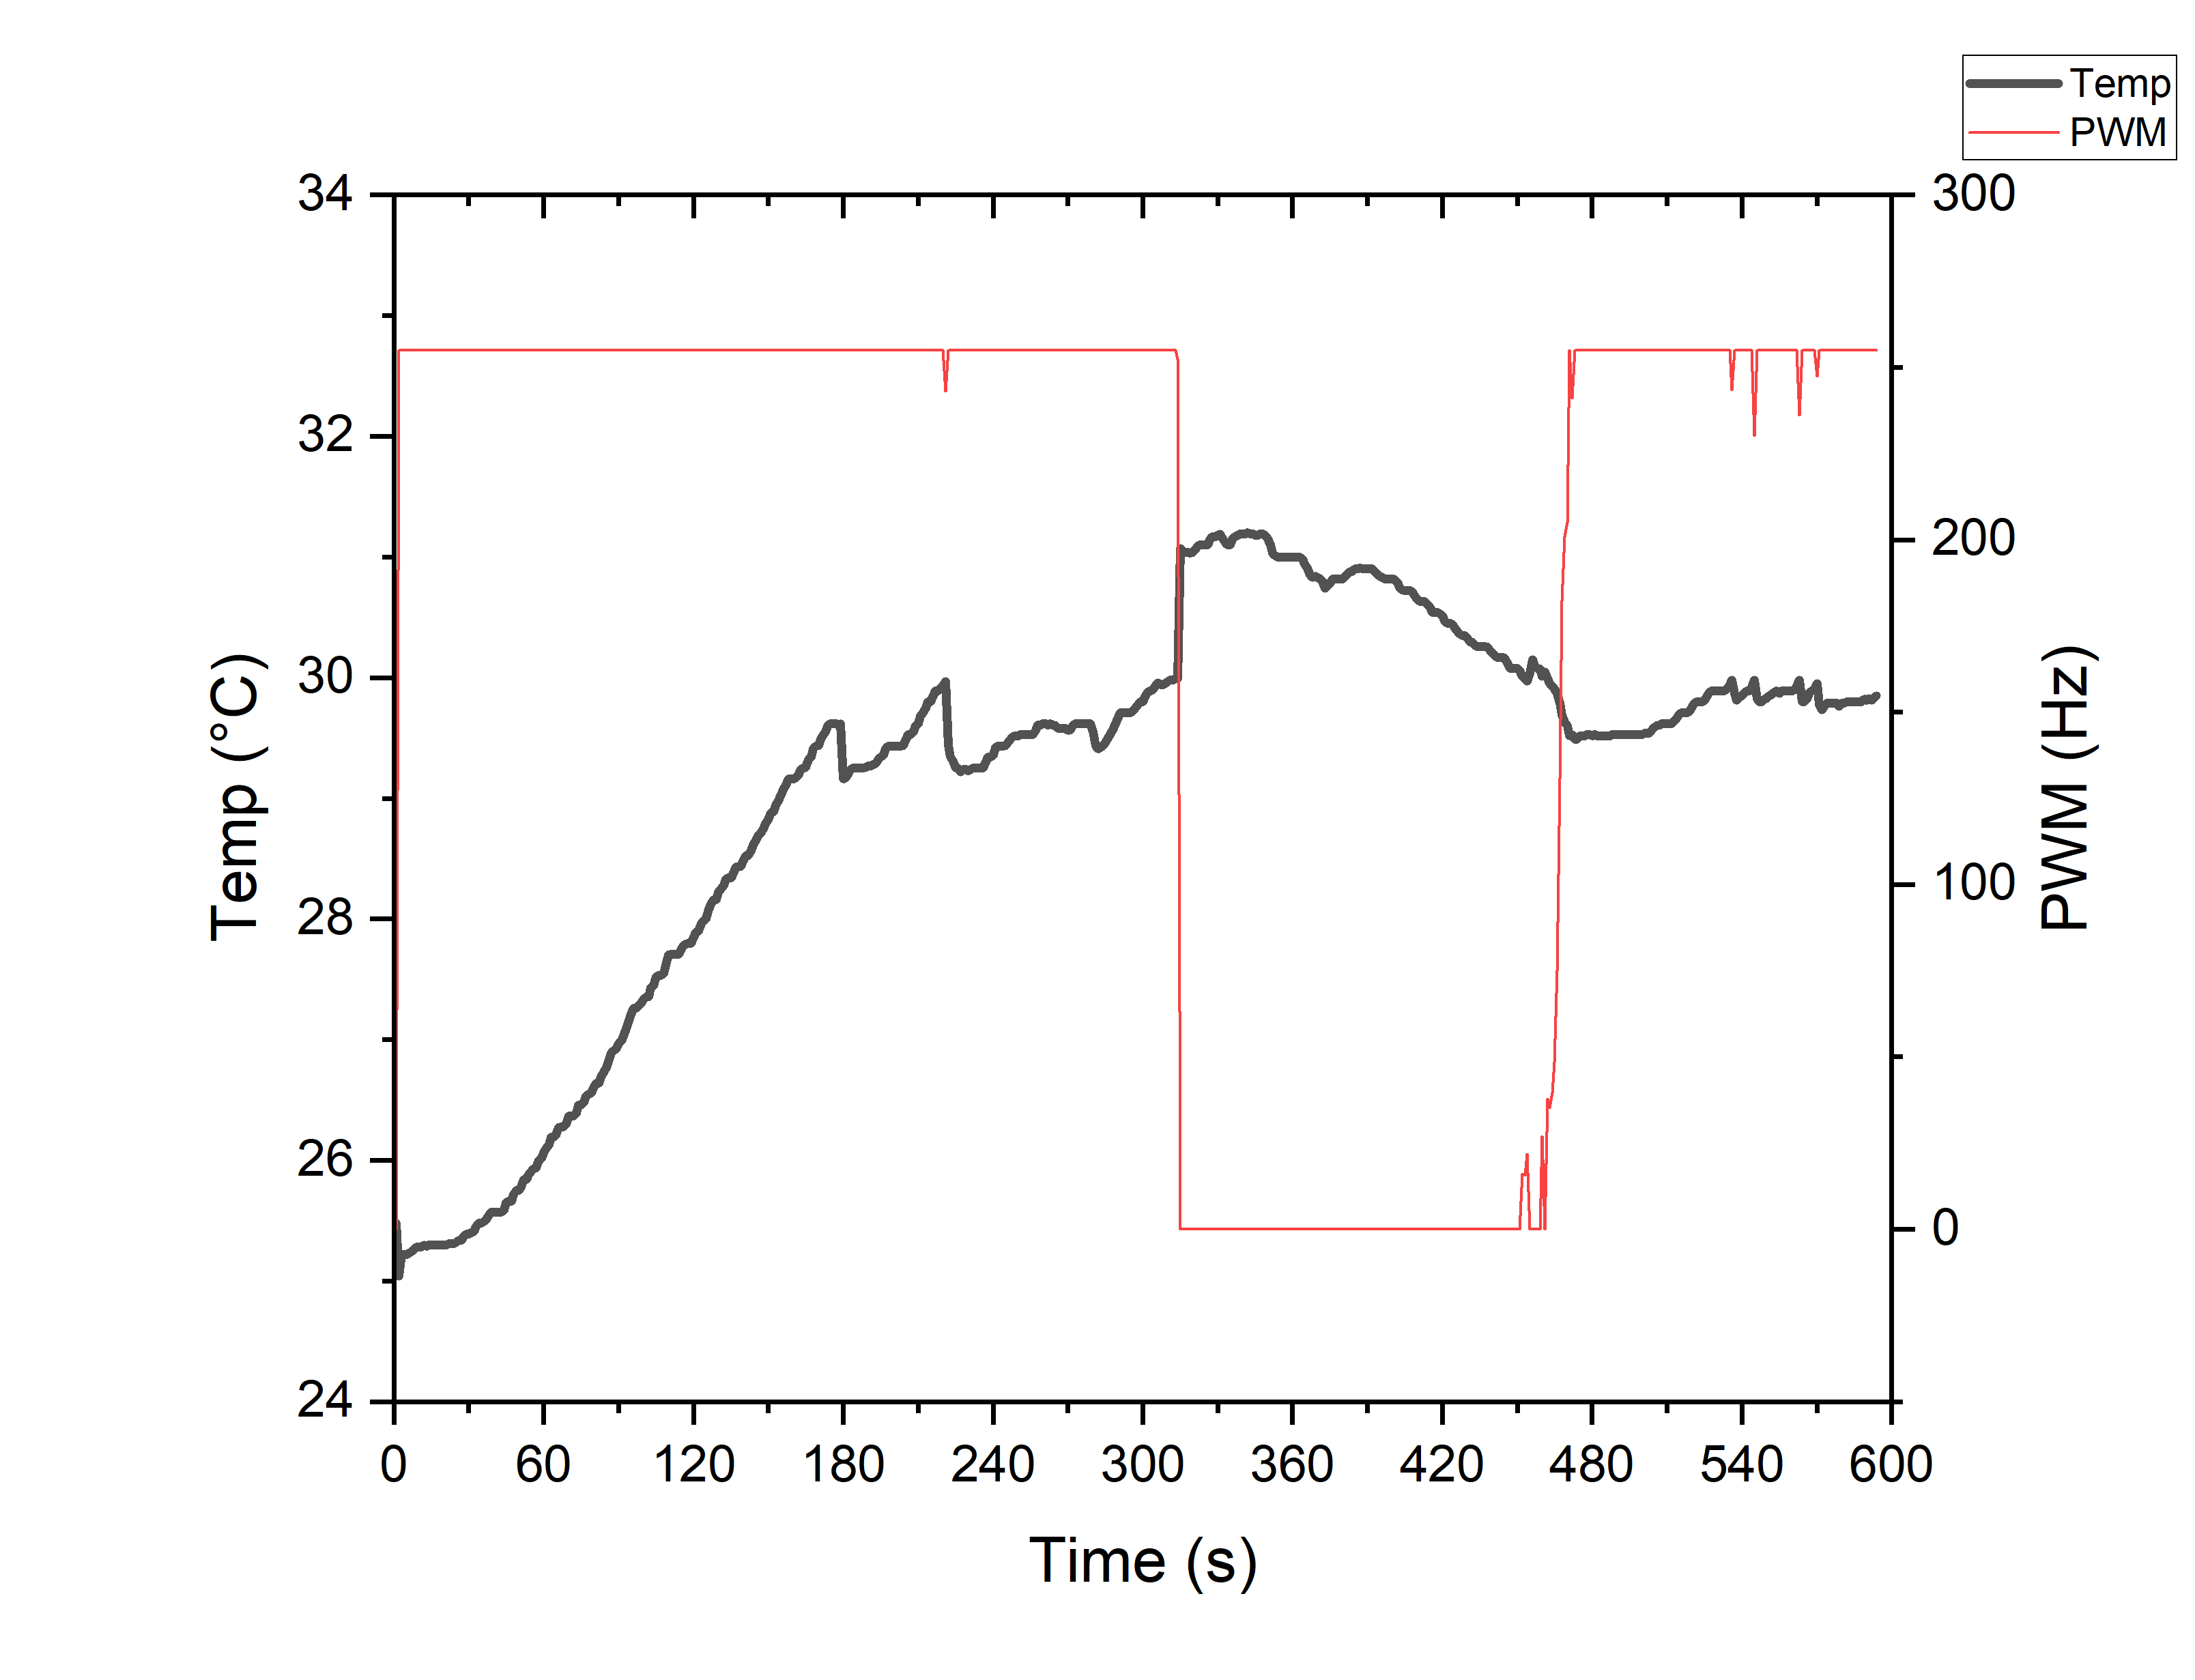
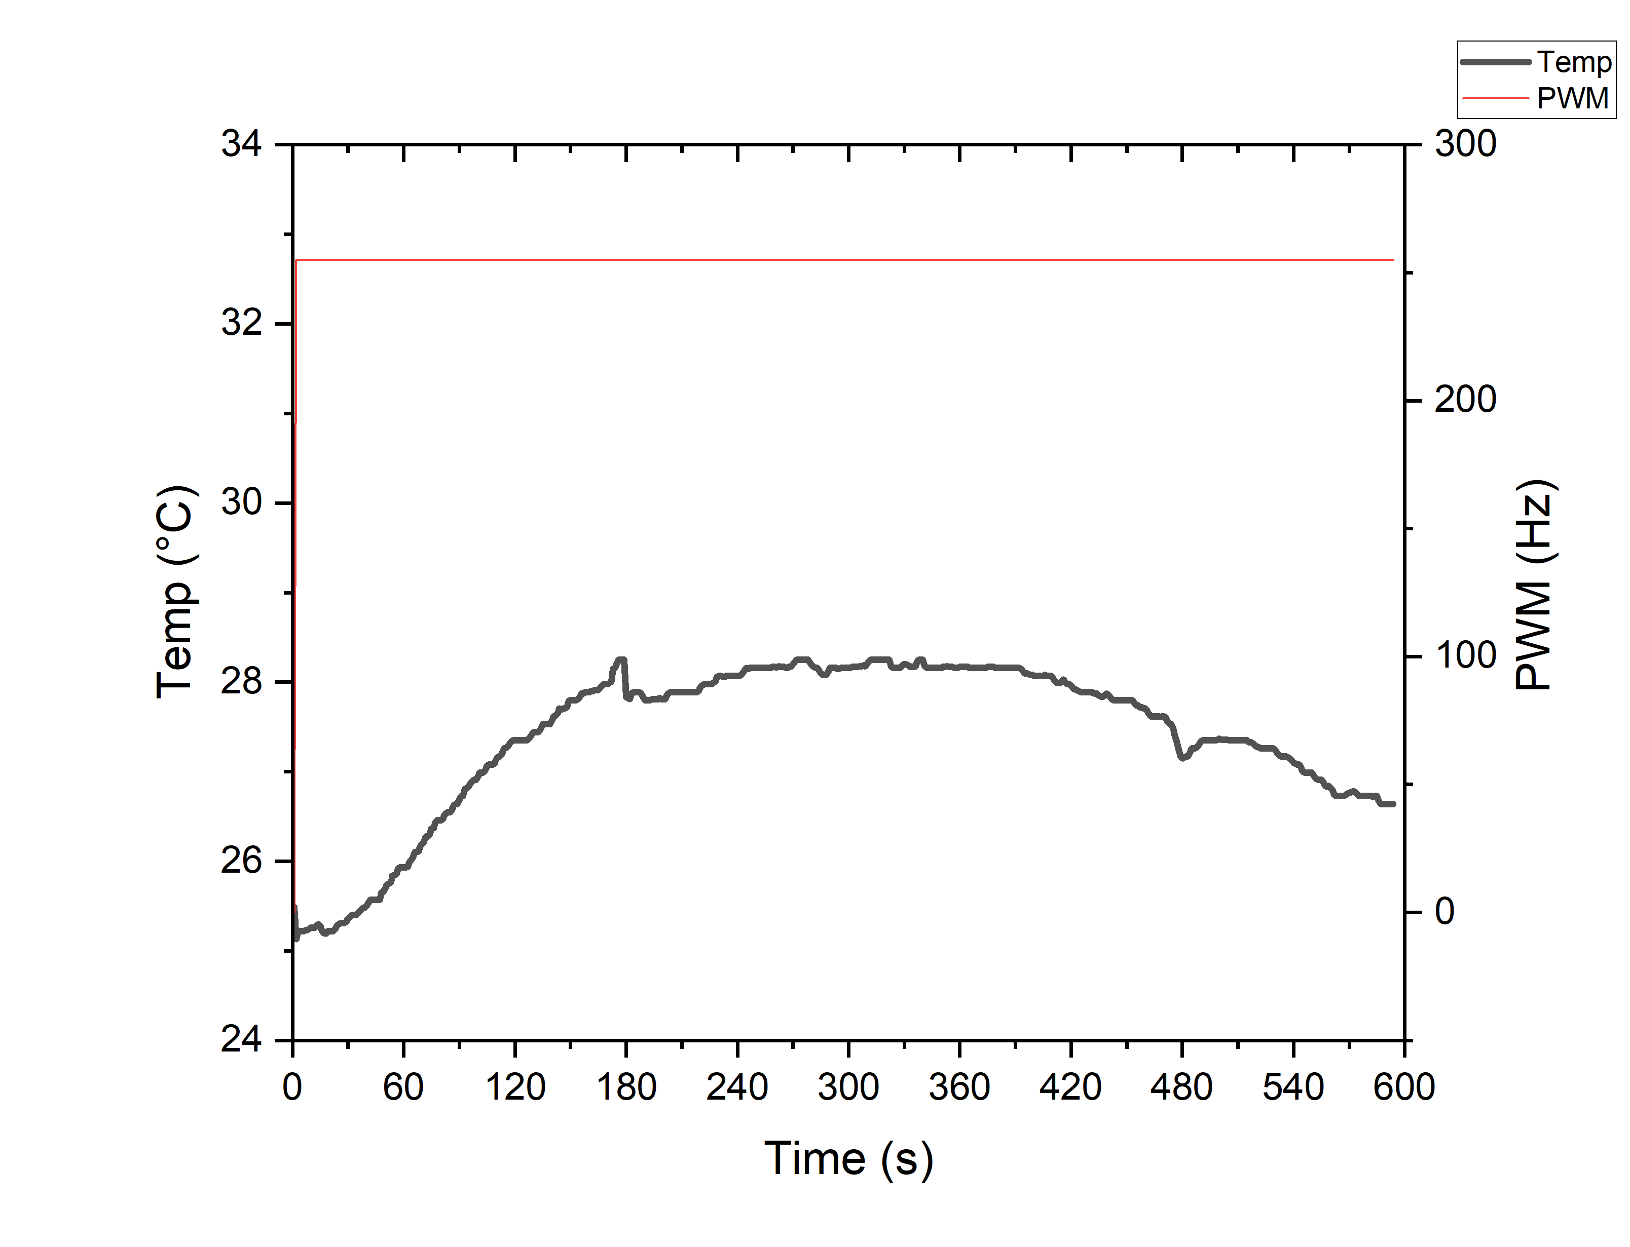
No PID
Kp = 50
Ki = 50
Kd = 0.5
Kp = 350
Ki = 300
Kd = 50
Kp = 350
Ki = 300
Kd = 100

Slide 5
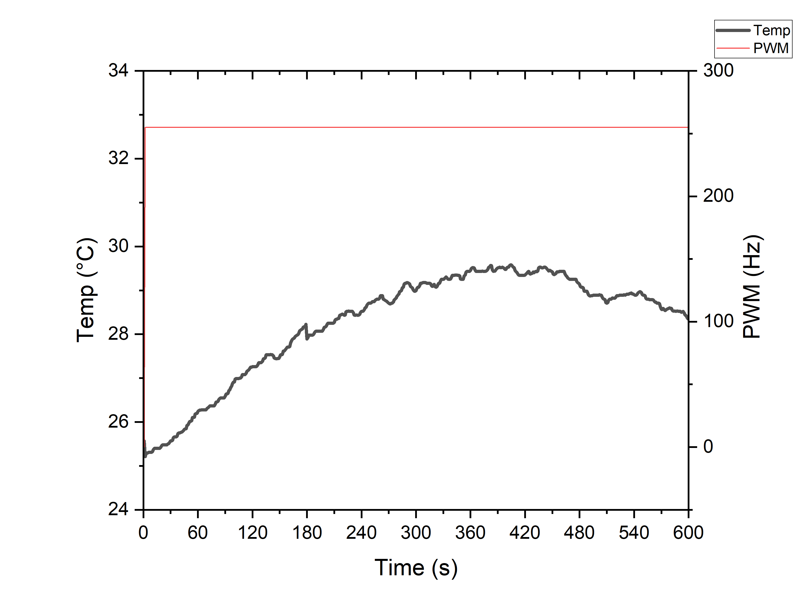
350300100 low bat

Slide 6
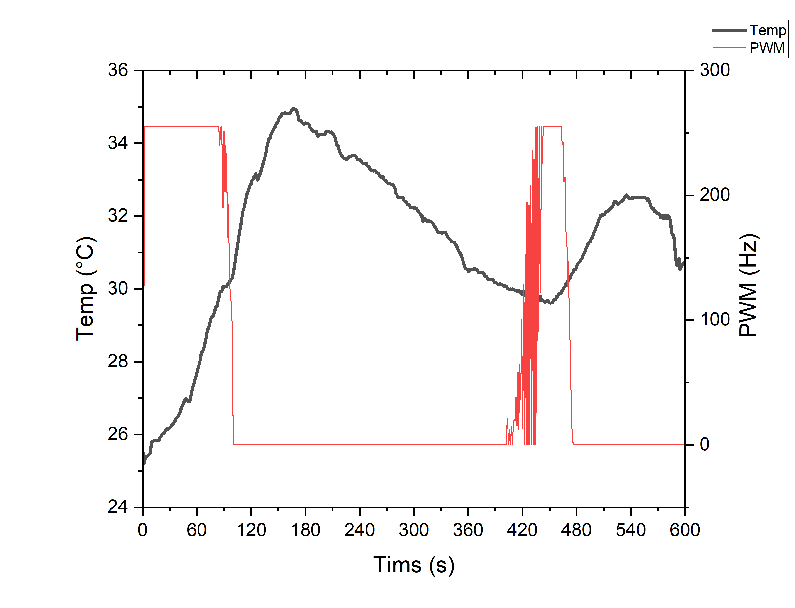
35030050 old and new bat

Slide 7
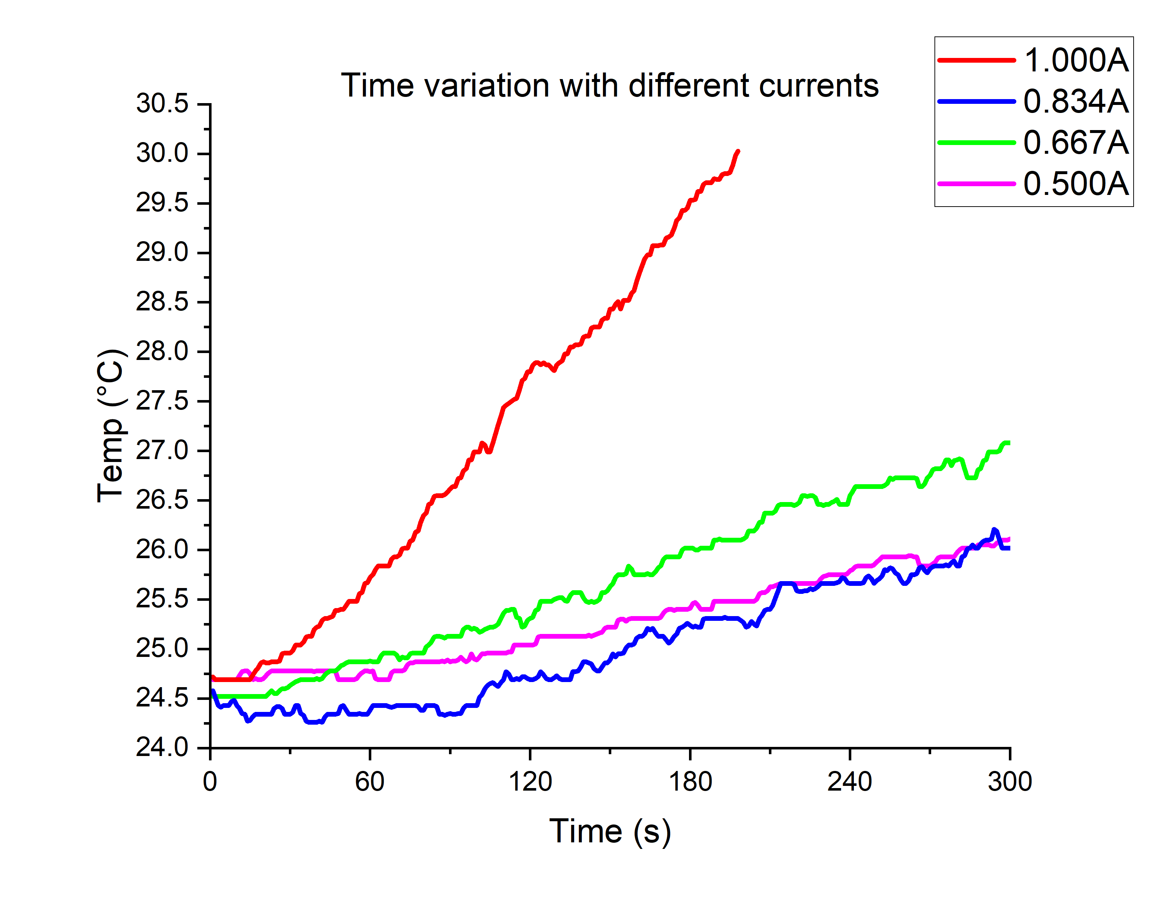
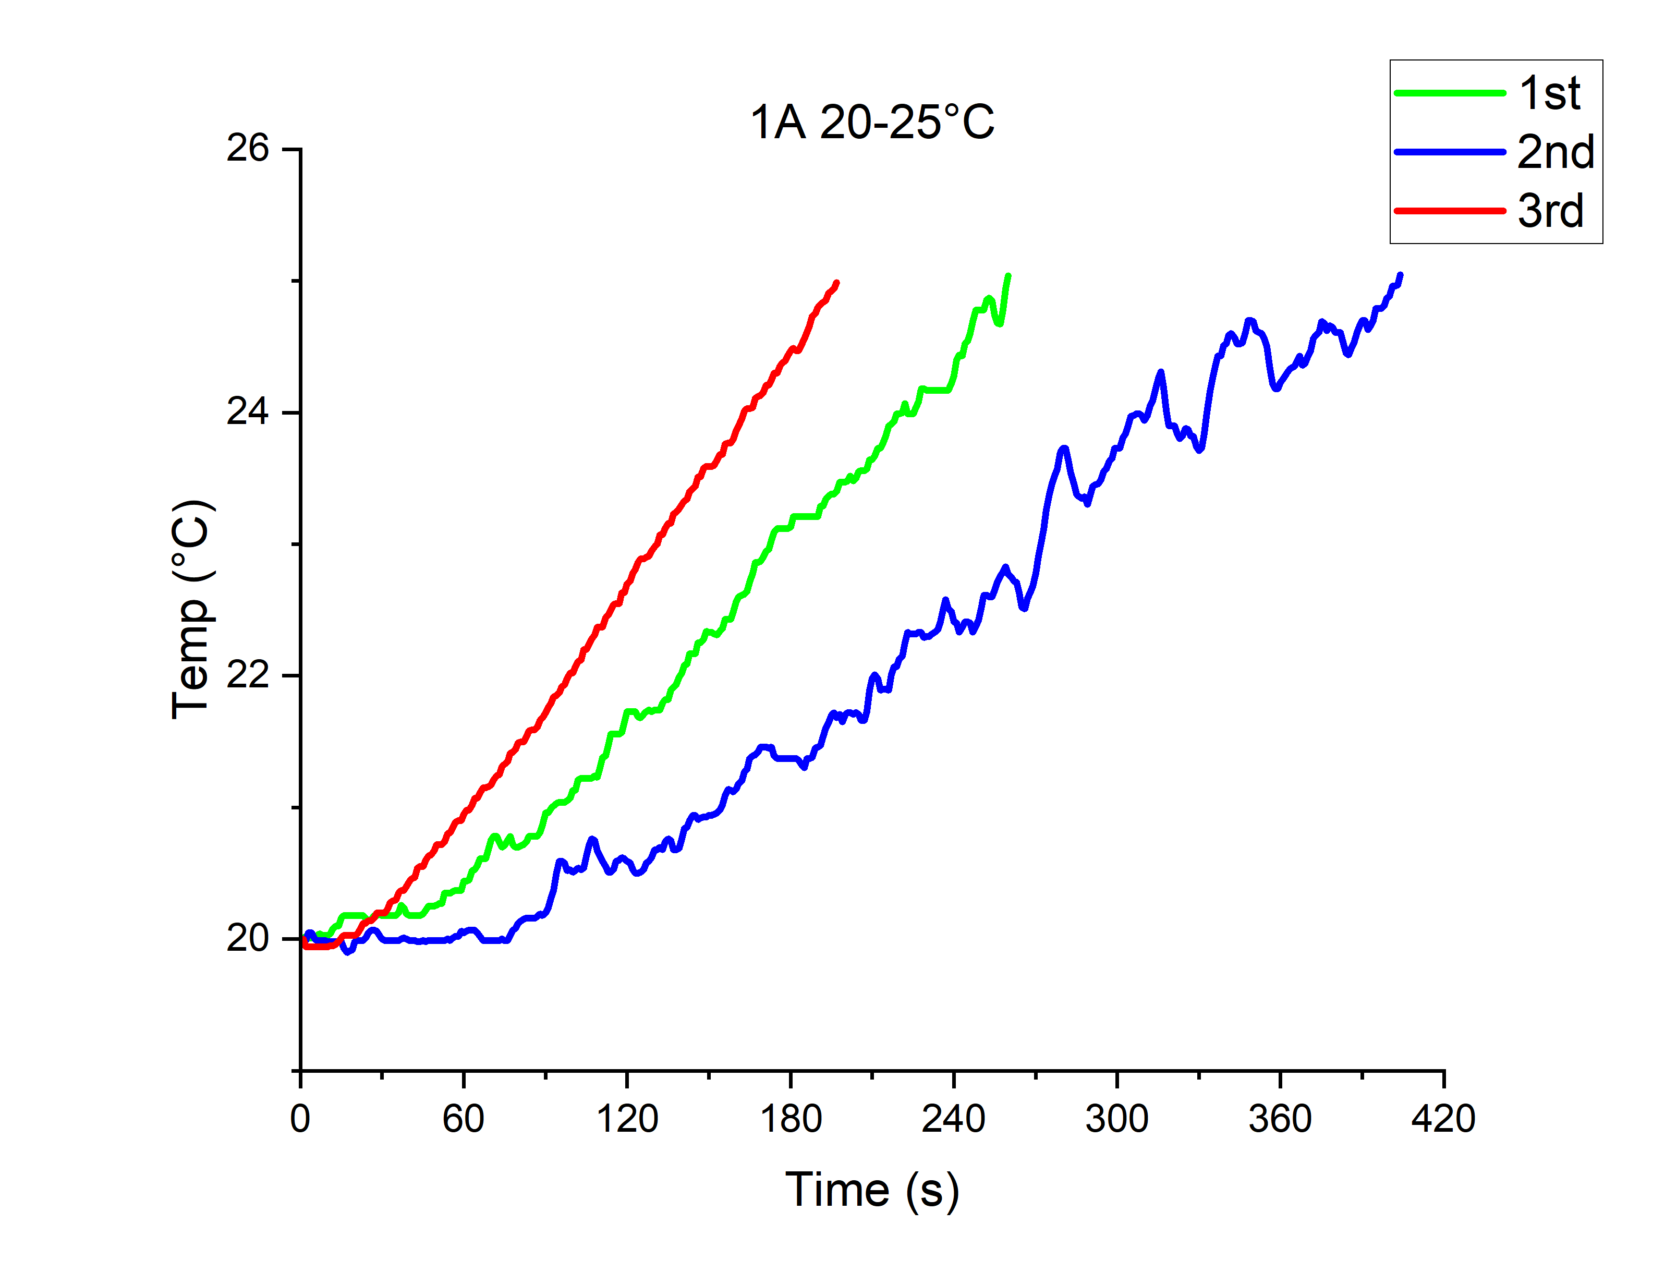
Time it takes for varying currents
For 21cm:
4.68V
3.96V
3.17V
2.37V
3min 18s
3min 17s
4min 20s
6min 44s

Slide 8
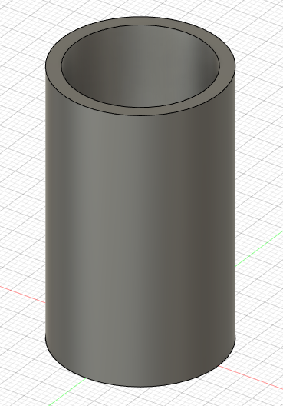
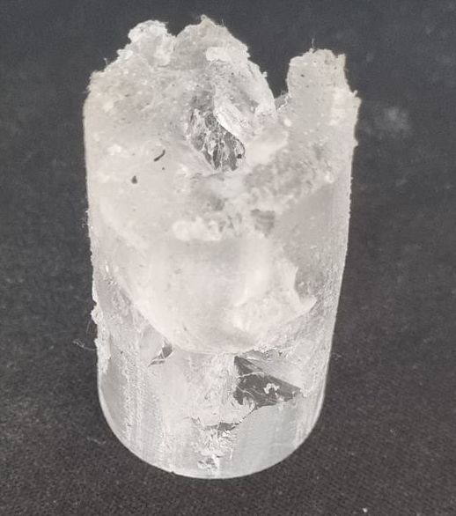
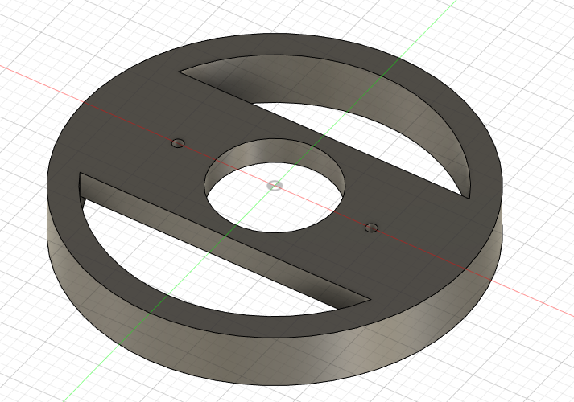
PDMS Mold
Mold cap for 1st iteration
Mold cap for 2nd iteration
Ø25
Holds tube
Holds wire
45mm
Problem | Solution
Poor mold due to short set time | Leave for ~48hrs room temp
Difficult to get out of mold | Breakable mold
Too big | Redesign and print mold

Slide 9
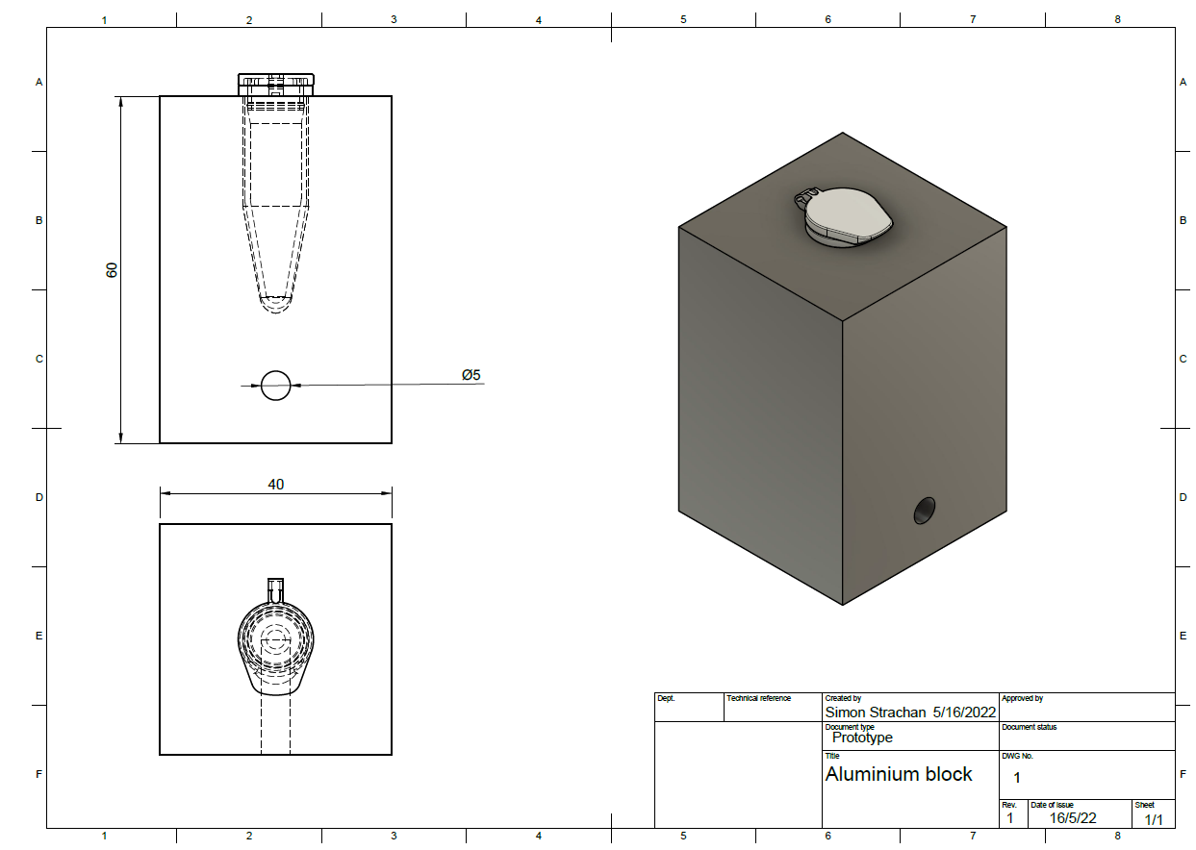
Aluminium block design
3 different PTC heating cartridges:
40W/12V
40W/24V
40W/24V (5mm longer)

Slide 10
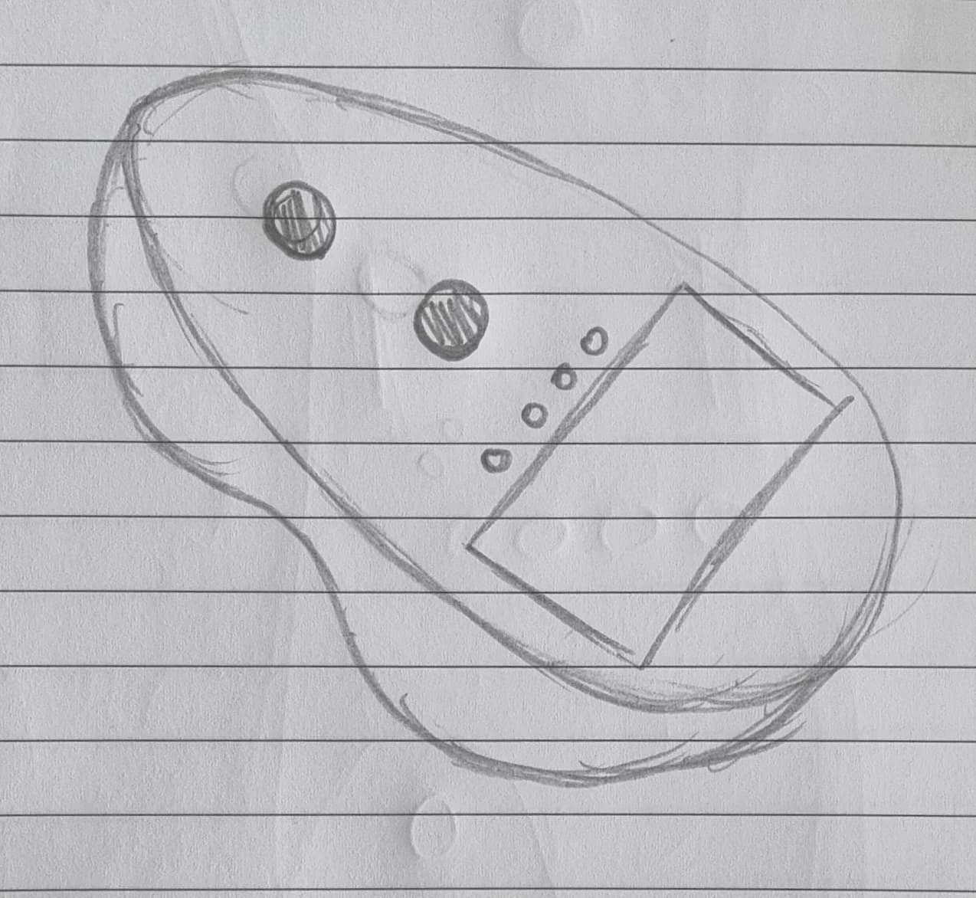
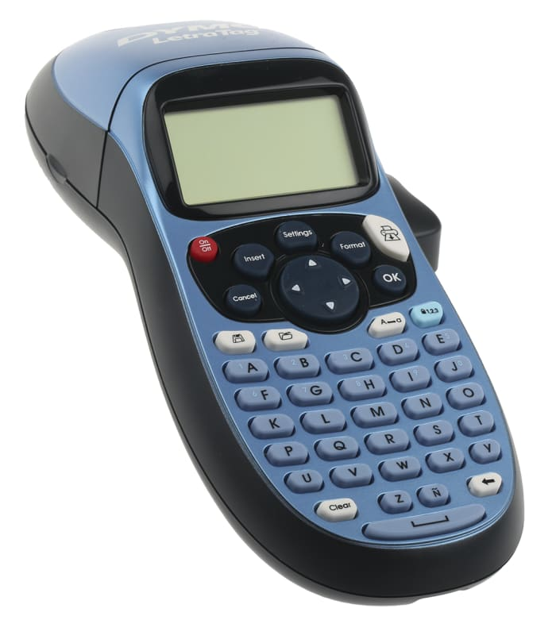
Potential redesign
Handheld, but supported so can be put down
Bottom shaped to fit hand: shaped after
Possibly 150x100mm
Small touch screens: 77x52mm
Heating tube
Detection tube
LEDs
Touch screen
Modelled after label maker
Easily add slant for improved screen visibility
Shaped for hand but sturdy on table

