Slide 1
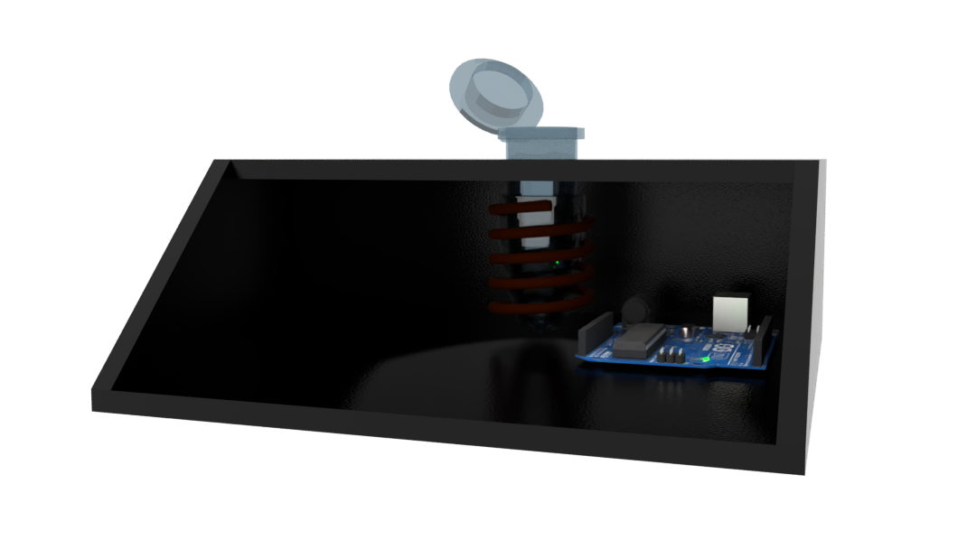
Eppendorf
PDMS tube
Nichrome heating coil
Microcontroller (Arduino)
3D printed PLA/ABS

Slide 2
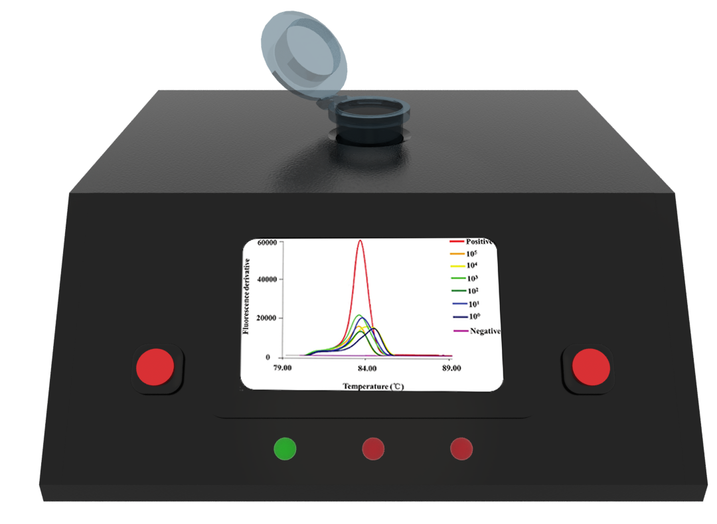
LED1 – Heat lysis is ready
LED2 – Heat lysis is done and amplification is ready
LED3 – Amplification is done
Display
Button to initiate heat lysis
Button to initiate amplification
LED1
LED2
LED3

Slide 3
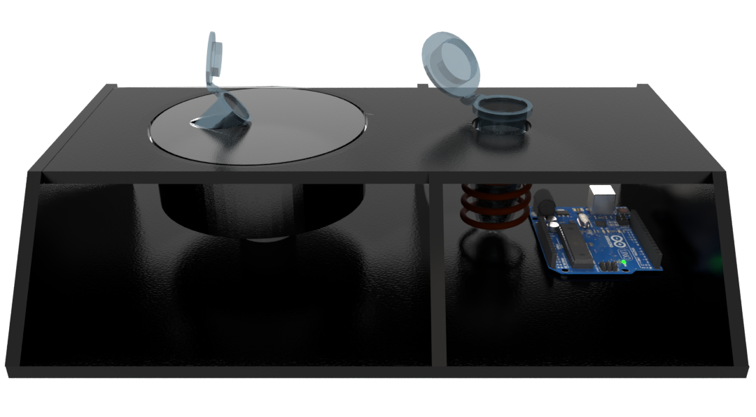
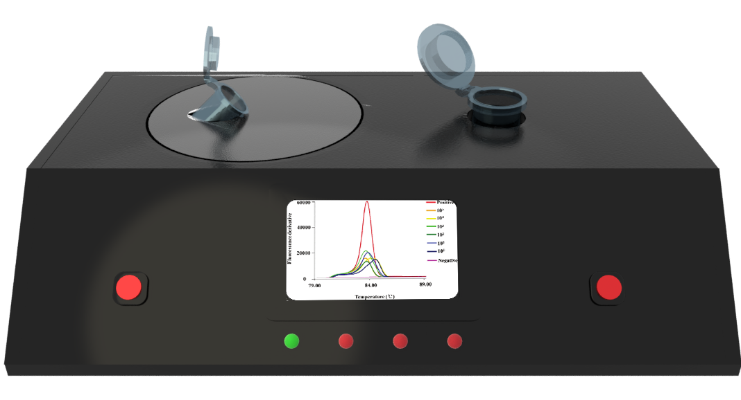
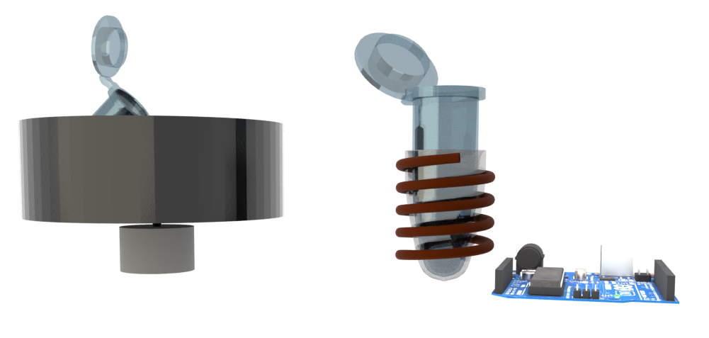
Eppendorf at 45°
Rotational arm
DC motor

