Slide 1
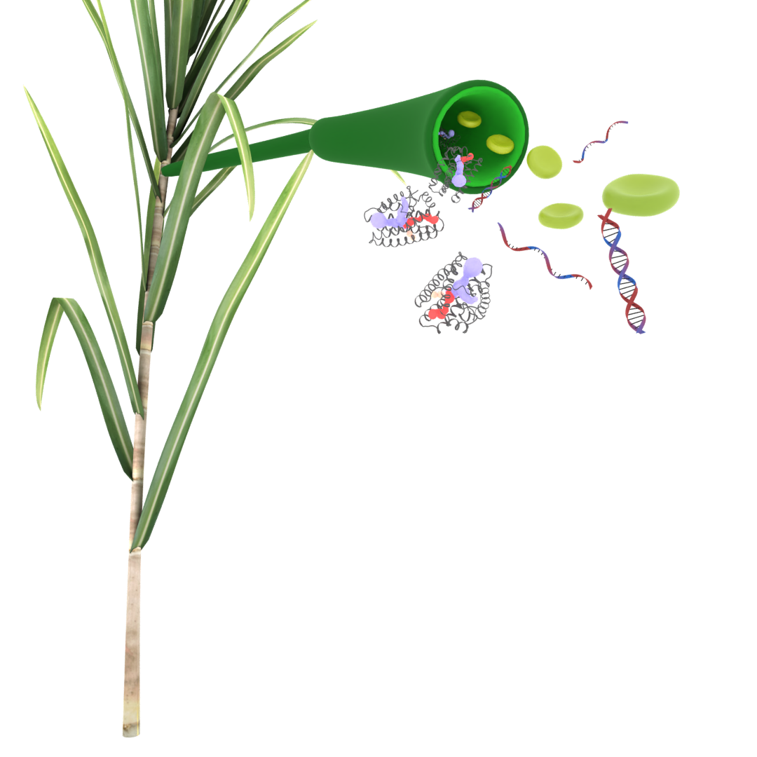
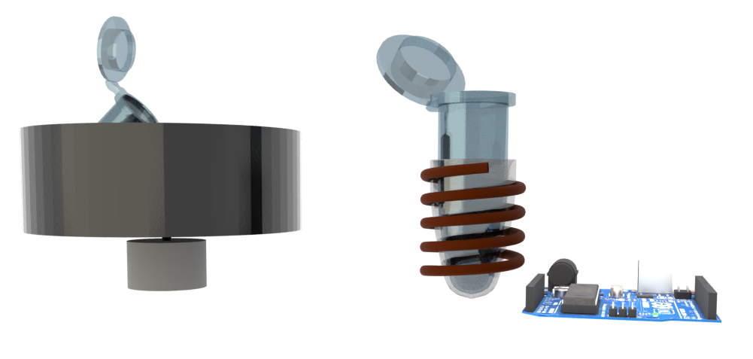
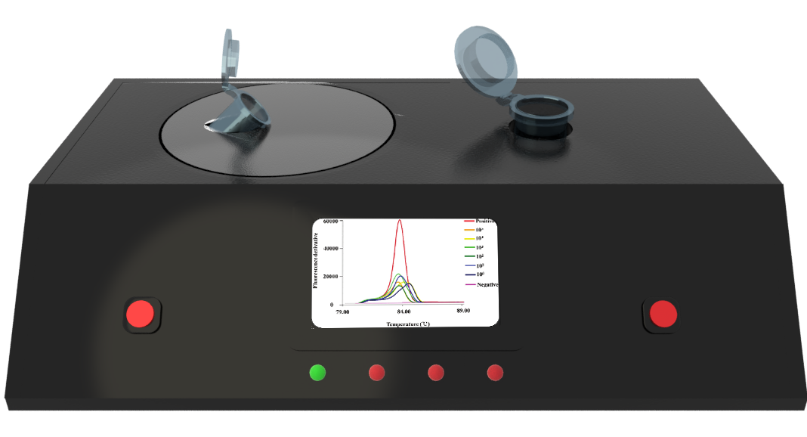
Portable on-farm device for RSD
“One device to get diagnostic results for RSD, Leaf Scald and other sugarcane diseases”

