Slide 1
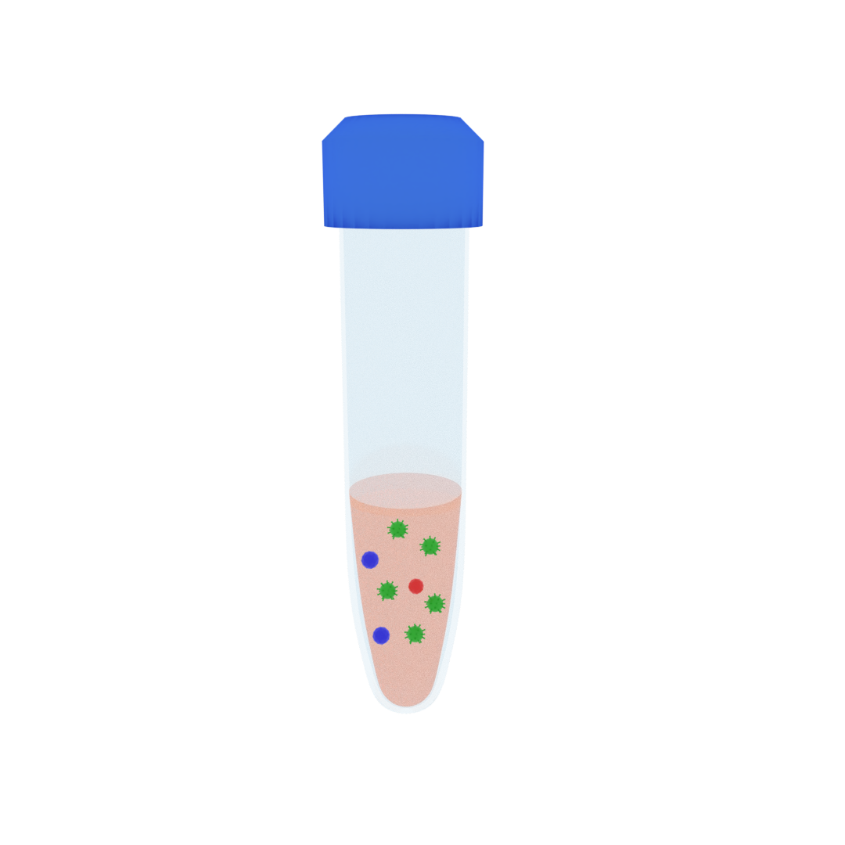



Sample loaded and mixed
Solution Partitioned
PEG-rich phase
Time
Centrifugation
Salt-rich phase

