Slide 1
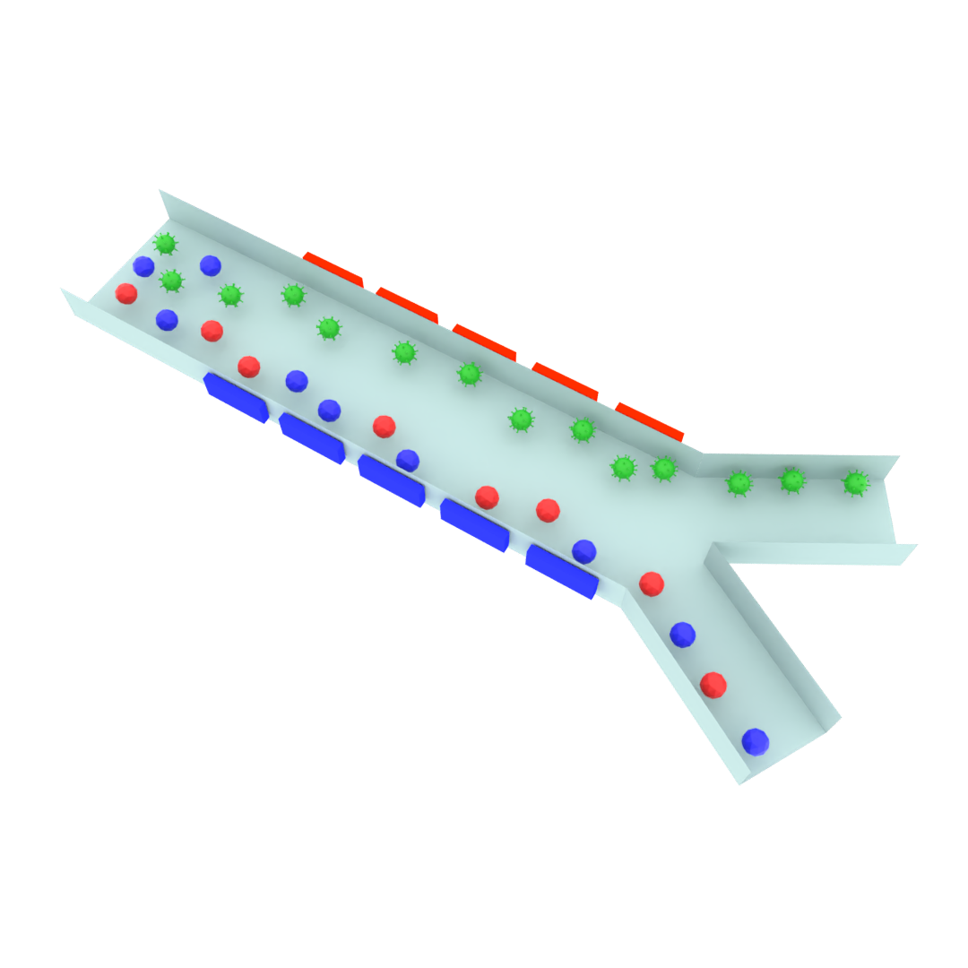
Electrodes
Inlet
Outlet A
Outlet B

