Slide 1
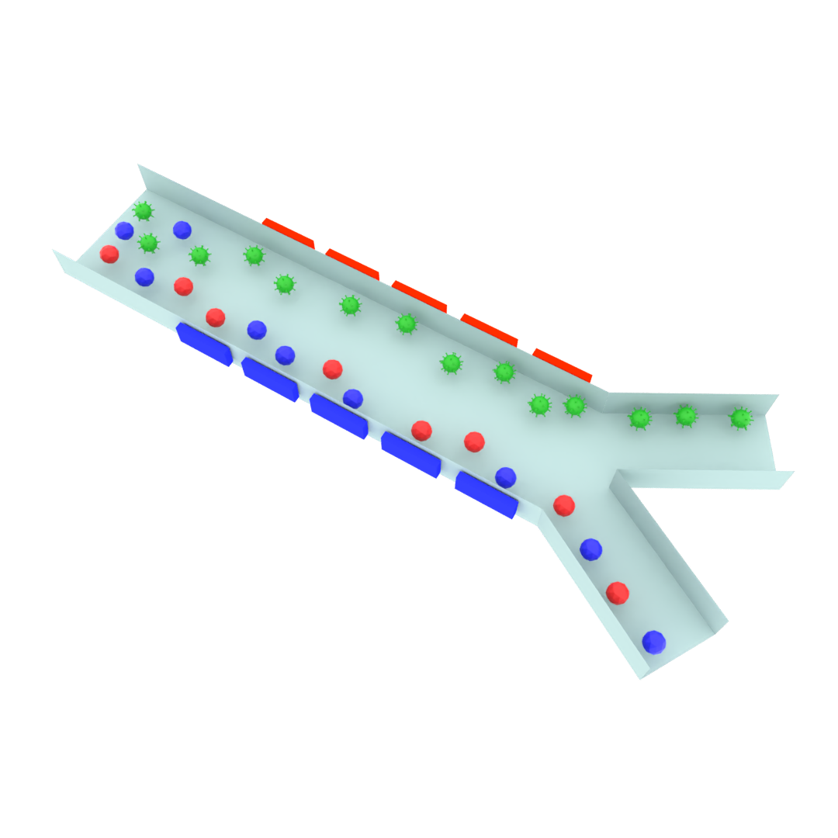
Inlet
Electrodes
Outlet A
Outlet B

