Slide 1
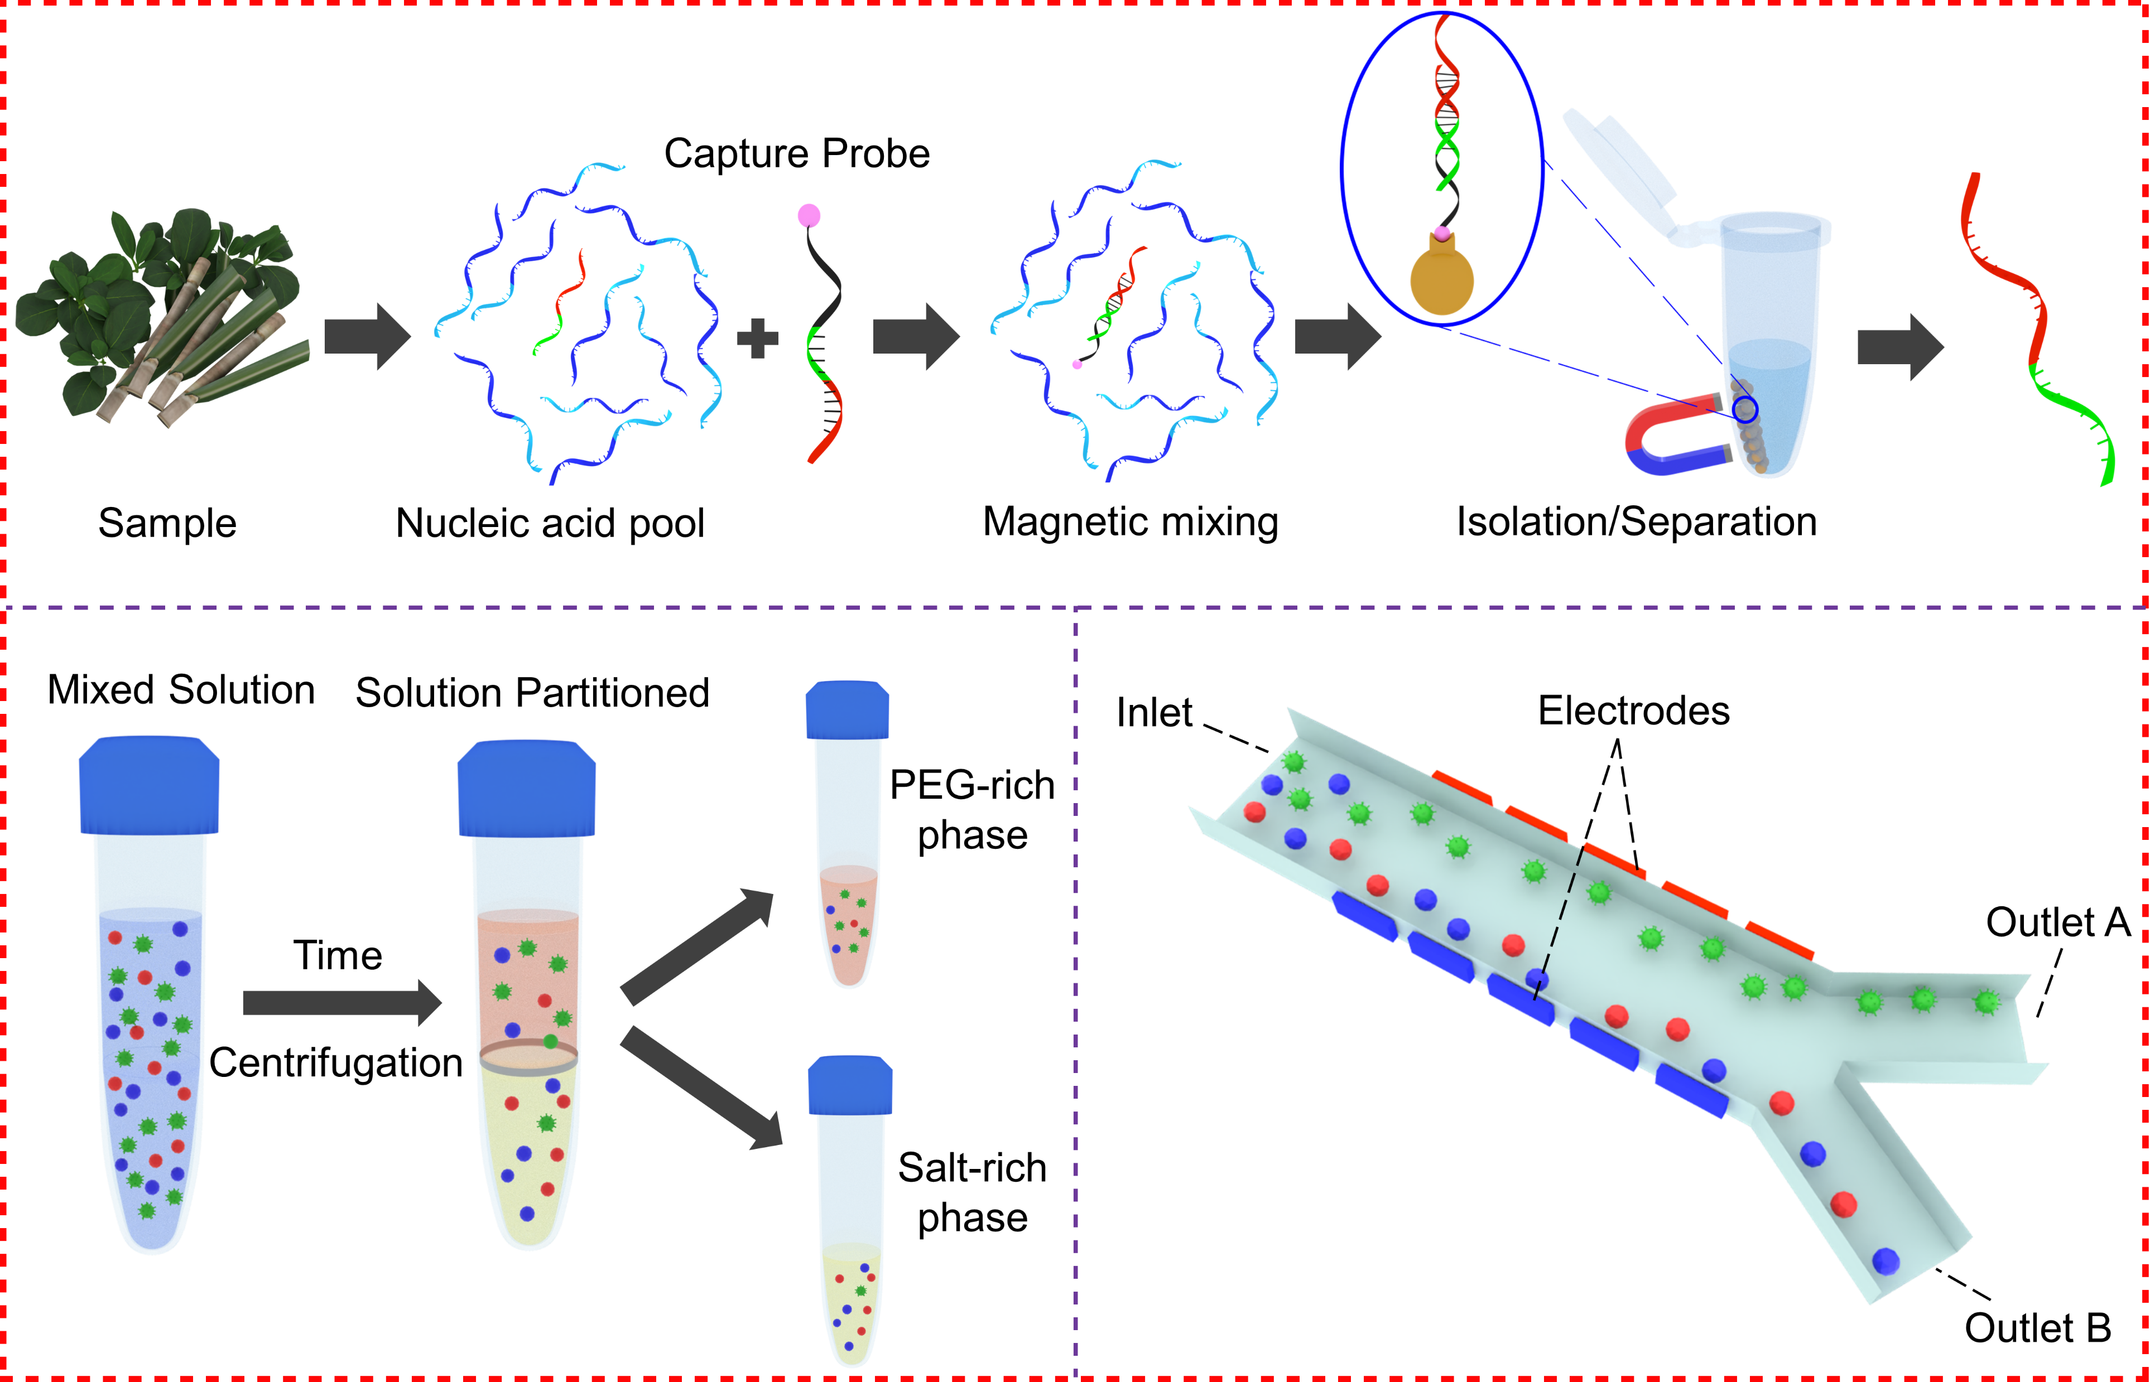
(i)
(ii)
(iii)

