Slide 1
Current (µA)
Time (s)

Slide 3
Z’’ (Ω)
Z’ (Ω)

Slide 4
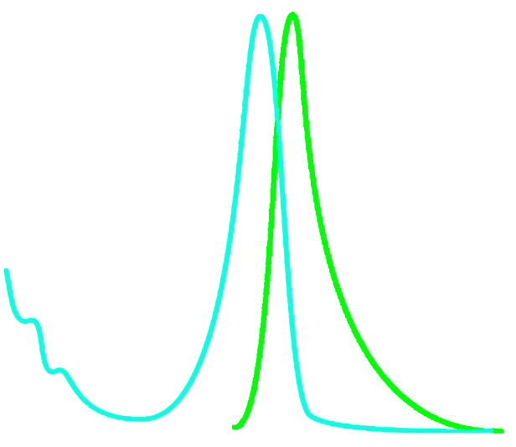

Slide 5
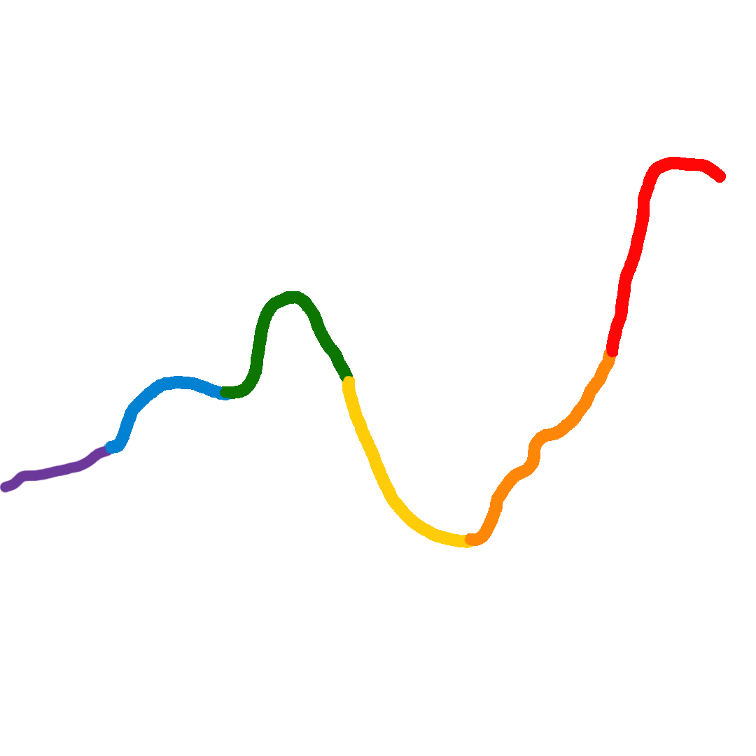

Slide 6
