Slide 1
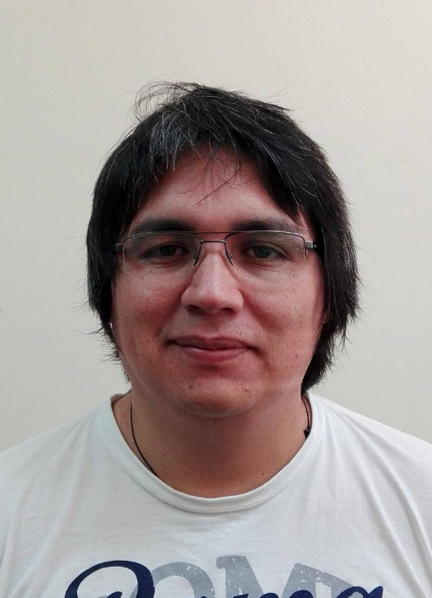
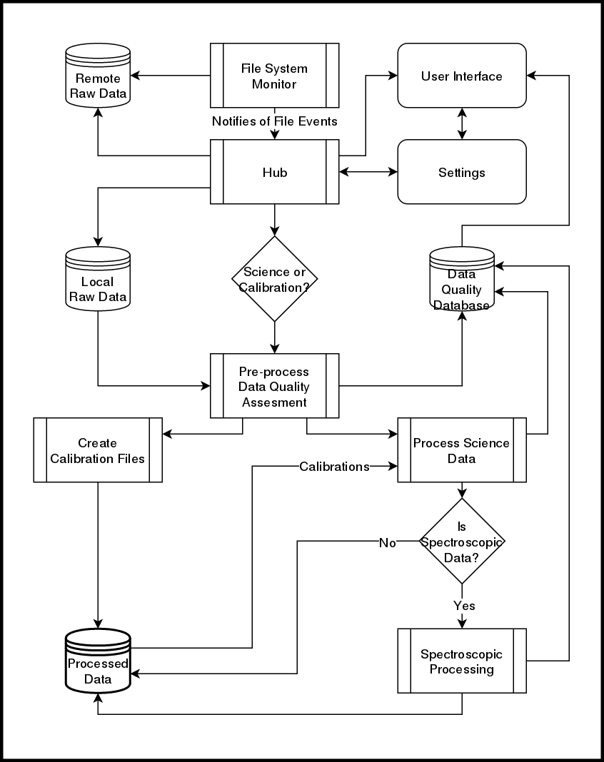

A near real time Data Reduction Pipeline for the
Goodman High Throughput Spectrograph
Simón Torres-Robledo¹, César Briceño^{1,2}.
¹SOAR Telescope, La Serena, Región de Coquimbo, Chile.
²Cerro Tololo Interamerican Observatory, Casilla 603, La Serena, Chile.
Abstract
Results
The Goodman Spectroscopic Pipeline (goodman-pipeline or GSP) is reaching some maturity and behaving in a stable manner. Though its development continues, we have started a parallel effort to develop a real-time version of the GSP, which aims to obtaining fully reduced data within seconds after the spectrum has been obtained at the telescope. Most of the required structure, algorithms and processes already exist with the offline version of the GSP. The real-time or online version differs in its requirements for flow control, calibration files, image combination, reprocessing, observing logging assistance, etc. Here we present results obtained with the offline version of GSP with various instrument setups, and outlined the route for implementation of real time, online version.
Though performance has not been a top requirement since we are focused on one instrument at one telescope and the data production rate is low and can be easily manageable with the resources available. The most important part of our focus is obtaining good wavelength solutions, we found that the most practical way for obtaining wavelength solutions for our new data is to have a template library, i.e. wavelength calibrated lamps for all possible instrument configurations. The Goodman HTS has 20 fixed instrument configurations and six possible comparison lamps choices which gives a total of 120 lamps required for the template library to be complete.
Interactive (Å) | Automatic (Å) | Slit Size
0.368 | 0.340 | 0.84”
0.296 | 0.521 | 1.03”
Table 2. Comparison of typical values for the RMS error for one of the nights used to evaluate the performance of the pipeline.
Highlighted Features
Conceptual Design and workflow
Challenges
The latest version of the Goodman Spectroscopic Pipeline is the result of extensive development carried over the period of two years. Our initial goals can be summarized as follows:
Must be easy to use
Well documented
Written according to current standards
Produce Science ready results
We believe we have achieved all of them, in addition, we can list the following attributes
Accurate on wavelength solution: High precision, repeatable results.
Modular: Part of the code can be imported for reuse.
Integrated test: Automatically tested everyday.
pip-installable: Since version v1.1.2
Absolutely portable: The pipeline works on Linux and Mac.
The live version of the pipeline has not been built yet, however we have experimented with parts that we are planning to use. From the technical point of view we don’t see any particular challenge that we did not face already. All the processing will be done using the current development with the exception of the Data Quality assessment part. We have not decided yet whether it will be built as a submodule of the current project or as an independent project. It will work by actions triggered by file-system events. For instance, a new file is added to the folder being monitored, the Hub (See Figure 1) is notified and the file is copied over to a local directory. Finally, the appropriate actions are triggered in order to ensure that the file is processed accordingly, this includes building master flats or master bias, show preview of current image or waiting for more images for combination.
User Interface: There are quite a few options for doing the UI; web based using Django, or any of the UI development tools, such as Qt. Django and Qt have good Python integration, but since nothing has been done yet, a better option would take over.
Metrics and Data Quality Assessment: Currently we do not have much on measuring the incoming data quality and for live data reduction this is extremely important.
Process Control: We have developed a working pipeline for data reduction at the end of the night, the requirements for an on-site reduction might differ in ways we can’t really preview. Also different projects might have different approaches to data reduction.
Faint Targets: We have intentionally left faint target extractions under-developed because we assumed they would show up in minor amounts, but at the telescope the observer might want to see a preview of a faint object’s spectrum.
Trying it out
Since we can’t provide technical support for installation due to the resources available we have set up a server on the summit that users can access using a VNC session, however the fact that we do not provide support for installation does not mean that installation is hard, in fact you can install it yourself using :
pip install goodman-pipeline
This will install everything except DCR which you can install very easily following the instructions on the documentation. The full documentation can be found at https://goodman.readthedocs.io or by scanning the QR code below.
Conclusion
We have a proven conceptual design for building an live spectroscopic data reduction pipeline for the Goodman High Throughput Spectrograph at SOAR Telescope, it will use most of the routines already developed for goodman-pipeline for data processing but it also needs a lot of other tools that we have not needed so far such as an user interface and some robust data quality assessment routines.
We continue committed to develop open source software using as much Astropy-affiliated packages as possible. Though we have been discussing the creation of the live data reduction pipeline for a long time, this is our first approach to put everything together, there are many iterations to come and ultimately, the final users will define what the end product will look like.
Figure 1. A proposed workflow schematic for the on-site
pipeline. It could work on one or two separated
computers with a TCP/IP link.
Contact
Acknowledgments
References
Simón Torres Robledo
SOAR Telescope
Email: storres@ctio.noao.edu
Website: https://github.com/simontorres
Phone: +56 51 2205348
The authors would like to acknowledge the important contributions from Bruno Quint, David Sanmartim and Tina Armond.
This research made use of Astropy, a community-developed core Python package for Astronomy (Astropy Collaboration, 2013 and 2018).
This work has been developed at the Southern Astrophysical Research (SOAR) telescope, which is a joint project of the Ministério da Ciência, Tecnologia, Inovaçãos e Comunicações do Brasil (MCTIC/LNA), the U.S. National Optical Astronomy Observatory (NOAO), the University of North Carolina at Chapel Hill (UNC), and Michigan State University (MSU).
Clemens, J. C., Crain, J. A., & Anderson, R. 2004, vol 5492 of Proceedings of SPIE, 331.
Astropy Collaboration et. al., 2013, A&A, 558, A33.
Astropy Collaboration et. al., 2018, AJ, 156, 123.
Marsh, T. R., 1989, PASP, 101:1032-1037.
Pych, W., 2004, PASP, 116, 148.
Van Dokkum, P. G., 2001, PASP, 113, 1420.

