Slide 1
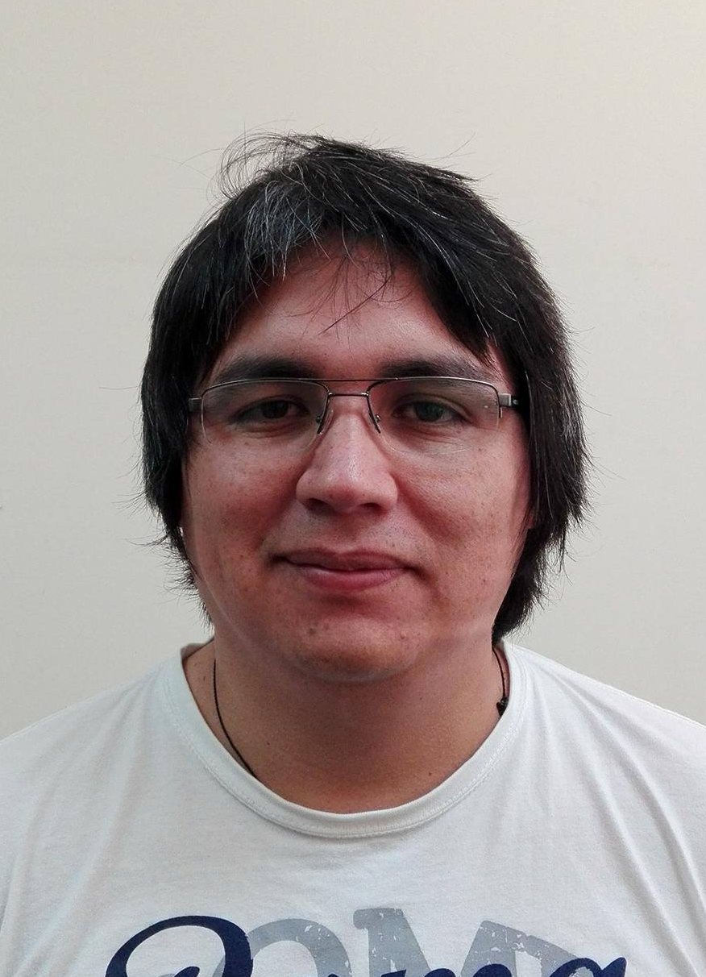
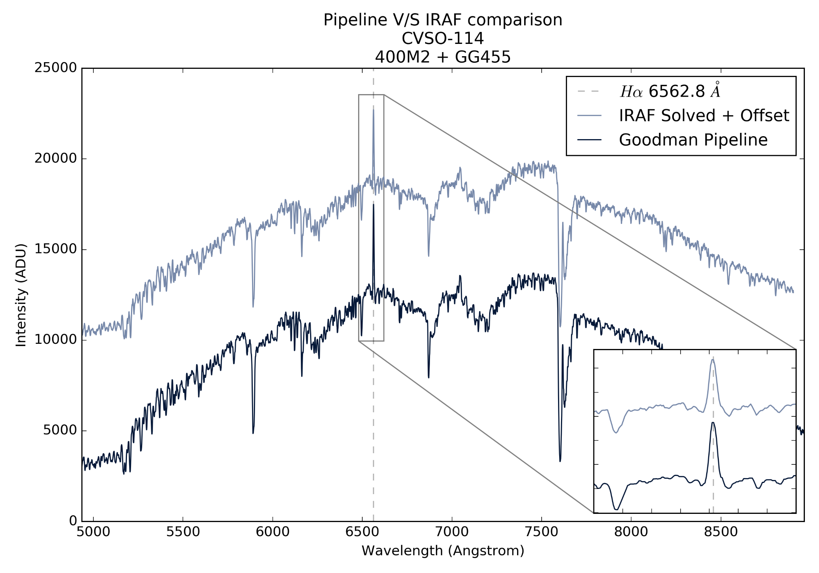
Spectroscopic Data Reduction Pipeline for the
Goodman High Throughput Spectrograph
Simón Torres-Robledo¹, César Briceño^{1,2}, Bruno Quint¹ and David Sanmartim³.
¹SOAR Telescope, La Serena, Región de Coquimbo, Chile.
²Cerro Tololo Interamerican Observatory, Casilla 603, La Serena, Chile.
³Gemini Observatory, La Serena, Chile
Abstract
The Goodman High Throughput Spectrograph (Goodman Spectrograph) [1] is a highly versatile instrument in operation at the SOAR Telescope on Cerro Pachón, Chile. It is capable of doing low to mid-resolution spectroscopy in a range from 3200 Å to 9000 Å. The data reduction pipeline is conceived as an easy-to-run software, that can process an entire night worth of data by execution of a simple command, with the least amount of arguments, from a terminal window. It is written almost entirely in Python, following several Python standard conventions. We aim towards using exclusively standard Python packages, such as AstroPy and
AstroPy-affiliated packages, while at the same time allowing for fast and efficient computing. In its current version the pipeline produces fully reduced, wavelength-calibrated spectra. Flux calibration will be an add-on option for a later release.
Pipeline Concept & Status
We aim to develop an easy to use software. A user should be able to run it with the least amount of command line arguments yet it should allow a large enough flexibility to be usable in a wide range of configurations just as the Goodman Spectrograph does. Also it should be built as a library in order to reuse the code in slightly different applications.
In general we consider most of this as achieved but in the spirit of objectivity we are still quite far from a final version. There are two scripts that are the command-line terminal user interface.
redccd: Does the initial 2D/Image processing. It has been tested for spectra images.
redspec: Does the spectroscopic analysis from where redccd left it. Up to the spectrum extraction it works automatically only. Potential users have requested the addition of interactive modes for selecting custom apertures for extraction. We might, but keep in mind that we are not developing a replacement for IRAF. For wavelength calibration redspec can work in interactive or automatic mode. In fact both methods work very well. For most common use cases the scripts can be called without any arguments.
Figure 1. The same spectrum was processed using IRAF as well as the pipeline. The pipeline operated fully automatic.
Results
Future Work
After one year of development we have achieved most of our goals. Figure 1 shows a comparison with IRAF where you clearly see a very good match. It is important to emphasize that the pipeline worked fully automatic. Table 1 summarizes a timing test for the pipeline fully automatic as well. The computer used has an Intel i7 processor with 32GB of RAM. For the same night tested the average RMS error was 0.62 Å considering three spectra observed in a spectroscopic mode that has not been fully testing, therefore the wavelength solution obtained is deficient. Removing them drops the error to 0.51 Å. In terms of the code itself we did not succeed in having a purely Python code since LaCosmic [5] did not provide satisfactory results, we implemented DCR [4] written in C but it is not intended to be a Python Extension, so the integration into the pipeline workflow was not so simple. We have released the first beta version and our plan is to release a second beta version before the end of the year. The pipeline version 1.0 will come once we implement the flux calibration.
From the software point of view:
Structure: There is a development version that includes a modified static structure more according to an AstroPy Affiliated Package.
Tests: Implement integrated test code.
Workflow: Review the current workflow and propose an update.
User Manual: Although we have a fully functional user manual we need feedback to improve it
AstroPy: One of our important goals is to develop software that is compliant with the current and future standards of Python programming. AstroPy is a good example, in fact when our software gets in a more mature level, we want to collaborate.
From the scientific point of view:
Extraction: We will implement fractional pixel extraction as well as the Optimal Extraction algorithm [2] [3].
Operation: Develop a Live reduction pipeline that can process data as it comes from the telescope, that will allow observers to take better and quicker decisions.
Telemetry: Develop a system to store the parameters of the wavelength solution polynomial
with the intention to validate new solution and eventually detect problems with the instrument.
WCS: We implemented part of the FITS standard for writing wavelength solutions, but we are aware of new developments and looking forward to implement them in our software.
Flux Calibration: This is one of our top priorities.
Task | Time (seconds)
redccd | 155
redspec | 32
Total | 187
Interactive (Å) | Automatic (Å) | Slit Size
0.368 | 0.340 | 0.84”
0.296 | 0.521 | 1.03”
Table 1. Quick stop-watch timing of each script. This is a full night,
with 105 raw images (redccd) from which 48 are usable by redspec
that at the end will leave 40 wavelength calibrated images, some
comparison lamps are included.
Table 2. Comparison of typical values for the RMS error for one of the nights used to evaluate the performance of the pipeline.
Contact
Acknowledgments
References
Simón Torres Robledo
SOAR Telescope
Email: storres@ctio.noao.edu
Website: https://github.com/simontorres
Phone: +56 51 2205348
This research made use of Astropy, a community-developed core Python package for Astronomy (Astropy Collaboration, 2013).
IRAF is distributed by the National Optical Astronomy Observatories, which are operated by the Association of Universities for Research in Astronomy, Inc., under cooperative agreement with the National Science Foundation.
We acknowledge the support from CPNQ (process 205459/2014-5) by funding the Post-Doc Fellowship of Bruno Quint.
This work has been developed at the Southern Astrophysical Research (SOAR) telescope, which is a joint project of the Ministério da Ciência, Tecnologia, Inovaçãos e Comunicações do Brasil (MCTIC/LNA), the U.S. National Optical Astronomy Observatory (NOAO), the University of North Carolina at Chapel Hill (UNC), and Michigan State University (MSU).
Clemens, J. C., Crain, J. A., & Anderson, R. 2004, vol 5492 of Proceedings of SPIE, 331.
Horne, K., 1986, PASP, 98:609-617.
Marsh, T. R., 1989, PASP, 101:1032-1037.
Pych, W., 2004, PASP, 116, 148.
Van Dokkum, P. G., 2001, PASP, 113, 1420.

