Slide 1
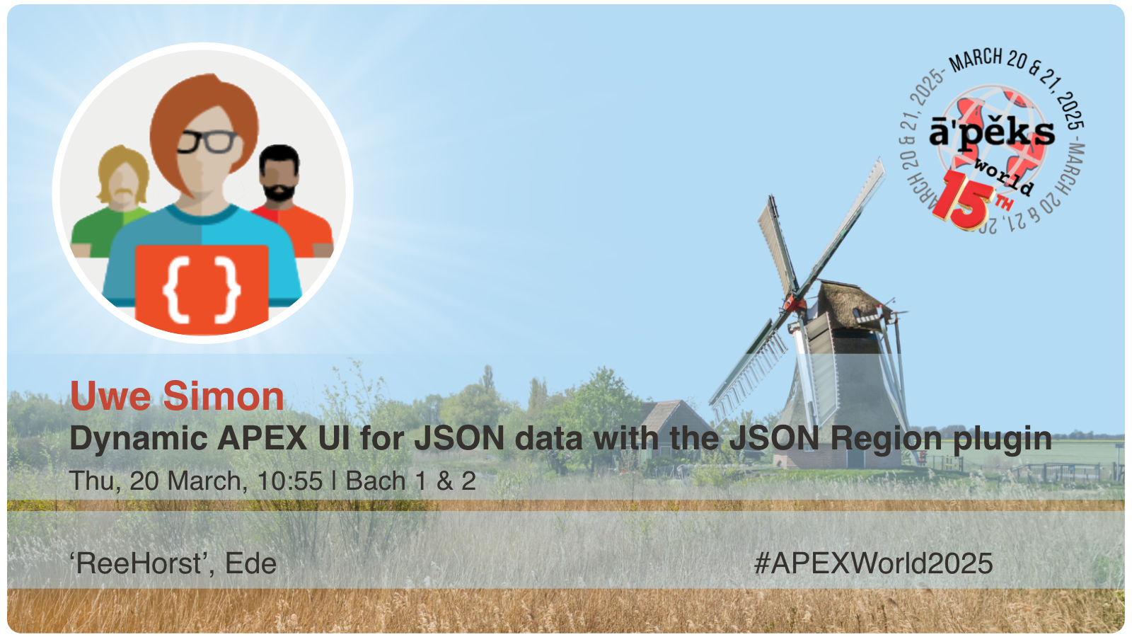

Slide 2

About Me
Name: Uwe Simon
Oracle-DB: Oracle-DB experience since 1992 starting with Oracle 5
Database modelling
Performance tuning of huge multi 100TB databases
Database analysis of “unknown” mission critical databases during major incident procedures
DB-migrations
Proof of Concepts
APEX: Started 1998 with OAS/OWS, HTML-DB, APEX ...24.2
Development: SQL, PL/SQL, C++, JavaScript, Java, HTML/CSS, ...
Other DBs: DB2, MySQL, PostgreSQL
Located in Cologne
during the last years partial on-site in The Netherlands, Czech Republic, India
In partial retirement and Freelancer since 2023

Slide 3
Agenda
History of the plug-in
Idea of the plug-in
JSON-Region-Plugin vs. JSON-source in APEX 24.2
JSON-Schema and APEX-UI
Complex JSON-schema and APEX-UI
Customizing the APEX-UI
Oracle 23ai
Experience during development
Miscellaneous

Slide 4
History of the plug-in
The development of the JSON-Region-Plugin started October 2023
First presentation of the plug-in at APEX-connect2024 in Germany,
Michael Hichwa (Oracle) gave the feedback that my plug-in is great and that
“Oracle definitely needs such a solution for JSON in APEX”
Oracle introduced a solution using new JSON/Duality-source in APEX 24.2, implementing parts of the plug-ins functions
The plug-in is continuously updated with new features for APEX 20.2-24.2

Slide 5
History of the plug-in
Idea of the plug-in
JSON-Region-Plugin vs. JSON-source in APEX 24.2
JSON-Schema and APEX-UI
Complex JSON-schema and APEX-UI
Customizing the APEX-UI
Oracle 23ai
Experience during development
Miscellaneous

Slide 6
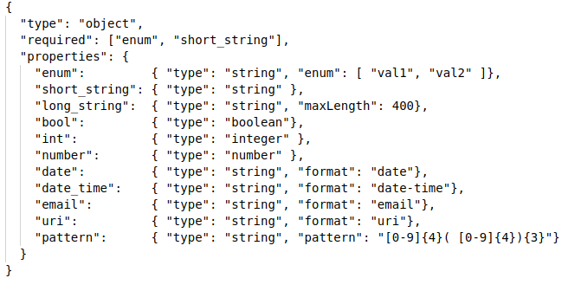
JSON-Schema in nutshell
Documentation of JSON-Schema could be found at https://json-schema.org/
JSON-schema is a description for the structure of JSON-data and could be used for the validation of JSON-data
  A JSON-schema is an object or an array (“type“: “object“, “type”: “array“) with attributes (“properties”, “items”)
  For each attribute it defines it’s data type (“type“) and format (“format“),
  if it’s “mandatory” (“required“),
  if it’s an enumeration (“enum“),
  must match a pattern (“pattern“), ....
  An attribute could be an object or an array, .
Oracle23ai supports JSON-schema-validations on a CLOB/JSON-columns and collection tables/views, duality-views
So what could be more obvious than using JSON Schema for the APEX UI.

Slide 7
Idea of the plug-in
APEX <24.2 offers no Out-Of-The-Box-solution for input/output of JSON-data
The plug-in generates at runtime a dynamic APEX-UI based on a JSON-schema
Support of all major APEX-item-types
Use of variable JSON-schemas for each row of a table
Modifying the JSON-schema changes the UI immediately without any modification in the APEX-code
Transparent for user, “look like APEX-UI”, so same error-handling, same items, ...
Customization of the UI with JSON-schema-extention by new property “apex”: {...}
Support of JSON-schema-references “$ref”: “...”
Support of conditional JSON-schema for dynamic UIs
“dependentRequired”: {},
“dependentSchemas”: {},
”$if”: {}, “$then”: {}, “$else”: {}

Slide 8
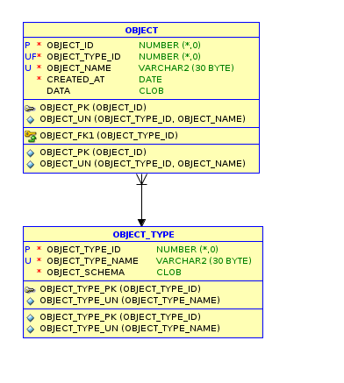
Possible usecases of the plug-in
Configurable workflows:
The data for the workflow is stored in JSON-columns
Configurable Asset-Management-Systems:
Attributes depending on asset types are stored in JSON-columns
Form-tools:
Form-structure is a JSON-schema and form-data is stored in JSON-columns
Polling-tools:
Questions and list of answers are stored in a JSON-schema and the data is stored in a JSON-column
APEX-applications with customization by customer:
Customizing of the application is possible with JSON-columns.

Slide 9
History of the plug-in
Idea of the plug-in
JSON-Region-Plugin vs. JSON-source in APEX 24.2
JSON-Schema and APEX-UI
Complex JSON-schema and APEX-UI
Customizing the APEX-UI
Oracle 23ai
Experience during development
Miscellaneous

Slide 10
Plug-in vs. JSON-support of APEX-24.2
Feature | Plug-in | APEX 24.2
VARCHAR2/CLOB/JSON column | √ | √
collection-table | √ | √
collection-view | √ | −
JSON-duality-view | √ | √
Fixed JSON-schema | √ | √ JSON-source
Variable JSON-schema | √ | −
Evaluation of JSON-schema | At runtime | In page-designer
JSON-schema from DB (23ai) | √ | √− (Duality-source only)
Dynamic UI | √ | −
Schema references | √ | −
Conditional JSON-schema | √ | −
Interactive grid/report | √− with JSON-Item-Plug-in | √

Slide 11
History of the plug-in
Idea of the plug-in
JSON-Region-Plugin vs. JSON-source in APEX 24.2
JSON-Schema and APEX-UI
Complex JSON-schema and APEX-UI
Customizing the APEX-UI
Oracle 23ai
Experience during development
Miscellaneous

Slide 12
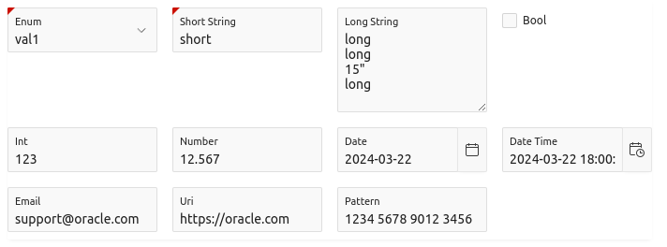
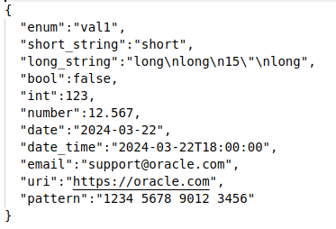
JSON-schema, JSON-data and APEX-UI

Slide 13
Demo
A demo says more than 1000 slides
My demo uses a simple data-model
  Table “OBJECT” for „generic“ objects in JSON-column “DATA” (CLOB/JSON)
  Table “OBJECT_TYPE” containing the valid object-types with column “OBJECT_SCHEMA” for the JSON-schema of each type
  JSON-collection-table/view “TABLE23AI”, “VIEW23AI”
  JSON-duality-view “JSON23AI”
  APEX-24.2 JSON-source, Duality-source
  When time left: 2 applications using the plug-in

Slide 14
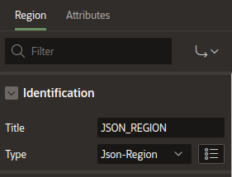
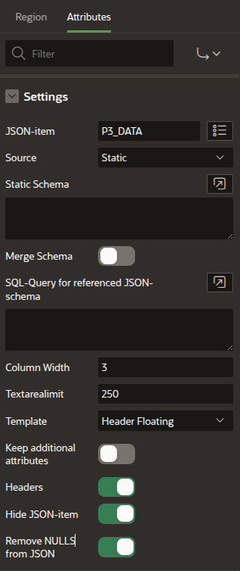

Plug-in configuration in APEX-dialog-editor
Simple configuration
  JSON-Item
  Source for JSON-schema
    Static JSON-schema
    SQL-Query, returning the JSON-schema
    Generated JSON-schema generated based on JSON-data
Other configurations
  UI: column width, limit when "textarea" is used, item-template to use
  Generate headers for sub-objects
  Hide the page-item containing the JSON-data
  Keep additional attribute in JSON
  Remove empty/null properties from JSON-data
  Read-only-attribute of region is used for all items in the region

Slide 15
Transformation JSON-Schema to APEX-UI
The attributes are displayed in the same order ad defined in the JSON-schema.
Depending on “type“/“format“/”pattern” in the JSON-schema a matching „APEX-Item-Type“ is used for input/output.
  string ”Text Field”/“Text, ”Image” when “contentEncoding“: “base64“ and “contentMediaType” are defined
  integer/number ”Number field”
  boolean ”Checkbox”,
  date/date-time/time ”Date/Date-Picker/Time-Picker
  enum ”Selectlist”
  email ”Text Field” with Subtype “Email”
  uri ”Text Field” with Subtype “URL”
  ipv4/v6/UUID ”Text Field” with pattern”
  …
Display name of APEX-items is per default the attribute name
(1. char capital, replace _- by “ “, same behaviour as for default-titles in page-designer)

Slide 16
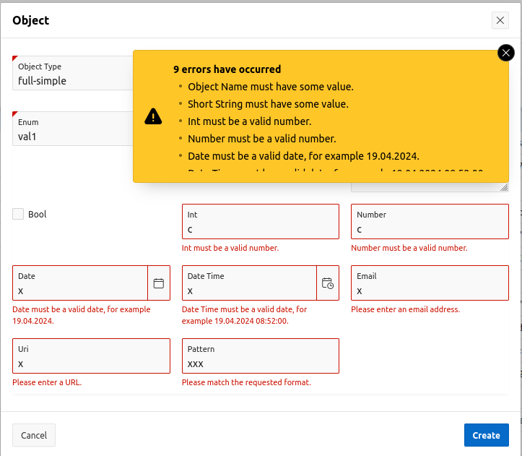
item validation and error messages
Supported validations
  mandatory
  integer, number, currency
  date, date-time, time
  regexp-pattern
  email-address, URI
  ipv4/v6 address, UUID
  min, max
  string length
  Enum (list of values)
Standard system error messages on validation errors

Slide 17
extended JSON-schema attributes
Constant value
  “const“: „constValue“
  constant value for string/number/integer/boolean
Binary data in strings (display only)
  “contentEncoding“: “base64“
  “contentMediaType“: “image/png“, “image/jpg““image/gif“
  for images on PNG, JPG or GIF format
Recursive
  “type“: “object“
  “type“: “array“, “items“: […]

Slide 18
JSON-schema references
Local schema-references
  “$ref“: “#/defs/...“
  The reference starts with “#/” and references in the current JSON-schema.
  To avoid redundancies. For example when multiple addresses are required in a JSON-schema.
Static schema-reference from DB-server
  “$ref“: “/defs/...“
  Callback to database for selecting a static “sub-schema”, which is used in multiple JSON-schemas. The reference starts with “/”.
Dynamic schema-reference from DB-server
  “$ref“: “/defs/...”
  Callback to database for generating a “sub-schema”. For example to dynamically generate a select-list or a hierarchy of select-lists from a hierarchical query.
  The reference starts with “/”.

Slide 19
Conditional JSON-schema...
  “dependentRequired“
  items become mandatory when another item is not empty
  "dependentRequired":{
  "payment": ["card", “validity”, “securitycode”]
  }
  “dependentSchema“
  A “sub-schema” is only available, when an item is not empty.
  "dependentSchemas": {
  "payment": {
  "type": "object",
  "properties": { "creditcard": {"$ref": "#/$defs/creditcard"} }
  }
  }

Slide 20
...Conditional JSON-schema
  “if“, “then“, “else“
  Depending on a condition additional items are available.
  "if": { "properties": { "deliverytohome": { "const": true} } },
  "then": { "properties": { "home_address": {"$ref": "#/$defs/address"} } }, "else": { "properties": { "delivery_info": {"type": "string"} } }
  “allOf“, “oneOf”, “anyOf“, “not“ in an “if“ condition
  “allOf” for schema concatenation
  Useful for simplifying complex “if/then/else” conditions

Slide 21
History of the plug-in
Idea of the plug-in
JSON-Region-Plugin vs. JSON-source in APEX 24.2
JSON-Schema and APEX-UI
Complex JSON-schema and APEX-UI
Customizing the APEX-UI
Oracle 23ai
Experience during development
Miscellaneous

Slide 22
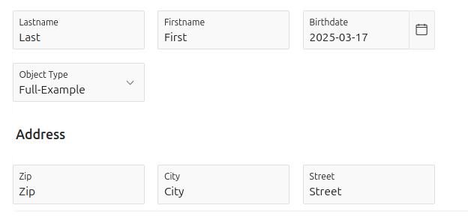
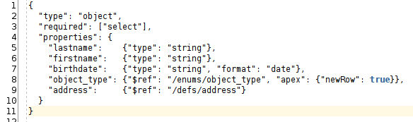
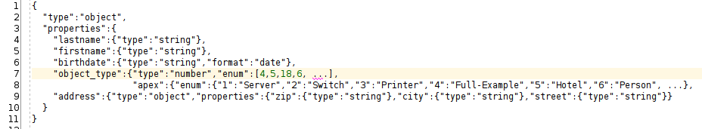

Complex JSON-schema attributes...
Schema-references: “$ref”: “/xxx/xxx”

Slide 23
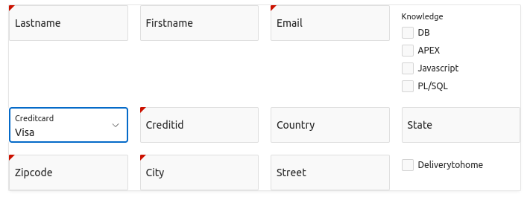
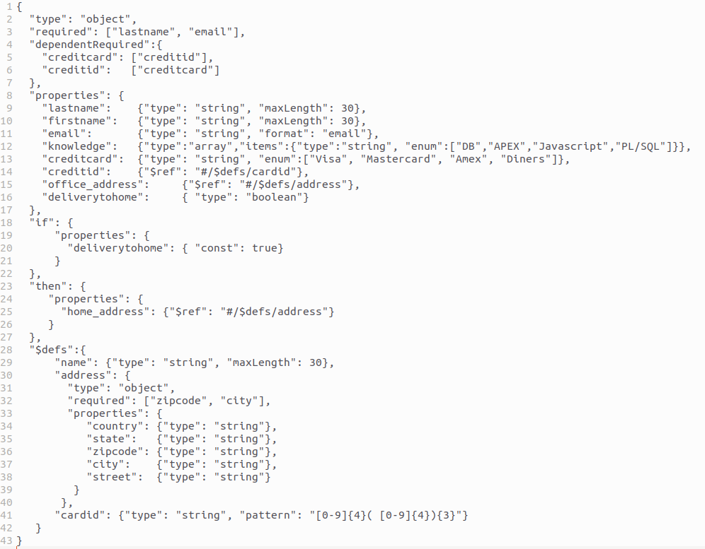
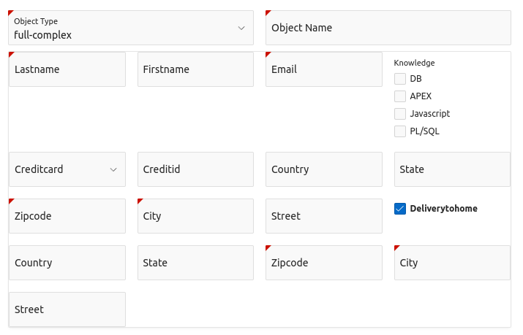
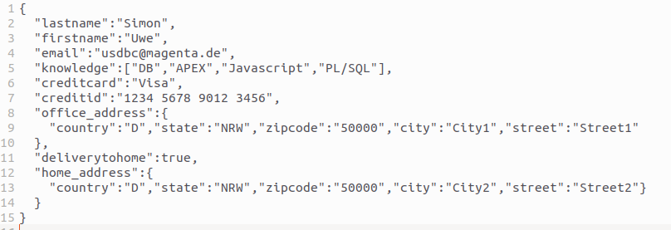
...Complex JSON-schema attributes
object/array, conditional schema:

Slide 24
History of the plug-in
Idea of the plug-in
JSON-Region-Plugin vs. JSON-source in APEX 24.2
JSON-Schema and APEX-UI
Complex JSON-schema and APEX-UI
Customizing the APEX-UI
Oracle 23ai
Experience during development
Miscellaneous

Slide 25
Customizing the APEX-UI ...
The APEX-UI provides multiple item-type for a data-type
All APEX-specific Configurations are stored below “apex“: {…}
  “itemtype": "starrating" Numeric as “Starrating” “apex“: {“itemtype”: “starrating”}
  "itemtype": "switch"/”radio” Boolean as “Switch”/”Radio”
  “itemtype“: “password“ Password item
  “itemtype“: “pctgraph“ Numeric as a bar in % (0-100, display only)
  “itemtype“: “currency“ Integer/Number as currency
  >=APEX-23.2
    "itemtype": "richtext" The “Richtext-editor” for long strings
    "itemtype": "combobox" A multiselect combobox with „Chips“
    „itemtype“: „qrcode“ Display of QR-Codes
    “itemtype”: “fileupload” Upload of files and store as “base64”-strings, “imageupload” for images
  >=APEX 24.1
    “itemtype”: “Selectone” For a single-select
    “itemtype”: “Selectmany” A multiselect combobox

Slide 26
...Customizing the APEX-UI ...
Other attributes below „apex“
  „label“: “Text“ Text as item label
  "newRow": true Start a new row before the item,
  "textBefore": "Text" Static “Text” in front of item
  "lines": 10 Number of rows for Textarea/Richtext-Editor
  "colSpan": 6 Width of the item (1-12)
  “readonly“: true Item is display only
  “direction“: “horizontal“ ”Radio”/”Checkbox” group horizontally

Slide 27
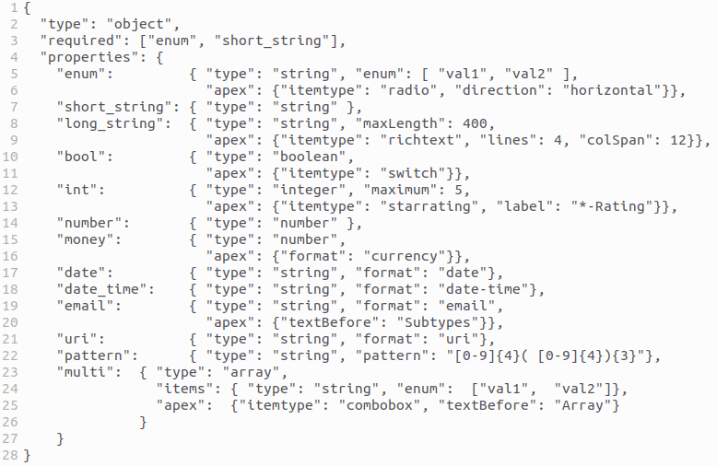
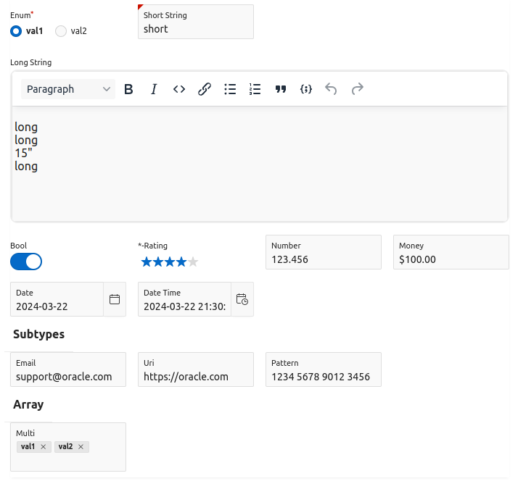
… Customizing der APEX-UI

Slide 28
History of the plug-in
Idea of the plug-in
JSON-Region-Plugin vs. JSON-source in APEX 24.2
JSON-Schema and APEX-UI
Complex JSON-schema and APEX-UI
Customizing the APEX-UI
Oracle 23ai
Experience during development
Miscellaneous

Slide 29
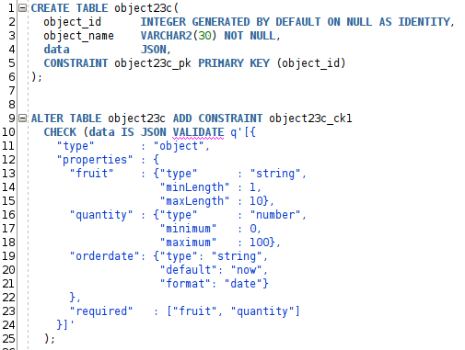
JSON-Schema generated from JSON-validation
Starting with Oracle23ai, it is possible to define an “IS JSON VALIDATE” Check-Constraint for a VARCHAR2/CLOB/JSON-columns or collection-tables.
So, why not use the JSON-schema in this constraints for generating the APEX-UI
Caution:
  Oracle doesn’t support all “complex” JSON-schema configurations.
  For example “$ref“: “…“ ignored / returns error
  In JSON-duality-views Oracle uses some extensions like “extendedType“, which is supported by the plug-in

Slide 30
History of the plug-in
Idea of the plug-in
JSON-Region-Plugin vs. JSON-source in APEX 24.2
JSON-Schema and APEX-UI
Complex JSON-schema and APEX-UI
Customizing the APEX-UI
Oracle 23ai
Experience during development
Miscellaneous

Slide 31
Experiences during development...
Different behaviours of UI-items in JavaScript
apex.item(…).setValue(…)
  Destroys Date/Date-Time-Picker in APEX<=22.2 when called after the UI-item is rendered
  For item-types “QRCode” and “RichTextEditor” (introduced in APEX-23.2) must wait until the rendering of the UI-Items has finished
  QR-Code is generated in PL/SQL, uses an AJAX-request via AJAX-callback
  RichTextEditor is initialized asynchronously, must be finished before using apex.item().setValue
<input ...>
  All common browsers support additional attributes like minLength=“..“, „pattern=“..“, type=“time“, …
  Error-messages for this <input>-tags is generated by the browsers, unfortunately in the language of the browser-UI but not in the language of the current page

Slide 32
...Experiences during development...
The first plug-in-version, supporting the “simple” property types „string“, „integer“, „number“, „boolean“, was implemented quite fast, the next versions supporting different APEX/DB-versions and additions APEX-item-types (‘Richtext”,”Switch”, “Combobox”, …) sub-object and arrays took much more time.
APEX-JavaScript-code
  JavaScript-code .../images/apex/libraries is available in minimized and “readable” format. The inline Documentation inside source code not always matching 100% / is partially missing
  Depending on item/widget different implementation pattern with different behaviour
  Oracle changes the used JavaScript-library for advanced item-types like “Richttext”, Date-Picker”, … which changes in behaviours/APIs

Slide 33
...Experiences during development
PL/SQL
  There is no PL/SQL-constant for the current APEX-Release like in JavaScript
  apex.env.APEX_VERSION
  The support of features (QR-code, collection-tables, …) in new APEX/DB-releases requires conditional compile in PL/SQL
  Workarround (here for APEX für 23.2):
  $if wwv_flow_api.c_current>=20231031 $then
  …
  $end

Slide 34
History of the plug-in
Idea of the plug-in
JSON-Region-Plugin vs. JSON-source in APEX 24.2
JSON-Schema and APEX-UI
Complex JSON-schema and APEX-UI
Customizing the APEX-UI
Oracle 23ai
Experience during development
Miscellaneous

Slide 35
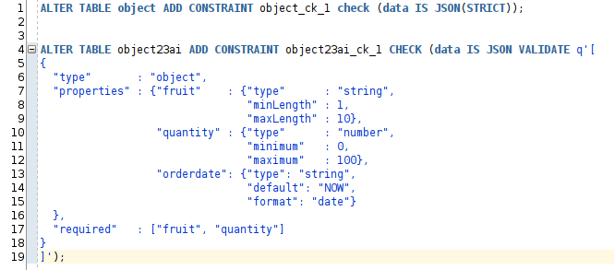
Miscellaneous...
When using JSON in CLOB use check-constraint
IS JSON(STRICT)
When using a static JSON-schema for a table. Starting with Oracle23ai use check-constraint
IS JSON VALIDATE ‘{….}’

Slide 36
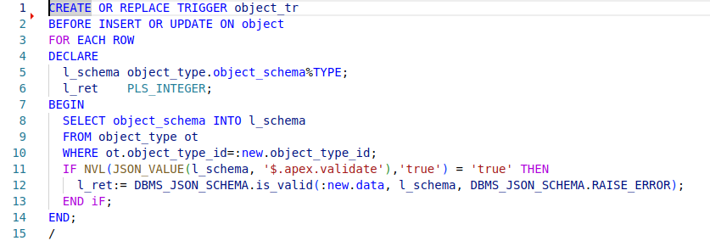


...Miscellaneous
When a JSON-column can contain data with different JSON-schema, the data could be verified with a row-trigger
Often the JSON-schema attribute “enum” must be in sync with a lookup-table.
2 solutions
  A statement-Trigger on the lookup-table
  Use a “dynamic”
  “$ref”: “/enum/….”
  to generate the values for an “enum” or a list of dependend “enum”

Slide 37
Known usages of the JSON-Region-Plugin
USA:
One of the hugest county offices
Workflow of complex forms translated into JSON
India:
PoC for a generic workflow
Germany:
Flows4Apex: An open-source BPEL-engine for APEX

Slide 38
Known issues with plugin
JSON-collection-table:
INSERT INTO table23ai VALUES('{"fruit":"Banana","quantity":10,"orderdate":"2025-02-20"}');
UPDATE table23ai SET data='{"fruit":"Banana","quantity":10,"orderdate":"2025-02-20"}'
where rowid='AAArpxAAQAAAAL1AAA';
Oracle DB < 23.7: JSON-collection-table:
INSERT, UPDATE
ORA-00932: inconsistent datatypes: expected VARCHAR, BLOB, CLOB, FILE, BINARY, JSON – got -
ORA-54059: cannot update an immutable column ("UWE"."TABLE23AI"."RESID")
Oracle DB >= 23.7: JSON-collection-table with JSON VALIDATE constraint:
INSERT works
UPDATE
ORA-00932: inconsistent datatypes: expected VARCHAR, BLOB, CLOB, FILE, BINARY, JSON – got -

Slide 39
Known issues APEX 24.2
JSON-Source:
  Defining a source with a complex JSON-schema returns – not very helpful - error
  Could not compute a Data Profile for the new JSON Source, because of the following error: ORA-06503: PL/SQL: function returned without value.
Duality-View:
  While defining a source on an Oracle >=23.7 DB, I get the – the not very helpful – error
  ORA-06503: PL/SQL: function returned without value
  In Oracle 23.7 the output of dbms_json_schema.describe has changed.
Reason:
JSON-schema contains some unknown keywords for the JSON-schema-parser of APEX 24.2, should be fixed with an upcoming patch.

Slide 40
Others
Ideas for further improvements
  Support of JSON-schema from OpenAPI https://swagger.io/specification/
  Support of JSON-schema from JSON-Form https://jsonforms.io/
Flows4Apex https://flowsforapex.org/ uses the JSON-Region-Plugin
  Here is a stand-alone APEX-application “JSON-Simple-Form-Builder” for defining and testing of forms. It also generates the JSON-schema used by the “JSON-Region-Plugin”
  There is a “Simple Process Starter” application, which uses forms generated by the JSON-Region-Plugin

Slide 41
Nearly done
Thank You for your attention
Time for questions ??
Bedankt voor uw aandacht
Tijd voor vragen ??
APEX: https://apex.world (JSON-Region)
Github: https://github.com/simonuwe/oracle-apex-json-region
Email: usdbc@magenta.de
LinkedIn: https://www.linkedin.com/in/uwe-simon-cologne/

Slide 42



Please fill in your
evaluations

