Slide 1
React/MongoDB
Full Stack
Project Starter Notes

Slide 2


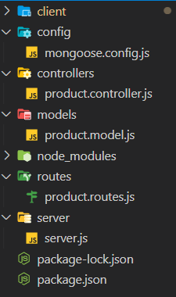

Folder Structure
→ Create overall project folder
create/initialize front end project folder
Inside your project folder run the following commands
npx create-react-app client
npm init -y
Initialize backend
Also create the following folders: with the corresponding files inside.
config → mongoose.config.js
controllers → project.controller.js
models → project.model.js
routes → project.routes.js
server → server.js

Slide 3
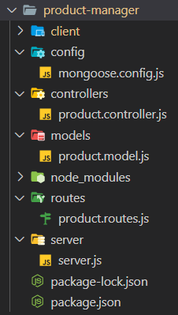
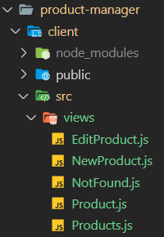
Folder Structure
Here’s a cleaner look
Also in client -> src -> create views folder

Slide 4
Install dependencies
(make sure you’re in the correct folders)
In the MAIN project folder
Cd into client folder
If using bootstrap you also need to into:
Client -> src -> index.js and add this line to the top
import "bootstrap/dist/css/bootstrap.css";

Slide 5

Start server and react
Easiest way is split terminal
One side cd into front end folder
Other side cd into server folder with server.js file
npm start
nodemon server.js

