Slide 1
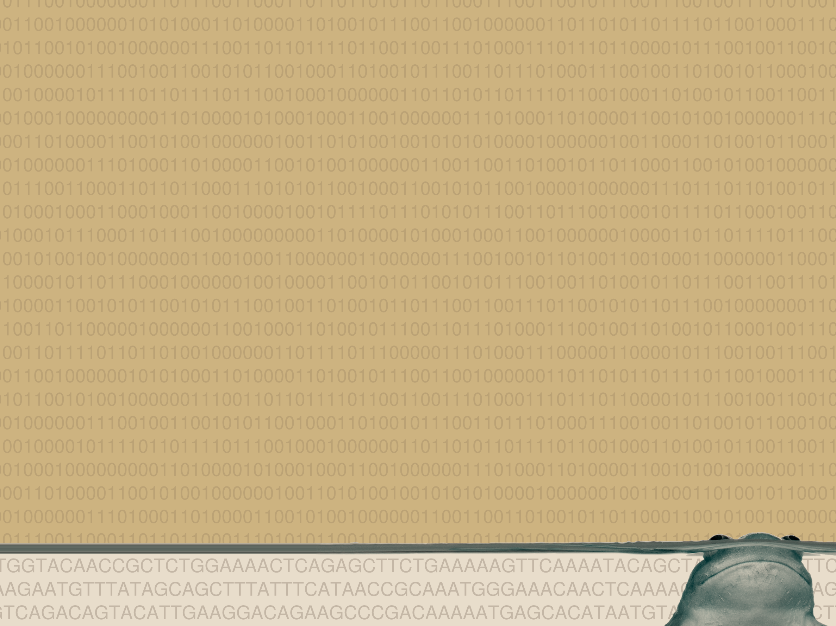
Xenopus functional genomics:
Computational analysis
of ChIP-seq data
Simon J. van Heeringen
14th International Xenopus conference
Notes:
I'm Simon van Heeringen and I would like to start by thanking the committee for inviting me here. I'm really excited to have the chance to present my proposal, titled: Cracking the Polycomb code

Slide 2
Support and more info
http://simonvh.github.com/xenopus2012
  Contains all presentations
  Links to databases, tools and materials
Mail me: s.vanheeringen@ncmls.ru.nl
Our website:
http://www.ncmls.nl/gertjanveenstra

Slide 3
Beyond browsing
Previous workshop showed a visual approach
  Good to look at your favorite gene
  Generate hypothesis
Usually, a more detailed analysis is necessary
  Visual inspection can be deceiving
  Need to know general, genome-wide patterns

Slide 4
Disclaimer
There are commercial solutions
  Genomatix
  CLC bio
  Avadis
  And other...
However, check if they support Xenopus!

Slide 5
Disclaimer
There are commercial solutions
If you're going to do a lot of analysis, it's worth learning command-line approaches
  Even if you don't have your own Linux server / computer (“cloud”, Amazon EC2)

Slide 6
Disclaimer
There are commercial solutions
If you're going to do a lot of analysis, it's worth learning command-line approaches
This is an introduction to basic analysis using freely available (web) resources
  Which can get you quite far

Slide 7
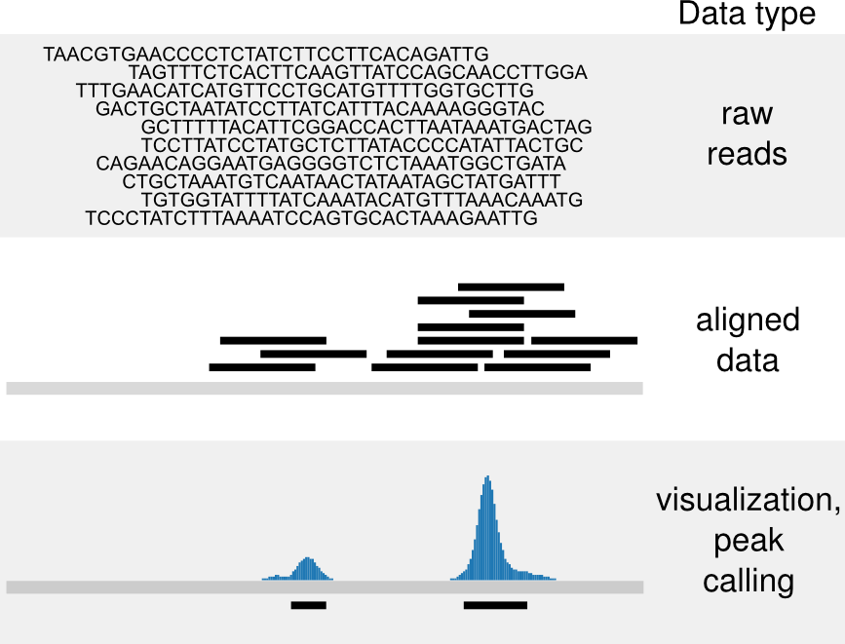
ChIP-seq workflow

Slide 8
Peak calling
Sounds easy, doesn't it?

Slide 9
Peak calling
Sounds easy, doesn't it?
Peak!

Slide 10
Peak calling
One peak-caller to call them all?

Slide 11
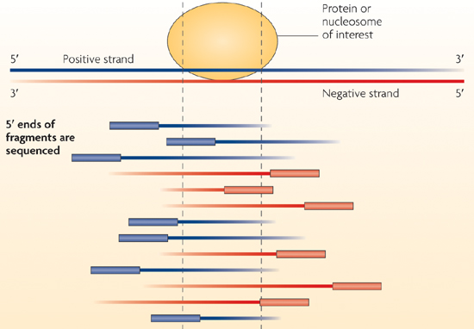
Strand information
Adapted from: Park, Nature, 2009

Slide 12
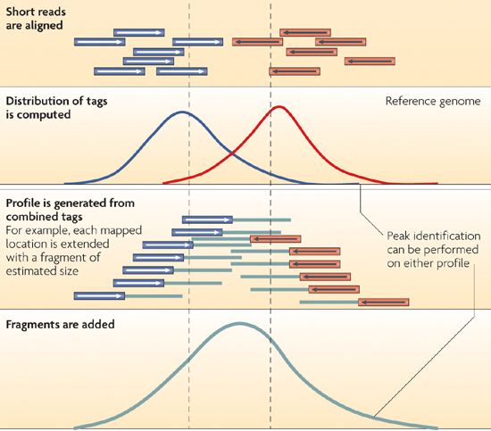
Strand information
Adapted from: Park, Nature, 2009

Slide 13
Which one to use?
Many options, I've lost count...
Many don't support Xenopus out-of-the-box
  “What's 'scaffolds', Precious?”
My personal (likely biased) advice
  MACS (widely used)
    With or without control
  PeakRanger (modENCODE)
    With control
YMMV

Slide 14
Galaxy
https://main.g2.bx.psu.edu/
Web-based analysis
Easy-to-use
Lots of tutorials
First choice if:
  you don't have your own analysis server
  you are unfamiliar with Linux, command-line based tools

Slide 15
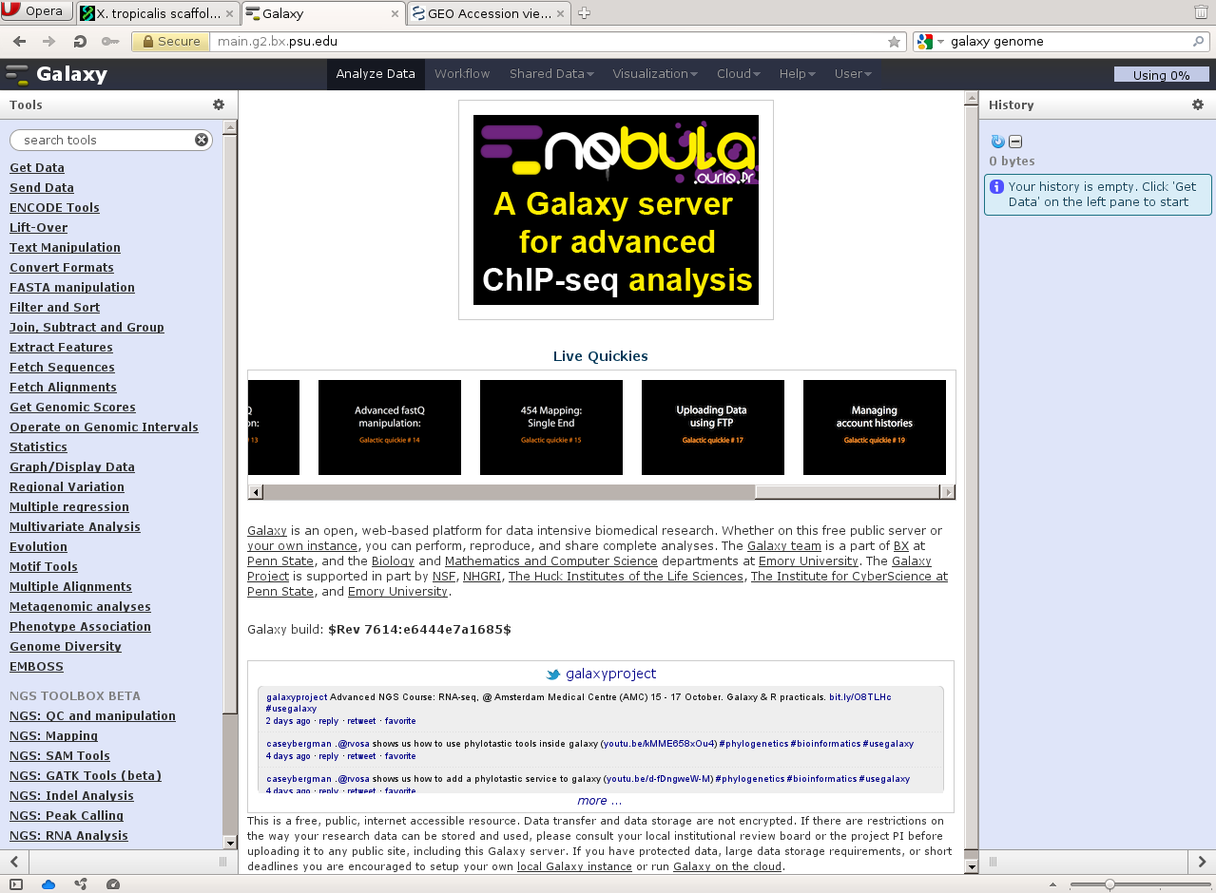

Slide 16
Example
Peak calling using Galaxy
TBP ChIP-seq (van Heeringen et al., 2011)
Download from GEO
Peak calling with MACS
Upload peaks to Genome Browser for inspection

Slide 17
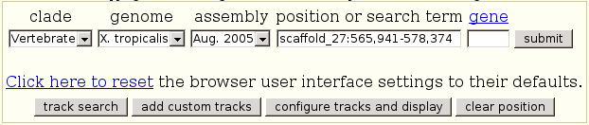
Try it out yourself!
Resources are linked on the tutorial page
Notice: I'm using JGI 4.1 / xenTro2 data

Slide 18
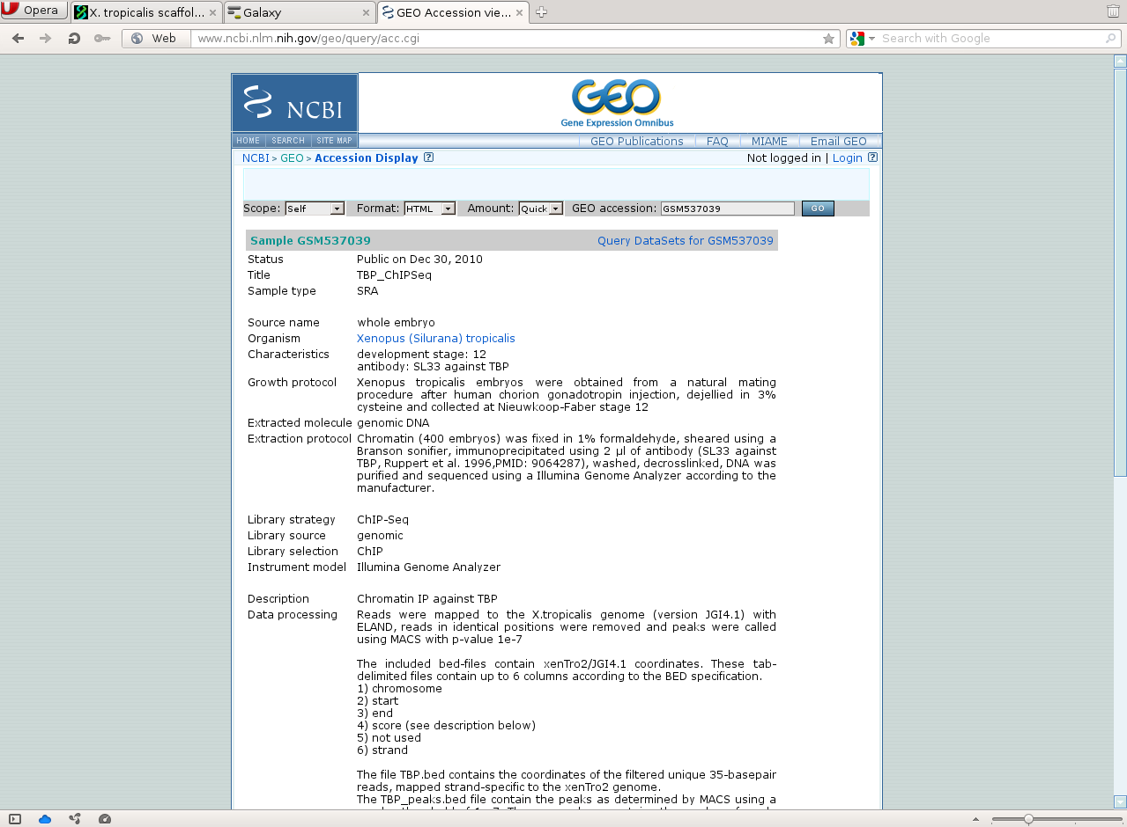

Slide 19
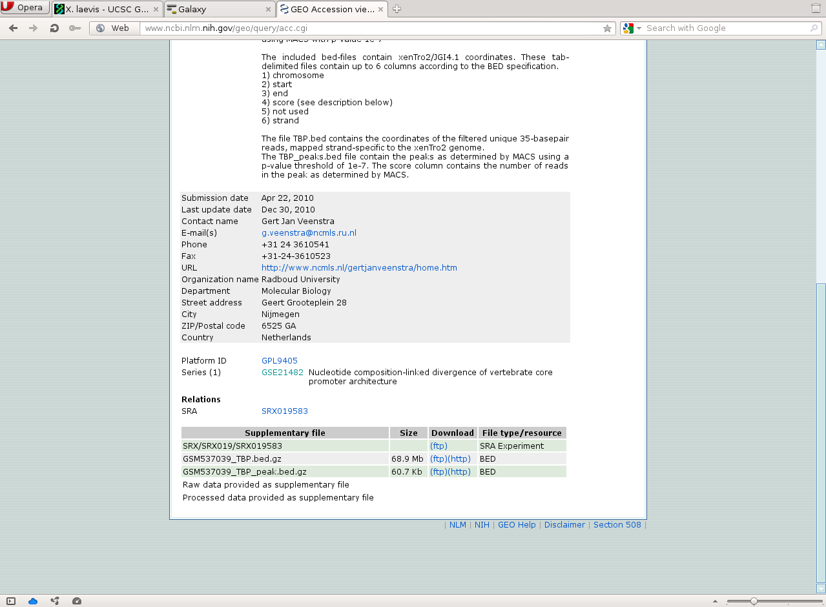

Slide 20
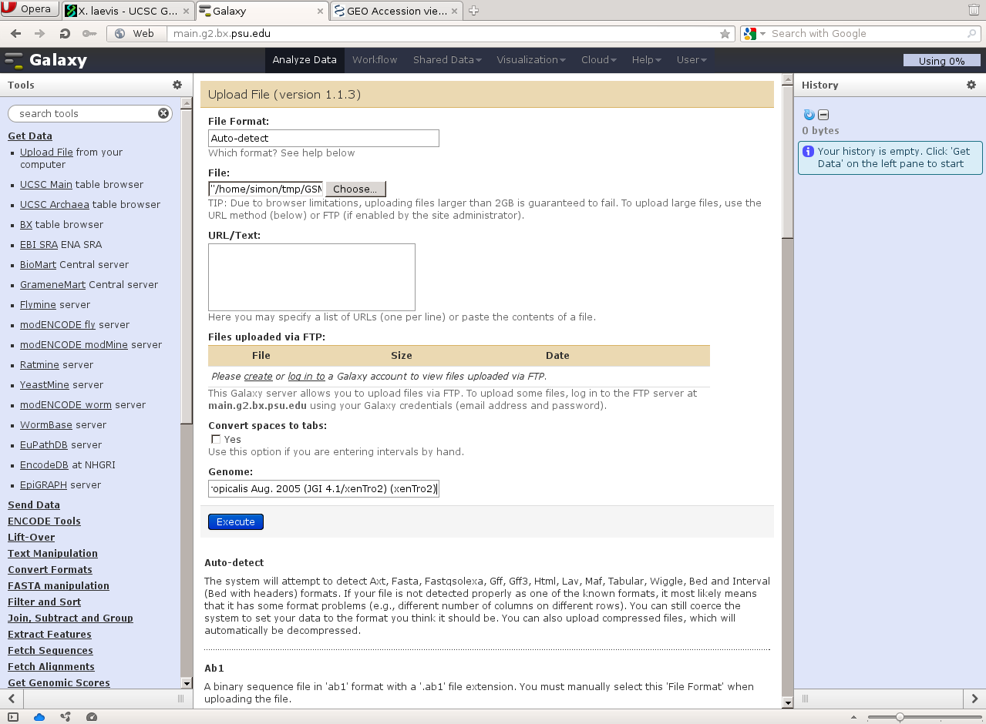

Slide 21
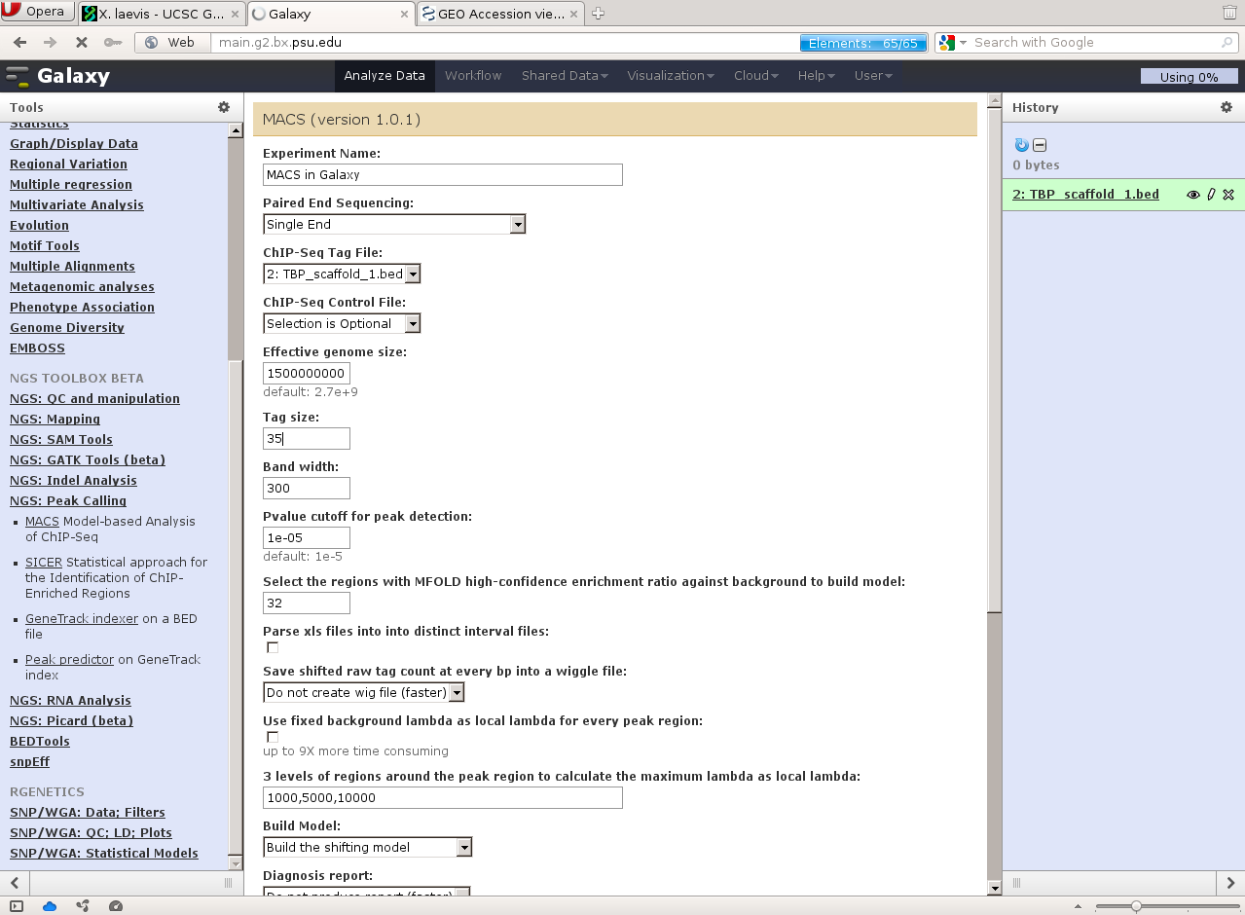

Slide 22
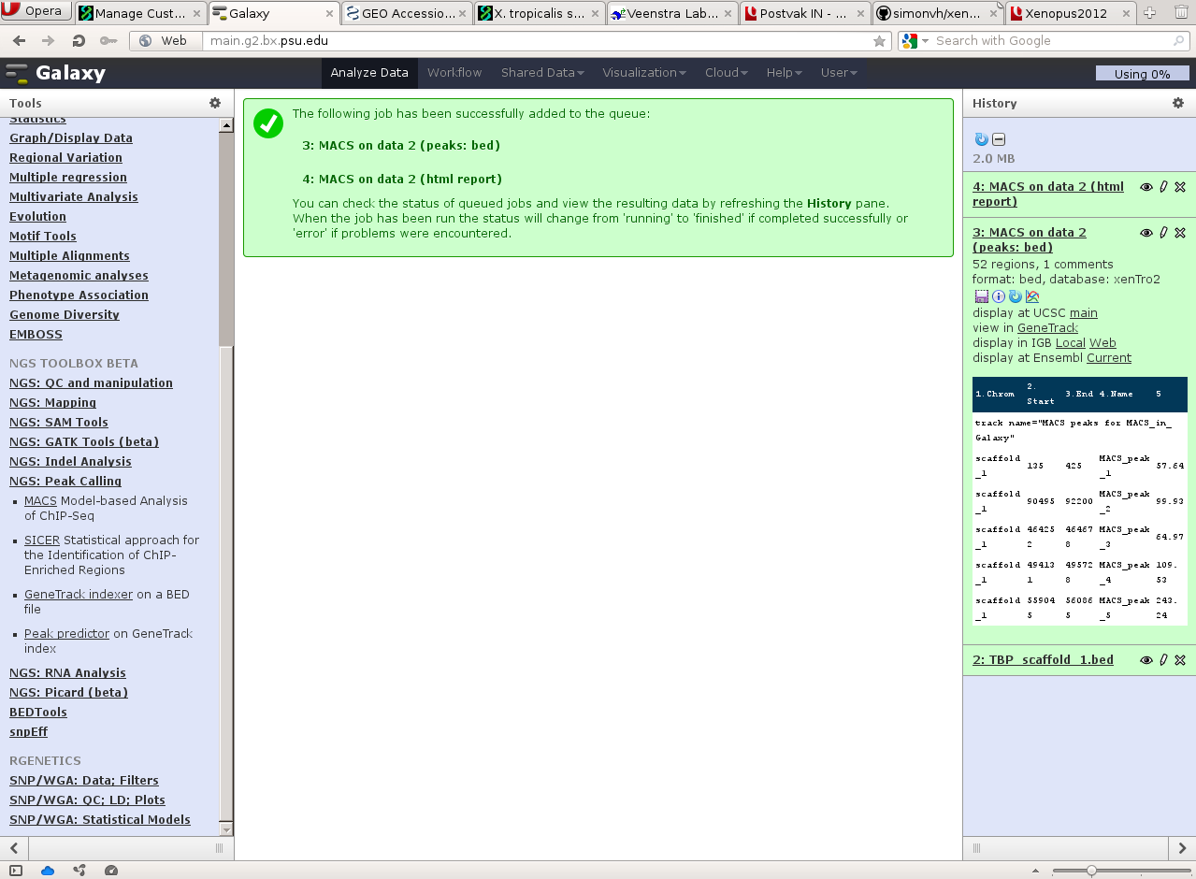

Slide 23
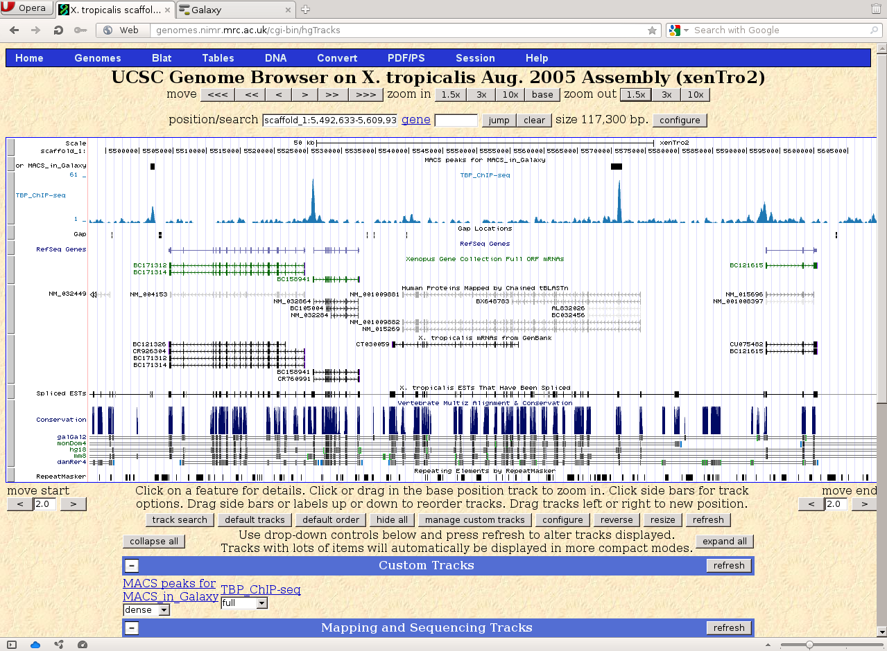

Slide 24
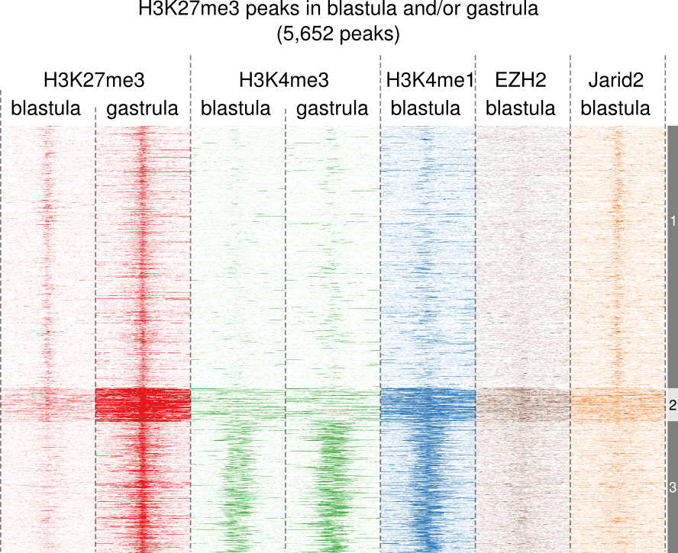
Heatmaps

Slide 25
Heatmaps
scaffold_1:1000-2000
scaffold_1:3000-4000

Slide 26
Heatmaps
scaffold_1:1000-2000
scaffold_1:3000-4000

Slide 27
Heatmaps
scaffold_1:1000-2000
scaffold_1:3000-4000
2
1
3
2
0
6
6
0
Heatmap data:
scaffold_1 1000 2000 2 1 3 2
scaffold_1 3000 4000 0 6 6 0

Slide 28
Heatmaps (from easy to “difficult”)
seqMINER
http://bips.u-strasbg.fr/seqminer/tiki-index.php
  Graphical Interface
  Easy to use
fluff http://github.com/simonvh/fluff
  Command-line
  Colorful plots
R
  Powerful language for statistical computing
  Many plotting functions
  Heatmaps using gplots library

Slide 29
seqMINER
Java program
  Runs on Windows, Mac OS X, Linux
  Easy to use
  Easy to play around with settings
  Runs on modest hardware
    However: more tracks = more memory needed
  Export is somewhat iffy
    it gets confused by scaffolds

Slide 30
Simple example
Goal: profile of H3K4me3 and H3K27me3 around TSS of genes
Download BED data from GEO (GSE14025)
Create the TSS of Xtev genes using UCSC Table Browser

Slide 31
Xtev genes
Based on Xenbase, JGI, Ensembl, Refseq genes and EST data (Akkers, 2009)
Available at
http://www.ncmls.nl/gertjanveenstra
Upload track as custom track in UCSC Genome Browser
Then, use the Table Browser

Slide 32
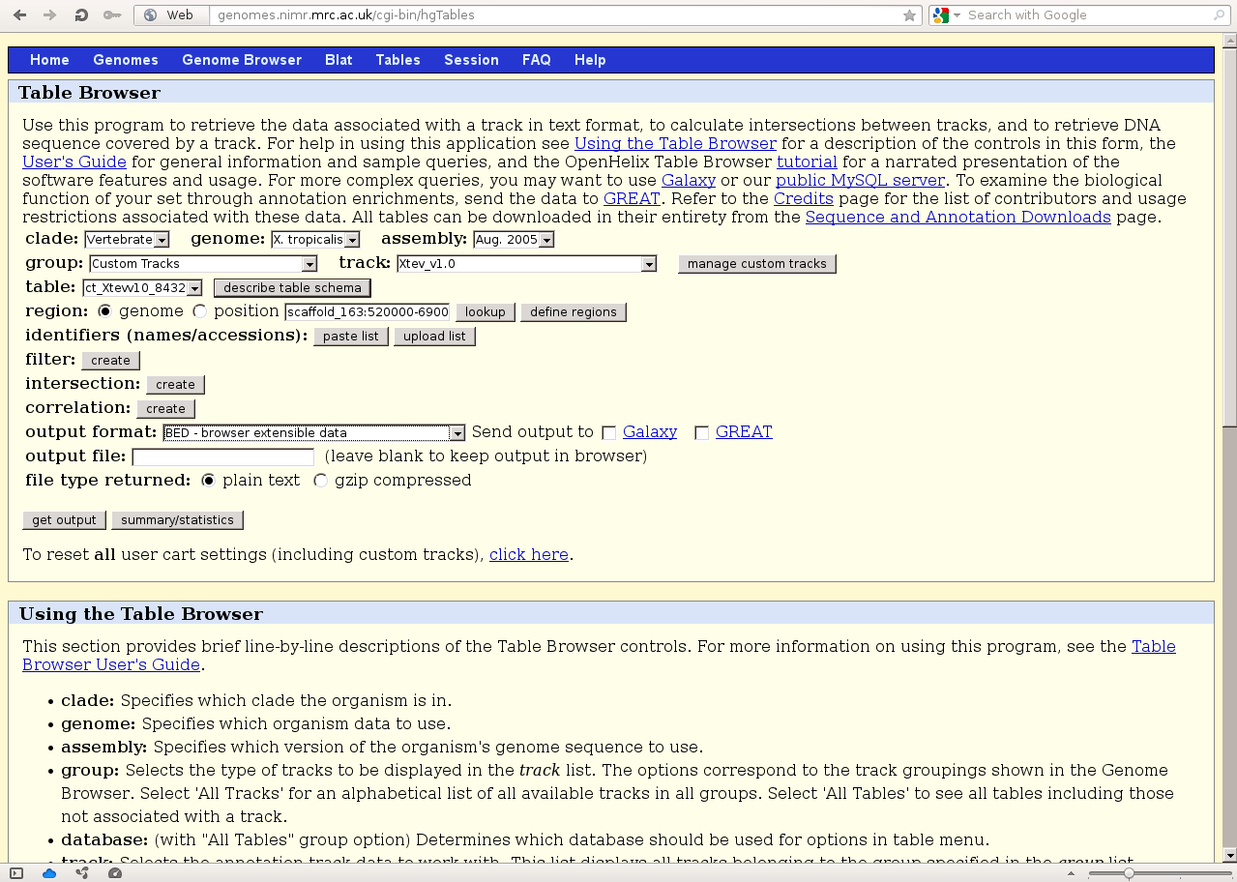

Slide 33
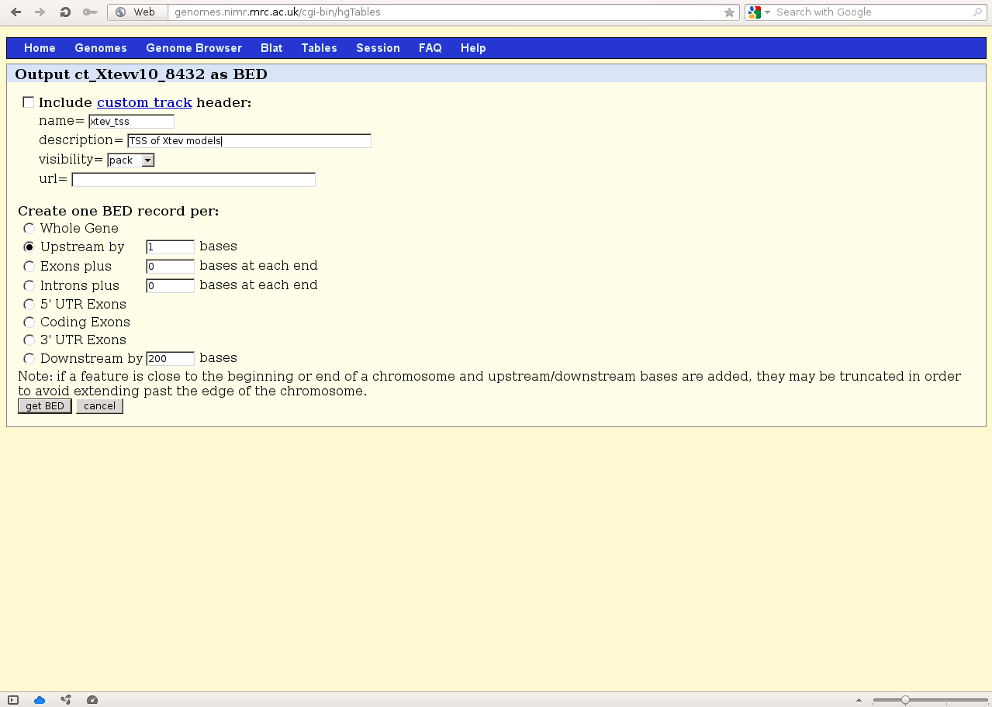

Slide 34
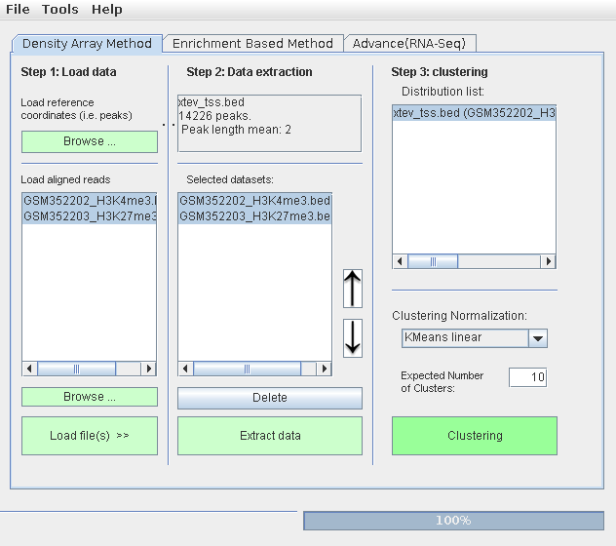
seqMINER
load reference
load reads (BED/BAM)
extract data
cluster
Tip: select window size under Tools

Slide 35
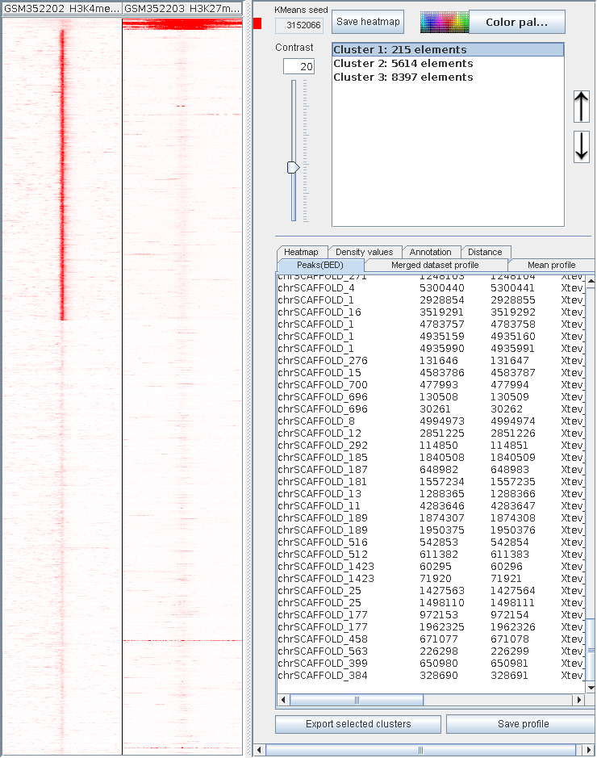
Result
Play around with number of clusters
Vary contrast to see how that looks

Slide 36
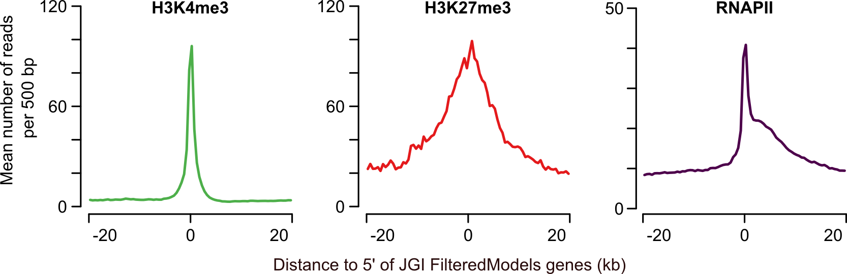
Profiles

Slide 37
Creating profiles
Many ways
seqMINER can do it for each cluster
  To generate a profile of the whole dataset, just use 1 cluster ;-)

Slide 38
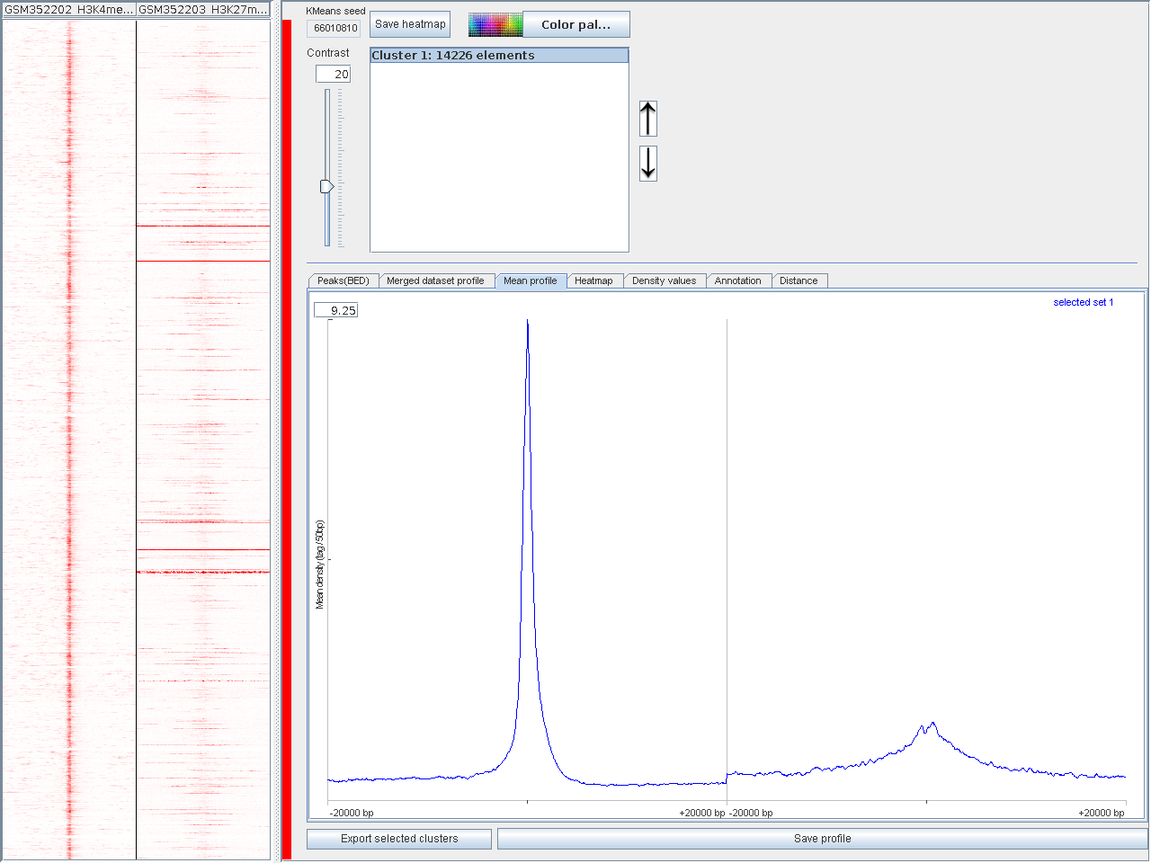
Creating profiles

Slide 39
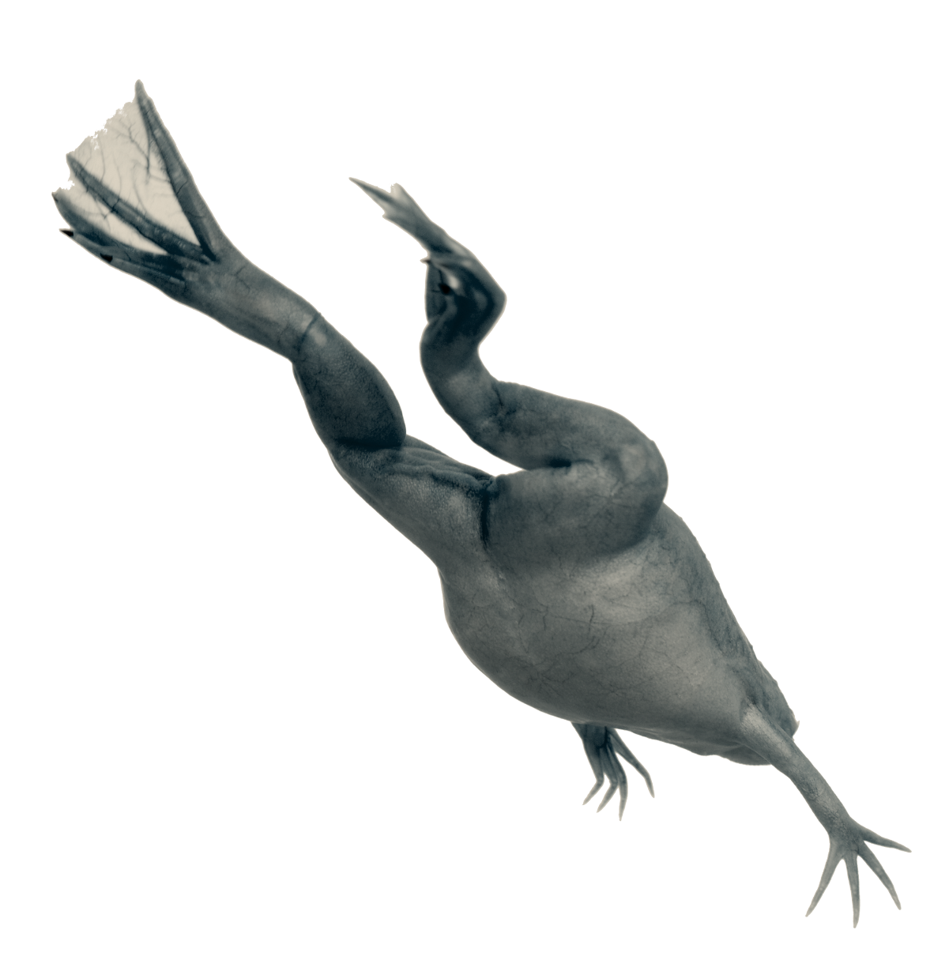




Thank you
for your
attention
NCMLS
Radboud University, Nijmegen
Robert Akkers
Ozren Bogdanovic
Ulrike Jacobi
Gert Jan Veenstra
Mike Gilchrist
Ilya Patrushev

Slide 40
Feel free to share or re-use these slides!
Creative Commons Attribution 3.0 Unported License, except where noted.
Xenopus laevis images (c) Shutterstock

