Slide 1
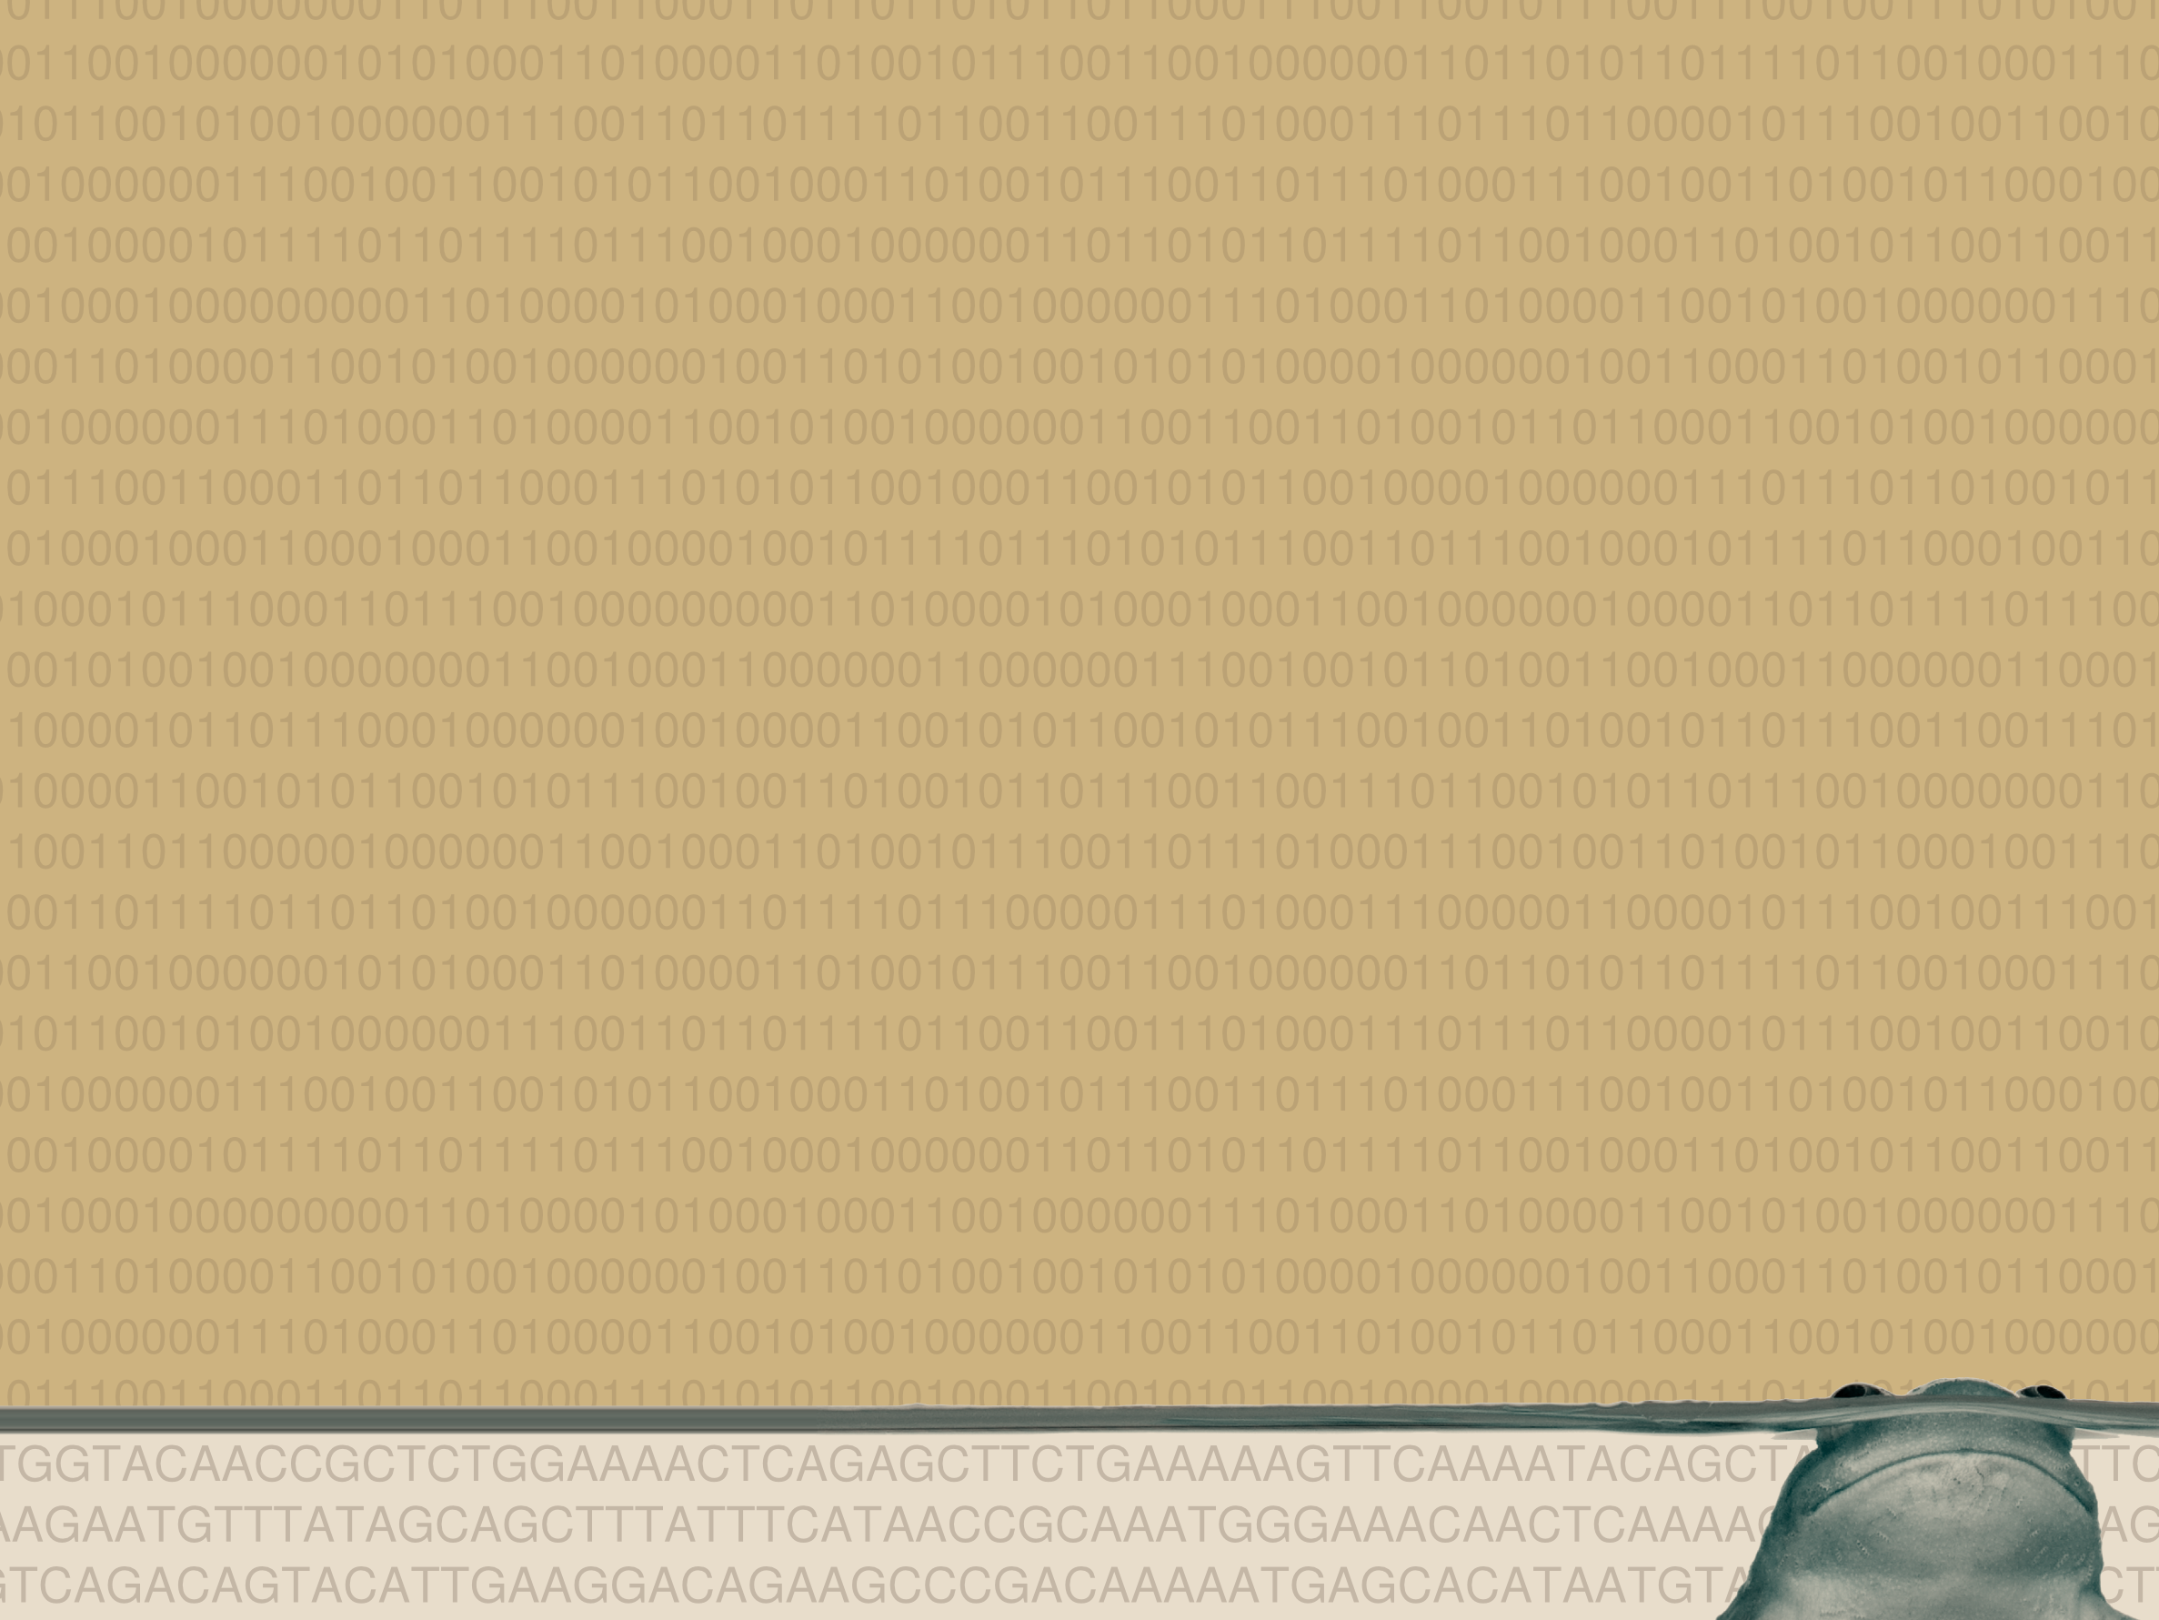
Xenopus functional genomics:
data availability and visualization
Simon J. van Heeringen
14th International Xenopus conference
Notes:
I'm Simon van Heeringen and I would like to start by thanking the committee for inviting me here. I'm really excited to have the chance to present my proposal, titled: Cracking the Polycomb code

Slide 2
Support and more info
http://simonvh.github.com/xenopus2012
  Contains all presentations
  Links to databases, tools and materials
Mail me: s.vanheeringen@ncmls.ru.nl
Our website:
http://www.ncmls.nl/gertjanveenstra

Slide 3
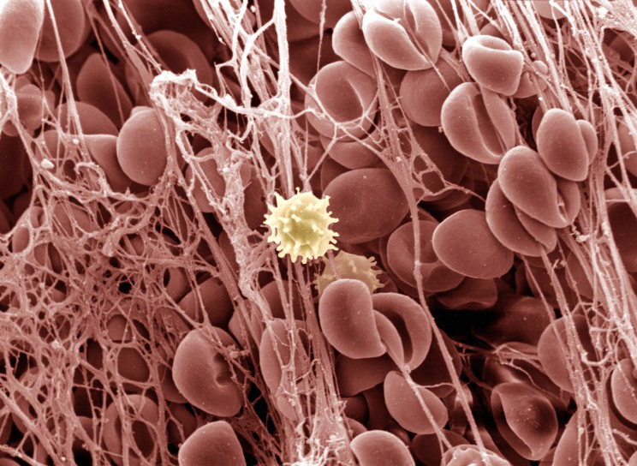
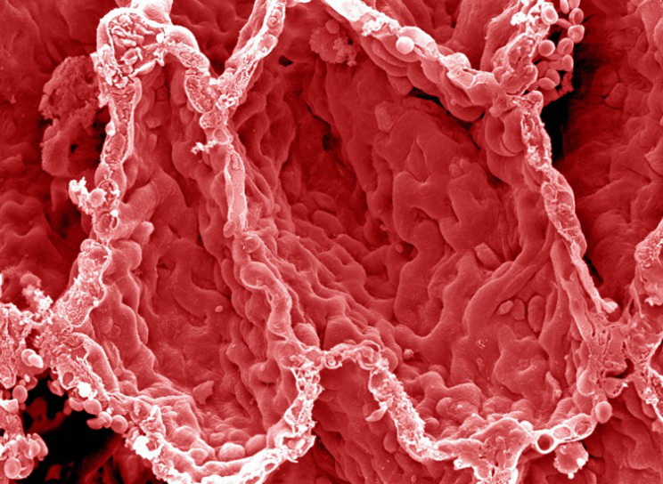
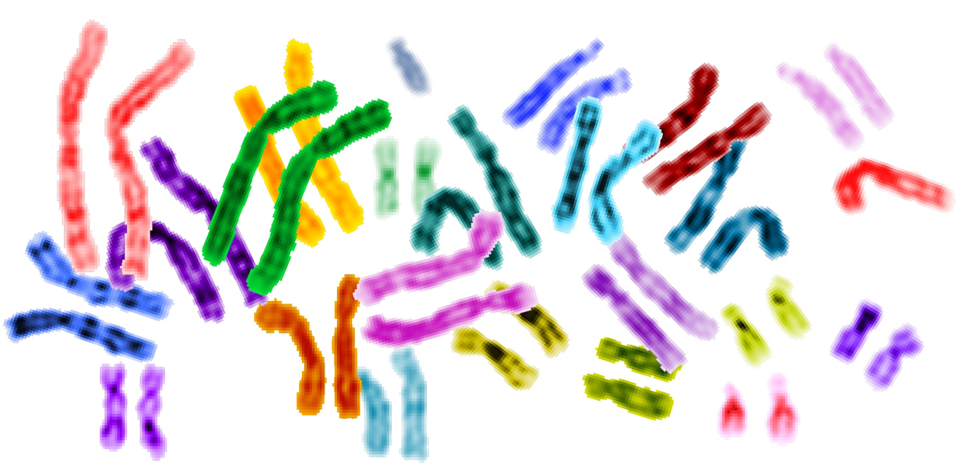
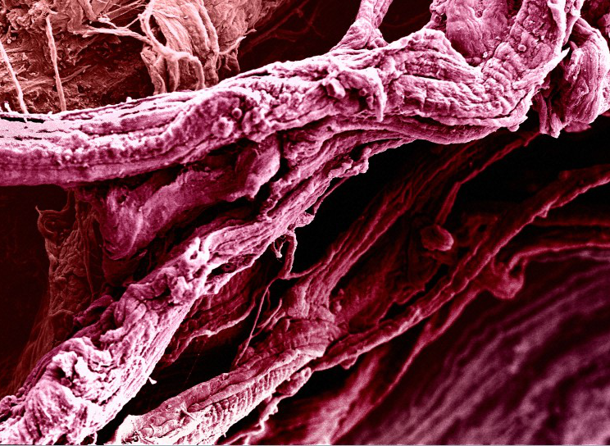
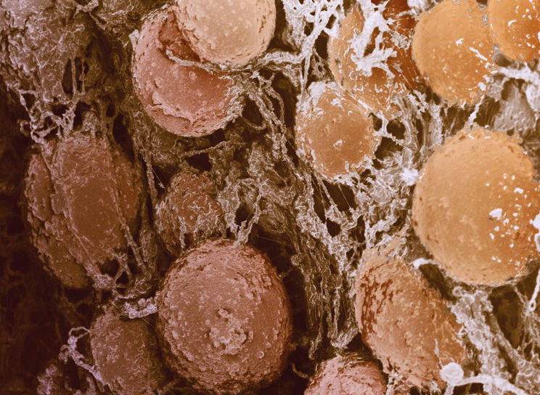
One genome, many functions
http://images.wellcome.ac.uk/
Notes:
The genetic information of an organism, encoded in the DNA, is identical in each and every cell. However, the same genome can give rise to many different cell types, with many different functions. This is made possible by the regulation of expression, turning specific genes on and off..

Slide 4

Encyclopedia of DNA Elements
http://www.nature.com/encode

Slide 5
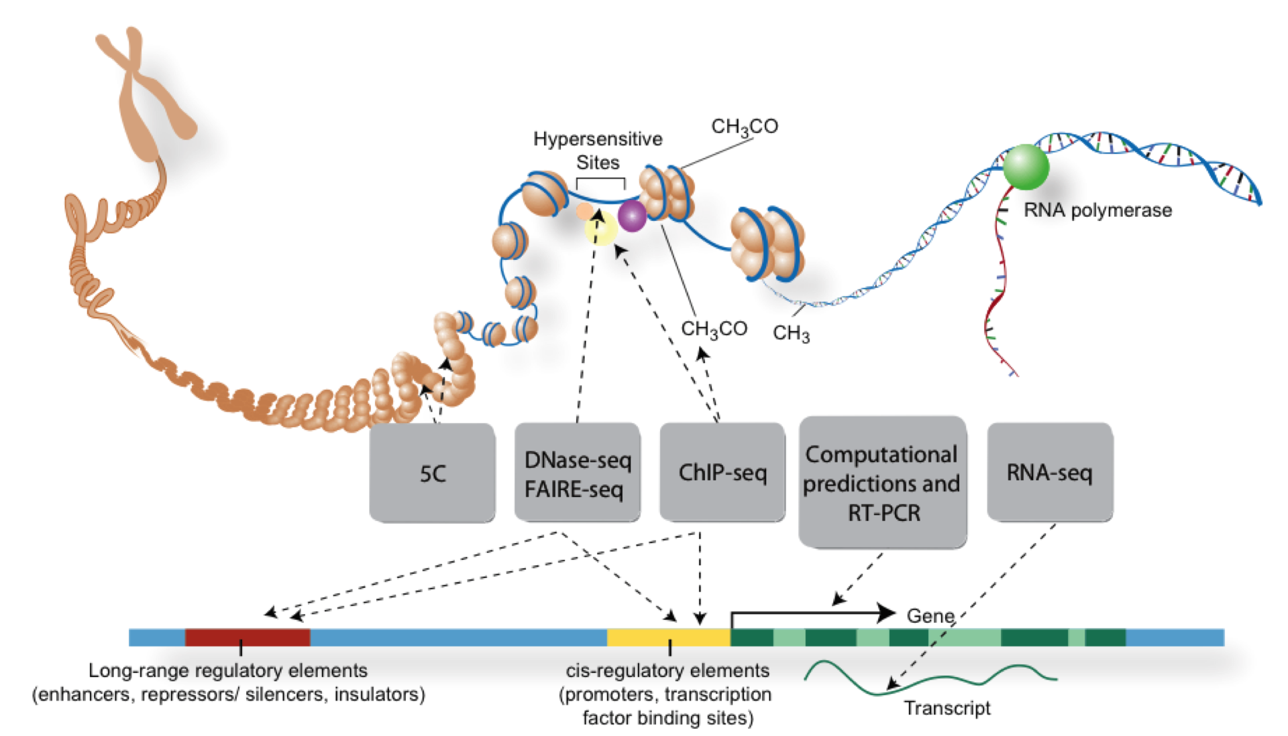
The functional genome
ENCODE, Darryl Leja (NHGRI), Ian Dunham (EBI)

Slide 6
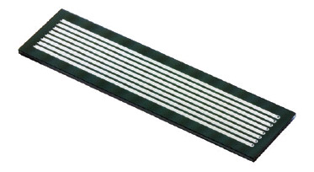
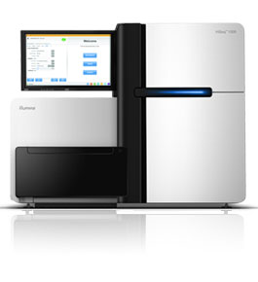
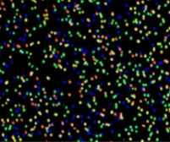
Illumina HiSeq 2000
Illumina, Inc.

Slide 7
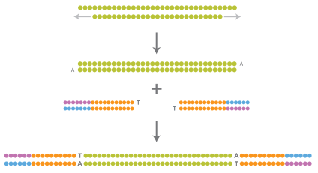
Adapter ligation
Illumina, Inc.

Slide 8
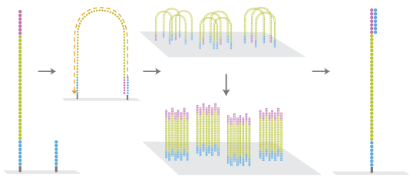
Cluster generation
Illumina, Inc.

Slide 9
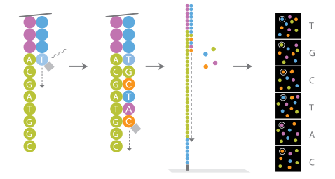
Sequencing
Illumina, Inc.

Slide 10
Applications of sequencing
RNA-seq: gene expression, small RNA, non-coding RNA
ChIP-seq: histone modifications, transcription factors
Bisulphite seq / MethylCap: DNA methylation
DNase-seq / FAIRE-seq: “open chromatin”
CAGE-seq / TSS-seq: transcription start sites

Slide 11
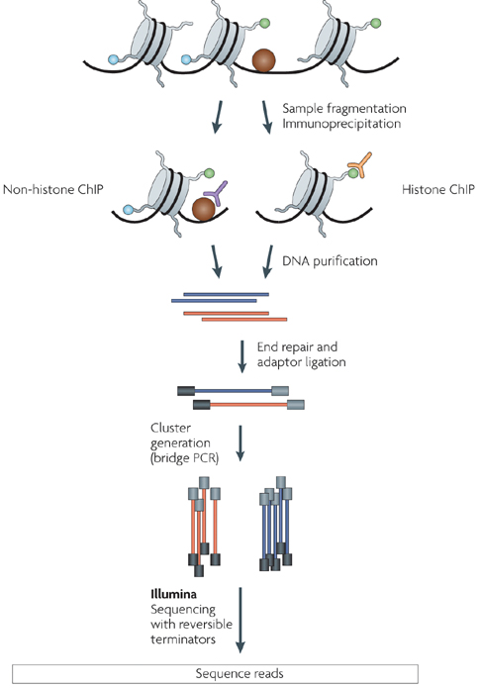
ChIP-sequencing
ChIP
Sample prep
Sequencing
Mapping
Analysis
  Peak calling
  Location
  Motifs
  ...
Based on Park, 2009

Slide 12
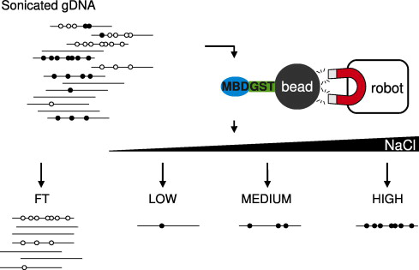
MethylCap
Brinkman, Methods, 2010

Slide 13
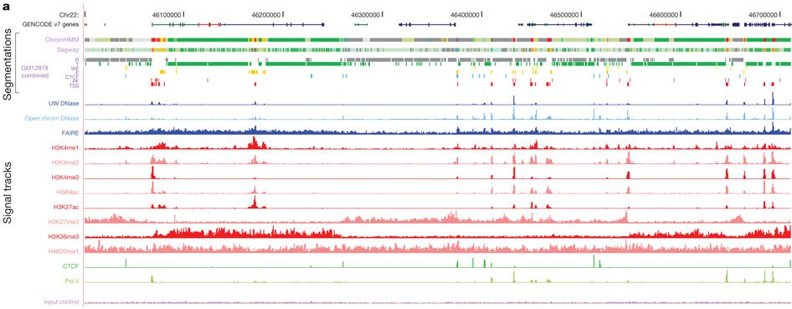
A genome-wide view of regulation
ENCODE, Nature, 2012

Slide 14
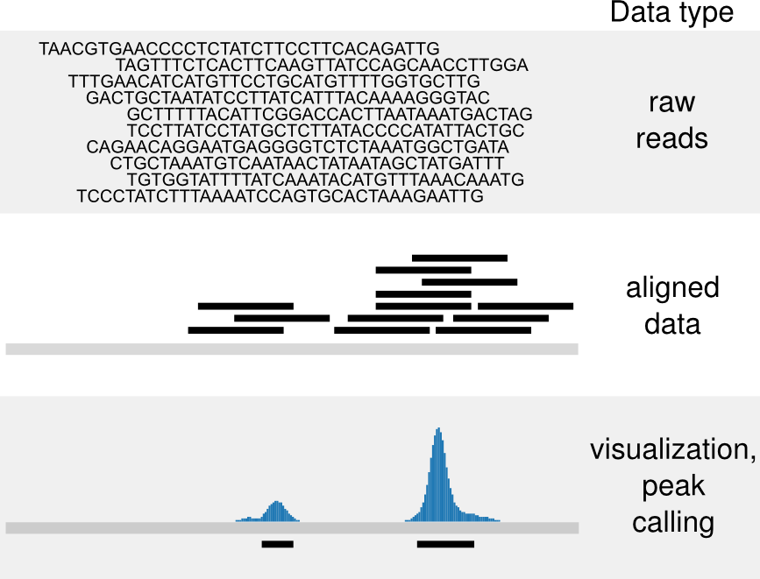
ChIP-seq workflow

Slide 15
File formats
File formats
FASTQ
SAM / BAM
BED
SAM / BAM
BED
WIG

Slide 16
File formats
All (except BAM) are text-based
FASTQ
@SOLEXAWS1:2:6362AAAXX:1:24:1990:6915
AATGATGCCACGATCGGCCGAAATCAGCTGAAAATGTTA
+
GG=GGGHHHFGBDGGF<DFCGGEDEG8GGGGGG@8GDGD
@SOLEXAWS1:2:6362AAAXX:1:80:5526:11071
AATGATGCCACGATCGGCCGAAATCAGCTGAAAATGTTA
+
IGIGGIIIIIIDIFIIHIIIIIIIIHBIHHHHIIIIIGH

Slide 17
BED format
Defined by the UCSC
http://genome.ucsc.edu/FAQ/FAQformat.html
Basic BED
chrom start end
scaffold_1 100203 100238
scaffold_1 100213 100248

Slide 18
BED format
Defined by the UCSC
http://genome.ucsc.edu/FAQ/FAQformat.html
Basic BED with strand information
chrom start end name score strand
scaffold_1 100203 100238 0 0 +
scaffold_1 100213 100248 0 0 -

Slide 19
Wiggle format
.wig files
For visualization
  Lossy!
  Don't use for analysis!
Similar to BED:
scaffold_1 100203 100213 123.0

Slide 20

Wiggle format
.wig files
For visualization
  Lossy!
  Don't use for analysis!
Similar to BED:
scaffold_1 100203 100213 123.0
Several other wig formats, for data compression, see UCSC

Slide 21
SAM / BAM format
Can contain both raw sequence and quality information as well as alignment
SAM is text-based
BAM is a binary version of SAM
  Not human-readable
  Much smaller filesize
  Can be indexed for faster analysis
http://samtools.sourceforge.net/

Slide 22
ChIP-seq workflow

Slide 23
Mapping to reference genome
A time- and memory-intensive process
Lots of options:
  ELAND (Illumina)
  BWA http://bio-bwa.sourceforge.net/
  Bowtie http://bowtie-bio.sourceforge.net/
However, for ChIP-seq it doesn't really matter which you use.

Slide 24
Repeats and duplicates
Repeats
?

Slide 25
Repeats and duplicates
Repeats
PCR duplicates
?

Slide 26
Alignment & post-processing
Different mappers behave differently
  BWA randomly assigns a repeat read to one location
  ELAND cannot map to repeats
Post-processing (at least in our lab)
  Remove reads in repeats
  Remove all duplicates
    Except in RNA-seq

Slide 27
Which reference genome?
JGI 4.1, 4.2, 7.1, …?
Raw data can always be remapped
  As long as you keep unmapped reads, no data is lost
  FASTQ, SAM, BAM can be remapped
Aligned data is dependent on a specific reference
  BED, WIG

Slide 28
Veenstra lab data
Blastula, gastrula, neurula, tadpole stages
  H3K4me3 (associated with activation)
  H3K27me3 (associated with repression)
  RNAPII (active transcription)
  RNAseq (expression)
Blastula and gastrula stages
  H3K4me1 (enhancers)
  MethylCap (DNA methylation)
Gastrula
  TBP (near Transcription Start Site)

Slide 29
Veenstra lab data
Blastula, gastrula, neurula, tadpole stages
  H3K4me3 (associated with activation)
  H3K27me3 (associated with repression)
  RNAPII (active transcription)
  RNAseq (expression)
Blastula and gastrula stages
  H3K4me1 (enhancers)
  MethylCap (DNA methylation)
Gastrula
  TBP (near Transcription Start Site)

Slide 30
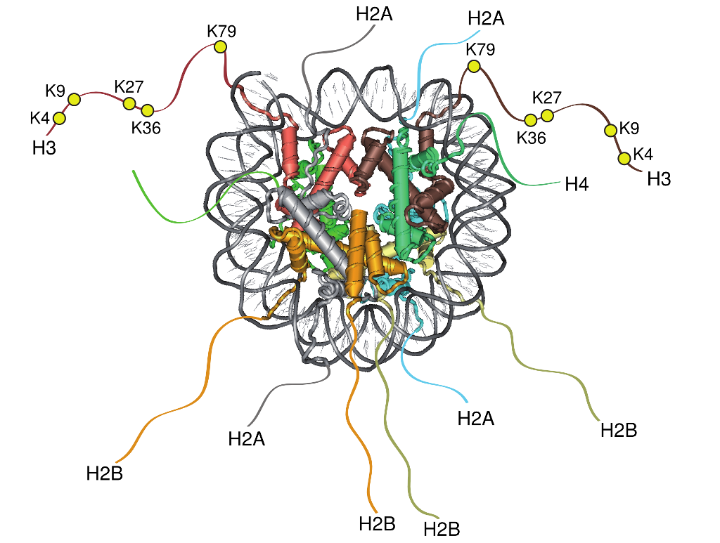
Histone modifications
Bogdanovic, 2012

Slide 31
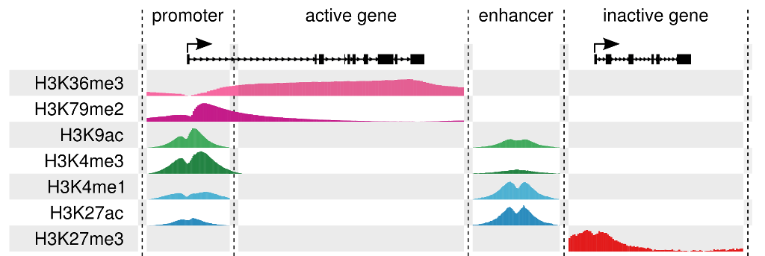
Histone modifications
Bogdanovic, 2012

Slide 32
How to visualize this data?
Gene profile browser
Xenbase
UCSC Genome Browser

Slide 33
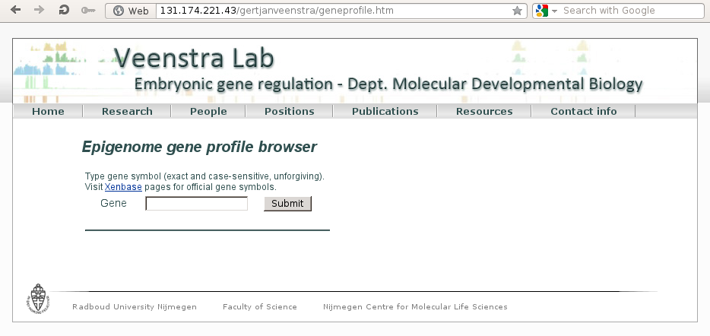
Quick gene-based overview
http://www.ncmls.nl/gertjanveenstra/
  Resources → Epigenome gene profile browser

Slide 34
Quick gene-based overview
http://www.ncmls.nl/gertjanveenstra/
  Resources → Epigenome gene profile browser
Images are automatically generated
  scale, size, annotation might be not optimal
H3K4me3 and H3K27me3 only
Exact gene name (lower case)!
Static image, no browsing

Slide 35
Xenbase
Integrated with all other Xenbase resources
H3K4me3 and H3K27me3 stage 12 ChIP-seq data (JGI 4.1 only; Akkers, 2009)
  Header: Methylation Data
Xenbase is working on supporting (custom) wig files

Slide 36
Genome browser tracks
UCSC Genome browser
  http://genome.ucsc.edu/
  Only X. trop JGI 4.1 tracks
Genome Browser mirror at MRC NIMR (Mike Gilchrist)
  http://genomes.nimr.mrc.ac.uk
  X.trop JGI 4.1 & 7.1
  X.laevis 2011 assembly
    No public tracks as of now

Slide 37
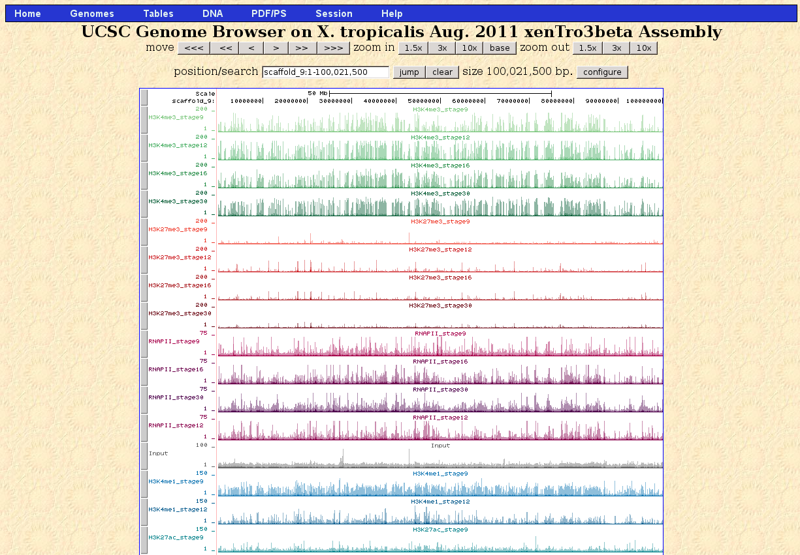
Genome Browser

Slide 38
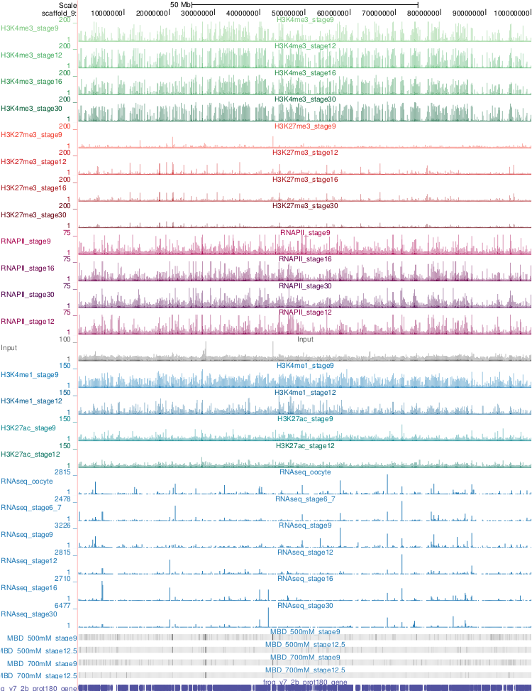
Genome Browser
Genome backbone; base position
Annotation tracks
Genes
ChIP-seq profiles
GC%
Repeats
Conservation
Etc..

Slide 39
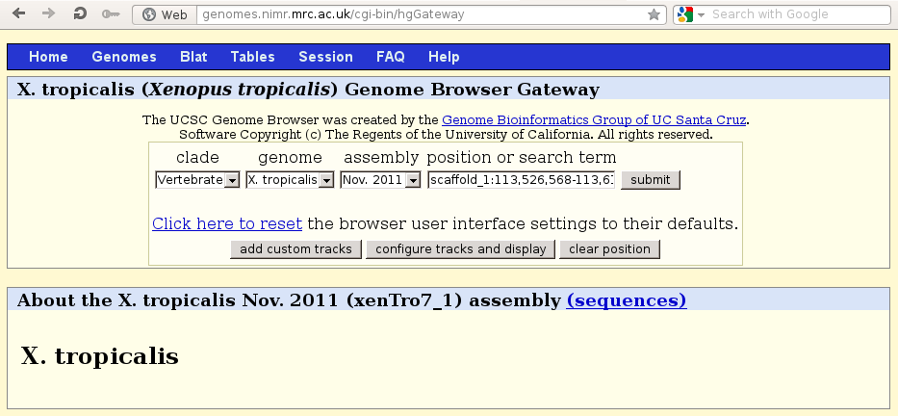
Adding tracks

Slide 40
add custom tracks

Slide 41
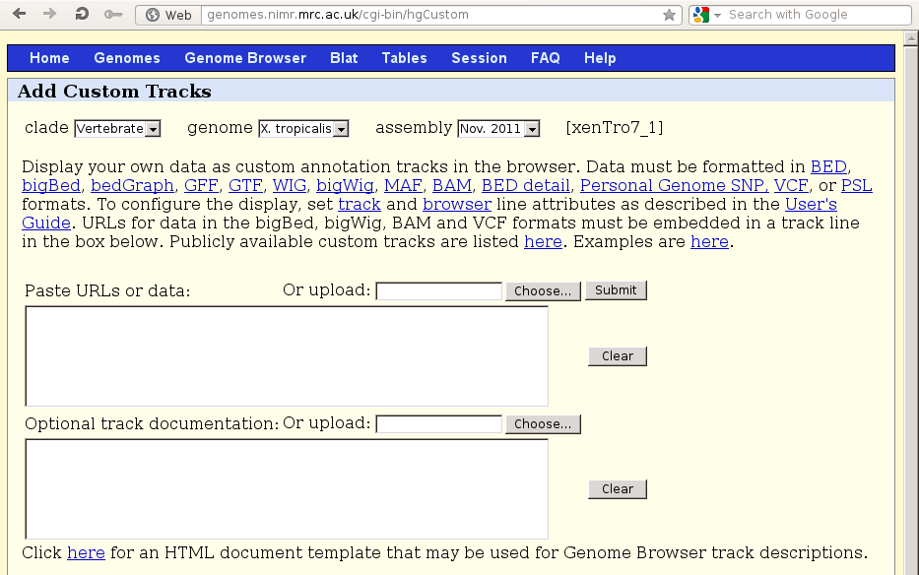
add custom tracks

Slide 42
add custom tracks
Tracks from: http://131.174.221.43/gertjanveenstra/genomedata.asp

Slide 43
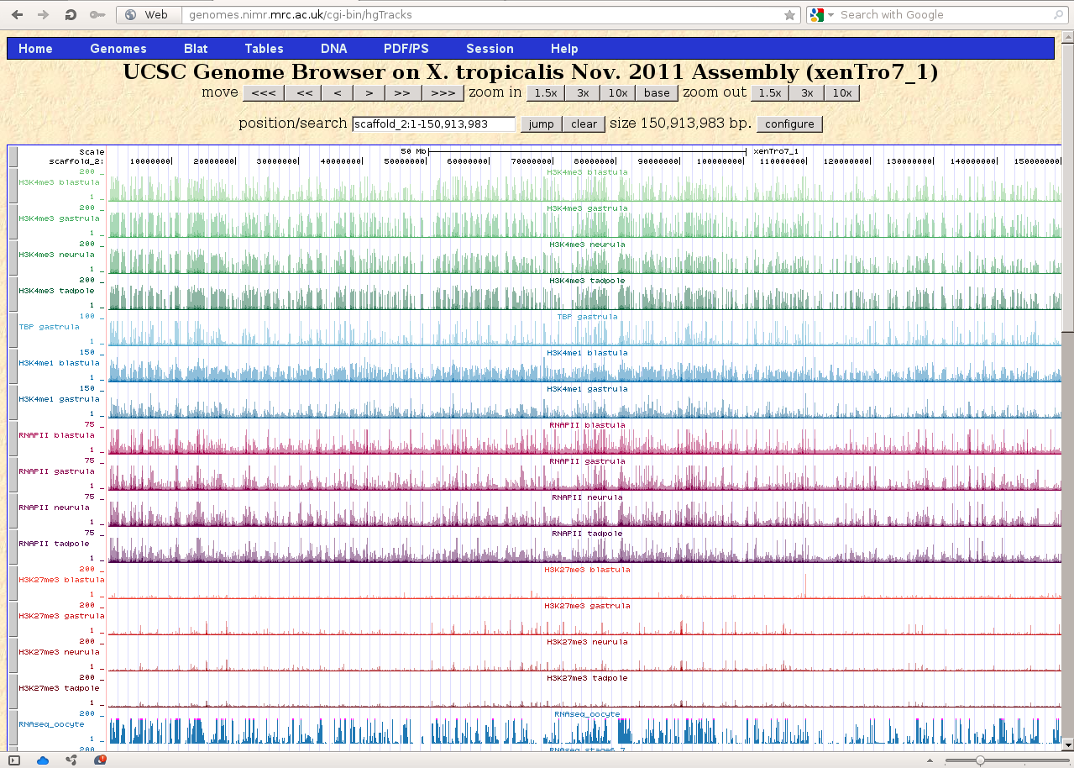
Veenstra lab tracks

Slide 44
Veenstra lab tracks
Genomic coordinates

Slide 45
Your favorite gene
Search by gene name is (not yet) available for JGI 7.1
Get coordinates from Xenbase!

Slide 46
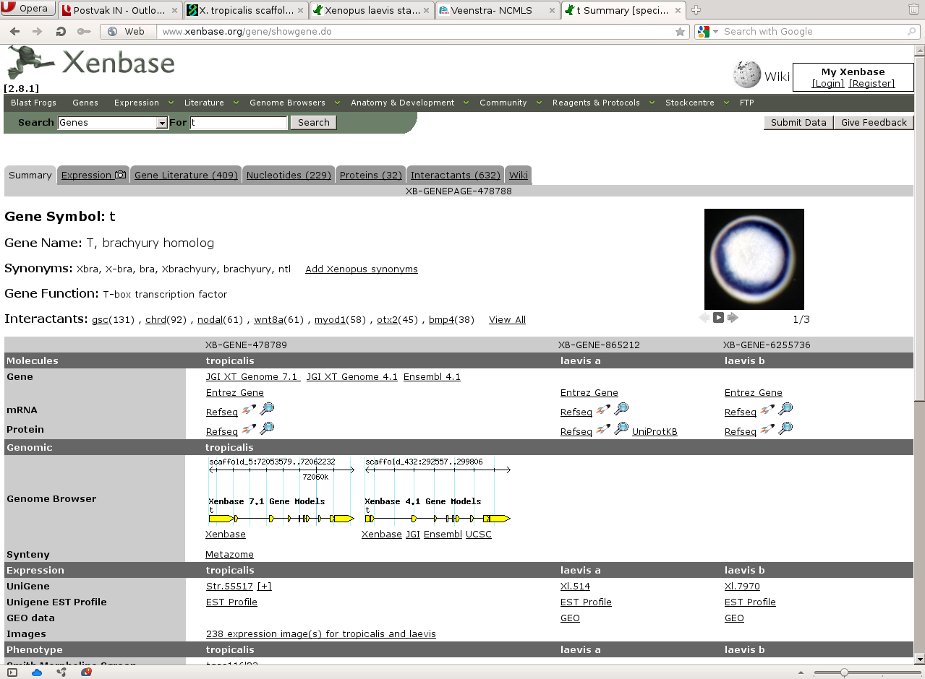
Your favorite gene
Search by gene name is (not yet) available for JGI 7.1
Get coordinates from Xenbase!

Slide 47
Your favorite gene
Search by gene name is (not yet) available for JGI 7.1
Get coordinates from Xenbase!
JGI 7.1 coordinates
JGI 4.1 coordinates

Slide 48
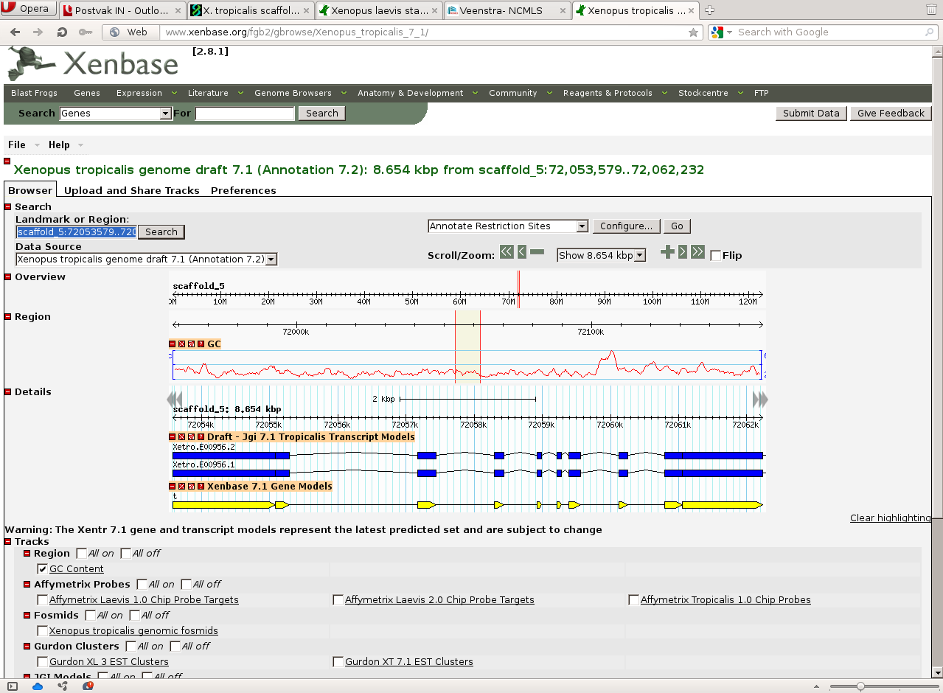

Slide 49
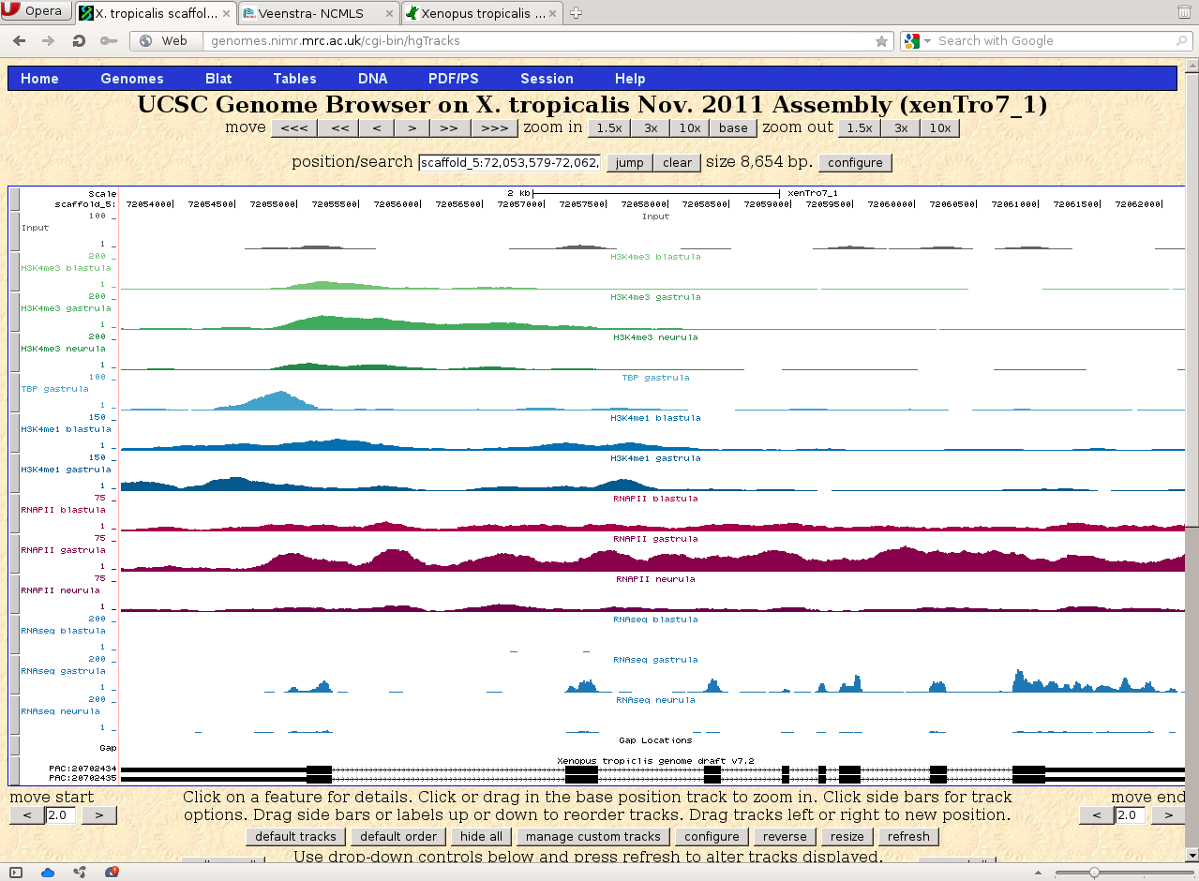

Slide 50
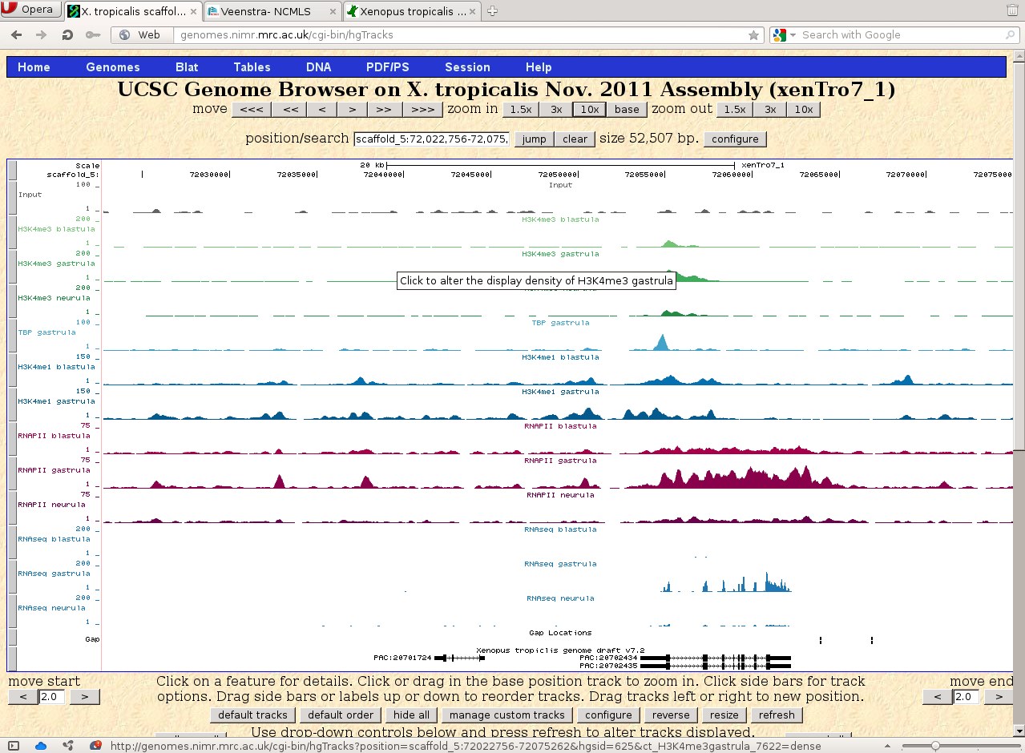

Slide 51
Other resources
All published sequencing data should be available in raw and processed format
See NCBI GEO for public datatets
http://www.ncbi.nlm.nih.gov/geo/

Slide 52
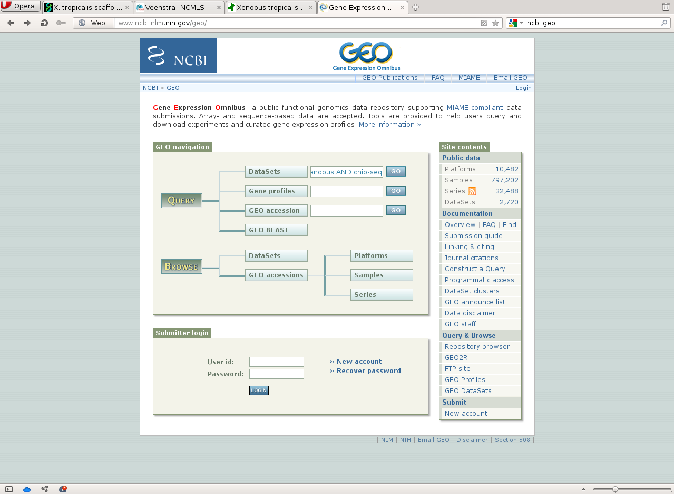

Slide 53
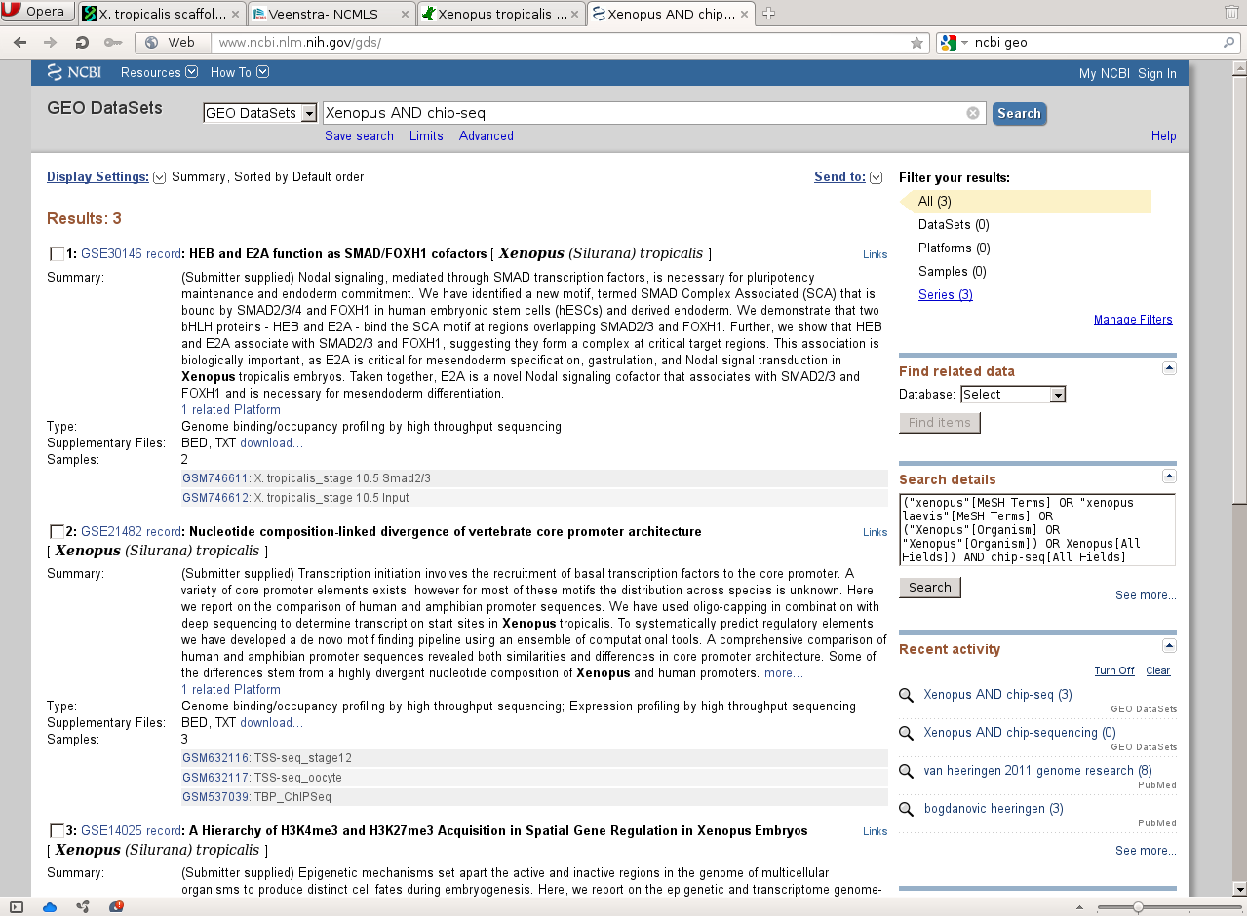

Slide 54
Other pointers
UCSC Genome Browser Tutorials: http://www.openhelix.com/ucsc
Publications
  Akkers et al., Dev Cell, 2009
  Bogdanovic et al., Genome Research, 201
  Van Heeringen et al., Genome Research, 2011
The epigenome in early development
  Bogdanovic et al., Genesis, 2012

Slide 55
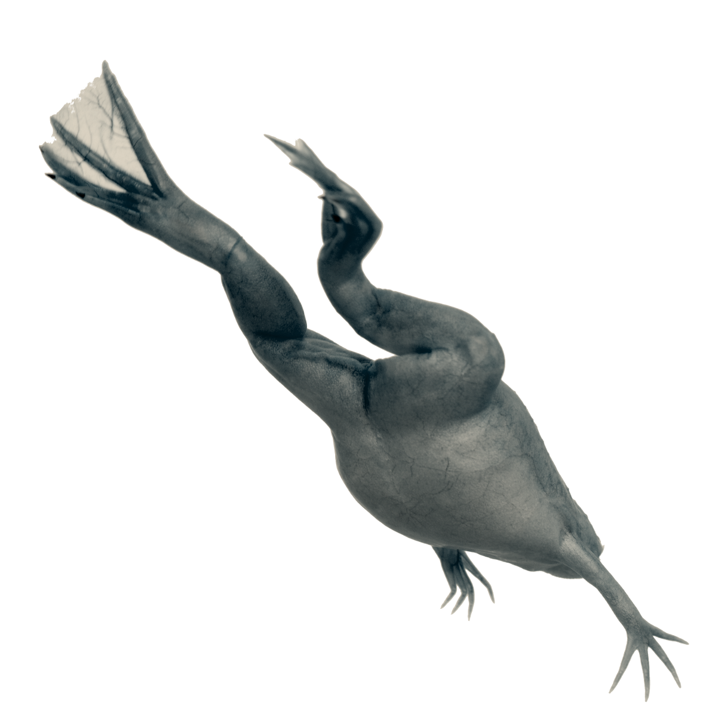




Thank you
for your
attention
NCMLS
Radboud University, Nijmegen
Robert Akkers
Ozren Bogdanovic
Ulrike Jacobi
Gert Jan Veenstra
Mike Gilchrist
Ilya Patrushev

Slide 56
Feel free to share or re-use these slides!
Creative Commons Attribution 3.0 Unported License, except where noted.
Xenopus laevis images (c) Shutterstock

