Slide 1
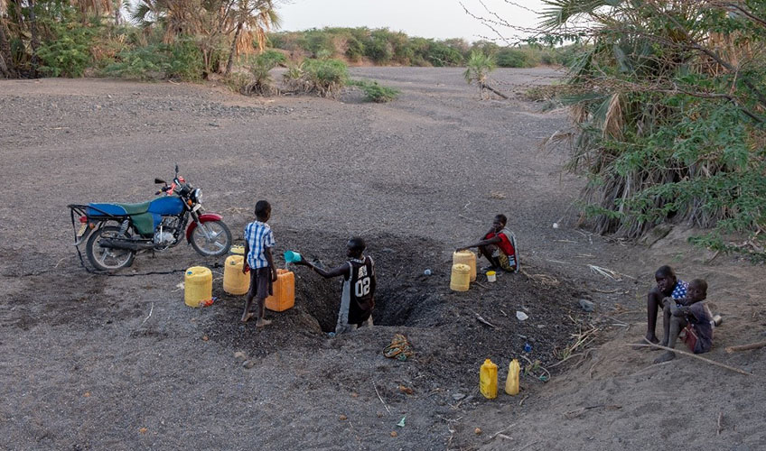
PHOTO ESSAY / NORTHERN KENYA
A Lake
Under Pressure
Water. Livelihoods. Cooperation.
Life around Lake Turkana, told through the people who depend on it.
A man draws water from a shallow well in a dry river bed.
PHOTO: MARTIN MWANGI / INTERNATIONAL ALERT
01 / 11

Slide 2
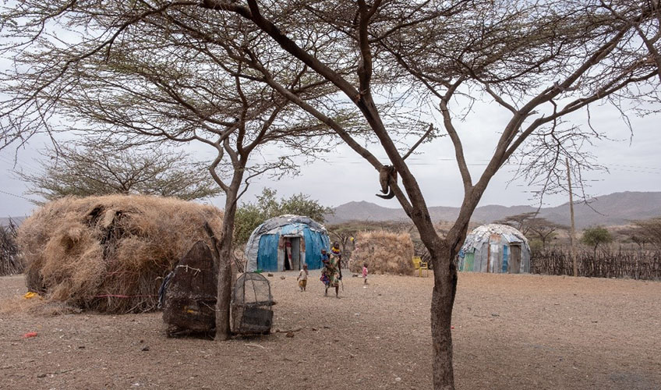
01 / THE SETTING
A desert lake.
Many ways of life.
In arid northern Kenya, families, pastoralists and fishing communities rely on a small number of wells and rivers. When these water sources weaken, the lake becomes even more central to daily life.
A family homestead in the Lake Turkana region.
PHOTO: MARTIN MWANGI / INTERNATIONAL ALERT
02 / 11

Slide 3
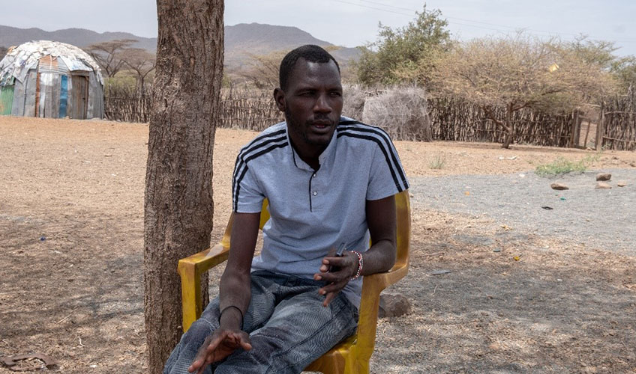
02 / A SHARED RESOURCE
“Water is the number one
natural resource.”
Narogoe Ebenyo Maisa
Pastoralist and chair, Kibish Water Resource User Association
The water table has fallen as rainfall has declined, making reliable water harder to find.
Narogoe Ebenyo Maisa speaks about water access in Kibish.
PHOTO: MARTIN MWANGI / INTERNATIONAL ALERT
03 / 11

Slide 4
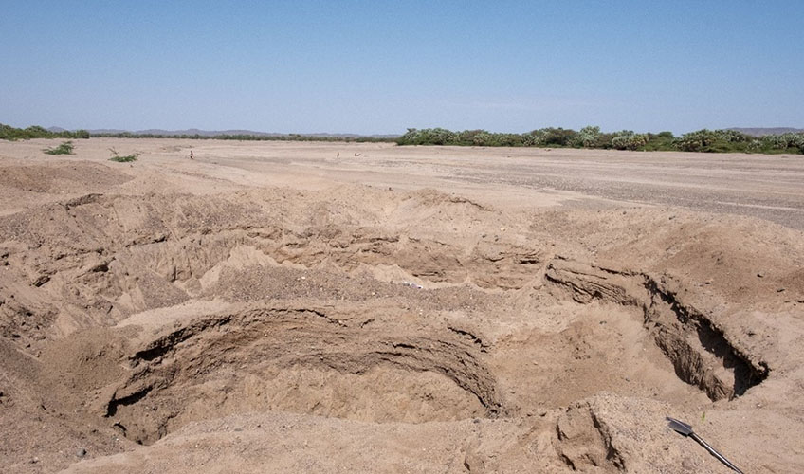
03 / THE DAILY JOURNEY
When a river bed
runs dry
A shallow well can become the difference between getting through the day and going without. Water collection is part of the rhythm of home, work and caring for livestock.
A resident fetches water from a shallow well in a dry river bed.
PHOTO: MARTIN MWANGI / INTERNATIONAL ALERT
04 / 11

Slide 5
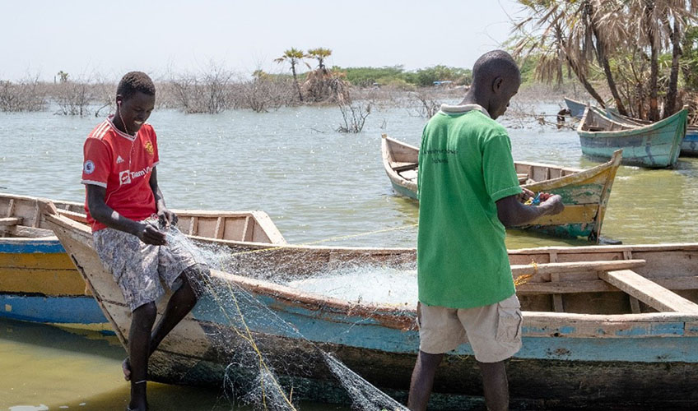
04 / WORK ON THE WATER
Fishing takes skill,
patience and teamwork.
Along the shore, fishing supports local food and livelihoods. Preparing nets and going out together are part of the daily work of communities around the lake.
Fishermen prepare nets at Impresa beach, Kalokol.
PHOTO: MARTIN MWANGI / INTERNATIONAL ALERT
05 / 11

Slide 6
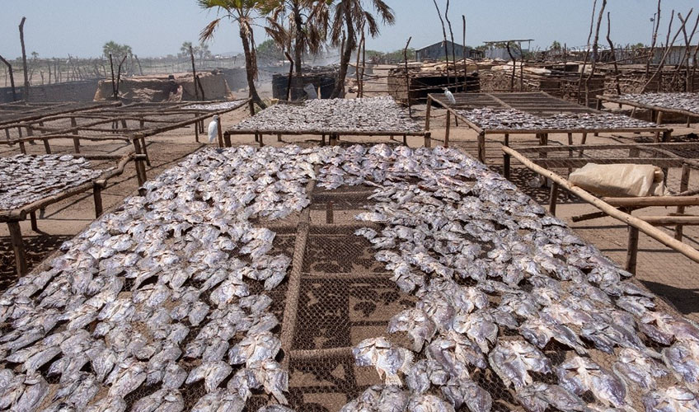
05 / FROM CATCH TO MARKET
The lake’s value
travels beyond shore.
Fish drying in the sun is a visible link between the lake and household livelihoods. The work continues after the boats return, as the catch is prepared and preserved.
Fish dry at Impresa beach in Kalokol town.
PHOTO: MARTIN MWANGI / INTERNATIONAL ALERT
06 / 11

Slide 7
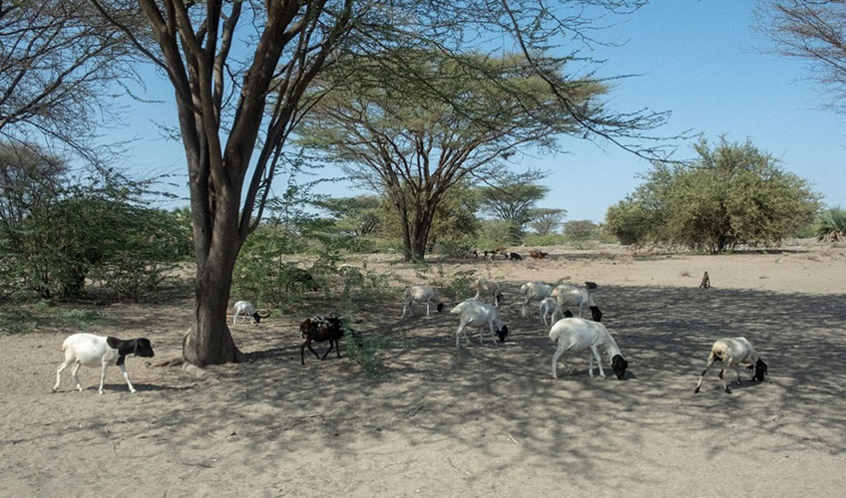
06 / PRESSURE ON LAND AND WATER
Scarcity is shared
by people and livestock.
Drought and unreliable water sources can push families to move and bring different needs together at the same wells and shorelines. Where access is tight, competition can turn into conflict.
Goats search for pasture in the dry landscape.
PHOTO: MARTIN MWANGI / INTERNATIONAL ALERT
07 / 11

Slide 8
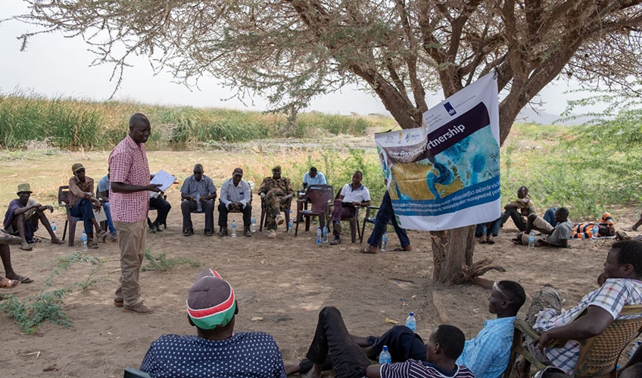
07 / MAKING SPACE FOR DIALOGUE
Shared resources
need shared decisions.
Water user groups, community leaders and local partners create ways to discuss access and manage pressure. Listening locally helps decisions reflect the people who live with the consequences.
A community meeting with local partners in the Lake Turkana area.
PHOTO: MARTIN MWANGI / INTERNATIONAL ALERT
08 / 11

Slide 9
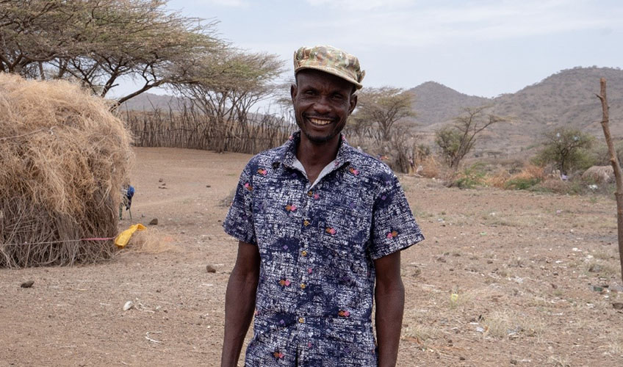
08 / COOPERATION IN PRACTICE
Dialogue can change
what happens next.
“The WPS project is engaging the community … to forge peaceful coexistence.”
Charles Losike
Plumber and vice chair, Kibish Water Association
Charles Losike, Kibish Water Association.
PHOTO: MARTIN MWANGI / INTERNATIONAL ALERT
09 / 11

Slide 10
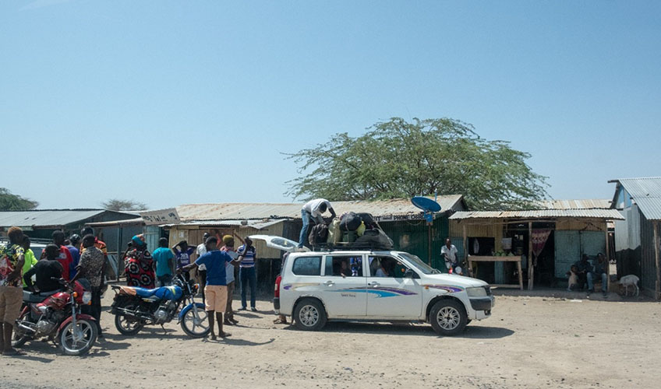
A WAY FORWARD
Protect the water.
Strengthen the ties.
Listen to the people closest to the water.
Support fair, dependable access.
Keep dialogue open across communities.
Resilience grows when shared resources are managed together.
Residents transport supplies in Kalokol.
PHOTO: MARTIN MWANGI / INTERNATIONAL ALERT
10 / 11

Slide 11
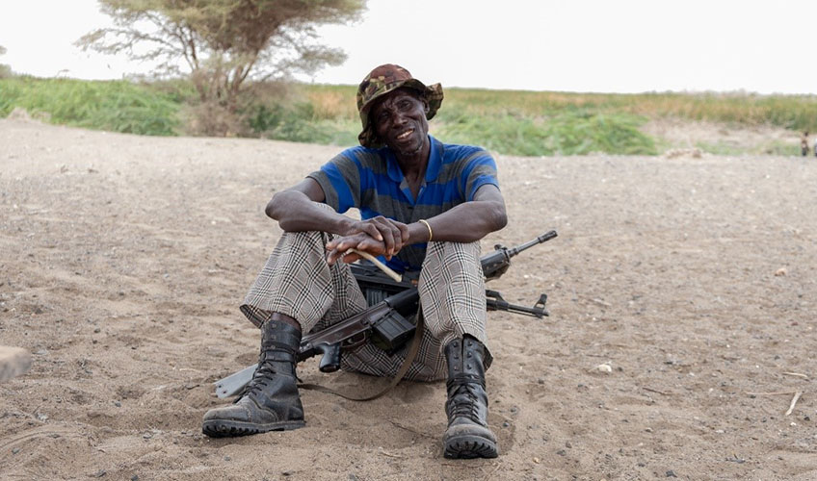
PHOTO CREDITS / SOURCES
The story behind
the photographs.
Photo essay: International Alert, “Water is the number one natural resource”: Lake Turkana photo essay (January 2023).
Photographs: Martin Mwangi / International Alert. Captions and community quotations are credited to the original story.
Source: international-alert.org/stories/water-is-the-number-one-natural-resource-lake-turkana-photo-essay/
Prepared by Simon Wamugunda Waweru
Community dialogue is part of managing shared water resources.
PHOTO: MARTIN MWANGI / INTERNATIONAL ALERT
11 / 11

