Slide 1
The CharStack Class
SUN, Qinbo
218019050@link.cuhk.edu.cn

Slide 2
Example: The CharStack Class
Write classes that use dynamic allocation
CharStack: a stack of characters
CharStack cstk;
Initializes an empty stack.
cstk.size()
Returns the number of characters pushed onto the stack.
cstk.isEmpty()
Returns true if the stack is empty.
cstk.clear()
Deletes all characters from the stack.
cstk.push(ch)
Pushes a new character onto the stack.
cstk.pop()
Removes and returns the top character from the stack.

Slide 3
The charstack.h Interface
/*
* File: charstack.h
* -----------------
* This interface defines the CharStack class.
*/
#ifndef _charstack_h
#define _charstack_h
class CharStack {
public:
/*
* CharStack constructor and destructor
* ------------------------------------
* The constructor initializes an empty stack. The destructor
* is responsible for freeing heap storage.
*/
CharStack();
~CharStack();

Slide 4
The charstack.h Interface
/*
* Methods: size, isEmpty, clear, push, pop
* ----------------------------------------
* These methods work exactly as they do for the Stack class.
* The peek method is deleted here to save space.
*/
int size();
bool isEmpty();
void clear();
void push(char ch);
char pop();
}
#endif
/*
* File: charstack.h
* -----------------
* This interface defines the CharStack class.
*/
#ifndef _charstack_h
#define _charstack_h
class CharStack {
public:
/*
* CharStack constructor and destructor
* ------------------------------------
* The constructor initializes an empty stack. The destructor
* is responsible for freeing heap storage.
*/
CharStack();
~CharStack();
The private section of the class goes here.

Slide 5
Private section for CharStack using a dynamic array
/*
*
* ---------------------
* It contains the private data for the CharStack class.
*/
private:
/* Instance variables */
static const int INITIAL_CAPACITY = 10;
/* Instance variables */
char *array; /* Dynamic array of characters */
int capacity; /* Allocated size of that array */
int count; /* Current count of chars pushed */
/* Private function prototypes */
void expandCapacity();

Slide 6
The charstack.cpp Implementation
/* File: charstack.cpp
* -------------------
* This file implements the CharStack class.*/
#include "charstack.h"
#include "error.h"
using namespace std;
/* Implementation notes: constructor and destructor
* ------------------------------------------------
* The constructor allocates dynamic array storage to hold the
* stack elements. The destructor must free these elements */
CharStack::CharStack() {
capacity = INITIAL_CAPACITY;
array = new char[capacity];
count = 0;
}
CharStack::~CharStack() {
delete[] array;
}
Notes:
T

Slide 7
The charstack.cpp Implementation
/*
* Implementation notes: constructor and destructor
* ------------------------------------------------
* The constructor allocates dynamic array storage to hold the
* stack elements. The destructor must free these elements
*/
CharStack::CharStack() {
capacity = INITIAL_CAPACITY;
array = new char[capacity];
count = 0;
}
CharStack::~CharStack() {
delete[] array;
}
int CharStack::size() {
return count;
}
bool CharStack::isEmpty() {
return count == 0;
}
void CharStack::clear() {
count = 0;
}
void CharStack::push(char ch) {
if (count == capacity) expandCapacity();
array[count++] = ch;
}
char CharStack::pop() {
if (isEmpty()) error("pop: Attempting to pop an empty stack");
return array[--count];
}

Slide 8
The charstack.cpp Implementation
int CharStack::size() {
return count;
}
bool CharStack::isEmpty() {
return count == 0;
}
void CharStack::clear() {
count = 0;
}
void CharStack::push(char ch) {
if (count == capacity) expandCapacity();
array[count++] = ch;
}
char CharStack::pop() {
if (isEmpty()) error("pop: Attempting to pop an empty stack");
return array[--count];
}
/*
* Implementation notes: expandCapacity
* ------------------------------------
* This private method doubles the capacity of the elements array
* whenever it runs out of space. To do so, it must copy the
* pointer to the old array, allocate a new array with twice the
* capacity, copy the characters from the old array to the new
* one, and finally free the old storage.
*/
void CharStack::expandCapacity() {
char *oldArray = array;
capacity *= 2;
array = new char[capacity];
for (int i = 0; i < count; i++) {
array[i] = oldArray[i];
}
delete[] oldArray;
}

Slide 9
Copying Objects
There is one remaining issue: how such objects behave if you copy them.
Typically, you need to define two methods to ensure that copies are handled correctly:
The operator operator=, which takes care of assignments
A copy constructor, which takes care of by-value parameters
The assignment operator has the following form:
The prototype for the copy constructor looks like this:
Call/return by value might cause unnecessary calls to the copy constructor. Constant call by reference protects the source.
Return by reference
type & type::operator=(const type & src)
Call by reference
Constructors have the same name as the class (type).
type::type(const type & src)
Notes:
http://www.icu-project.org/docs/papers/cpp_report/the_anatomy_of_the_assignment_operator.html

Slide 10
Assignment and Copy Constructors
If you don't provide assignment operator and copy constructor yourself, C++ provides them for you.
Unfortunately, the default behavior of C++ is to copy only the top-level fields in an object, which means that all dynamically allocated memory is shared between the original and the copy.
This default behavior, which is called shallow copying.
What you need to implement instead is deep copying, which copies the data in the dynamically allocated memory as well.

Slide 11
Shallow vs. Deep Copying
Suppose that you have an existing Vector<int> with three elements as shown in the diagram to the right.
A shallow copy allocates new fields for the object itself and copies the information from the original. Unfortunately, the dynamic array is copied as an address, not the data.
A deep copy also copies the contents of the dynamic array and therefore creates two independent structures
10
1000
elements
1000
20
100
capacity
30
3
count
.
.
.
1000
elements
100
capacity
3
count
2000
10
2000
elements
20
100
capacity
30
3
count
.
.
.

Slide 12
Implementing Deep Copy Semantics
This becomes an issue especially when you implement a class that uses dynamic memory.
The crux of the problem is that copying an abstract data object typically needs to copy the underlying data (deep copying) and not just the fields directly accessible in the object.
Unfortunately, the default interpretation in C++ is to copy only the top-level fields (shallow copying), which can lead to serious errors if you are expecting deep copying.
Therefore, it is important to specify how the object can be properly copied in your implementation.

Slide 13
Code to Implement Deep Copying
/*
* Implementation notes: copy constructor and assignment operator
* --------------------------------------------------------------
* These methods make it possible to pass a CharStack by value or
* assign one CharStack to another.
*/
CharStack::CharStack(const CharStack & src) {
deepCopy(src);
}
CharStack & CharStack::operator=(const CharStack & src) {
if (this != &src) {
delete[] array;
deepCopy(src);
}
return *this;
}
void CharStack::deepCopy(const CharStack & src) {
array = new char[src.count];
for (int i = 0; i < src.count; i++) {
array[i] = src.array[i];
}
count = src.count;
capacity = src.capacity;
}
capacity (a typo in the textbook, at least in my copy)

Slide 14
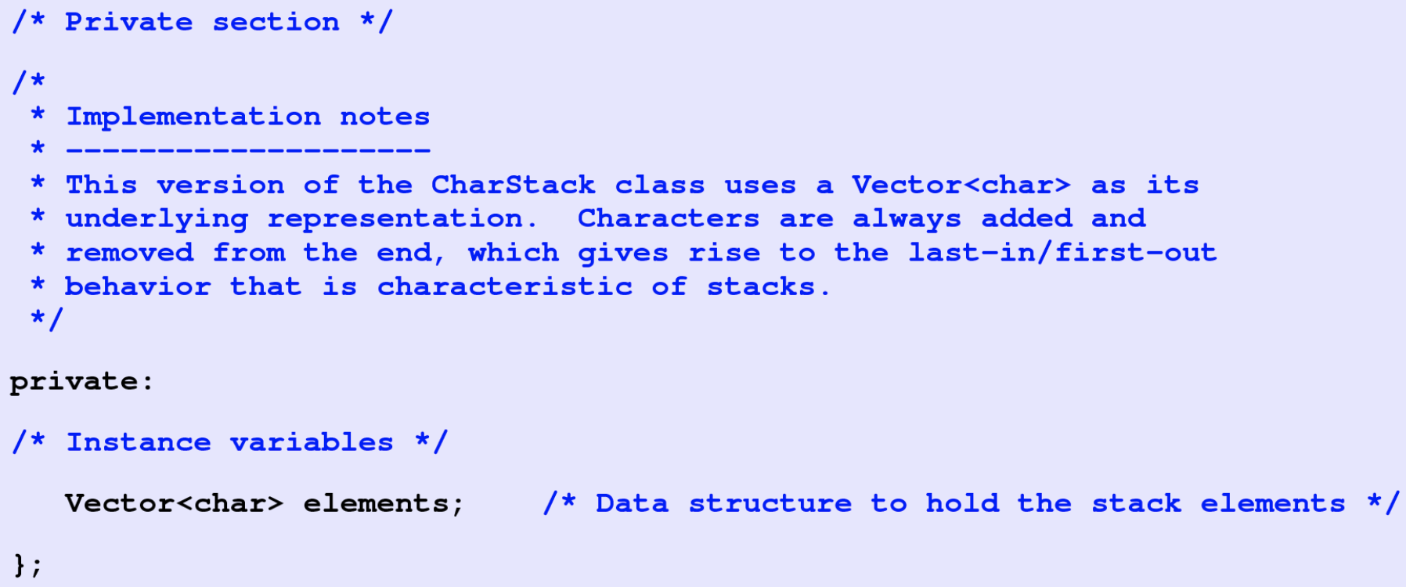
CharStack using vector

Slide 15
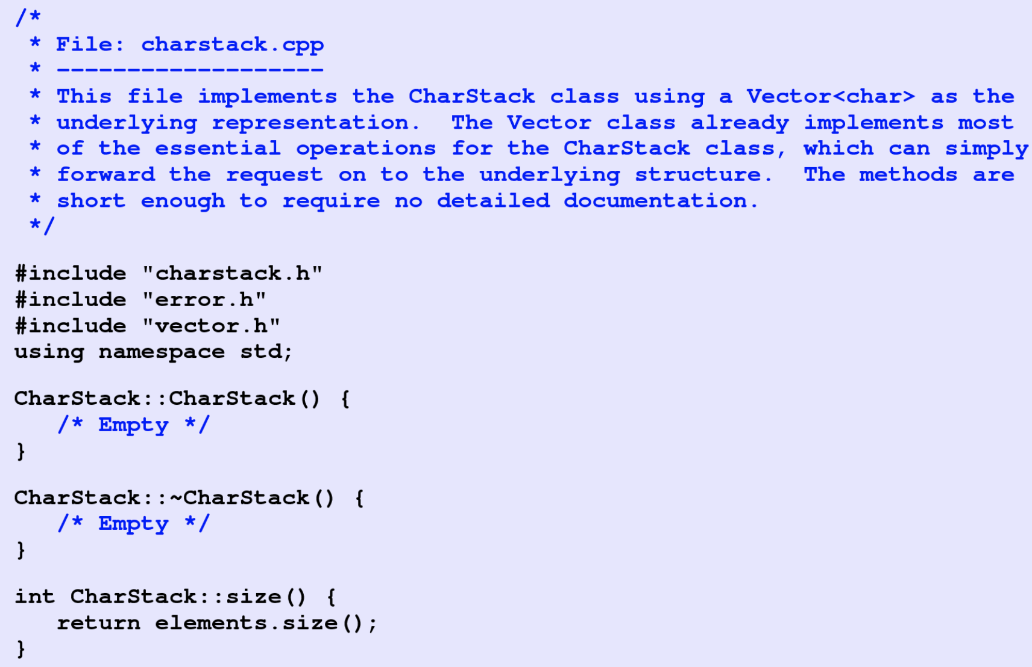
CharStack using vector

Slide 16
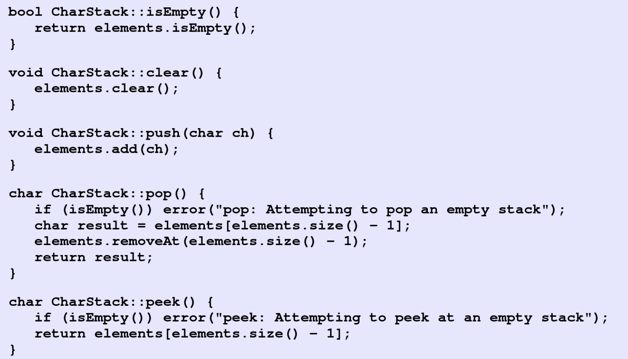
CharStack using vector

Slide 17
The End

