Slide 1
Online Judge system Guideline

Slide 2
CUHKSZ Online Judge
Website [Campus only], if you are not in campus, please connect to school VPN.
http://10.26.200.13/
Why use the OJ?
Evaluate the coding assignments
Easily get the feedback (both for you and TA)
Enjoy programming

Slide 3
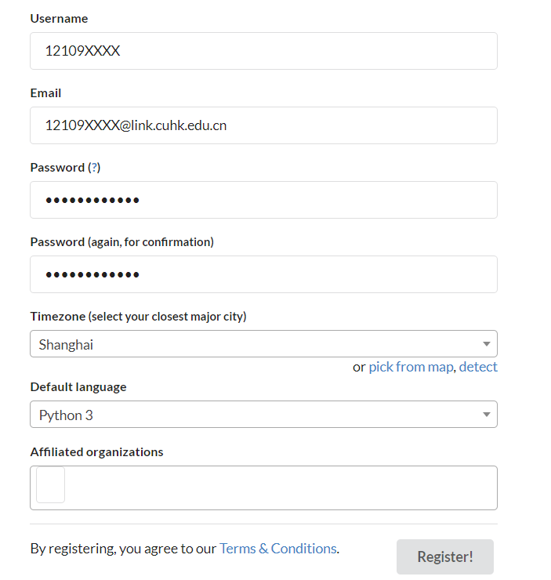
Register 10.26.200.13/accounts/register/
Your student ID
Please use official email address
Please choose UTC+8 Time Zone
Such as Shanghai, Hong Kong etc.
You can simply ignore them

Slide 4
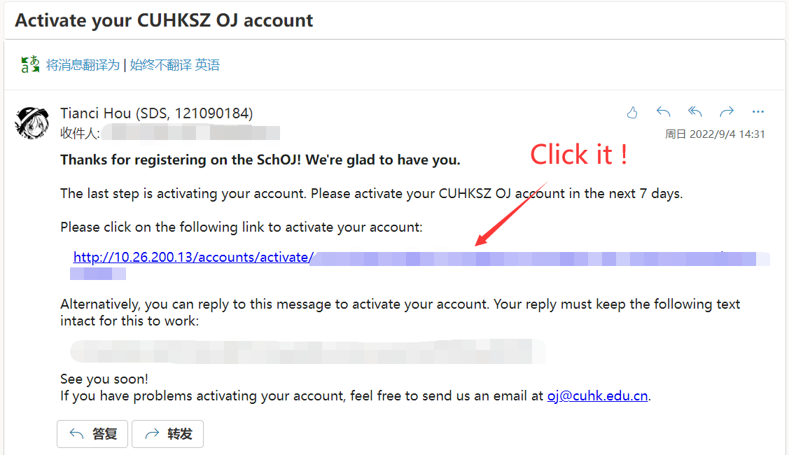

Slide 5
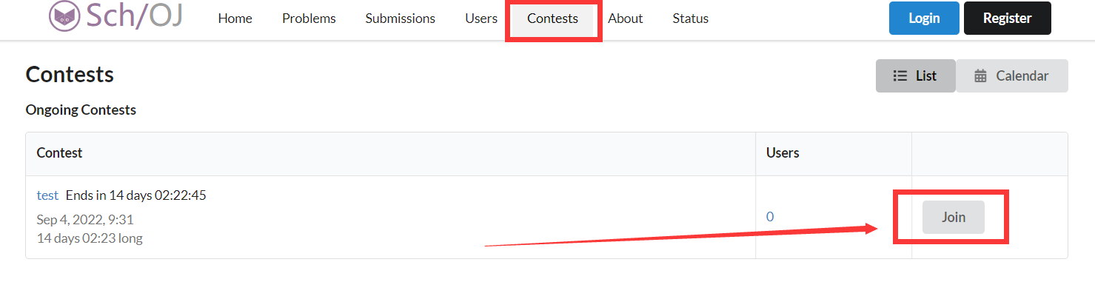
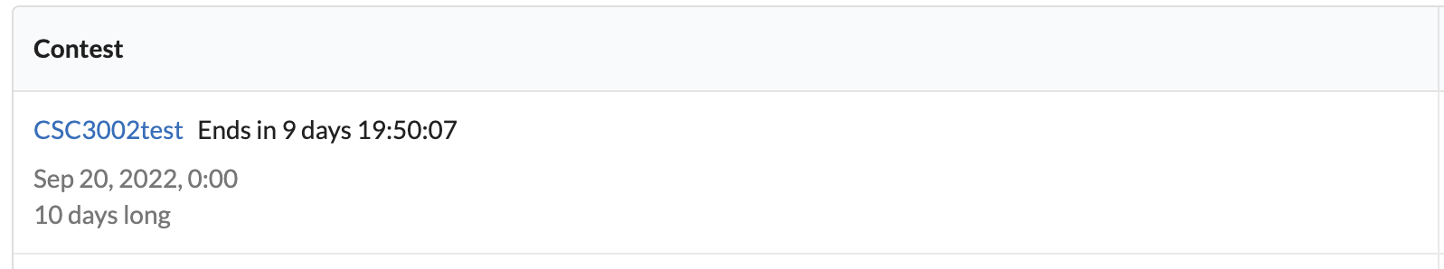
Now please join the contest to test. http://10.26.200.13/contest/testcontest

Slide 6
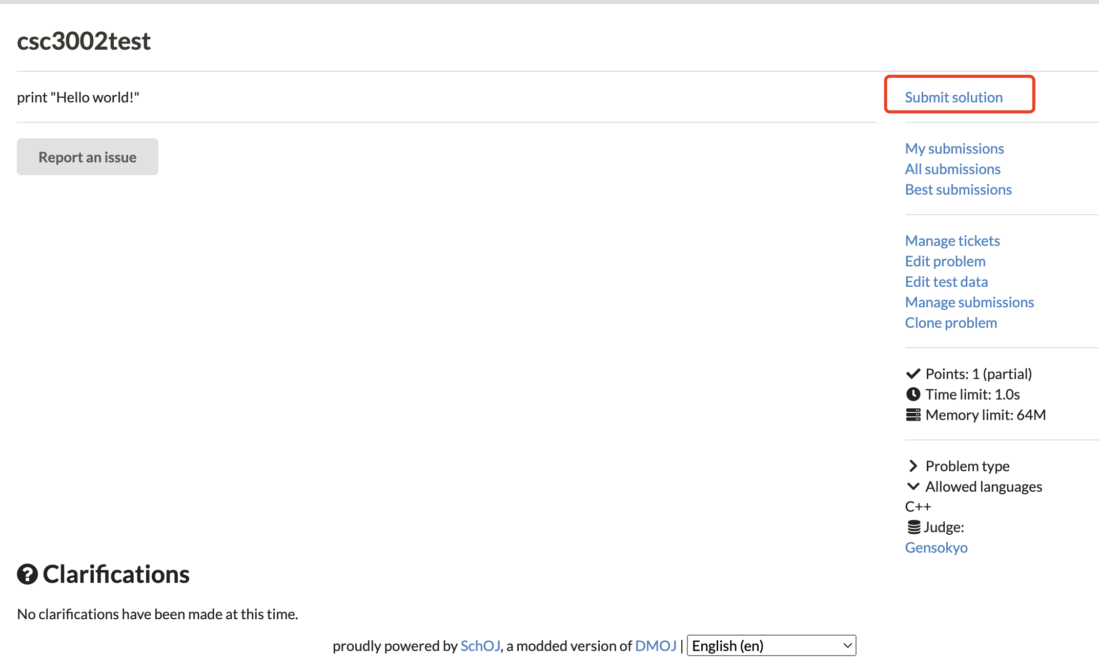
hello, world

Slide 7
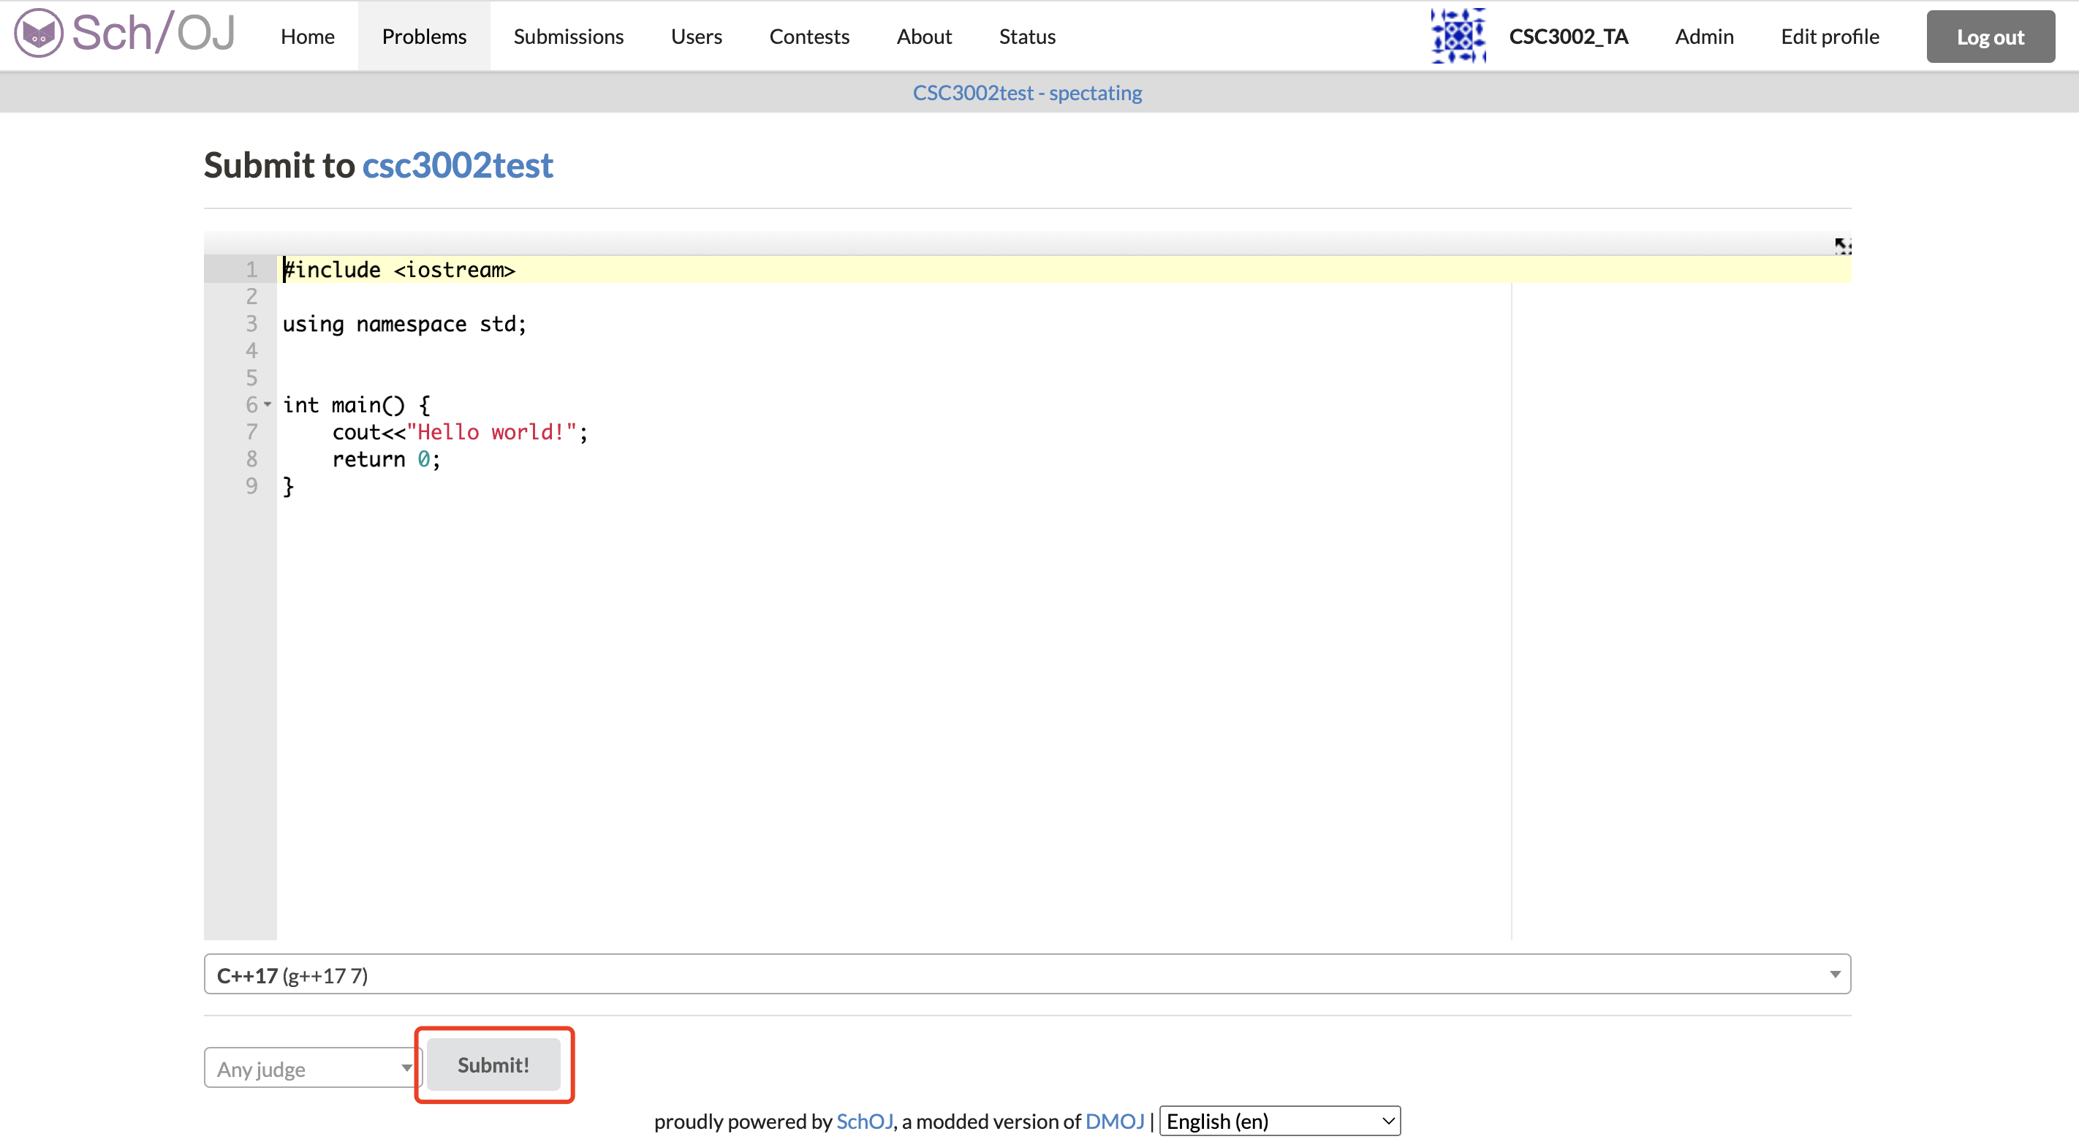
hello, world [solution]

Slide 8
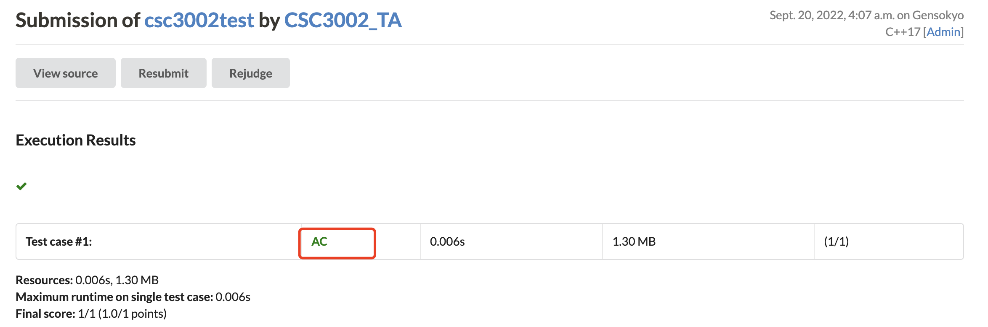
hello, world [solution]

