Slide 1
Tutorial 4 Review for “class” concepts and “TokenScanner” Applications
Sep. 19, 2022
Lai Wei (USTF)
(SDS, 120090485@link.cuhk.edu.cn)

Slide 2
Objectives today
Terminal knowledges
Class & objects basics
Class constructors
Class attributes & functions
Class member scopes
Class overload operators
One example with class applications: Token Scanner
How to learn this course well (continued)
Q & A time

Slide 3
1. Terminal knowledges
Actually, our terminal has a concept of “current working directory” （当前目录）
The terminal can only see files (programs) under current working directory, and the environment variable “Path”
A relative path （相对路径） refers to a location that is relative to a current directory.
An absolute path （绝对路径）always contains the root element and the complete directory list required to locate the file.

Slide 4
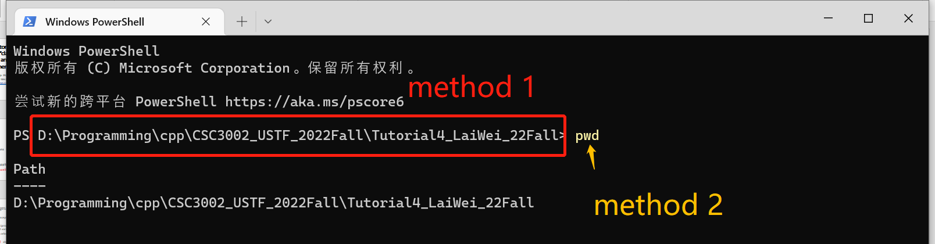
1. Terminal knowledges
Actually, our terminal has a concept of “current working directory” （当前目录）
How to get this “current working directory” ? (windows, mac same)
We use PowerShell in windows here!

Slide 5
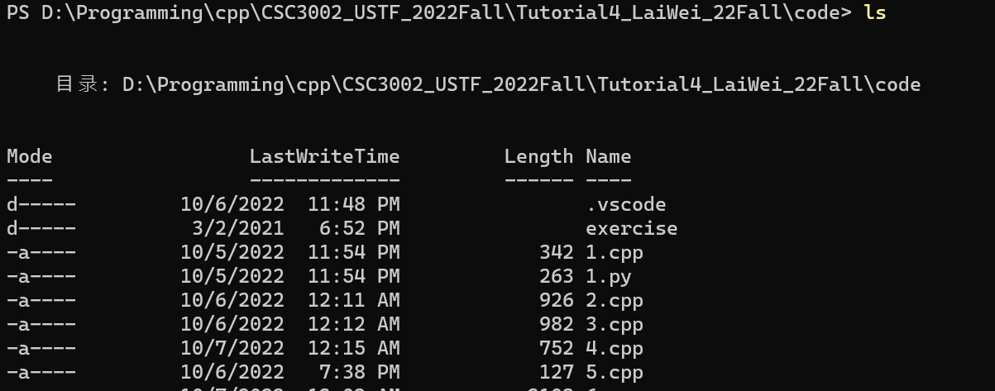
1. Terminal knowledges
A relative path （相对路径） refers to a location that is relative to the current directory.
“ls”: list all files in current working directory

Slide 6
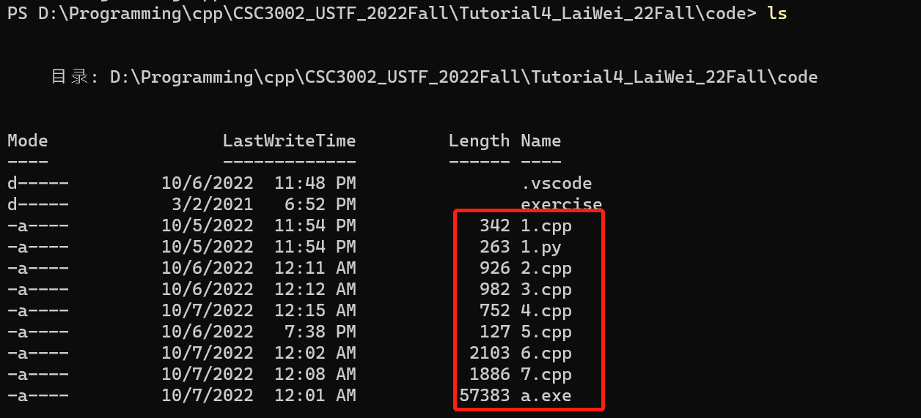
So basing that we’re in “D:\Programming\cpp\CSC3002_USTF_2022Fall\Tutorial4_LaiWei_22Fall\code” directory,
These files have relative path to “1.cpp” “1.py” “2.cpp”……

Slide 7
1. Terminal knowledges
An absolute path （绝对路径）always contains the root element and the complete directory list required to locate the file.
“D:\Programming\cpp\CSC3002_USTF_2022Fall\Tutorial4_LaiWei_22Fall\code\1.cpp”
“D:\Programming\cpp\CSC3002_USTF_2022Fall\Tutorial4_LaiWei_22Fall\code\1.py”
……

Slide 8
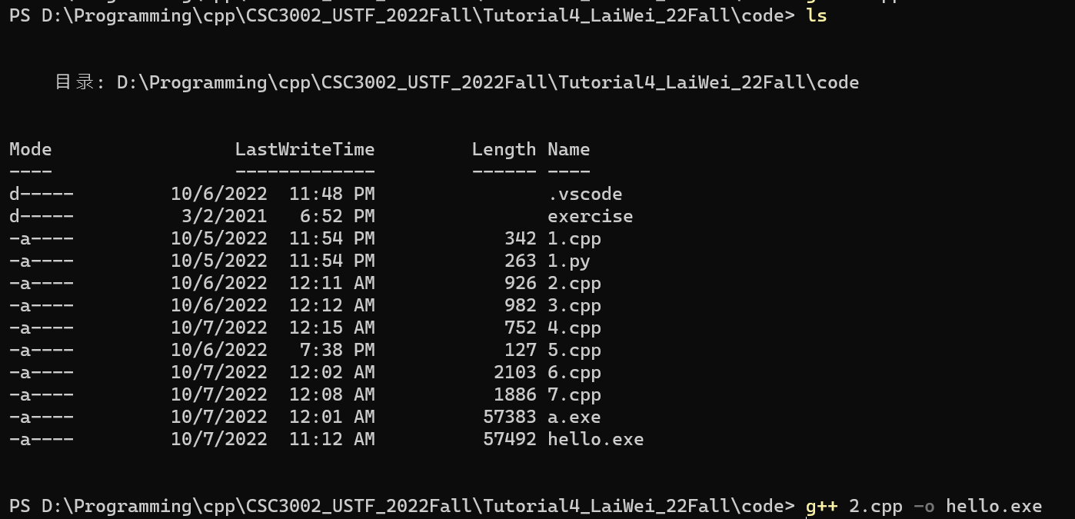
1. Terminal knowledges
The terminal can only see files (programs) under current working directory, and the environment variable “Path”
“g++” is in the environment variable path, so we can call it by relative path
“2.cpp” is in the current working directory, so we can call it by relative path
“hello.exe” is a relative path, create executable under current working dir
Absolute path form:

Slide 9
1. Terminal knowledges
Changing directories: by “cd <dir>” command
“..” means upper level directory
<dir> can be a relative path or an absolute path

Slide 10
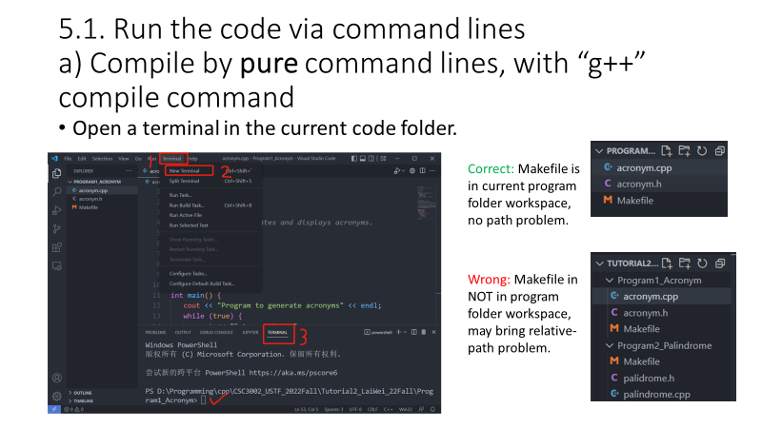
1. Terminal knowledges
Recall this in tutorial 2: When you open the terminal in VS Code, it automatically change the current working directory at your opened folder.
So I forced you to do like this, so we won’t have problem in “relative path”. If you are in wrong working directory, you can’t compile the code “g++ helloworld.cpp” because it can’t find the “helloworld.cpp”.

Slide 11
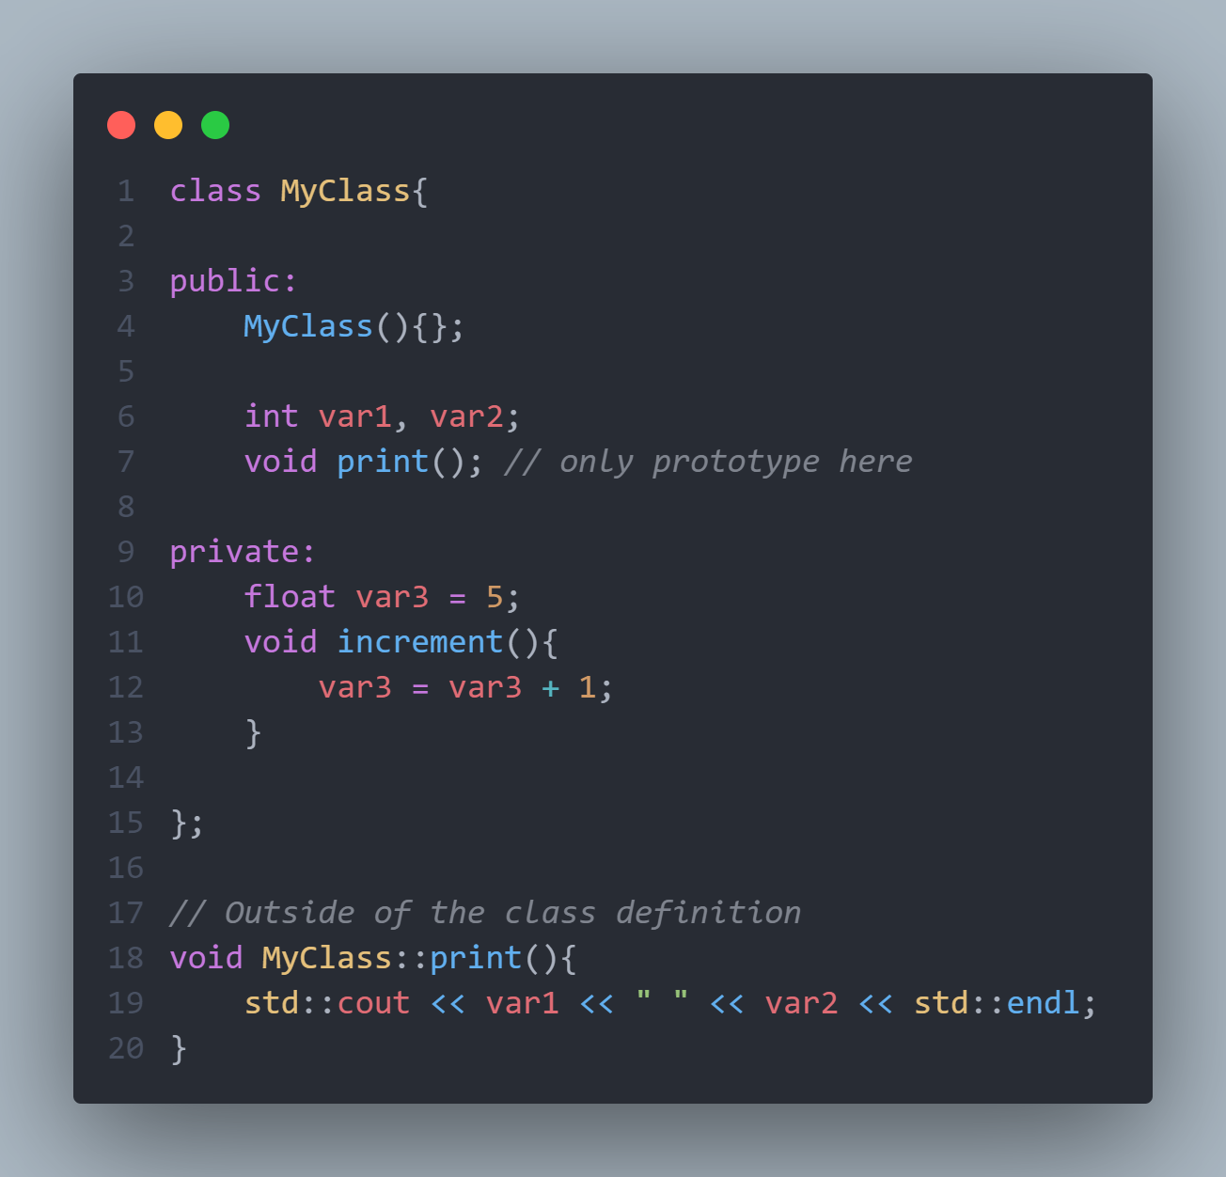
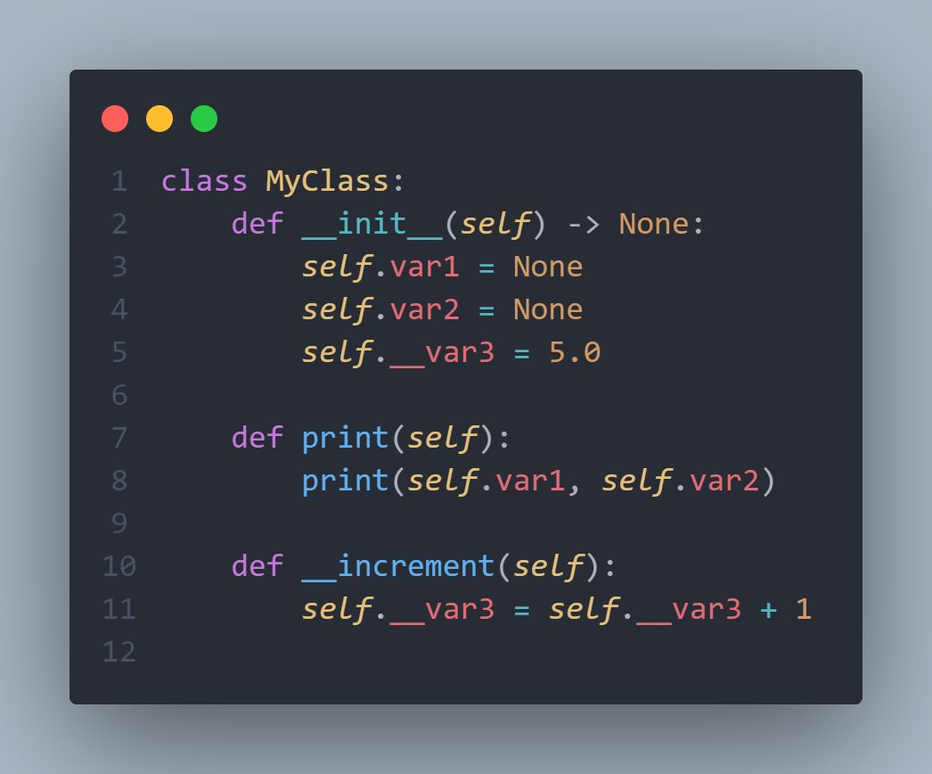
2. Class & objects basics

Slide 12
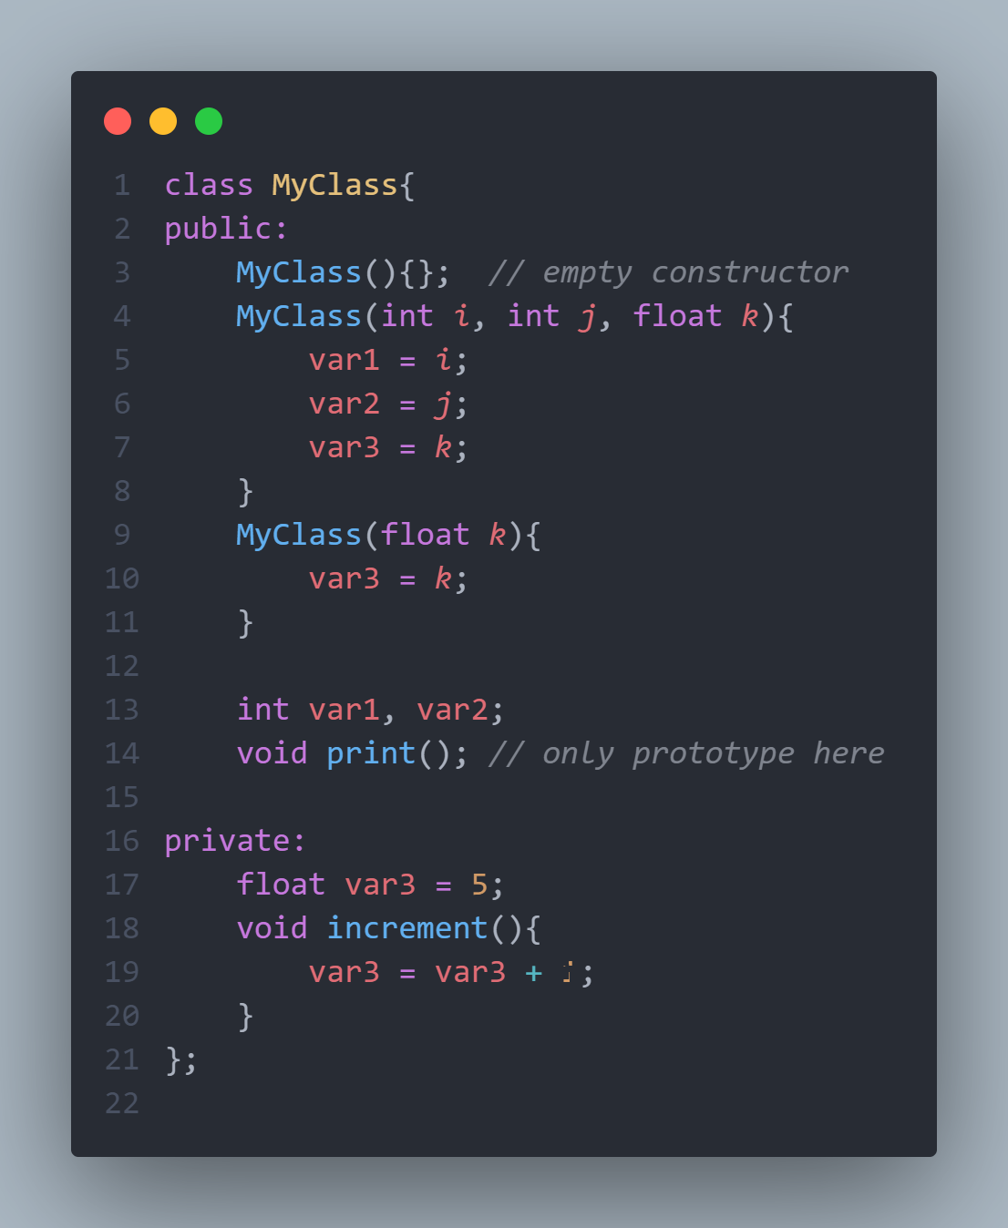
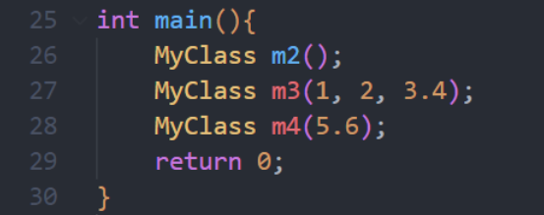
3. Class constructors
C++ class can have multiple constructors, with different parameter list.

Slide 13
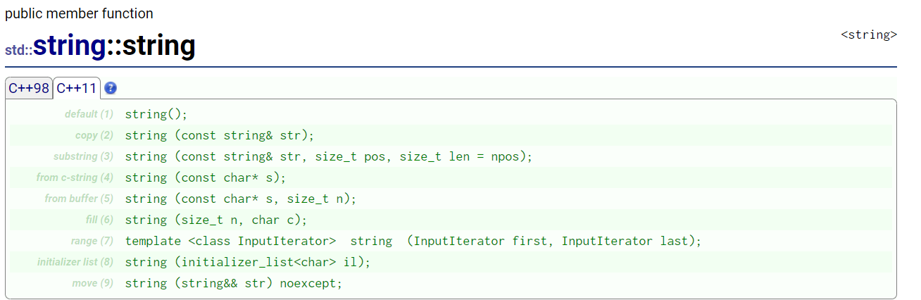
3. Class constructors
E.g., the std::string class.

Slide 14
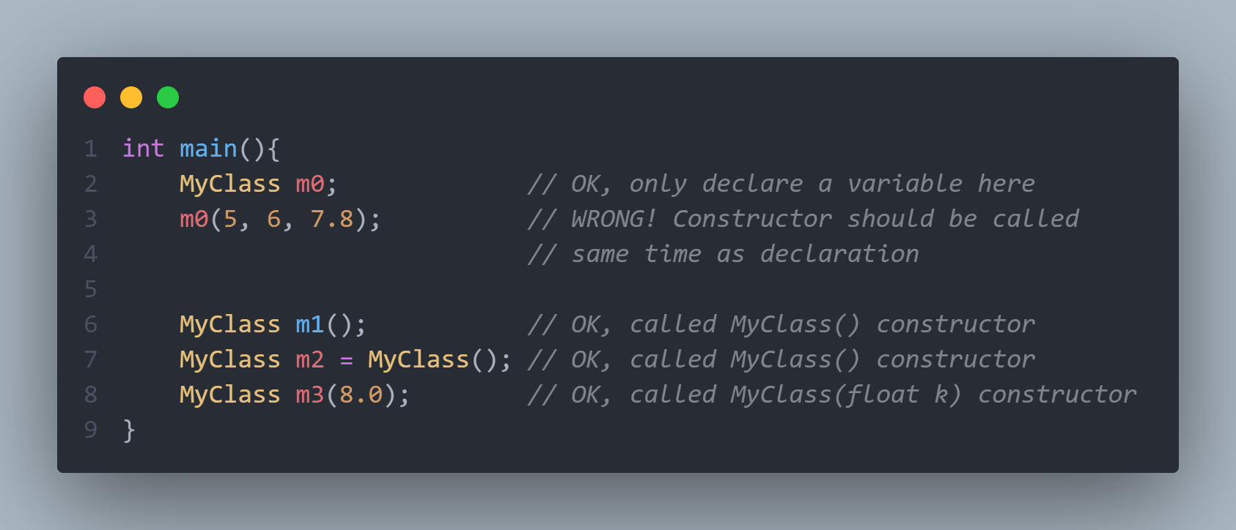
3. Class constructors
Instantize an instance.

Slide 15
4. Class attributes & functions
Attributes are basically variables that belongs to the class.
No need to use grammar such as “self.” in the class.
1

Slide 16
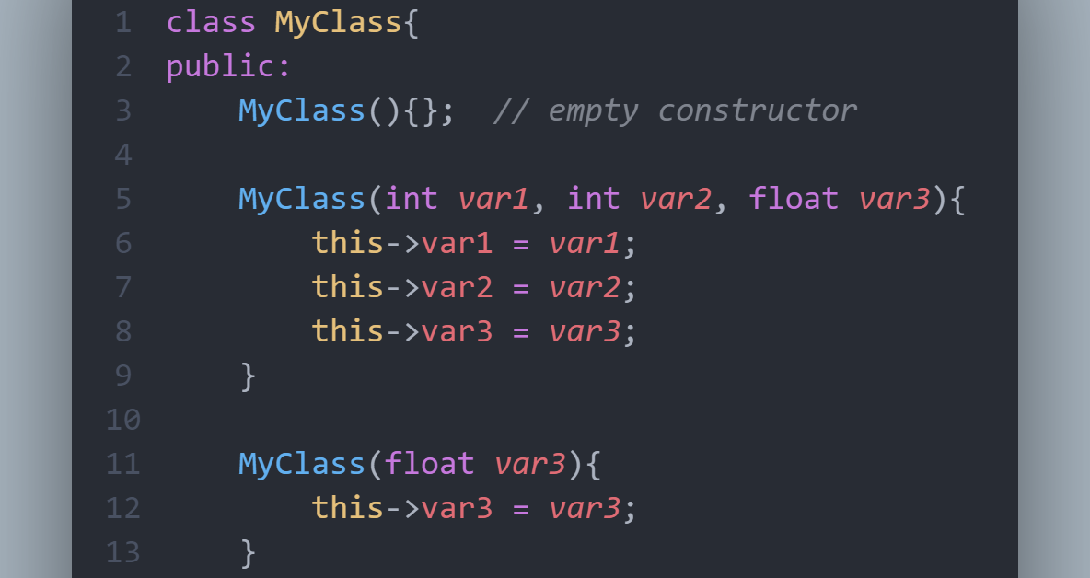
4. Class attributes & functions
If member function parameter has the same name as the class attribute, use “this->x” to distinguish them.
Why not “this.x”? Because “this” is a pointer pointing to this instance.

Slide 17
4. Class attributes & functions
You can declare the function inside the class definition (.h file), and implement it outside of the class (.cpp file)
or you can implement it in class definition as well. (not recommend)

Slide 18
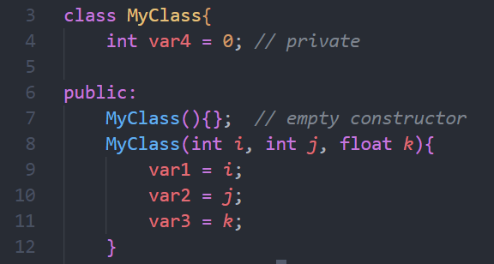
5. Class member scopes
In C++, there are three access specifiers:
public - members are accessible from outside the class
private - members cannot be accessed (or viewed) from outside the class. By default, attributes are private!
protected - members cannot be accessed from outside the class, however, they can be accessed in inherited classes. You will learn more about Inheritance later.

Slide 19
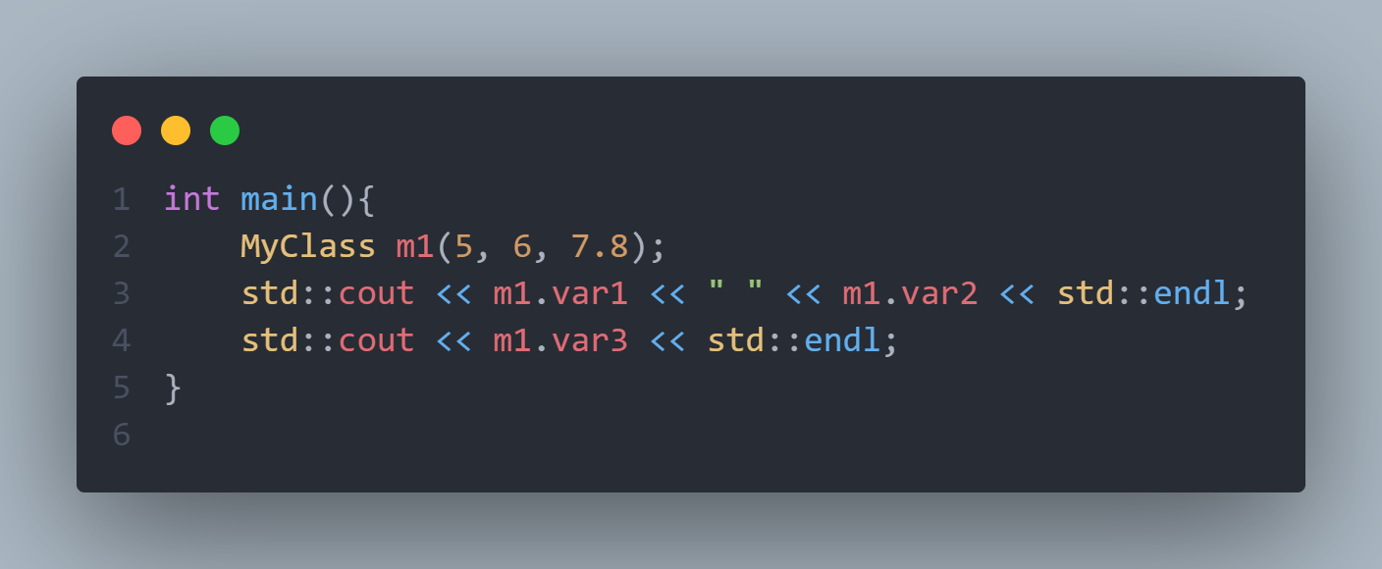
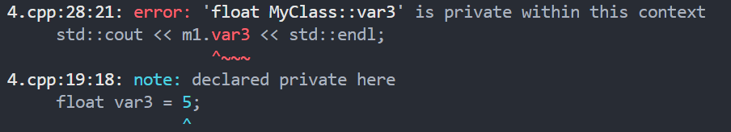
5. Class member scopes

Slide 20
6. Class overload operators
Customizes the C++ operators for operands of user-defined types.
What operator can be overloaded?
How to do that?
as a member function
as a non-member function (free function)
As a “friend” function

Slide 21
6. Class overload operators
 | as a member function | as a non-member function (free function) | As a “friend” function
Definition where? | In class definition | Out class, or together with implementation | In class definition
Implementation where? | In class, with definition / Out class, both OK | Out of class definition | Out of class definition
prototype | Unary operator: 0 parameter. Binary operator: 1 parameter. | Unary operator: 1 parameter. Binary operator: 2 parameter. | Same as free function prototype

Slide 22
6. Class overload operators
https://en.cppreference.com/w/cpp/language/operators
Expression | As member function | As non-member function | Example
@a | (a).operator@ ( ) | operator@ (a) | !std::cin calls std::cin.operator!()
a@b | (a).operator@ (b) | operator@ (a, b) | std::cout << 42 calls std::cout.operator<<(42)
a=b | (a).operator= (b) | cannot be non-member | Given std::string s;, s = "abc"; calls s.operator=("abc")
a(b...) | (a).operator()(b...) | cannot be non-member | Given std::random_device r;, auto n = r(); calls r.operator()()
a[b] | (a).operator[](b) | cannot be non-member | Given std::map<int, int> m;, m[1] = 2; calls m.operator[](1)
a-> | (a).operator-> ( ) | cannot be non-member | Given std::unique_ptr<S> p;, p->bar() calls p.operator->()
a@ | (a).operator@ (0) | operator@ (a, 0) | Given std::vector<int>::iterator i;, i++ calls i.operator++(0)
in this table, @ is a placeholder representing all matching operators: all prefix operators in @a, all postfix operators other than -> in a@, all infix operators other than = in a@b
unary, prefix
binary
*assignment
*call
*indexing (at)
*get pointer’s attribute
unary, postfix

Slide 23
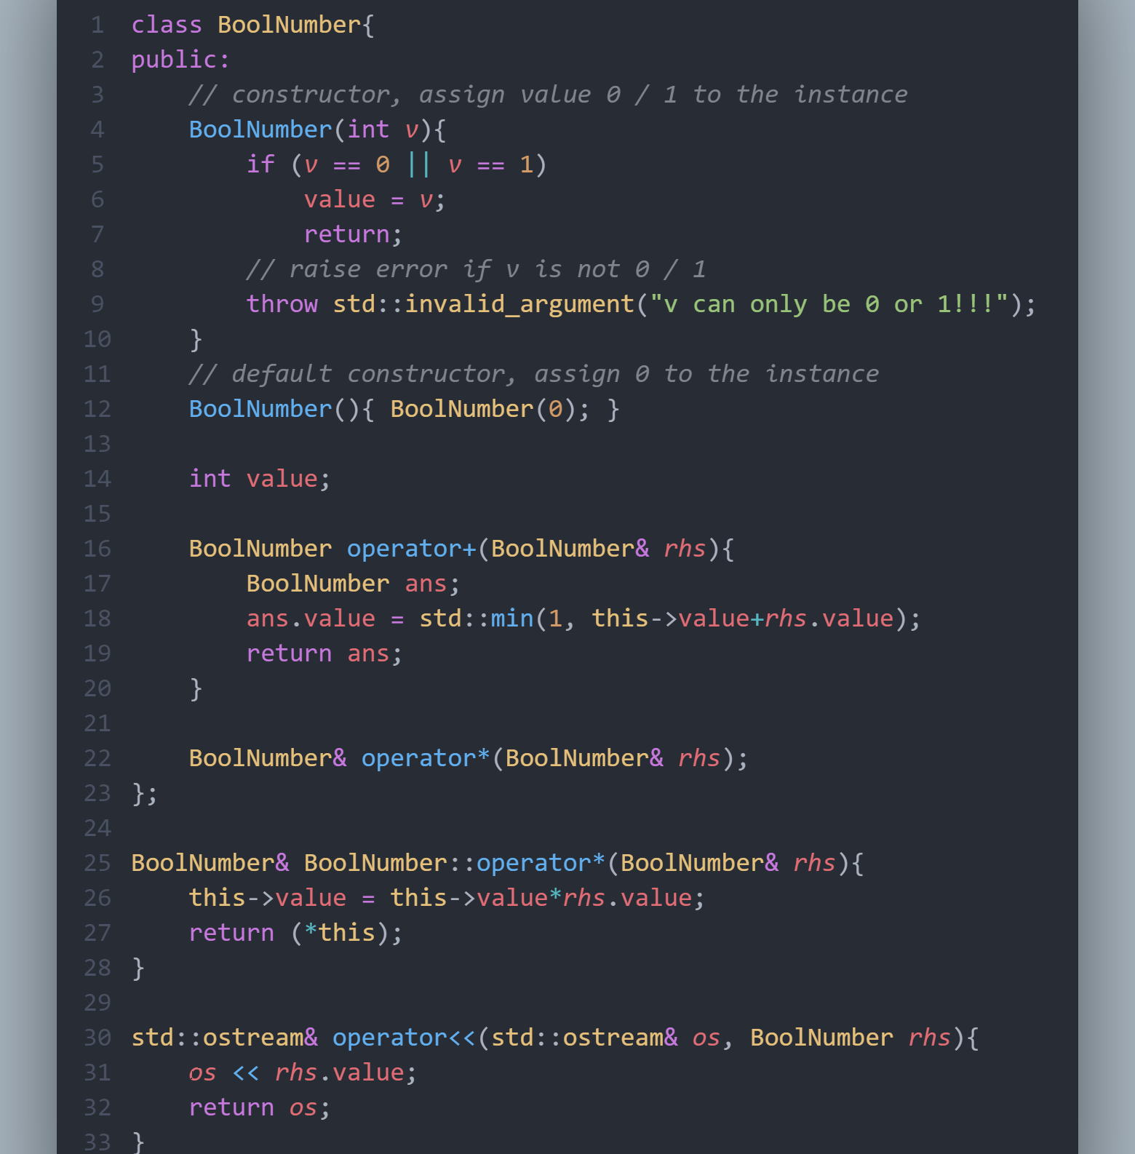
Member function, defined and implement in the class
Member function, defined in class and implement out
Free function to overload operator<<

Slide 24
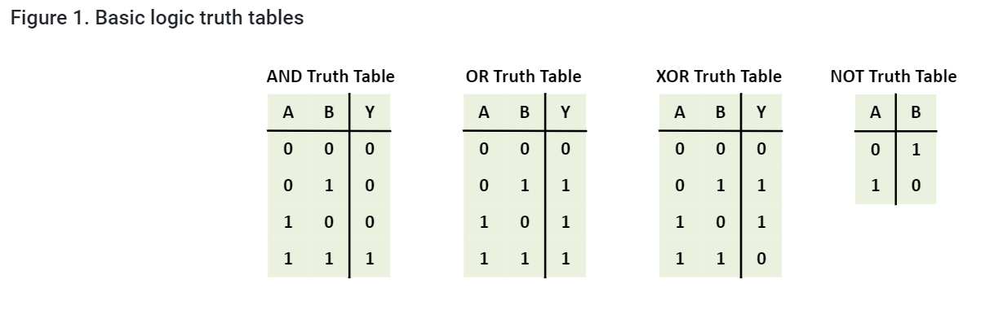
DEMO in BoolNumber.cpp
Boolean Algebra: only 0 and 1.

Slide 25
Motivation
7. Token Scanner: From previous years’ slides
Many applications need to divide a string into words, or more generally, into tokens (i.e. logical units that may be larger than a single character).
Given that the problem of dividing a string into individual tokens comes up so frequently in applications, it is useful to build a library package that takes care of that task. The primary goal is to build a package that is simple to use but also flexible enough to meet the needs of a variety of clients.

Slide 26
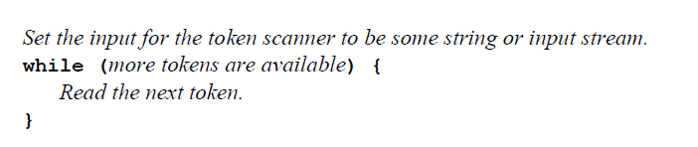
Design
Task 1: Associate the token scanner with a source of tokens, which might be a string, an input stream, etc.
Task 2: Retrieve individual tokens from the source of tokens and deliver them one at a time.
Task 3: Test whether the token scanner has any tokens left to process.
pseudocode - reading tokens from a scanner:

Slide 27
Design
TokenScanner should define tokens. What should be considered as a token?
a word in a string?
a single character?
a punctuation mark?
a space?
Different applications define tokens in different ways
TokenScanner class must give the client some control over what types of tokens are recognized, e.g. whether a space should be recognized as a token.

Slide 28
Methods in the TokenScanner Class
Design
scanner.setInput(str) or scanner.setInput(infile)
Sets the input for this scanner to the specified string or input stream.
scanner.hasMoreTokens()
Returns true if more tokens exist, and false at the end of the token stream.
scanner.nextToken()
Returns the next token from the token stream, and "" at the end.
scanner.saveToken(token)
Saves token so that it will be read again on the next call to nextToken.
scanner.ignoreWhitespace()
Tells the scanner to ignore whitespace characters.
scanner.scanNumbers()
Tells the scanner to treat numbers as single tokens.
scanner.scanStrings()
Tells the scanner to treat quoted strings as single tokens.

Slide 29
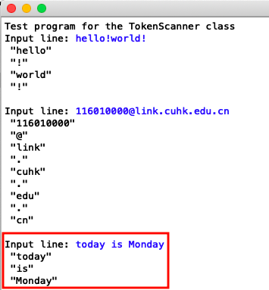
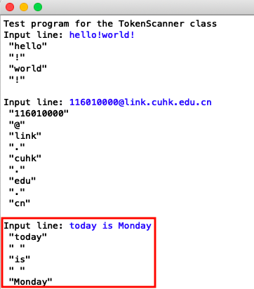
Demo
Ignoring white space:
Not ignoring white space:

Slide 30
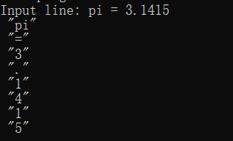
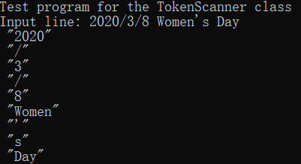
Demo
Scan single digits:
Scan the numbers as a whole:

Slide 31
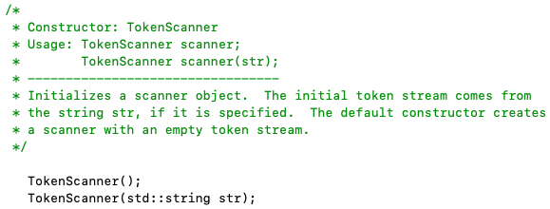
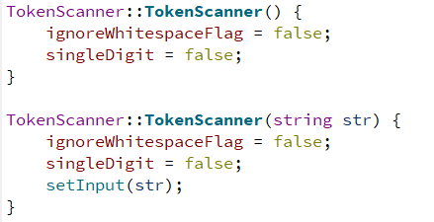
Implementation: constructor
In tokenscanner.h:
In tokenscanner.cpp:

Slide 32
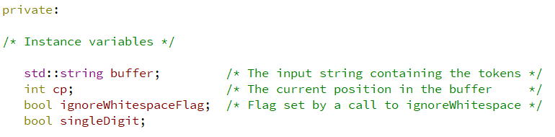
Implementation: private attributes
In tokenscanner.h:

Slide 33
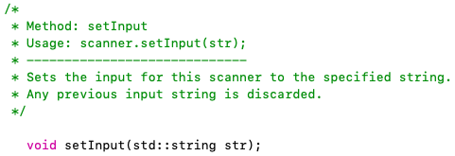

Implementation: setInput()
In tokenscanner.h:
In tokenscanner.cpp:

Slide 34
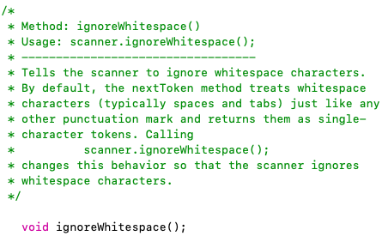
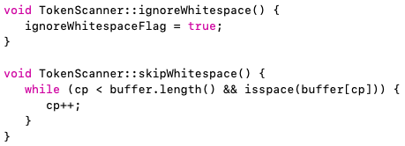

Implementation: options::skipWhitespace
In tokenscanner.h:
In tokenscanner.cpp:

Slide 35
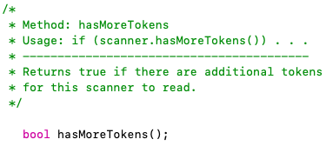

Implementation: hasMoreTokens()
In tokenscanner.h:
In tokenscanner.cpp:

Slide 36
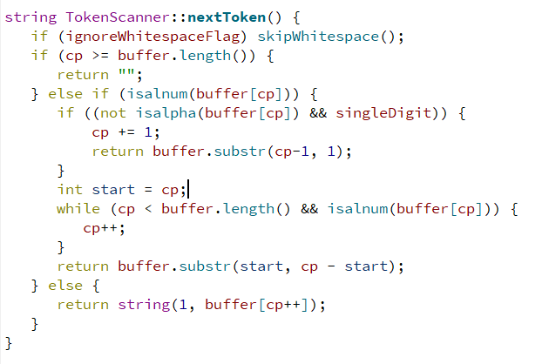
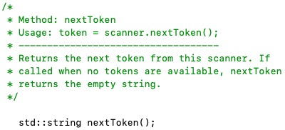
Implementation: nextToken()
In tokenscanner.h:
In tokenscanner.cpp:

Slide 37
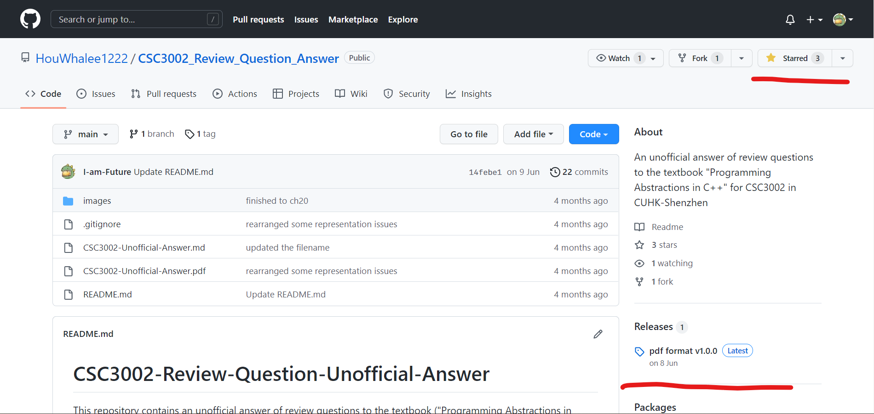
8. How to learn this course well (continued)
Finish the “Review Questions” for each chapter in textbook
https://github.com/HouWhalee1222/CSC3002_Review_Question_Answer
Register and star this repo!
Download pdf here

Slide 38
8. How to learn this course well (continued)
Supplementary materials for this tutorial
Class basic concepts
https://www.learncpp.com/cpp-tutorial/welcome-to-object-oriented-programming/
Operator overloading
https://www.learncpp.com/cpp-tutorial/introduction-to-operator-overloading/

Slide 39
9. Q & A time
Thank you for your listening!
Lai Wei (USTF)
(SDS, 120090485@link.cuhk.edu.cn)
Additional office hour appointment is temporality not available. Ask others instead.
WeChat Q&A is deprecated in the future.
Don’t ask me about homework problems anymore. Ask TAs instead.
Office hour: Friday 10:00-11:00 am, Start-up Zone library L103

