Slide 1
CSC3002 Tutorial 3
Collections
Zhiyuan Zhao
120090128

Slide 2
Outline
Guideline about OJ system
Something about this course
Information of Collection class
Example of Collection class
Vector: Example1 - Tic-tac-toe check
Stack: Example2 - IsBalanced
Queue: Example3 - Checkout line simulation
Exercises

Slide 3
Self Introduction
Year 3, a USTF of CSC3002
SSE-ECE-EE
Office hour: 16:00-17:00 Thursday at L103, Start-up Zone Library

Slide 4

How to learn this course well?
Review lecture notes
Type the code by yourself
Learn to debug (assignment)
Learn pointer well
Finish the “Review Questions” in textbook
.

Slide 5
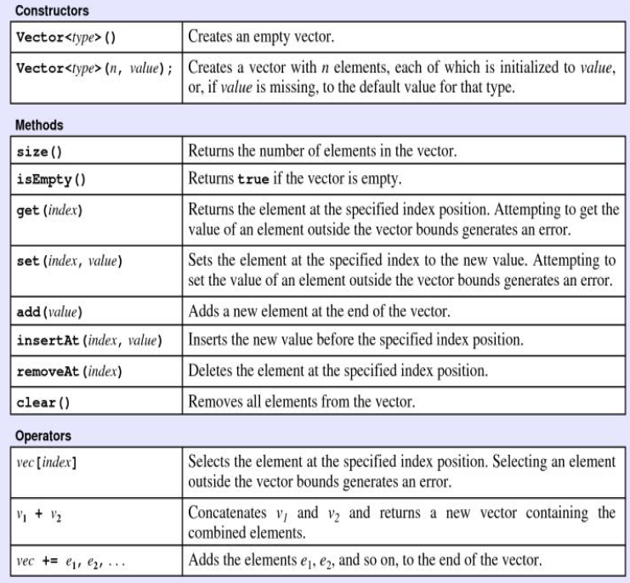
Review: Vector
The underlying implementation is based on array. Similar to list in Python.
More flexible than array
(Difference?)
[extendable, operations, memory use…]

Slide 6
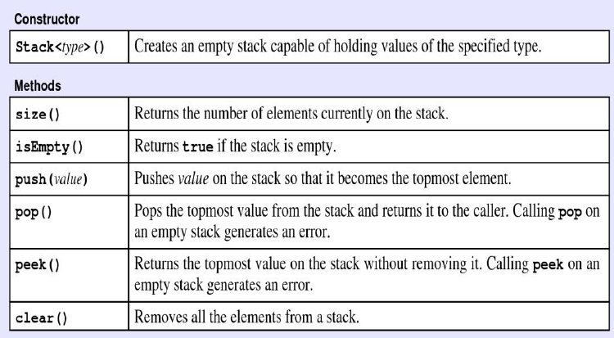
Review: Stack
Last In, First Out (LIFO)
Two key operations:
Push - add a new value to the top of the stack
Pop - remove and return the top value of the stack

Slide 7
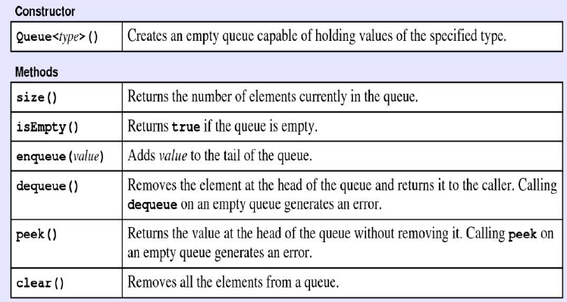
Review: Queue
First In, First Out (FIFO)
Two key operations:
enqueue: add a new element to the end (tail) of the queue
dequeue: remove the element at the head of the queue

Slide 8
Review: Stack VS Queue
C
B
A
push
Stack:
pop
A
B
C
enqueue
Queue:
dequeue

Slide 9
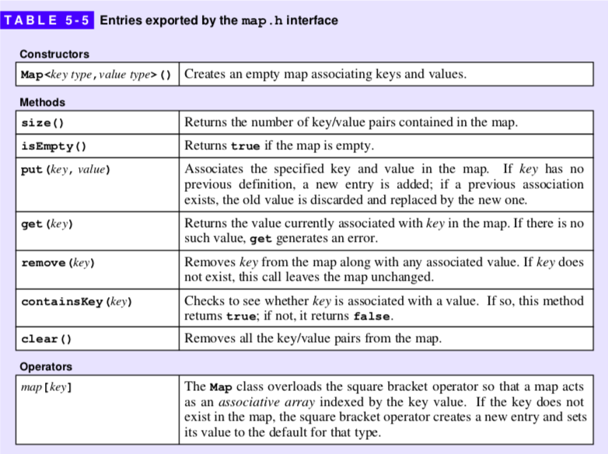
Review: Map
Similar to dictionary in Python
A map contains key-value pairs, where the keys can be compared and ordered
Map uses the key to locate the value, whereas Vector and Array use the index to locate the value

Slide 10
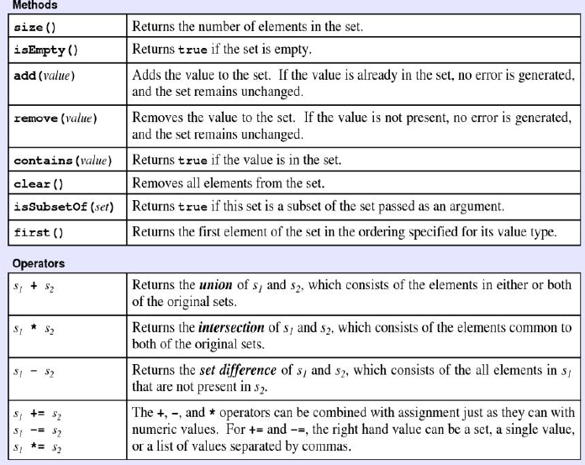
Review: Set
Set models the mathematical abstraction of a set
The elements of a set are unordered and each value appears only once (no duplicate)
Eliminate repeat elements

Slide 11
Review: Iterating over a collection
The modern approach to iterate over a collection is to use a general tool called an iterator that delivers the elements of the collection, one at a time.
C++11 uses a range-based for statement to simplify iterators:
The Stanford libraries implement the same idea like this:
for (string key : map) {
. . . code to process that key . . .
}
foreach (string key in map) {
. . . code to process that key . . .
}
Notes:
15

Slide 12
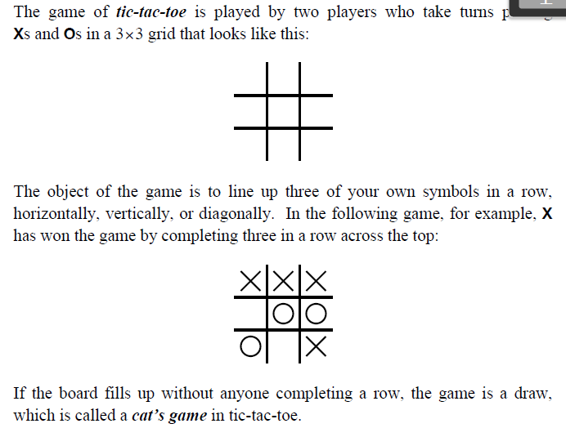
Example1: Tic-tac-toe check
The game of Tic-tac-toe:

Slide 13
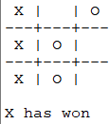
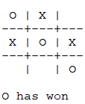
Example1: Tic-tac-toe check
This example aims to check which player wins the game by the state of the grid, instead of simulating the game.

Slide 14

Example1: Tic-tac-toe check
Question: How to implement a 3*3 board?
Vector< Vector<char> > board(3, vector<char>(3));
Vector<string> board(3);
Vector<int> board(9);
string board;
char board[9];
Grid<char> board(3, 3);
……

Slide 15
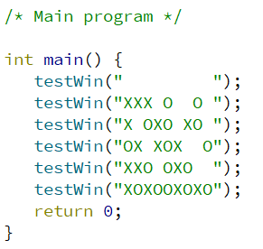
Example1: Tic-tac-toe check
Question: How to check the wining status of the board?
Check a line
Check the whole

Slide 16
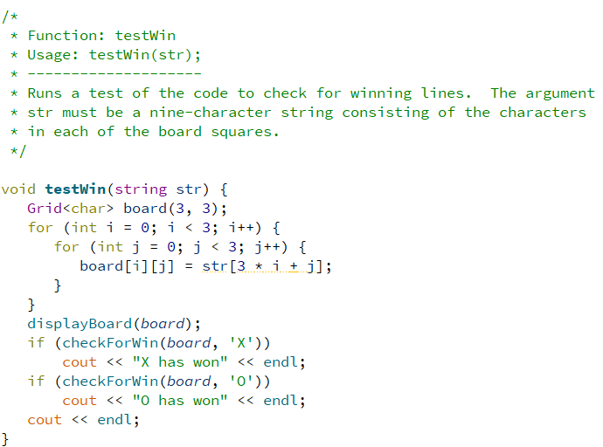
Example1: Tic-tac-toe check
Function implementation – check the winner of a given state

Slide 17
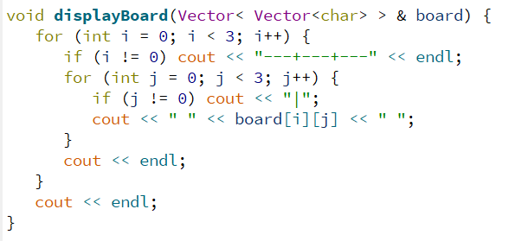
Example1: Tic-tac-toe check
Function implementation – display the current board position

Slide 18
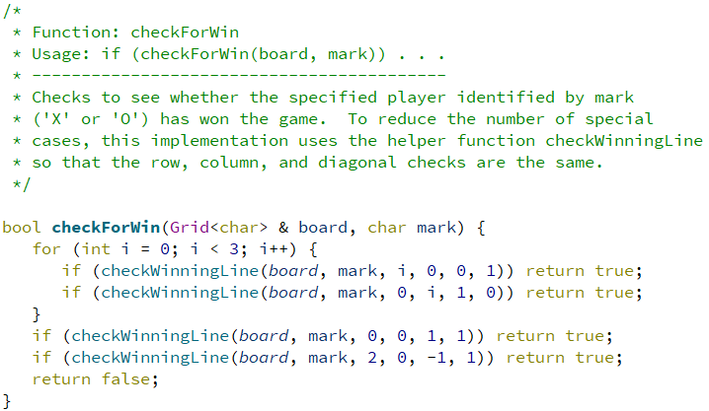
Example1: Tic-tac-toe check
Function implementation – check whether a specific symbol wins by checking the rows, columns, and diagonals
How can we replace this sentence?

Slide 19
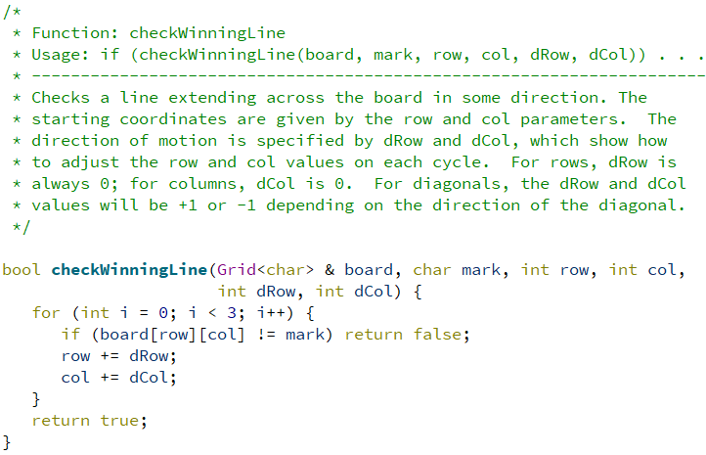
Example1: Tic-tac-toe check
Function implementation – check if a line is occupied by a specific symbol
Notes:
25

Slide 20

Example2: IsBalanced
This example aims to check whether the bracketing operators (parentheses, brackets, and curly braces) in a string are properly matched.

Slide 21
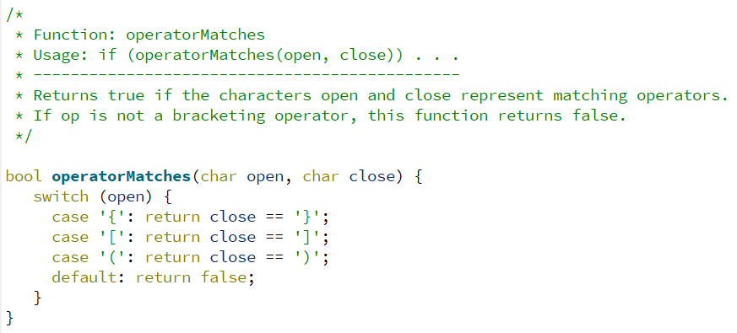
Example2: IsBalanced
Function implementation – match the symbol

Slide 22
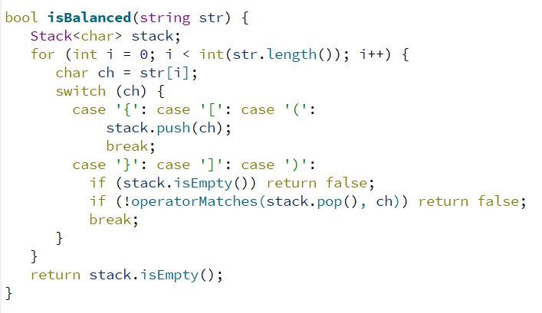
Example2: IsBalanced
Function implementation – check if the expression is balanced
Left ‘(‘: push
Right ‘)’: compare
and pop

Slide 23
Example3: Checkout line simulation
One cashier is serving customers from a single queue.
Customers arrive with a random probability and enter the queue at the end of the line.
Whenever the cashier is free and someone is waiting in line, the cashier begins to serve that customer.
After an appropriate service period, the cashier completes the transaction with the current customer, and is free to serve the next customer in the queue.

Slide 24
Example3: Checkout line simulation
The core of the simulation is a loop that runs for the number of seconds indicated by the parameter SIMULATION_TIME. In each second, the simulation performs the following operations:
Determine whether a new customer has arrived according to a certain probability ARRIVAL_PROBABILITY, and, if so, add that person to the queue.
If the cashier is busy, note that the cashier has spent another second with the current customer. Eventually, the required service time will be complete, which will free the cashier.
If the cashier is free, serve the next customer in the waiting line, for a certain amount of time, randomly chosen between MIN_SERVICE_TIME and MAX_SERVICE_TIME.
Notes:
40 Show example: CheckoutLine

Slide 25
Exercises
True or False: An abstract data type is one defined in terms of its behavior rather than its representation.
True
Which one is not the three advantages this chapter cites for separating the behavior of a class from its underlying implementation?
Simplicity B. Flexibility C. Security D. Efficiency
D

Slide 26
Exercises
How would you initialize a 20*10 Vector, with all elements equal to 1?
A. Vector<int> vec(20, 10, 1);
B. Vector< Vector<int>(20) > vec(10, 1);
C. Vector< Vector<int> > vec(20, Vector<int>(10, 1));
D. Vector< Vector<int> > vec(20, 10, 1));

Slide 27
Exercises
Which of the following collection classes do not support the use of the range-based for loop?
A. Vector
B. Stack
C. Queue
D. Map
E. Set

Slide 28
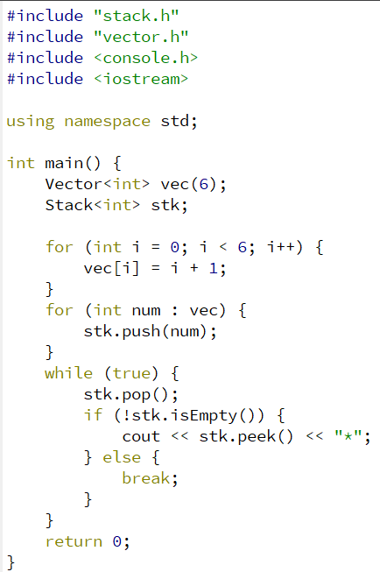
Exercises
What is the formatted output of this code?

Slide 29
End of tutorial

