Slide 1

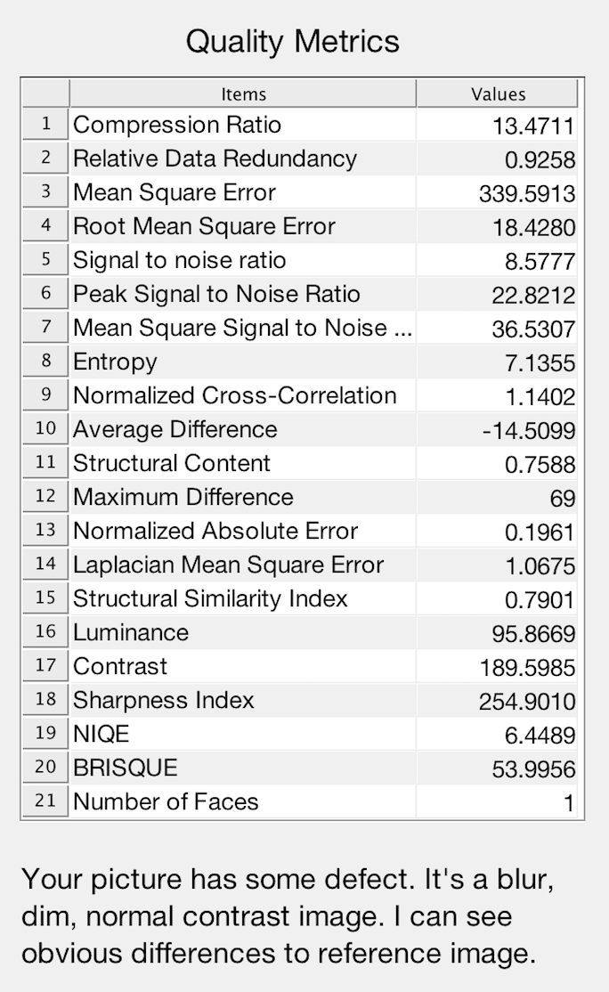
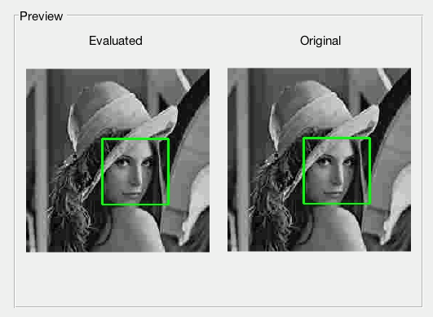
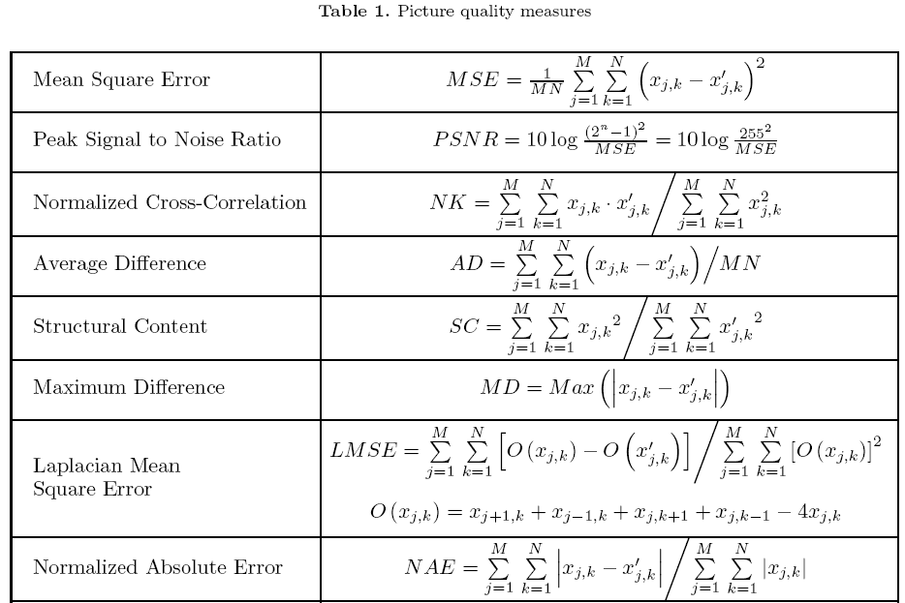
Developing Image Quality Assessment
Simon Wu and Kadir Aktas
{Shan.Wu, Kadir.Aktas}@tudeng.ut.ee
ABSTRACT
Image quality characteristics of an image are subjective when there are not mathematical calculations included. Our aim is to assess image quality of an image by using mathematical calculations based on pixel values and patterns on the images. In this project, assessment is done between two images whereas one of them is the original image and the other one is the assessed image. The result consists referenced and non-referenced image quality assessments. Additionally, faces on the images are detected and number of faces are obtained.
-
University of Tartu
METHODOLOGY
In this project, 18 referenced and 2 non-referenced, a total of 20 different image quality characteristics are assessed. Referenced assessments are made between two images. We use Mean Squared Error to get how big differences it is comparing to original image. The large value of MSE denotes the image has more differences to the original one. We also use Peak Signal to Noise Ratio to check the image quality. PSNR is an approximation to human perception of image quality. If it’s more than 37 then we can hardly notice the difference. Structural Similarity Index is also included for the similarity between two images. It’s based on three comparison measurements: luminance, contrast and structure. If the value close to 1, that means this two images has more similarity. There are two metrics for Non-Referenced assessments: NIQE and BRISQUE. NIQE uses the Naturalness Image Quality Evaluator while the other uses Blind Image Spatial Quality Evaluator. Both of them can use customized model to get better score for specific data sets. We finally use Cascade Classifier with haar feature to detect faces.

