Slide 1
Summary
This software lets you do 2 things:
1) Register your MR images in 3D. Put a virtual electrode in the 3D space and let you steer. Depending on the position of the electrode, the corresponding coronal and sagittal MR images will be displayed with the electrode tip marking on them. This way you know where your electrode is in the 3D space of the coronal and sagittal MRIs.
2) Draw on the MRIs to make notes.
To achieve this you need to do 3 things (directions are in the following slides):
Save MR images as BMP files and name them (ImageJ will do this for you). The name should reflect the coordinate of the section.
Provide the dimension of the MRI pixel, indicate the origin (0, 0) of the MR image, for the coronal and/or sagittal MR images.
Provide the position and tilt of the recording grid for the 3D application.
Notes:
References:
Neural substrate of Temporal Discount:
9. Samejima K, Ueda K, Doya K, Kimura M: Representation of action-specific reward values in the striatum. Science 2005, 310:1337-1340.
10. Tanaka SC, Doya K, Okada G, Ueda K, Okamota Y, Yamawaki S: Prediction of immediate and future rewards differentially recruits cortico-basal ganglia loops. Nat Neurosci 2004, 7:887-893.
28. Doya K: Metalearning and neuromodulation. Neural Netw 2002, 15:495-506.

Slide 2
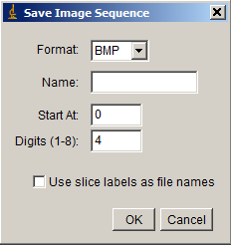
Preparation – (1) Get MR images
Open a sequence of MR images using the ImageJ.
For your convenience, align the recording chamber along the axes of the MRI.
Make a mark (fill a pixel) at an MR image to reference it as the 3D origin. This will be especially helpful if coronal and sagittal figures are to be used at the same time.
Crop MRI images (Image → Crop).
*For the sagittal images, make rostral part of the brain point to the right (right is rostral & positive).
For the coronal images, make the right side brain point to the right (rightward is positive along the abscissa).
Save the sequence of BMP images to a folder (File → Save As → Image Sequence).
When a dialog window pops out. Leave “Name:” part blank. And click “OK”
Save the files in a folder of your choice; Virtual_Electrode.exe will remember this folder.
*Note:
This program assumes that all the MR images (coronal/sagittal) have the same horizontal and vertical pixel dimensions (e.g., 0.5mm x0.5mm; NOT 0.5mm x 1mm). However, the distance between MR images can vary.
If you are to display and manipulate the coronal and sagittal MRIs at the same time, they need to be from the same ImageJ MRI source and their MR images need to be in the same folder, therefore sharing the same configuration file, “_3D_2D_Config.txt”
Notes:
References:
Neural substrate of Temporal Discount:
9. Samejima K, Ueda K, Doya K, Kimura M: Representation of action-specific reward values in the striatum. Science 2005, 310:1337-1340.
10. Tanaka SC, Doya K, Okada G, Ueda K, Okamota Y, Yamawaki S: Prediction of immediate and future rewards differentially recruits cortico-basal ganglia loops. Nat Neurosci 2004, 7:887-893.
28. Doya K: Metalearning and neuromodulation. Neural Netw 2002, 15:495-506.

Slide 3
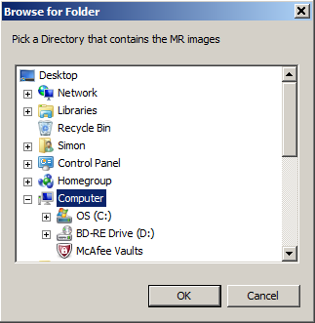
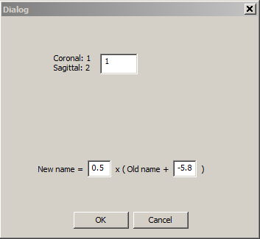
Preparation – (2) Rename MR images
Execute “Virtual_Electrode.exe”.
Select “Tools→Rename_MRI_Files”
When a Dialog box appears, select the folder that contains the MRI images whose names you are intending to change.
A new Dialog box will appear asking 2 questions:
Are the MRIs coronal or sagittal sections? Put 1 incase they are coronal, 2 for sagittal. In the example shown on the right, the user specifies the MR images as coronal slices.
Give a “multiplication” and “addition” factors to change the names: For coronal slice, for example, 4.2.bmp to indicate it is the slice 4.2mm anterior of the ear bar 0 (or any other origin that you chose). For sagittal slices, for example, L-3.52.bmp, to indicate 3.52 mm away from the midline on the left side of the brain. In the example shown on the right, 0.5 and -5.8 are given: NewName = [ 0.5 ] x (OldName + [ -5.8 ]). For example, if an existing MR image’s name is -4.2.bmp it will be changed to -5.0.bmp. Click “OK”.
5. The program will then make a new folder “_NewData” under the same parent directory and move those name-changed files in it. You need to move the newly named files to a folder where you intend to keep the MR images.
Notes:
References:
Neural substrate of Temporal Discount:
9. Samejima K, Ueda K, Doya K, Kimura M: Representation of action-specific reward values in the striatum. Science 2005, 310:1337-1340.
10. Tanaka SC, Doya K, Okada G, Ueda K, Okamota Y, Yamawaki S: Prediction of immediate and future rewards differentially recruits cortico-basal ganglia loops. Nat Neurosci 2004, 7:887-893.
28. Doya K: Metalearning and neuromodulation. Neural Netw 2002, 15:495-506.

Slide 4
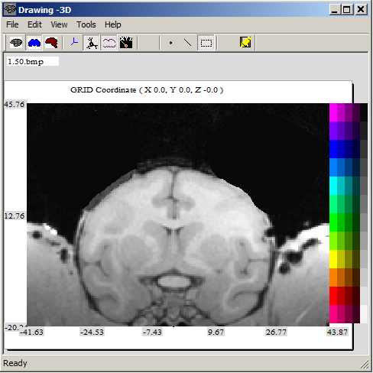
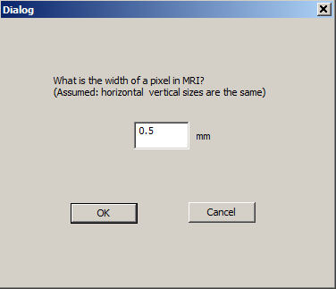
Preparation – (3) Register MR images in 3D
Execute “Virtual_Electrode.exe”; if not already running.
Click the coronal (blue) or sagittal (red) icon to load MRIs.
When a Dialog box appears, select the folder where the MRIs are. After loading the MRIs, your program will look like the one on the right.
Select Tools → Set_Origin.
Then a dialog will appear asking the dimension of the pixels. In the example on the right 0.5mm is given. Press OK.
Then you will be asked to click on an MR image to indicate the origin (0, 0, 0) of the MRI, which could be anything (anterior commissure, ear bar 0 etc.).
The program will display MRI of depth 0, “0.00.bmp”. Click on a point on the MRI. A crosshair will mark the new center of the MRI.
*All the configuration settings here and in the following will be saved automatically in the file “_3D_2D_Config.txt” in the same folder where the MRI images are.
0.00.bmp
Notes:
References:
Neural substrate of Temporal Discount:
9. Samejima K, Ueda K, Doya K, Kimura M: Representation of action-specific reward values in the striatum. Science 2005, 310:1337-1340.
10. Tanaka SC, Doya K, Okada G, Ueda K, Okamota Y, Yamawaki S: Prediction of immediate and future rewards differentially recruits cortico-basal ganglia loops. Nat Neurosci 2004, 7:887-893.
28. Doya K: Metalearning and neuromodulation. Neural Netw 2002, 15:495-506.

Slide 5
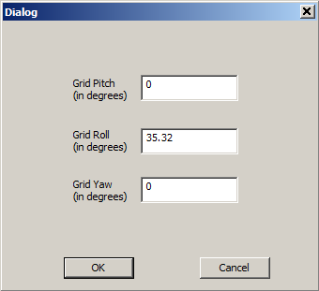
Preparation – (4) Register Grid in 3D
Execute “Virtual_Electrode.exe”; if not already running. And load MRIs.
Select Tools → Set_Grid_Origin.
Then a dialog will appear asking you to left-mouse-click on the origin of the grid.
When you left-mouse click on the origin of the grid, you will see a red cross marking the grid origin.
After the mouse click, there will be a Dialog, like the one on the right, asking to enter the pitch, roll, yaw angles of the grid. After entering the values, click OK.
If you have both the Coronal and Sagittal MRIs running at the same time, you just need to define the grid origin and angles from only one program; the other one should reflect the input values automatically.
Now you have finished the registration of everything.
You can go back and do the registration process as many times as you want.
Also you can set up both the coronal and sagittal MRIs.
Notes:
References:
Neural substrate of Temporal Discount:
9. Samejima K, Ueda K, Doya K, Kimura M: Representation of action-specific reward values in the striatum. Science 2005, 310:1337-1340.
10. Tanaka SC, Doya K, Okada G, Ueda K, Okamota Y, Yamawaki S: Prediction of immediate and future rewards differentially recruits cortico-basal ganglia loops. Nat Neurosci 2004, 7:887-893.
28. Doya K: Metalearning and neuromodulation. Neural Netw 2002, 15:495-506.

Slide 6
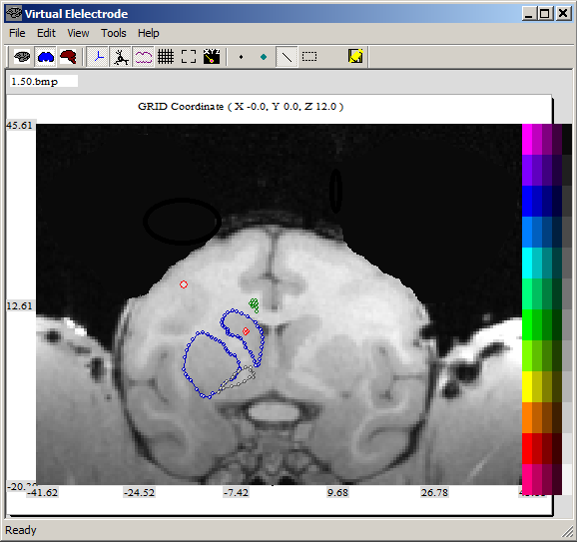
Using Virtual Electrode
After registering the MRIs and the grid to the 3D space, you can drive the electrode using the up/down arrow keys. This will move the electrode along the z-axis of the grid. The grid’s origin will appear as a red cross and the electrode tip will be a red circle.
As the electrode travels along the Z axis, different MR images may appear depending on the position of the electrode. Pressing the “Home” button will set the current coordinate of z of the electrode as 0.
If you have set up both the coronal and sagittal MRIs in the 3D, you can open them separate windows by clicking the blue and red icons.
You can navigate MR images by left or right arrows.
You can draw any shape in dots or in line segments on MRIs just by clicking on the MR image. The color can be chosen by clicking on the color palette.
Manipulation of drawing objects are possible by right-clicking on an object and selecting “Edit Points”. Also you can capture and move existing objects by selecting the dotted box icon and click-dragging items.
Remember to save the drawing by clicking the save icon. It will be saved in “_DrawingData.txt”
Show/hide Drawings
Show/hide neuron markings
Set electrode position
Show/hide origins
Draw dots
Draw Markings
Draw lines
Sagittal MRI
Capture drawing objects
Coronal MRI
Save Drawing
3D viewing of the drawings
Show grid ruler
Reset image to its original position
color palette
for drawing
Notes:
References:
Neural substrate of Temporal Discount:
9. Samejima K, Ueda K, Doya K, Kimura M: Representation of action-specific reward values in the striatum. Science 2005, 310:1337-1340.
10. Tanaka SC, Doya K, Okada G, Ueda K, Okamota Y, Yamawaki S: Prediction of immediate and future rewards differentially recruits cortico-basal ganglia loops. Nat Neurosci 2004, 7:887-893.
28. Doya K: Metalearning and neuromodulation. Neural Netw 2002, 15:495-506.

Slide 7
Hotkeys
Move the electrode along the GRID coordinate :
Number 1: move electrode along the grid –X axis
Number 2: move electrode along the grid +X axis
Number 3: move electrode along the grid –Y axis
Number 4: move electrode along the grid +Y axis
Arrow ↑: move electrode along the grid +Z axis
Arrow ↓: move electrode along the grid -Z axis
Home key: set the current z coordinate as 0
Move the electrode along 3D coordinate:
F1: move electrode along the 3D –X axis
F2: move electrode along the 3D +X axis
F3: move electrode along the 3D -Y axis
F4: move electrode along the 3D +Y axis
F5: move electrode along the 3D -Z axis
F6: move electrode along the 3D +Z axis
Navigation of MRI images:
Arrow → : Show the next (+ direction) MRI image
Arrow ← : Show the previous (- direction) MRI image
Notes:
References:
Neural substrate of Temporal Discount:
9. Samejima K, Ueda K, Doya K, Kimura M: Representation of action-specific reward values in the striatum. Science 2005, 310:1337-1340.
10. Tanaka SC, Doya K, Okada G, Ueda K, Okamota Y, Yamawaki S: Prediction of immediate and future rewards differentially recruits cortico-basal ganglia loops. Nat Neurosci 2004, 7:887-893.
28. Doya K: Metalearning and neuromodulation. Neural Netw 2002, 15:495-506.

Slide 8
Under the hood
Notes:
References:
Neural substrate of Temporal Discount:
9. Samejima K, Ueda K, Doya K, Kimura M: Representation of action-specific reward values in the striatum. Science 2005, 310:1337-1340.
10. Tanaka SC, Doya K, Okada G, Ueda K, Okamota Y, Yamawaki S: Prediction of immediate and future rewards differentially recruits cortico-basal ganglia loops. Nat Neurosci 2004, 7:887-893.
28. Doya K: Metalearning and neuromodulation. Neural Netw 2002, 15:495-506.

Slide 9
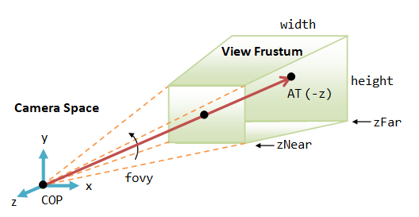
3D system
The 3D system uses a right hand system (see figure on the right).
This is a little different from the convention of the OpenGL:
The grid uses it’s own right hand coordinate system (xgrid , ygrid, zgrid). But for user’s convenience, the displayed value of zgrid is flipped (downward is positive for display purpose only).
In MRI, you can think of the Y axis in 3D as the positive coronal distance from the ear bar 0.
Electrode
OpenGL
zgrid (↑)
ygrid
Grid
xgrid
Z
MRI/Drawing
Y
(Rostral)
Sagittal Viewing
X
(Subject’s right)
(Caudal)
Coronal Viewing
Notes:
References:
Neural substrate of Temporal Discount:
9. Samejima K, Ueda K, Doya K, Kimura M: Representation of action-specific reward values in the striatum. Science 2005, 310:1337-1340.
10. Tanaka SC, Doya K, Okada G, Ueda K, Okamota Y, Yamawaki S: Prediction of immediate and future rewards differentially recruits cortico-basal ganglia loops. Nat Neurosci 2004, 7:887-893.
28. Doya K: Metalearning and neuromodulation. Neural Netw 2002, 15:495-506.

Slide 10
Display
There are 4 display routines running in the program
Event-based display:
takes care of window manipulations (resizing, unblocking of the window…)
Electrode position-based display:
In the main function; automatically updates the MRI and drawing depending on the position of the electrode.
User-key-triggered display:
reacts upon the request of the user (arrow keys etc.)
User-mouse-triggered display:
manipulation of the 3D, and drawing, etc.
Notes:
References:
Neural substrate of Temporal Discount:
9. Samejima K, Ueda K, Doya K, Kimura M: Representation of action-specific reward values in the striatum. Science 2005, 310:1337-1340.
10. Tanaka SC, Doya K, Okada G, Ueda K, Okamota Y, Yamawaki S: Prediction of immediate and future rewards differentially recruits cortico-basal ganglia loops. Nat Neurosci 2004, 7:887-893.
28. Doya K: Metalearning and neuromodulation. Neural Netw 2002, 15:495-506.

Slide 11
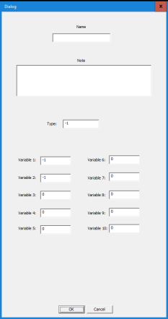

Saving / Loading Files
Reads/writes the 2D & 3D configuration at “_3D_2D_Config.txt”
Read_3D_2D_Config()
Save_3D_2D_Config()
Reads MRI files (BMP)
Load_MRIs()
Reads/writes the drawing data at “_DrawingData.txt”
Load_DrawingData()
OnFileSaveDrawing()
Reads/writes the description of neurons’ data from “_Neuron_Data.txt”. The Dialog that accepts neuronal data can be evoked by putting the tip of the electrode at the intended coordinate and hitting the “Return” key.
Save_Neuron_Data()
Load_Neuron_Data_and_Texture()
Reads the texture files for description of neuron from “Texture” folder. The icon-style textures are made and stored in the Texture folder by the user. Example:
Load_All_Texture_forCoronalSections()
Load_All_Texture()
Notes:
References:
Neural substrate of Temporal Discount:
9. Samejima K, Ueda K, Doya K, Kimura M: Representation of action-specific reward values in the striatum. Science 2005, 310:1337-1340.
10. Tanaka SC, Doya K, Okada G, Ueda K, Okamota Y, Yamawaki S: Prediction of immediate and future rewards differentially recruits cortico-basal ganglia loops. Nat Neurosci 2004, 7:887-893.
28. Doya K: Metalearning and neuromodulation. Neural Netw 2002, 15:495-506.

Slide 12
Organization of MRI / Drawing
m_MRI[ ]{
double m_Depth;
…
}
m_Drawing[ ]{
double m_Depth;
…
}
m_Selected_MRI_Idx
m_Selected_Drawing_Idx
At the beginning MRIs sorted in an ascending order according to their depth Y in the figure on the right).
Since drawings can be added by the user after loading the drawing data, they are not sorted according to their depth. However the program internally sorts the order according to the depth of the drawings and keeps the table.
m_MRI[1]
m_MRI[2]
Z
m_MRI[0]
Y
X

Slide 13
Pixel representation
Initial configuration without magnification and shift of anchor
Figure frame
m_MaxZ
3D-center in pixel
(Xpixel=4.6)
3D-center coordinate in 3D
(X3D=0)
Pixel is represented by
its lower-left corner and its dimension
E.g., (1, 1,1) & 0.5x0.5mm
First lower-left pixel’s center
0.5
(1, 1.5)
(1.5, 1.5)
m_MinZ
0.5
(1, 1)
(1.5, 0)
m_MinX
= (0 - 3Dcenter in pixel )x one pixel width
m_MaxX
= { m_imgWidth - 3Dcenter in pixel } x one pixel width

Slide 14
How to “anchor” and “magnify” MRI in the figure frame?
Figure frame
m_MaxY
Figure Anchor !=Figure center
When the user puts his mouse arrow at a point and rolls the wheel, the viewing area defined by m_MinX, m_MaxX, m_MinZ, m_MaxZ will change.
This expands / shrinks the figure anchored at the mouse point represented by (AnchorX_in3D, AnchorZ_in3D).
The “over-flowing” MR image part out of the figure frame will not be displayed.
m_MinY
m_MaxX
When magnification happens:
m_MinX=
AnchorX_in3D - (AnchorX_in3D -m_dMinX)*(m_PrevMag2D/m_Magnification2D);
m_MinX_corner remains the same even when the magnification happens.
Magnification affects only the m_MinX, m_MaxX, m_MinZ, m_MaxZ;

Slide 15
Registry between 3D and 2D images and drawings
There are the MR Images and the drawing files corresponding (does not have to) to the images.
And there are two ways to change a selected MR image or a selected drawing: by changing the coordiante of the electrode or by left-right arrow keys.
By left/right arrow keys.
Coordinate of the electrode or by left-right arrow keys.
3D Displayer
Coronal or Sagittal Image displayer
3D Displayer
Coronal or Sagittal Image displayer
Change of coordinate of electrode?
no
Change of coordinate of electrode?
no
Change of Drawing?
no
Change of MR Image?
no
yes
yes
yes
yes
Display the chosen MRI
Move the electrode
Find the cloest MR image
Coresponding Drawing found?
Is there any Neuron correspinding to the coordinate of the electrode?
no
Found?
no
no
yes
yes
yes
Highlight the neurons
Inform 2D displayers to update the image & drawing
Display the image
Highlight the Drawing and
Update the displayed drawing INDEX for 2D
Display the Drawsing &
Update the displayed drawing INDEX for 3D
Find the corresponding DRAWING
And display it if it exists

Slide 16
How 3D figure calls 2D figures
When the 3D rendering is displayed, the coordinate of the tip of the electrode is detected and the closest coronal and sagittal figures are displayed (if coronal and sagittal applications are running).
3D application: At the beginning of the application, it reads the files, and figures out the A-P depth using the file name. For example 4.5.txt means A-P 4.5mm from the origin.
2D applications: At the beginning of the application, it reads the MRI file names under the folder that the 3D application is using, and registers the A-P (for coronal 2D application) or M-L (for sagittal 2D application) level of each BMP file.
Whenever the tip of the electrode moves, the 2D applications get informed and they recalculate the closest section to display.
Notes:
References:
Neural substrate of Temporal Discount:
9. Samejima K, Ueda K, Doya K, Kimura M: Representation of action-specific reward values in the striatum. Science 2005, 310:1337-1340.
10. Tanaka SC, Doya K, Okada G, Ueda K, Okamota Y, Yamawaki S: Prediction of immediate and future rewards differentially recruits cortico-basal ganglia loops. Nat Neurosci 2004, 7:887-893.
28. Doya K: Metalearning and neuromodulation. Neural Netw 2002, 15:495-506.

Slide 17
Rotation coordinates –Right hand system
Current Configuration
z
y
x
Notes:
References:
Neural substrate of Temporal Discount:
9. Samejima K, Ueda K, Doya K, Kimura M: Representation of action-specific reward values in the striatum. Science 2005, 310:1337-1340.
10. Tanaka SC, Doya K, Okada G, Ueda K, Okamota Y, Yamawaki S: Prediction of immediate and future rewards differentially recruits cortico-basal ganglia loops. Nat Neurosci 2004, 7:887-893.
28. Doya K: Metalearning and neuromodulation. Neural Netw 2002, 15:495-506.

Slide 18
Three-D Vector Representation
Pre-Rotation Object-Centered coordinate surface point vector
(ObjCntrd_Coordnt_SrfcPoint[0], , )
Light Source
(LtSourceX, LtSourceY, LtSourceZ)
Object Rotation
*
Object-Centered coordinate surface point vector
(ObjCntrd_Coordnt_SrfcPoint[0], , )
ζ
Normal Vector
In right-handed system:
Object Center
(ObjCntrX, ObjCntrY, ObjCntrZ)
Light Reflection
(li[0], li[1], li[2])
Object-Centered coordinate surface point vector
(ObjCntrd_Coordnt_SrfcPoint[0], , )
ξ
Rotation along x-axis
Allocentric coordinate surface point vector
(AlloCntrc_Coordnt_SrfcPoint[0],,)
Observer
(ObserverCntrX,ObserverCntrY,ObserverCntrZ)
Egocentric coordinate surface point vector
(EgoCntrc_Coordnt_SrfcPoint[0], , )
Rotation along y-axis
Pre-Rotation Egocentric coordinate surface point vector
(EgoCntrc_Coordnt_SrfcPoint[0], , )
Object Center
(ObjCntrX, ObjCntrY, ObjCntrZ)
y
Allocentric coordinate surface point vector
(AlloCntrc_Coordnt_SrfcPoint[0],,)
0°
z
Rotation along z-axis
Viewer Rotation
(rotation matrix is negative)
z
*
y
Observer
(ox,oy,oz)
x
Egocentric coordinate surface point vector
(EgoCntrc_Coordnt_SrfcPoint[0], , )
x
Allocentric Origin
(0,0,0)
3D to 2D Mapping (Y-asis is the gaze axis):
Monitor (X,Y)=(x/y, z/y)
Retinal Image
2-D Egocentric Representation
Notes:
References:
Neural substrate of Temporal Discount:
9. Samejima K, Ueda K, Doya K, Kimura M: Representation of action-specific reward values in the striatum. Science 2005, 310:1337-1340.
10. Tanaka SC, Doya K, Okada G, Ueda K, Okamota Y, Yamawaki S: Prediction of immediate and future rewards differentially recruits cortico-basal ganglia loops. Nat Neurosci 2004, 7:887-893.
28. Doya K: Metalearning and neuromodulation. Neural Netw 2002, 15:495-506.

