Slide 1
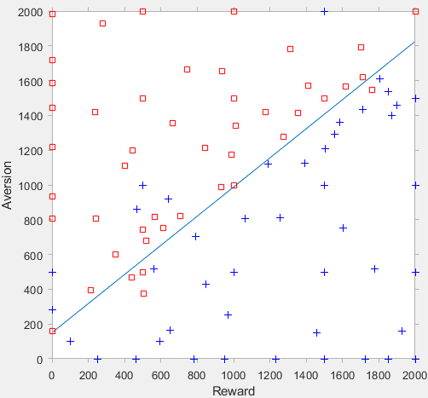
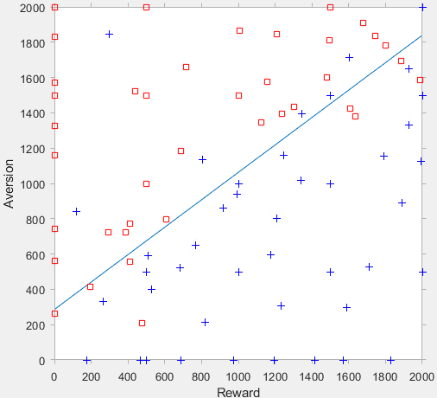
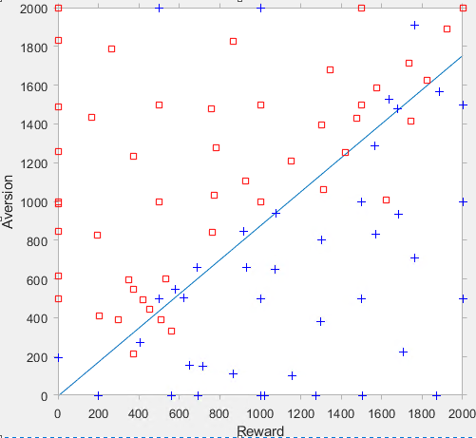
Monkey’s Decision Making
3rd session
5th session
14th session

Slide 2




Equation of Motivation
Motivation is measurable$(in the monkey$)!
$Motivation is inversly corellated with error rate and reaction time, in the monkey$ (Minamimoto +Richmond, 2009)
Motivation
Motivation
Motivation
Reward
Satiation
Delay
$$Motivation=\frac{1}{1+c∙Delay}$$
$$Motivation=a∙Reward$$
$Motivation=b∙f(Satiation$)
$$Motivation=\left\{a∙Reward\right\}×\left\{b∙f(Satiation)\right\}×\left\{\frac{1}{1+c∙Delay}\right\}$$
Simon’s formula
$$Motivation=\left\{a∙Reward×Prospect\right\}×\left\{b∙f(Satiation)\right\}×\left\{\frac{1}{1+c∙Delay}\right\}−Cost$$
You buy a lottery by fantasizing the Prospect!
Notes:
Motivation is measured by the Error rate and reaction time.
Is motivation a limited resource within a set time period? Motivation can last reasonably long (dopamine action; Iron Man Triathlon) but in some cases, may need some boost. Drowsy drivers, kamikaze pilots.
What are some of the proven ways to replenish it? → Can do sprit; never give up! By fantasizing the prospect.

Slide 3
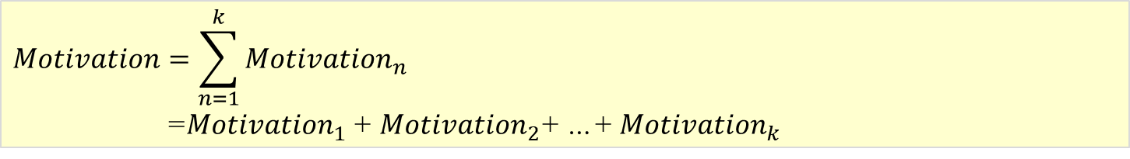
Questions
Simon’s formula
$$Motivation=\left\{a∙Reward×Prospect\right\}×\left\{b∙f(Satiation)\right\}×\left\{\frac{1}{1+c∙Delay}\right\}−Cost$$
$$Motivation=\sum_{n=1}^{k}{{Motivation}_{n}}$$
=${Motivation}_{1}$+ ${Motivation}_{2}$+ …+ ${Motivation}_{k}$
Reward amount may be stored in OFC ? – Rudebeck et al., 2017
Prospect may be calculated in VLPFC? – Rudebeck et al., 2017
Notes:
Motivation is measured by the Error rate and reaction time.
Is motivation a limited resource within a set time period? Motivation can last reasonably long (dopamine action; Iron Man Triathlon) but in some cases, may need some boost. Drowsy drivers, kamikaze pilots.
What are some of the proven ways to replenish it? → Can do sprit; never give up! By fantasizing the prospect.

Slide 4
Members’ Decision Making?
Negative Scores
(Sum of the negative scores from the features in the PCA analysis)
Rewards
()

