Slide 1
New word detection Algo
Presenter: Simon Zhang
Date: July 18th, 2022
@ University of waterloo

Slide 2
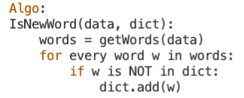
How to detect new words?
It looks easy, right?
Why is it so challenging in Chinese?

Slide 3


delimiter
Unlike many other western languages, Chinese words are not delimited by white space. Therefore, it becomes difficult to do word segmentation.
Word Segmentation
Word Segmentation

Slide 4
Key statistical term
1. Frequency
2. Entropy
3. Pointwise Mutual Information

Slide 5
Frequency
“the rate at which something occurs over a particular period of time or in a given sample”

Slide 6
Entropy
“a logarithmic measure of the rate of transfer of information in a particular message or language”
Intelligence
is
are
artificial
shows
were
Idiot
was
should
… …

Slide 7
Pointwise mutual information
“quantify the likelihood of co-occurrence of two words, taking into account the fact that it might be caused by the frequency of the single words”

Slide 8
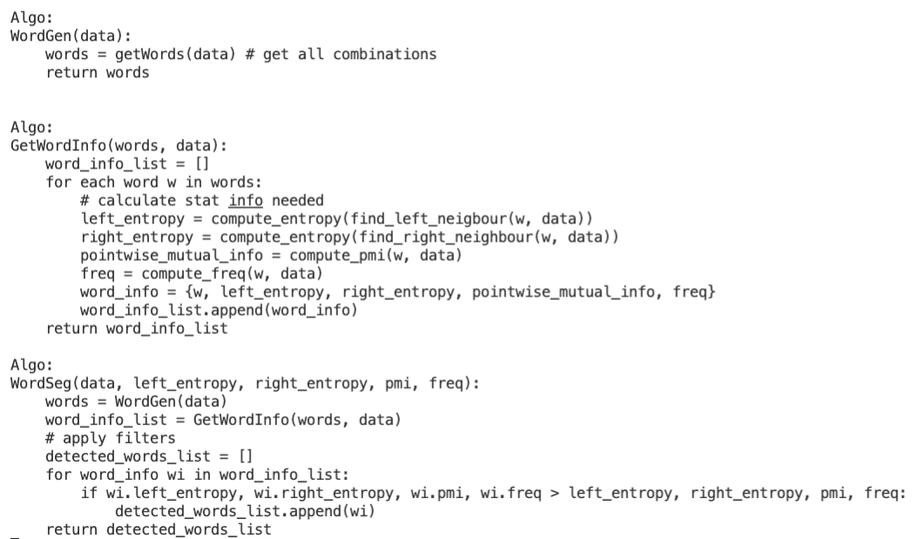
New word detect algo
Get all possible candidates
Get stat for each possible candidate
Apply filter

Slide 9
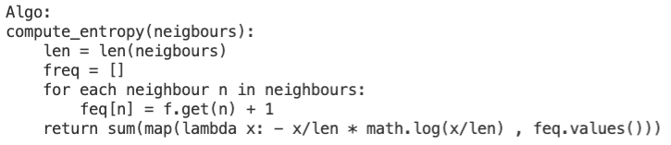
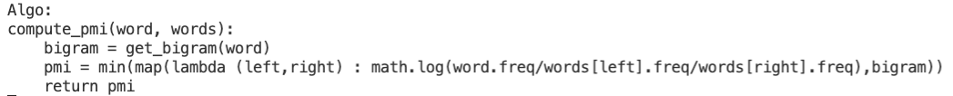
details

Slide 10
improvement
For different size of the corpus, the filter should be adjusted
Space Complexity and runtime complexity is hard to reduced

Slide 11
References
Ao Chen, Maosong Sun (N/A). “Domain-Specific New Words Detection in Chinese”. Retrieved from https://aclanthology.org/S17-1005.pdf.
Peing, F. (2004). "Chinese Segmentation and New Word Detection using Conditional Random Fields. Retrieved from https://scholarworks.umass.edu/cs_faculty_pubs/92.
Valentina Alto (2020). “Understanding Pointwise Mutual Information in NLP”. Retrieved from
https://medium.com/dataseries/understanding-pointwise-mutual-information-in-nlp-
e4ef75ecb57a.

