Slide 1
Containers
by Simon

Slide 2
Basic Core

Slide 3
Container?
Docker?
VM (Virtual Machine)?
Docker ? Not today…

Slide 4
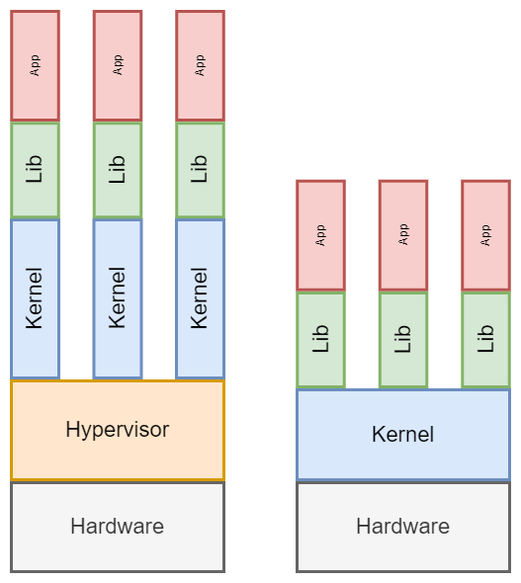
Difference?
VM
Container

Slide 5
What is kernel?
A big program that interact with hardware directly.

Slide 6
Basic functions for Container
Namespaces
Give illusion of processes, mount points, network interfaces, files, etc..
Cgroups
Control Groups
Resource Allocation
CPU/Memory limits
I/O Bandwidth
Userspaces
User info
Permissions
Security

Slide 7
Userspace examples
sudo chroot /
chroot —userspec=u:u /

Slide 8
Container Standards
Decide by OCI (Open Container Initiative)
https://github.com/opencontainers
Main two components
Image
Runtime (Container)

Slide 9
Container-like non-containers
WSL (Windows Sub-Linux System) (Partially)
Most of Linux package manager (for security)
Snap
Appimage
Nix
Flatpak
https://www.heise.de/select/ct/2016/17/1471178736497222#&gid=1&pid=4
Firejail
Chroot
LXC, LXD
Android Apps

Slide 10
Middle Mantle

Slide 11
Container Image
Docker Hub or GitHub Packages
Can be build manually using Container File
Layers - like git commits
Versions/Tags
Demo

Slide 12
Container Runtime (Container)
Running Containers like running programs
Command-line or container-compose.yml
Basic arguments
<runner> run <image_name> <guest_commands>
Basic flags
-v (sharing file/folder)
-p (mapping port)
–name (container name)
-e (sharing environment)
-d (detach)
-i (interact) & -t (terminal)
CLI demo
Compose demo

Slide 13
Other Basic Commands
start/restart - start container/restart container
pull - pull images from hub
build - build images from Containerfile
compose - run by container-compose
rmi - remove container image
rm - remove container
network - networking related
images - list images
ps - list containers
attach - reattach the detached container
exec - execute command to container
stop/kill - stop container/stop with specific signal

Slide 14
More Example
https://github.com/peterzam/box
https://levelup.gitconnected.com/a-complete-go-development-environment-with-docker-and-vs-code-2355aafe2a96
https://github.com/phuctm97/go-restful
https://github.com/veggiemonk/awesome-docker

Slide 15
Upper Crust

Slide 16
Container Orchestration
Intro to microservice

Slide 17
Container Networking
Bridge
Host
Overlay
IPvLAN
MACvLan

Slide 18
Bridge
Most used
Default
Isolated Network
Can communicate with host
Will not appear as device on host

Slide 19
Host
Share your host’s network stack without any isolation
No IP allocation for container
-p 8080:80

Slide 20
Overlay
Distributed Network on container
Calico
Virtual
Allow to build custom networks
CNI

Slide 21
IPvLAN
MACvLAN
VLAN
Layer 2 & 3 to IP in container
Appear as a device on host
Appear as a network card/device on host
Get network the same as host
Useful for Low-protocol-level
Cannot directly connect to host due to security reasons

Slide 22
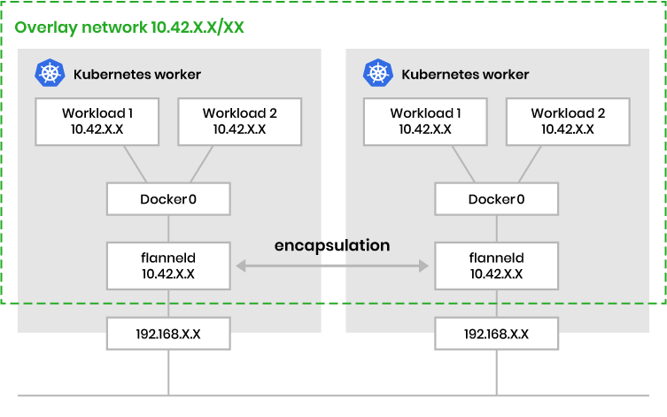
CNI

Slide 23
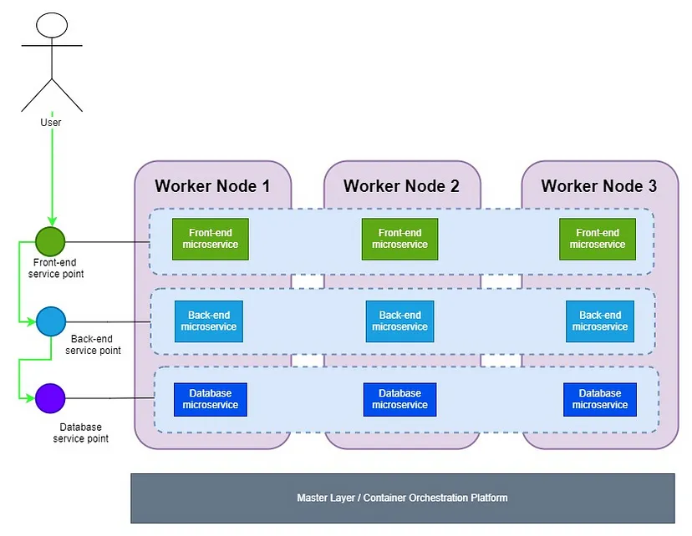
K8/Kubernetes Cluster

Slide 24
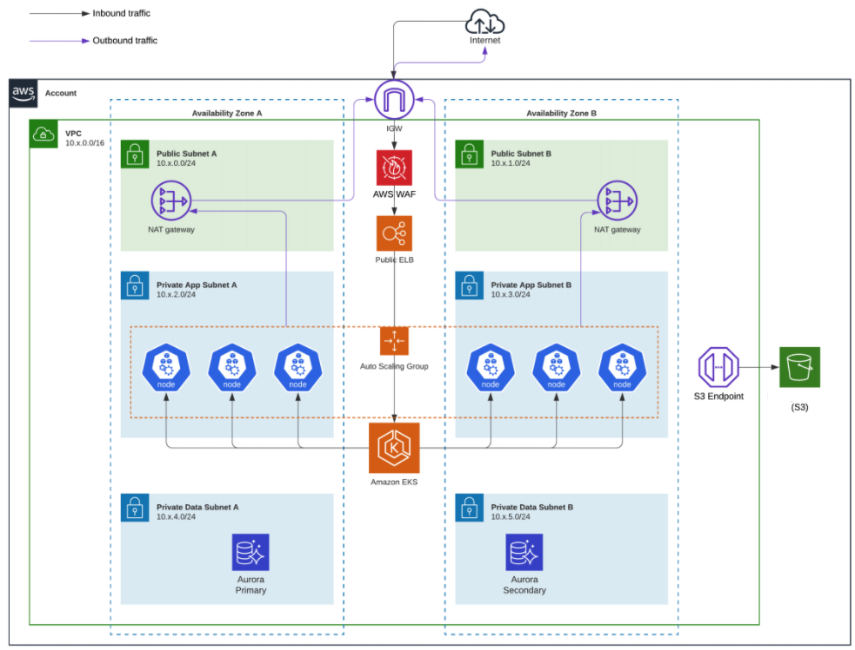
AWS EKS Cluster

Slide 25
Q & A

Slide 26
Thanks for your time

Slide 27
Next Topic
Container Orchestration (Kubernetes)
CI/CD (Pipelines - GitLab, GitHub, AWS CodePipeline)
IaC (Infrastructure as Code - Terraform and OpenTofu)
Serverless (AWS Lambda and Cloudflare Workers)
AWS Basic Services (EC2, S3, LightSail, Beanstalk…)
Linux in Depth

