Slide 1
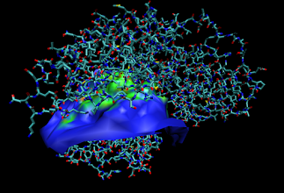
Interface between proteins
Simon Ziza
6 months internship
Student at CPE Lyon
David Ritchie and Bernard Maigret

Slide 2
Introduction : Intersurf ++
Finding dynamically the interface between two proteins
Calculate the new interface when one or several atom(s) has moved

Slide 3
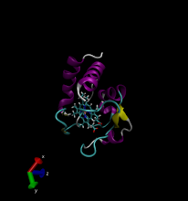
Existing Software
Intersurf : Static calculation of a surface between proteins (works as a module for VMD)
VMD : Protein visualization (*.pdb)

Slide 4
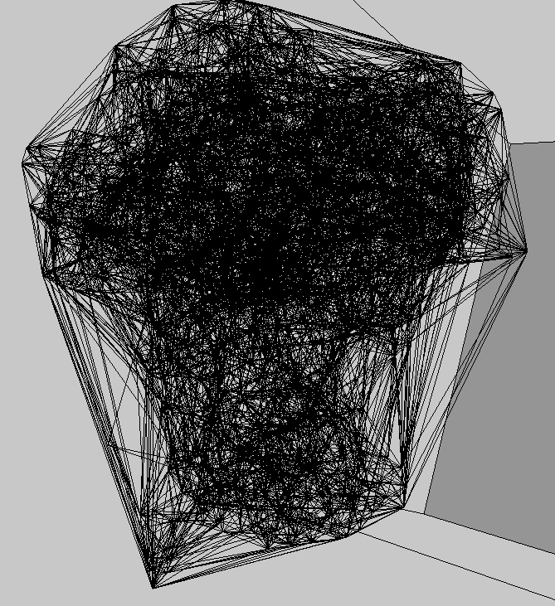
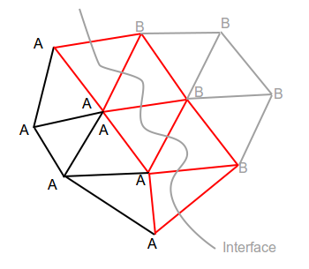
Delaunay Tesselation

Slide 5
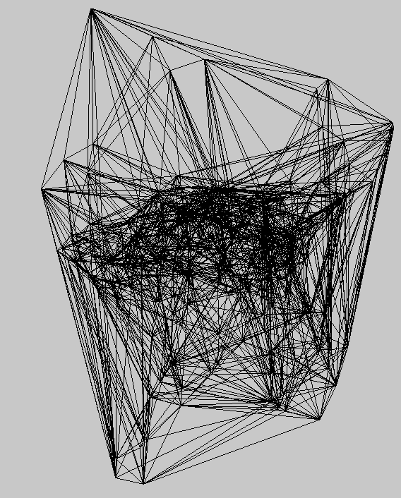
Delaunay Tesselation

Slide 6
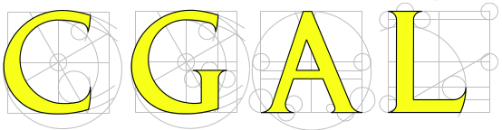
: Software library to compute geometry algorithms
Advantages
Great pre-defined structures (Delaunay Triangulation)
Fast calculation
Fast location
Disadvantages
Amount of information and structures
Hidden data
Visualization (Using Qt5)

Slide 7
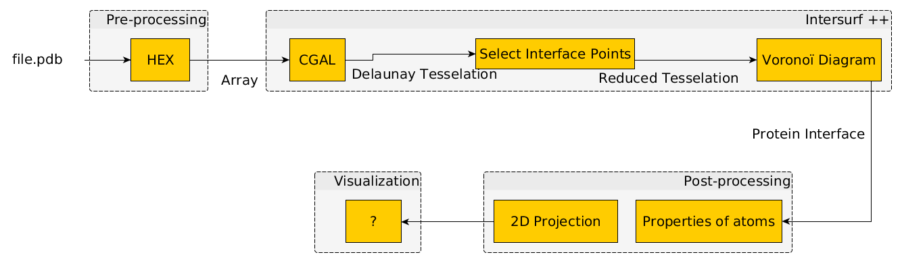
Software processing pipeline

Slide 8
Next functionalities
Dynamical display
Information regarding the atoms
2D Projection (Comparison of complexes)

Slide 9
Thank you for your attention.

