Slide 1


Simscape Onramp
Simone Montepiani
MATLAB Student Ambassador
29/04/2026
Notes:
.

Slide 2

Contacts
Simone Montepiani
simone.montepiani@mail.polimi.it
MATLAB PoliMi
matlab.polimi@gmail.com
@mtlbsapdm (Instagram)
FOLLOW US ON INSTAGRAM
@MTLBSAPDM
Notes:
These are the contacts: there is my personal Polimi e-mail, the MATLAB PoliMi gmail and, above all, the official Instagram account of the MATLAB Student Ambassador, so please follow us using the link or the QR code.

Slide 3
Agenda
17:30 – 18:00: Intro
Introduction
Differences between Simulink and Simscape
18:00 – 19:15: Coding part
Demo: mechanical system
If we have time… electrical system and thermal system
Additional resources
19.15 – 19.30: QUIZ and gadgets!
Notes:
This is the agenda for today: we have an initial setup, then we move to examples with the coding part, and finally, we have the quiz and the MATHWORKS gadgets.

Slide 4

What is Simscape?
Notes:
Let’s see how much you know about Machine Learning, so what is ML in your opinion?

Slide 5
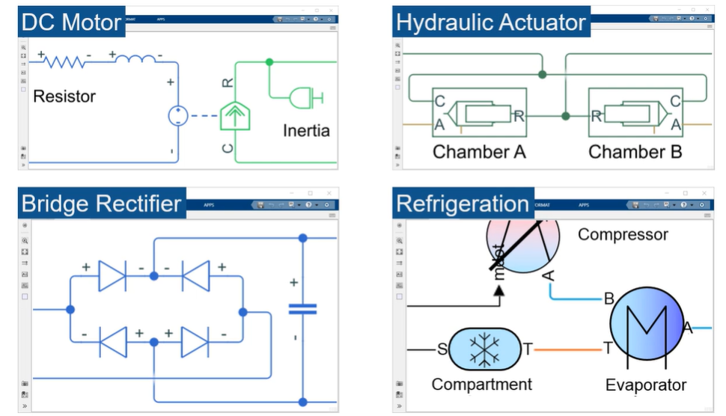
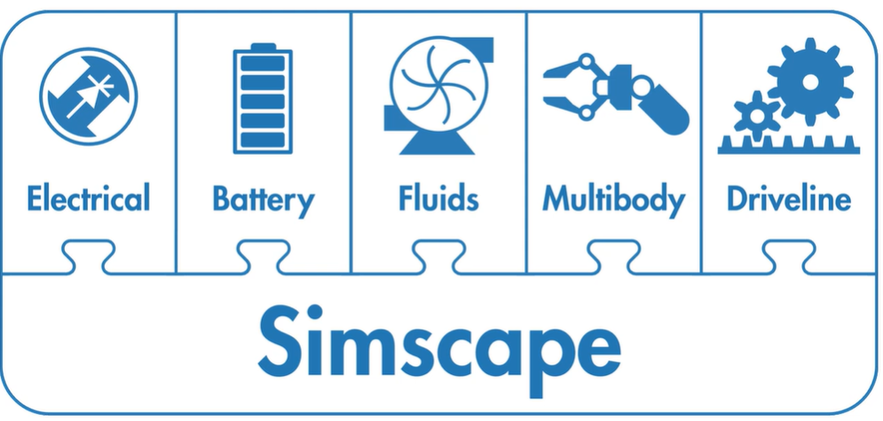
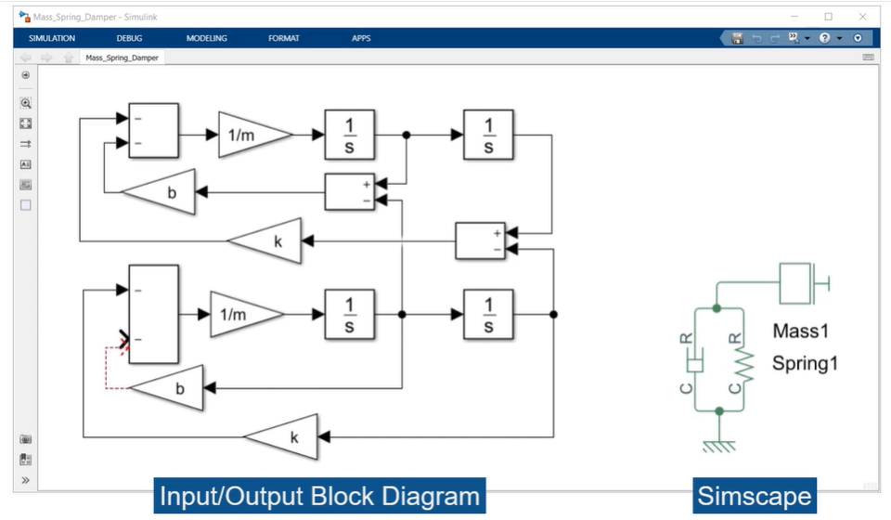
Why use Simscape?
Create models of physical systems within the Simulink environment
Develop control systems and test system-level performance
Supports C-code generation
Notes:
Build physical component models based on physical connection that directly integrate with block diagrams.
Create custom components models through text-based authoring of physical modeling components, domains, and libraries.
Deploy your models to other simulation environments, such as HIL.

Slide 6
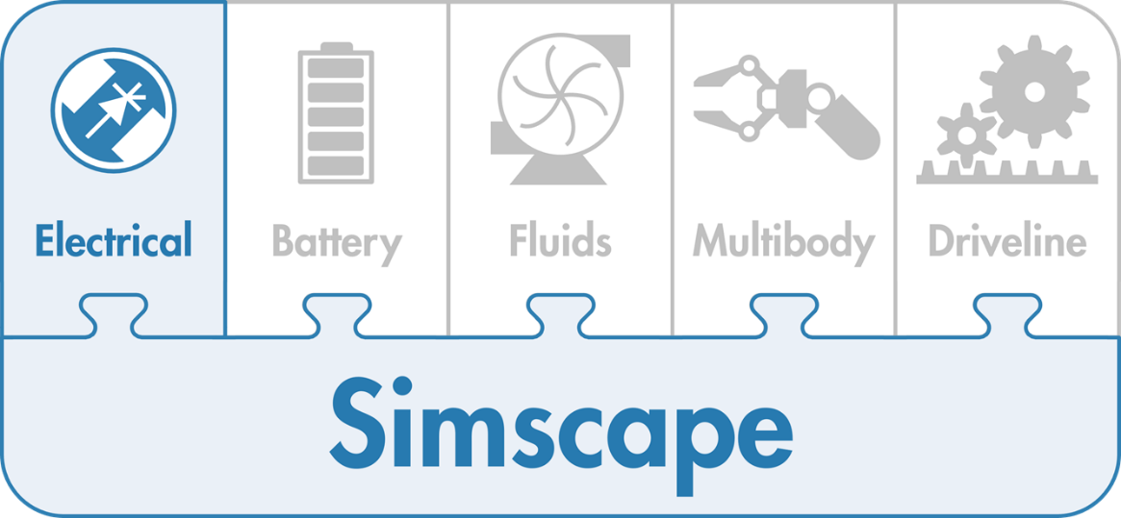
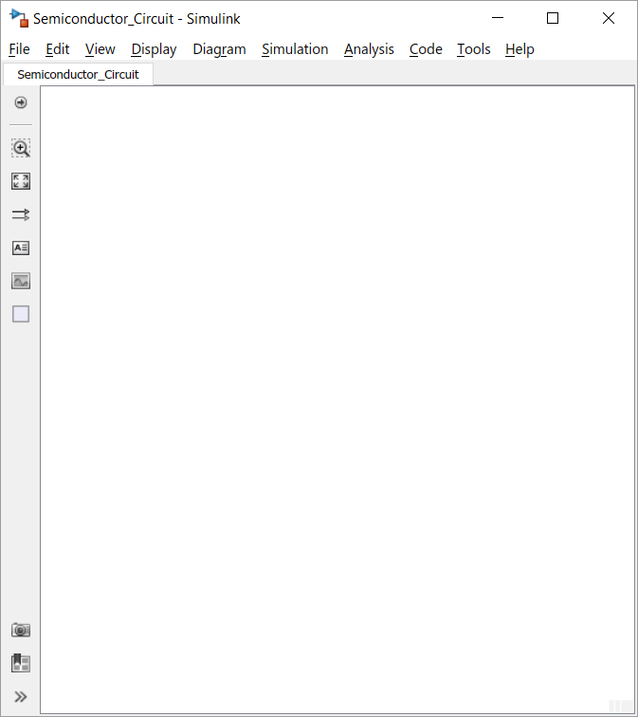
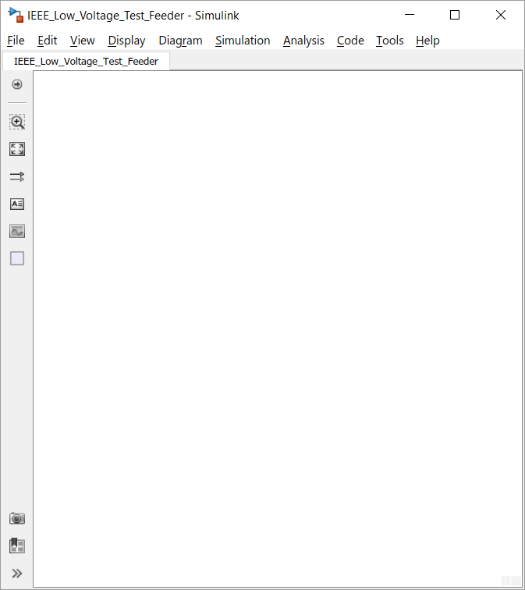
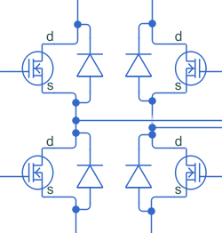
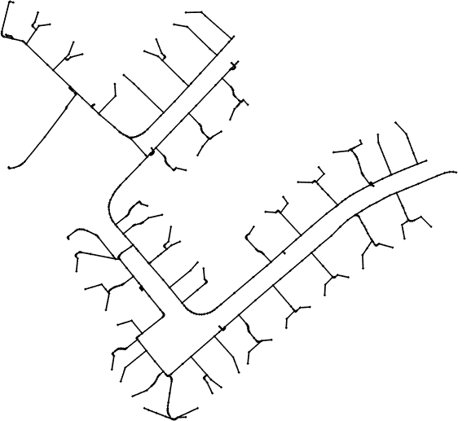
Simscape Electrical Overview
Enables physical modelling of electronic, mechatronic, and electrical power systems
Electrical system topology represented by a schematic circuit
With Simscape Electrical, you can
Evaluate analogue circuit architectures
Develop mechatronic systems with electric drives
Analyze the generation, conversion, transmission, and consumption of electrical power at the grid level
IEEE European Low Voltage Test Feeder (906 buses)
Notes:
Simscape Electrical™ (formerly SimPowerSystems™ and SimElectronics®) provides component libraries for modeling and simulating electronic, mechatronic, and electrical power systems. It includes models of semiconductors, motors, and components for applications such as electromechanical actuation, smart grids, and renewable energy systems. You can use these components to evaluate analog circuit architectures, develop mechatronic systems with electric drives, and analyze the generation, conversion, transmission, and consumption of electrical power at the grid level.
Simscape Electrical helps you develop control systems and test system-level performance. You can parameterize your models using MATLAB® variables and expressions, and design control systems for electrical systems in Simulink®. You can integrate mechanical, hydraulic, thermal, and other physical systems into your model using components from the Simscape family of products. To deploy models to other simulation environments, including hardware-in-the-loop (HIL) systems, Simscape Electrical supports C-code generation.
Simscape Electrical was developed in collaboration with Hydro-Québec of Montreal.

Slide 7
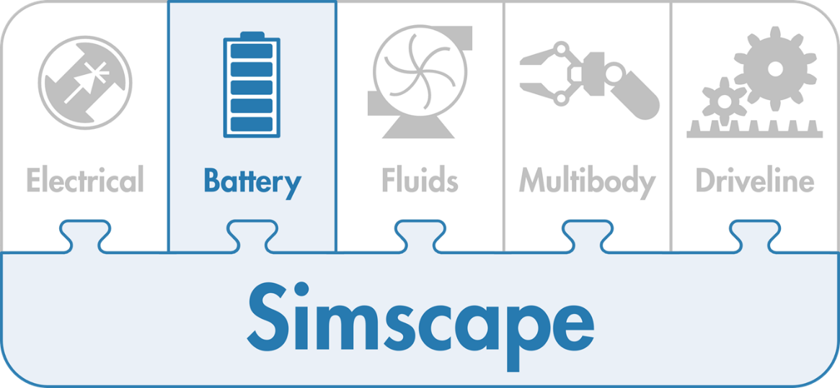
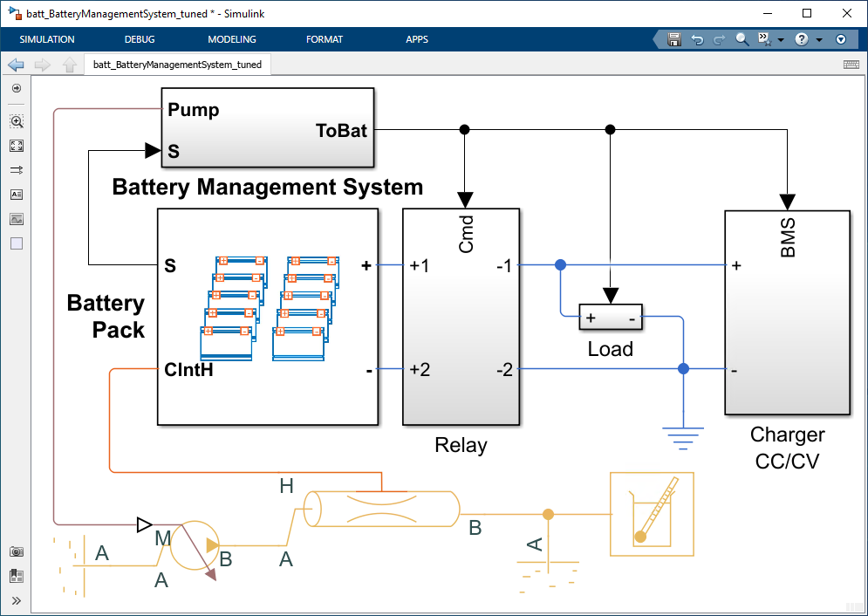
Simscape Battery Overview
Design and simulate battery and energy storage systems
Electrothermal cell behaviour
Battery pack design
Battery management systems (BMS)
With Simscape Battery, you can
Evaluate pack architectures for electrical and thermal requirements
Verify robustness of discharge, charge and thermal management algorithms
Validate algorithms using HIL testing
Notes:
Simscape Battery™ provides design tools for modeling and simulating battery and energy storage systems.
You can use these tools to test battery architectures, design battery management systems, and evaluate battery system behavior across normal and extreme conditions. You model these systems by assembling the components into a schematic. Then select the physical effects you wish to include, assign parameter values, and you are ready to simulate.
Simscape Battery includes design tools that automate the creation of battery pack models. You create models that represent your desired topology. These models can include cooling plate connections so that electrical and thermal responses can be evaluated.
You can integrate electrical, hydraulic, pneumatic, and other systems into your model using components from the Simscape family of products. Simscape offers a set of fundamental components in many physical domains, and it provides the technology for simulating and analyzing physical systems.
The Simscape add-on products provide additional models and analysis capabilities for applications such as electrical power networks, heating and cooling systems, and mechatronics. You can integrate these with three-dimensional mechanical systems and analyze their behavior using an animation of the simulation results.
Simscape Battery models can also be converted to C code. This enables them to support testing of embedded software in configurations such as processor-in-the-loop and hardware-in-the-loop testing, which is much safer and more efficient than testing on hardware prototypes.
Simscape Battery models integrate directly with block diagrams in Simulink, state machines in Stateflow®, and MATLAB functions. You can simulate your entire system in a single environment. This accelerates tasks such as designing control systems and optimizing system-level performance.

Slide 8
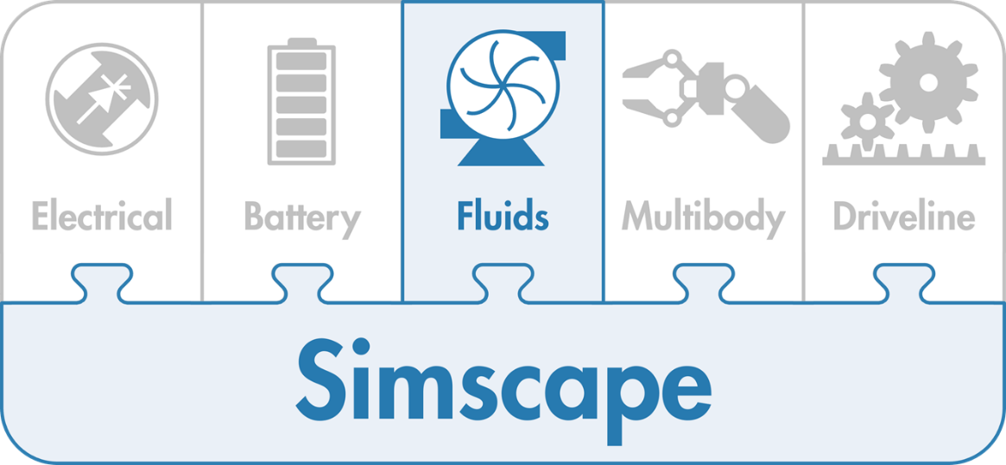
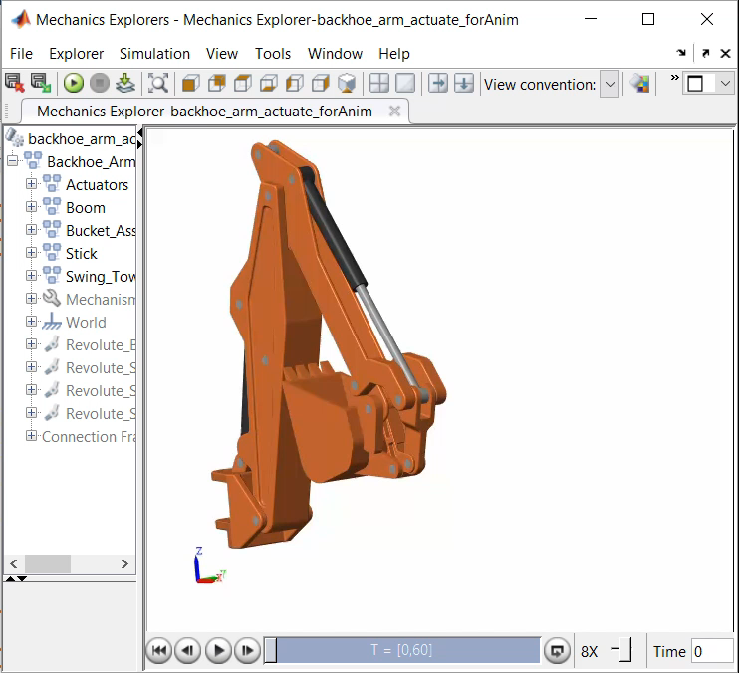
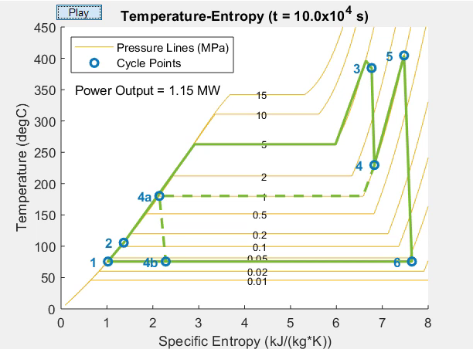
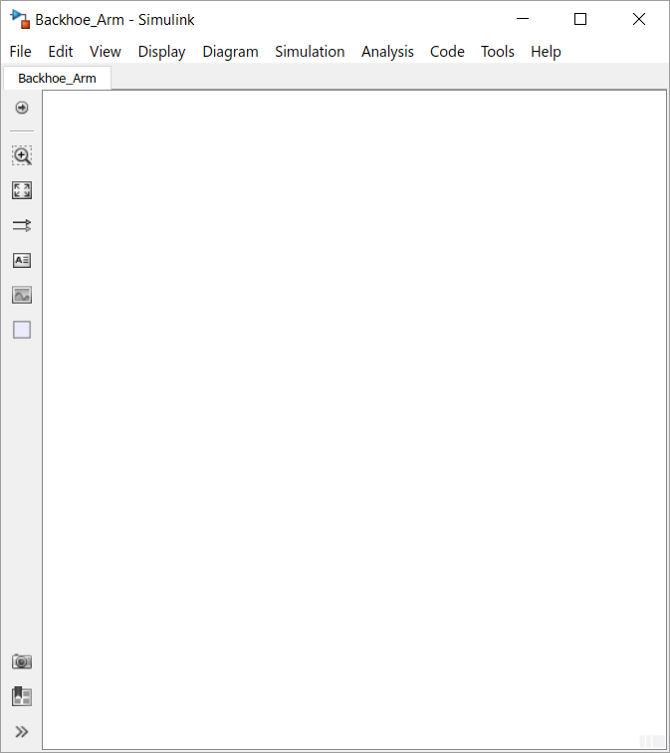

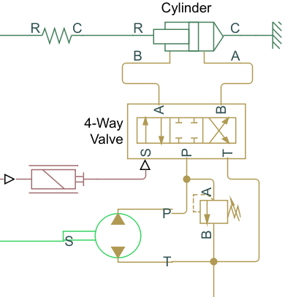
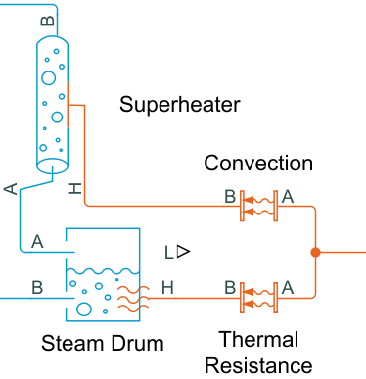
Simscape Fluids Overview
Enables physical modelling of fluid systems
Fluid power, heating, cooling, and fluid transportation
Liquids, gases, and multiphase fluids
With Simscape Fluids, you can
Refine requirements for fluid systems
Discover integration issues early
Design control algorithms and logic within the Simulink environment
Test embedded software without hardware prototypes
Notes:
Read the slide, and advance.
Hydraulic circuit model description
No need to derive equations of hydraulic system dynamics
No co-simulation

Slide 9
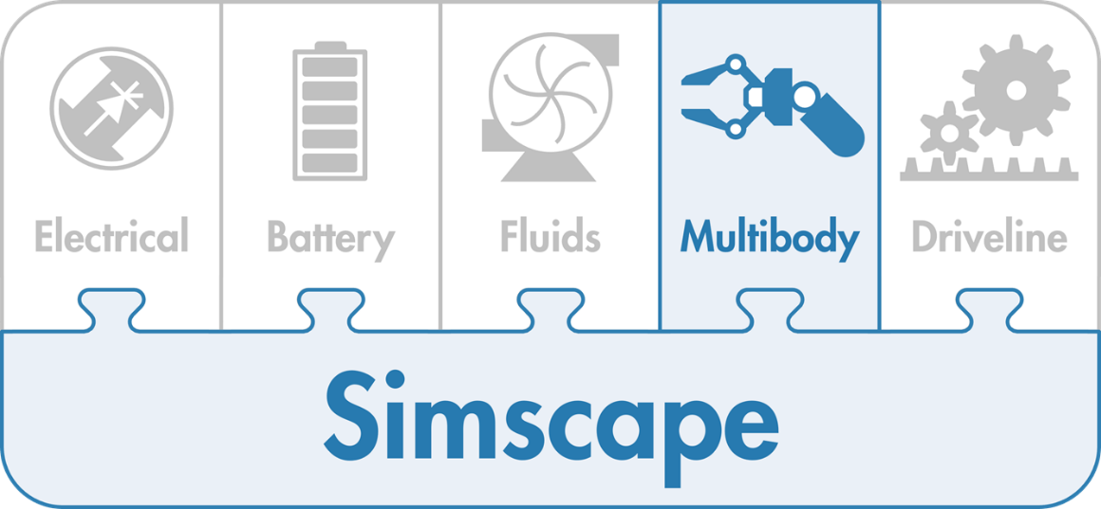
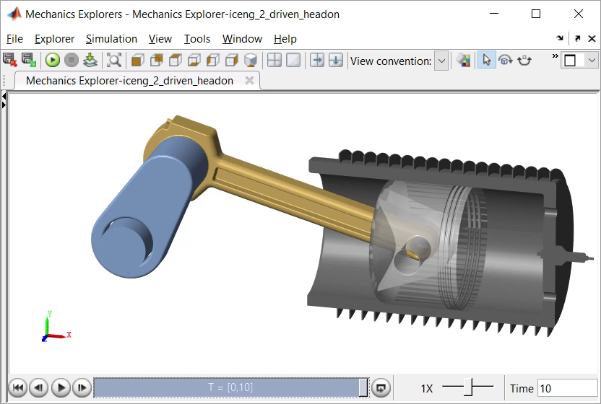
Simscape Multibody Overview
Enables multibody simulation of 3D mechanical systems
Assemble bodies and joints including import from CAD
No need to derive and program equations
With Simscape Multibody you can:
Refine requirements for mechanical system
Discover integration issues early
Design control algorithms and logic
Test embedded software without hardware prototypes

Slide 10
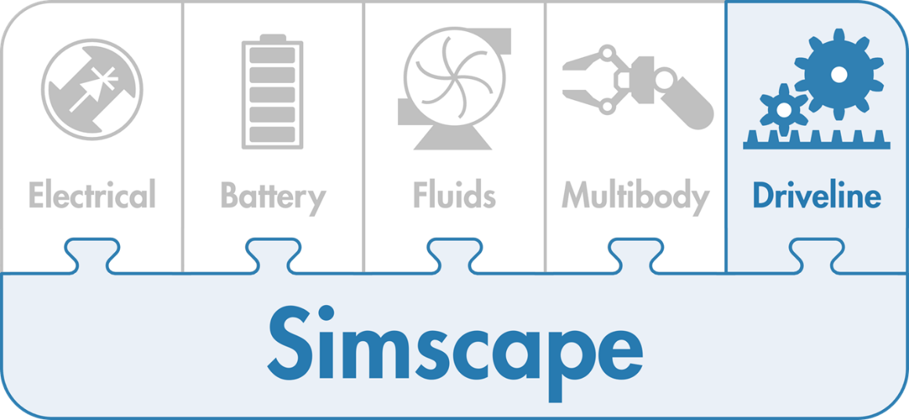
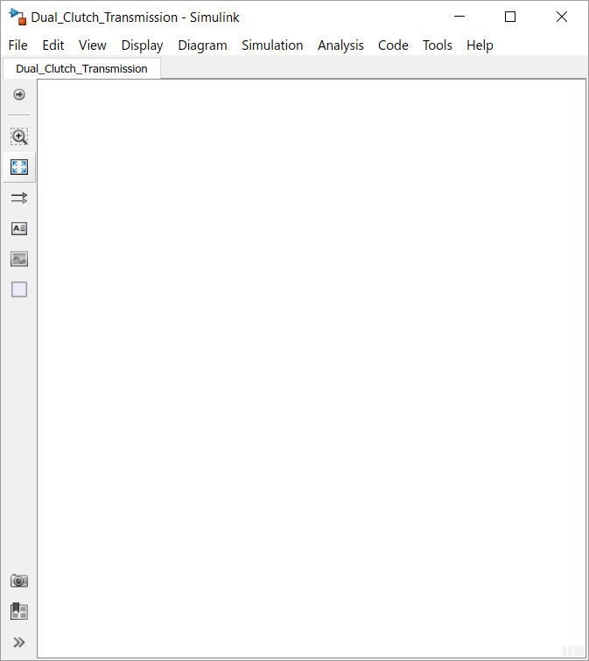
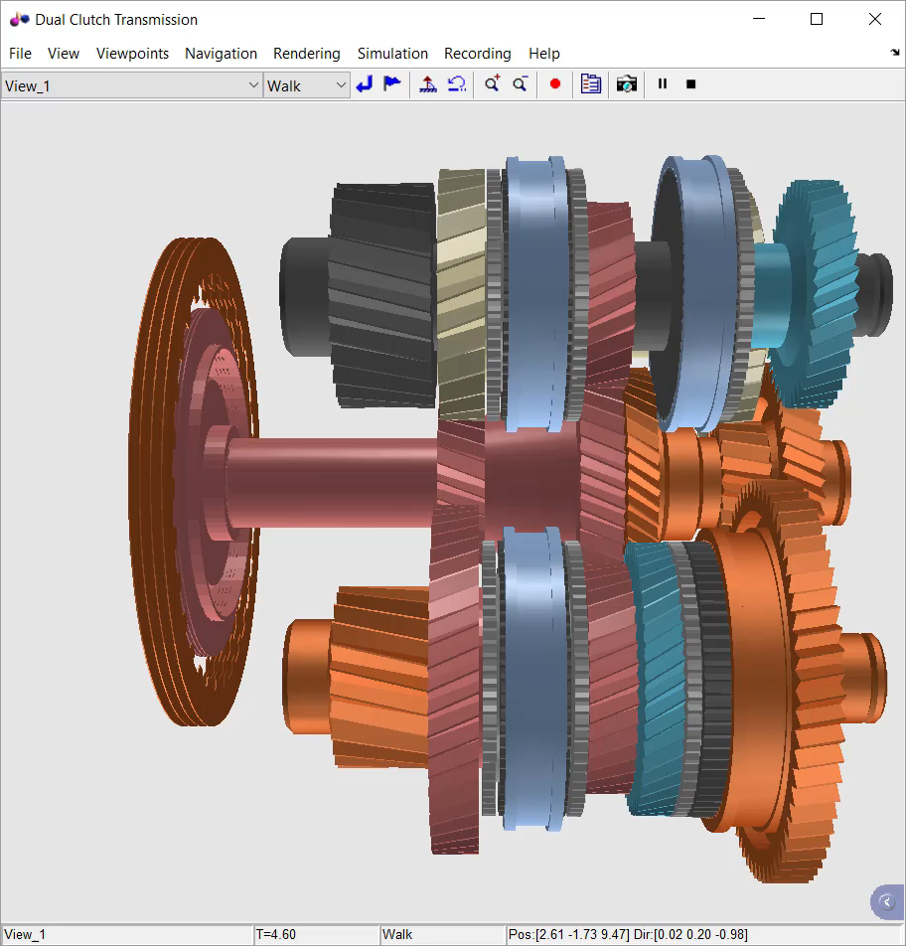
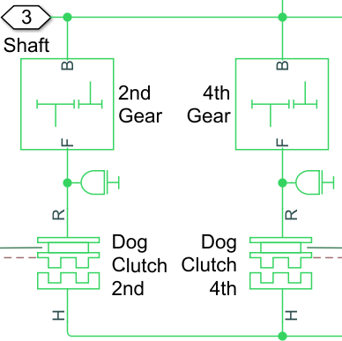
Simscape Driveline Overview
Enables physical modeling of multidomain powertrain systems
Rotational and translational systems
With Simscape Driveline you can:
Refine requirements for mechanical transmission systems
Discover integration issues early
Design control algorithms and logic within the Simulink environment
Test embedded software without hardware prototypes

Slide 11
Differences between Simulink and Simscape

Slide 12
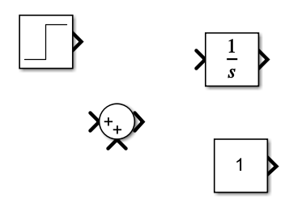
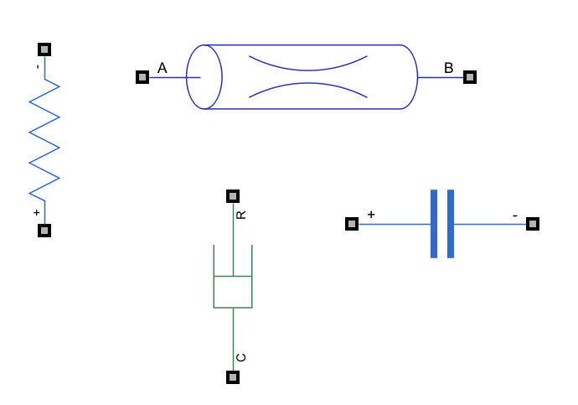
Simscape vs Simulink 1. Modelling Approach
Simulink uses a block-diagram approach based on signal flow. It is ideal for modelling control systems, signal processing, and time-based dynamic systems using a top-down, algorithmic approach.
Simscape uses a physical modelling approach based on physical networks. It allows you to model systems using physical connections and component-level representations, following the laws of physics directly (e.g., Kirchhoff’s laws, conservation of energy).

Slide 13
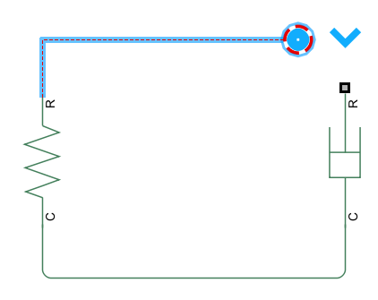
Simscape vs Simulink 2. Signal and Physical Connections
In Simulink, blocks are connected by unidirectional signals, which represent data or control flow.
In Simscape, components are connected by bidirectional physical connections (ports), which represent real-world interactions like force, current, voltage, and flow rate.

Slide 14
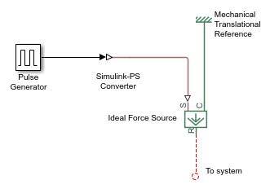
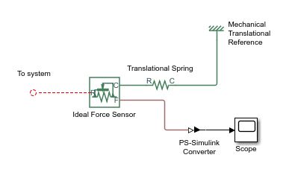
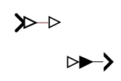
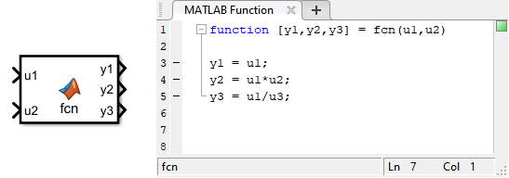
Simscape vs Simulink 3. Integration
Simscape models can be integrated into Simulink environments seamlessly. You can do so using, for example:
PS-Simulink Converter
Simulink-PS Converter
As Simulink, Simscape can also be integrated into MATLAB to work with the results you get. Workspace variables are seen by Simulink and Simscape

Slide 15
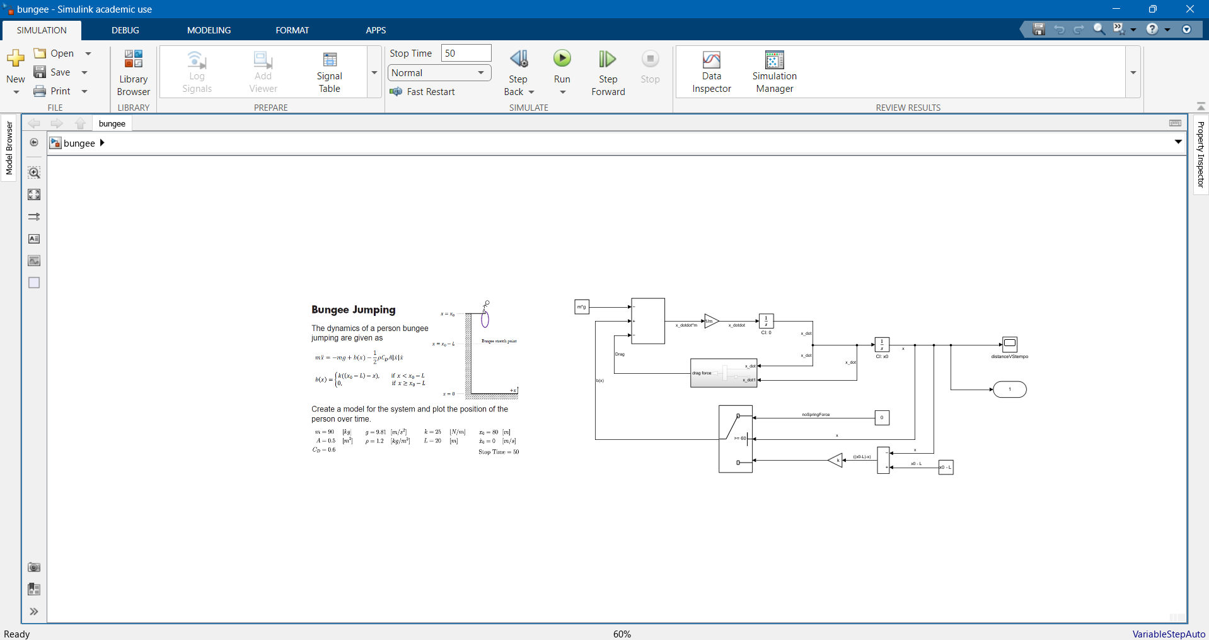
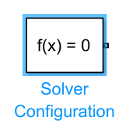
Simscape vs Simulink 4. Solver Configuration
Simulink models typically use the default solver settings specified in the model configuration. The solver is applied globally and automatically handles the numerical integration of signals.
Simscape models require a dedicated Solver Configuration block to define solver parameters for the physical network. This block is essential to initialize and simulate the physical system correctly, especially when working with stiff systems or when initialization needs are complex.

Slide 16
How can Simscape be used in the real world?

Slide 17
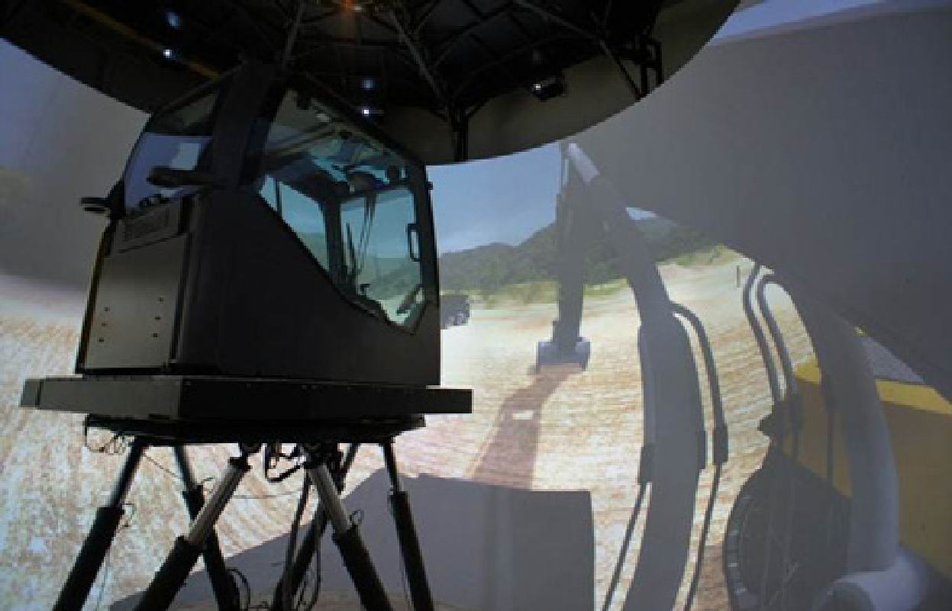
Volvo Construction Equipment Streamlines Product Development with a Real-Time, Human-in-the-Loop Simulator
Challenge
Evaluate design concepts and parameter values for construction equipment before building physical prototypes
Solution
Use Simulink, Simscape, and Simulink Real-Time to model hydraulic, mechanical, and engine systems and perform real-time, operator-in-the-loop simulations
Results
Number of prototypes reduced
Issues in the field resolved faster
Controller tuned in simulation
Volvo Construction Equipment’s real-time, human-in-the-loop simulator.
“It was technically impossible for us to build a full-scale hydraulic system model to run in real time without Simulink, Simscape, and Simulink Real-Time. Our simulator enables us to test new concepts for construction equipment, tune parameters, reduce lead times, and minimize issues in the field.”
- Jay Yong Lee, Volvo Construction Equipment
Notes:
Industries: Automotive, Industrial automation and machinery
Application Areas: Control systems, Mechatronics
Capabilities: Mathematical modeling, Algorithm development, System design and simulation, Physical modeling, Rapid prototyping
Products Used: MATLAB, Simulink, SimHydraulics, SimMechanics, Simscape, Simulink Control Design, Simulink Real-Time
Country: USA
Volvo Construction Equipment Streamlines Product Development with a Real-Time, Human-in-the-Loop Simulator
When designing excavators, wheel loaders, haulers, and other construction equipment, engineers develop prototype versions of the machinery to evaluate performance, responsiveness, and operability. Building physical prototypes costs manufacturers millions of dollars and months of development time. Until recently, however, this was the only way to effectively understand the experience of operating a new machine.
Volvo Construction Equipment (Volvo CE) can now evaluate new machine designs before a prototype is built. Volvo CE engineers built a real-time, human-in-the-loop simulator for construction machines using Simulink®, Simscape™, and Simulink Real-Time™. The Virtual Machine Simulator (VMS) gives operators realistic visual, auditory, and motion feedback during simulation.
“With Simscape and Simulink Real-Time we can simulate not only fuel economy and performance but also the feel of operating the machine—all before we build a physical prototype,” says Jae Yong Lee, Chief Engineer at Volvo CE. “Evaluating operator experience through simulation is vital to making trade­off decisions in the early stages of product development.”
Challenge
Volvo construction machines rely on sophisticated hydraulic systems comprising numerous valves, pumps, and pipes, as well as a control system and various sensors. These hydraulic systems must be matched with an appropriately sized engine and then optimized for performance and fuel economy by tuning controller parameters.
Volvo engineers knew that this complex task would be too costly to perform on physical prototypes, but they lacked a way to accurately simulate hydraulics in real time. Further, domain-specific simulation tools would enable them to simulate only individual subsystems, making it impossible to develop a full-scale simulator of a complete machine incorporating hydraulic, mechanical, electrical, and electronic subsystems.
The team needed tools that would enable them to model all subsystems in a single environment and perform real-time simulations of the complete system. This approach would let them make informed design trade­off decisions that took into account not only performance and efficiency but also feedback from the operator driving the machine. A modeling and simulation environment that supported multiple domains was also essential to the company’s concurrent engineering approach, in which teams develop various subsystems of the final product in parallel and then converge on an optimal solution.
“It was technically impossible for us to build a full-scale hydraulic system model to run in real time without Simulink, Simscape, and Simulink Real-Time. Our simulator enables us to test new concepts for construction equipment, tune parameters, reduce lead times, and minimize issues in the field.”
- Jae Yong Lee, Volvo Construction Equipment
Solution
Volvo CE engineers selected Simulink, Simscape, and Simulink Real-Time for the development of the VMS platform.
The team modeled the main control valve, relief valves, swing motor, and hydraulic circuits of the first machine to be simulated—an excavator—with SimHydraulics® and Simscape. They then modeled the mechanical components, including the boom, arm, and bucket, with SimMechanics™.
Working in Simulink, the team created an engine model and then integrated it with the hydraulic, mechanical, and other subsystem models to create a model of the complete machine.
Using Simulink and Simulink Control Design™, they developed a controller model and performed closed-loop simulations with the machine model. They used MATLAB® to postprocess simulation results. They then refined the controller design based on their analysis of system behavior in simulation, and verified the machine model with test data from an actual machine.
They generated C code from their models using Simulink Coder™, and used Simulink Real-Time to run the code concurrently on three target PCs from Speedgoat.
The real-time simulation platform is currently in use for excavator product development, and the company plans to use it to develop wheel loaders and articulated haulers, as well. The team recently added controller-in-the-loop and rapid control prototyping capabilities to the simulator to support software development and testing.
Results
■ Number of prototypes reduced. “The simulations that we run with Simulink and Simscape let us evaluate various design concepts and parameter values, reducing the risk of redesign later in the development cycle,” says Lee. “Once we identify an optimal design via simulation, we can build it. We anticipate a 30–50% reduction in prototype builds as a result.”
■ Issues in the field resolved faster. “Using the simulator, we can replicate any issue that arises in the field, troubleshoot the problem, and quickly find a solution,” says Lee.”
■ Controller tuned in simulation. “We refined the controller design by simulating the controller model with the machine model and analyzing system behavior,” says Lee. “Using this approach we reduced lead time for product development and increased product quality by covering a wide range of test scenarios.”
Learn more about Volvo Construction Equipment: www.volvoce.com

Slide 18
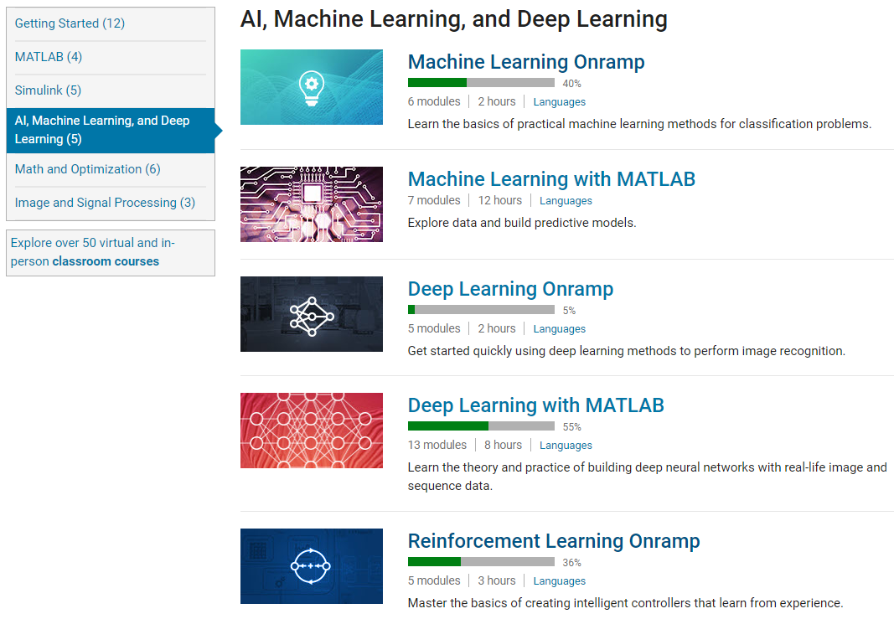
Self-paced Online Courses
“The interactive MATLAB tutorials were perfect for engaging students and getting them up to speed quickly.”
–Dr. Yu-li Wang, Carnegie Mellon University
Notes:
In addition to apps and interactive programming, using self-paced tutorials are a good way to guide students through their learning. Concepts that you teach in your courses may already be developed as a part of our self-paced tutorials. You can assign the entire course or sections of it. Each of the courses provides a certificate and you can verify which sections were completed. Many of these courses are offered in multiple languages.
The first 7 offerings are free courses that help the learner understand the basics of the particular topic. They typically take about 2-3 hours to complete. Many instructors assign the onramps as homework or a suggested refresher at the beginning of the course. This allows students to get the foundation they need to be successful in your course without taking valuable class time to review MATLAB.

Slide 19
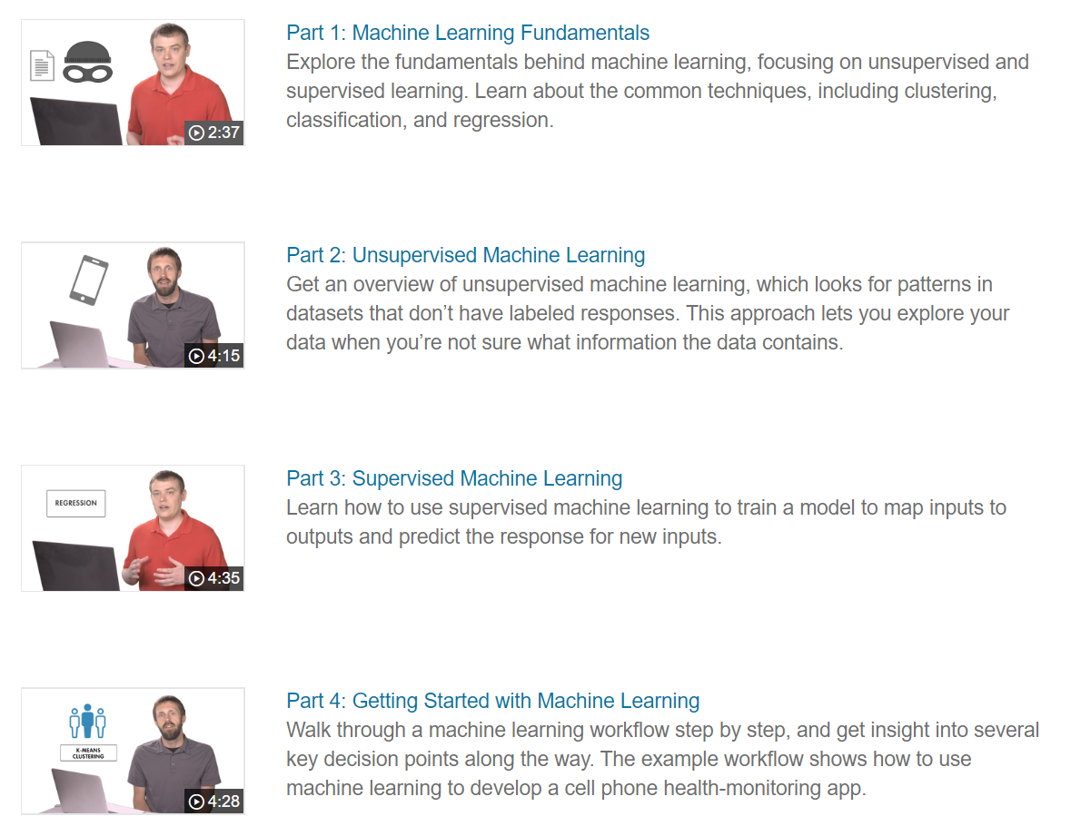
Resources
Overview
Cheat sheet
Introductory eBook
Mastering Machine Learning eBook
Machine Learning Tech Talks
Classification Learner App in your browser

Slide 20
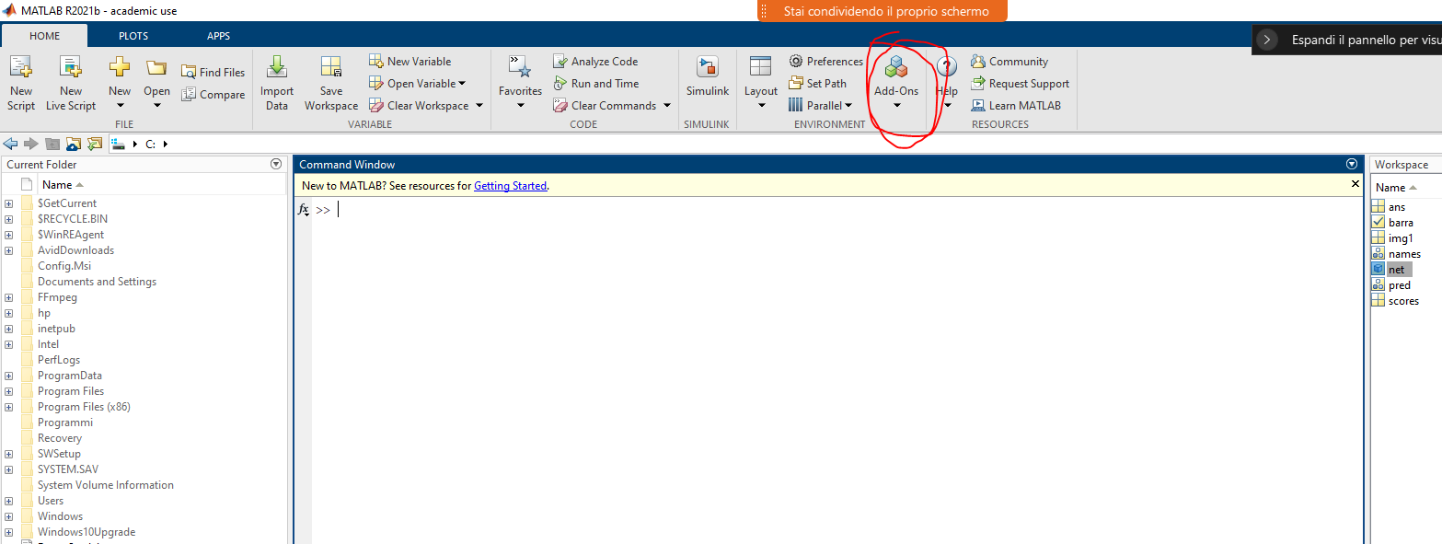
TO DO
Have you created the MATLAB account with the POLIMI credentials?
https://www.software.test.polimi.it/mathworks-matlab/
Open MATLAB
Open Simulink from the Home tab

Slide 21

Let’s start coding!
Visit this link to download the initial code:
https://github.com/simoomonte/Simscape-Onramp
Or scan the QR/code:

Slide 22
Before the quiz…
SPOLIER ALERT!
⚠️⚠️⚠️

Slide 23


Hack the Drone - MATLAB Hackathon
REGISTER HERE⤵️
https://matlab-hack-the-drone.devpost.com/
HACK THE DRONE – MATLAB HACKATHON
📆Friday, 29 May 2026
🕐13:00 – 18:00
Teams up to 4 participants
💸💸💸Cash prize for the winners
Gadgets for all participants
The competition is in parallel with UniBo, UniGe and UniPd

Slide 24

Feedback form…
SCAN THE QR CODE TO FILL THE FEEDBACK FORM
and then you can have access to the quiz!

Slide 25

…and now

Slide 26

Wooclap quiz
Go to wooclap.com
Enter the code: DOJDUN
Or scan this QR CODE:

Slide 27


Thank you for your attention! Questions?
A special thanks to
Associazione degli Ingegneri Matematici (AIM)
STAY UPDATED!

