Slide 1
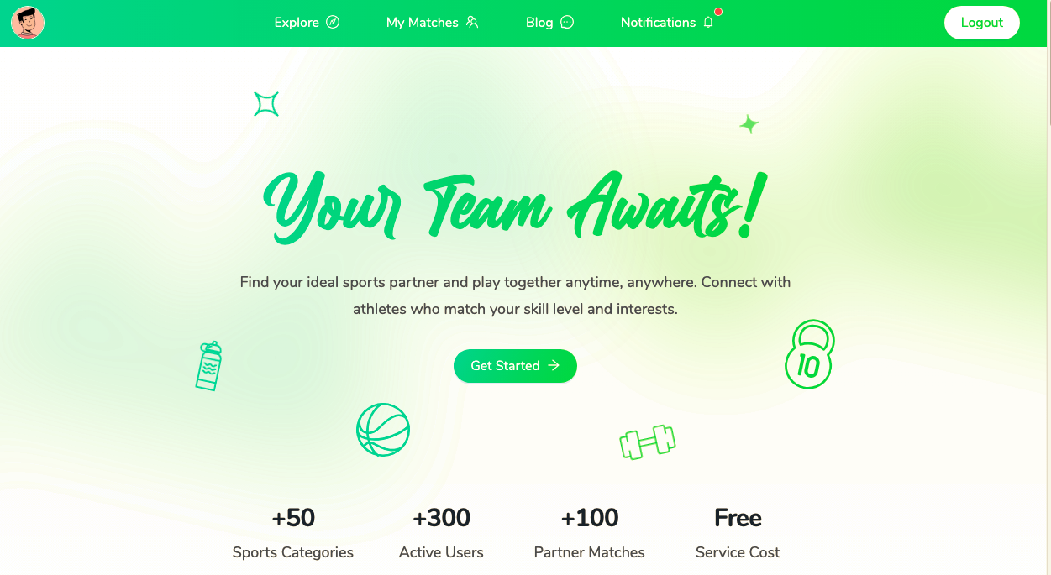
SportLink Portfolio Project Presentation
Developed & presented by :
Seifeddine Aaza, Mohamed Mahla
Date : 20-09-2024

Slide 2
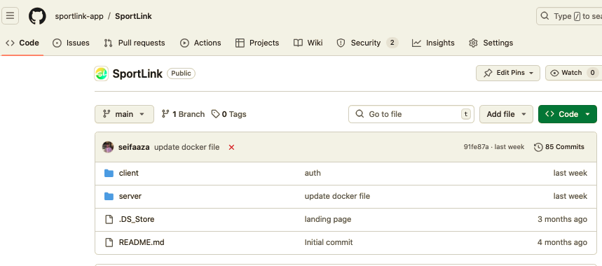
Public GitHub Repository
You can find the full source code for the project at:
https://github.com/sportlink-app/SportLink

Slide 3
SportLink Overview
SportLink is a platform designed to help athletes connect and organize street games.
Users can sign up, create profiles, and manage availability.
Explore incomplete teams, create or join teams, and receive notifications.
Post articles in the blog section and check top creators.

Slide 4
Problem Statement
Athletes face difficulties in finding teammates for casual or street games.
Traditional social networks don't provide features specific to athletes' needs.
SportLink fills this gap by providing a platform tailored to organizing and joining local games.

Slide 5
Solution
A platform that allows athletes to connect, manage availability, and create or join teams.
Personalized notifications for joining teams and completing teams.
A blog feature to engage users and highlight top creators.

Slide 6
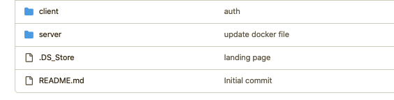
Directory Structure:

Slide 7
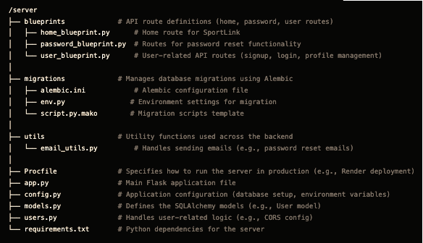
Server-Side Architecture

Slide 8
Technologies Used (Server)
Flask: The web framework used to build the backend.
SQLAlchemy: ORM for database management.
Flask-Migrate: For handling database migrations with Alembic.
Gunicorn: WSGI HTTP server for production deployment.
Psycopg2: PostgreSQL database adapter.

Slide 9
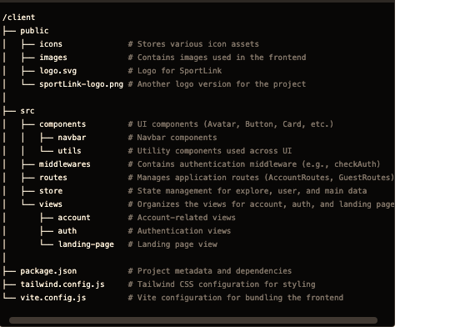
Client-Side Architecture

Slide 10
API Development
RESTful APIs for handling user management (signup, login, profile).
JWT authentication for secure access to the API.
Notifications API for sending and receiving notifications about team events.

Slide 11
Technologies Used (Client)
React: Used for building the frontend user interface.
Vite: A fast build tool for bundling the frontend.
Zustand: Lightweight state management for React.
Axios: For handling HTTP requests to the server API.
TailwindCSS: Utility-first CSS framework for fast styling.

Slide 12
Report of developments

Slide 13
Successes
Full API Development: Implemented APIs for signup, login, user profiles, and notifications.
JWT Authentication: Secure authentication and session management.
Error Handling: Implemented detailed error messages for sign-up and login.
Deployment: Successfully deployed both the client and server on Render(just first version).

Slide 14
Challenges
Deployment Issues: Faced challenges with database migrations on Render.
State Management: Handling user profile states across different routes.
Token Management: Ensuring proper JWT token usage and validation across routes.

Slide 15
Areas for Improvement
Better Error Handling: Improve user feedback with specific error messages for various conditions.
Pagination: Add pagination to handle large datasets in user search and teams.
Security Enhancements: Implement rate-limiting and better input validation to prevent abuse.

Slide 16
Lessons Learned
Importance of Clear Version Control: Effective collaboration with GitHub.
Managing State: Learned the challenges of managing user states between frontend and backend.
Deployment Experience: Gained insight into deploying apps on cloud platforms and handling database migrations.

Slide 17
Next Steps
Caching: Implement Redis for session management.
Unit Testing: Add unit tests for key functionalities and API endpoints.
Monitoring: Set up Datadog for performance monitoring and error tracking.
User Feedback: Gather feedback from users and improve the user experience.

Slide 18
Conclusion
SportLink provides a complete solution for connecting athletes and organizing street games.
The project showcases the use of modern technologies like React, Flask, SQLAlchemy, and JWT.
Next steps: Improve user experience, add more sports-related features, and scale the platform.

