Slide 1
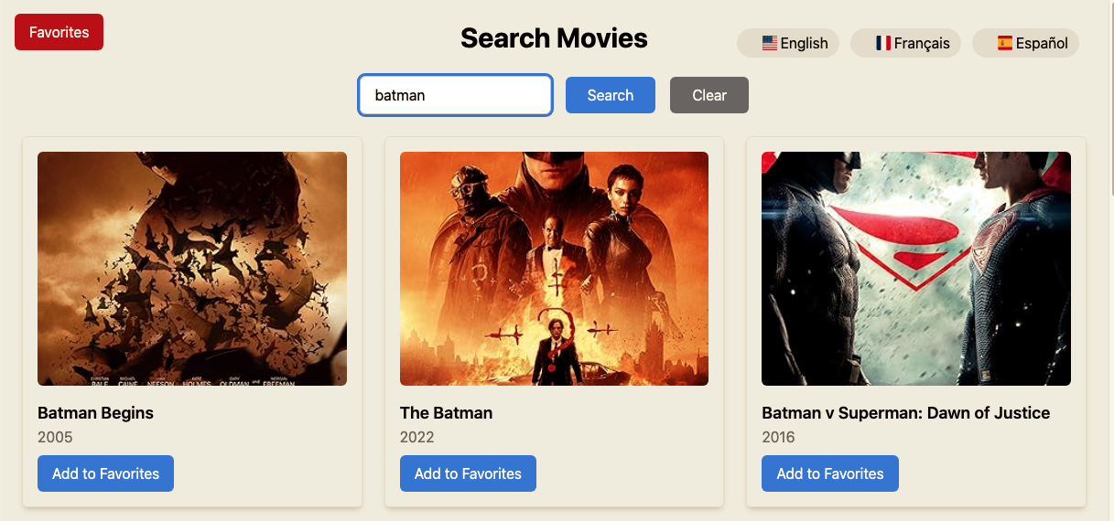
Movie-Database Capstone Project Presentation
Developed & presented by :
Mohamed Mahla
Date : 14-01-2025

Slide 2
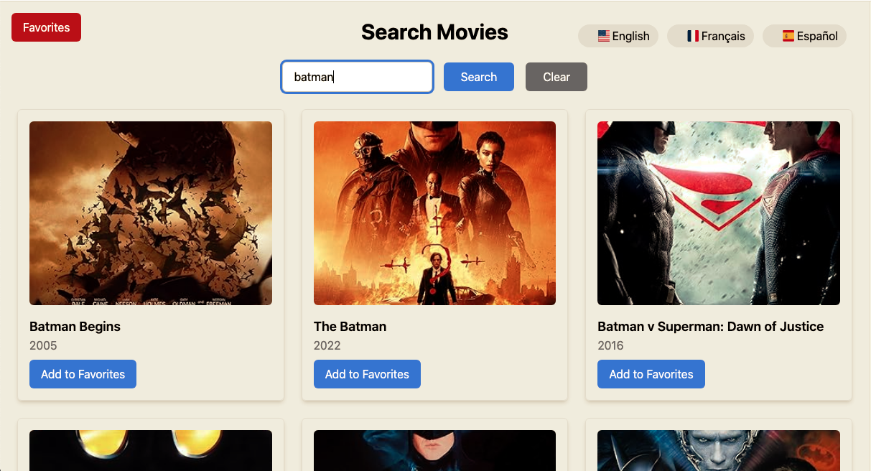
Movie-Database Capstone Project Presentation
Developed & presented by :
Mohamed Mahla
Date : 14-01-2025

Slide 3
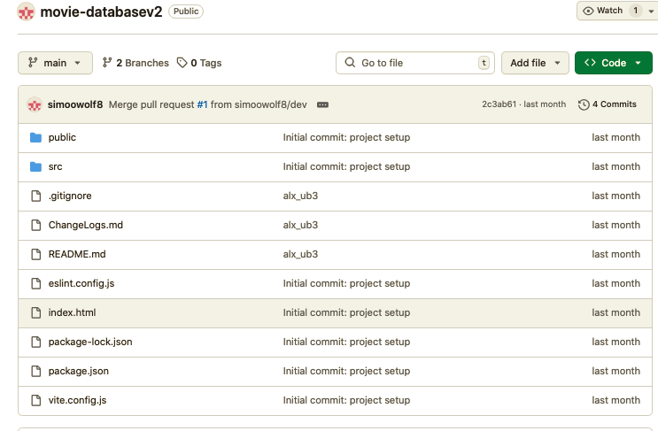
Public GitHub Repository
You can find the full source code for the project at:
https://github.com/simoowolf8/movie-databasev2

Slide 4
Movie-Database Overview
Movie-Database is an application designed to help users search, explore, and manage movie collections.
Users can:
Search movies using titles and view detailed information.
Add or remove movies from their favorites.
Switch between languages (English, French, Spanish).
The app includes:
Pagination for browsing results efficiently.
A dedicated favorites section to manage saved movies.
A good user experience.

Slide 5
Problem Statement
Movie enthusiasts struggle to find a convenient platform to:Search for movies and access detailed information.
Save their favorite movies for later reference.
Navigate a user-friendly interface with localized language support.
Existing platforms may lack customization options such as:Multilingual support.
Pagination for better browsing.
Dedicated sections for managing favorite movies.

Slide 6
Solution
A user-friendly movie database platform that provides:
Efficient movie search with detailed information.
Ability to save favorite movies for future reference.
Support for multiple languages (English, French, Spanish).
Enhanced User Experience:
Pagination for smooth browsing of search results.
Localized content for diverse audiences.
Dark and light mode for better accessibility.
Modern Features:
Integration with React Helmet and OpenGraph tags for improved SEO.
Social sharing buttons for movie promotion.
Favorites management with localStorage or database integration.

Slide 7
Directory Structure:

Slide 8
Directory Architecture
src Folder:
components:
Favorites.jsx: Handles displaying and managing the user's favorite movies.
LanguageSelector.jsx: Allows users to switch between different languages.
MovieDetails.jsx: Shows detailed information about a selected movie.
SearchBar.jsx: Contains the search input and clear functionality.
locales:
en.json, es.json, fr.json: JSON files for internationalization, storing translations for English, Spanish, and French.
services:
movieService.js: Handles API requests to fetch movie data and details.
App.jsx: Main application file with the movie search and favorites functionality.
main.jsx: Entry point of the application for rendering components.
i18n.js: Configures the i18n library for translations.

Slide 9
Directory Architecture
Public Folder:
flags: Contains flag images for different languages.
placeholder-image.jpg: A fallback image for movies without posters.
Other Files:
.env:
Contains environment variables (e.g., API keys, sensitive information).
.gitignore:Specifies files and directories that should be ignored by Git.
package-lock.json and package.json:
package.json: Lists project dependencies, scripts, and metadata.
package-lock.json: Ensures consistent dependency versions across environments.
postcss.config.cjs:
Configures PostCSS for processing CSS files (e.g., autoprefixing, optimizations).
tailwind.config.js:
Configures Tailwind CSS for custom styles and themes.
vite.config.js:
Configures Vite, your project's bundler and development server.

Slide 10
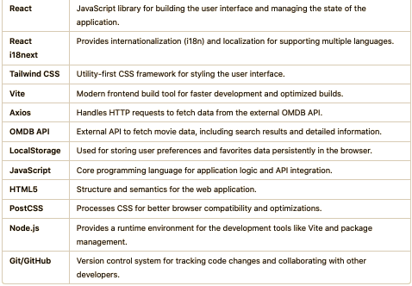
Technologies Used

Slide 11
APIs
OMDB API Purpose: Fetches movie data, including:
Search results based on user queries.
Detailed information about individual movies (title, year, genre, actors, plot, poster, etc.).
Implementation: Used with Axios to send HTTP requests and retrieve data.
Endpoint Example: https://www.omdbapi.com/?apikey=YOUR_API_KEY&s=movie_title for search queries.

Slide 12
Report of developments

Slide 13
Successes
Successes
API Integration: Successfully implemented OMDB API to fetch movie data, search results, and detailed information.
Favorites Feature: Added a favorites list stored locally, with plans for backend integration.
Internationalization (i18n): Supported multiple languages (English, French, Spanish) with translations for UI components.
Pagination: Implemented pagination for seamless navigation through search results.
Error Handling: Designed meaningful error messages for no results and API issues.
Responsive Design: Created a responsive UI adaptable to various screen sizes.

Slide 14
Challenges
Limited API Data: The OMDB API only provided 10 results per page, requiring extra handling for pagination and navigation.
Language Integration: Ensuring seamless switching between multiple languages for all UI elements and features.
Favorites Synchronization: No backend integration yet for persisting user favorites across devices.
Error Handling Complexity: Managing edge cases like invalid API responses or network failures.
SEO Optimization: Incorporating tools like React Helmet and OpenGraph tags for better discoverability.

Slide 15
Areas for Improvement
Deployment
User Authentication: Add a secure login system to provide personalized experiences, such as managing user profiles and syncing favorites.
Database Integration: Implement a backend database (e.g., MongoDB) to store user preferences, favorites, and movie data for better persistence.
Advanced Search Features: Include filters and sorting options like genres, ratings, and release years for enhanced searchability.
Performance Optimization: Leverage lazy loading for images and components to improve application speed and responsiveness.
Mobile Responsiveness: Ensure seamless usability across various screen sizes, including smartphones and tablets.
Enhanced SEO: Use React Helmet and OpenGraph tags for better search engine discoverability and sharing.

Slide 16
Thank You Alx

