Slide 1
HOME ZONE ANALYZER
Rinaldi Simone
Desiati Valerio

Slide 2
Purpose
Home Zone Analyer Building Process:
Choice of library to manage frontend (Leaflet)
Retrieve PoI(Point of interests) datasets from https://opendata.comune.bologna.it
Architecture Choice(PERN STACK)
Virtualization Through Docker & Kubernetis
Example of usage
Survey
Mapbox Isochrone API
Filtering PoI
Polygon Area Apartments Search

Slide 3

Leaflet
Purpose:
Leaflet is an open-source JavaScript library designed for interactive, mobile-friendly maps.
Features:
Basic Features: Supports panning, zooming, and map layers.
Markers and Popups: Allows adding custom markers and popups to the map.
GeoJSON: Can easily integrate with GeoJSON data to display geographic data.
Tile Layers: Supports various tile layers, including those from OpenStreetMap, Google Maps, and custom tiles.
Plugins: A wide range of plugins are available to extend its functionality (e.g., heatmaps, routing).

Slide 4
Point of Interests
Theaters and cinemas
Green Areas
Sports areas
Ludics Areas
Bus Stops
Hospitals
Pharmacies
Bike Racks
Libraries
Electric stations
Schools

Slide 5
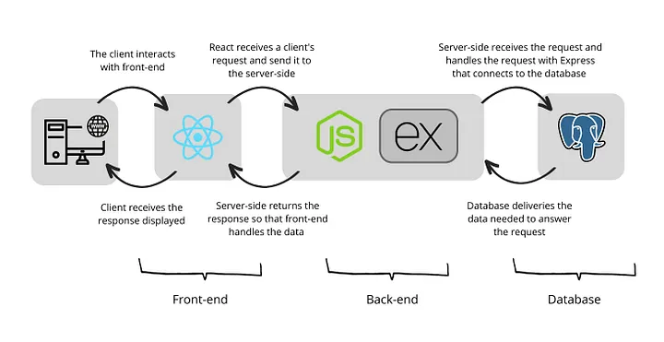
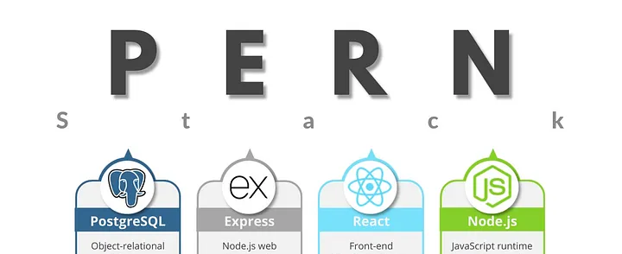
PERN STACK
Architecture:
Frontend → React
Backend → Python/NodeJS
Database → PostgreSQL + postgis

Slide 6


Virtualization
Docker Images Creation
Frontend Image
Backend(js) Image
Backend(python) image
DB system image
Kubernetis manifest
Creation of Deployments and services for each docker image

Slide 7
Example of usage

Slide 8
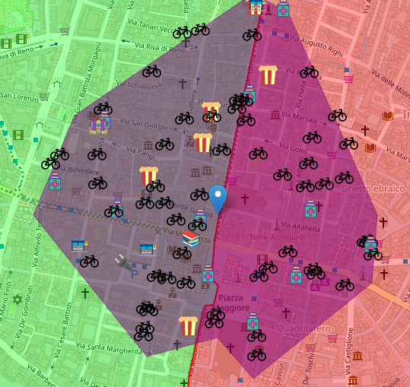

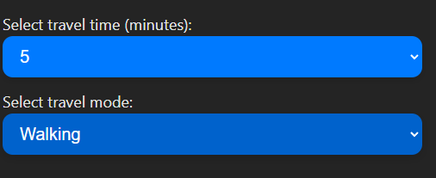
Isochrone API
Mapbox
Access Token
Fast and easy access
POST request through axios(React library)
Return a polygon given:
Time travel
Travel mode
Coordinate position

Slide 9
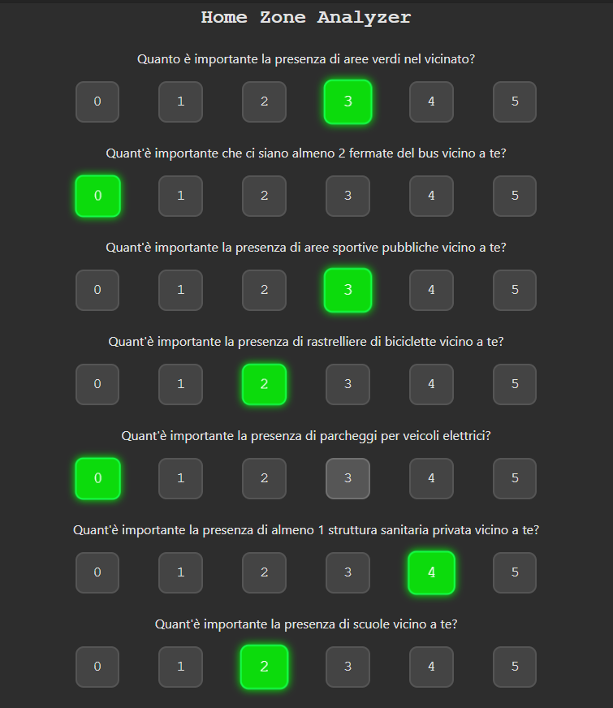
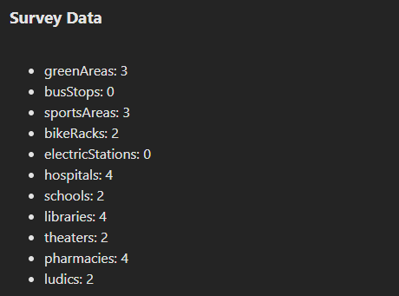
Survey
Some questions about PoI
Rendering of react Map component after survey sent
Priority level from 0 to 5
On Map component are showed the evaluation.
DB table for priority marks

