Slide 1
Systems Analysis & Design
6K:183
Methodologies

Slide 2
SDLC vs. Methodologies
SDLC
A stage all systems naturally undergo
Methodology
An approach invented by humans to manage events naturally occurring in the SDLC
A formalized approach to implementing the SDLC
Series of steps and deliverables
Frequently, SDLC is used synonymously with the waterfall or traditional methodology.
This is not correct. They are two different things.

Slide 3
The Systems Development Life Cycle
Idea
Planning
Analysis
Design
System
Implementation

Slide 4
SDLC and Deliverables
Artifacts
Process
Product
System Request
Feasibility Analysis
Workplan
System Proposal
System
Specification
New System and
Maintenance Plan
Planning
Analysis
Design
Implementation

Slide 5
Players in the Process
Systems Analyst
Focuses on the IS issues surrounding the system.
How can IT improve business processes
Helps design new business processes
Ensures all IT standards are maintained

Slide 6
Players in the Process
Business Analyst
Focuses on the business issues surrounding the system.
Identifies business value that the system will create.
Develops ideas for improving business processes
Designs new business processes and policies.

Slide 7
Players in the Process
Infrastructure Analyst
Focuses on technical issues surrounding how the system will interact with existing IT infrastructure
Hardware, software, network, databases, security

Slide 8
Players in the Process
Change Management Analyst
Focuses on the people and management issues
Documentation, support, training
PR (overcoming resistance to change)
Expertise in organizational behavior and change management

Slide 9
Players in the Process
Project Manager
Highly experienced systems analyst
Manages the hundreds of tasks and roles involved in the creation of the new system
Ensures the project is completed
On time
Within budget
Providing the expected benefit to the organization

Slide 10
Players in the Process
Project Sponsor
See the need for change and have the authority to make it happen
Accountability
Strategic Fit
Funding & resources
Ultimately owns the final product

Slide 11
Predominant Methodologies
Waterfall
RAD
Agile

Slide 12
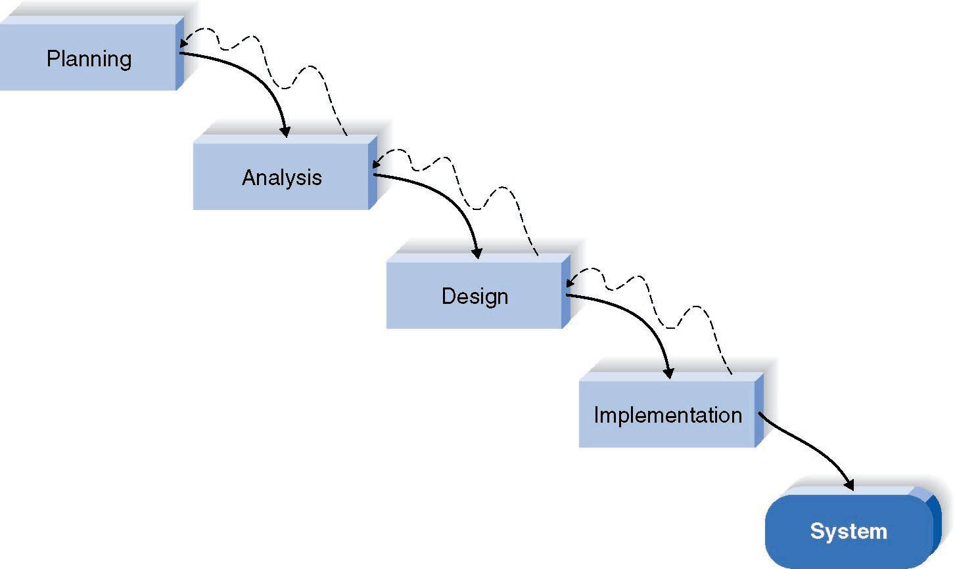
Waterfall Method
Traditional

Slide 13
Waterfall
Analysts and users proceed sequentially from one phase to the next.
Key deliverables are often hundreds of pages.
All deliverables presented to approval committee and project sponsor for approval as it moves phases.
Suited to large projects with long development cycles.

Slide 14
Waterfall Benefits
Identifies requirements long before programming begins and limits changes as the project proceeds.
Explicit guidelines allow the use of less experienced staff.
All steps clearly outlined.
Reliance on individual expertise reduced.
Training of junior staff
All projects run similar

Slide 15
Waterfall Benefits
Promotes consistency among projects.
Reduced cost for ongoing support.
Staff can be transferred among projects.
Extensive documentation simplifies ongoing maintenance.
Less reliance on original developers to explain modules, functions, etc.

Slide 16
Waterfall Disadvantages
Design must be completely specified before programming begins.
It can be difficult for customers to identify all requirements early on.
Important requirements may be overlooked in the volumes of deliverables.
Very expensive and time consuming if an important requirement.

Slide 17
Waterfall Disadvantages
Long time lapse between completion of system proposal in the analysis phase and delivery of a system.
Forget intend purpose.
Dynamic environment
Systems that met conditions originally may need re-worked to meet current conditions
Testing treated as an afterthought in the implementation phase.

Slide 18
Waterfall Disadvantages
Customer is only involved periodically rather than being an active participant.
misunderstandings – on both sides.
Infrequent communication and long time lapse increases probability that system will be off track when it is delivered.
Integration is one big bang!

Slide 19
Parallel Development Variant
Reduces time required to deliver a system
so business environment changes less
likely to cause rework.
General design for entire system
Divided into sub-projects that can be completed a the same time.
Final integration of the separate projects
System is delivered.

Slide 20
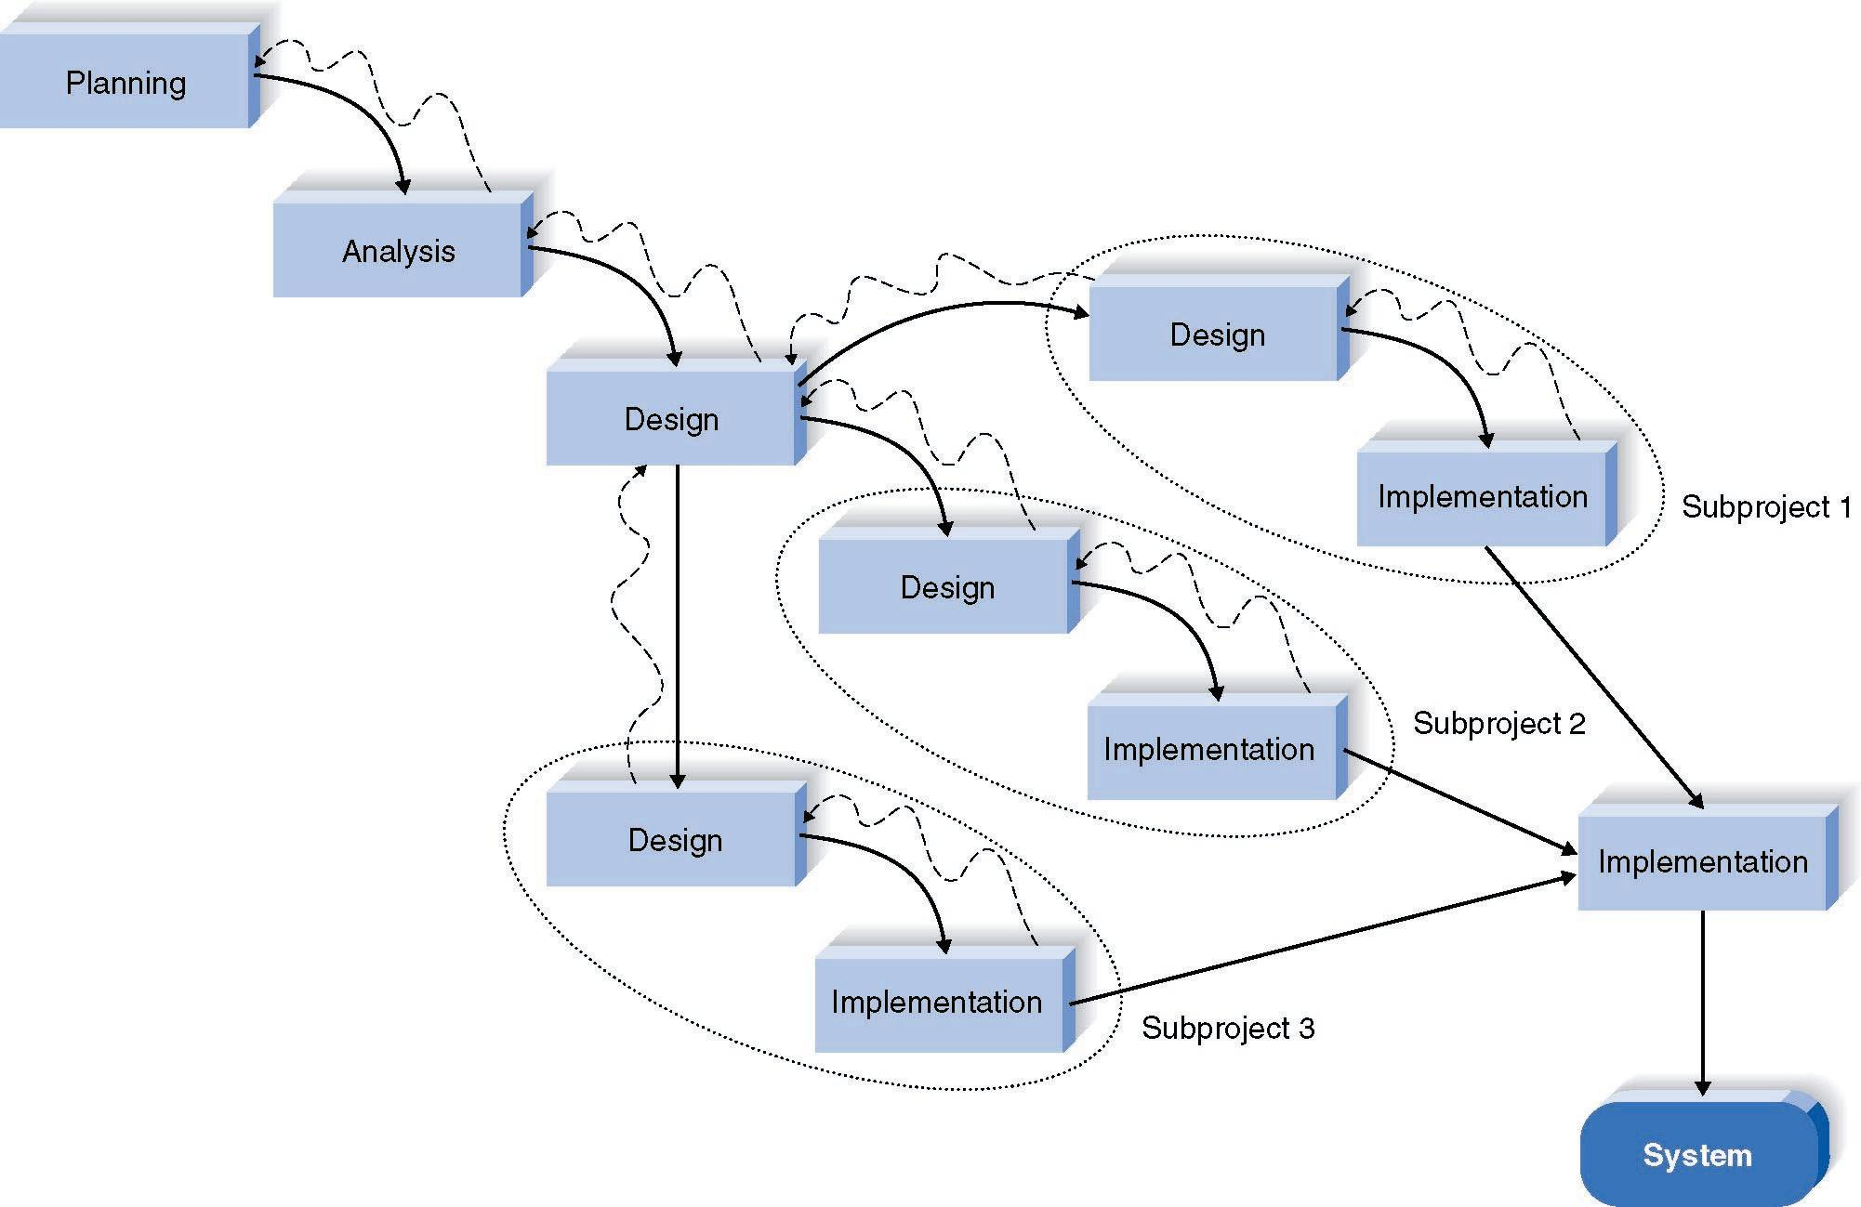
Parallel Development Methodology

Slide 21
Parallel Disadvantages
Voluminous deliverables
Sub-projects need to be completely independent.
Design decisions on one sub-project may affect another.
Final integration can be challenging.

Slide 22
V Model Variant
As requirements are specified and components designed, testing for those elements is also defined.
High quality, relevant testing.

Slide 23
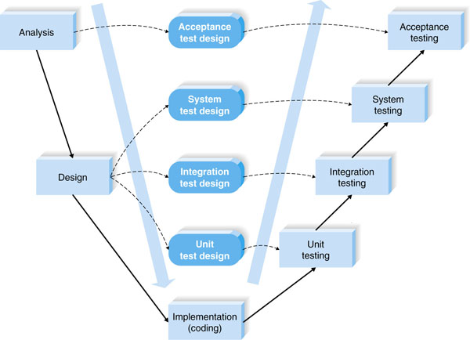
V Model Methodology

Slide 24
V Model Disadvantages
Suffers from rigidity of waterfall process.
Even more deliverables.
Long timeline can affect the dynamic nature of the business.

Slide 25
Rapid Application Development
Emerged in response to Waterfall and variant weaknesses.
uses minimal planning in favor of rapid prototyping. The "planning" of software developed using RAD is interleaved with writing the software itself. The lack of extensive pre-planning generally allows software to be written much faster, and makes it easier to change requirements.
may entail compromises in functionality and performance in exchange for enabling faster development and facilitating application maintenance.
http://en.wikipedia.org/wiki/Rapid_application_development

Slide 26
RAD Benefits
Improved speed
Improved quality
Faster evaluation and feedback

Slide 27
RAD Disadvantages
User expectation may dramatically increase
System requirements may increase
Scope creep or Feature creep

Slide 28
RAD Iterative Development
Project broken into a series of “versions”.
Versions developed sequentially.
Most important and fundamental functionality in first version.
Quickly developed by mini-waterfall process.
User feedback incorporated into the next version.

Slide 29
RAD Iterative
Gets preliminary version of the system to users quickly – adds business value quickly.
Users work with an intentionally incomplete system.
Users must wait for subsequent versions for more functionality.
Users must tolerate version upgrades.

Slide 30
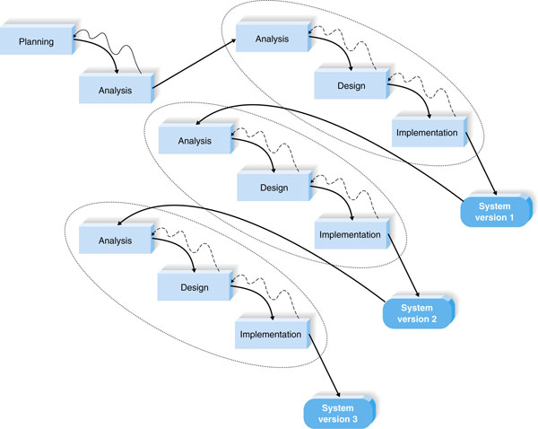
RAD Iterative Development

Slide 31
RAD System Prototyping
Perform the analysis, design, and implementation phases concurrently.
Quick & dirty
Minimal features
Second prototype
Based on user feedback + some additional features
Process continues until analysts, users, and sponsors agree there is enough functionality to be installed and used.

Slide 32
RAD System Prototyping
Quickly provides system for users to evaluate.
Assures users that progress is being made
Useful when users have difficulty expressing requirements.
Lack of careful, methodical analysis before decisions.
Prototypes have some fundamental limitations due to lack of understanding requirements.

Slide 33
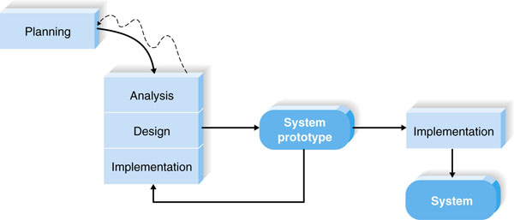
RAD System Prototyping

Slide 34
RAD Throwaway Prototyping
Prototypes are used to explore design alternatives rather than as the actual new system.
Longer analysis phase.
Features may not be well documented or understood or challenging technical issues
Issues examined by analyzing, designing and building a design prototype.
Not a working system, just enough features to enable users to understand the issues.

Slide 35
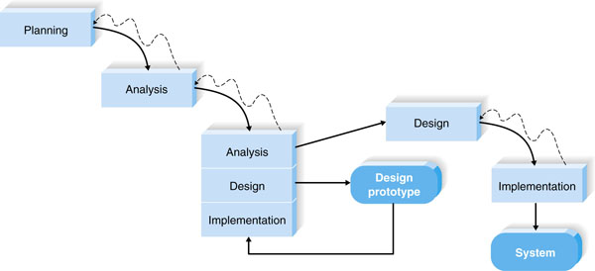
RAD Throwaway Prototyping

Slide 36
RAD Throwaway Prototyping
Once the issues are resolved, the project moves to more deliberate design and implementation phases.
Prototypes are “thrown away”
Takes longer because prototypes are not the basis for the system.
Produces more stable and reliable systems.

