Slide 1

Using Conky to monitor your homelab
Simon Lees
Simotek
sflees@suse.de
Simotek on Discord / libera.chat
@simotek_dot_net
http://simotek.net

Slide 2
About Me
From Adelaide Australia
Using Linux since 2003
Using openSUSE since 2011
openSUSE Contributor for 10 years
Worked at SUSE for 6 years
Notes:
I’ve always enjoyed customising
First remember windows 95 or 98 adding html to my home directory
The ability to customize everything has always been something that's attracted me to Linux.
Started modifying themes 10 years ago
This has always lead me to think about User Interfaces as a modern form of art. Which in part is what has lead to this talk.

Slide 3
Inspiration
Notes:
Will be a thread through this talk

Slide 4
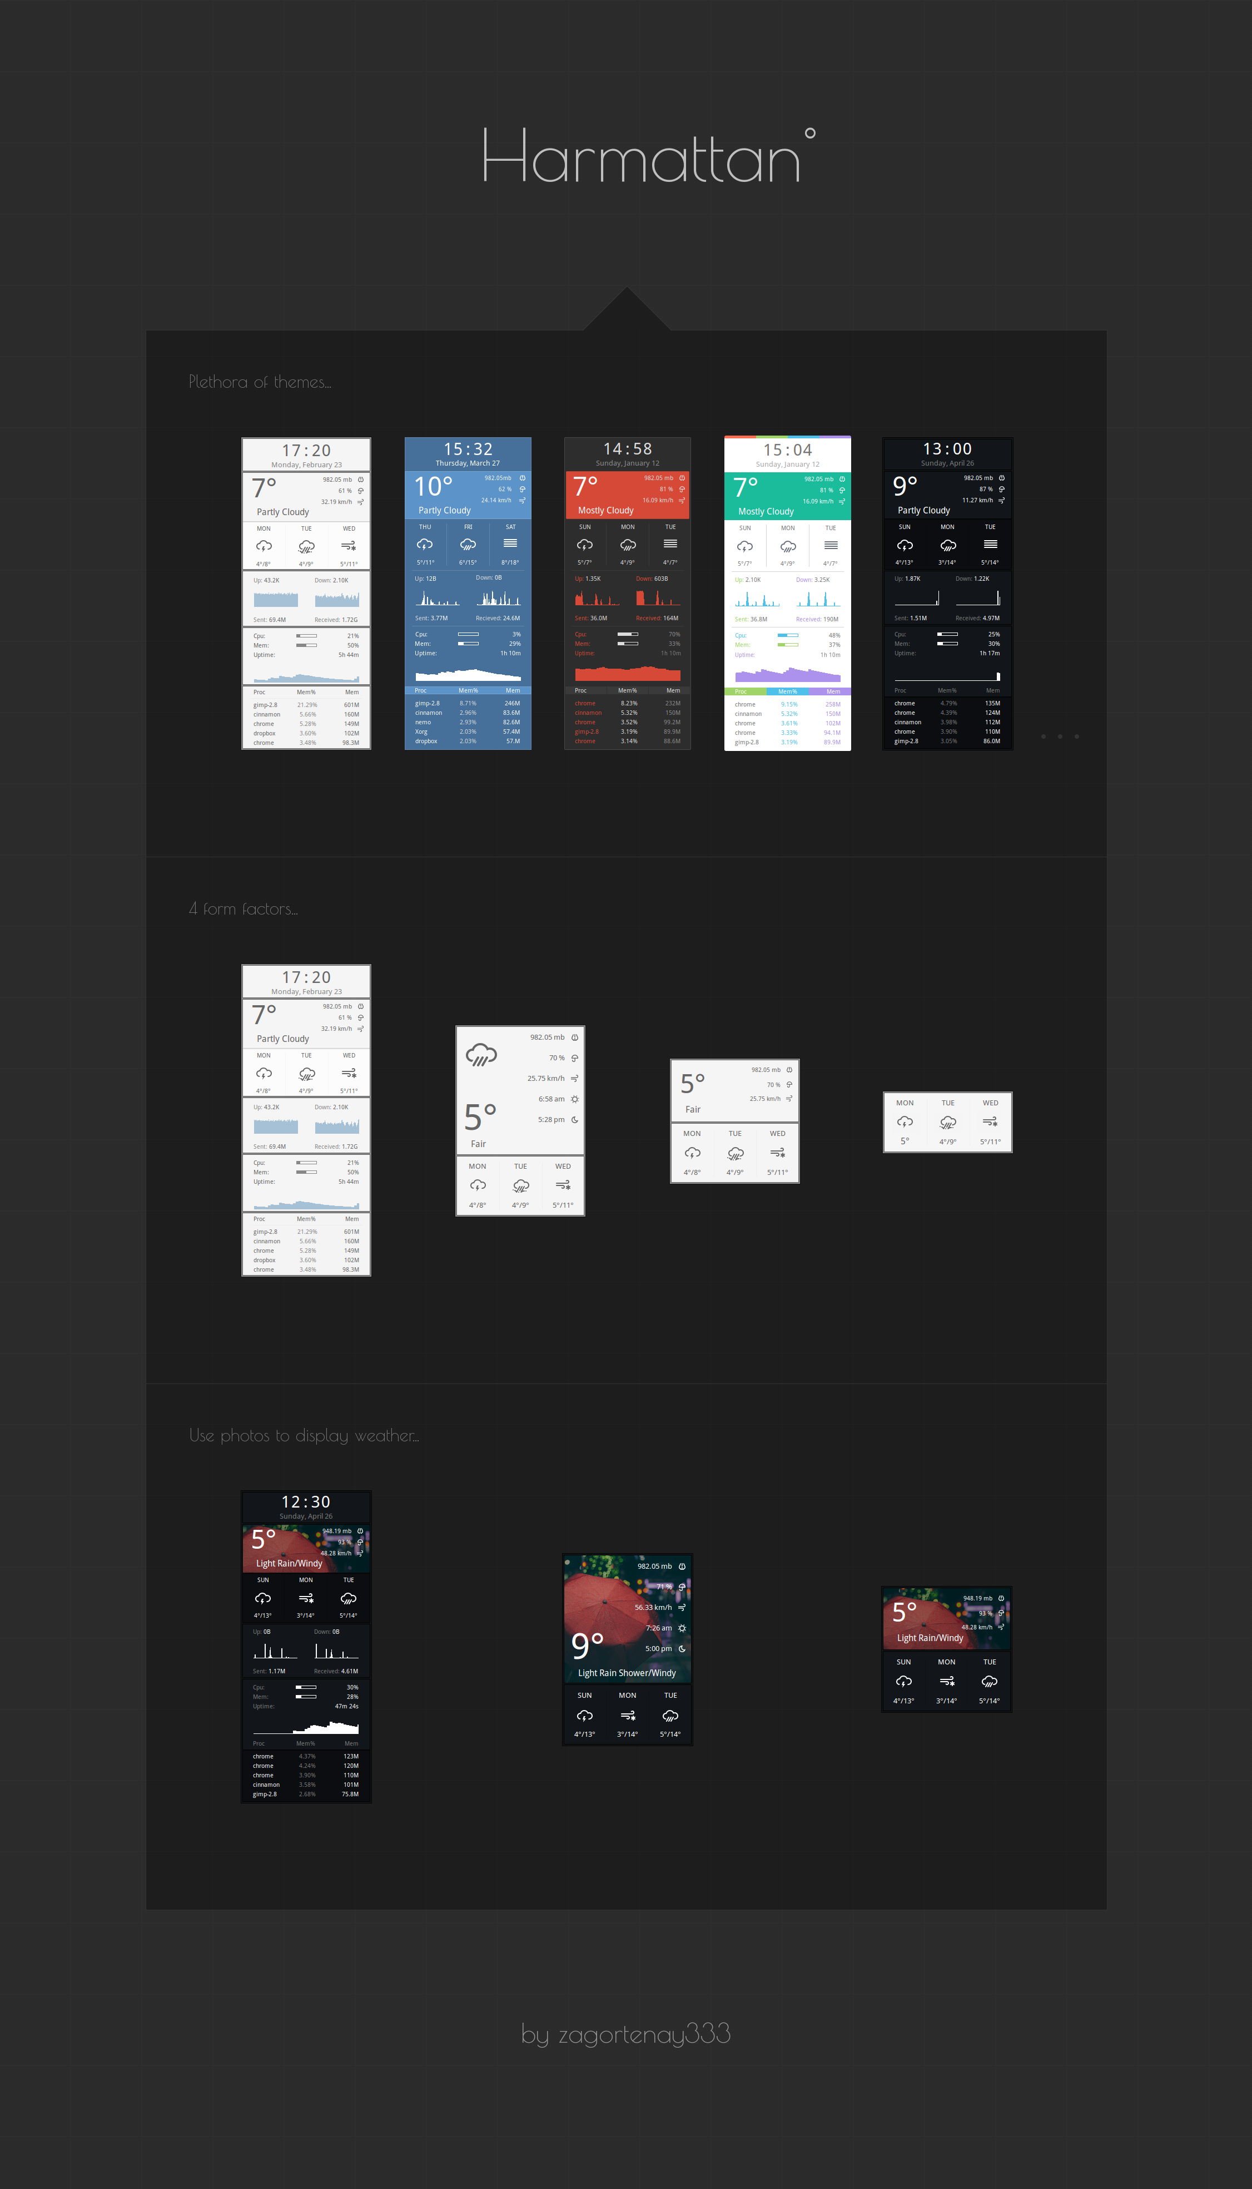
https://github.com/zagortenay333/conky_themes/tree/master/conky_harmattan
Notes:
Siggraph
80’s graphics demo groups
Comodore 64 demo - https://www.youtube.com/watch?v=Jx2w9Wd4g4Q
These weren’t really interactive user interfaces yet so for the purpose of time I’ll skip over them in this talk
Raster Video game UI

Slide 5
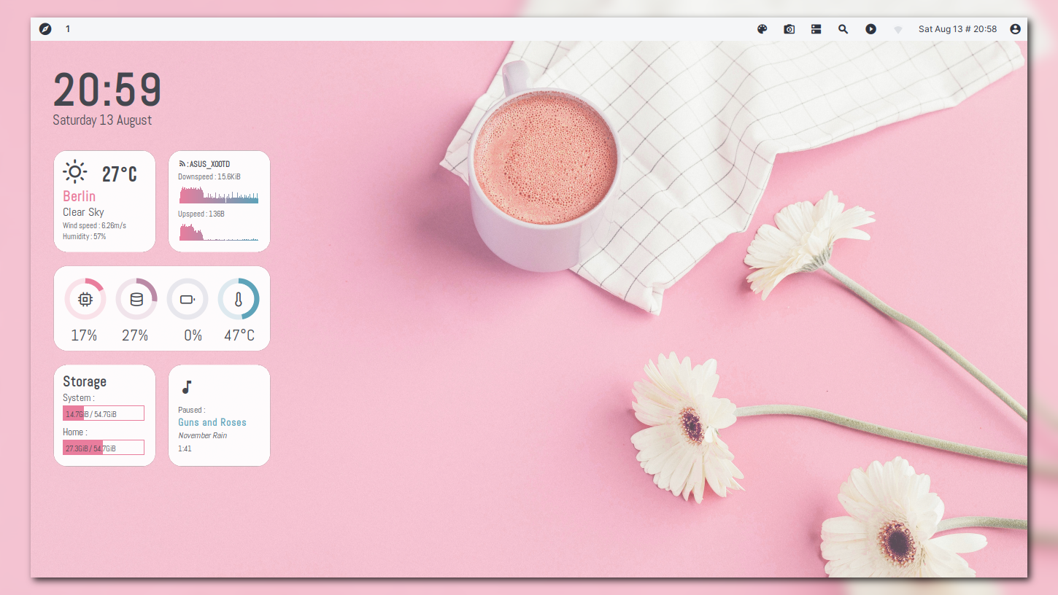
https://github.com/closebox73/Leonis
Notes:
Siggraph
80’s graphics demo groups
Comodore 64 demo - https://www.youtube.com/watch?v=Jx2w9Wd4g4Q
These weren’t really interactive user interfaces yet so for the purpose of time I’ll skip over them in this talk
Raster Video game UI

Slide 6
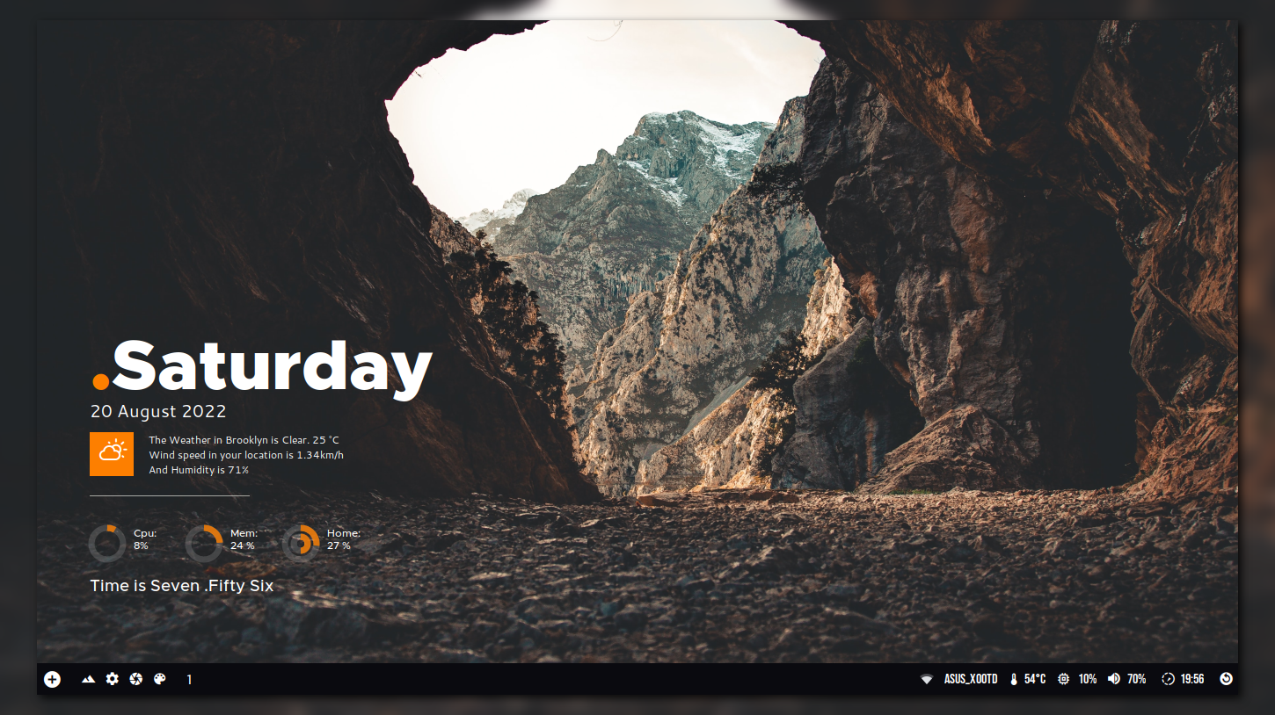
https://github.com/closebox73/Scorpio
Notes:
Siggraph
80’s graphics demo groups
Comodore 64 demo - https://www.youtube.com/watch?v=Jx2w9Wd4g4Q
These weren’t really interactive user interfaces yet so for the purpose of time I’ll skip over them in this talk
Raster Video game UI

Slide 7
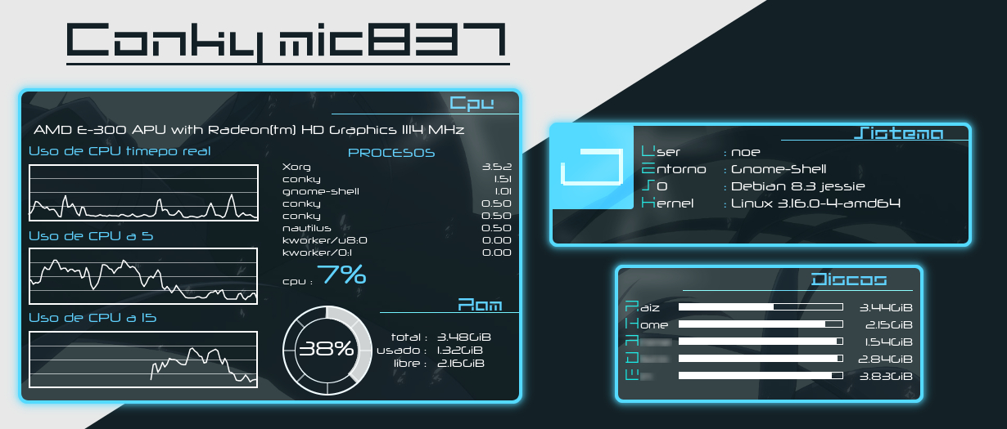
https://www.deviantart.com/xnoex011/art/Conky-mic837-597448454
Notes:
Siggraph
80’s graphics demo groups
Comodore 64 demo - https://www.youtube.com/watch?v=Jx2w9Wd4g4Q
These weren’t really interactive user interfaces yet so for the purpose of time I’ll skip over them in this talk
Raster Video game UI

Slide 8
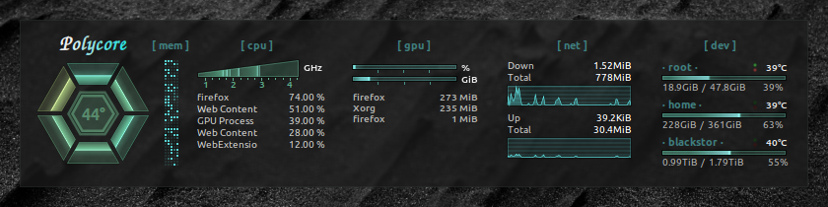
https://github.com/philer/polycore
Notes:
Siggraph
80’s graphics demo groups
Comodore 64 demo - https://www.youtube.com/watch?v=Jx2w9Wd4g4Q
These weren’t really interactive user interfaces yet so for the purpose of time I’ll skip over them in this talk
Raster Video game UI

Slide 9
The Basics
Notes:
Siggraph
80’s graphics demo groups
Comodore 64 demo - https://www.youtube.com/watch?v=Jx2w9Wd4g4Q
These weren’t really interactive user interfaces yet so for the purpose of time I’ll skip over them in this talk
Raster Video game UI

Slide 10
Three Ways to Render
Text Wildcards
  replaces wildcards such as `${cpu}` or `${memperc}` alongside some basic positioning strings
Static images
  Imlib2
Lua Scripting
  Uses Cairo for drawing
Notes:
23ozGlass
FinalE
E13
Inferno
Fools of Machines
BS-E
Neuromancer2
Aqua

Slide 11
Config files
Config files are valid lua syntax
`conky.config = { };`
`conky.text = [[ ]];`
/etc/conky/conky.conf
You can use different config files with -c
Notes:
23ozGlass
FinalE
E13
Inferno
Fools of Machines
BS-E
Neuromancer2
Aqua

Slide 12
Variables
${top_mem name 1} ${top_mem pid 1}
${if_existing /proc/net/route eth0}${else} ${endif}
http://conky.sourceforge.net/variables.html
Notes:
23ozGlass
FinalE
E13
Inferno
Fools of Machines
BS-E
Neuromancer2
Aqua

Slide 13
Variables
${exec /usr/bin/command} – execute a command
${execi N /usr/bin/command} – execute a command every N seconds
${texeci N /usr/bin/command} – execute a command every N seconds in a separate thread
${texeci 36000 wget http://ipinfo.io/ip -qO - | tail} - Get Your public Ip Address
Notes:
23ozGlass
FinalE
E13
Inferno
Fools of Machines
BS-E
Neuromancer2
Aqua

Slide 14
Using Conky Remotely
Notes:
Siggraph
80’s graphics demo groups
Comodore 64 demo - https://www.youtube.com/watch?v=Jx2w9Wd4g4Q
These weren’t really interactive user interfaces yet so for the purpose of time I’ll skip over them in this talk
Raster Video game UI

Slide 15
From the command line
conky-cli package on its way
-c [conf] - specify config
-t [text] – specify a text string
-i [n] - only run n times.

Slide 16
Command line - Examples
conky -c conky_console.conf -t '${top name 1} ${top_mem name 1} ${top_io name 1}'
conky -c conky_console.conf -t 'cpu:${cpubar 4} mem: ${membar 4} swap: ${swapbar 4} disk: ${fs_bar 6/}'
conky -c conky_console.conf -i 1 -t '$cpu $freq_g $mem/$memmax '

Slide 17
Command Line Config
conky_console.conf
> conky.config = {
> out_to_x = false,
> out_to_console = true,
> background = false,
> cpu_avg_samples = 2,
> net_avg_samples = 2,
> no_buffers = true,
> out_to_stderr = false,
> update_interval = 1.0,
> uppercase = false,
> use_spacer = 'none',
> };
>
> conky.text = [[ ]];

Slide 18
Using ssh for remote monitoring
${texeci 10 ssh 172.16.0.101 1 -c /home/simon/.conky/conky_console.conf -t '$cpu $freq_g $mem/$memmax'}
It would be nice if this worked but in reality the amount of things that need escaping really just make it one big headache.

Slide 19
Using ssh for remote monitoring
${texeci 10 ~/.conky/ConkyBar/scripts/remote_status.sh 172.16.0.101}
remote_status.sh
> #!/bin/bash
> ssh $1 conky -i 1 -c /home/simon/.conky/conky_console.conf -t \'\$cpu \$freq_g \$mem/\$memmax\'

Slide 20
Using ssh for remote monitoring
This is simple
It works
Is opening and destroying an ssh connection once a second the most efficient way of monitoring a remote machine
probably not

Slide 21
Websockets
Notes:
Siggraph
80’s graphics demo groups
Comodore 64 demo - https://www.youtube.com/watch?v=Jx2w9Wd4g4Q
These weren’t really interactive user interfaces yet so for the purpose of time I’ll skip over them in this talk
Raster Video game UI

Slide 22
Why Websockets
Simple
Library support for most languages
Easy to intergrate into webpages and other tools

Slide 23
Server - Websocketd
Go application
Reads and Writes standard in / out to a websocket.
websocketd conky -i 1 -c /home/simon/.conky/conky_console.conf -t \'\$cpu \$freq_g \$mem/\$memmax\'
http://websocketd.com/

Slide 24
Client - Javascript
Javascript allows you to dynamically update html elements
https://www.w3schools.com/js/js_htmldom_html.asp
If you have a monitoring dashboard it might be simple to integrate conky this way

Slide 25
Conky and Lua
Conky can run lua scripts
Usually this is paired with cairo to draw pretty things
Can call a function on startup, shutdown, and before and after rendering conky content.

Slide 26
Lua and Websockets
This was harder then it should have been
  Either a semi maintained library with lots of missing deps or a library that isn’t really maintained anymore
  Not packaged – SLE / Leap also missing a lot of lua packages
  https://build.opensuse.org/project/show/home:simotek:conky

Slide 27
lua-websockets
https://github.com/lipp/lua-websockets
Client and Server
  Coroutine base (copas)
  Asynchronous (lua-ev)
  Synchronous (Client only)
Unmaintained
Poorly documented
Works though

Slide 28
lua-copas
http://lunarmodules.github.io/copas/
Uses coroutines for asynchronous networking
Can run either its own event loop or importantly for us can be intergrated into an existing event loop
  copas.step()

Slide 29
Writing code with minimal documentation in a language you don’t really understand
Notes:
Siggraph
80’s graphics demo groups
Comodore 64 demo - https://www.youtube.com/watch?v=Jx2w9Wd4g4Q
These weren’t really interactive user interfaces yet so for the purpose of time I’ll skip over them in this talk
Raster Video game UI

Slide 30
Google
websocket.client.copas
https://stackoverflow.com/questions/42945538/copas-looping-issue-while-connecting-the-server
  This almost works
  I added a comment on what I needed to change

Slide 31
Simple Test Case
local copas = require'copas'
local new_lock = require('copas.lock').new
local websocket = require'websocket'
local json = require'cjson'
local lock = new_lock()
local last_data = ""

Slide 32
Simple Test Case Pt 2
local function init ()
client = websocket.client.copas({timeout=2})
local ok,err = client:connect('ws://172.16.0.101:20101')
if not ok then
print('could not connect',err)
end
while true do
local message,opcode = client:receive()
if message then
local ok,err,wait = lock:get()
if ok then
last_data = message
lock:release()
end
end
end

Slide 33
Integrating with Conky
I was surprised this just works

Slide 34
Simple Test Case Pt 3
copas.addthread (init)
-- Use our own "Event loop" instead
--copas.loop()
local socket = require 'socket'
while true do
copas.step()
local ok,err,wait = lock:get()
if ok then
print(last_data)
lock:release()
end
socket.sleep(2)
end

Slide 35
Making it look good Unfortunately a topic mostly for another day
Notes:
Siggraph
80’s graphics demo groups
Comodore 64 demo - https://www.youtube.com/watch?v=Jx2w9Wd4g4Q
These weren’t really interactive user interfaces yet so for the purpose of time I’ll skip over them in this talk
Raster Video game UI

Slide 36
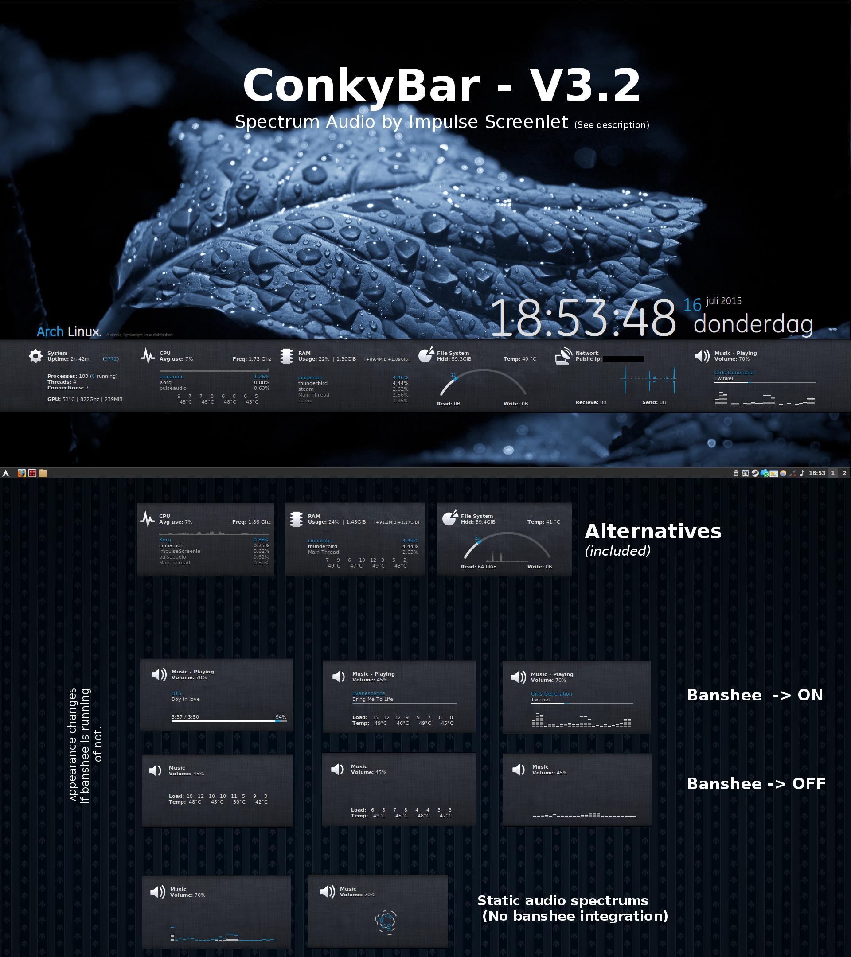
A Rant / The problem with conky

Slide 37
A walk through my setup
https://github.com/simotek/Conky-Lines

Slide 38
Getting it ready for a Distro
Better Hardware Detection
Finding a good way to offer a choice of predefined themes

Slide 39
Todo list
Send a pull request with a minimal example
Push conky-cli to Tumbleweed
Push lua-websockets to Tumbleweed and Leap 15.5 with deps
Rewrite my config using MIT implementations of widgets
Cleanup my github repo
Make new Icons or change look

